Slide 1

AI-Driven System for Behavioral Analysis

Slide 2




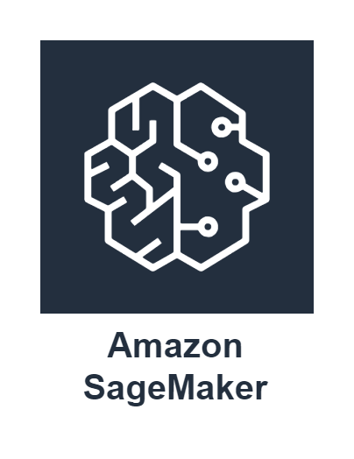

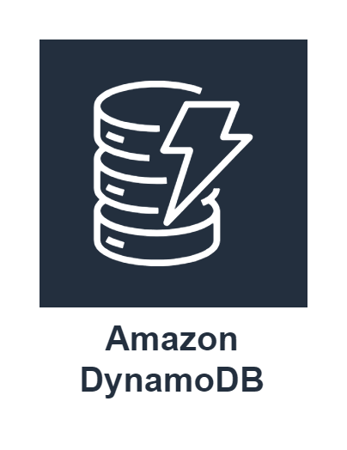
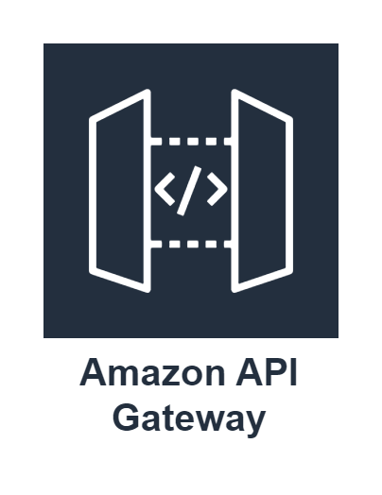

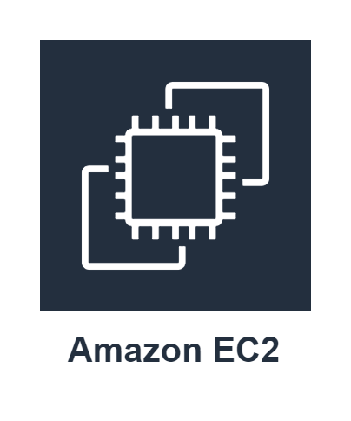


MindMetrics
Traits Identification
Emotional Stability
Adaptability
Anxiety
Social Interaction
Data Collection and Preprocessing
Traits
1
Deployment
Questionnaires
01
Comparison Analysis
2
This involves evaluating Questionnaires (the beginning and end of a program) to assess changes in individual behavior
Output
LLM Fine Tuning
Fine Tuned LLM
Prediction
Analysis
Report
Report Generation
The model produces a concise report outlining initial, final behavioral traits and story, along with a comparison analysis to track and offer personalized recommendations.
02
03
3
Fine Tune(Q-LoRA)
Narrative
MindMate
Benefits and Risks
1
Rapid Processing
Quickly analyzes and identifies traits for timely feedback.
Data Privacy Concerns
Ensuring secure handling of sensitive user information
2
1
Companion Support
2
Trait Integration
BENEFITS
RISKS
Always available, providing tailored guidance and support throughout the program
3
Chatbot adapts to user traits identified by MindMetrics for personalized interactions through prompt engineering.
Personalized Insights
Tailored feedback based on individual behavioral traits.
Hallucinations
Preventing the AI from generating incorrect or misleading information.
3
Continuous Learning
Tools
Summarizes conversations for weekly trait updates and enhanced responses.
MindMetrics
MindMate

