Slide 1
Aws-Cloudwatch-Rum
Demo by
Bala

Slide 2
Agenda
1. what is rum
2.why we used rum
3.benfits
4.how to configure rum
5. pricing details of rum

Slide 3
What is Rum
monitoring web applications with the goal of understanding performance and providing an optimal experience for your users.
Because of the number of variables involved:
1.browser type,
2.browser configuration,
3.user location,
4.connectivity

Slide 4
Benfits :
Amazon CloudWatch RUM will help you to collect the metrics that give you the insights that will help you to identity, understand, and improve this experience.
You simply register your application, add a snippet of JavaScript to the header of each page, and deploy. The snippet runs when your users step through each page of your application, and sends the data to RUM for consolidation and analysis

Slide 5
Available & billing
CloudWatch RUM is available now and you can start using it today in ten AWS Regions: US East (N. Virginia), US East (Ohio), US West (Oregon), Europe (Ireland), Europe (London), Europe (Frankfurt), Europe (Stockholm), Asia Pacific (Sydney), Asia Pacific (Tokyo), and Asia Pacific (Singapore).
You pay $1 for every 100K events that are collected.

Slide 6
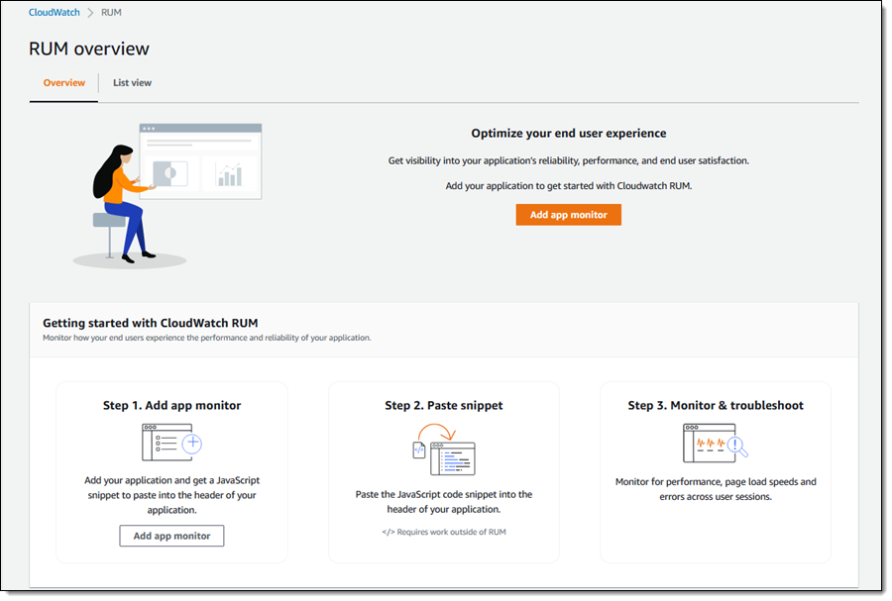
CloudWatch RUM in Action To getstarted, I open the CloudWatch Console and navigate to RUM. Then I click Add app monitor:

Slide 7
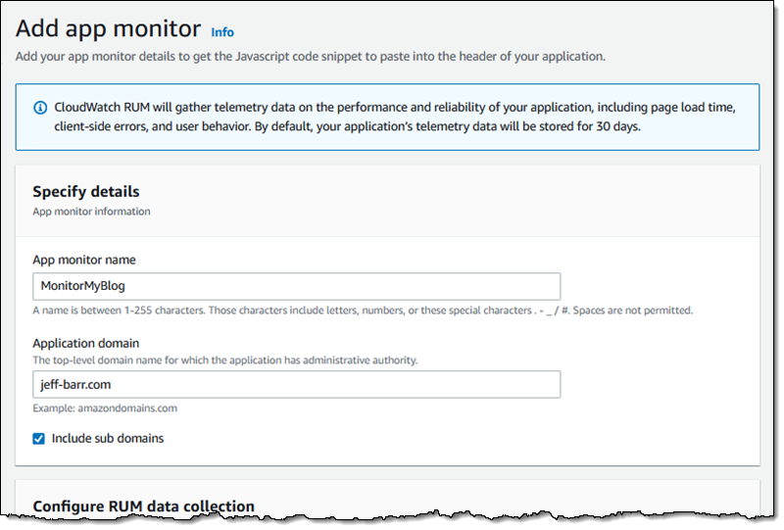
I give my monitor a name and specify the domain that hosts my application:

Slide 8
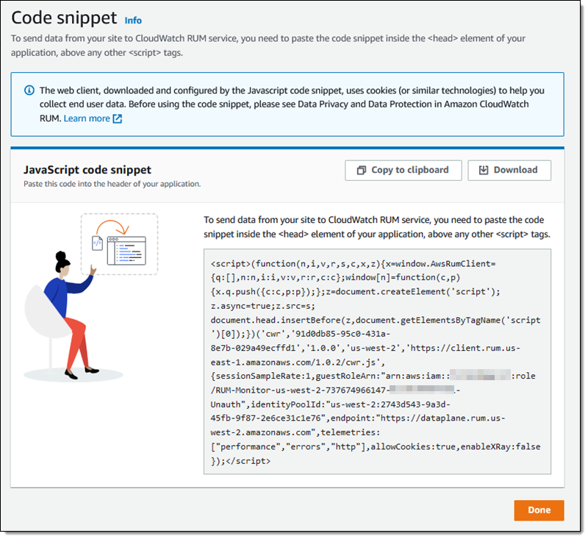
The console then shows me the JavaScript code snippet that I need to insert into the <head> element of my application:

Slide 9
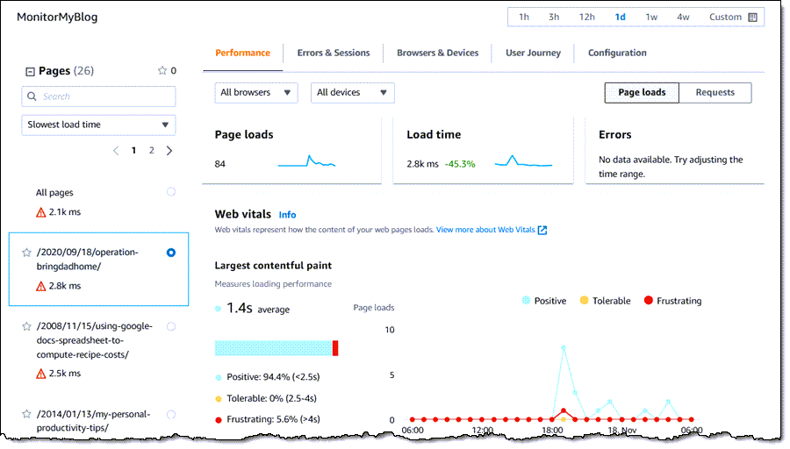
I can also see all of this information on a page-by-page basis:

