Slide 1




Usage of AWS – ECR (Elastic Container Registry) and deploy a Docker Image – Hands-on guide.
Mr. Subramanyam Tirumani Vemala
subramanyam.vemala@capgemini.com

Slide 2
Pre-requisites:
Docker Desktop installed, on your local system.
A working, Java Microservices project on your local system, with the Dockerfile setup. Create a local Docker Image using a Dockerfile. The same Docker image can be used for tagging, pushing and testing on ECR.
For detailed hands-on guide including the steps, screenshots and code base for the above points 2 and 3, please refer to my below URL’s.
https://github.com/subbugh/java-microservices-springboot-docker-dockerhub
https://github.com/subbugh/java-microservices-springboot-docker
https://github.com/subbugh/java-microservices-springboot

Slide 3
Steps: This document is to guide you to push an image to AWS-ECR and deploy the same.
Log into AWS Console.
Create ECR Repository.
A local Java Microservices application and Docker setup on your desktop. (Refer to Slide number 2)
Create a local Docker image, using a Dockerfile. . (Refer to Slide number 2)
Log into AWS – ECR, through a terminal.
Tag the local docker image, to push to the ECR.
Push the tagged docker image into the ECR Repository.
Run the pushed image and test it on the Browser, for the expected results.

Slide 4
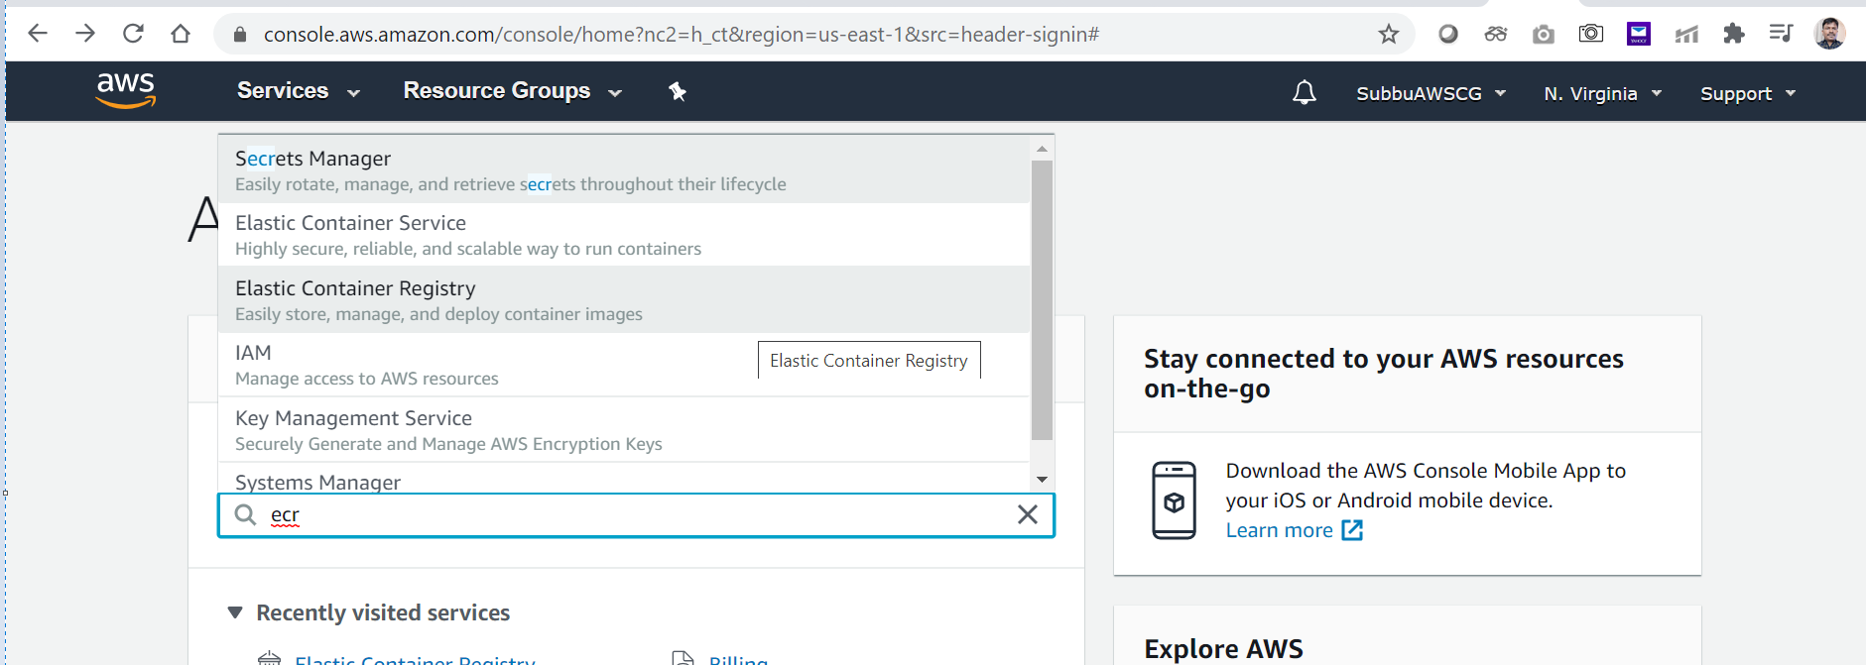
Log into AWS Console and go to ECR:

Slide 5
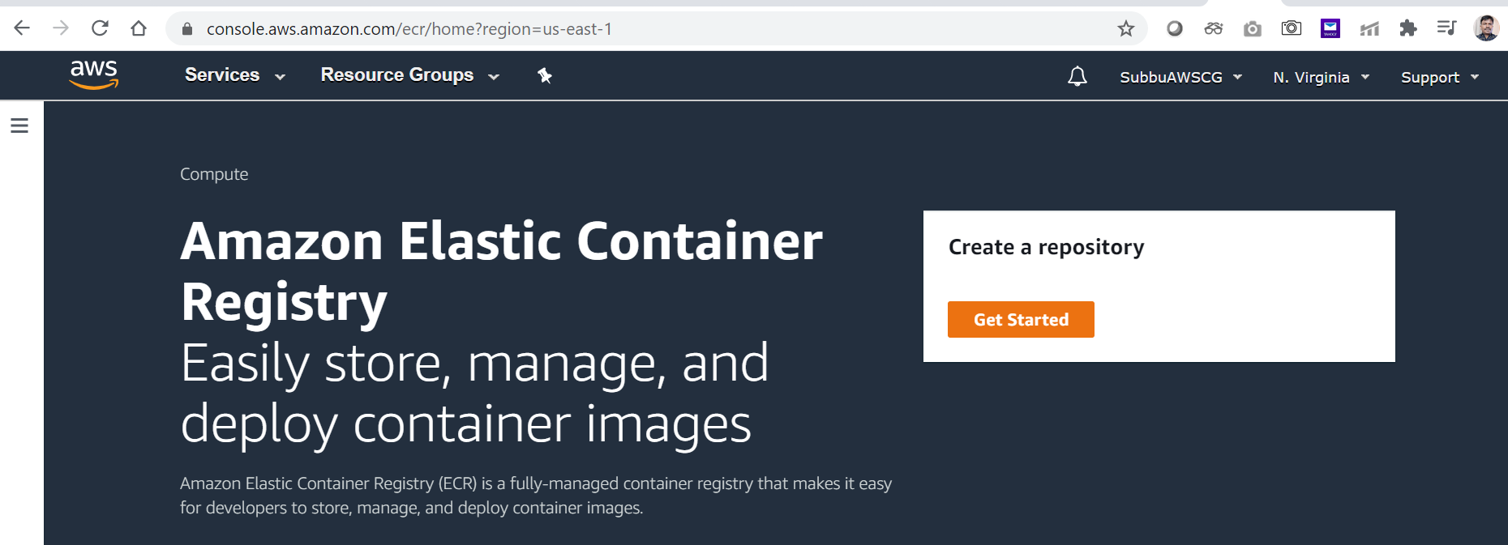
Get started with ECR:

Slide 6
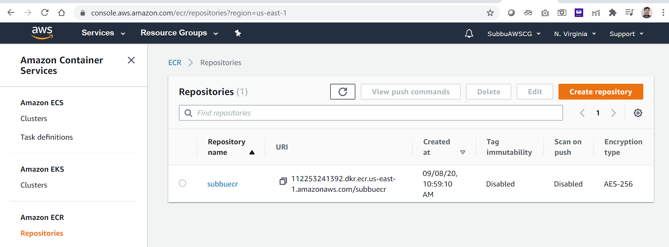
Click on Create Repository:

Slide 7
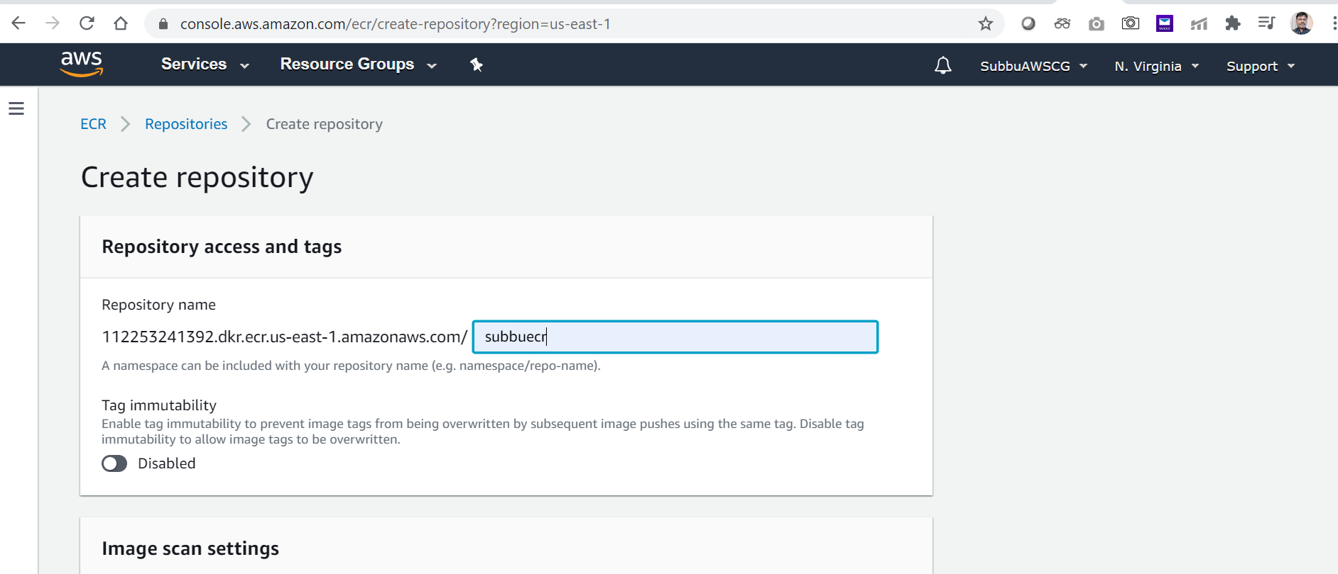
Type in the name for the Repository:

Slide 8
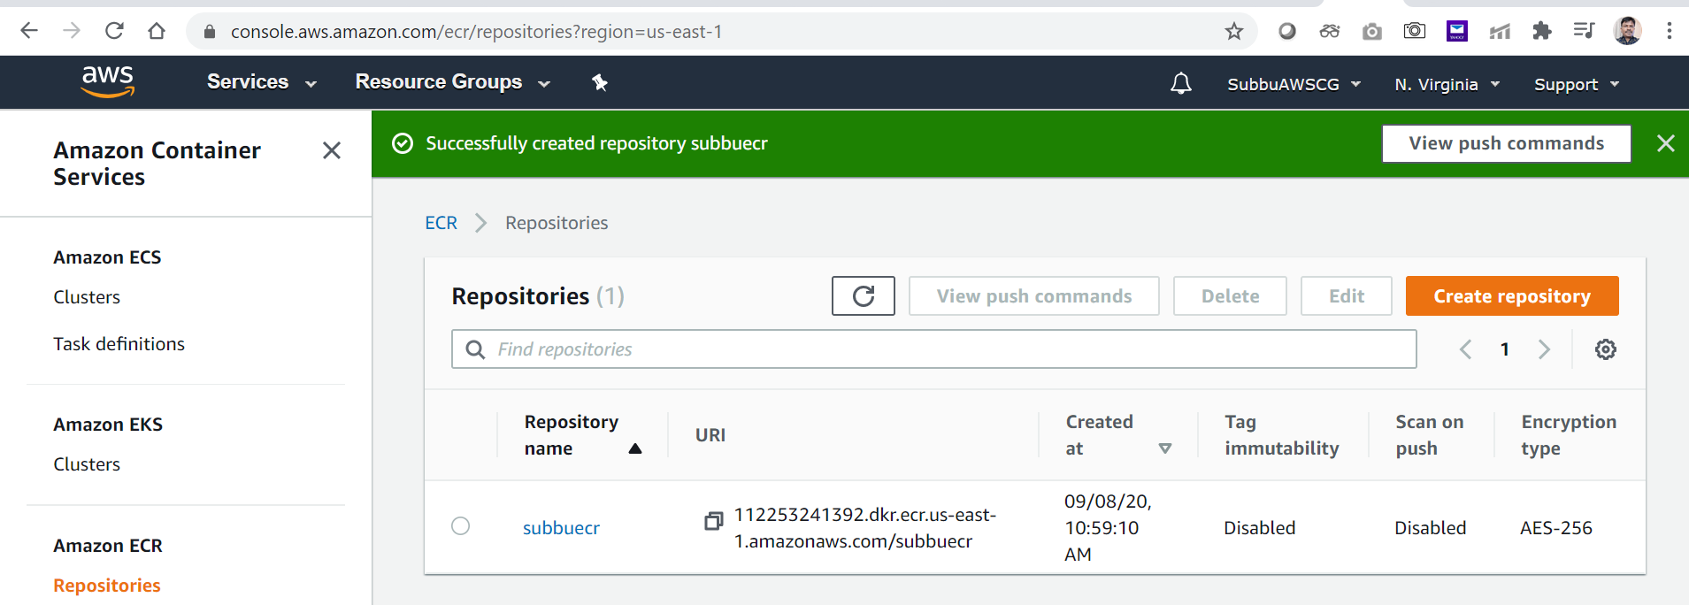
ECR Repository is created successfully:

Slide 9
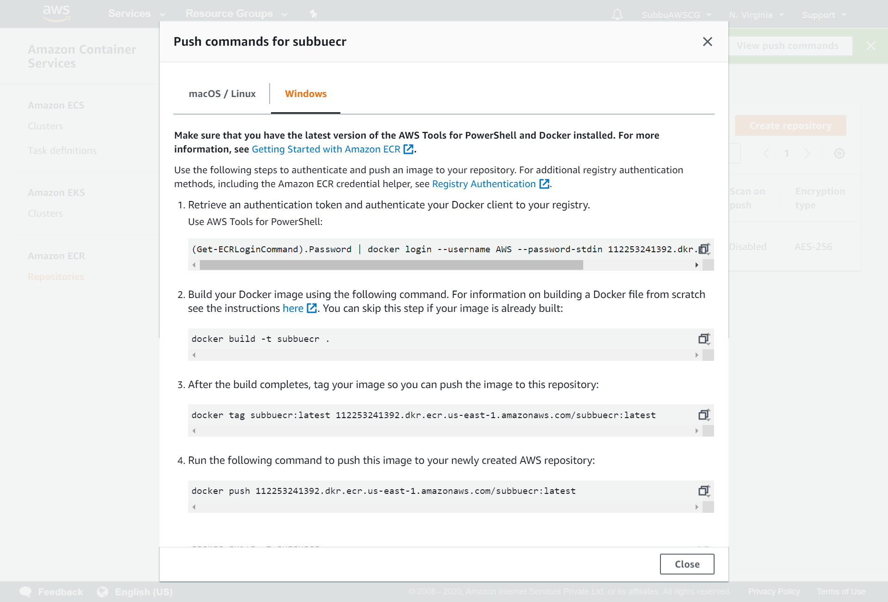
Click on View Push Commands:

Slide 10
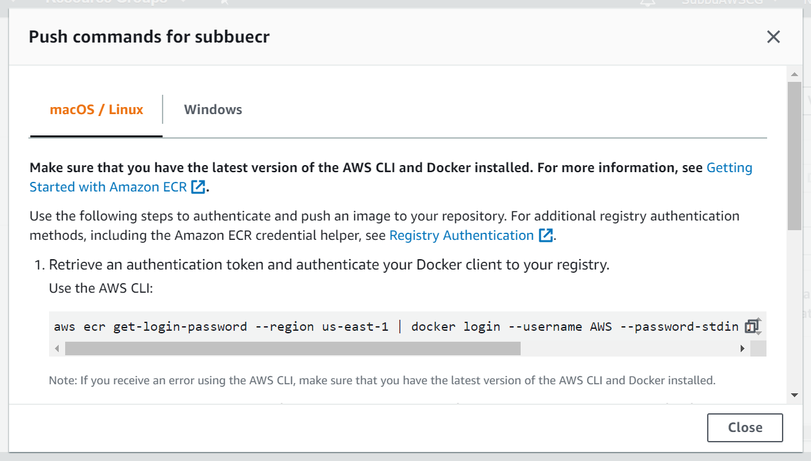
Commands to Login:

Slide 11
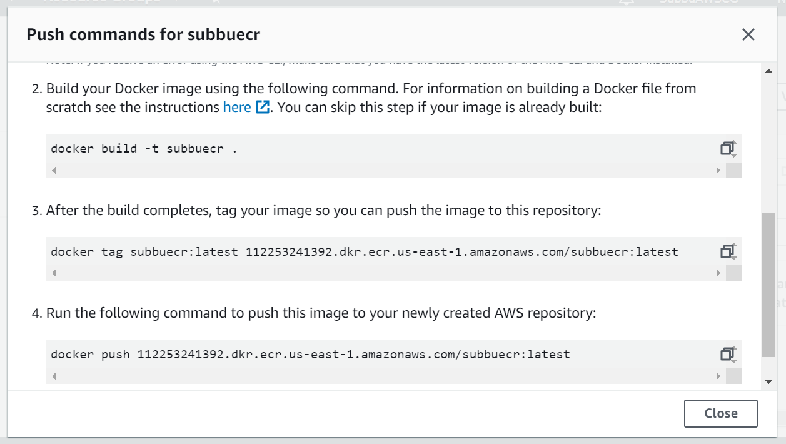
Commands to build the image, from the local jar “”. Also has the commands to tag the image and push into ECR – AWS.

Slide 12
Commands used on the PowerShell:
Login to the ECR-AWS:
aws ecr get-login-password --region us-east-1 | docker login --username AWS --password-stdin 112253241392.dkr.ecr.us-east-1.amazonaws.com
Build your Docker image using the following command:
docker build -t subbuecr .
Tag your image so you can push the image to this repository:
docker tag subbuecr:latest 112253241392.dkr.ecr.us-east-1.amazonaws.com/subbuecr:latest
Run the following command to push this image to your newly created AWS repository:
docker push 112253241392.dkr.ecr.us-east-1.amazonaws.com/subbuecr:latest
Run the Image:
docker run -p 9094:8080 112253241392.dkr.ecr.us-east-1.amazonaws.com/subbuecr:latest
Test the Deployment on the Browser:
https://localhost:9094/message

Slide 13
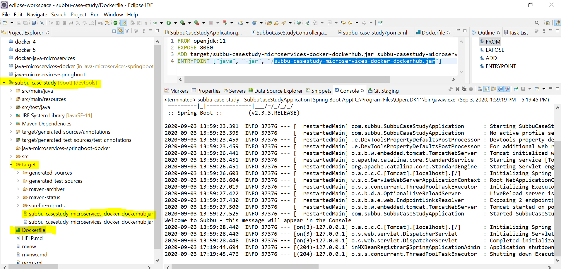
A Demo Java Microservices project on the Eclipse, to enable our Docker and AWS-ECR:

Slide 14
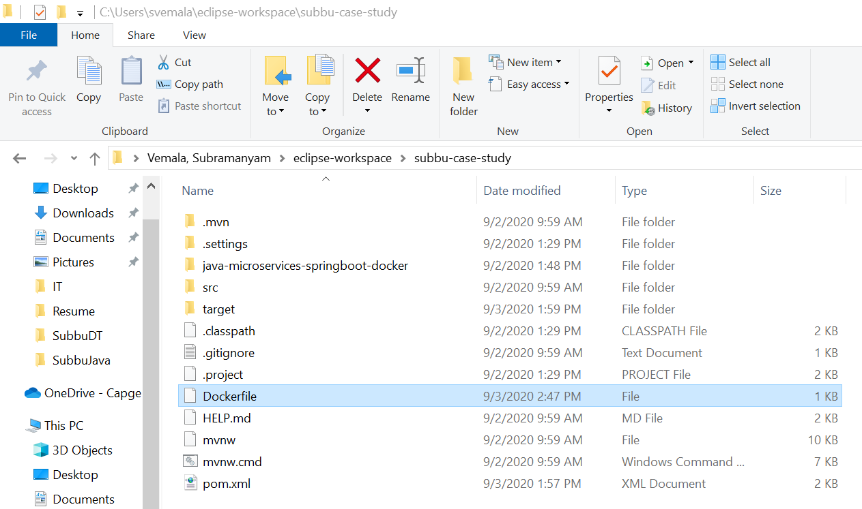
C:\Users\svemala\eclipse-workspace\subbu-case-study

Slide 15
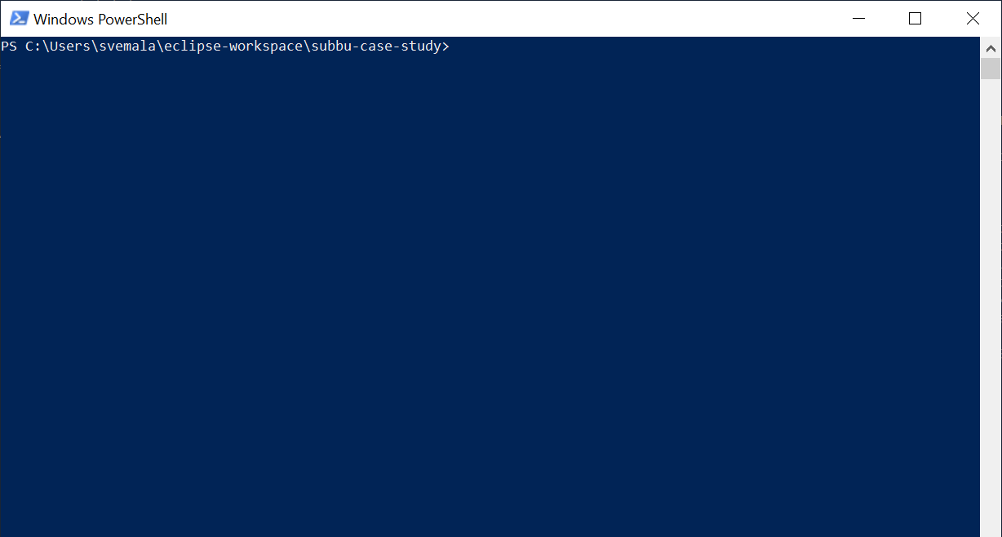
Power Shell – Change the path to the location of Dockerfile:

Slide 16
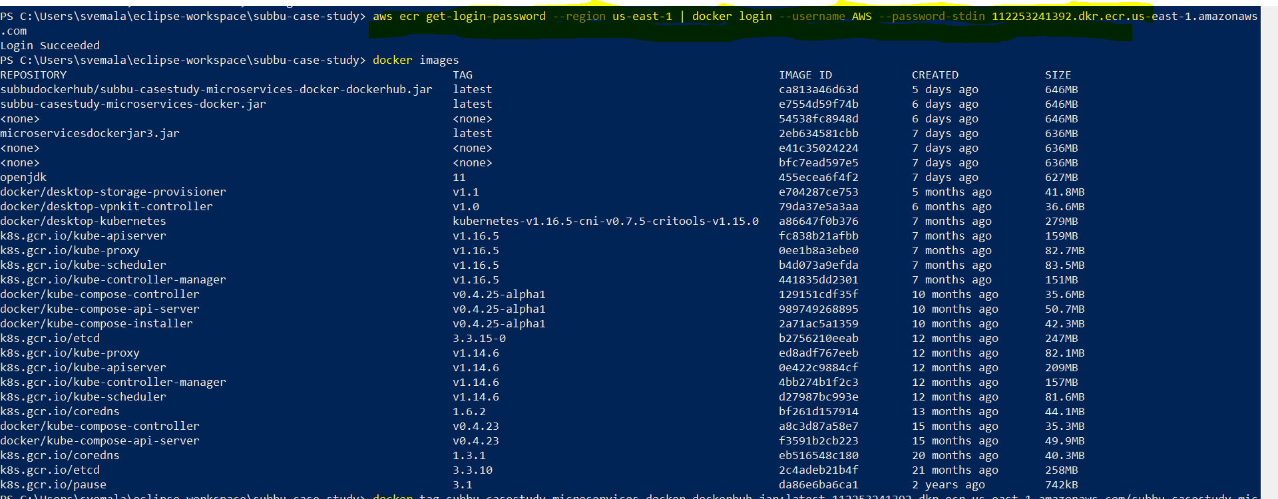
Log into AWS – ECR:

Slide 17
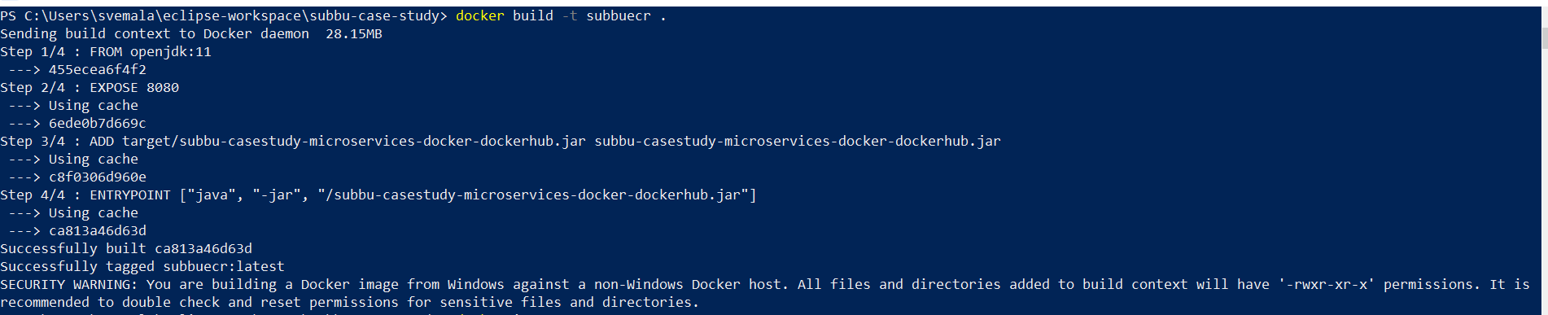
Build command to create repository:

Slide 18
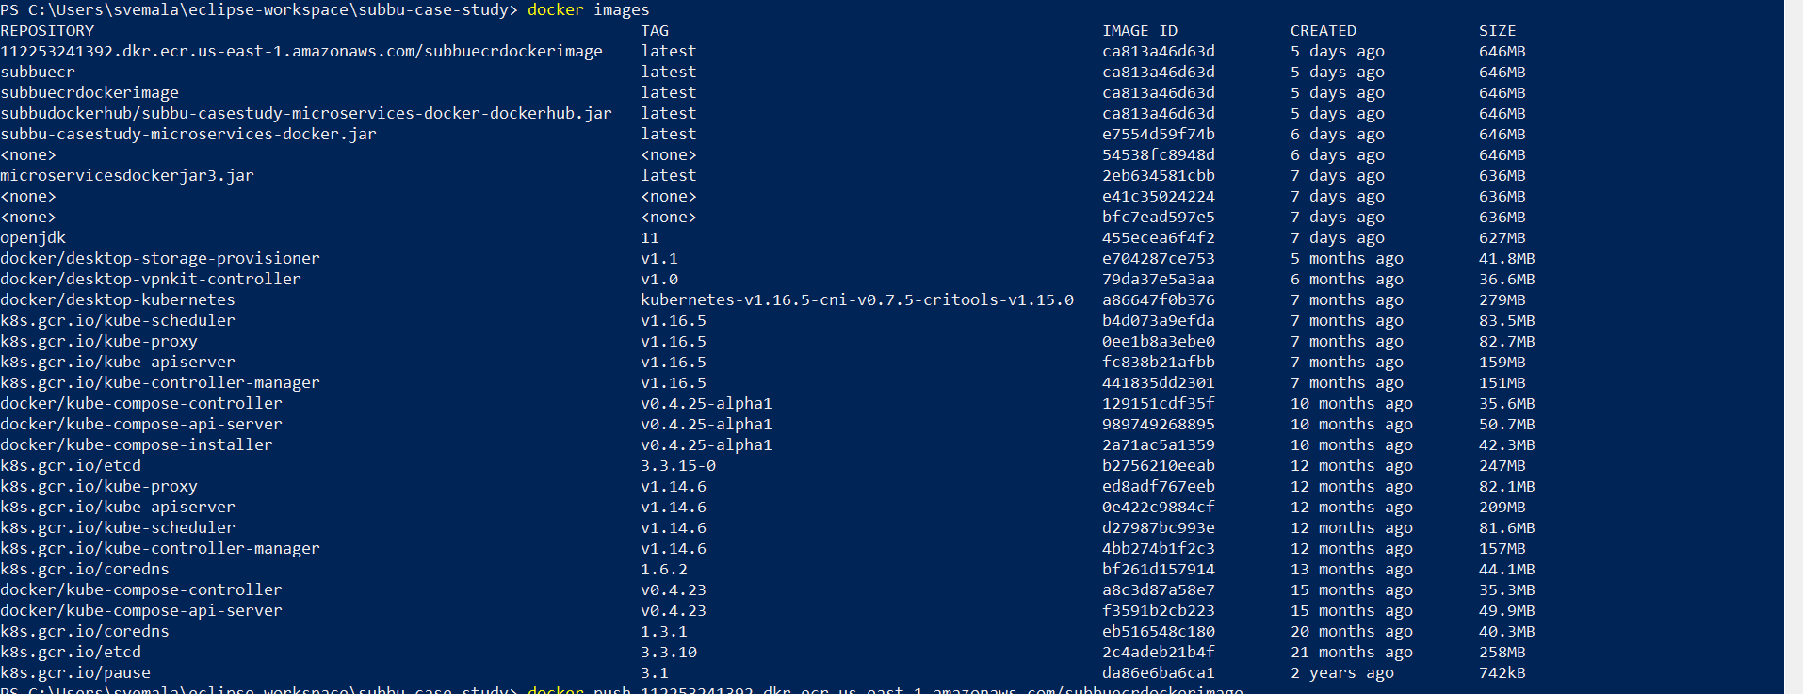
New repository created: subbuecr

Slide 19
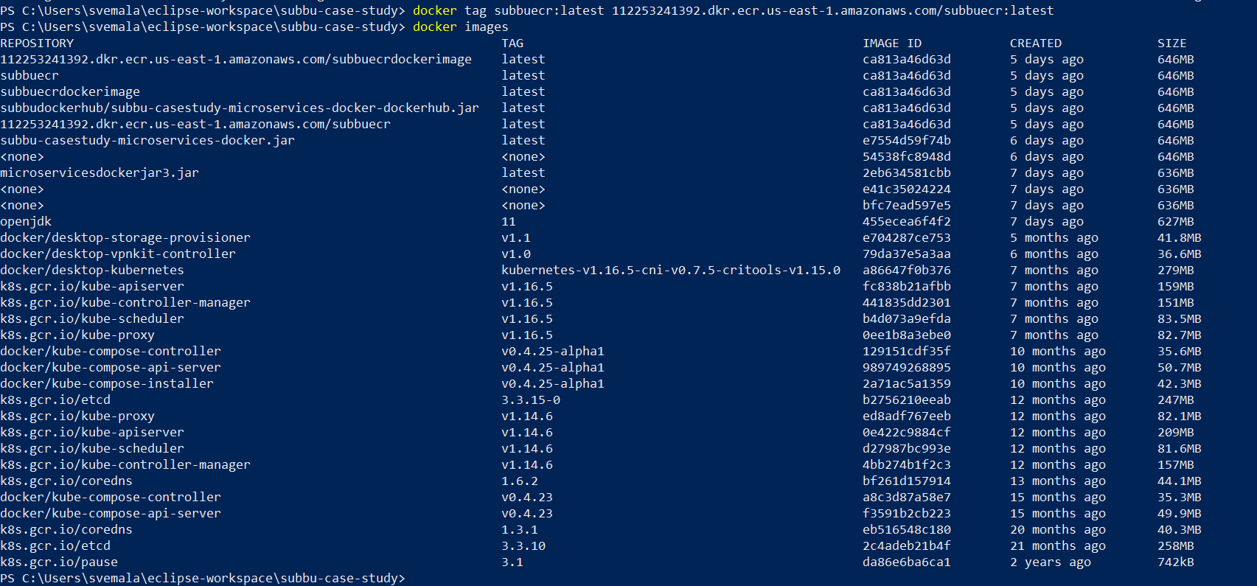
Tag the repository: docker tag subbuecr:latest 112253241392.dkr.ecr.us-east-1.amazonaws.com/subbuecr:latest

Slide 20
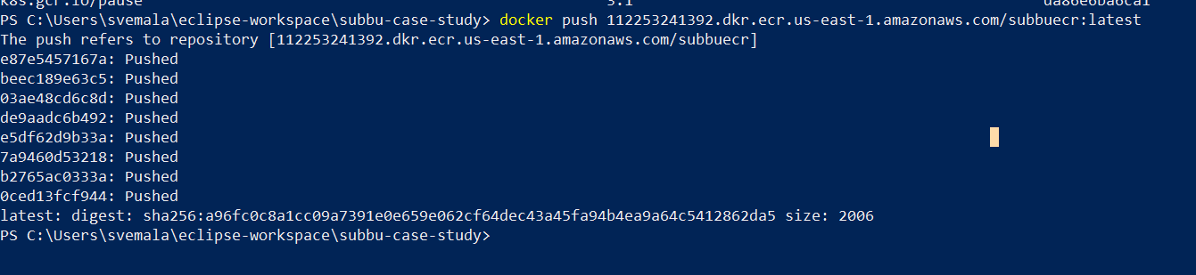
Push the Docker Image, that we have tagged: “docker push 112253241392.dkr.ecr.us-east-1.amazonaws.com/subbuecr:latest”, is the command.

Slide 21
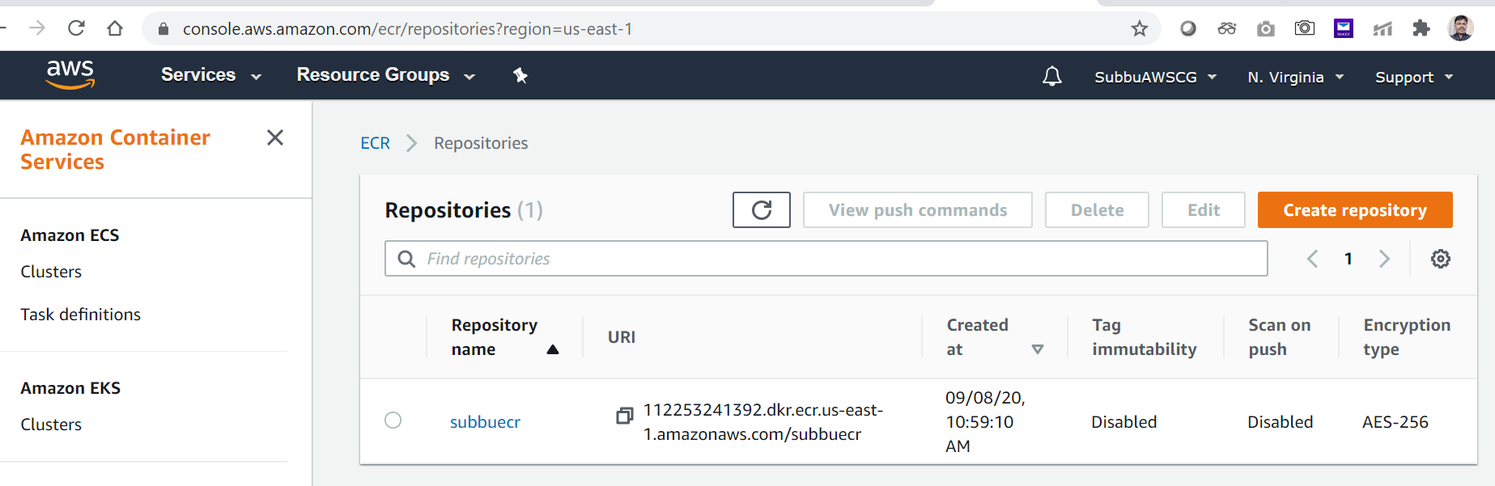
AWS – ECR – Repository: “subbuecr”, is the name.

Slide 22
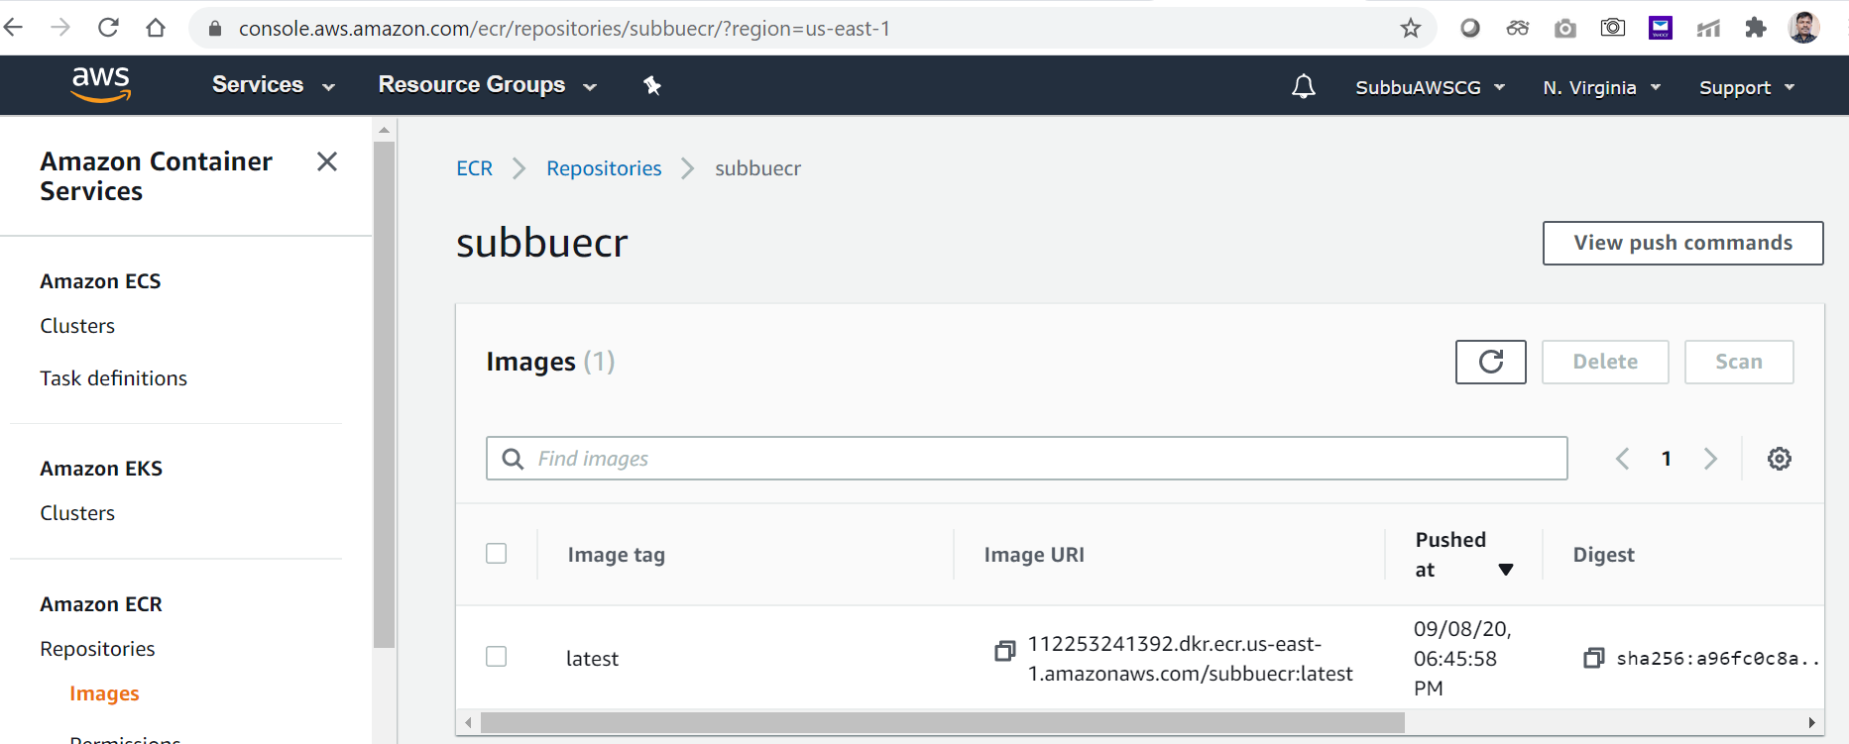
Image pushed to the Repository subbuecr: Image URI is reflecting.

Slide 23
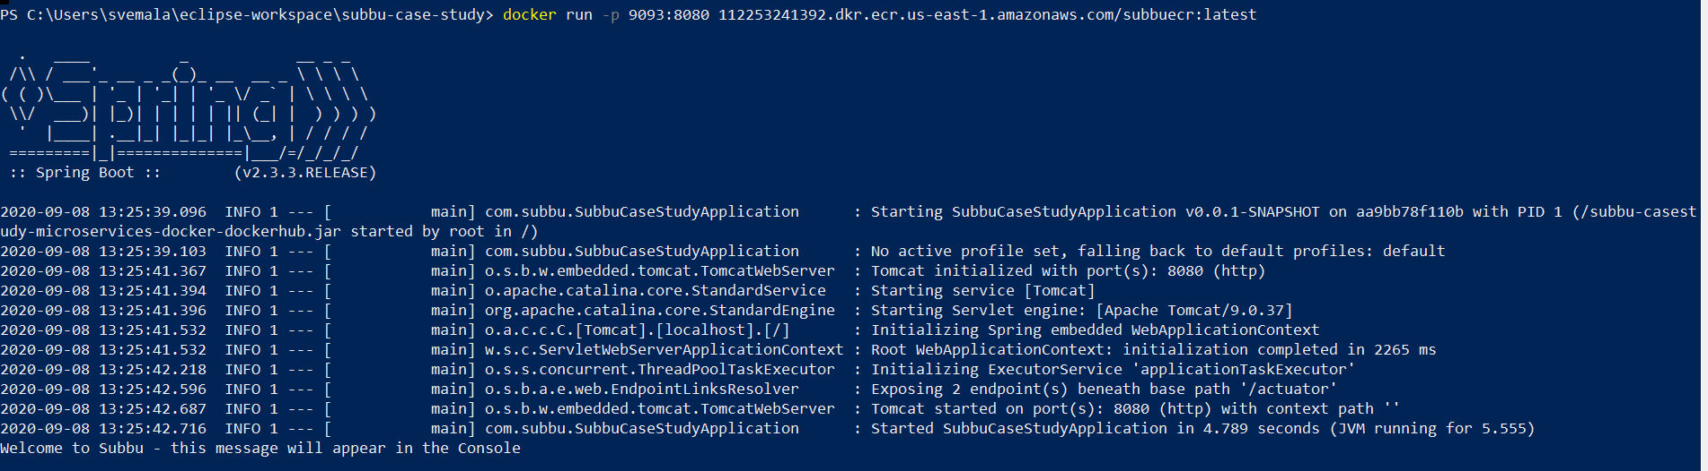
Run the tagged Docker image, 9093 is the external port mapped to the Docker’s internal port 8080: “docker run -p 9093:8080 112253241392.dkr.ecr.us-east-1.amazonaws.com/subbuecr:latest”

Slide 24
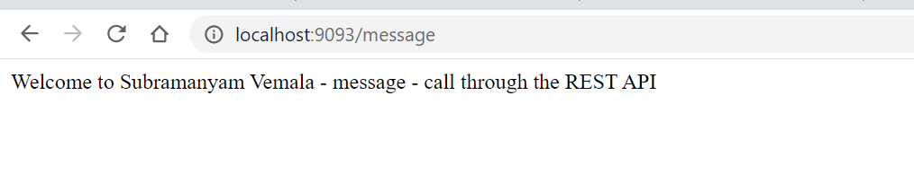
Test the URL on the Browser: http://localhost:9093/message

Slide 25
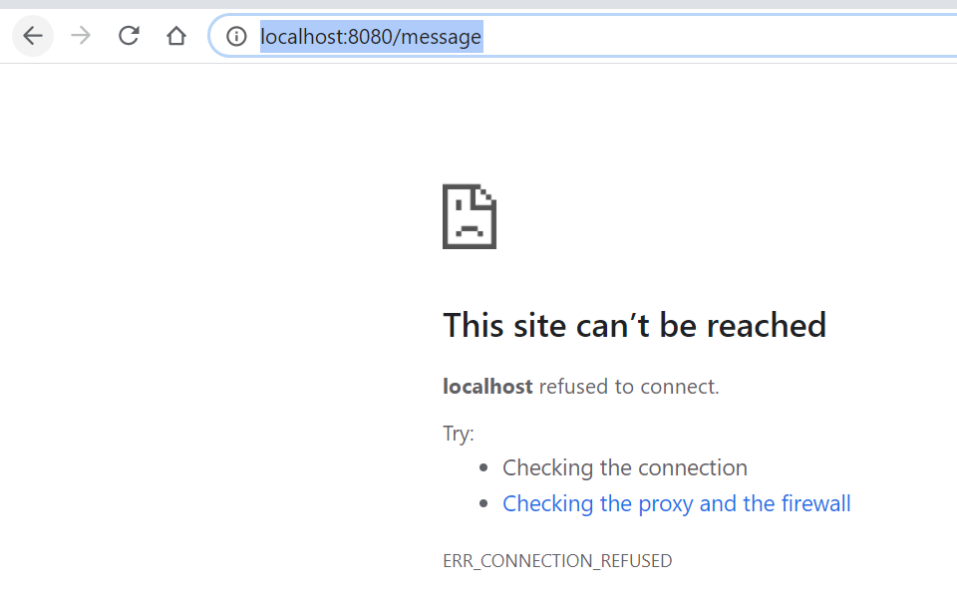
Make sure like local application or Tomcat not running: http://localhost:8080/message:

Slide 26
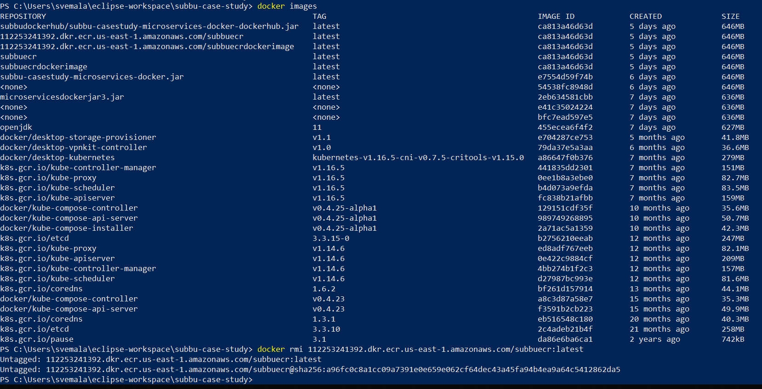
Delete the local image: “docker rmi 112253241392.dkr.ecr.us-east-1.amazonaws.com/subbuecr”, is the command.

Slide 27
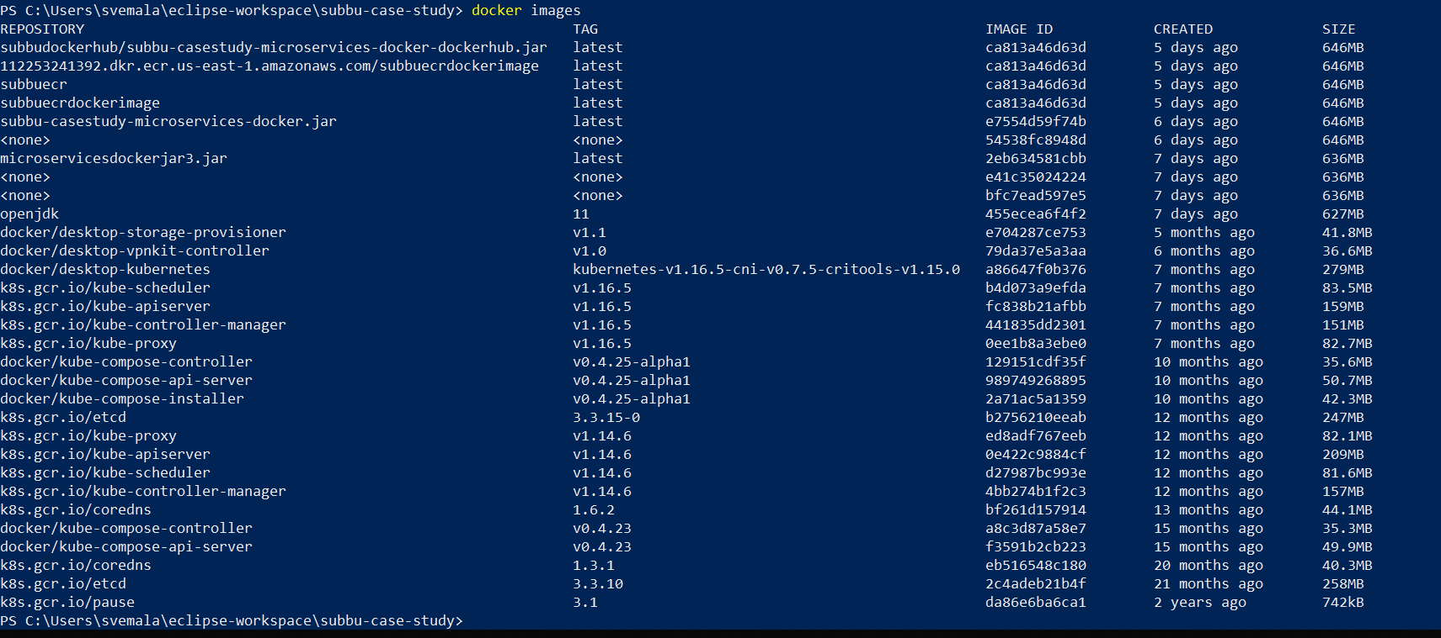
Local image “112253241392.dkr.ecr.us-east-1.amazonaws.com/subbuecr” is deleted:

Slide 28
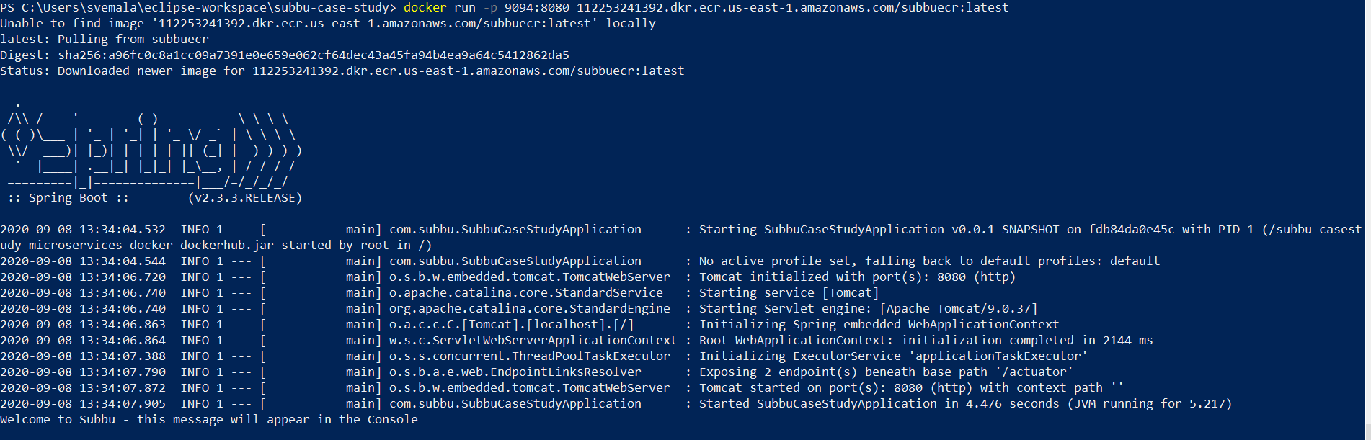
Now the image is downloaded from ECR-subbuecr-AWS, as it could not find the image (112253241392.dkr.ecr.us-east-1.amazonaws.com/subbuecr:latest) locally and the application is mapped with the external port 9094, through the command.

Slide 29
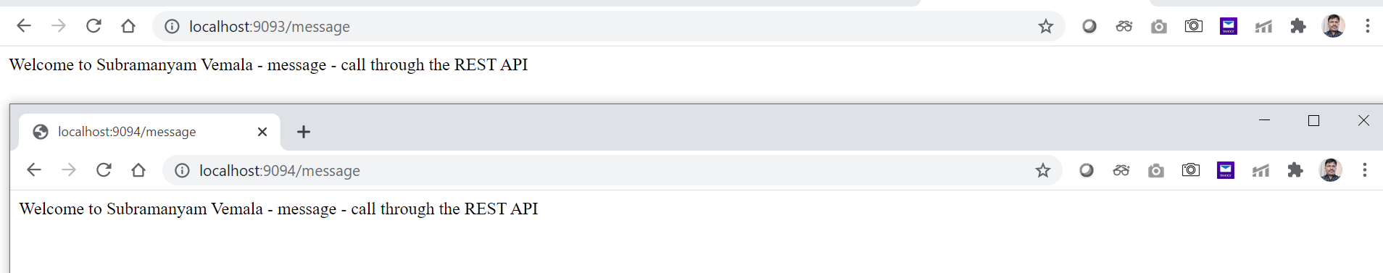
Now you can see like the application is working on both the ports 9094 and 9093:

Slide 30
Appendix:
AWS – ECR:
https://aws.amazon.com/ecr/
https://docs.aws.amazon.com/AmazonECR/latest/userguide/Registries.html
https://docs.aws.amazon.com/AmazonECR/latest/userguide/troubleshooting.html
Java, SpringBoot, Docker and DockerHub:
https://github.com/subbugh/java-microservices-springboot-docker-dockerhub
https://github.com/subbugh/java-microservices-springboot
https://github.com/subbugh/java-microservices-springboot-docker

