Slide 1


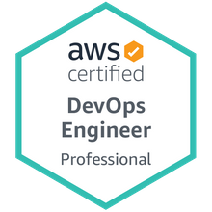

A Java Microservices project using Spring Boot deployment on Docker – Hands-on guide
Mr. Subramanyam Tirumani Vemala
subramanyam.vemala@capgemini.com

Slide 2
Detailed Steps:
This document contains the detailed steps with screenshots, to setup a Java Microservices project using Spring Boot, generate jar and deploy it on Docker:
Target Audience:
All, with knowledge of Java or coding and Containerization.
Artifacts needed:
JDK11
Eclipse – IDE
Docker
Internet
Implementation Steps:
Create a Spring Starter Project.
Add the necessary classes and dependencies in the pom.xml
Run as Spring Boot App on the Eclipse. Check for the output both on the Console and the Browser.
Create the jar in the target folder, through maven install.
Create Dockerfile.
Use Build command to create the Docker image.
Run the command to deploy the Docker image.
Check the expected output on the Browser.

Slide 3
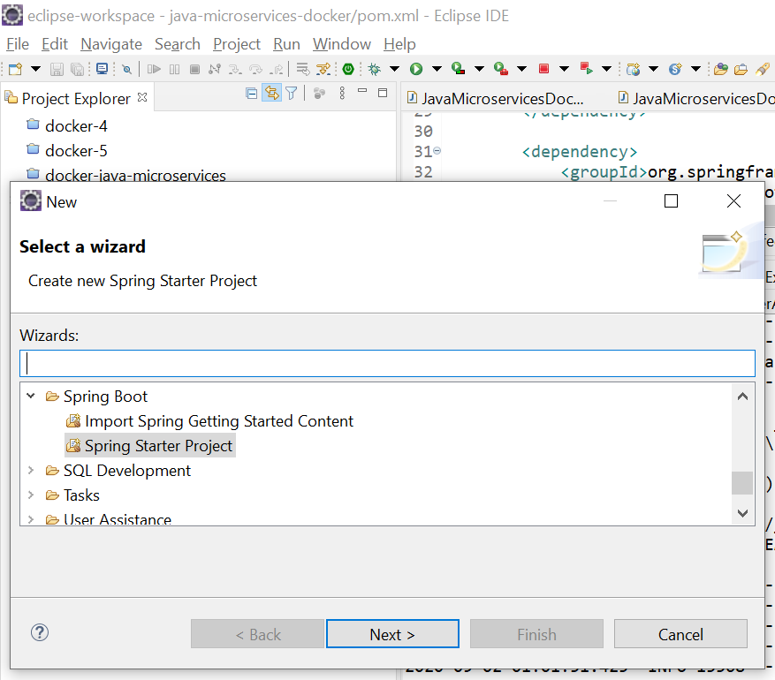
File – New – Spring Starter Project - Create

Slide 4
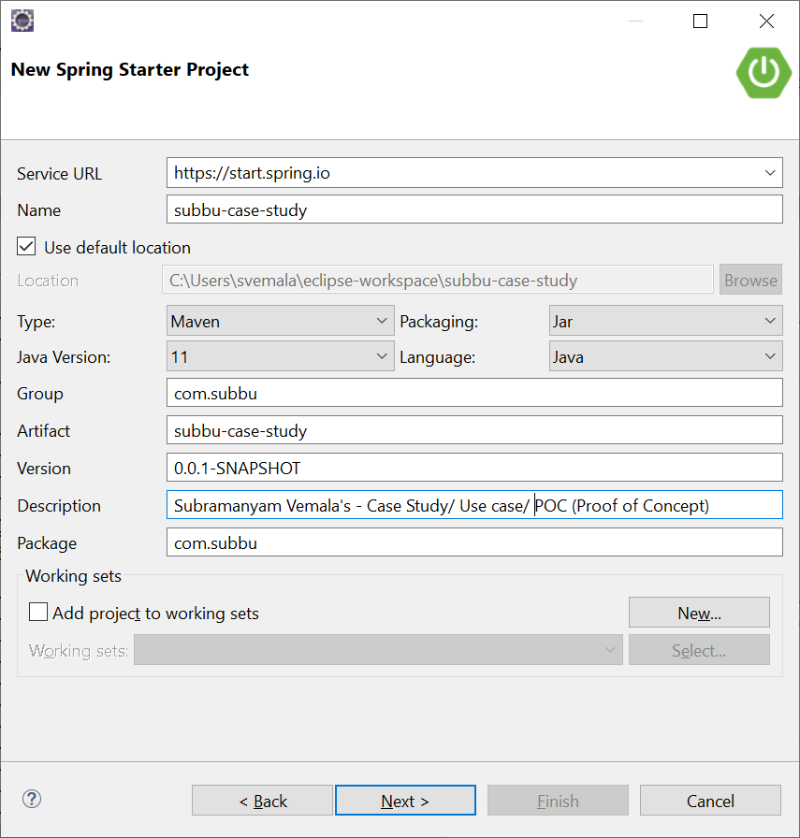
Provide the project details:

Slide 5
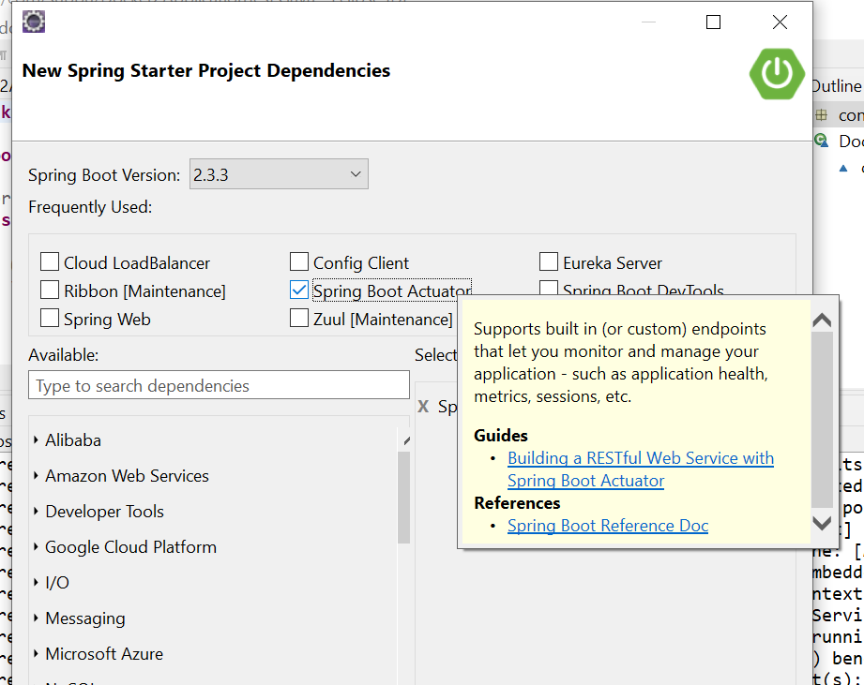
Choose the dependencies - Actuator:

Slide 6
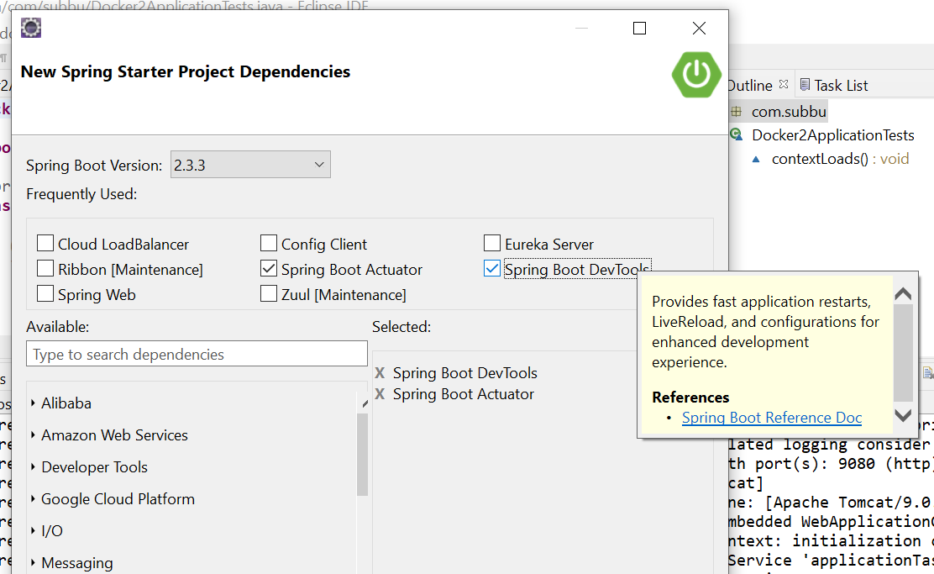
Choose the dependencies - DevTools:

Slide 7
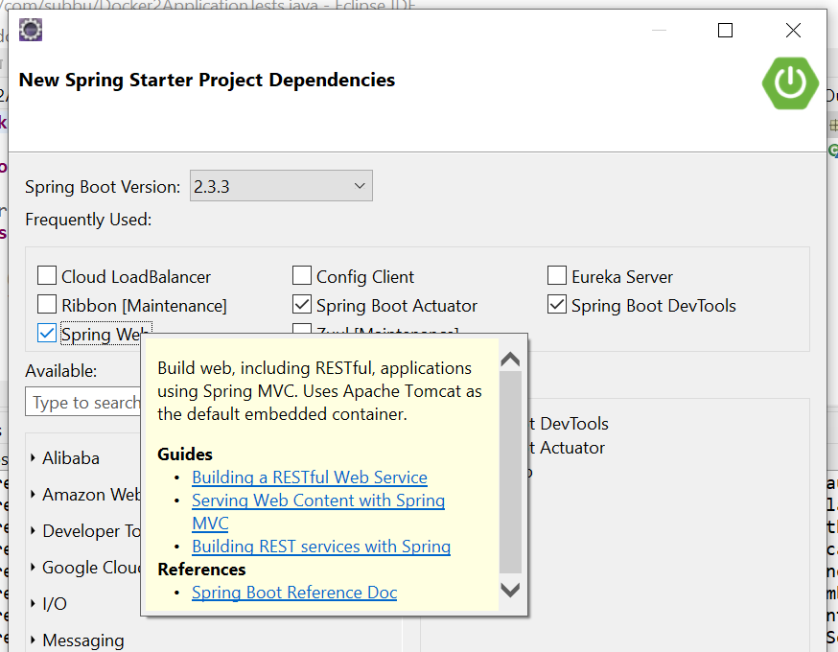
Choose the dependencies – Spring Web:

Slide 8
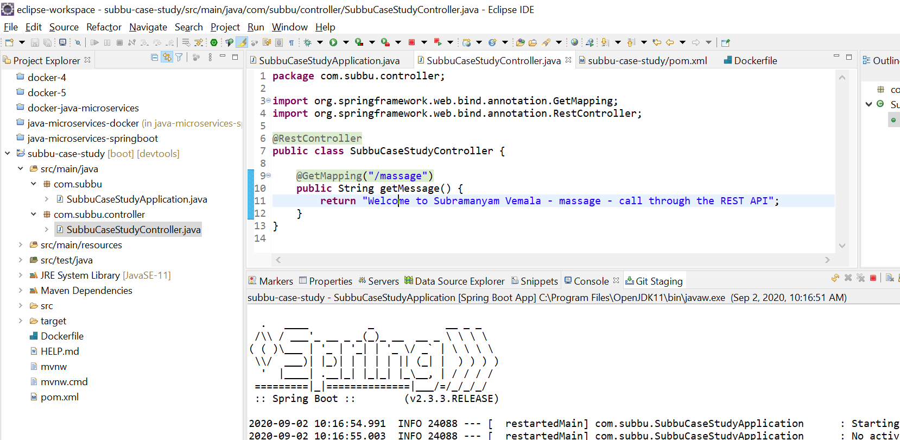
Project is created (subbu-case-study):

Slide 9
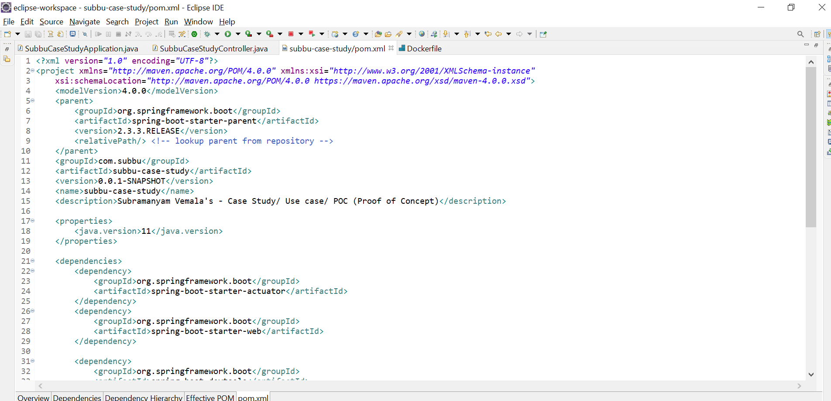
pom.xml – Deployment descriptor

Slide 10
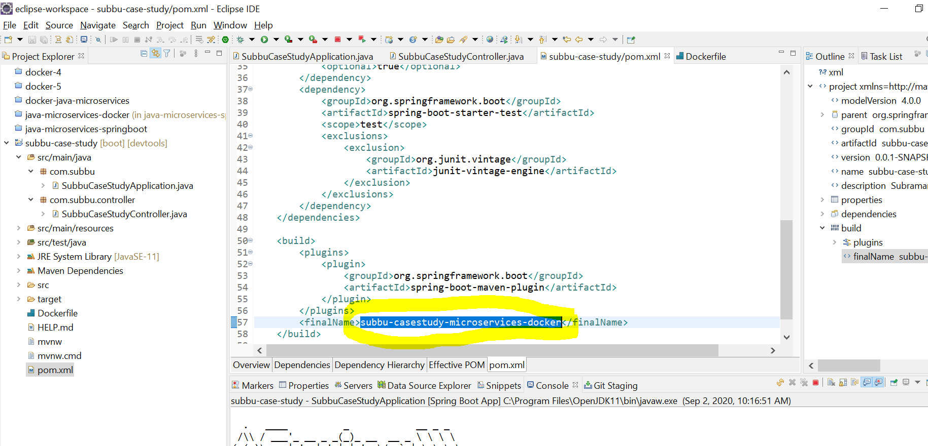
Give the jar name in the pom.xml:

Slide 11
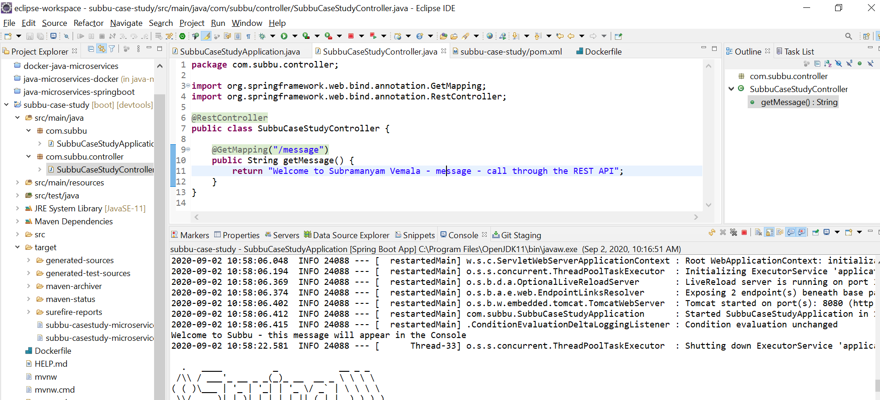
Create Controller with GetMapping and RestController:

Slide 12
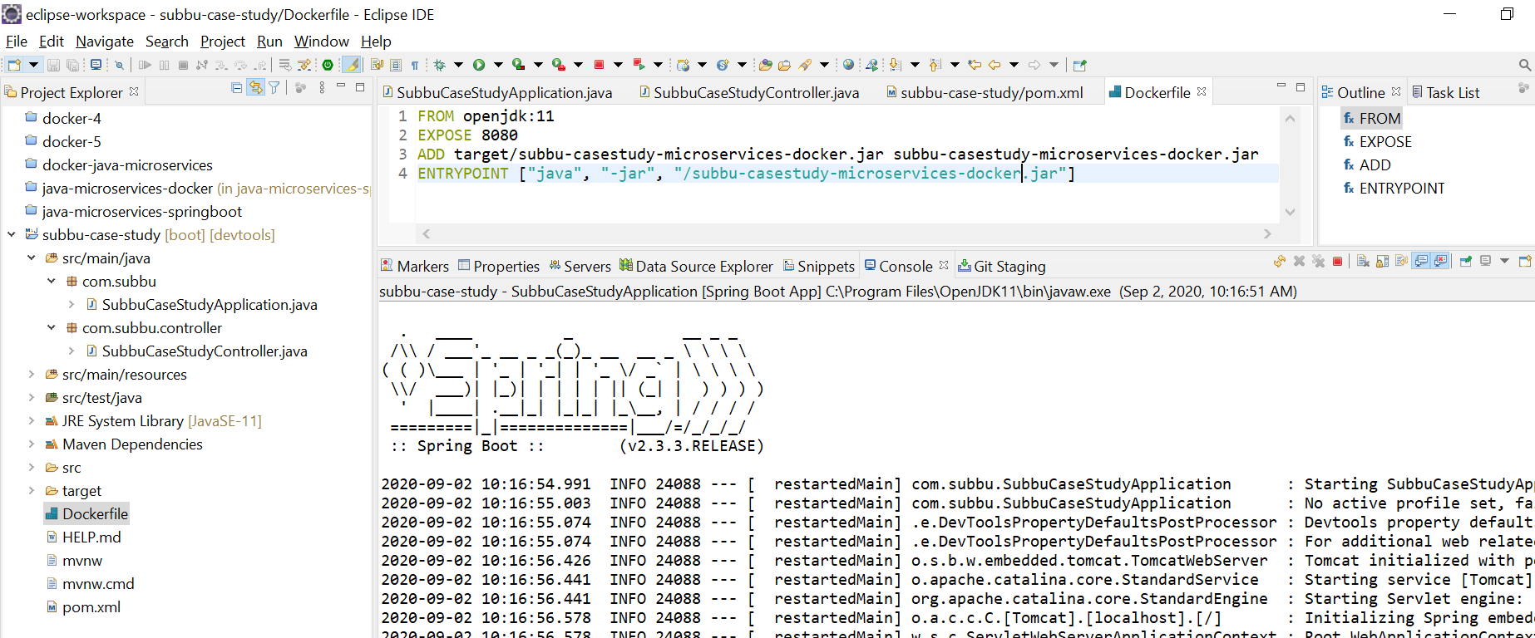
Create Dockerfile:

Slide 13
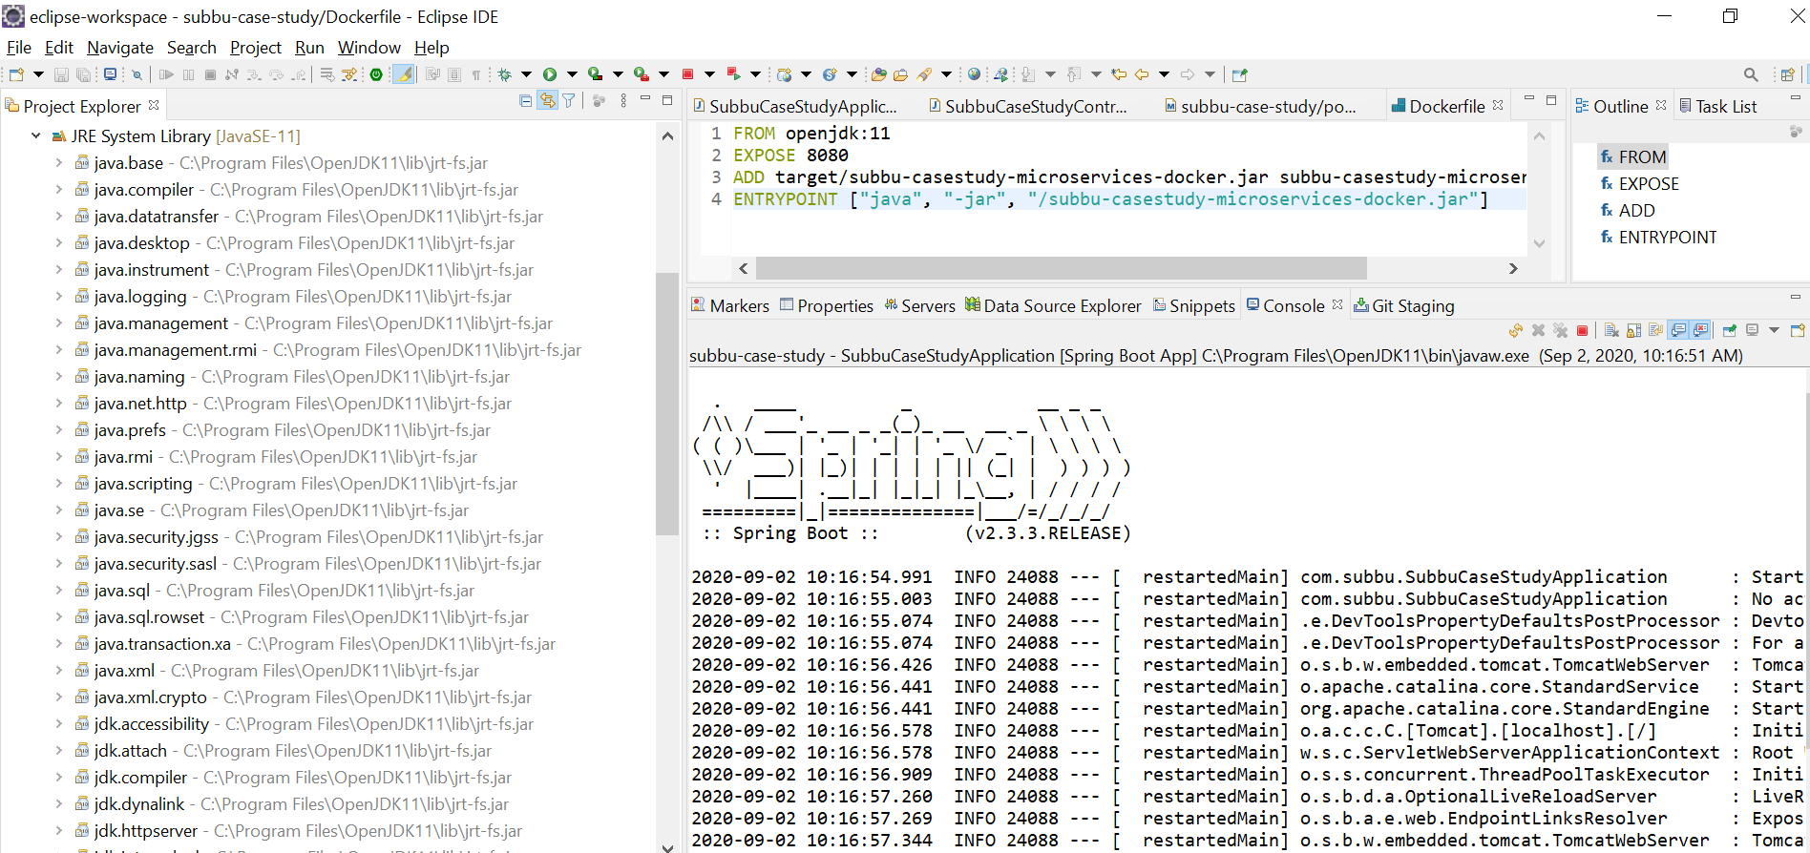
JRE System Library:

Slide 14
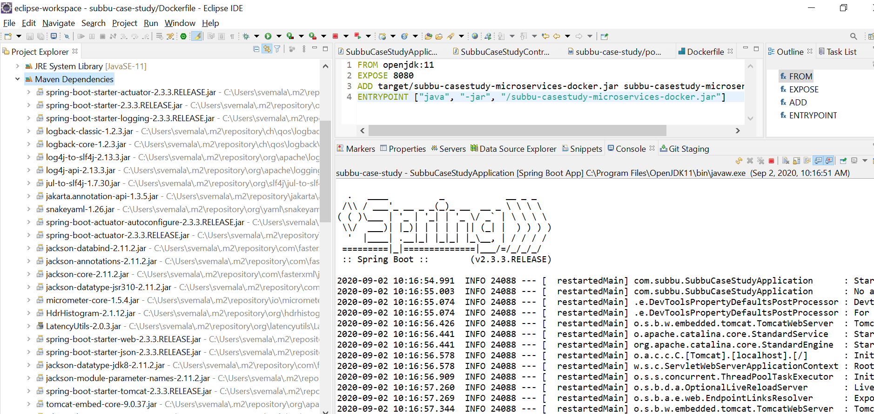
Maven Dependencies:

Slide 15
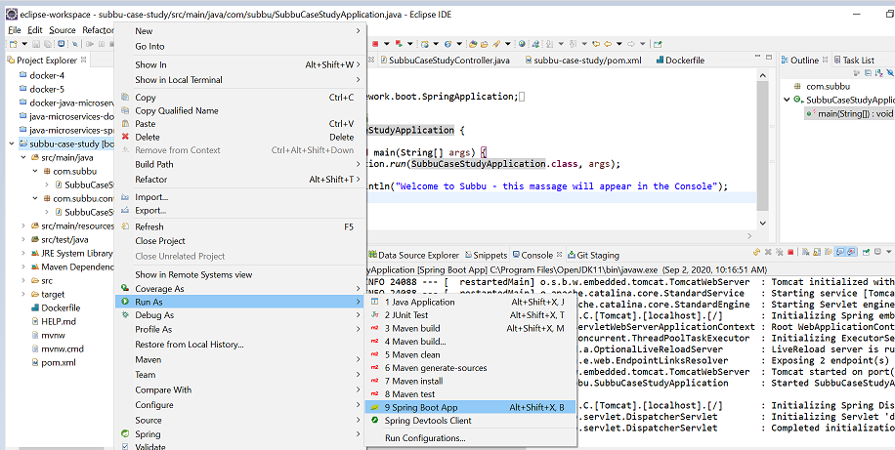
Run as a Spring Boot App:

Slide 16
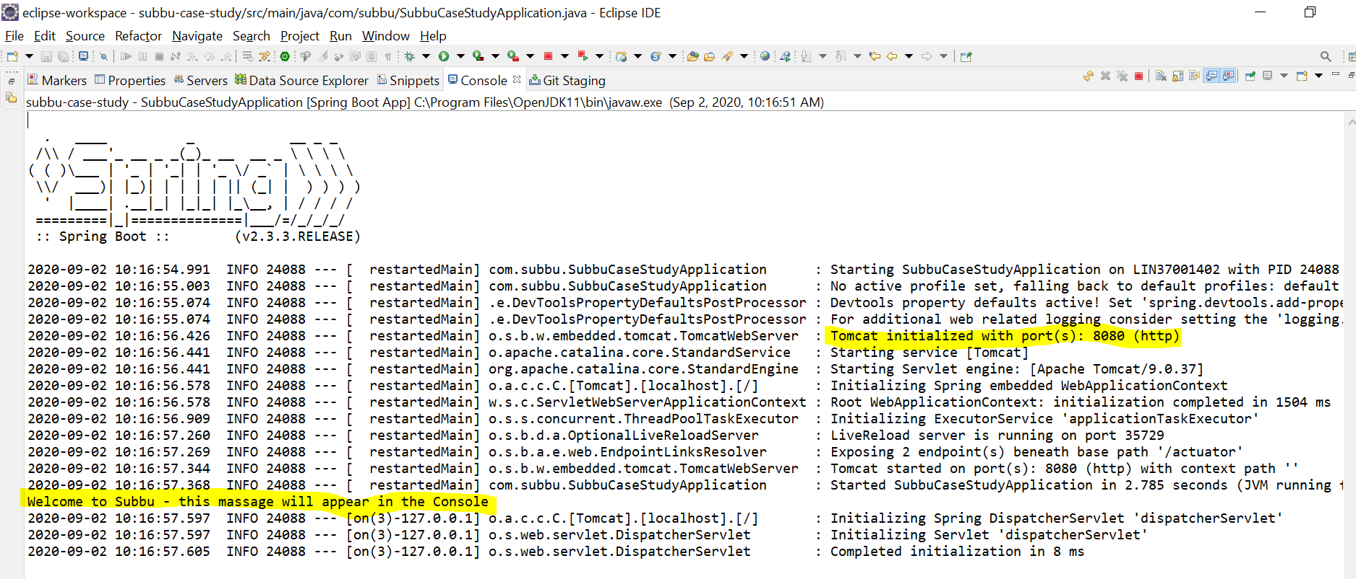
Tomcat started successfully and message can be seen on Console:

Slide 17
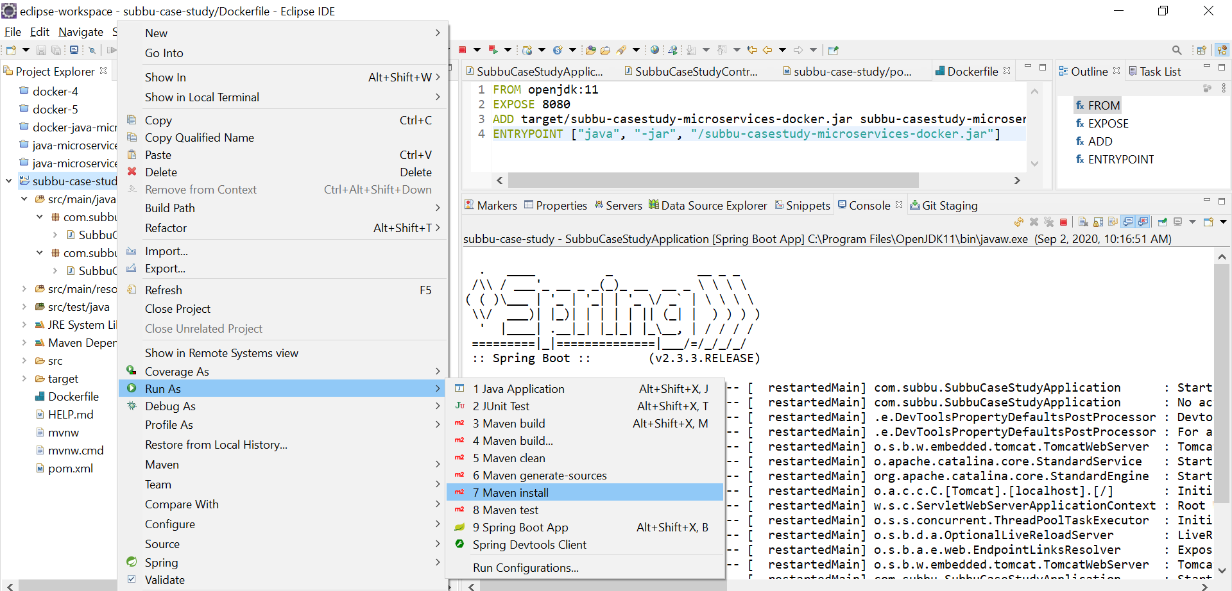
Run as Maven Install to create jar:

Slide 18
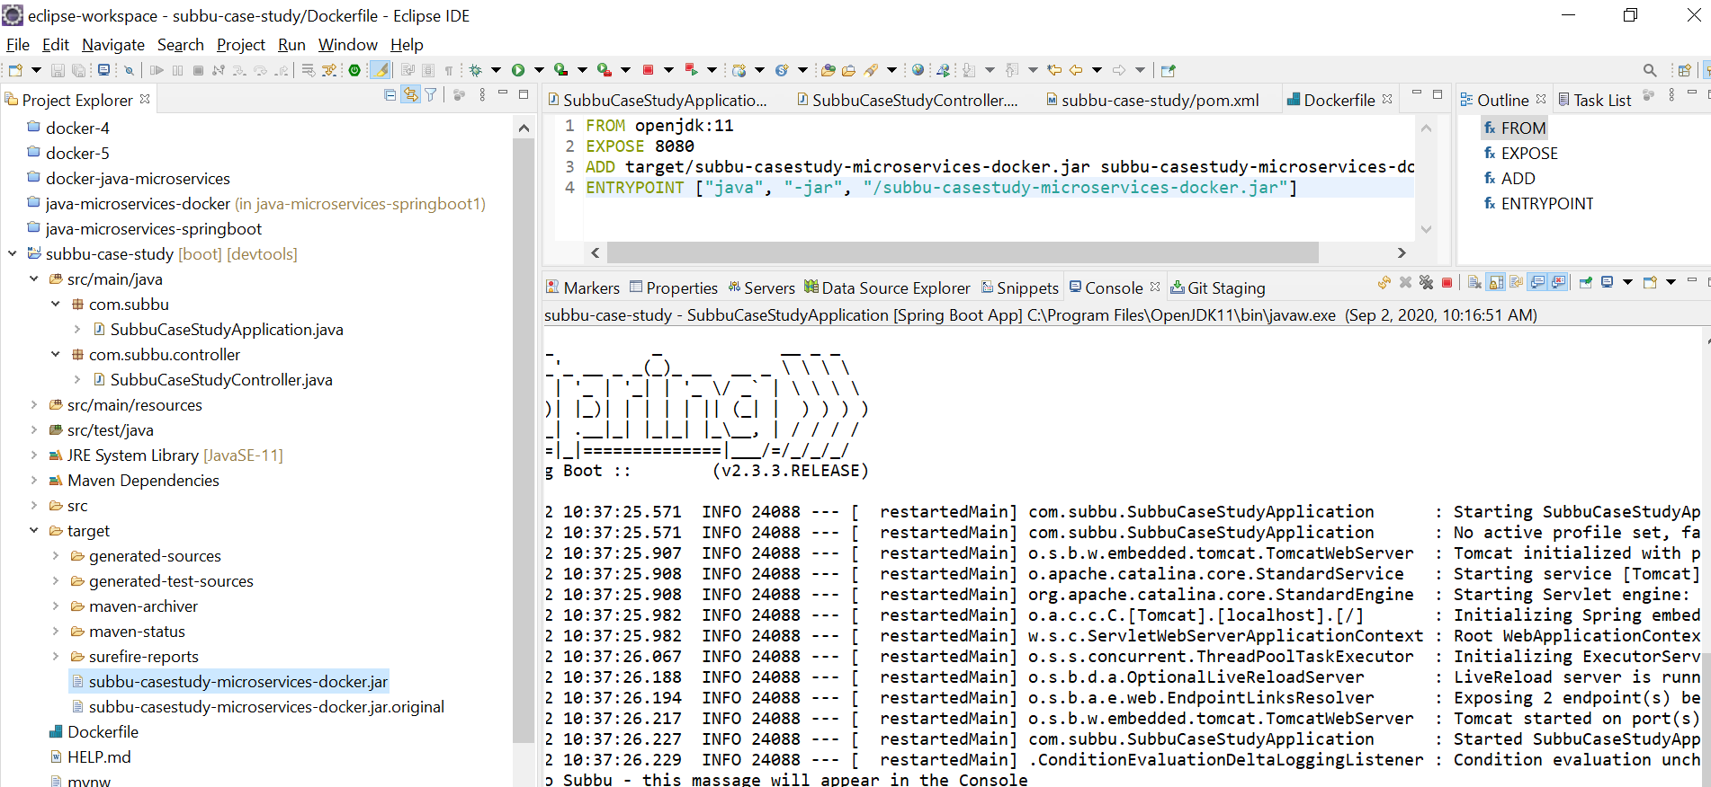
Jar is created in the Target folder:

Slide 19
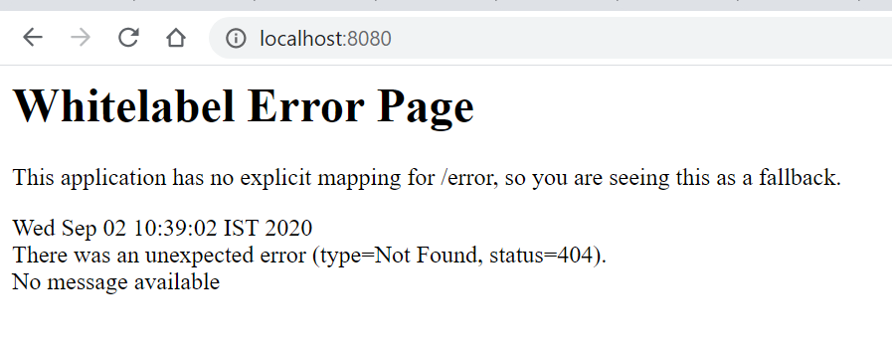
http://localhost:8080

Slide 20
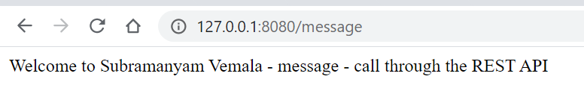
http://127.0.0.1:8080/message

Slide 21
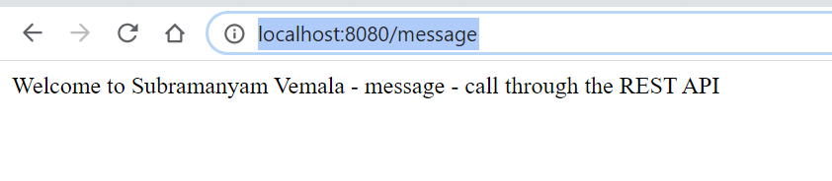
http://localhost:8080/message

Slide 22
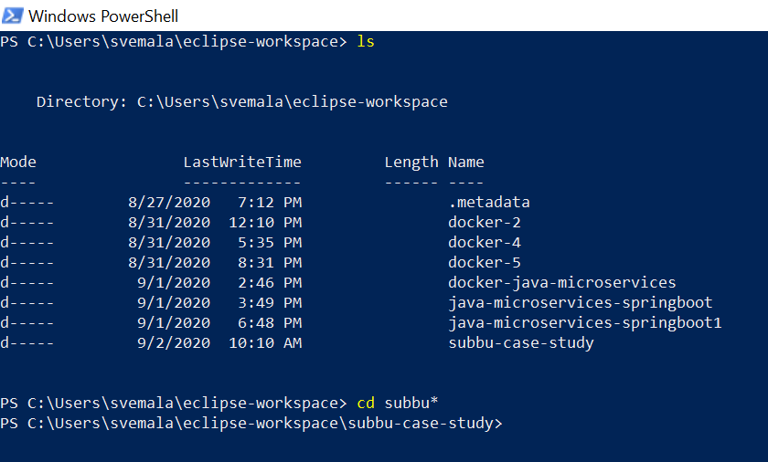
Launch Power Shell – goto the Dockerfile folder:

Slide 23
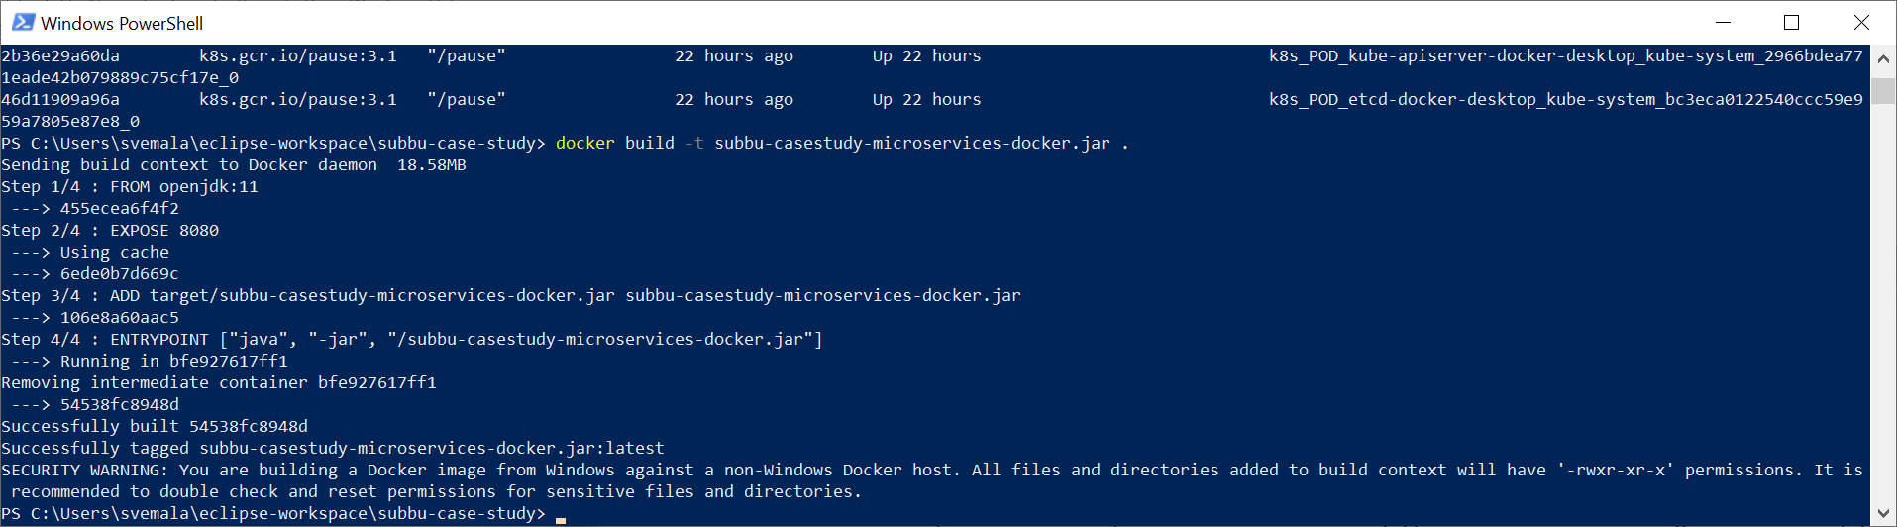
Build the Docker image using the Dockerfile using the command: docker build –t <jar name> .

Slide 24
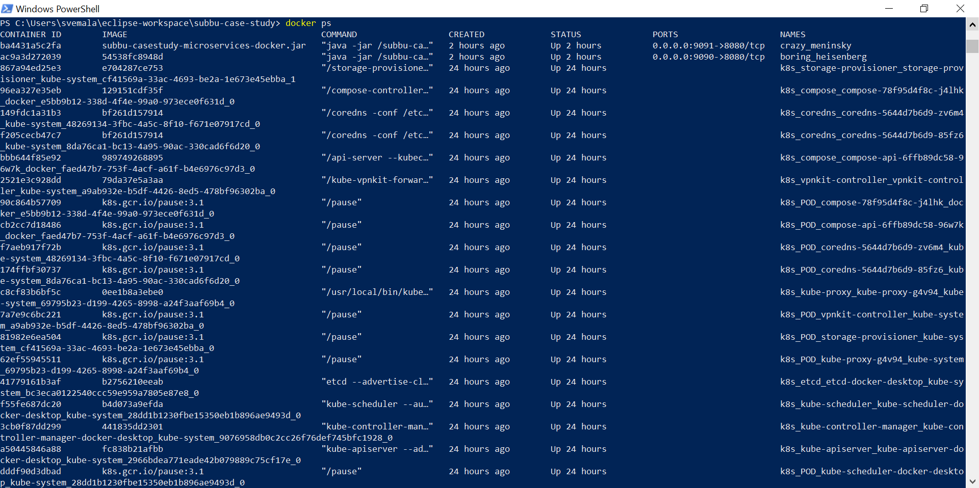
Docker Image created: docker ps

Slide 25
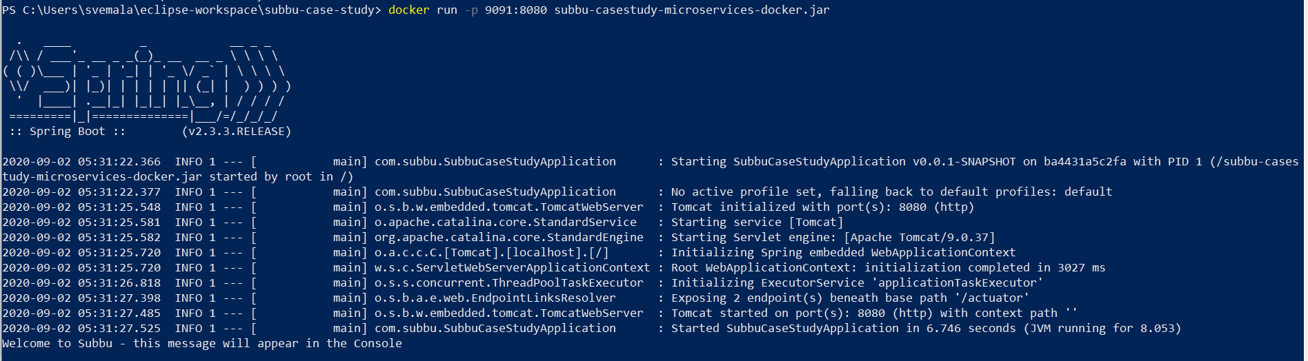
Run the Docker image using the command: docker run –p <port number mapped to the exposed port>:<Exposed port> <jar name>

Slide 26
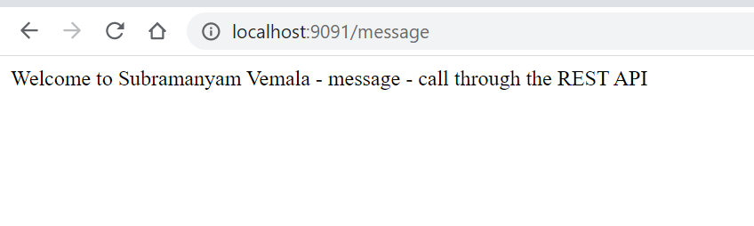
http://localhost:9091/message

Slide 27
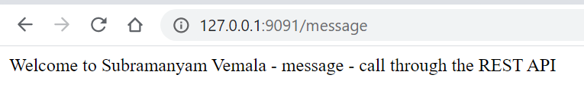
http://127.0.0.1:9091/message

Slide 28
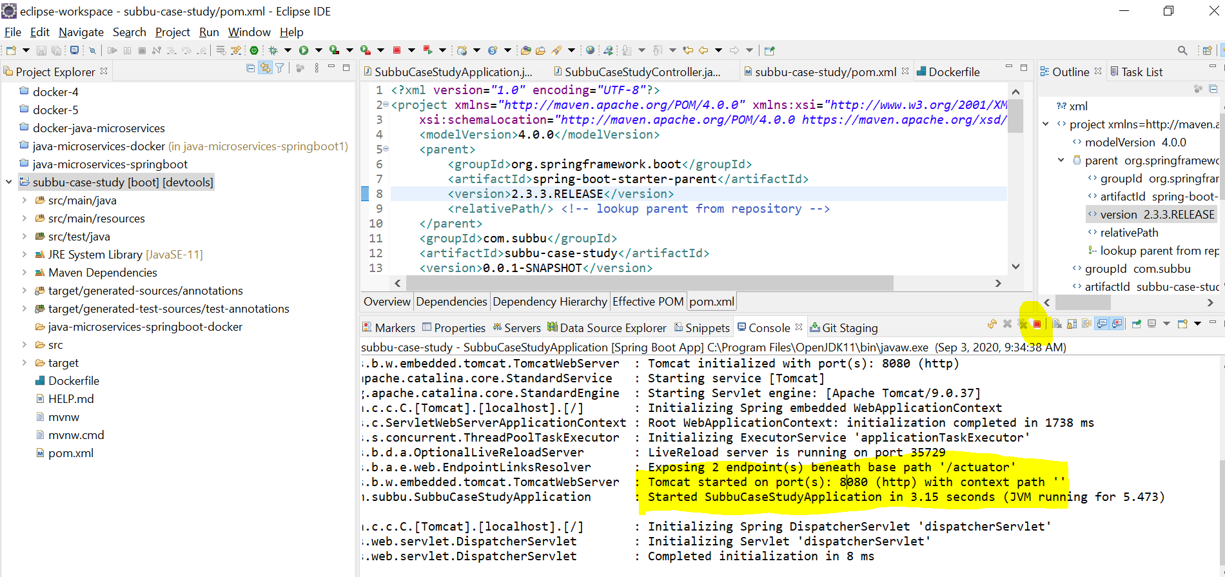
Stop the application:

Slide 29
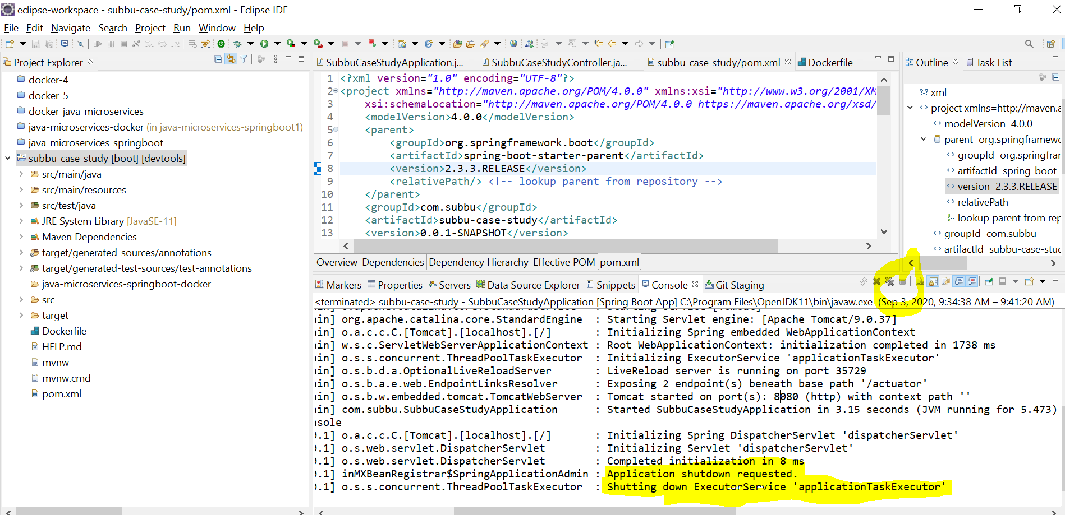
Application is stopped:

Slide 30
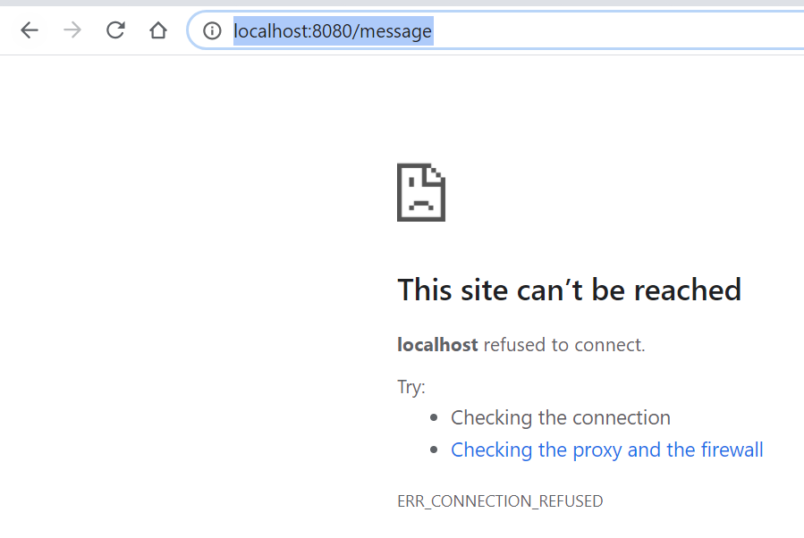
Check for the output on the browser - Now no output, on the browser as the application is stopped: http://localhost:8080/message

Slide 31
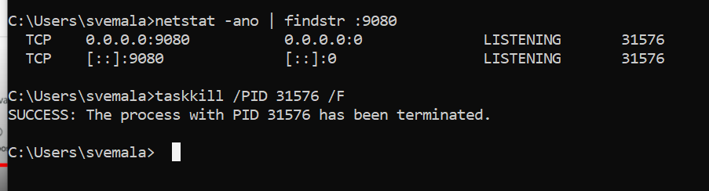
Kill the tasks if the port has been used by other services - optional:

Slide 32
Kill the tasks if the port has been used by other services - optional:
C:\Users\svemala>netstat -ano | findstr :9080
TCP 0.0.0.0:9080 0.0.0.0:0 LISTENING 31576
TCP [::]:9080 [::]:0 LISTENING 31576
C:\Users\svemala>taskkill /PID 31576 /F
SUCCESS: The process with PID 31576 has been terminated.
C:\Users\svemala>

Slide 33
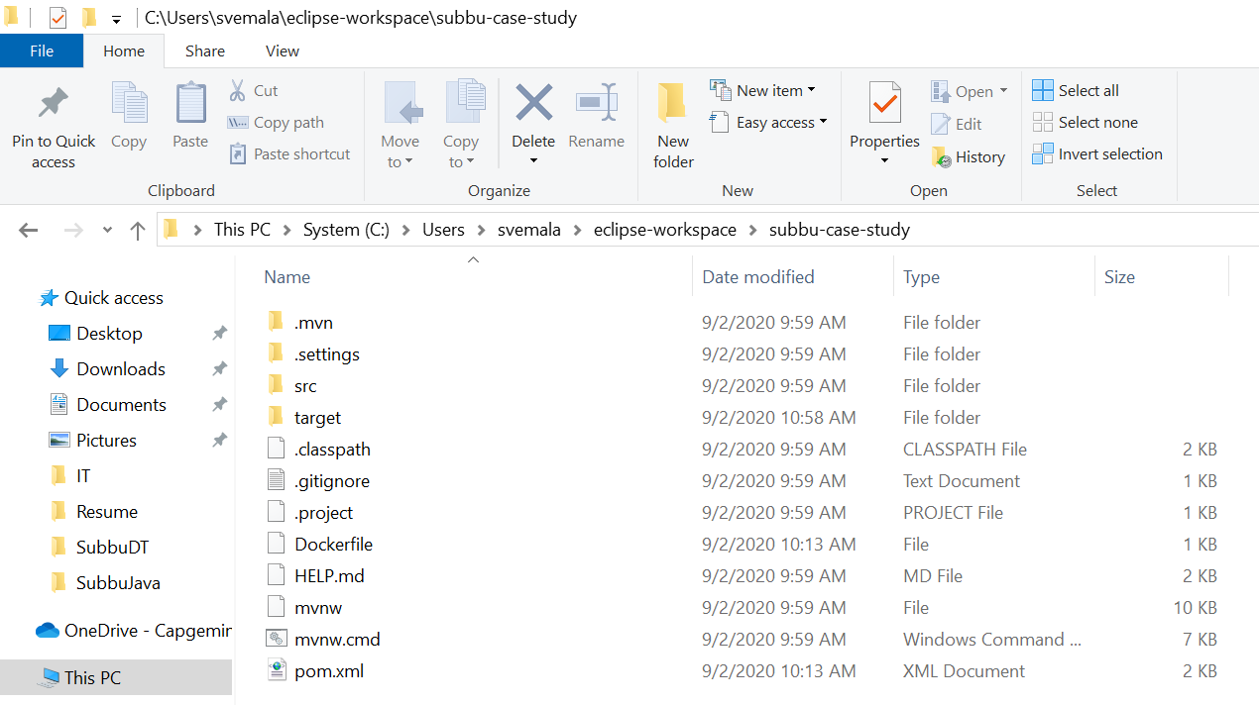
C:\Users\svemala\eclipse-workspace\subbu-case-study

Slide 34
Appendix:
Download the code from public GitGub:
1. HTTPS:
https://github.com/subbugh/java-microservices-springboot-docker.git
2. SSH:
git@github.com:subbugh/java-microservices-springboot-docker.git
3. Code Zip file:

