Slide 1




A Java Microservices project using Spring Boot– Hands-on guide
Mr. Subramanyam Tirumani Vemala
subramanyam.vemala@capgemini.com

Slide 2
Detailed Steps:
This document contains the detailed steps with screenshots, to setup a Java Microservices project using Spring Boot:
Target Audience:
All
Artifacts needed:
JDK11
Eclipse – IDE
Internet
Implementation Steps:
Create a Spring Starter Project.
Add the necessary Classes and dependencies in the pom.xml
Run as Spring Boot App on the Eclipse.
Check for the output both on the Console and the Browser.

Slide 3
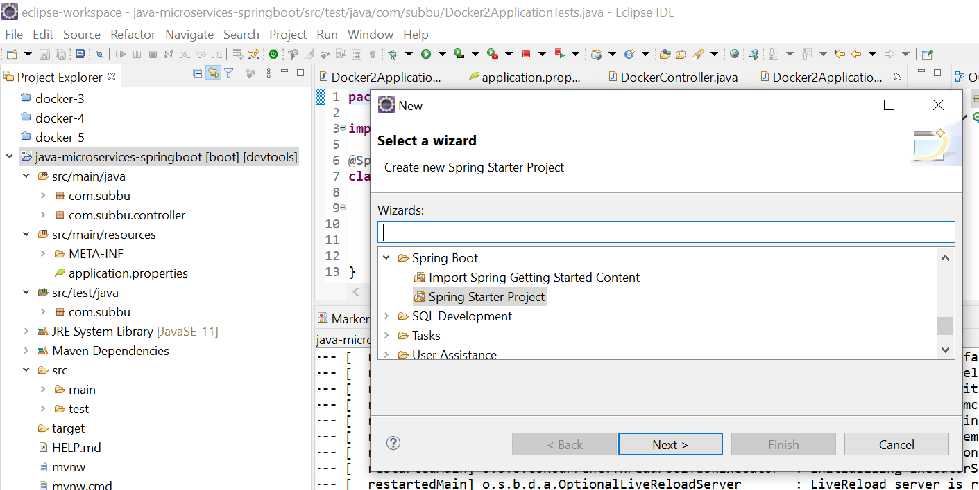
File – New – Spring Starter Project - Create

Slide 4
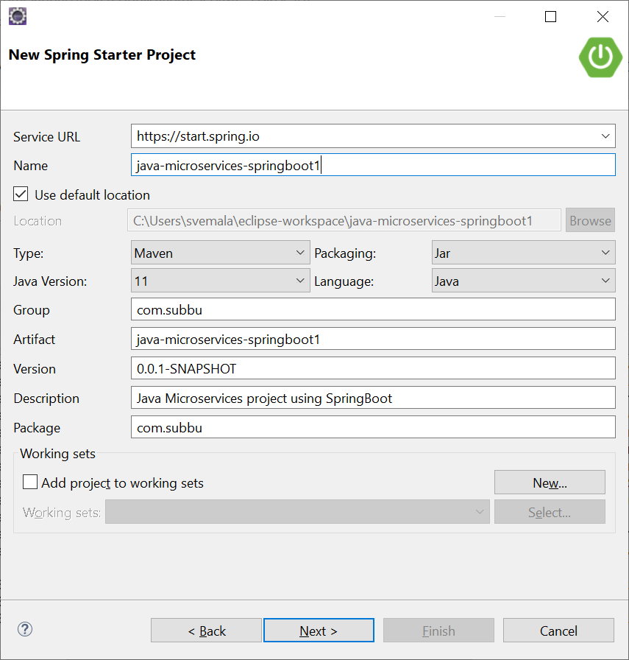
Provide the necessary details for the Spring starter project:

Slide 5
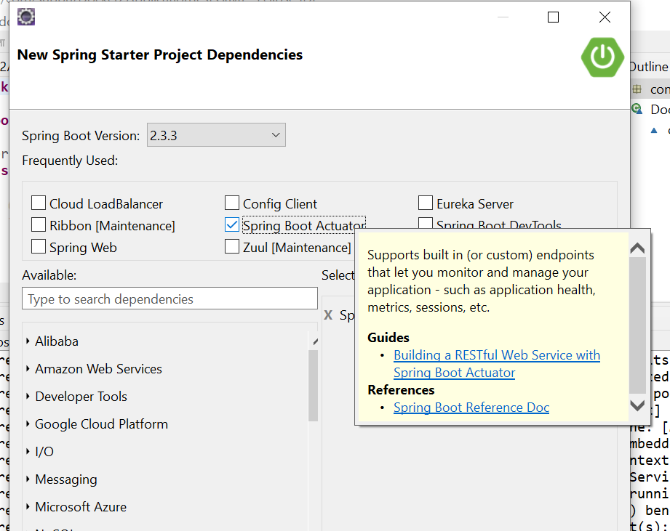
Choose the dependencies - Actuator:

Slide 6
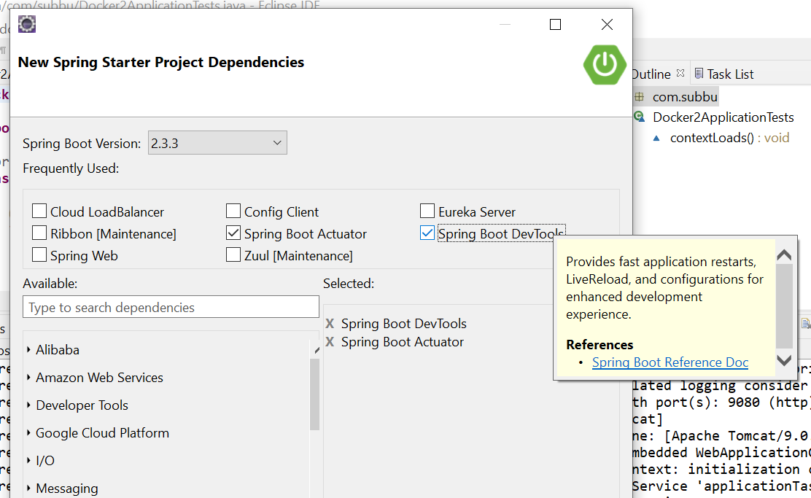
Choose the dependencies - DevTools:

Slide 7
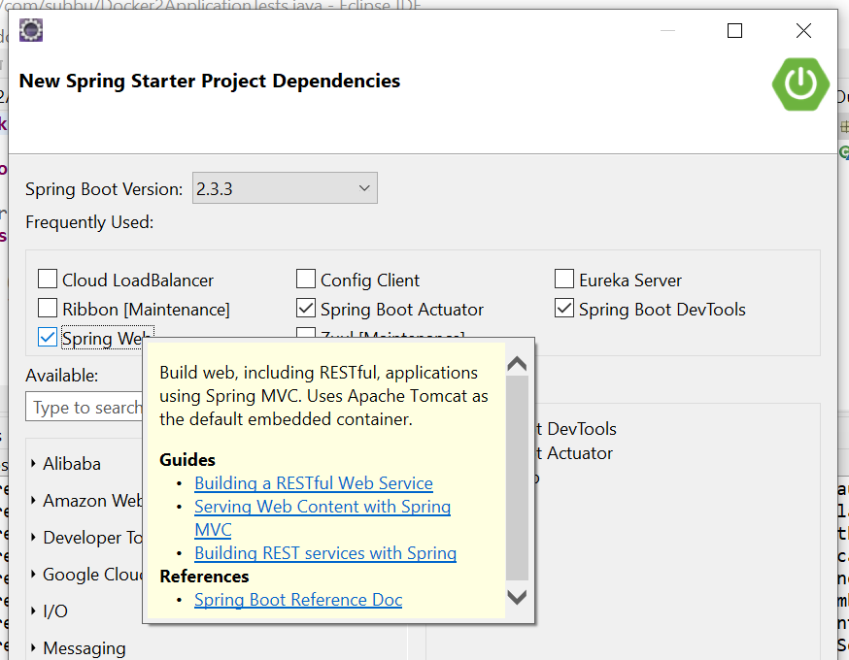
Choose the dependencies – Spring Web:

Slide 8
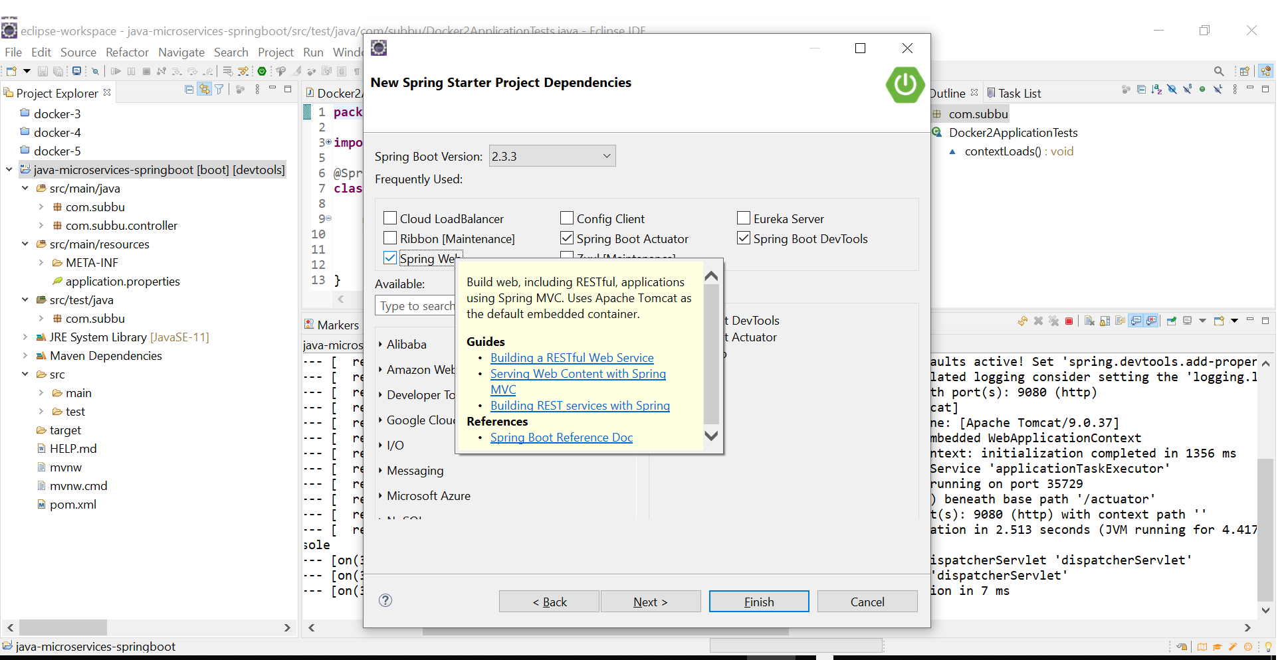

Slide 9
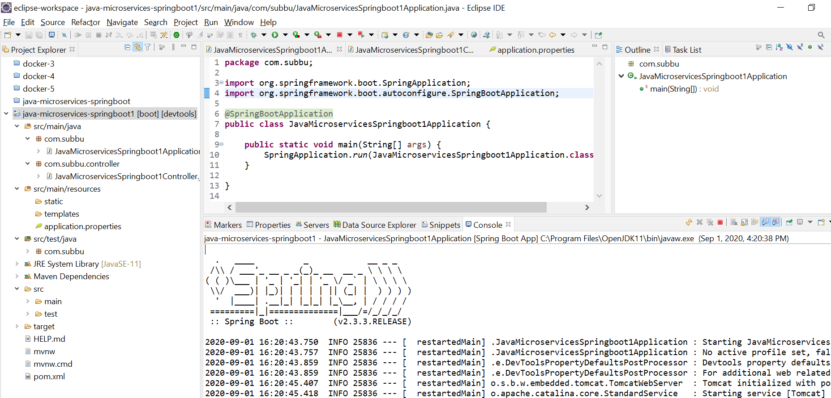
Project is created on the Eclipse:

Slide 10
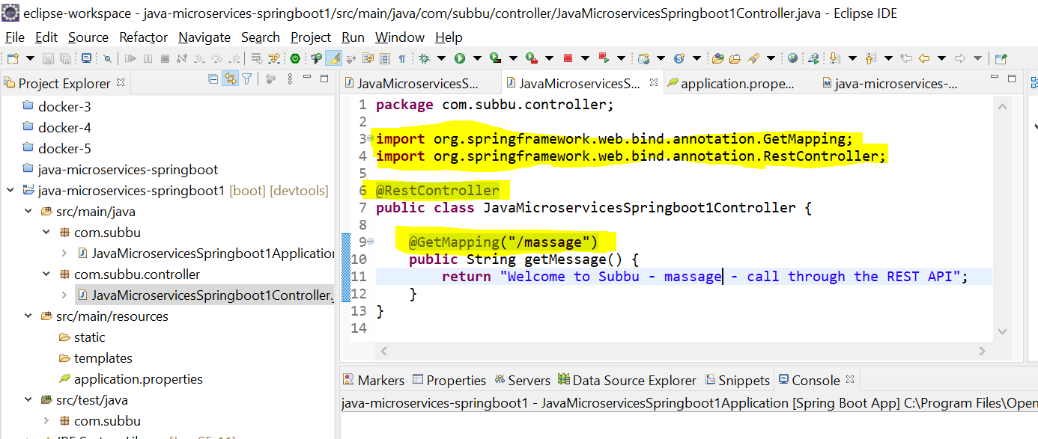
Create Controller with GetMapping and RestController:

Slide 11
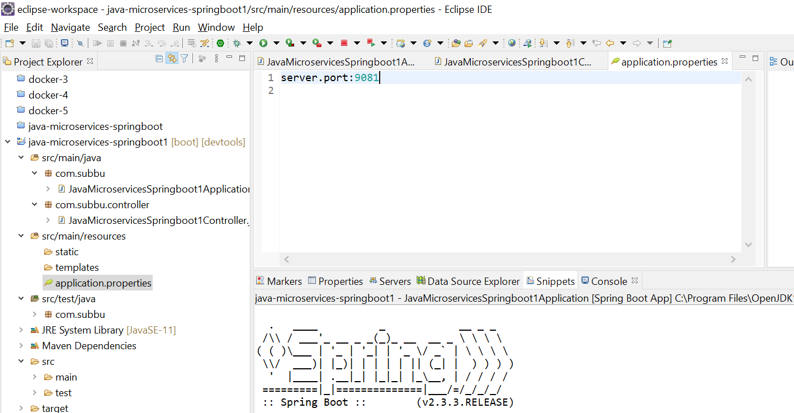
A Microservices project structure on Eclipse:

Slide 12
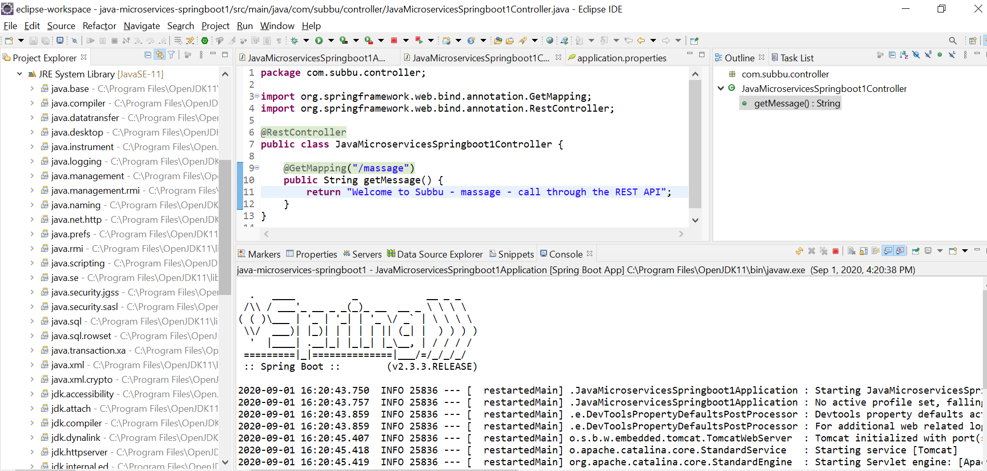
View of JRE System Library:

Slide 13
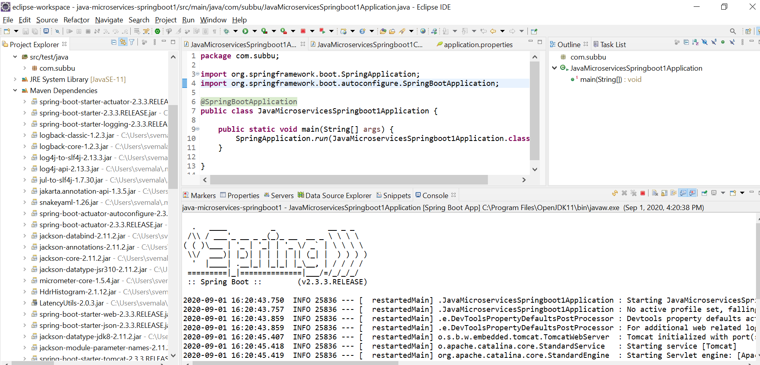
View of Maven Dependancies:

Slide 14
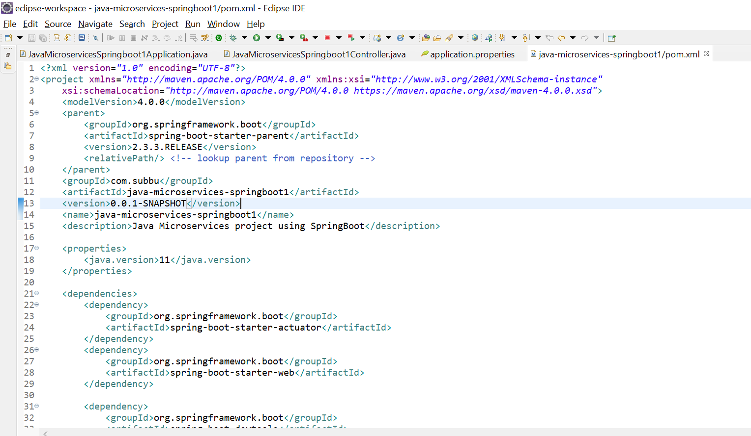
pom.xml – Deployment descriptor

Slide 15
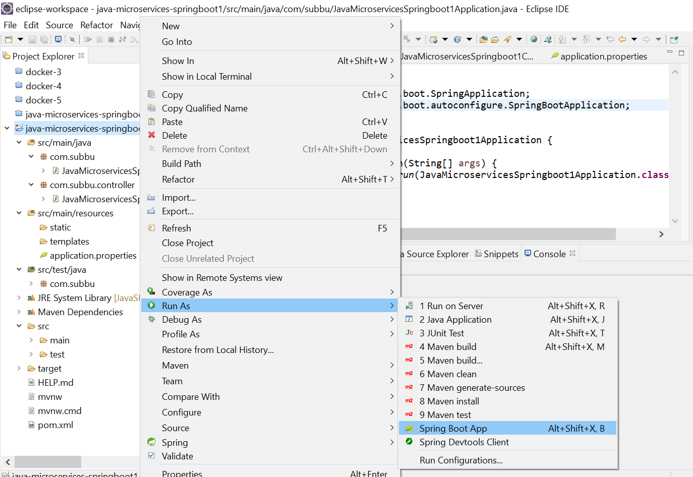
Project – Run as Spring Boot App:

Slide 16
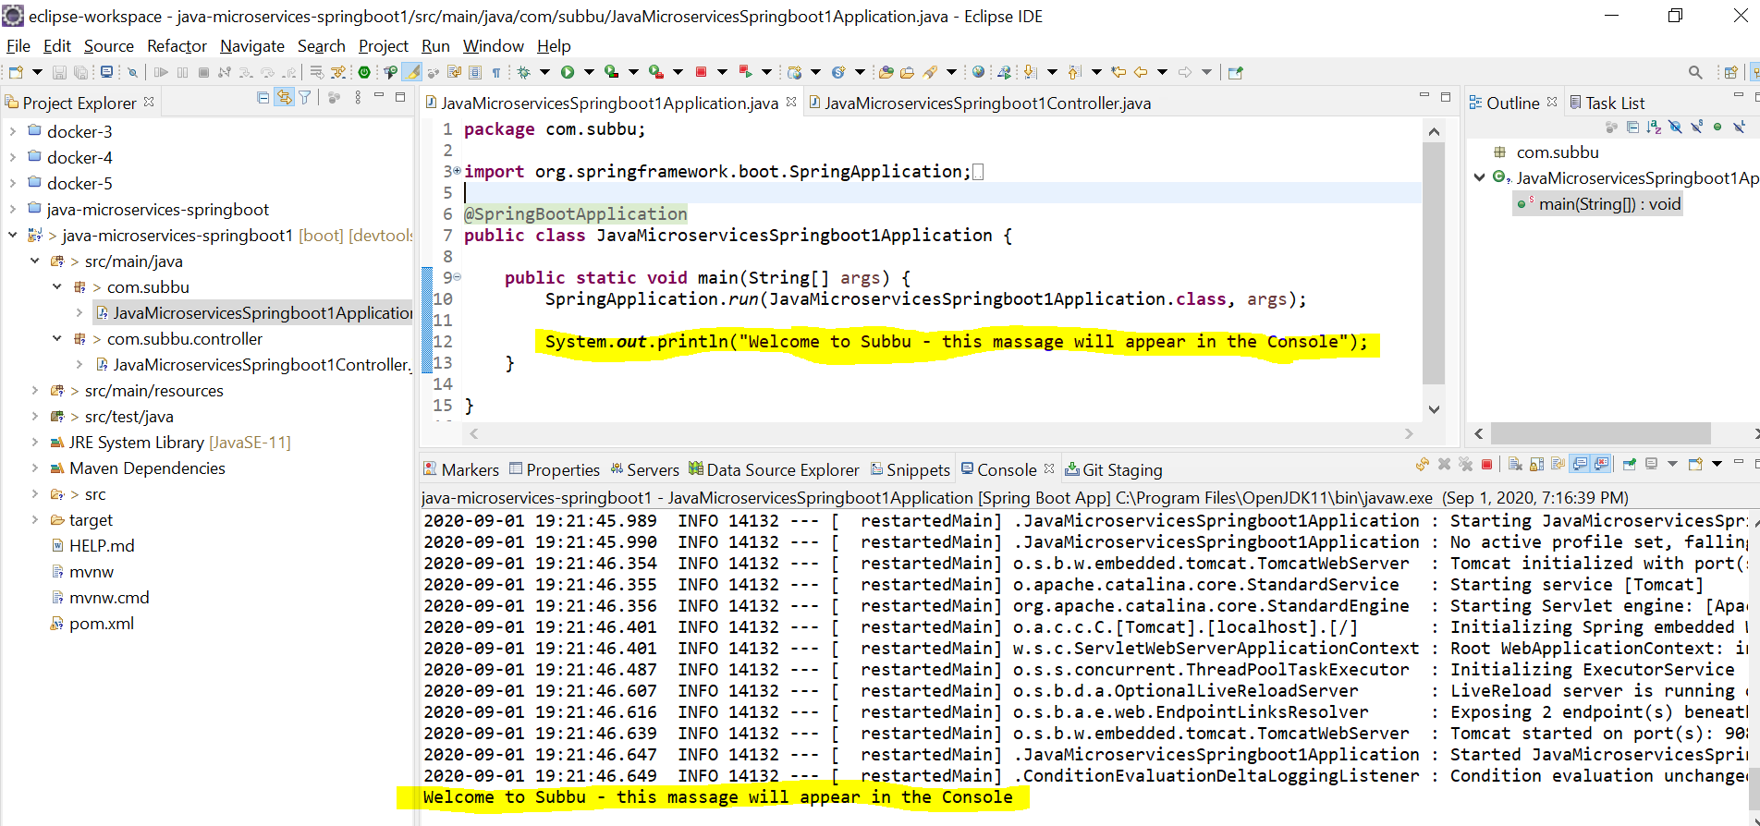
Successfully deployed with tomcat started on port 9081:

Slide 17
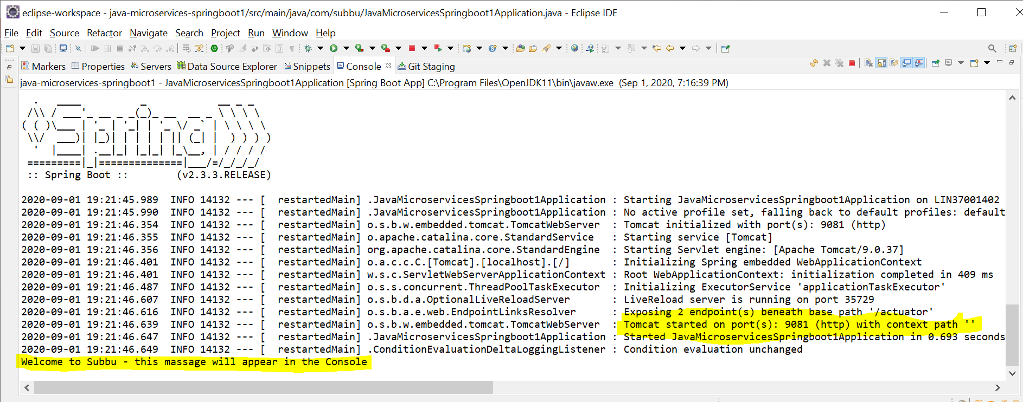
Console - Successfully deployed with tomcat started on port 9081:

Slide 18
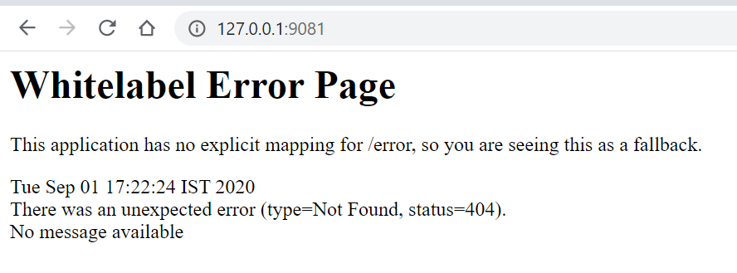
Browser output without GetMessage string:

Slide 19
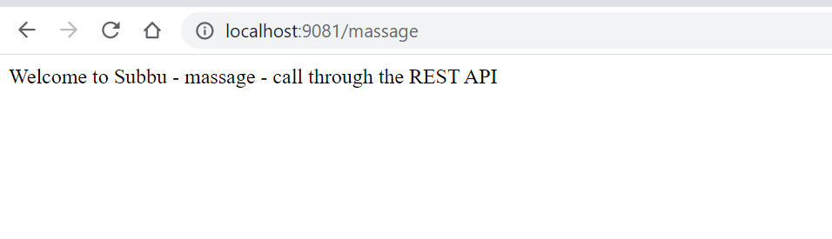
http://localhost:9081/massage - output on Chrome by REST call:

Slide 20
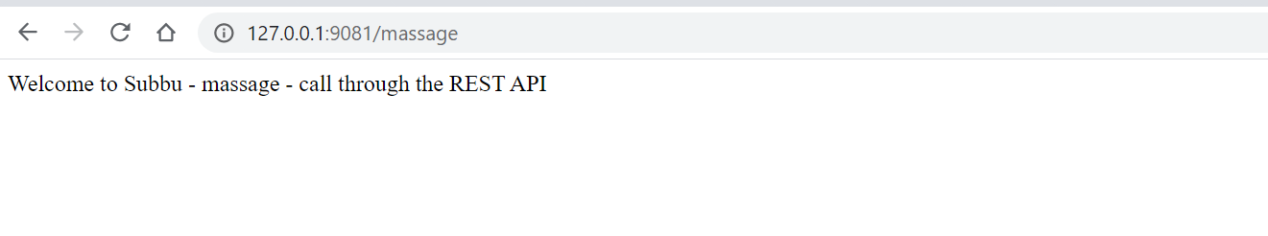
http://127.0.0.1:9081/massage - output on Chrome by REST call:

Slide 21
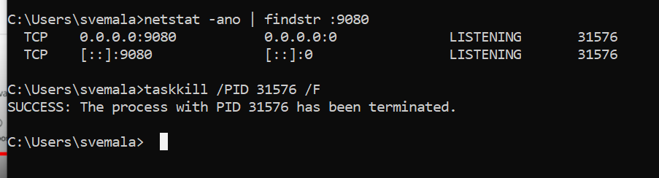
Kill the tasks if the port has been used by other services:

Slide 22
Kill the tasks if the port has been used by other services:
C:\Users\svemala>netstat -ano | findstr :9080
TCP 0.0.0.0:9080 0.0.0.0:0 LISTENING 31576
TCP [::]:9080 [::]:0 LISTENING 31576
C:\Users\svemala>taskkill /PID 31576 /F
SUCCESS: The process with PID 31576 has been terminated.
C:\Users\svemala>

Slide 23
Appendix:
Download the code from public GitGub:
1. HTTPS:
https://github.com/subbugh/java-microservices-springboot1.git
2. SSH:
git@github.com:subbugh/java-microservices-springboot1.git
3. Code Zip file:

