Slide 1

MS-Applied Data Science
Portfolio Milestone
Git repo: https://github.com/subbukandhaswamy/IST782-MSADS
Subbu Kandhaswamy
ID 743189972
SKANDHAS

Slide 2

Introduction to ADS?
This Applied Data science program in Syracuse enables students to apply appropriate analytical and computational methods to handle real-world problems effectively.
Understanding the data, enhances clarity and communicate technical information to targeted audience thru great visualization.
Methods to collect, analyze and develop insights using data from multitude of domains using various tools and techniques.
The projects and presentations exemplifies the skills that we developed through this program that includes the below courses but not limited to
IST 659 – DATABASE ADMIN CONCEPTS AND DB MANAGEMENT
IST 722 – DATA WAREHOUSING
IST 651 – SCRIPTING FOR DATA ANALYTICS
IST 718 – BIG DATA ANALYTICS

Slide 3
Key Learning Objectives
Describe a broad overview of the major practice areas in data science
Collect and organize data
Identify patterns in data via visualization, statistical analysis, and data mining
Develop alternative strategies based on the data
Develop a plan of action to implement the business decisions derived from the analyses
Demonstrate communication skills regarding data and its analysis for managers, IT professionals, programmers, statisticians, and other relevant professionals in their organization
Synthesize the ethical dimensions of data science practice.

Slide 4

IST 659 DATABASE ADMINISTRATION 4SEASONS
Prof: Chad Harper

Slide 5
Data Administration for 4 seasons
Identified the requirement to design and implement appropriate data-oriented solutions using the relational data storage model.
Applied normalization techniques to improve the database schema, Created database objects (tables/columns) to meet business requirement and queries for CRUD operations using TSQL.
Performance and data integrity improvements to handle rapid data growth and latency.
The solution enabled Four Seasons their following business operations efficiently-
Inventory
Sales
Customers
Orders

Slide 6
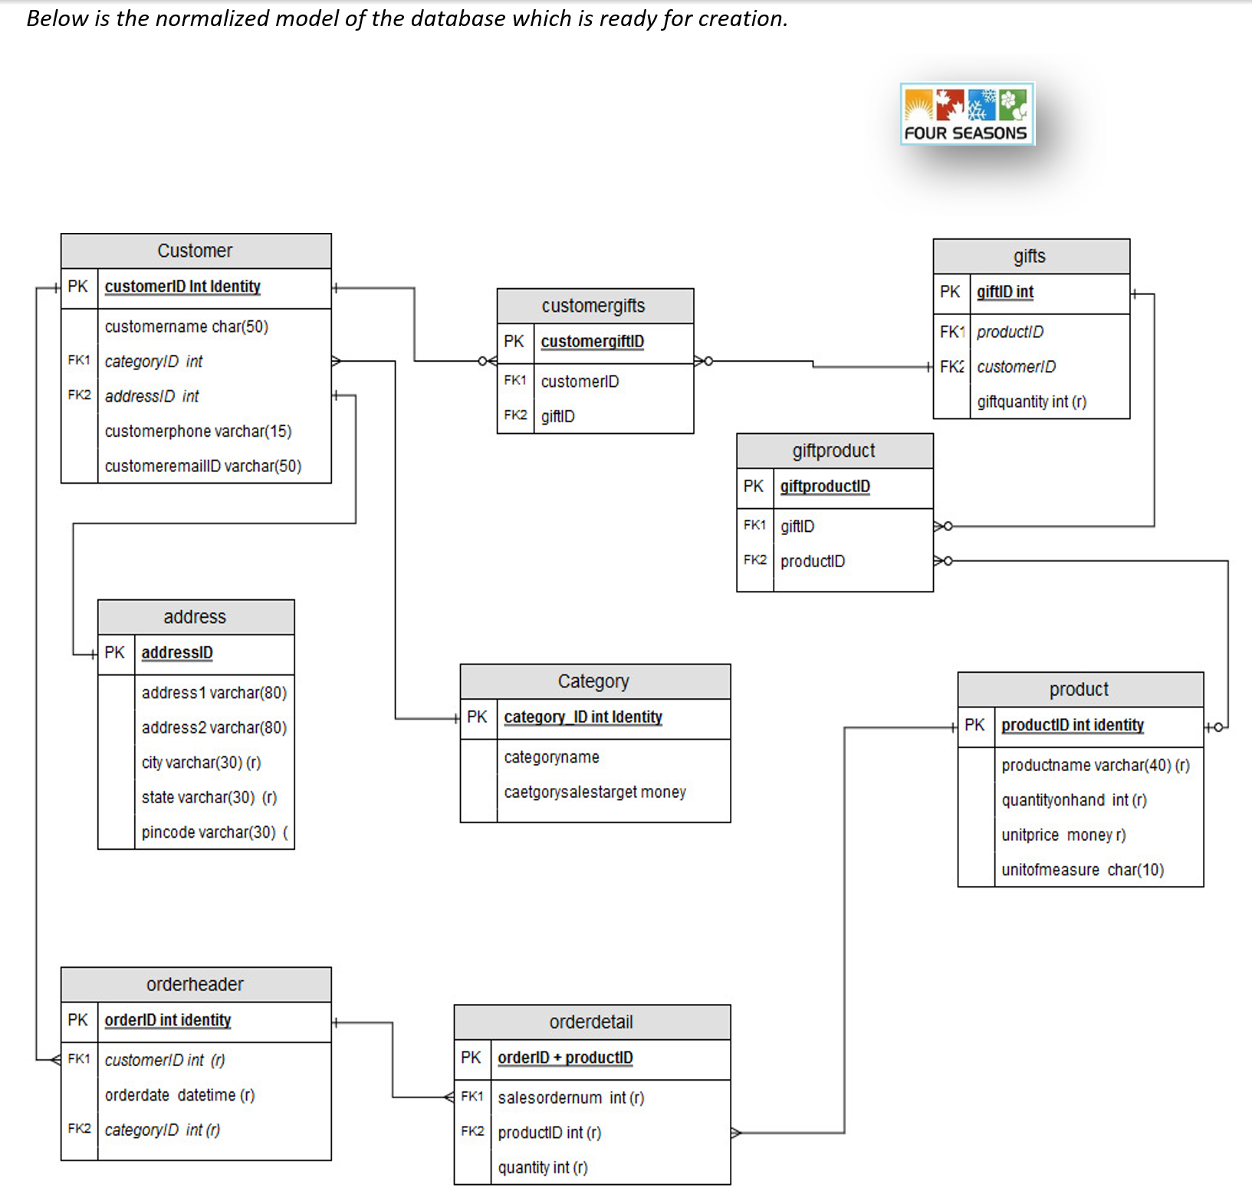
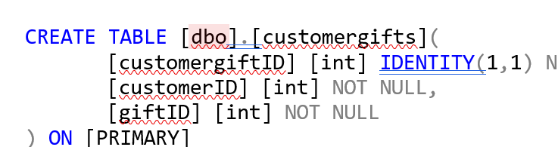
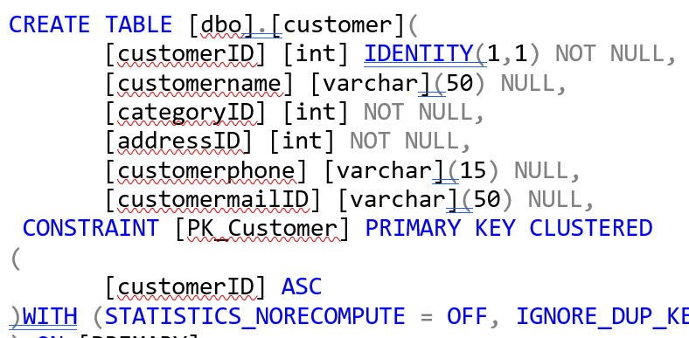
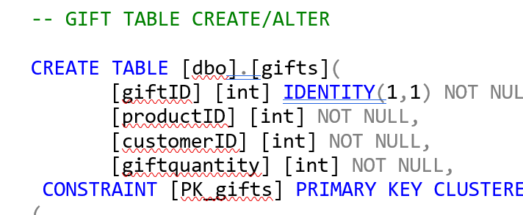
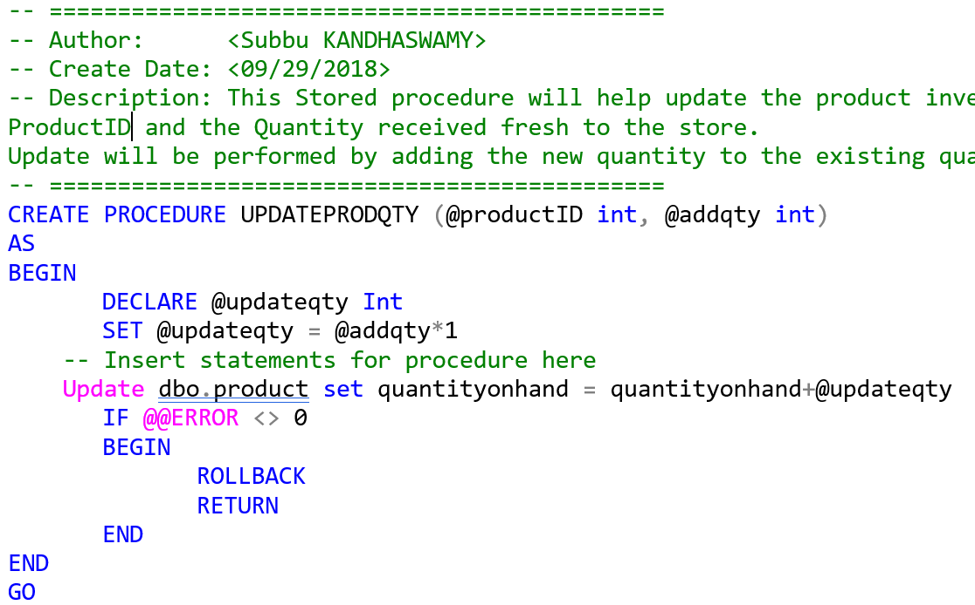
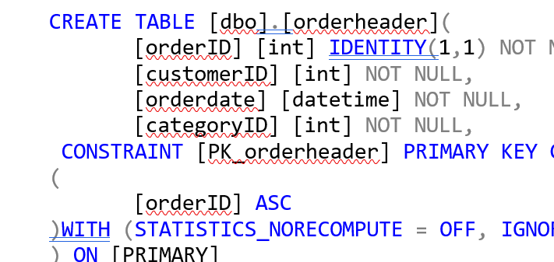
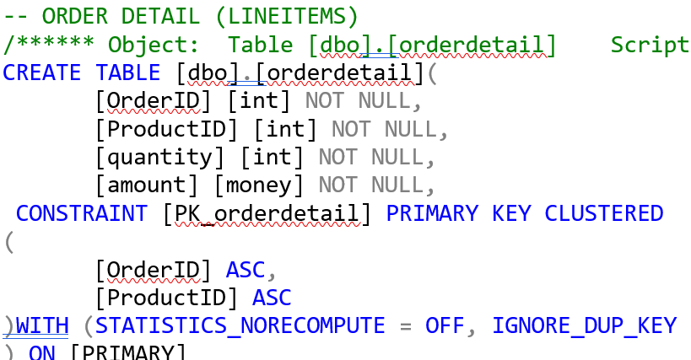
Data Administration for 4 seasons

Slide 7
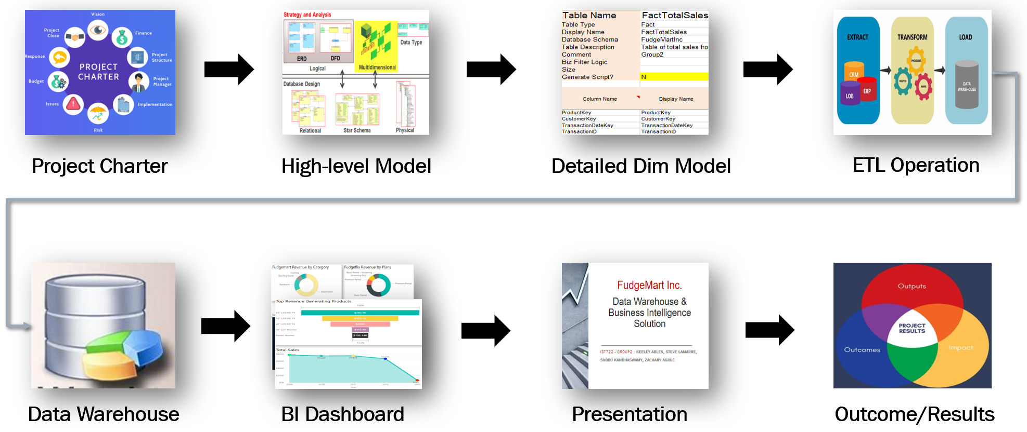

IST 722 - DATA WAREHOUSE & BI SOLUTIONS Fudgemart
Prof: Humayun Khan

Slide 8
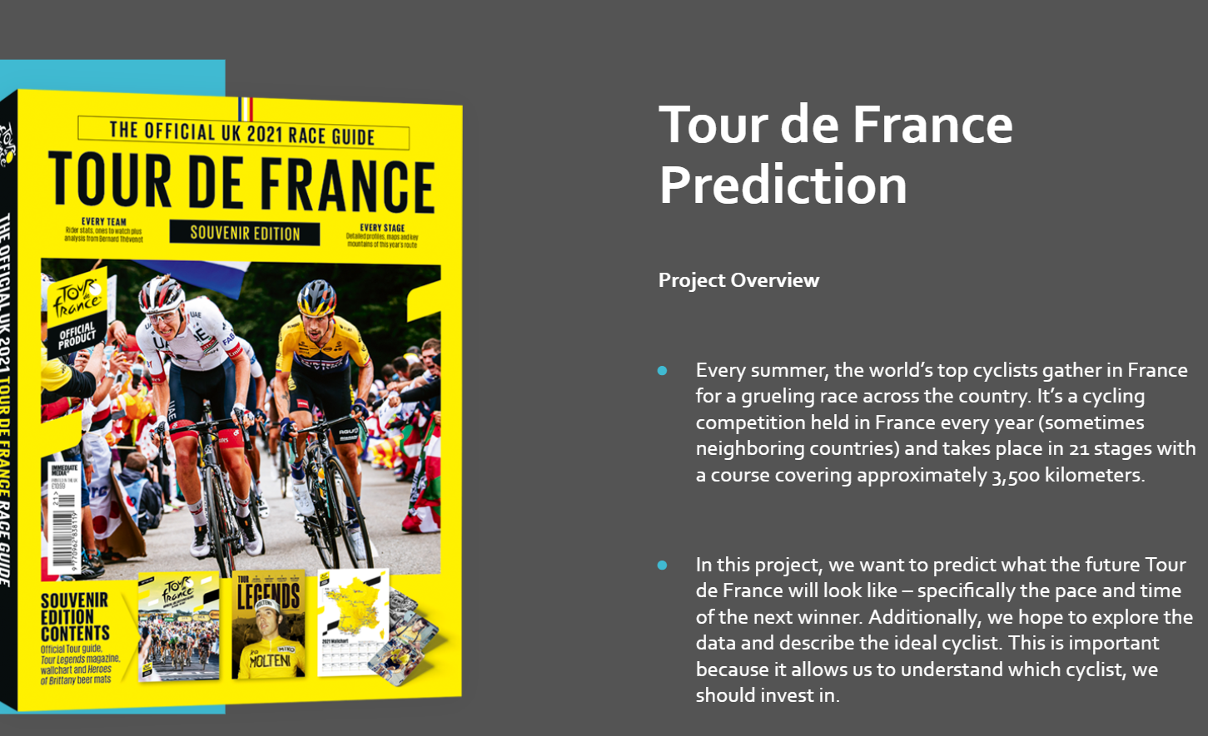

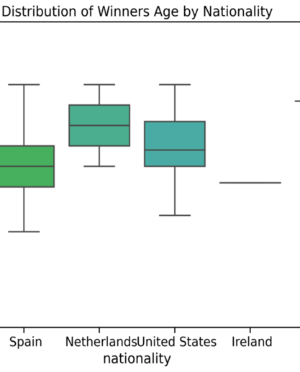
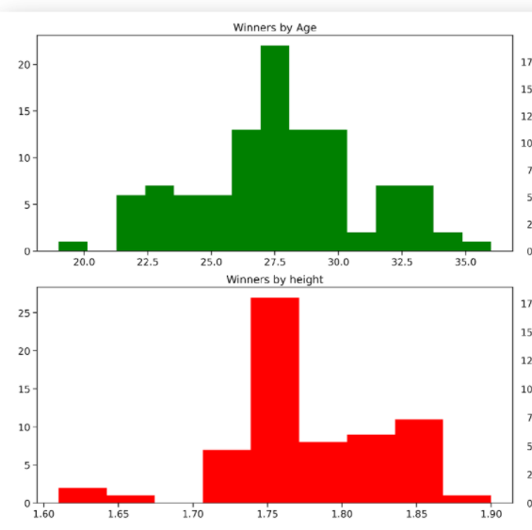
IST 718 - DATA ANALYTICS Tour De France
Dr. Jonathan Fox

Slide 9
IST 652 – Scripting Data Analytics
Pending

Slide 10
Conclusion
Pending

Slide 11
Thank You! to Syracuse University Professors and fellow classmates for sharing their knowledge & experience

