Slide 1
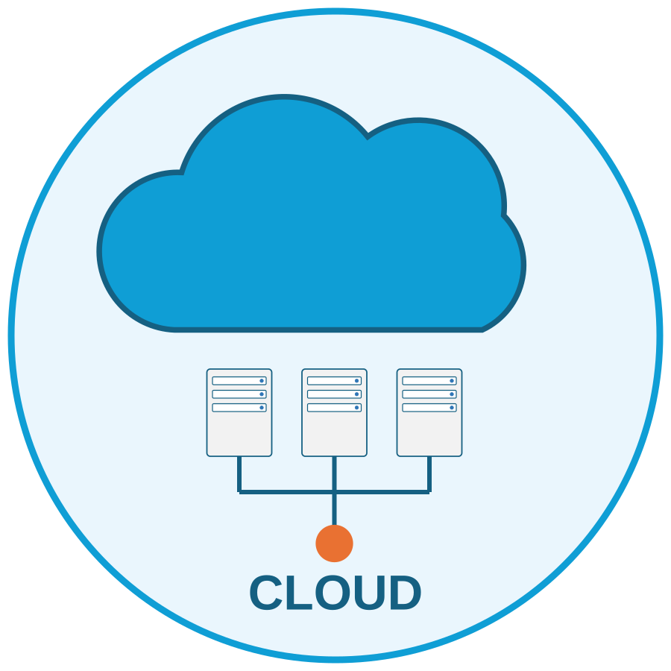

25CS2206E | CO1: Cloud Foundations
Cloud Infrastructure and Services
Course Instructor: Dr. Y. Subbarayudu
Notes:
Course Outcome 1 introduces cloud foundations: service and deployment models, virtualization, global infrastructure, the Well-Architected Framework, migration and TCO, request tracing and the shared responsibility model.

Slide 2
Chapters
Foundations
Migration & Economics
Review
1. Cloud Service Models
6. The 7 Rs of Migration
Chapter Summary
2. Deployment Models
7. Migration Process
Review Questions
3. Virtualization
8. Total Cost of Ownership
Infrastructure & Design
Operations
4. Global Infrastructure
9. Tracing an HTTP Request
5. Well-Architected Framework
11. Shared Responsibility and Break-Fix
10. Tri-Cloud Terminology
Notes:
Click any topic to jump to it. Every content slide has a 'back to chapter index' link at the bottom right.

Slide 3
Learning Objectives of CO1
1
Explain the NIST definition of cloud computing and its five characteristics
6
Apply the six Well-Architected pillars to review a workload
2
Compare IaaS, PaaS, SaaS, FaaS and CaaS by control and responsibility
7
Choose a migration strategy from the 7 Rs
3
Select a deployment model: public, private, community, hybrid, multi-cloud
8
Build a TCO and breakeven estimate
4
Describe how hypervisors, VMs and containers abstract hardware
9
Trace an HTTP request through a multi-tier system
5
Map Regions, AZs and edge locations to availability and latency goals
10
Diagnose break-fix incidents caused by shared-responsibility mistakes
back to chapter index
Notes:
Ten outcomes the student should be able to demonstrate after this chapter.

Slide 4
What is Cloud Computing? The NIST Definition
NIST SP 800-145: “Cloud computing is a model for enabling ubiquitous, convenient, on-demand network access to a shared pool of configurable computing resources (e.g., networks, servers, storage, applications, and services) that can be rapidly provisioned and released with minimal management effort or service provider interaction.”
On-demand self-service
Broad network access
Resource pooling
Rapid elasticity
Measured service
Provision resources yourself, without a provider approving each request
Reach services over the network from phones, laptops and tablets
Many customers share pooled hardware in a multi-tenant model
Scale out and in quickly, often automatically
Usage is metered, which makes pay-per-use billing possible
3 service models (IaaS, PaaS, SaaS) + 4 deployment models (public, private, community, hybrid) in NIST. Industry adds FaaS, CaaS and multi-cloud.
back to chapter index
Notes:
NIST SP 800-145 is the reference definition. The five characteristics are the test for whether an offering is genuinely cloud.

Slide 5
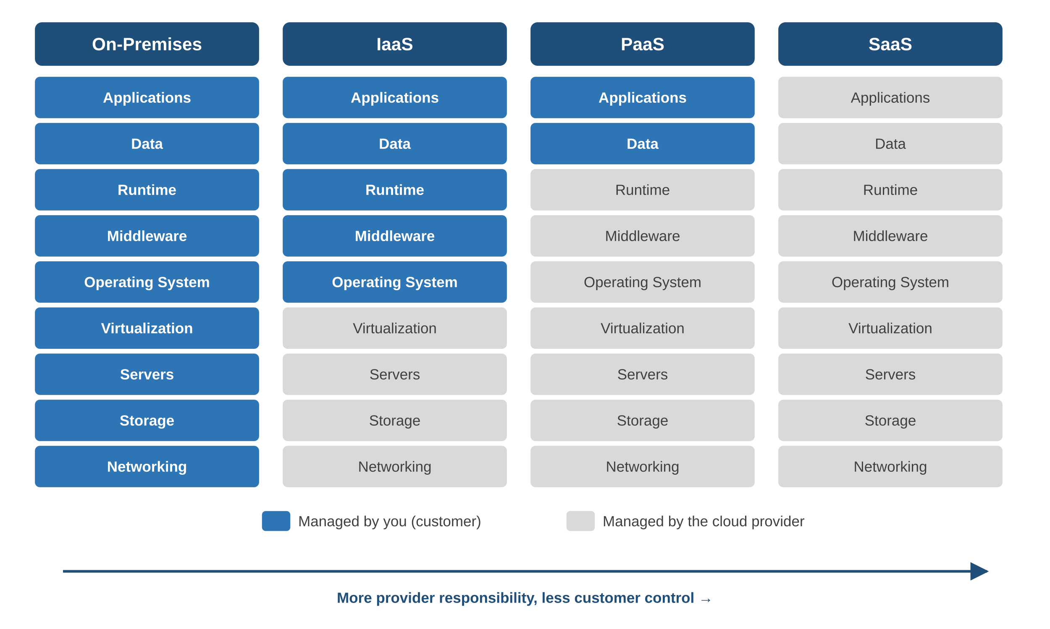
Cloud Service Models: who manages which layer
Pizza analogy
On-premises: make it all at home
IaaS: take-and-bake, your oven
PaaS: delivery, your table
SaaS: dine out
Service model = how much the provider operates. Deployment model = where it runs and who may use it.
Managed by you (blue) | Managed by provider (grey)
back to chapter index
Notes:
Read left to right: the customer's share of the stack shrinks. This picture returns in the shared responsibility section.

Slide 6
Software as a Service (SaaS)
SaaS delivers a complete application over the internet on a subscription. Users work in a browser; the provider runs, updates and secures every layer beneath the user's data and settings.
Provider manages
Customer manages
Category | Examples
CRM | Salesforce, HubSpot
Productivity | Microsoft 365, Google Workspace
Collaboration | Slack, Asana, Jira
Finance / HR | QuickBooks, Xero, Workday
E-commerce | Shopify, BigCommerce
IT service mgmt | ServiceNow
Data centres, servers, storage, network
OS, middleware, databases
The application, patches, new features
Availability, scaling, platform backups
Users and access
Application configuration
Business data entered
Integrations with other systems
Pros: no infrastructure, same-day adoption, predictable cost. Cons: limited control over features, release timing and data residency.
back to chapter index
Notes:
SaaS is the easiest model to adopt; the customer still owns users, configuration and data.

Slide 7
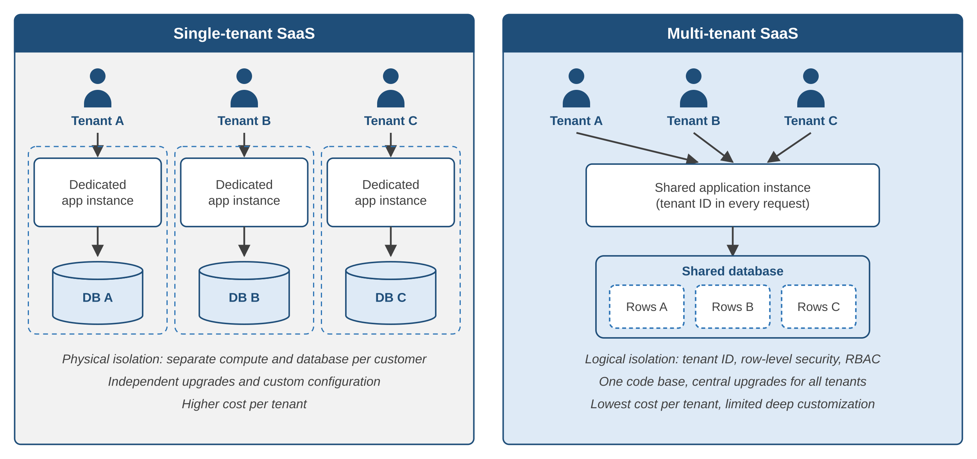
Single-Tenant vs Multi-Tenant SaaS
Feature | Multi-tenant | Single-tenant
Infrastructure | Shared | Dedicated
Cost | Lower | Higher
Customization | Configuration | Extensive
Data isolation | Logical | Physical
Upgrades | Vendor-controlled | Customer-controlled
Compliance fit | Good | Stronger (regulated)
Analogy: detached houses (single-tenant) versus an apartment block (multi-tenant).
back to chapter index
Notes:
Houses versus apartments: single tenancy gives each customer its own walls; multi-tenancy shares the structure.

Slide 8
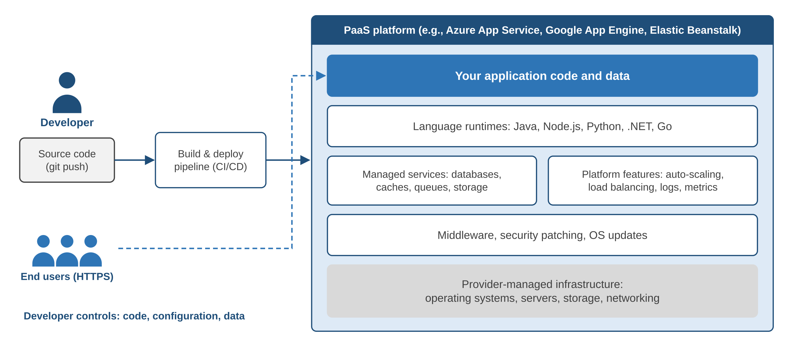
Platform as a Service (PaaS)
Typical PaaS offers
Language runtimes and hosting
Managed DB, cache, queue
CI/CD and dev tools
Auto-scaling, load balancing, monitoring
Examples
Azure App Service, Google App Engine, AWS Elastic Beanstalk, Heroku, Amazon RDS
Pros: faster delivery, no OS patching, built-in scaling. Cons: less infrastructure control, lock-in risk, runtime versions follow the provider.
back to chapter index
Notes:
Developers focus on code; the platform handles OS, runtime, scaling and patching.

Slide 9
Infrastructure as a Service (IaaS)
IaaS provides virtual machines, storage, networks, load balancers and firewalls on demand. It gives the highest control of the NIST models: the customer manages OS, runtime, apps and data.
# Launch a VM in the Hyderabad Region (ap-south-2)
aws ec2 run-instances --region ap-south-2 \
--image-id ami-0123456789abcdef0 \
--instance-type t3.micro --key-name my-keypair \
--subnet-id subnet-0abc1234def567890 \
--security-group-ids sg-0123abcd4567ef890
# Customer now owns OS patching and data backup
Major IaaS services
AWS: EC2, EBS, VPC
Azure: Virtual Machines, Managed Disks, VNet
Google Cloud: Compute Engine, Persistent Disk, VPC
Pros: no capex, capacity in minutes, any software. Cons: you patch and secure the OS, need admin skills, idle VMs still cost money.
back to chapter index
Notes:
IaaS behaves like a server you own, without buying hardware. Everything inside the VM is the customer's job.

Slide 10
Comparing SaaS, PaaS and IaaS
Feature | SaaS | PaaS | IaaS
What you get | Ready-to-use software | Development and runtime platform | Virtualized infrastructure
User control | Minimal | Moderate | High
Who manages the OS | Provider | Provider | Customer
Typical users | Business end users | Developers | System administrators
Customization | Low (configuration) | Medium (code, settings) | High (full stack)
Billing unit | Per user / transaction | Per app, request or resource | Per instance-hour, GB
Use cases | Email, CRM, HR, payroll | Web apps, APIs, DevOps | ERP hosting, big data, DR
Example | Microsoft 365 | Azure App Service | Amazon EC2
back to chapter index
Notes:
SaaS = ready-to-use software, PaaS = development environment, IaaS = virtualized infrastructure.

Slide 11
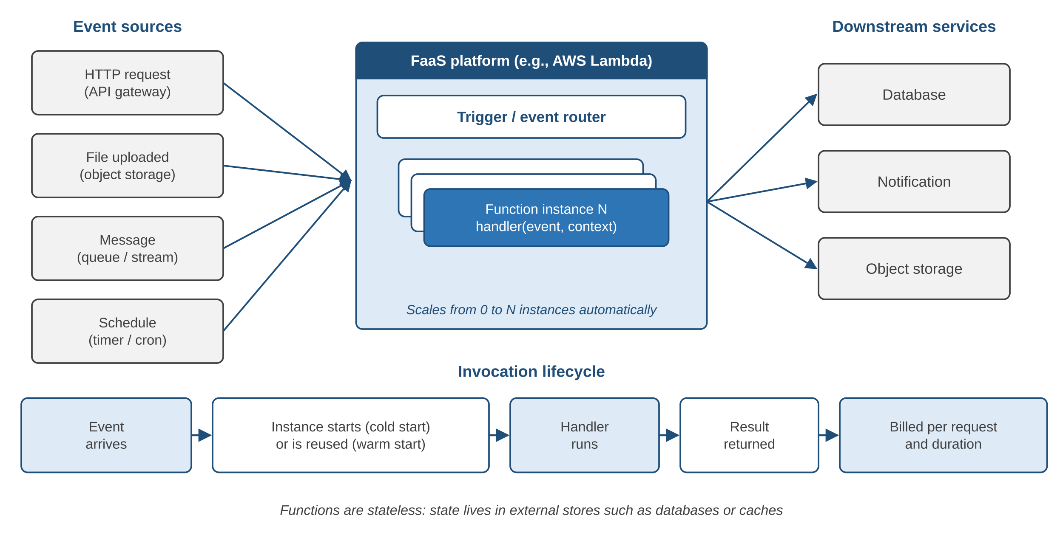
Emerging Models: Function as a Service (FaaS)
Key features
Event-driven execution
Scales from zero to thousands
Pay per request and duration
Stateless functions
Cold start on first call
Platforms
AWS Lambda, Azure Functions, Google Cloud Run functions
Best for: microservices, file processing, scheduled jobs and other event-based workloads with uneven traffic.
back to chapter index
Notes:
Serverless: there are still servers, you just never manage them. Cold starts are the main trade-off.

Slide 12
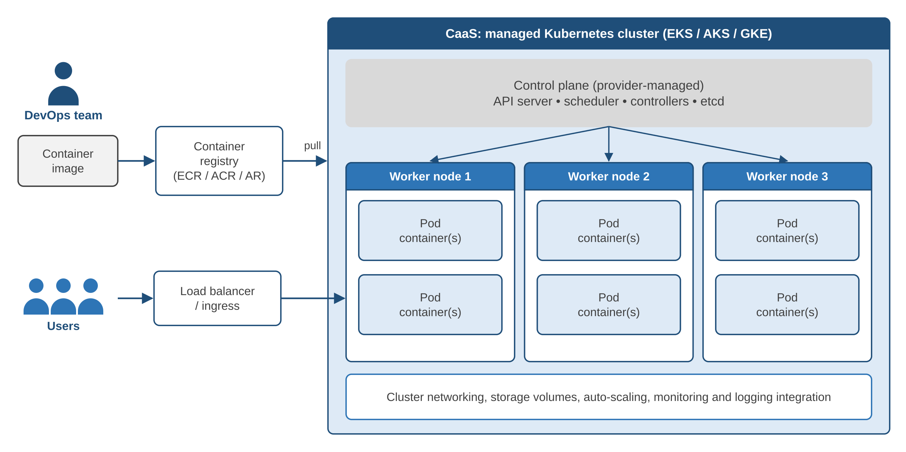
Emerging Models: Container as a Service (CaaS)
CaaS provides
Container runtime (OCI images)
Kubernetes orchestration
Managed control plane upgrades
Pod and node auto-scaling
Load balancing, storage, logging
Examples
Amazon EKS, Azure AKS, Google GKE
Same image runs on a laptop, a test cluster and production
back to chapter index
Notes:
CaaS sits between IaaS and PaaS: Kubernetes portability without running the control plane.

Slide 13
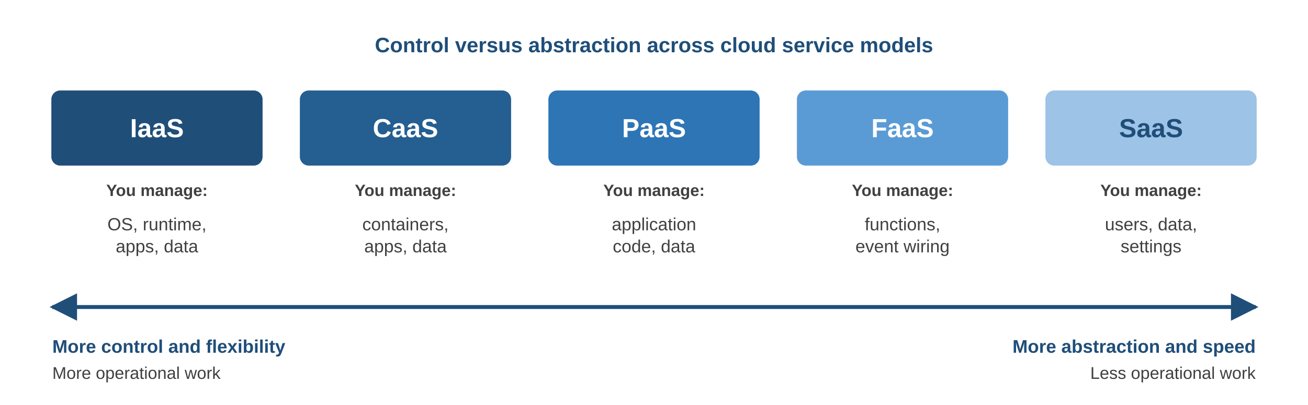
Choosing the Right Service Model
If the main need is... | Choose | Because
A standard business function | SaaS | No development or operations needed
Build a web app or API quickly | PaaS | Provider handles OS, scaling, patching
Short event-driven tasks | FaaS | Pay per execution, scales to zero
Portable microservices | CaaS | Kubernetes without running the control plane
Full OS control or legacy software | IaaS | Behaves like your own server
back to chapter index
Notes:
Most organizations use several models at once: SaaS for email, PaaS for web apps, IaaS for legacy ERP.

Slide 14
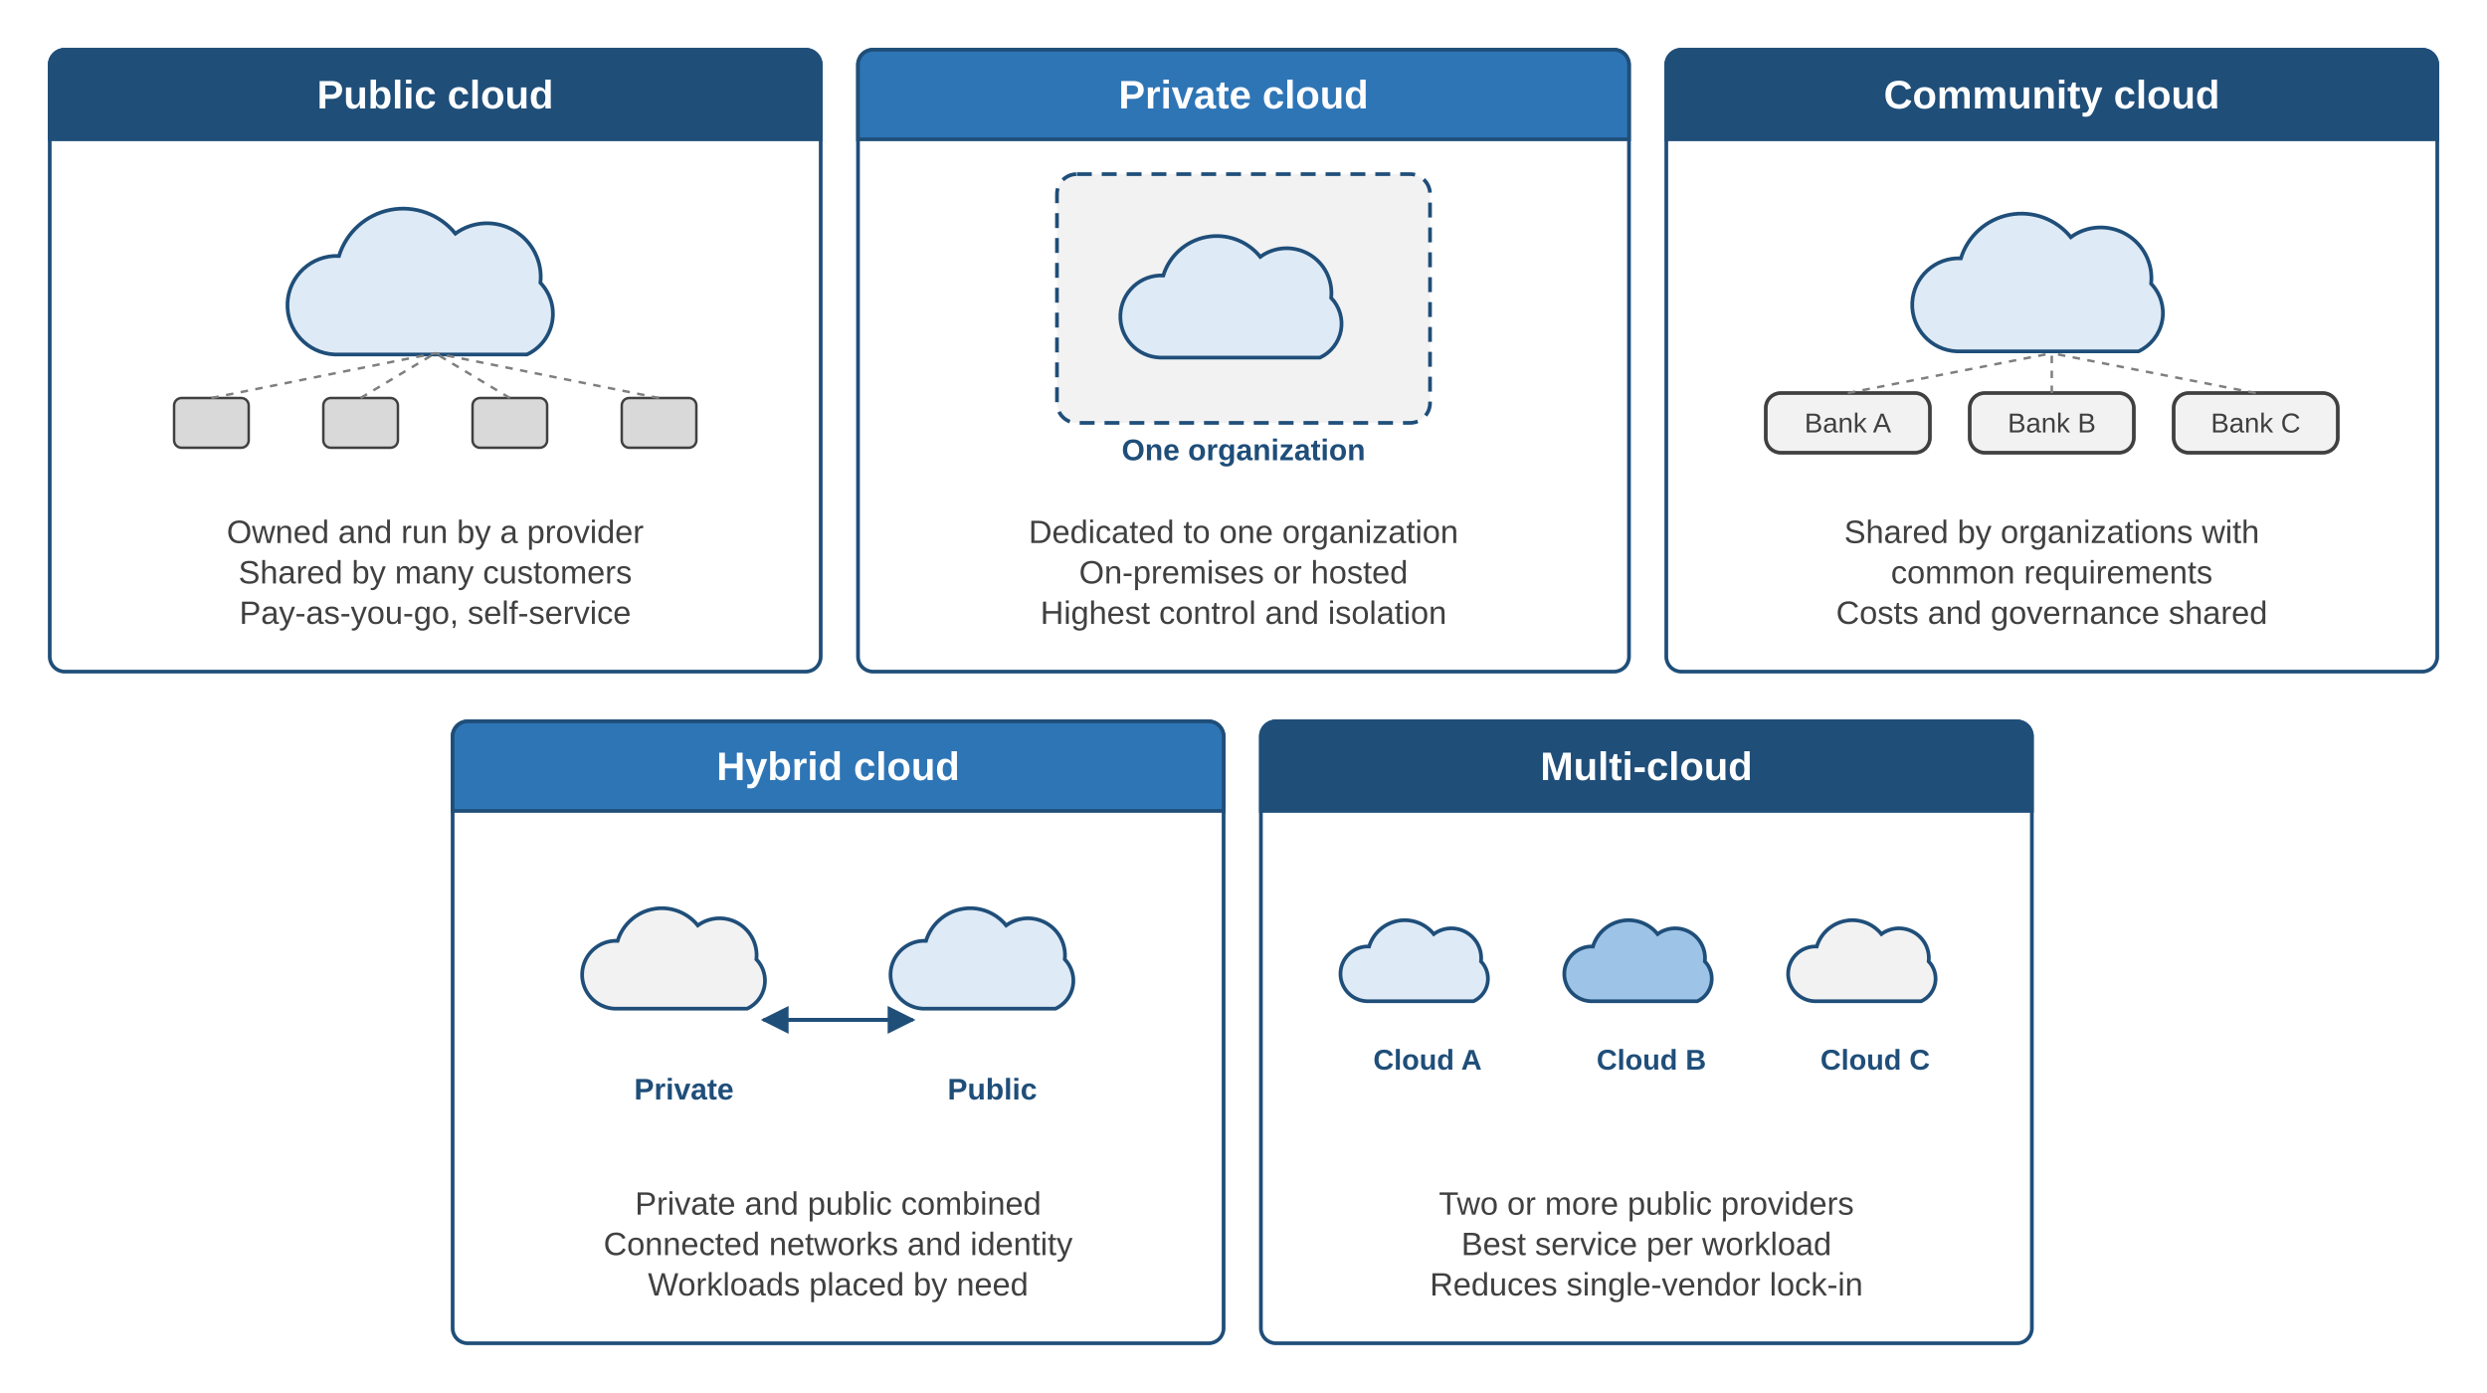
Cloud Deployment Models: where it runs, who uses it
Places to stay
Public: a hotel
Private: your own house
Community: a gated housing society
Hybrid: house + hotel rooms for guests
Multi-cloud: several hotel chains
“Public” means anyone can sign up, not that your data is visible.
back to chapter index
Notes:
Places to stay: hotel (public), own house (private), gated society (community), house plus hotel (hybrid), several hotel chains (multi-cloud).

Slide 15
Public Cloud vs Private Cloud
Public cloud
Private cloud
Owned by a provider, shared by many customers, pay-as-you-go (AWS, Azure, Google Cloud, OCI)
Dedicated to one organization, on-premises or hosted (VMware Cloud Foundation, OpenStack)
Advantages
Disadvantages
Advantages
Disadvantages
No hardware cost
Simple scaling
High availability
Provider patches platform
Limited control
Config mistakes are costly
Egress and hidden costs
Vendor lock-in
Full security control
Data privacy
Deep customization
Legacy system support
High upfront cost
Slow to scale
Needs skilled staff
Weeks to set up
Steady 24 x 7 workloads may cost more over years in public cloud: see the TCO section
back to chapter index
Notes:
Public suits variable demand and fast starts; private suits strict isolation, sovereignty and legacy integration.

Slide 16
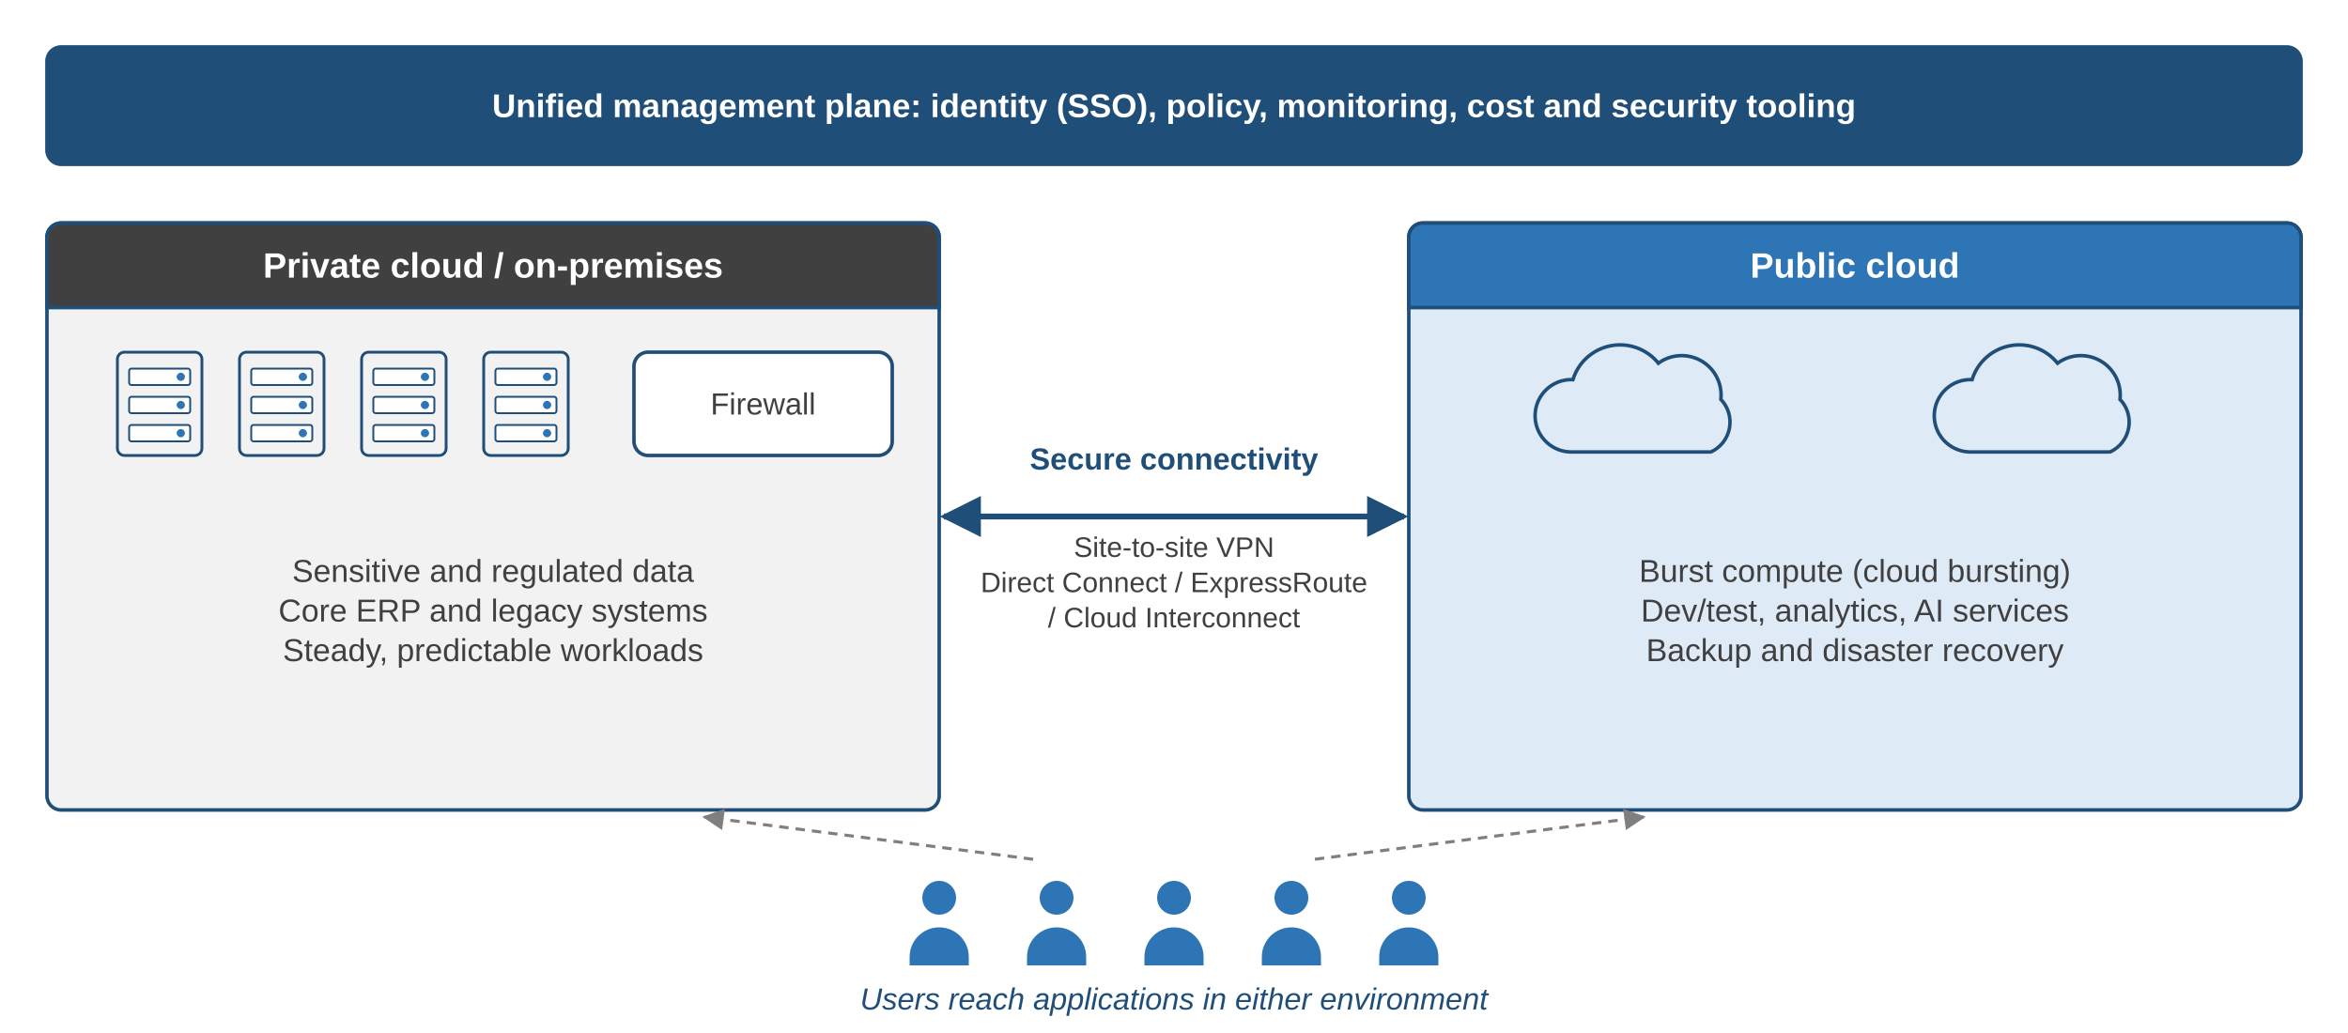
Community Cloud and Hybrid Cloud
Community cloud
Shared by organizations with common rules (banks, government, hospitals, universities)
Pros: shared cost, collaboration, sector-specific controls
Cons: slower scaling, joint governance, consensus for changes
Hybrid enablers
Private links: AWS Direct Connect, Azure ExpressRoute, Google Cloud Interconnect. Extend provider tools on-premises: AWS Outposts, Azure Arc, Google Distributed Cloud.
back to chapter index
Notes:
Hybrid keeps sensitive data private and bursts to public cloud for peaks, dev/test and DR.

Slide 17
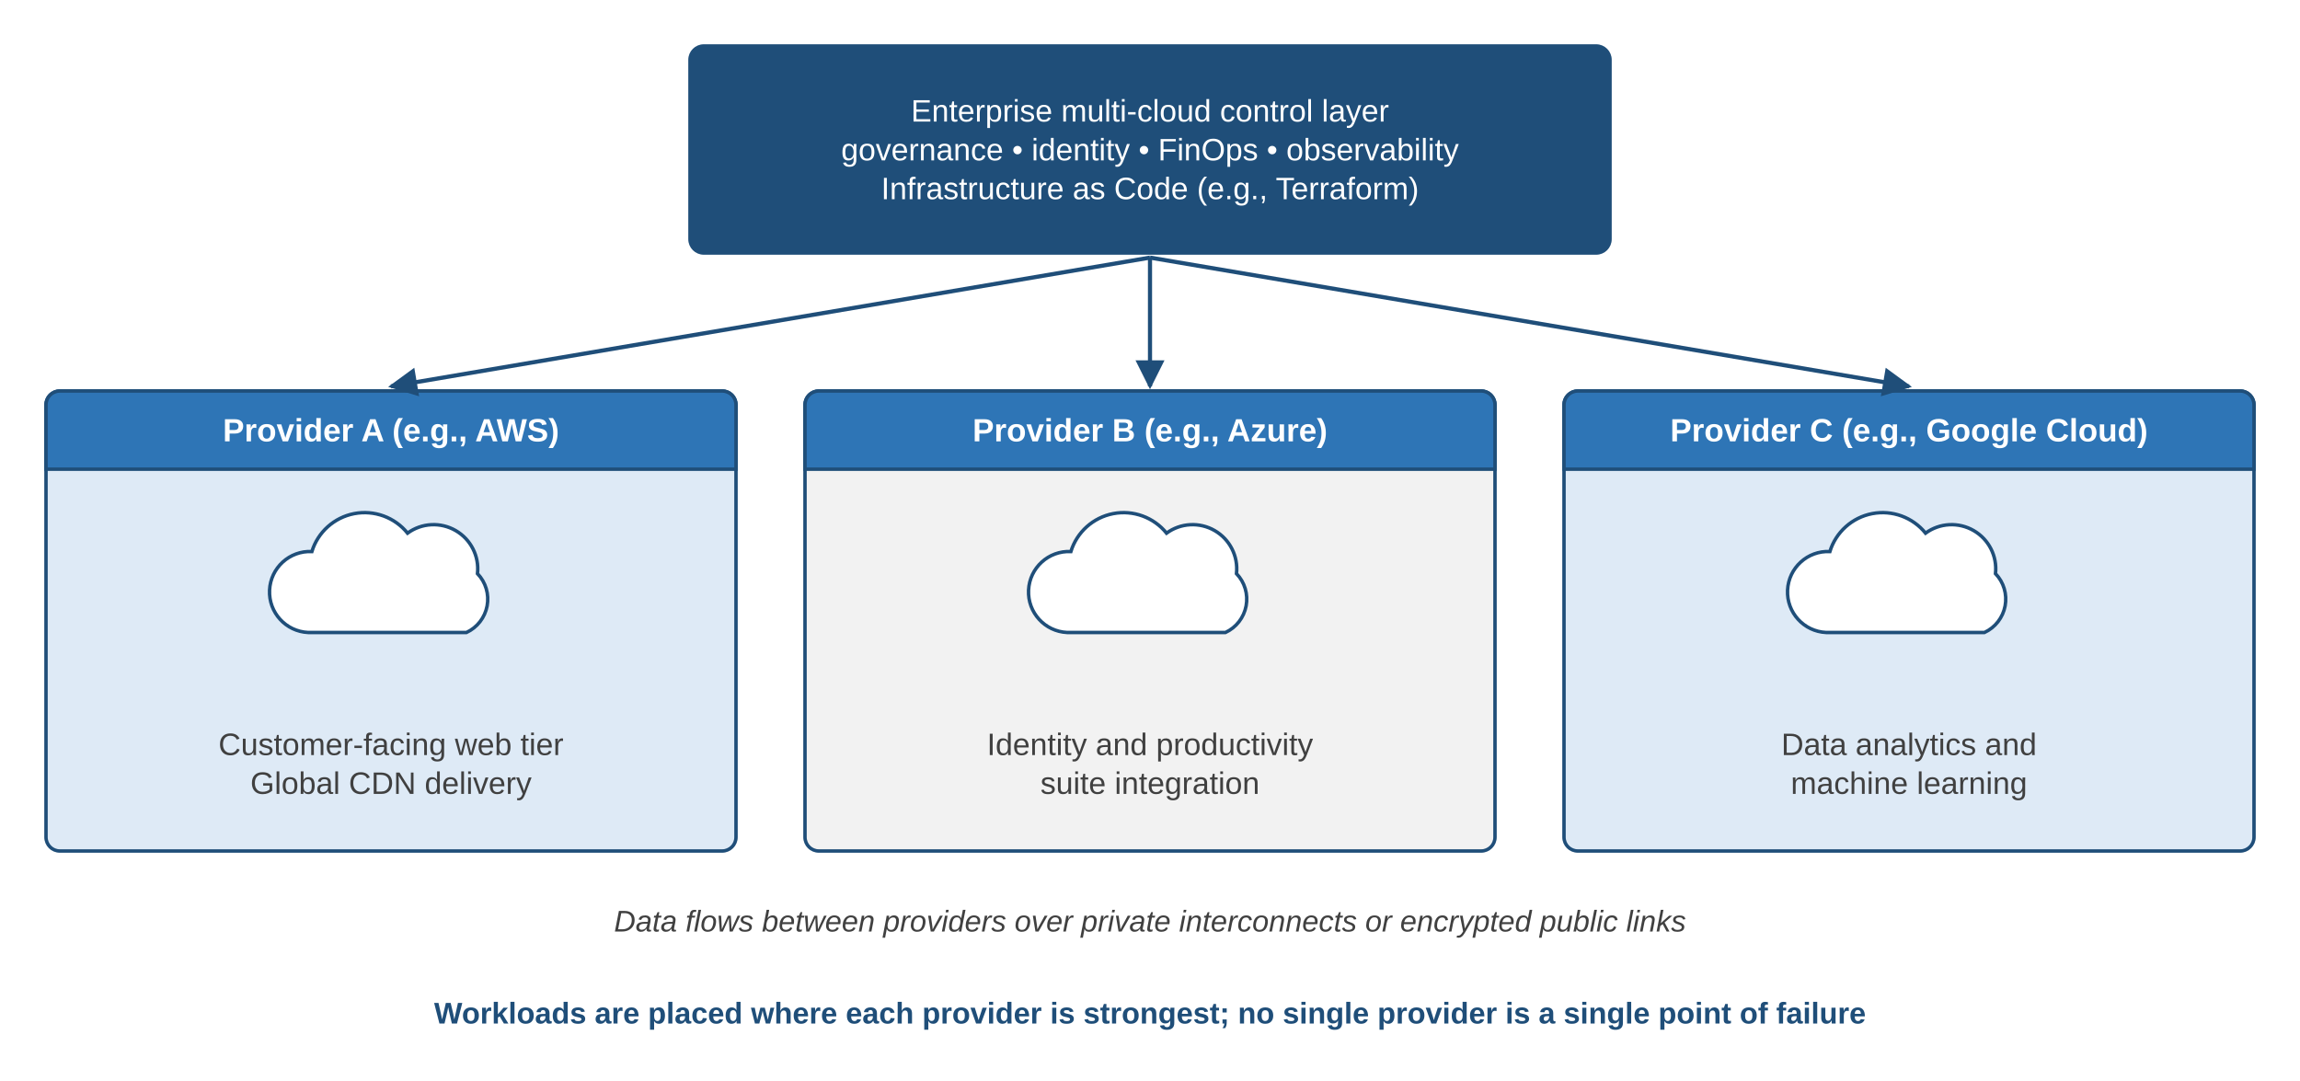
Multi-Cloud: two or more public providers
Why multi-cloud
Avoid single-vendor lock-in
Best service per workload
Meet data residency rules
Challenges
Complex management
Larger attack surface
Interoperability, egress cost
Hybrid = private + public, managed together. Multi-cloud = more than one public provider. An organization can be both.
back to chapter index
Notes:
An organization with its own data centre plus AWS and Azure is both hybrid and multi-cloud.

Slide 18
Comparing Deployment Models
Criterion | Public | Private | Community | Hybrid | Multi-cloud
Ownership | Provider | One organization | Member group | Mixed | Several providers
Upfront cost | None | High | Shared | Medium | None
Ease of set-up | Very easy | Hard | Moderate | Hard | Moderate
Scalability | Very high | Limited by hardware | Moderate | High (bursting) | Very high
Control | Low | Very high | High (shared) | High (private part) | Low per provider
Isolation | Logical | Physical | Shared in group | Per workload | Logical
Complexity | Low | High | High | High | Highest
Typical users | Start-ups, SMEs | Banks, defence | Govt, hospitals | Enterprises in transition | Global enterprises
back to chapter index
Notes:
Public is the usual starting point for SMEs; regulation and steady workloads add private or hybrid components later.

Slide 19
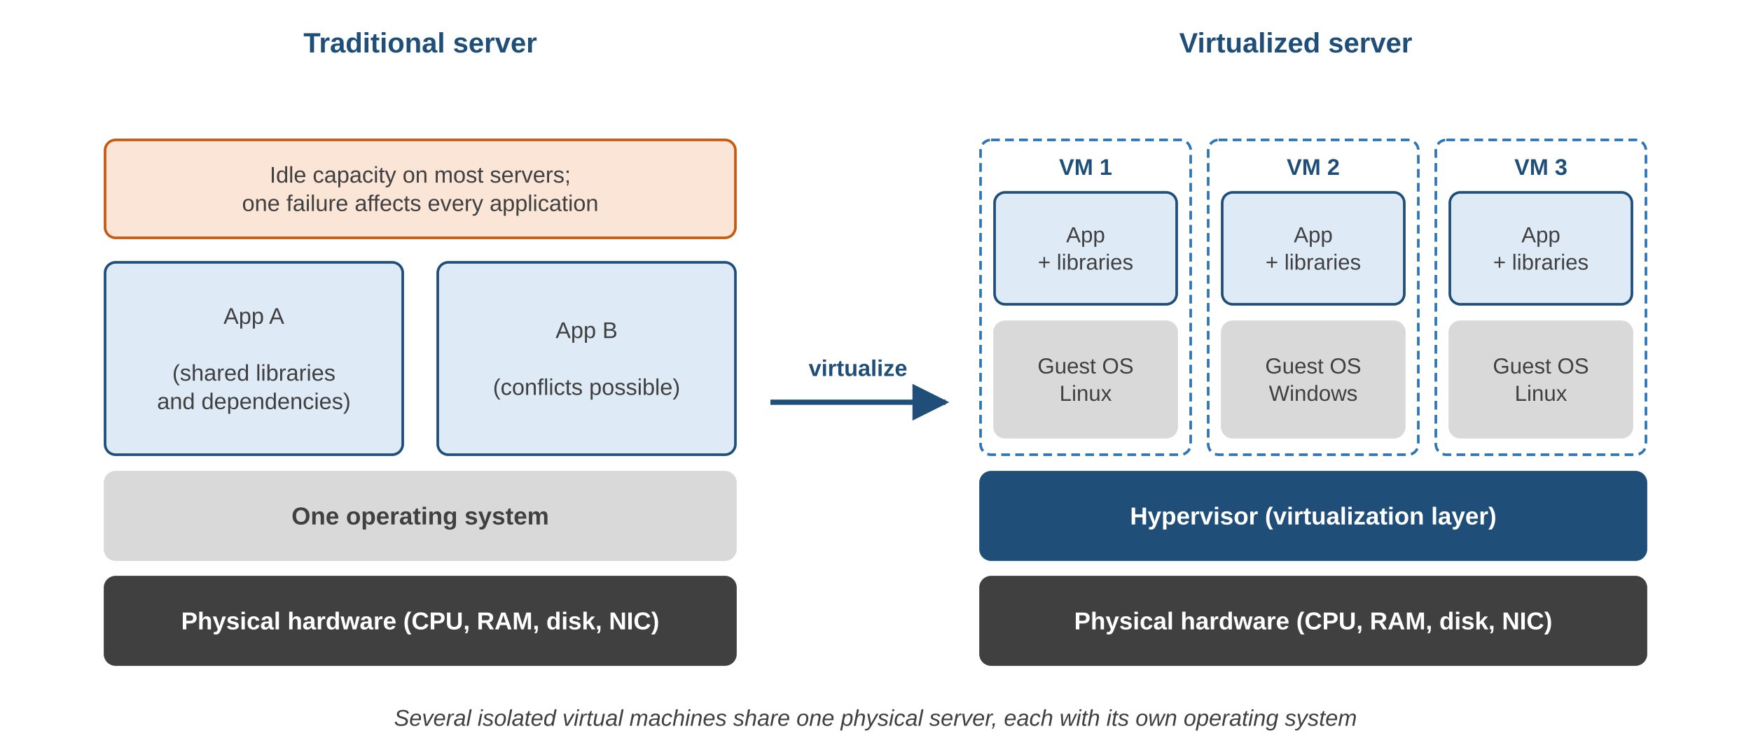
What is Virtualization?
Virtualization abstracts physical CPU, memory, storage and network into software-defined resources, so several isolated operating systems run on one physical machine.
Apartment analogy
Plot of land = physical server
Flats = virtual machines
Building manager = hypervisor
Without virtualization there is no pooling and no elasticity, so no cloud.
back to chapter index
Notes:
The hypervisor is the building manager, VMs are the flats, the physical server is the plot of land.

Slide 20
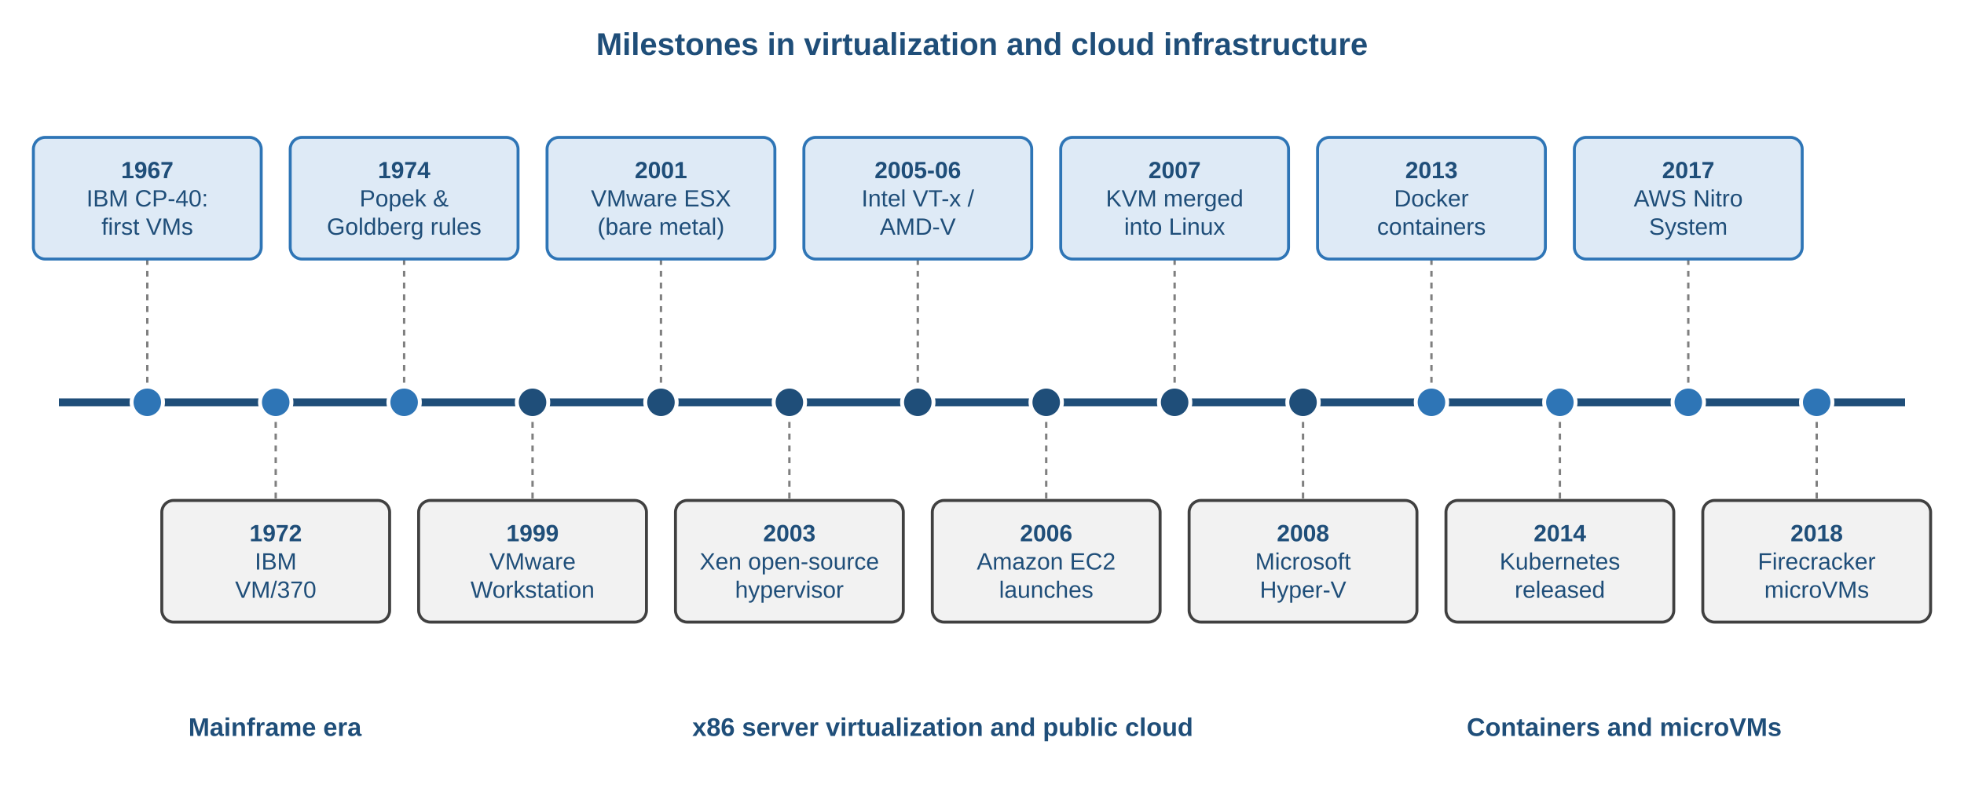
History of Virtualization
1960s-70s
1999-2008
2013 onward
IBM CP-40 and VM/370 share mainframes safely
VMware, Xen, VT-x/AMD-V, EC2, KVM, Hyper-V
Docker, Kubernetes, AWS Nitro, Firecracker microVMs
back to chapter index
Notes:
Three turning points: IBM mainframes, VMware on x86, and Amazon EC2 selling VMs by the hour in 2006.

Slide 21
Core Concepts and the Popek-Goldberg Rules
Key terms
Popek & Goldberg (1974)
Hypervisor: creates, runs and isolates VMs
VM: software computer with its own OS
Host / guest: physical machine / VM on it
Resource pooling: shared CPU, RAM, disk
Isolation: one VM's fault stays inside it
Snapshot: point-in-time VM state
Live migration: move a running VM
Overcommitment: allocate more than physical
Equivalence: behaves as on real hardware
Resource control: monitor controls resources
Efficiency: most instructions run directly
Technique | Example
Full (binary translation) | Early VMware
Paravirtualization | Xen
Hardware-assisted | KVM, Hyper-V, ESXi
OS-level | Docker, LXC
back to chapter index
Notes:
x86 broke the Popek-Goldberg rule (sensitive instructions that do not trap), hence binary translation and later VT-x/AMD-V.

Slide 22
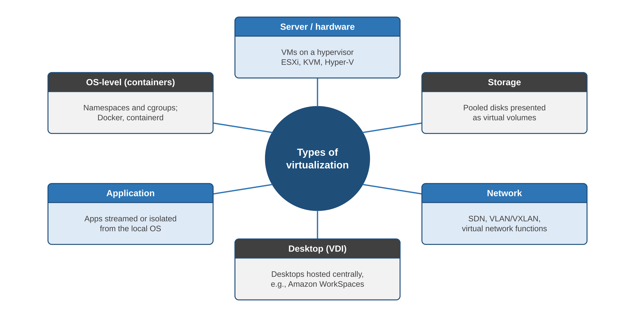
Types of Virtualization
In the cloud
Server: Amazon EC2 VMs
Storage: Amazon EBS volumes
Network: Amazon VPC, SDN
Desktop: Amazon WorkSpaces, Azure Virtual Desktop
Containers: namespaces + cgroups
back to chapter index
Notes:
Every major resource class can be virtualized; cloud VPCs are network virtualization, EBS is storage virtualization.

Slide 23
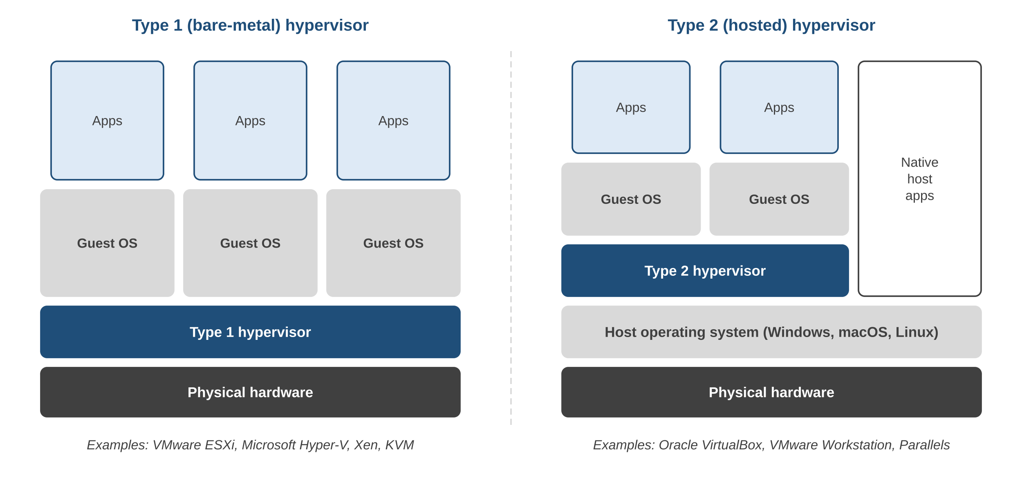
Type 1 and Type 2 Hypervisors
CPU and memory
Intel VT-x / AMD-V let guests run directly on the CPU
EPT / NPT translate guest memory in hardware
Ballooning reclaims unused VM memory
Aspect | Type 1 (bare-metal) | Type 2 (hosted)
Runs on | Hardware directly | A host OS
Performance | Near-native | Lower
Attack surface | Smaller | Inherits host OS
Typical use | Data centres, cloud | Laptops, labs
Examples | ESXi, Hyper-V, Xen, KVM | VirtualBox, Workstation
back to chapter index
Notes:
KVM is a Linux kernel module that turns Linux itself into a Type 1 hypervisor.

Slide 24
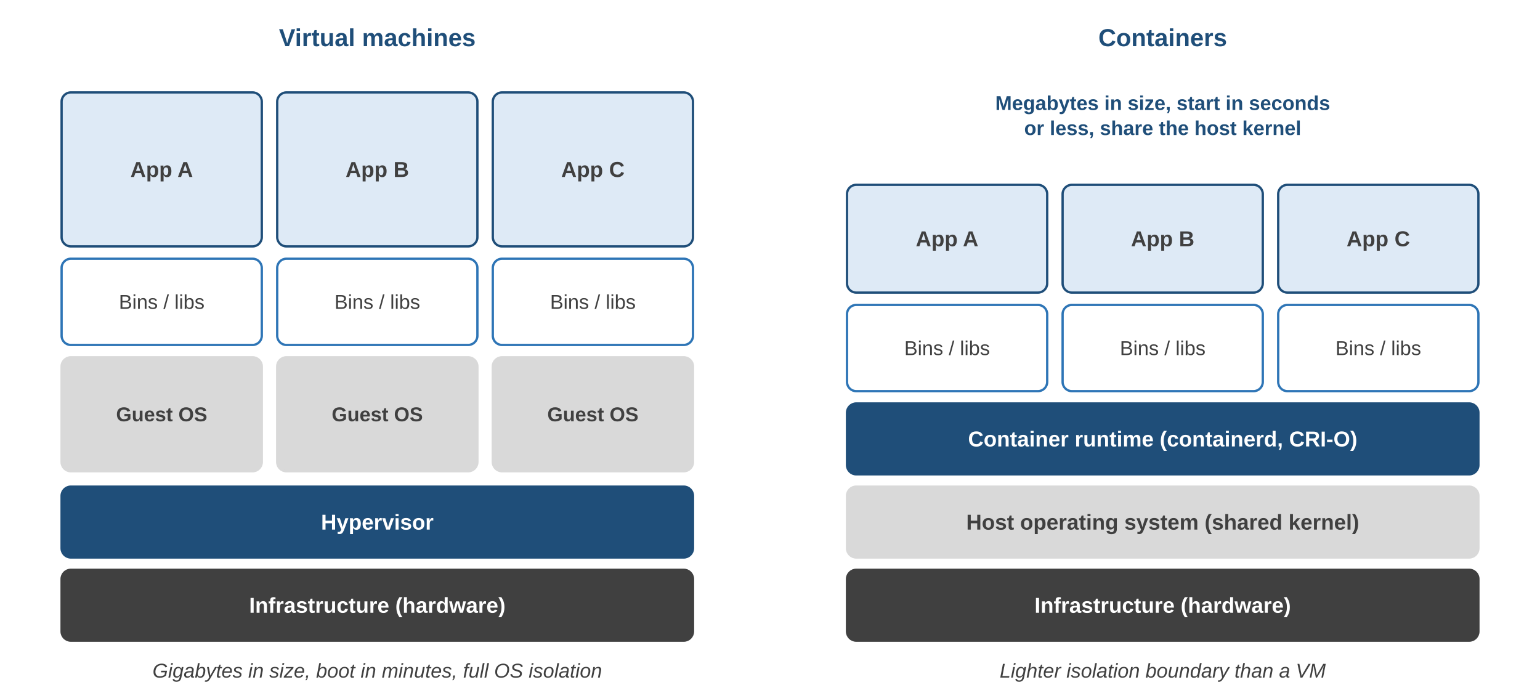
Virtual Machines vs Containers
Aspect | VM | Container
Isolates at | Hardware | OS kernel
Includes | Full guest OS | Libs + app
Size | Gigabytes | Megabytes
Start-up | Seconds-minutes | Milliseconds-seconds
Density | Tens per host | Hundreds
Isolation | Stronger | Weaker by default
Kubernetes schedules, heals and scales containers across a cluster; managed versions are CaaS.
back to chapter index
Notes:
Containers pair with microservices and Kubernetes; VMs give stronger isolation and mixed operating systems.

Slide 25
Virtualization Management Tools
Tool | Platform | Type | Best use
VMware vSphere | Enterprise | Hardware-assisted | Mature HA, vMotion, DRS
Microsoft Hyper-V | Windows Server | Hardware-assisted | Active Directory estates
KVM / QEMU | Linux | Full + emulation | OpenStack, open source
Docker | Linux, Windows, macOS | OS-level | Microservices, CI/CD
# KVM: create a VM (2 vCPU, 2 GB RAM, 10 GB disk)
virt-install --name MyVM --vcpus 2 --memory 2048 --disk size=10 \
--cdrom ubuntu-24.04.iso --os-variant ubuntu24.04
# VMware PowerCLI: live-migrate a running VM (vMotion)
Move-VM -VM "AppVM01" -Destination (Get-VMHost "esxi02.lab.local")
# Docker: run a container
docker run -it --rm ubuntu:24.04 /bin/bash
back to chapter index
Notes:
VMware is now part of Broadcom; review licensing for new deployments.

Slide 26
Security, Resilience and What Comes Next
Security
DR and HA
Next generation
VM escape: patch hypervisors
Cross-VM attacks: segmentation, dedicated hosts
Unauthorized access: RBAC, MFA
VM sprawl: tag and retire
DR: replicate VMs to another site (Site Recovery Manager, Hyper-V Replica)
HA: restart VMs on healthy hosts automatically
Live migration before maintenance
AI-assisted placement and right-sizing
MicroVMs (Firecracker) for serverless
Hardware offload (AWS Nitro)
Confidential computing (SEV-SNP, TDX)
back to chapter index
Notes:
Because a VM is a set of files, it can be replicated and restarted elsewhere.

Slide 27
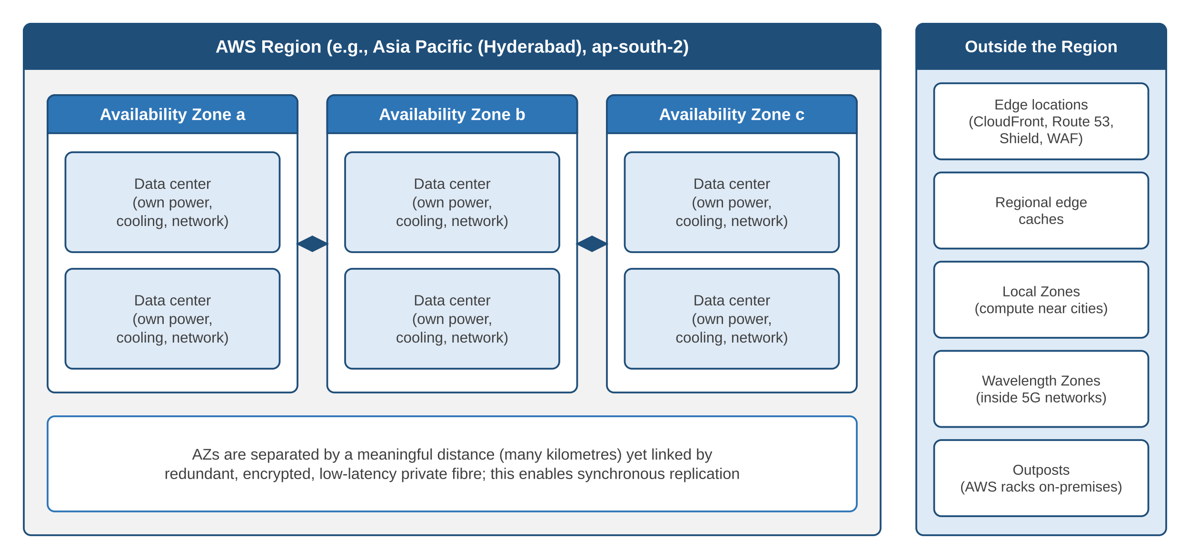
Global Infrastructure: Regions, AZs and Data Centres
38
Regions
120
Availability Zones
2
Regions in India
AWS, early 2026; India: Mumbai (ap-south-1), Hyderabad (ap-south-2)
back to chapter index
Notes:
Figures change several times a year; check the AWS Global Infrastructure page for current numbers.

Slide 28
Choosing a Region and Knowing Service Scope
Criterion | Question
Latency | Where are most users?
Data residency | Must data stay in a country?
Services | Is the service offered there?
Cost | What is the regional price?
Resilience | Do we need a DR Region?
Scope | Examples
Global | IAM, Route 53, CloudFront
Regional | S3 buckets, DynamoDB, Lambda, VPC
Zonal | EC2 instances, EBS volumes, subnets
Zonal resources are single points of failure. Deploy copies in other AZs for resilience.
# List AZs in the Hyderabad Region
aws ec2 describe-availability-zones --region ap-south-2 \
--query "AvailabilityZones[].[ZoneName,ZoneId]" --output table
back to chapter index
Notes:
A single EC2 instance with one EBS volume is a single point of failure even when the Region is healthy.

Slide 29
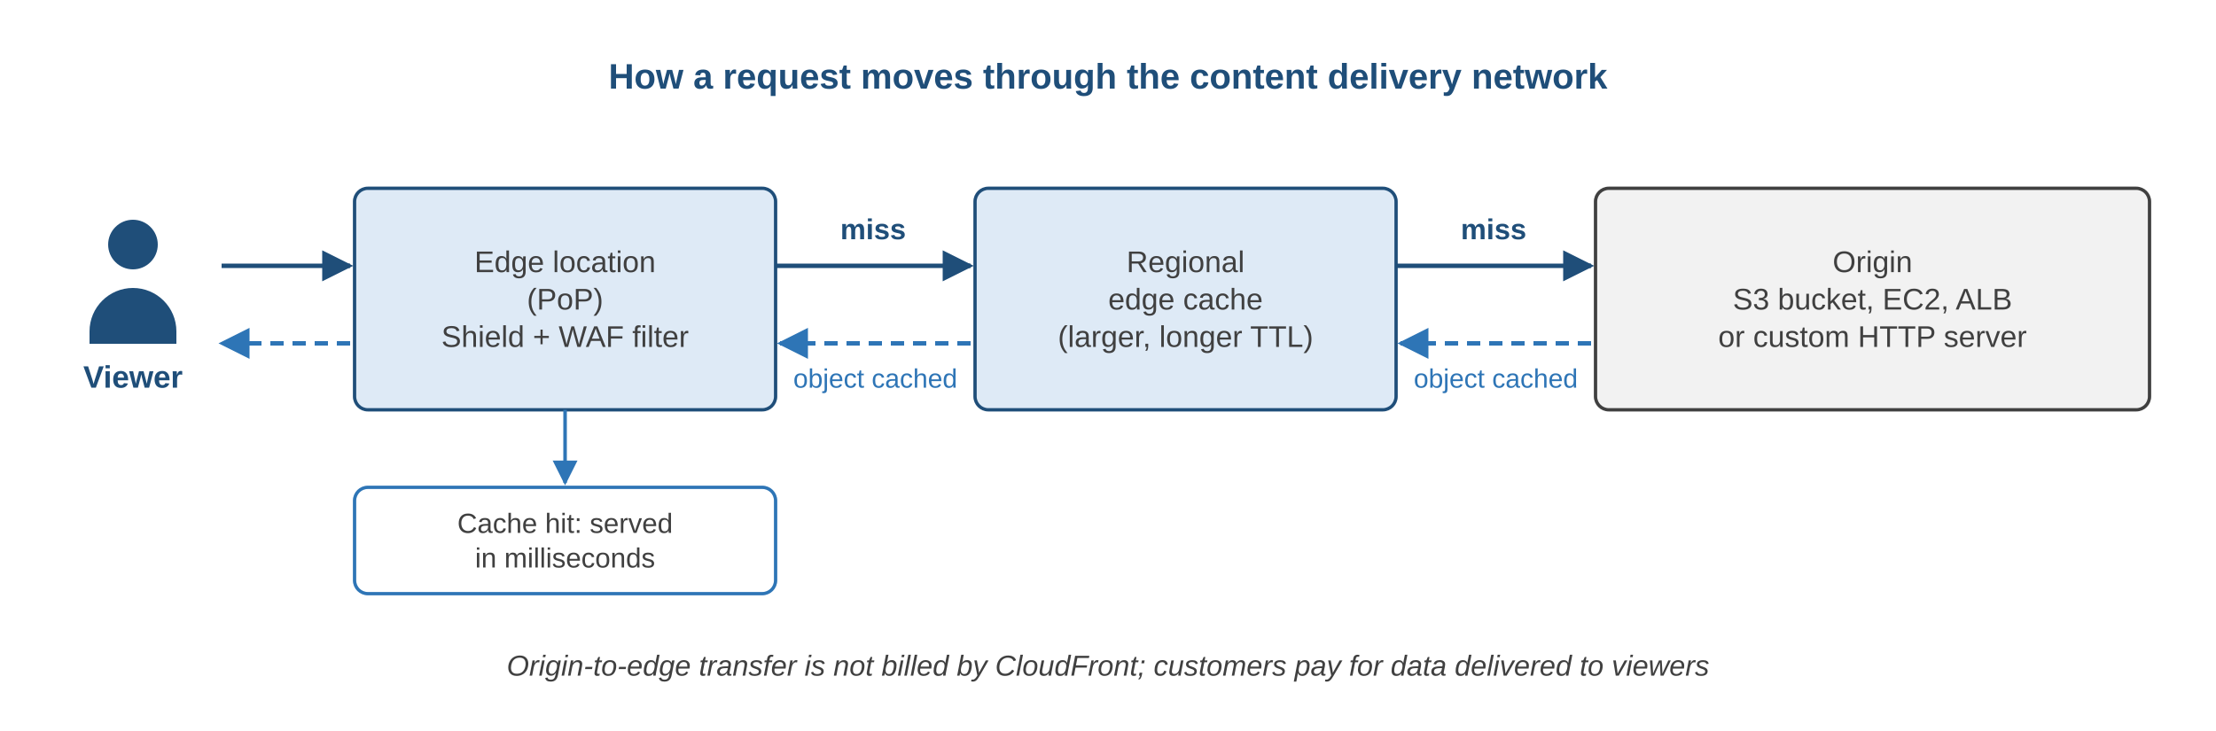
Edge Locations and the CDN Request Path
Local Zones
Wavelength Zones
Outposts
Compute near large cities for single-digit-ms latency
AWS compute inside 5G carrier networks
AWS racks in the customer's own data centre
back to chapter index
Notes:
Edge locations, regional edge caches and extensions bring content and compute closer to users.

Slide 30
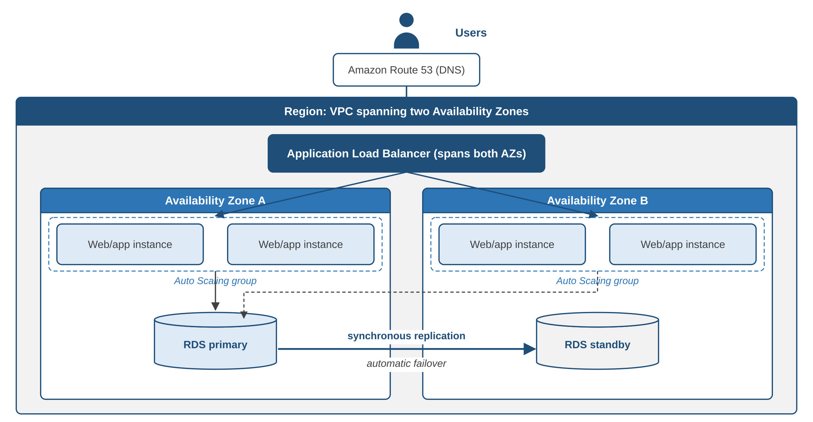
Designing for Availability: Multi-AZ Architecture
How it survives an AZ loss
Route 53 resolves to the load balancer
ALB spans both AZs
Auto Scaling keeps instances in each AZ
RDS replicates synchronously to a standby
Failover is automatic
back to chapter index
Notes:
Every tier exists in two AZs; the RDS standby takes over automatically if the primary fails.

Slide 31
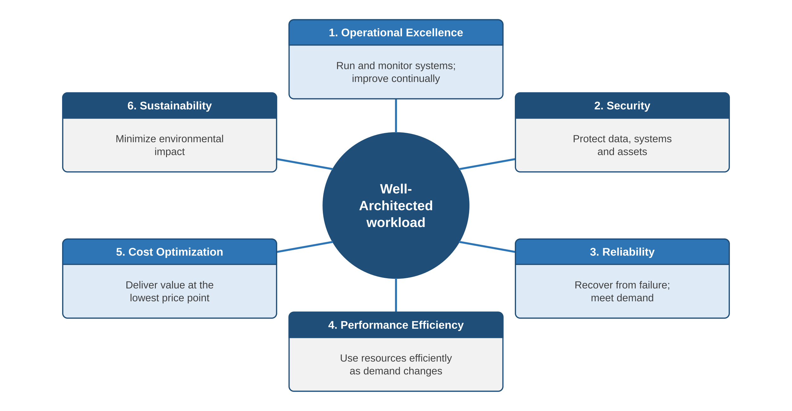
The AWS Well-Architected Framework: Six Pillars
General design principles
Stop guessing capacity
Test at production scale
Automate experimentation
Evolutionary architectures
Data-driven decisions
Improve through game days
Azure and Google Cloud publish equivalent frameworks
back to chapter index
Notes:
Published 2015 with four pillars; Operational Excellence added 2016; Sustainability added December 2021.

Slide 32
The Six Pillars at a Glance
Pillar | Central question | Design principle | AWS services
Operational Excellence | How do we run and improve it? | Operations as code; small reversible changes | CloudFormation, Systems Manager
Security | How do we protect data and systems? | Strong identity; security at all layers | IAM, CloudTrail, GuardDuty, KMS
Reliability | How does it recover and meet demand? | Auto-recover; scale horizontally | Auto Scaling, Multi-AZ RDS
Performance Efficiency | Right resources, used efficiently? | Go global in minutes; use serverless | CloudFront, Lambda, X-Ray
Cost Optimization | Value at the lowest cost? | Consumption model; attribute spend | Cost Explorer, Savings Plans
Sustainability | How do we cut environmental impact? | Maximize utilization | Compute Optimizer, Graviton
back to chapter index
Notes:
Examples: Netflix chaos engineering (operations), CloudTrail plus GuardDuty (security), Auto Scaling across AZs (reliability).

Slide 33
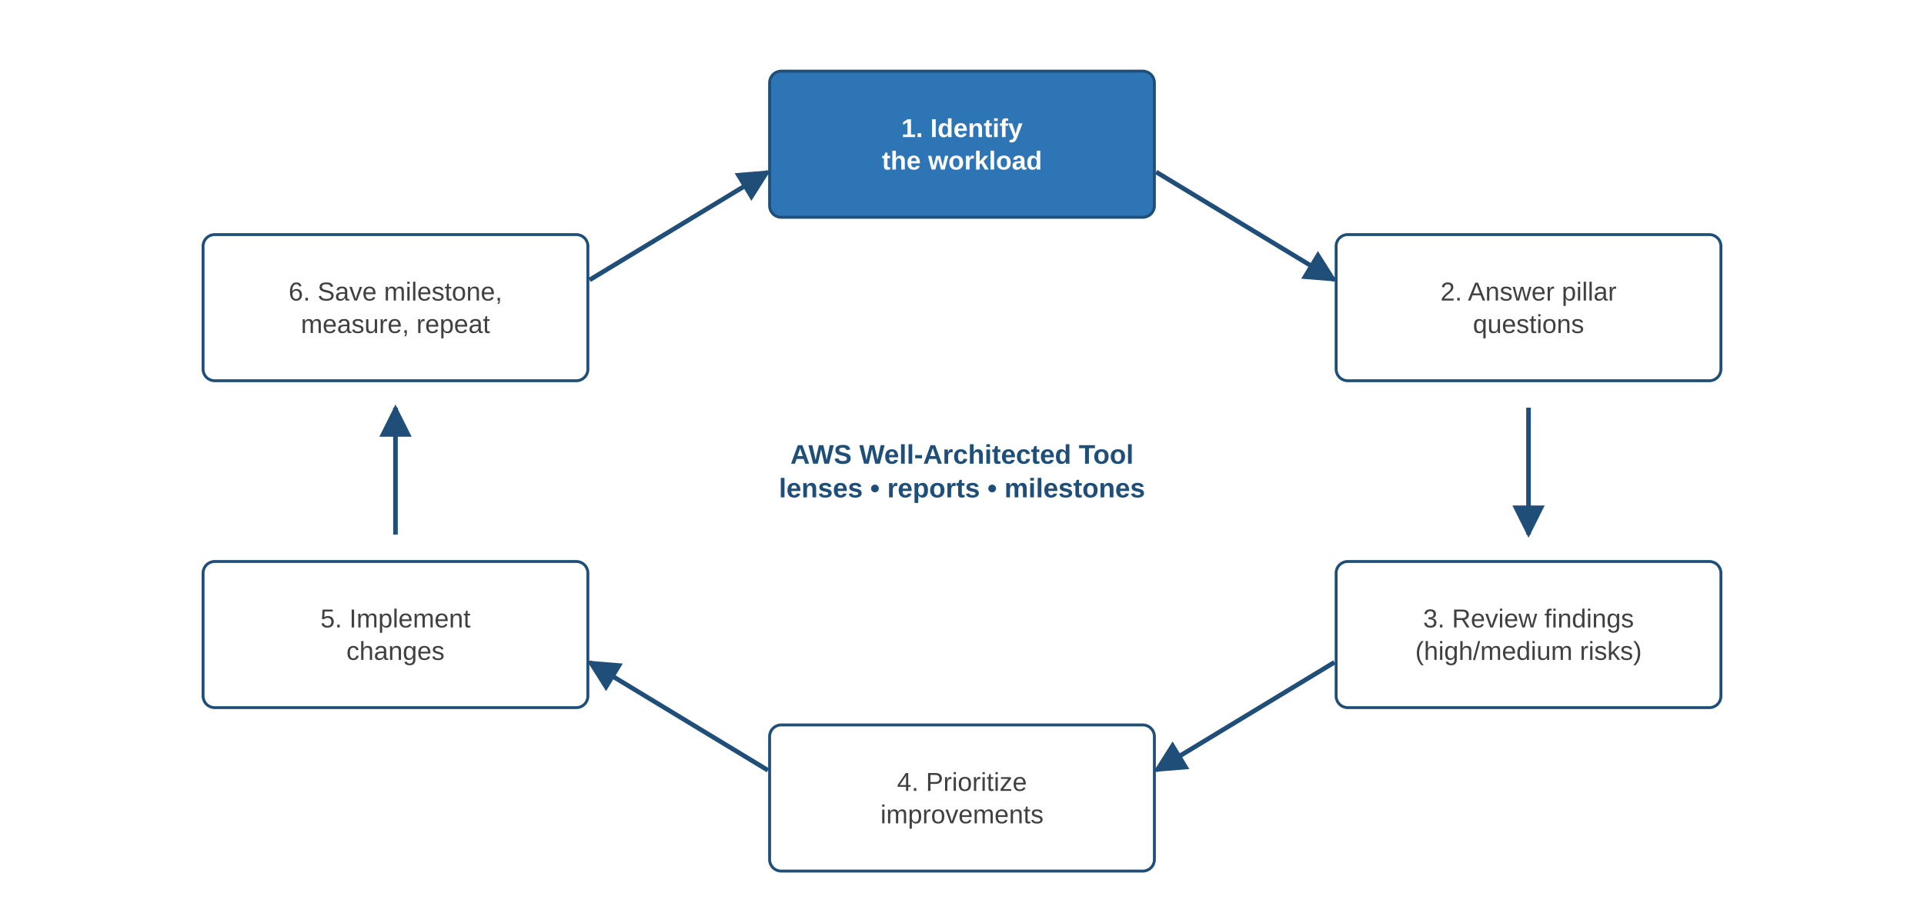
The Well-Architected Review Cycle
AWS Well-Architected Tool
Free in the AWS console
Flags high and medium risk issues
Improvement plan and reports
Milestones track progress
Lenses, custom lenses
Sharing and API access
back to chapter index
Notes:
A review is a conversation, not an audit. Lenses add domain questions: Serverless, SaaS, ML, Financial Services.

Slide 34
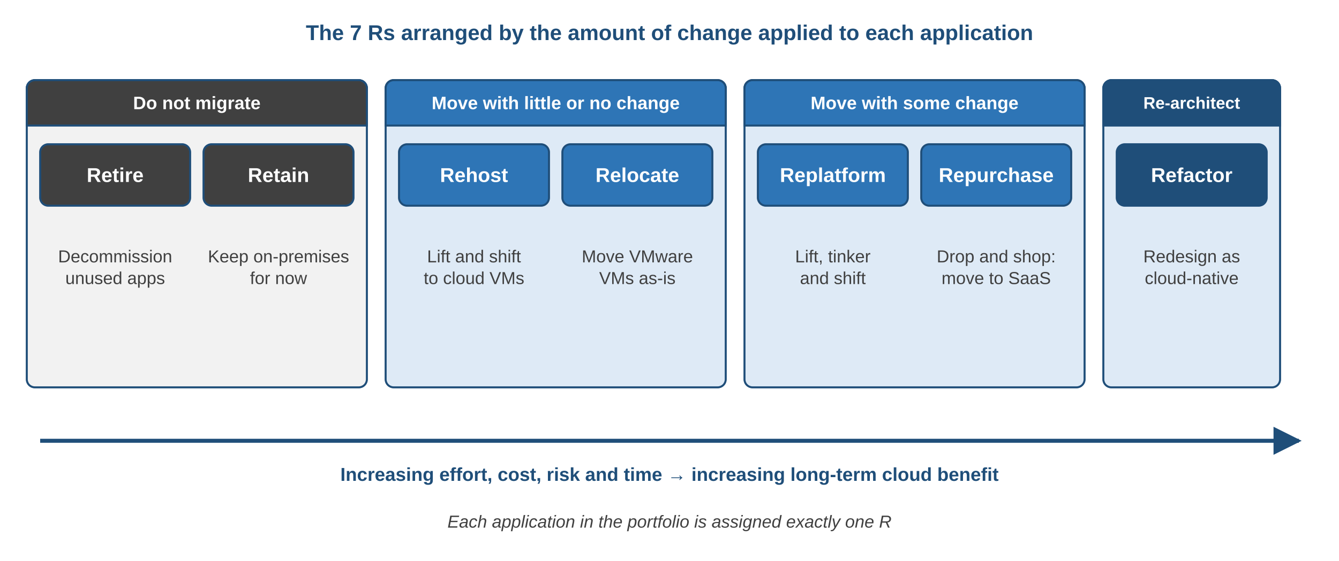
Migration Strategies: The 7 Rs
Moving-house analogy: throw away old papers (Retire), leave the piano with a relative (Retain), load furniture as-is (Rehost), ship the container (Relocate), swap the stove (Replatform), buy a laptop subscription (Repurchase), redesign the room (Refactor).
back to chapter index
Notes:
Moving house: throw away, leave with a relative, move as-is, move the container, swap the stove, buy new, redesign the room.

Slide 35
The 7 Rs in Detail
Strategy | Also called | Example | Use when
Retire | Decommission | Switch off an unused intranet tool | App is outdated or unused
Retain | Revisit | Keep factory control system on-premises | Compliance, latency or readiness
Rehost | Lift and shift | 150 servers to EC2 with AWS MGN | Fast, low-risk data-centre exit
Relocate | Hypervisor lift and shift | VMware VMs to VMware Cloud on AWS | Large VMware estates, same tools
Replatform | Lift, tinker, shift | Self-managed MySQL to Amazon RDS | Quick wins without a rewrite
Repurchase | Drop and shop | On-prem CRM to Salesforce | SaaS fits better than own app
Refactor | Re-architect | Monolith to Lambda, EKS, DynamoDB | Need cloud-native scale and agility
back to chapter index
Notes:
AWS MGN replaced the older Server Migration Service for rehosting.

Slide 36
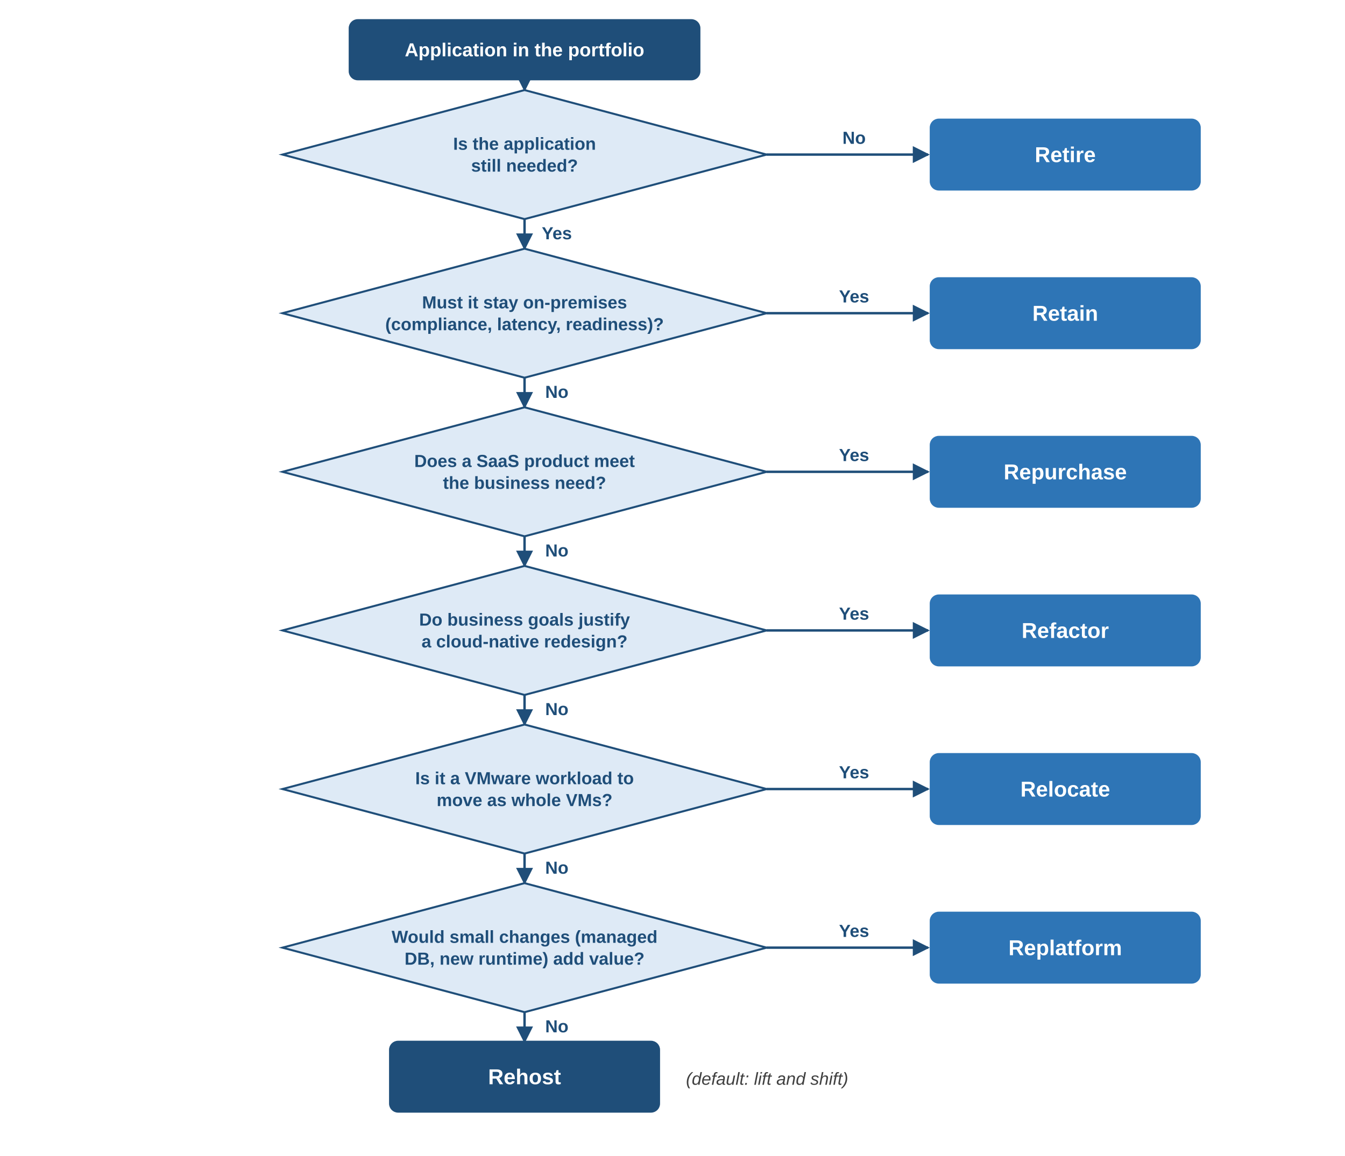
Choosing an R for Each Application
Rules of thumb
Rehost for speed
Replatform for quick wins
Repurchase when SaaS fits
Refactor for cloud-native goals
Remember
One R per application
Group dependent apps into waves
Many rehosted apps are optimized later
back to chapter index
Notes:
Treat the flow as a starting point; real decisions also weigh business priority, risk, skills and deadlines.

Slide 37
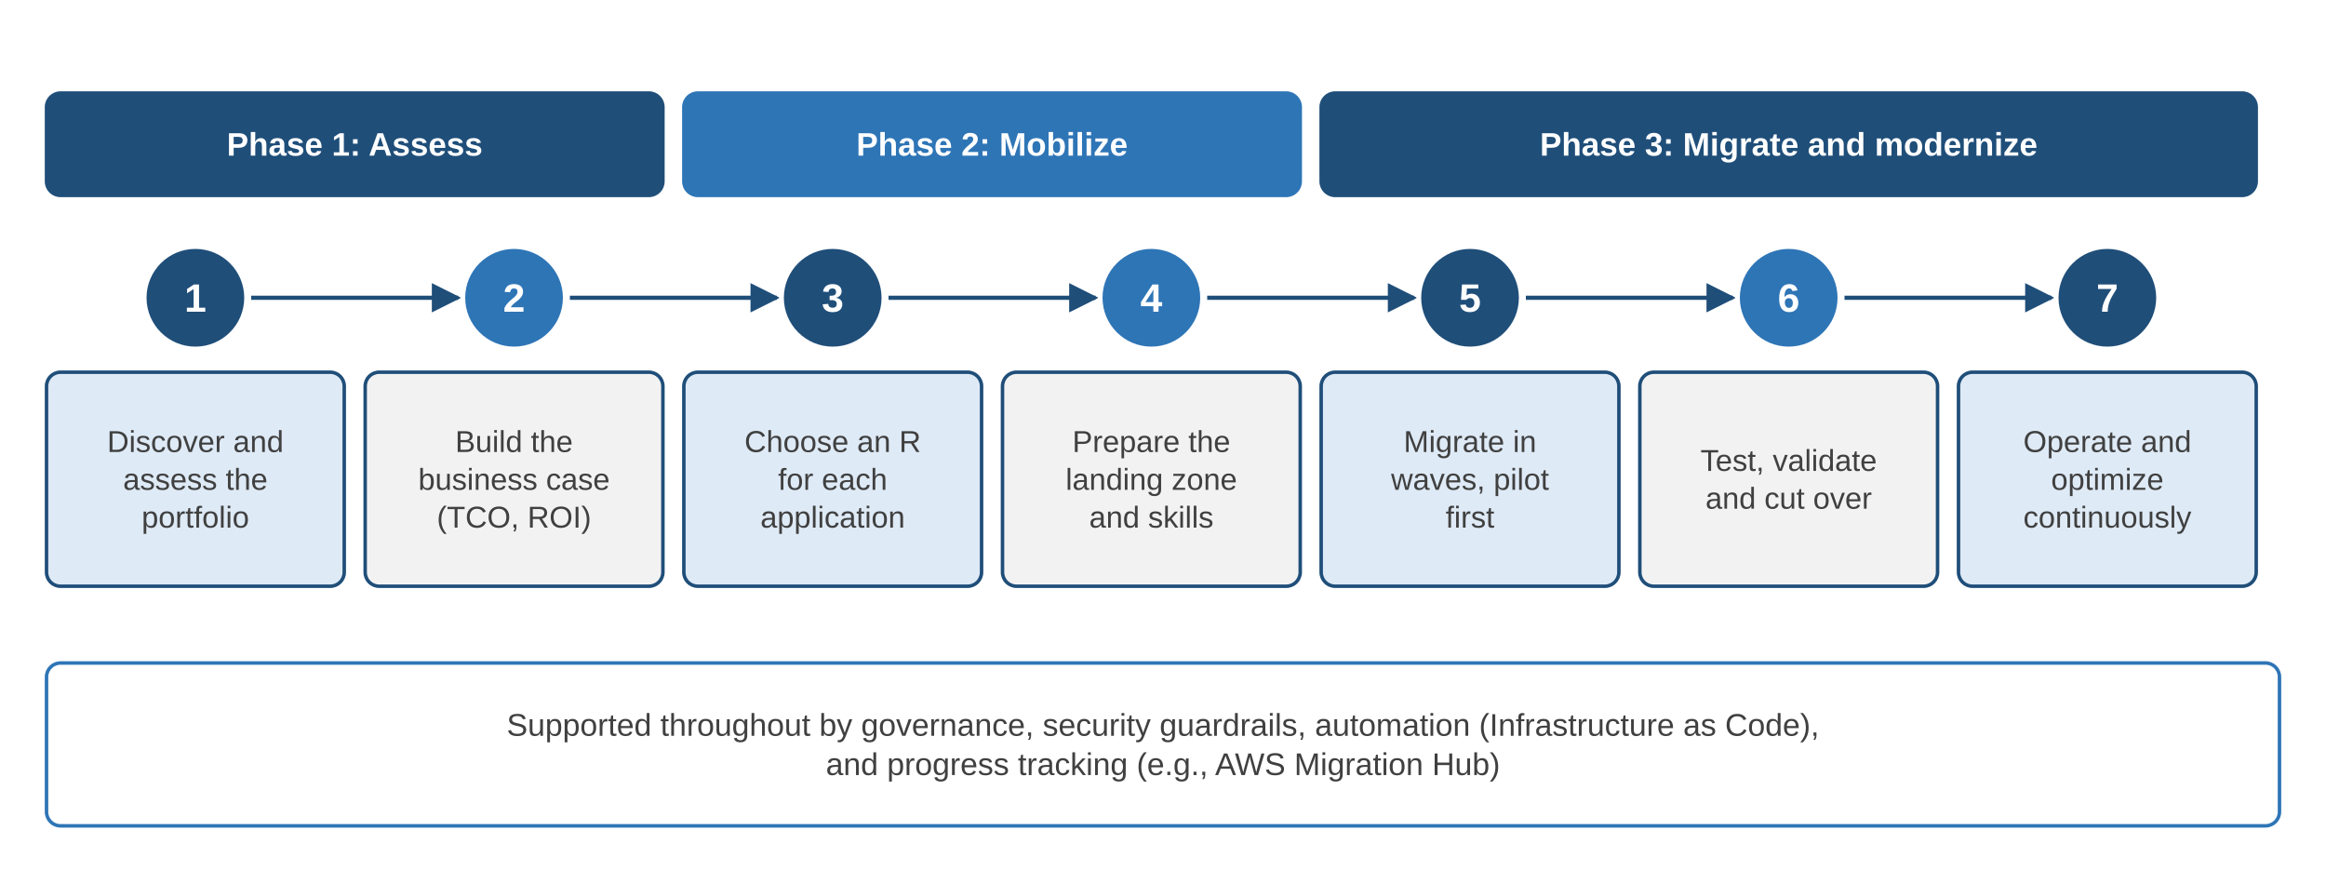
The Cloud Migration Process
Landing zone: a secure multi-account foundation (accounts, network, IAM, logging, guardrails), for example with AWS Control Tower.
back to chapter index
Notes:
Assess, Mobilize, Migrate and Modernize: AWS's three phases expanded into seven practical steps.

Slide 38
Migration Best Practices
Assess thoroughly
Inventory apps, data and dependencies; pick an R for each
Security at every layer
IAM least privilege, VPC isolation, KMS encryption
1
5
Well-Architected design
Build security, reliability and cost in from the start
Monitor performance
CloudWatch metrics, X-Ray or OpenTelemetry traces
2
6
Multi-AZ deployment
At least two AZs for every production tier
Plan rollback and cost
Tested rollback path; budgets and alerts
3
7
Infrastructure as Code
CloudFormation or Terraform for repeatable environments
4
back to chapter index
Notes:
Set budgets before the first wave; forgotten test resources are a common source of surprise bills.

Slide 39
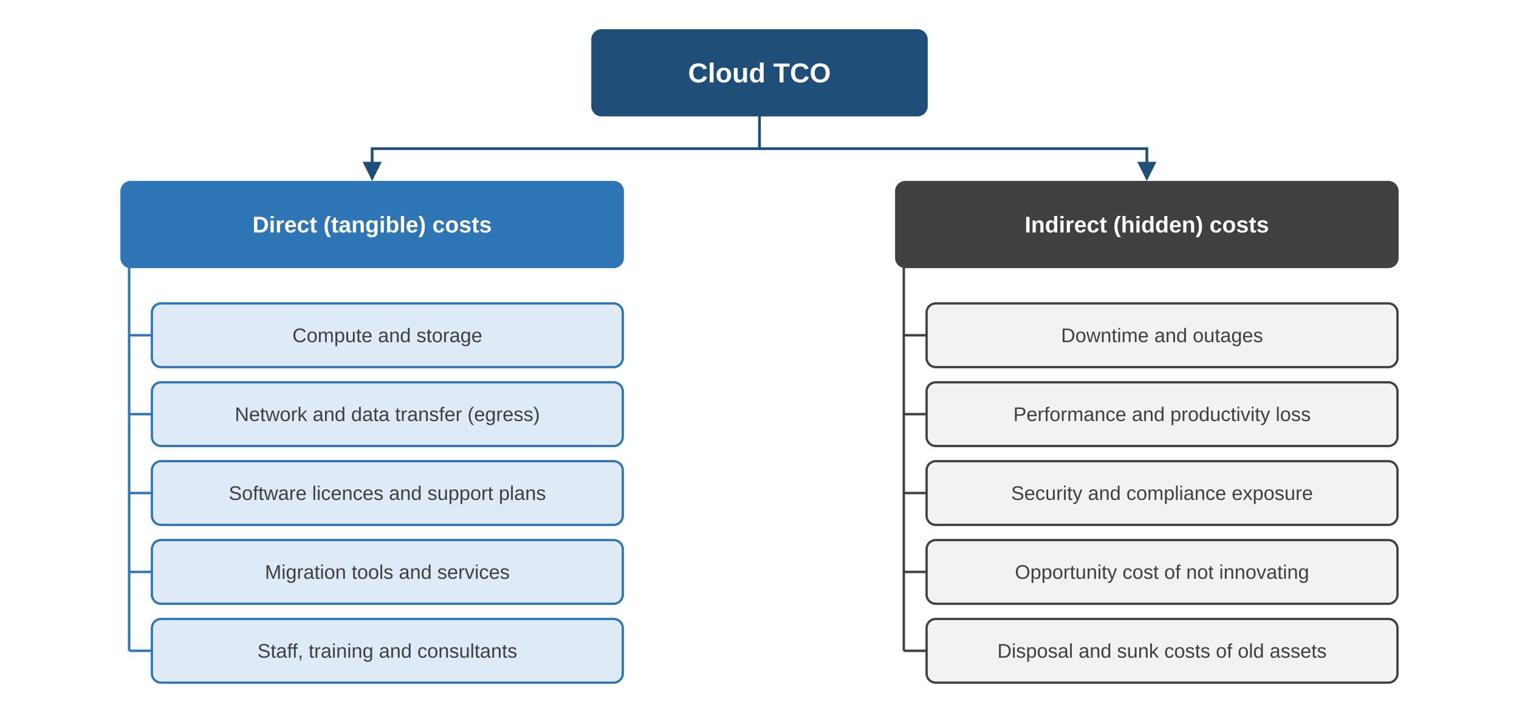
Total Cost of Ownership (TCO)
 | TCO | ROI
Question | Total lifetime cost? | Value per rupee spent?
Focus | All costs incl. hidden | Benefits vs investment
Use | Compare alternatives | Judge worth
ROI = (Net benefit − Investment) ÷ Investment × 100%
TCO covers acquiring, migrating, operating and exiting a cloud environment over a defined period
back to chapter index
Notes:
TCO measures cost; ROI measures value relative to investment.

Slide 40
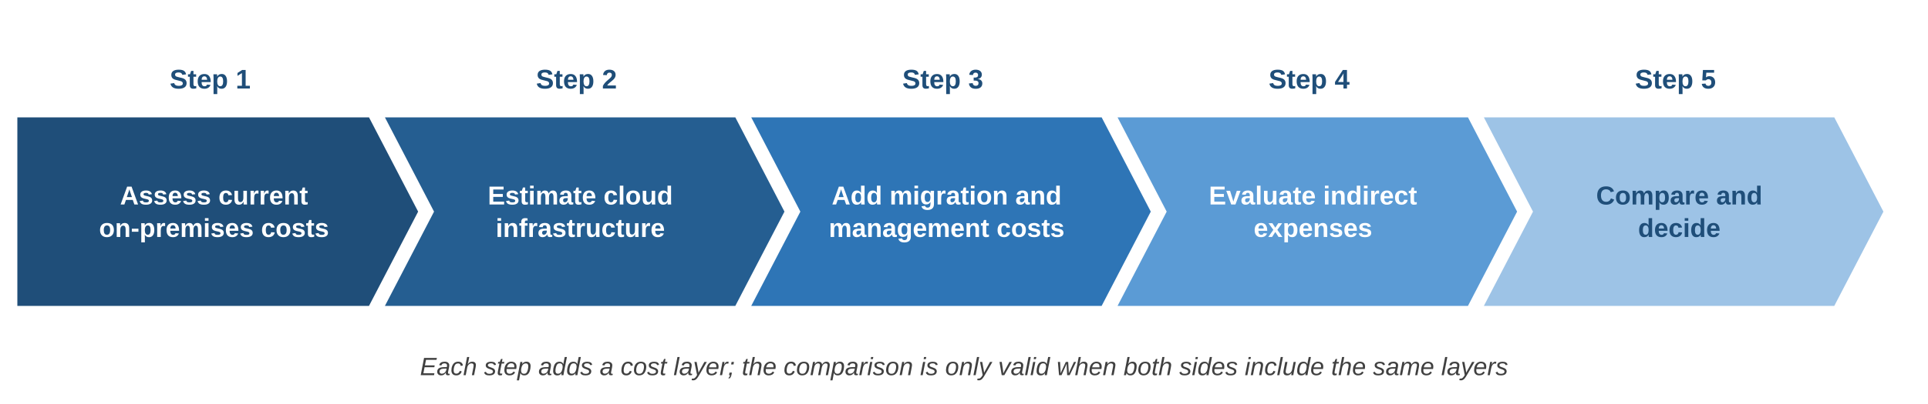
Calculating TCO in Five Steps
Factors that raise TCO
Pricing models
Hidden costs
Regulated domain
Skills and training
Multi-Region designs
Refactoring effort
On-demand: flexible
Reserved / Savings Plans: 1-3 yr discount
Spot: cheapest, interruptible
Downtime
Slow performance
Staff time on upkeep
Disposal and sunk costs
back to chapter index
Notes:
Both sides of the comparison must include the same cost layers.

Slide 41
Worked Example: Breakeven Calculation
Option | Rate / cost | 5-year cost (US$)
Cloud on-demand | $98.32 / h | 4,306,416
Cloud 1-yr reserved | $77.43 / h | 3,391,434
Cloud 3-yr reserved | $53.95 / h | 2,363,010
On-premises | $833,806 + $0.87 / h | 871,912
Breakeven when r · x = C + c · x
x* = C ÷ (r − c)
x* = 833,806 ÷ (98.32 − 0.87) ≈ 8,556 h
≈ 11.7 months of 24 x 7 use
11.7
14.9
21.5
months: on-demand
months: 1-yr reserved
months: 3-yr reserved
At 30% utilization the on-demand breakeven moves to about 40 months: low or uncertain use favours cloud.
back to chapter index
Notes:
Illustrative prices: EC2 P5 (8 x H100) versus Lenovo ThinkSystem SR675 V3. AWS cut P5 prices in 2025; always use current prices.

Slide 42
Cumulative Cost: Cloud vs On-Premises
Reducing cloud TCO
Negotiate contracts
Savings Plans and RIs
Right-size and schedule
Storage lifecycle rules
Automate scaling
Practise FinOps
back to chapter index
Notes:
Lines cross at the breakeven points. The on-prem line excludes facilities, staff and refresh, so the real crossing is later.

Slide 43
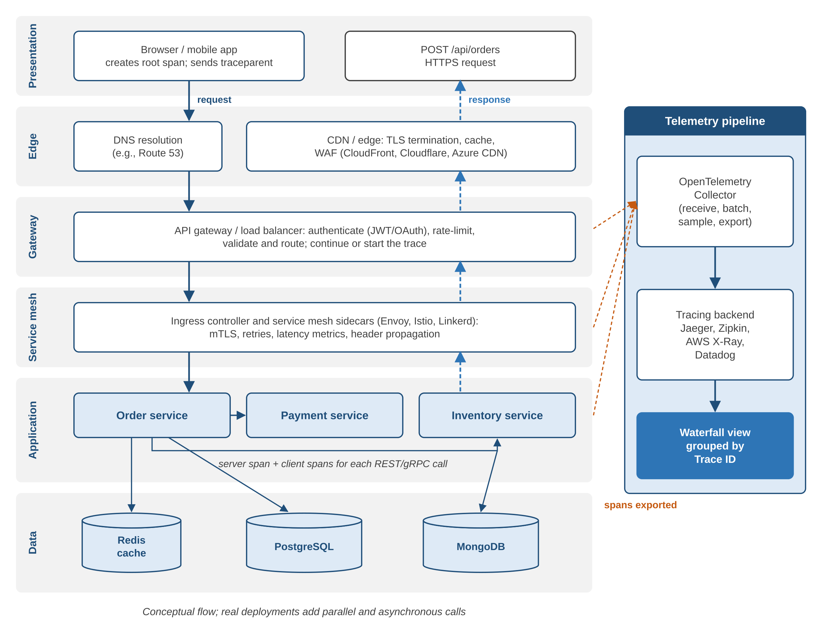
Tracing One HTTP Request Through Every Tier
Client
Root span; sends traceparent header
Edge / CDN
DNS, TLS, cache, WAF
Gateway / LB
Auth, rate limit, route; span
Service mesh
mTLS, retries, header propagation
Microservices
Server + client spans per call
Data tier
DB spans; never log secrets
Export
OTel Collector to Jaeger / X-Ray
back to chapter index
Notes:
Courier analogy: trace ID is the tracking number, each service is a hub, each scan is a span.

Slide 44
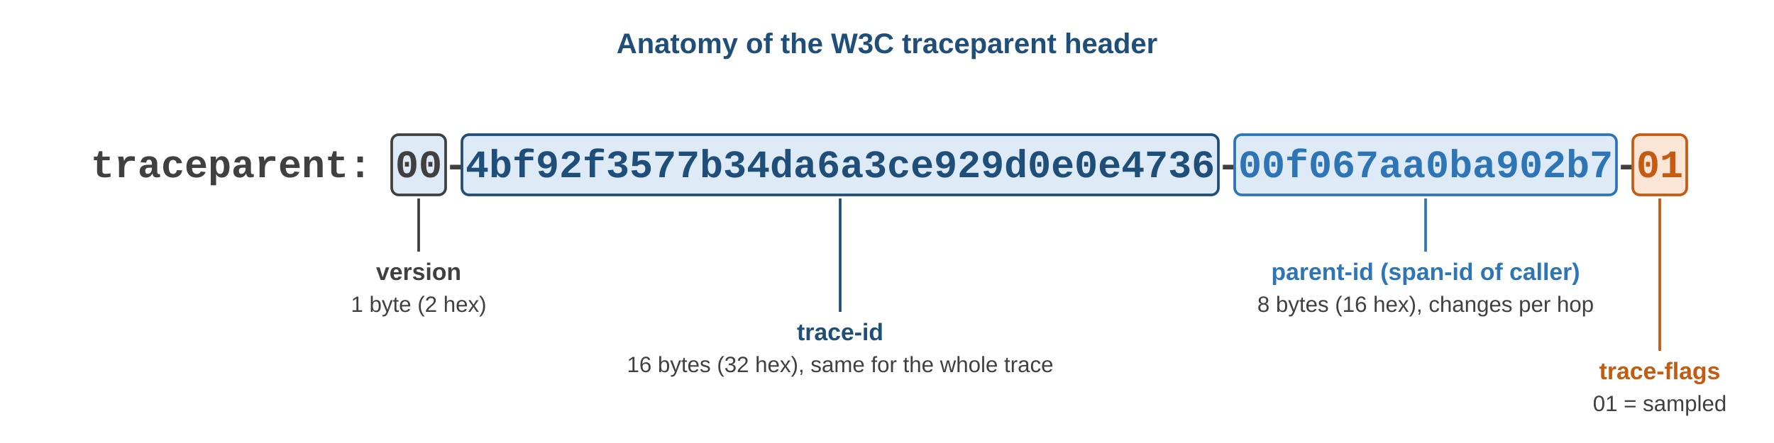
Trace Concepts and the W3C traceparent Header
Concept | Meaning
Trace | Full record of one request
Span | One timed operation
Trace ID | Shared by all spans of a request
Span ID | Unique per span
Parent span ID | Rebuilds the call tree
Sampling | Keep a fraction of traces
Standard / tool | Purpose
W3C Trace Context | Header format
OpenTelemetry | Vendor-neutral SDKs + Collector
Jaeger / Zipkin | Open-source backends
AWS X-Ray | AWS managed tracing
Flag 01 = sampled
back to chapter index
Notes:
Trace ID stays the same across the whole request; every span has its own span ID.

Slide 45
Worked Example: Reading a Trace Waterfall
Time since request start (ms)
Insight
POST /api/orders (root)
3,000 ms
Payment = 50% of time
Check payment API, network, payment DB
Parallel calls would cut latency
API gateway
200 ms
Order service
300 ms
Payment service
1,500 ms
Inventory service
400 ms
PostgreSQL query
600 ms
0
1000
2000
3000
Illustrative sequential timings
back to chapter index
Notes:
Payment takes 1,500 ms of 3,000 ms. Real traces often run Payment and Inventory in parallel, cutting total latency.

Slide 46
Tri-Cloud Terminology: Infrastructure and Compute
Concept | AWS | Microsoft Azure | Google Cloud
Geographic area | Region | Region (often paired) | Region
Failure domain | Availability Zone | Availability Zone | Zone
Virtual machine | Amazon EC2 | Azure Virtual Machines | Compute Engine
Object storage | Amazon S3 | Azure Blob Storage | Cloud Storage
Block storage | Amazon EBS | Azure Managed Disks | Persistent Disk / Hyperdisk
Virtual network | Amazon VPC | Azure VNet | VPC network
Serverless functions | AWS Lambda | Azure Functions | Cloud Run functions
Managed Kubernetes | Amazon EKS | Azure AKS | Google GKE
Relational DB | Amazon RDS, Aurora | Azure SQL Database | Cloud SQL, AlloyDB
back to chapter index
Notes:
Same concepts, different names across AWS, Azure and Google Cloud.

Slide 47
Tri-Cloud Terminology: Operations and Pricing
Concept | AWS | Microsoft Azure | Google Cloud
Identity | IAM | Microsoft Entra ID | Cloud IAM
Key management | AWS KMS | Azure Key Vault | Cloud KMS
Monitoring | CloudWatch | Azure Monitor | Cloud Monitoring
Tracing | AWS X-Ray | Application Insights | Cloud Trace
IaC | CloudFormation, CDK | ARM, Bicep | Infrastructure Manager
AWS discounts
Azure discounts
Google Cloud discounts
Savings Plans
Reserved Instances
Spot Instances
Reservations
Savings Plan for Compute
Hybrid Benefit, Spot VMs
Committed use discounts
Sustained use (automatic)
Spot VMs
back to chapter index
Notes:
Google Cloud applies sustained use discounts automatically; CUDs need a commitment but no upfront payment.

Slide 48
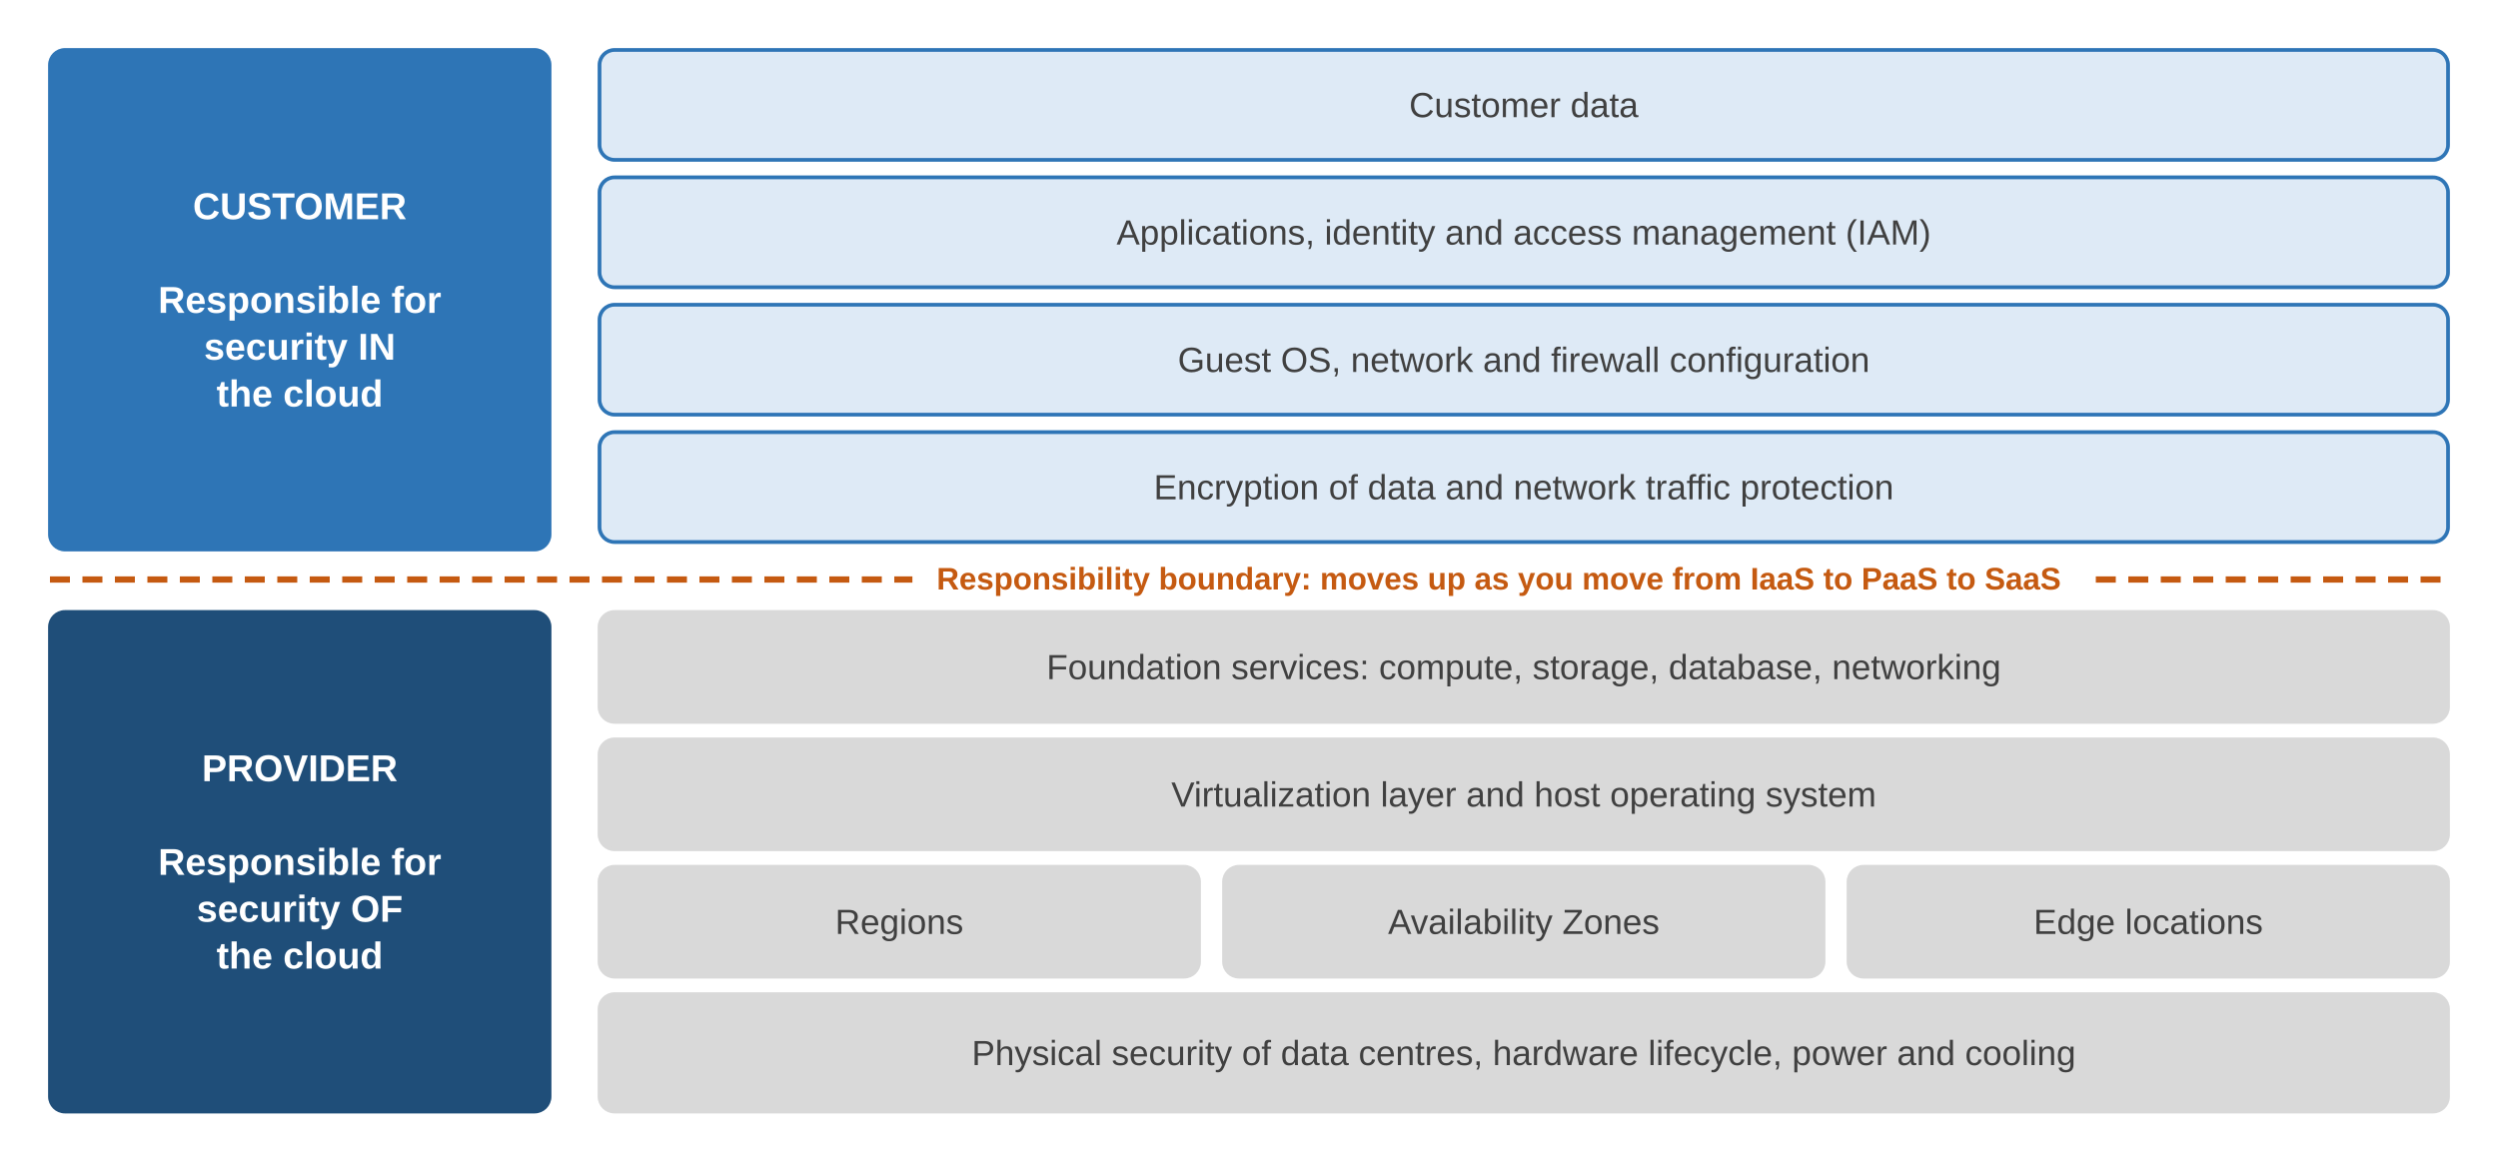
The Shared Responsibility Model
Layer | IaaS | PaaS | SaaS
Data, identities | You | You | You
App code | You | You | Provider
OS patching | You | Provider | Provider
Hosts, network | Provider | Provider | Provider
Responsibility misattribution: assuming the provider does a task that is really yours. The task never happens, and the fix never comes.
back to chapter index
Notes:
Provider secures OF the cloud; customer secures IN the cloud. Google calls its version shared fate.

Slide 49
Common Misattribution Scenarios
IaaS: EC2, Azure VMs
PaaS: Azure SQL, Beanstalk
SaaS: Microsoft 365, Salesforce
“The provider patches my OS and backs up my data.”
“Managed database means my data is secure.”
“The vendor will restore what an employee deleted.”
Reality
Reality
Reality
Provider guarantees hardware and hypervisor only. Malware and lost data are yours to fix.
Provider patches the engine. Public network access or weak passwords are your fault.
Vendor guarantees availability, not unlimited retention. Use your own backup.
Cost: finger-pointing downtime, unpatched servers, data loss, compliance failures
back to chapter index
Notes:
Each model has a boundary where customers commonly assume too much of the provider.

Slide 50
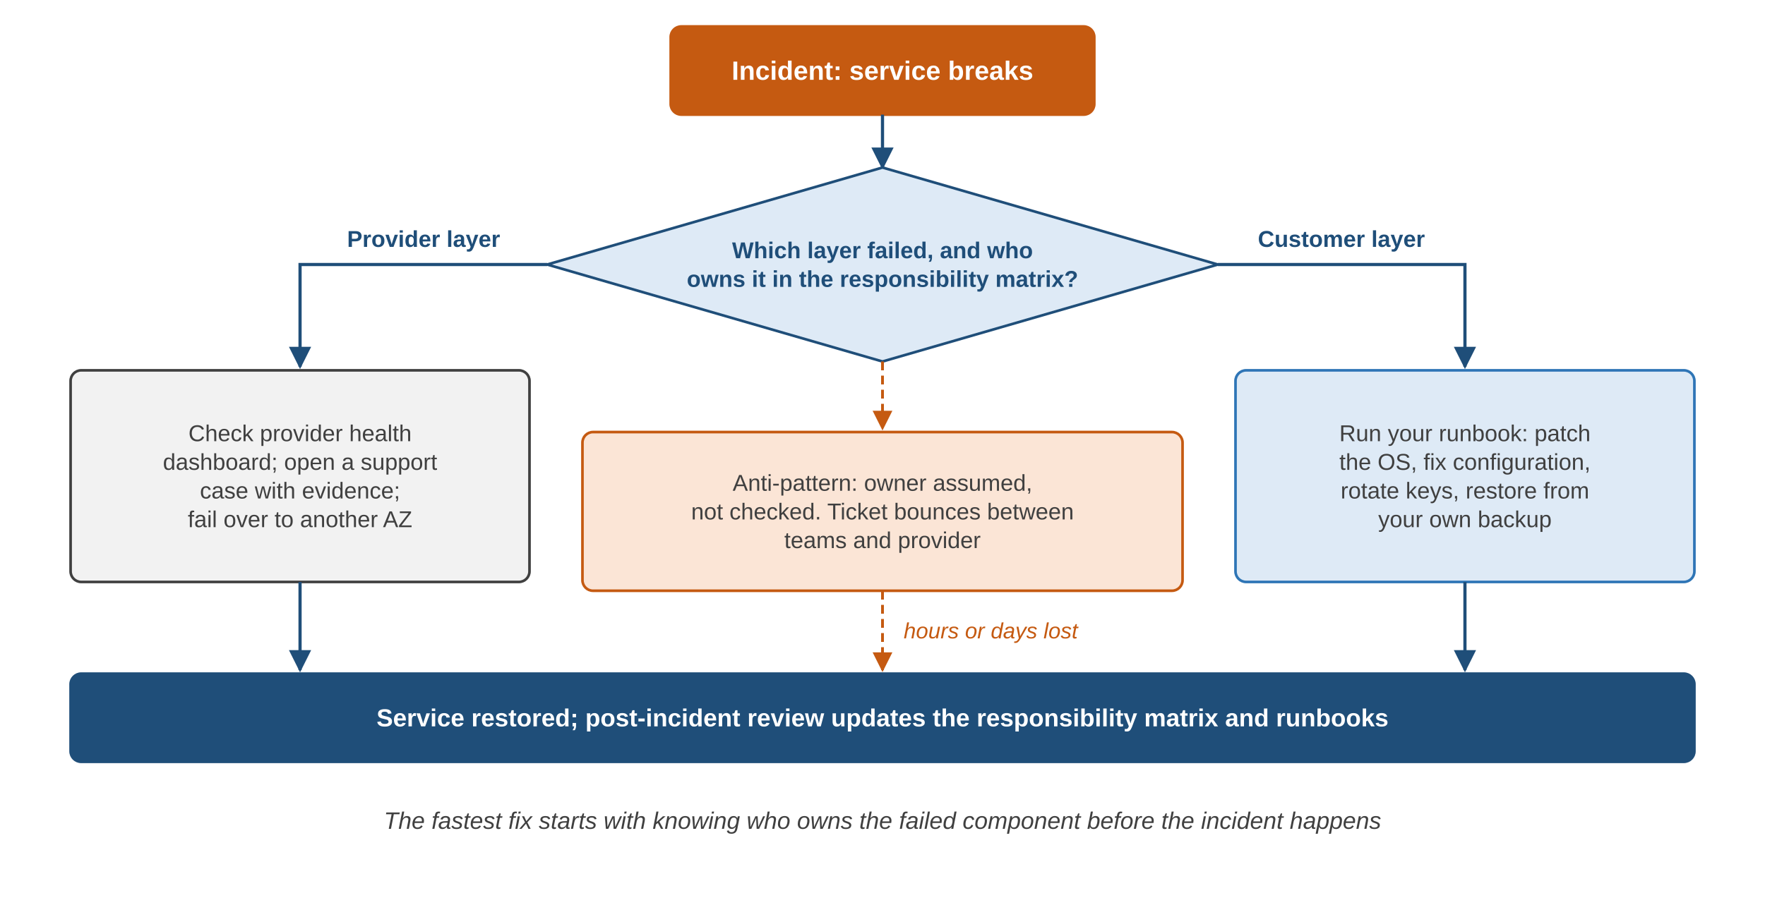
Case Study: The Server Nobody Patched
What happened
Retailer rehosts order app to EC2
Assumes AWS patches OS and backs up
8 months later: OS exploit, data encrypted
Ticket to AWS: host healthy, issue is in guest OS
No snapshots: 2 days rebuilding
Fix: Patch Manager, AWS Backup, RACI matrix, restore tests
back to chapter index
Notes:
Illustrative scenario. Two days offline because guest OS and data had no documented owner.

Slide 51
Preventing Misattribution
Responsibility matrix
Infrastructure as Code
Least privilege
Who configures, patches, backs up, responds
Secure settings inherited by every resource
Mistakes cannot change everything
CSPM tools
Own your backups
Runbooks
Security Hub, Defender for Cloud, Security Command Center
Separate account; test restores
Start with: which layer failed, who owns it?
back to chapter index
Notes:
Read the model before deploying and encode it in runbooks and automation.

Slide 52
Chapter Summary
Service models
Deployment
Virtualization
SaaS, PaaS, IaaS, FaaS, CaaS split the stack
Public, private, community, hybrid, multi-cloud
Hypervisors, VMs, containers
Global infra
Well-Architected
7 Rs
Regions, AZs, edge; spread across AZs
Six pillars, repeatable review
One strategy per application
TCO
Tracing
Responsibility
x* = C ÷ (r − c); utilization matters
Trace ID, spans, traceparent, OTel
Know the owner before it breaks
back to chapter index
Notes:
Recap of the eleven topics.

Slide 53
Review Questions
1
Which NIST characteristic enables pay-per-use billing?
(a) Broad access (b) Pooling (c) Measured service (d) Elasticity
2
Under IaaS, who patches the guest OS?
(a) Provider (b) Customer (c) Hypervisor vendor (d) Nobody
3
Moving VMware VMs unchanged to VMware Cloud on AWS is:
(a) Rehost (b) Relocate (c) Replatform (d) Refactor
4
In traceparent, the final 01 means:
(a) Version 1 (b) Sampled (c) One retry (d) HTTP 201
5
Breakeven hours between cloud rate r and owned server (C, c) are:
(a) C × (r − c) (b) C ÷ (r + c) (c) C ÷ (r − c) (d) (r − c) ÷ C
Discuss: recommend a deployment model for a start-up game studio, a national bank and a group of state hospitals
back to chapter index
Notes:
Answers: 1 (c), 2 (b), 3 (b), 4 (b), 5 (c).

