Slide 1
OD
OD
7
OMNIORDER MVP
One order.
One continuous workflow.
connected handoffs
1
Customer
A complete walkthrough from shared customer catalog to final invoice.
2
Sales
3
Distribution
ORDER DESK · OMNIORDER MVP
01
Notes:
Open by explaining that the demo follows one order all the way through. The key promise is no retyping between customer request, sales quotation, distribution, and invoicing.
[Sources]
- OmniOrder MVP application and implementation blueprint

Slide 2
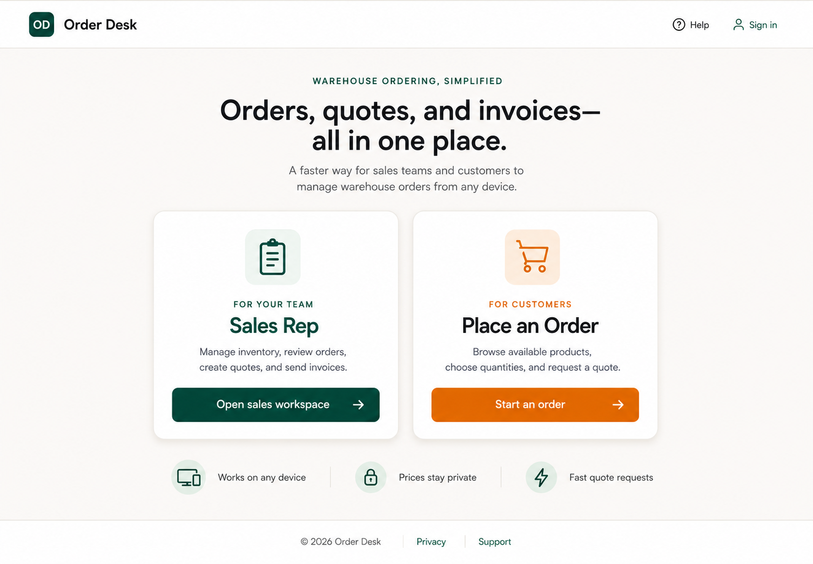
STEP 1 · ACCESS
Two clear entry paths keep every role focused
Sales signs into the workspace; customers use only the secure access shared by their representative.
Customer access requires no account or password.
1
ACCESS
2
REQUEST
3
REVIEW
4
PRO-FORMA
5
APPROVAL
6
DISPATCH
7
INVOICE
ORDER DESK · OMNIORDER MVP
02
Notes:
Start on the public home page. Point out the separate Sales Rep and Place an Order paths. Customers can use a direct shared link, or the access code plus their email. Mention the assigned sales rep and tap-to-call number at the top.
[Sources]
- User-provided Order Desk home-page design screenshot; OmniOrder MVP application

Slide 3
STEP 2 · CUSTOMER REQUEST
Customers choose quantities—never prices
The catalog exposes SKU, pack size, and availability while commercial terms stay private.
SEARCH BY ITEM OR SKU
$
⌕ turmeric
10191
Turmeric Ground 3oz
12 × 3oz
In stock
− 6 +
Price stays
private
10123
Cumin Seeds 3oz
12 × 3oz
In stock
− 8 +
No price column.
No price placeholder.
No total before quoting.
10143
Cardamom Green 2oz
12 × 2oz
Low stock
− 4 +
1
ACCESS
2
REQUEST
3
REVIEW
4
PRO-FORMA
5
APPROVAL
6
DISPATCH
7
INVOICE
ORDER DESK · OMNIORDER MVP
03
Notes:
Demonstrate search, category filters, stock badges, and quantity controls. Stress that the customer sees no unit prices or totals. The order review clearly says this is only a request and does not reserve stock.
[Sources]
- OmniOrder MVP application and implementation blueprint

Slide 4
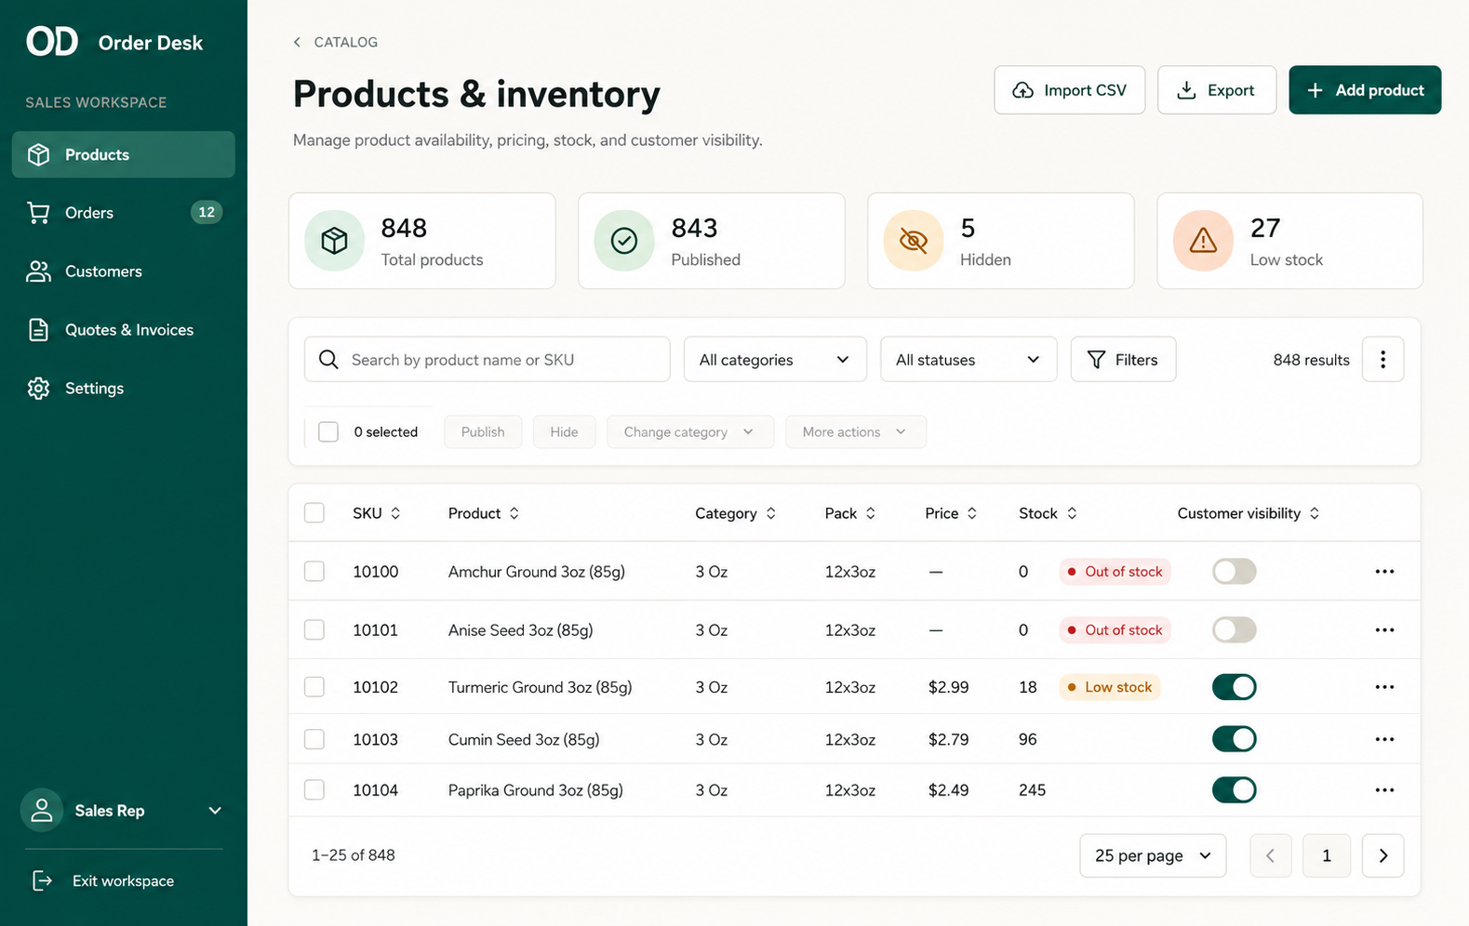
STEP 3 · SALES CONTROL
Sales owns the product list, inventory, and visibility
The representative can import a CSV, correct products, publish items, and hide unavailable stock.
1
ACCESS
2
REQUEST
3
REVIEW
4
PRO-FORMA
5
APPROVAL
6
DISPATCH
7
INVOICE
ORDER DESK · OMNIORDER MVP
04
Notes:
Switch to the sales workspace. Show the products and inventory page: CSV import, product editing, sales-only pricing, exact stock, and customer visibility controls. The source list maps 848 SKUs; the MVP uses representative seeded items for the live workflow.
[Sources]
- User-provided Order Desk products-and-inventory design screenshot; OmniOrder MVP application

Slide 5
STEP 3 · SALES REVIEW
The request becomes a commercial order only after review
Sales confirms stock, adjusts quantities, adds prices, and sets delivery terms.
CUSTOMER REQUEST
AVAILABILITY
ESTIMATED TOTAL
OR-2026-0137
All lines confirmed
$486.38
3 lines · Delivery Aug 12
Exact warehouse stock stays internal
Visible to sales only at this stage
Sales can revise quantities before the quote—but the customer’s original request remains traceable.
1
ACCESS
2
REQUEST
3
REVIEW
4
PRO-FORMA
5
APPROVAL
6
DISPATCH
7
INVOICE
ORDER DESK · OMNIORDER MVP
05
Notes:
Open the newly received order. Compare requested quantities against exact inventory. Explain that sales can revise quantities, add unit prices, tax, freight, payment terms, and customer notes while preserving the original request.
[Sources]
- OmniOrder MVP application and implementation blueprint

Slide 6
STEP 4 · PRO-FORMA
A frozen pro-forma introduces pricing for the first time
The numbered document captures confirmed quantities, prices, tax, shipping, validity, and terms.
ORDER DESK WHOLESALE
PRO-FORMA
PF-2026-0042
BILL TO
FIRST CUSTOMER
PRICE VIEW
Valley Market
ITEM
QTY
UNIT PRICE
TOTAL
$486.38
Turmeric Ground 3oz
6
$2.49
$14.94
Cumin Seeds 3oz
8
$2.69
$21.52
Cardamom Green 2oz
4
$7.99
$31.96
Pricing remains hidden until this document is sent.
1
ACCESS
2
REQUEST
3
REVIEW
4
PRO-FORMA
5
APPROVAL
6
DISPATCH
7
INVOICE
ORDER DESK · OMNIORDER MVP
06
Notes:
Create PF-2026-0042. This is the first customer-facing state that contains pricing. Explain that the pro-forma is a frozen snapshot with its own number, validity date, payment terms, and secure link or PDF.
[Sources]
- OmniOrder MVP application and implementation blueprint

Slide 7
STEP 5 · CUSTOMER APPROVAL
Approval is explicit, traceable, and easy
The customer can approve the pro-forma or request changes without creating an account.
✓
PF-2026-0042
Your pro-forma is ready
Valley Market · Valid through Aug 21 · $486.38
Request changes
Approve pro-forma
Offline approval can also be recorded by sales, preserving the same status history.
1
ACCESS
2
REQUEST
3
REVIEW
4
PRO-FORMA
5
APPROVAL
6
DISPATCH
7
INVOICE
ORDER DESK · OMNIORDER MVP
07
Notes:
Open the secure customer document. Point out the assigned rep and phone number, the total, PDF download, Request changes, and Approve pro-forma actions. If approval arrives by phone or WhatsApp, sales can record it without breaking the history.
[Sources]
- OmniOrder MVP application and implementation blueprint

Slide 8
STEP 6 · DISTRIBUTION
Only approved work moves to fulfillment
Distribution sees agreed quantities and terms, then records dispatch when products leave the warehouse.
✓
✓
✓
4
Approved
Ready to pick
Picking
Dispatched
Customer accepted
Queued for warehouse
Items checked
Invoice trigger
MARK PRODUCTS DISPATCHED → ISSUE FINAL INVOICE
1
ACCESS
2
REQUEST
3
REVIEW
4
PRO-FORMA
5
APPROVAL
6
DISPATCH
7
INVOICE
ORDER DESK · OMNIORDER MVP
08
Notes:
Move to the shared fulfillment timeline. Distribution only sees the order after approval. Walk through pick, pack, and dispatch. The key control is that dispatch—not approval—is the trigger for the actual invoice.
[Sources]
- OmniOrder MVP application and implementation blueprint

Slide 9
STEP 7 · FINAL INVOICE
Dispatch triggers a separate, immutable invoice
The customer receives the final invoice automatically, and the originating sales rep is copied.
INVOICE
INV-2026-0028
SENT
Source pro-forma PF-2026-0042
✉
Issued Aug 7, 2026
Due Aug 22, 2026
TOTAL
Customer
+ Sales rep CC
$486.38
1
ACCESS
2
REQUEST
3
REVIEW
4
PRO-FORMA
5
APPROVAL
6
DISPATCH
7
INVOICE
ORDER DESK · OMNIORDER MVP
09
Notes:
Mark the shipment dispatched. Show that INV-2026-0028 is a separate immutable business document linked to PF-2026-0042 and the original request. The customer receives it automatically, with the sales representative copied.
[Sources]
- OmniOrder MVP application and implementation blueprint

Slide 10
THE COMPLETE LOOP
One request becomes
a traceable order.
No retyping. No early price exposure. No lost handoffs.
1
2
3
4
5
6
7
Shared access
Quantity request
Sales review
Pro-forma
Approval
Dispatch
Invoice
NEXT: connect durable data, authentication, PDF generation, and email delivery for the customer pilot.
ORDER DESK · OMNIORDER MVP
10
Notes:
Close by restating the control points: price privacy before pro-forma, an explicit customer approval, distribution visibility only after approval, and invoice issuance only after dispatch. The next implementation phase makes this workflow durable and multi-user.
[Sources]
- OmniOrder MVP application and implementation blueprint

