Slide 1
WHT IS STACK?
A STACK IS THE LIST OF THE ELEMENT IN WHICH AN ELEMENT MAY BE INSERTED OR DELETED ONLY AT THE ONE END CALLED THE TOP OF STACK
A STACK IS A SPECIAIZED DATA STORAGE STRUCTURE.

Slide 2
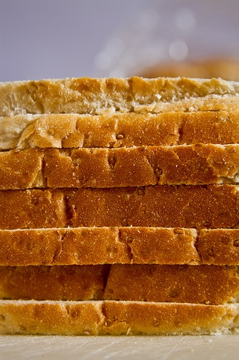
IT’S THE GENERAL EXAMPLE OF STACK

Slide 3
ARRAY AND STACK
Unlike array access of element in stack restricted
It has two main function push or pop
Insertion inn stack is done by using push function and removal is done by using pop function

Slide 4
representation
Stack allows to the only the last element inserted and hence an item can be inserted or remove from only one end called top of the stack
Therefore it’s also called last in first out list

Slide 5
Implementation
Stack can be implemented as
-array
-linked list
-dynamics array

Slide 6
Array implementation
Operations
-PUSH
-POP

Slide 7
#include<stdio.h>
#include<stdlib.h>
#define MAX 10
int top = -1;
int stack_array[MAX];
int pop();
int peek();
int isEmpty();
int isFull();
void display();
int element;
void push(int element);
int main()
{
int option,element;
while(1)
{
printf("\n1. Push / Insert An Element in Stack");
printf("\n2. Pop / Delete An Element From Stack");
printf("\n3. Display All Contents of Stack");
printf("\n4. Display Top-Most Content of Stack");
printf("\n5. Exit\n");
printf("\nSelect an Option:\t");
scanf("%d", &option);
switch(option)
{
case 1:
printf("\nEnter The Element To Be Inserted:\t");
scanf("%d", &element);
push(element);
break;
case 2:
element = pop();
printf("Element Deleted:\t%d",element);
break;
case 3:
display();
break;
case 4:
printf("Top-Most Element of Stack:\t%d",peek());
break;
case 5: exit(1);
}
}
return 0;
}
int pop()
{
if(isEmpty())
{
printf("\nStack Undeflow\n");
exit(1);
}
else
{
element = stack_array[top];
top = top - 1;
return element;
}
}
int peek()
{
if(isEmpty())
{
printf("\nStack Undeflow\n");
return 1;
}
else
{
return stack_array[top];
}
}
int isEmpty()
{
if(top == -1)
return 1;
else
return 0;
}
int isFull()
{
if(top == MAX - 1)
return 1;
else
return 0;
}
void display()
{
int count;
if(isEmpty())
{
printf("\nStack is Empty\n");
return;
}
else
{
for(count = top; count >= 0; count--)
{
printf("%d\t",stack_array[count]);
}
}
}
void push(int element)
{
if(isFull())
{
printf("\nStack Overflow\n");
return;
}
else
{
top = top + 1;
stack_array[top] = element;
}
}

