Slide 1

LOW RESOURCE LANGUAGE UNDERSTANDING IN VOICE ASSISTANTS
May 20, 2022
Dissertation Proposal – Subendhu Rongali
Committee – Andrew McCallum, Mohit Iyyer, Andrew Lan, Konstantine Arkoudas
Notes:
Good morning, everyone! Thank you so much for joining me for my dissertation proposal. My name is Subendhu. I’m a fifth year PhD student. I work with Prof. Andrew McCallum, who is the chair of my committee, also consisting of professors Mohit Iyyer, Andrew Lan, and Konstantine Arkoudas from Amazon. This proposal covers my research on low resource language understanding in voice assistants.

Slide 2
Outline
Introduction: Language Understanding in Voice Assistants
Dissertation Goals
Completed Work
A State-of-the-Art Natural Language Understanding System for Semantic Parsing
An End-to-End System for Spoken Language Understanding
Semantic Parsing with Very Little Data
Upcoming Work
Low Resource Domain Adaptation
Notes:
Here’s a quick outline of today’s talk. I will first introduce language understanding in voice assistants. I will then describe the goals of this dissertation. Next, I will present the completed research work in three sections and finally, I will describe proposed upcoming work.

Slide 3
Introduction
Notes:
First, an introduction to voice assistants.

Slide 4
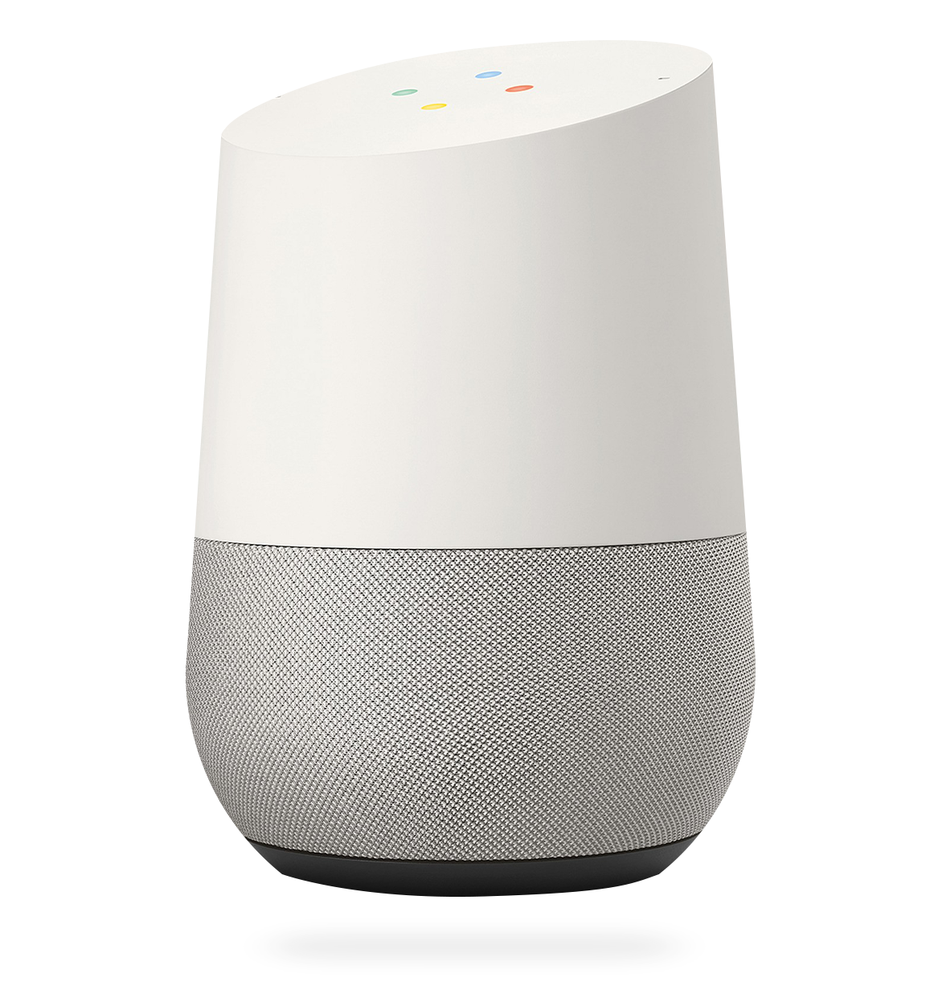
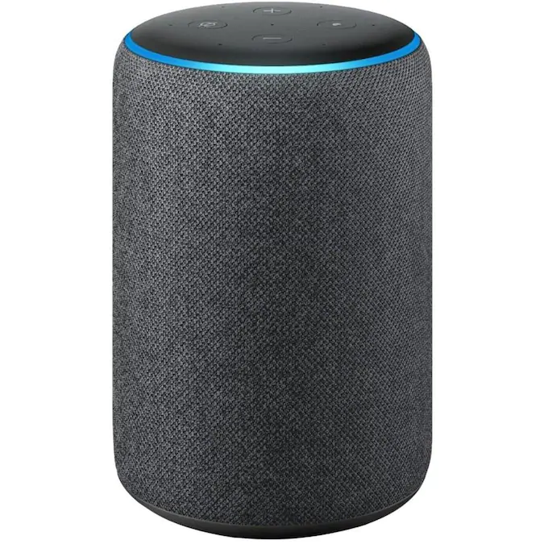

Voice Assistants
As of 2019, estimated that 21% of U.S. adults own a smart speaker, a 78% year-over-year increase. [National Public Radio 2019]
Notes:
Voice assistants such as Alexa, Siri, and Google Assistant are widely used nowadays. As of 2019….. Apart from being the core component in smart speakers, they are now deeply entrenched in our lives by being introduced into phones, cars, and pretty much any user electronic device that can run them.

Slide 5





Voice Assistants
Notes:
They are designed to process user dialog and perform actions in a variety of domains such as music, video, shopping, weather, and home automation.

Slide 6
How do they work?
Language Understanding
Task-oriented Semantic Parsing
Identify the intents (play music, turn on lights, etc.)
Identify the slots (which song to play? which light to turn on?)
Notes:
But how exactly do they work? The core intelligence that allows them to function is language understanding. Specifically, it is referred to as task-oriented semantic parsing, where a user utterance is taken as input and parsed into a machine-understandable logical form. This logical form consists of any actions requested by the user, called intents, such as playing music, turning on lights, or checking weather and any entities that further refine that action, called slots, such as which song to play, or which light to turn on.

Slide 7
A Simple Example
Play the song don’t stop believin by Journey
Intent: PlaySongIntent
Slots: SongName( don’t stop believin )
ArtistName( Journey )
Notes:
Let’s look at an example of this task. Take the user utterance “Play the song don’t stop believing by Journey”. In task oriented semantic parsing, the goal is to identify the intent of the utterance, which here is PlaySong, and the slots which correspond to don’t stop believing being the songname and journey being the artist. This utterance is also what is referred to as a simple parsing example since utterance consists of a single overall intent and a few non-overlapping and disjoint sub-spans parsed as slots.

Slide 8
A Complex Example
How far is
the
coffee
shop
IN:GET_DISTANCE
SL:DESTINATION
IN:GET_RESTAURANT_LOCATION
SL:FOOD_TYPE
Notes:
With increasing expectations of users from voice assistants to perform more complex tasks, more complex examples were introduced. These consists of multiple nested intents and slots, making the logical form look like a tree. Let’s take a look at one such example here. The utterance is how far is the coffee shop. It is parsed into this tree-like logical form. Here, the top-level intent is to get distance. Just below that is the destination slot. But to get the destination slot, we first need to execute another action, defined here by the intent – get restaurant location. This intent again has a slot modifier of food type being coffee. So overall, the parse here describes that we need to get the distance to a destination, that is the location of a restaurant, which serves coffee.

Slide 9





Architecture
Semantic Parsing
Automatic Speech Recognition
Language
Understanding
Transcription
(query)
Logical form
Notes:
Moving on, let’s take a look at the high-level architecture of current voice assistants. The user first utters something. The speech goes through an automatic speech recognition or ASR module to generate a transcript. This transcript is then passed through a natural language understanding or NLU module to obtain the logical form semantic parse consisting of intents and slots. And as described, the core component of this language understanding module is the semantic parsing model.

Slide 10

Resource Issues
Lots of annotated data required.
Train with fewer ex?
Lots of annotated data required.
Train with fewer ex?
Automatic Speech Recognition
Language
Understanding
Transcription
(query)
Logical form
New domains? Universal Semantic Parsing?
Pipeline system due to lack of E2E data.
E2E system?
Notes:
Now while this architecture is currently what’s used everywhere, it is heavily resource-dependant. Take each of the ASR and NLU modules for example. Both these modules are typically trained with hundreds of thousands of annotated data examples, typically annotated by an army of crowd workers. Given the complexity of annotated as we’ve seen from the examples earlier, this process is very time consuming and expensive. So, a big question here is, can we train these models to do well with fewer examples.
In addition, the whole system is designed as a two-stage pipeline due to the lack of end-to-end data and sufficiently high-performing end-to-end models. And end-to-end system promises to be faster and better optimized, so building such a system is another important question.
Finally, to improve the capabilities of voice assistants, they are trained to handle user requests in more, newer domains. This process requires that the model be re-trained on lots of annotated data from the new domains every time. Naturally, we ask, how can we build a model that can do this without requiring new annotations? This paves way to universal semantic parsing, where the model can parse utterances from any domain into a given intent-slot schema.

Slide 11
Dissertation Statement
Notes:
This brings us to my dissertation statement.

Slide 12
Statement
Address low resource language understanding problems in voice assistants
Notes:
We aim to address all these low resource language understanding problems to build better and more efficient voice assistants.

Slide 13
Dissertation Outline
Lots of annotated data required.
Train with fewer ex?
Lots of annotated data required.
Train with fewer ex?
OUT OF SCOPE
3
Automatic Speech Recognition
Language
Understanding
Transcription
(query)
1
Logical form
New domains? Universal Semantic Parsing?
Pipeline system due to lack of E2E data.
E2E system?
4
2
Notes:
Recall the big picture outline that details all the resource-related issues. The speech low-resource problem is out of scope since this dissertation focuses on language understanding. To address the other issues, we first build a language understanding system that is state-of-the-art, and also enables us to tackle the subsequent resource constraint problems. We then propose an E2E system that can potentially replace the current pipelined system. Next, we describe how to train semantic parsing models with very few examples and finally, we propose a model to perform zero-shot domain adaptation in semantic parsing. The central theme among all my research is to use transfer learning and the power of pre-trained language models to account for resource scarcity and build robust, high-performing systems.

Slide 14
Dissertation Outline
1
A State-of-the-Art Natural Language Understanding System for Semantic Parsing Don’t Parse, Generate! A Sequence-to-Sequence Architecture for Task-Oriented Semantic Parsing. Rongali et al. WWW 2020
2
An End-to-End System for Spoken Language Understanding Exploring Transfer Learning For End-to-End Spoken Language Understanding. Rongali et al. AAAI 2021
3
Semantic Parsing with Very Little Data Training Naturalized Semantic Parsers with Very Little Data. Rongali et al. IJCAI 2022
4
Zero-shot Domain Adaptation for Semantic Parsing Upcoming work
Notes:
For the first three sections, I will present completed research work. For zero-shot domain adaptation, which is upcoming work, I will present our proposed models, preliminary results and observations, remaining challenges, and a research plan.

Slide 15
A State-of-the-Art Natural Language Understanding System for Semantic Parsing
Notes:
Now, onto the first section. Here, we describe a state-of-the-art model to perform task-oriented semantic parsing and provide a base for our remaining work.

Slide 16

Big Picture
Lots of annotated data required.
Train with fewer ex?
3
Automatic Speech Recognition
Language
Understanding
Transcription
(query)
1
Logical form
New domains? Universal Semantic Parsing?
Pipeline system due to lack of E2E data.
E2E system?
4
2
Notes:
In terms of our big picture diagram, we are currently on problem 1.

Slide 17

Task
Task-oriented Semantic Parsing
IN:GET_DISTANCE
How far is
the
coffee
shop
How far is
SL:DESTINATION
IN:GET_RESTAURANT_LOCATION
the
SL:FOOD_TYPE
shop
coffee
Notes:
Just to re-iterate, the task we are solving here is task-oriented semantic parsing. So given an utterance such as how far is the coffee shop, we want to parse it into its logical form containing intents and slots.

Slide 18
Prior Work
Shift-reduce parser based on RNN-Grammars [Gupta et al. 2018, Einolghozati et al. 2019]
For simple queries, Text Classification + Sequence Tagging [Lafferty et al. 2001, Mesnil et al. 2016, Liu et al. 2016]
Notes:
In terms of prior work, the best performing models for parsing complex utterances were shift-reduce parsers that were trained to open and close nodes in the tree-like logical form. These models require a defined grammar for the target parse.
For simple utterances with a single intent and disjoint slots, the task was accomplished by classification and sequence tagging models which first classify the intent and then tag each word in the sentence and combine adjoining tags.
In both these cases, models typically assume a specific structure for the logical form. So in cases where the logical form has overlapping or repeating slots, they can’t be easily applied.

Slide 19
Our goals
Develop a unified approach for simple and complex queries
Architecture should be conducive to transfer learning
Handle queries that don’t conform to the grammar of either simple or complex queries
Notes:
For our work, our goal is to develop a unified approach for both simple and complex queries. In addition, we want our architecture to be simple and unstructured so that it can be used for future transfer learning style work to tackle low-resource problems and also take advantage of the widely available pretrained language model checkpoints. Finally, we also want to handle user queries that don’t just conform to the grammar of simple or complex queries such as ones with repeating and overlapping slots.

Slide 20
Proposed Architecture
Transformer Sequence-to-Sequence model [Vaswani et al. 2017] with Pointer Generator Network [Vinyals et al. 2015, See et al. 2017]
SEQ2SEQ-PTR
Easy transfer learning
Pretrained LMs
Source Sequence – user query
Target Sequence – custom formulation of intents and slots
Notes:
With all these considerations in mind, we propose our model. It consists of a transformer sequence-to-sequence model, augmented with a custom pointer generator network. We refer to our model as Seq2seq-ptr. By solving semantic parsing using a simple encoder-decoder sequence-to-sequence model, we remove any structural dependencies and clear the way for transfer learning with other seq2seq data. We also take better advantage of pre-trained language model checkpoints that are trained in the same style on unsupervised text data. Seq2seq models are trained to take a source sequence as input and predict a target sequence. For task-oriented semantic parsing, the user query becomes the source sequence. For the target sequence, we define a custom formulation of intents and slots, which I will describe now.

Slide 21
Target Formulation
Source:
Movie in the park events nearby this week
[Get Event
[Category Event Movie ]
in
[Location
[Get Location
[Category Location the park ]
]
]
events
[Location
[Get Location
[Location Modifier nearby ]
]
]
[Date Time this week ]
]
[Get Event
[Category Event @ptr0 ]
@ptr1
[Location
[Get Location
[Category Location @ptr2 @ptr3 ]
]
]
@ptr4
[Location
[Get Location
[Location Modifier @ptr5 ]
]
]
[Date Time @ptr6 @ptr7 ]
]
[Get Event [Category Event @ptr0 ] @ptr1 [Location [Get Location [Category Location @ptr2 @ptr3 ] ] ] @ptr4 [Location [Get Location [Location Modifier @ptr5 ] ] ] [Date Time @ptr6 @ptr7 ] ]
Target:
Notes:
Take the utterance movie in the park events nearby this week, which is the source. The target logical form initially looks like this, with intent and slot tokens tagging and enclosing tokens from the source utterance in a tree-like logical form. To create our target sequence, we first replace each of the source tokens with custom pointer tokens pointing to the position index of the word in the source sequence. So here, ptr0 corresponds to the word movie and ptr1 to the word in etc. We then flatten the whole thing to create a flat target sequence with open and close tag tokens marking the structure.

Slide 22
Architecture: SEQ2SEQ-PTR
@ptr₂
@ptr₂ (country)
SL:genre]
SL:genre]
Pointer scores
Intents and slots
Pretrained Encoder
Transformer Decoder
play top country hits
[IN:play [SL:sort @ptr₁ SL:sort] [SL:genre
Utterance
Semantic Parse
Notes:
I will now briefly describe the architecture of seq2seq-ptr. Given the utterance play top country hits, we first pass it through a pretrained encoder such as BERT to generate encoder hidden states for each of the words. The decoder then decodes the target tokens by creating decoder representations, attending to previous decoder states and all the encoder states. Let’s take a look now at how the decoder hidden state at step 5 is used to decode the next token. We take the decoder hidden state that is produced in this step to compute attention pointer scores for each of the source tokens. A simple operation here could be the dot product between the decoder hidden state and each of the encoder hidden states. The decoder hidden state is then also projected into an output layer to compute scores for the intent and slot tags in the target vocabulary. All these unnormalized scores are then combined to generate the overall distribution for the next token. This is used to train the model using cross entropy loss and during inference, the highest scoring token is picked as the next token in the target sequence being decoded.

Slide 23
Why is this good?
The target vocabulary size is reduced to pointers + tags; model is smaller, learns faster, and is more robust
The target parse can have overlapping and disjoint slots
The encoder and decoder components can be pre-trained with other sequence-to-sequence tasks for transfer learning
Notes:
So why is our model good? First, the target vocabulary size is reduced to just the pointer and tag tokens instead of a simple sequence-to-sequence model, whose target vocabulary also consists of all the source English words. This modifications makes our model smaller, helps it learn faster and make it more robust.
This architecture can also parse utterances with non-conforming slots since their logical form can now be just expressed as a sequence with pointer and tag tokens, in any way we want. Finally, as mentioned earlier, we can initialize the encoder and decoder components with pretrained checkpoints and the whole architecture also makes transfer learning easy.

Slide 24
Evaluation
Complex datasets
Facebook TOP [Gupta et al. 2018]
Simple datasets
SNIPS [Coucke et al. 2018]
ATIS [Price et al. 1990]
Internal Amazon Music and Video datasets
Notes:
We evaluate Seq2seq-ptr on many parsing datasets, some public and some internal to Amazon, which I had access to during my internship there. I present some of those results here.

Slide 25

Results: Facebook TOP
Model | EM Accuracy | Intent Accuracy
Shift-reduce (SR) Parser (Gupta et al 2018) | 80.86 | -
SR + ELMo (Einolghozati et al 2018) | 83.93 | -
SR ensemble + ELMo + SVM Reranker (Einolghozati et al 2018) | 87.25 | -
SEQ2SEQ-PTR (no pretraining) | 79.25 | 97.43
SEQ2SEQ-PTR (BERT encoder) | 83.13 | 97.91
SEQ2SEQ-PTR (RoBERTa encoder) | 86.67 | 98.13
Our
models
We improve by 2.7 (+3.3%) absolute EM accuracy points over the previous best single model on TOP, only surpassed by an ensemble model by 0.6 EM accuracy points
Notes:
First on Facebook TOP dataset, which consists of complex utterances, we see that our model beats the previous best single-model in terms of exact match accuracy of the semantic parse, which is a shift-reduce parser. It also comes really close to the overall best score on this dataset achieved by an ensemble of pre-trained shift-reduce models, and a re-ranker on top of that. We improve….

Slide 26
Results: Simple Query Datasets
Model | SNIPS |  | ATIS
Model | EM Accuracy | Intent Accuracy | EM Accuracy | Intent Accuracy
Joint BiRNN | 73.20 | 96.90 | 80.70 | 92.60
Attention BiRNN | 74.10 | 96.70 | 78.90 | 91.10
Slot Gated Full Attention | 75.50 | 97.00 | 82.20 | 93.60
CapsuleNLU | 80.90 | 97.30 | 83.40 | 95.00
SEQ2SEQ-PTR (no pretraining) | 85.43 | 97.00 | 81.08 | 95.18
SEQ2SEQ-PTR (BERT encoder) | 86.29 | 98.29 | 86.37 | 97.42
SEQ2SEQ-PTR (RoBERTa encoder) | 87.14 | 98.00 | 87.12 | 97.42
Our
models
We improve by 6.2 (+7.7%) and 3.3 (+4.5%) absolute EM accuracy points over previous best models on SNIPS and ATIS respectively
Notes:
On the SNIPS and ATIS datasets, we also achieve state-of-the-art results by beating many sequence tagging-style approaches. We improve… This brings us to the end of this chapter.

Slide 27
An interesting example
What time do I need to leave to get to Helen by 8 pm ?
[Get Estimated Departure
What time do I need to leave to get to
[Destination Helen ]
[Date Time Arrival by 8 pm ]
]
GOLD
[Get Estimated Departure
What time do I need to leave to get to
[Destination
[Get Location Home
[Contact Helen ]
]
]
[Date Time Arrival by 8 pm ]
]
PREDICTED

Slide 28
An End-to-End System for Spoken Language Understanding
Notes:
Next, I describe an E2E system for spoken language understanding, to replace the pipelined 2-stage ASR-NLU system.

Slide 29

Big Picture
Lots of annotated data required.
Train with fewer ex?
3
Automatic Speech Recognition
Language
Understanding
Transcription
(query)
1
Logical form
New domains? Universal Semantic Parsing?
Pipeline system due to lack of E2E data.
E2E system?
4
2
Notes:
Recall the big picture, we are now on problem 2.

Slide 30

Task
Spoken Language Understanding
Intent: PlayMusic
Slots: SongName don’t stop believing
(play don’t stop believing)
PlayMusic( play SongName( don’t stop believing )SongName )PlayMusic
Notes:
To re-iterate, the task here is spoken language understanding. So given user speech consisting of a request, here it says play don’t stop believing, we want to directly generate the target semantic parse consisting of the intents and slots. By following the seq2seq formulation from the previous chapter, this becomes just a sequence.

Slide 31




Why End-to-End?
ASR
NLU
Text Transcription
NLU Hypothesis
E2E
NLU Hypothesis
Smaller and faster engine!
No cascading errors!
Possibly better optimization!
Notes:
So why do we want to build an end-to-end system? In the traditional 2-stage pipeline, the user speech is first sent through an ASR model to generate the text transcription. The transcription then goes through an NLU system to obtain the logical form hypothesis. By converting the audio to the hypothesis in just one step, we can build a better system because we now have a smaller and faster engine……

Slide 32
Prior Work
Mostly pipelined systems – ASR + NLU
Few end-to-end models but with lower performance than pipelined [Hagani et al. 2018]
Notes:
In terms of relevant prior work, most SLU systems proposed are pipelined. There have been a few end-to-end models proposed but they typically showed lower performance than pipelined systems.

Slide 33
Limitations of Prior End-to-End SLU Models
They require lots of end-to-end training data
There is a huge amount of ASR (speech-text) and NLU (text-NLU) training data that is not used
No feature expansion – new domains
Notes:
This is because of limitations in prior approaches to end-to-end models. By trying to solve a combined harder problem, these models require lots of end-to-end training data. Previous approaches also don’t take advantage of the huge amount of ASR and NLU data because it isn’t necessarily aligned to create end-to-end data. Another limitation of end-to-end models is feature expansion. When we want to add new domains to the model, we would need end-to-end data and can’t do with just a few text-to-text samples that domain developers write.

Slide 34
Our goals
Design an improved end-to-end SLU model that can transfer knowledge from other available data sources (ASR, NLU)
Support low-resource feature expansion with just text data
Notes:
This brings us to our goals for this work. We want to design an improved e2e model that can train not only with end-to-end data but also transfer knowledge from other data sources and modalities such as the ASR and NLU data. We also want our model to be designed in such a way that it supports feature expansion with just some annotated text data.

Slide 35
Proposed Architecture
Transformer Sequence-to-Sequence model with two encoders – audio and text, and a shared decoder
Designed to perform knowledge transfer by training on many different tasks with seq-to-seq style data [Raffel et al. 2019]
AT-AT (Audio-Text All-Task)
Notes:
To accomplish this, we propose a transformer seq2seq model with two encoders - one for audio and one for text, and a single shared decoder. We design our model to be able to train on many different tasks, both audio-to-text and text-to-text ones and achieve knowledge transfer. We call our model AT-AT, for audio-text all-task.

Slide 36




Architecture: AT-AT
SLU
PlayMusic( okay Artist( rihanna )Artist )PlayMusic
AT-AT
ASR
Audio
Encoder
Joint
Target
Decoder
it was a glorious morning to wake up to
an old-fashioned bar was close by
MLM
Text Encoder
PlayMusic( play Song( don’t stop believing )Song )PlayMusic
NLU
play don’t stop believing
Notes:
This is how it works. Here we have our model with the two encoders and the joint decoder. It is pretrained with many different tasks. It can process an E2E SLU example. The input goes to the audio encoder and the output is decoded by the joint decoder. It can also be trained on ASR examples with audio input and the transcript as the output and on MLM style-examples where the input is masked audio and the output is the full unmasked transcript. In addition, the model can also be trained on text-to-text sequence to sequence examples such as NLU here. The text input is processed by the text encoder and the output is decoded by the joint decoder. By jointly training on all these tasks together, we are enabling the model to learn from different tasks and share knowledge. By also using two encoders and a shared decoder, we are forcing the model to learn a shared audio-text space, which can help us perform zero-shot E2E feature expansion, as I will describe shortly.

Slide 37
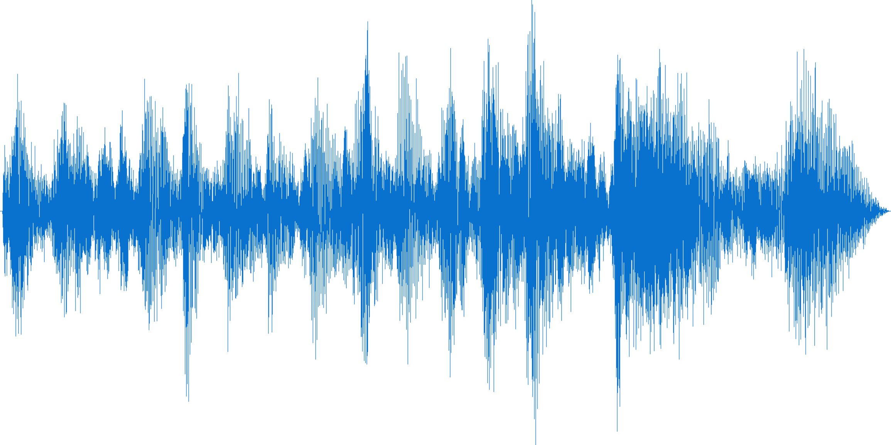
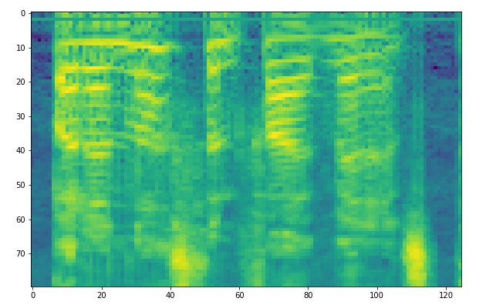
Architecture: Audio Processing
Log filter-bank spectrograms (LFB)
Audio waveform
Spectrogram

Slide 38
Model Components
Audio Encoder
CNN Embedder
Transformer Encoder
Joint Target Decoder
Transformer Decoder
Embedder
BERT Encoder
Embedder/Generator
Text Encoder
Notes:
Before we move onto the zero-shot feature expansion details, here’s a brief overview of the model components of AT-AT. The audio encoder consists some convolutional layers and a transformer encoder. We process the audio signal into a log filterbank spectrogram, which sort of looks like an image, hence the CNN layers. The text encoder is designed like a traditional text-based encoder such as BERT with an embedder and a transformer encoder to contextualize the embeddings. The joint decoder is again a transformer decoder, with a tied embedder-generator layer.

Slide 39
How can we do zero-shot with this?
In the zero-shot setting, we have text NLU data for a new domain but no corresponding audio
Shared audio-text space due to training scheme
Train with text data, generalize to audio
Notes:
Coming back to the zeroshot question, how can we do feature expansion with just text NLU data but no audio. As described earlier, we hypothesize that by training on both audio and text tasks and sharing a decoder, AT-AT learns a shared audio-text space. Now, given text data, we can simply train with text data and expect it to generalize to audio.

Slide 40
Shared audio-text space
Information bottleneck
Audio
Encoder
Text Encoder
play don’t stop believing
Notes:
We note that isn’t how shared spaces are traditionally constructed. Usually, there is some penalty that forces the learning of this shared space. But this is tricky in the audio-text space because the audio encoder encodes the audio signal into a set of hidden states that are typically more than and different from the number of hidden states produced by a text encoder for the corresponding text transcription. We could combine all of them into single states and force a penalty on them but this introduces a huge information bottleneck in a seq2seq architecture i.e. decoding the whole target sequence from just a single vector.

Slide 41
Shared audio-text space
Requires manual chunking and alignment
[Denisov et al. 2020]
Audio
Encoder
Text Encoder
play don’t stop believing
Notes:
We can instead combine the audio states per word and force a penalty then, which is an approach previously explored but it then requires additional manual chunking and alignment steps. In any case, all these penalty approaches require aligned audio-transcription data.

Slide 42
Shared audio-text space
We avoid these issues by simply delegating this to the decoder
Sufficiently constrained decoder should learn to share space since it is not big enough to separately learn each task
Notes:
In AT-AT, while building our shared space, …..

Slide 43
AT-AT: Three phases
Pretraining
Finetuning
Zero-shot learning
Notes:
Moving on, AT-AT has three main phases……

Slide 44
AT-AT: Pretraining phase
The model is trained using all available data from multiple tasks such as ASR, SLU etc. The goal is to learn as much knowledge as possible.
The task label, which denotes which task is being performed, is passed as the BOS token while decoding.
Source | Task | Target
Audio1.wav | ASR | play the latest hit songs
Audio2.wav | ASR | let’s listen to early nineties hip hop songs
Audio3.wav | SLU | PlayStation( play StationName(ninety-three f m )StationName)PlayStation
Audio4.wav | ASR | skip this song
Audio5.wav | SLU | PlayMusic( play ArtistName( the weeknd )ArtistName )PlayMusic
… |  | ….
Notes:
In the pretraining phrase, the model is …..
The pretraining data looks something like this. You have audio files as the source, the task token as the BOS and the target targets depends on the task being performed. Here, if it is ASR, it is just a transcript, and if is SLU, it is the full logical form.

Slide 45
AT-AT: Finetuning phase
In this phase, we simply continue training AT-AT on a specific downstream task that we want to evaluate on.
This is done with gradual unfreezing with different learning rate multipliers to prevent any catastrophic forgetting.
Notes:
In the finetuning phase….
In this phase, we found that is typically useful to experiment with gradual unfreezing of layers and LR multipliers to prevent any catastrophic forgetting from the pretraining phase

Slide 46
AT-AT: Zero-shot phase
Train with at least one audio and one text task in the pretraining phase to learn a shared audio-text representation
Finetune with text data from a new domain
Notes:
Finally, for the zero-shot end-to-end phase when necessary, we first require that the model be pretrained with atleast one audio and one text task in the pretraining phase to learn the shared audio-text representation.
Once this is done, we simple finetune with text data from the new domain.

Slide 47
Evaluation
End-to-End SLU performance
SNIPS Audio
FluentSpeech
Internal Amazon datasets
Zero-shot End-to-End
Facebook TOP
Internal Amazon datasets
Notes:
We evaluated AT-AT to compare it to pipelined models for spoken language understanding and also to measure its zeroshot end-to-end performance. I will present some of our findings here.

Slide 48
SNIPS Audio
1660 examples, numbers reported on 5-fold cross validation
SOTA models
SNIPS pipeline: acoustic model, LM, NLU slot-filler
Google DialogFlow Service
Notes:
First, we report numbers on SNIPS audio. This is a really small public dataset with just 1660 examples. Previous SOTA models are pipelines models with custom ASR and NLU engines.

Slide 49
SNIPS Audio
Model | EM Accuracy
Close Field
SNIPS (Saade et al. 2018) | 84.22
Google (Saade et al. 2018) | 79.27
E2E Model | no convergence
AT-AT | 84.88
Far Field
SNIPS (Saade et al. 2018) | 71.67
Google (Saade et al. 2018) | 73.43
E2E Model | no convergence
AT-AT | 74.64
Notes:
We report the exact match accuracy here. As you can see a simple e2e model fails to converge when trained on such a small dataset. However, AT-AT trains effectively and beats the previous best scores on both sets of the SNIPS audio dataset consisting of close field and far field recorded audio.

Slide 50
FluentSpeech
Speech-NLU dataset where NLU is a 3-tuple of (action, object, location), converted into a sequence
Example:
Audio : Turn on the kitchen lights
Tuple : activate, lights, kitchen
Target : Activate( Turn on the Location( kitchen )Location Object( lights )Object )Activate
23k train, 3k valid, 4k test
Notes:
We also evaluate AT-AT on fluent-speech, a dataset consisting of voice inputs and corresponding 3-tuple targets consisting of an action, object and a location. An example from this dataset looks like this. We convert the three tuple into a target sequence to train our AT-AT model. This datasets is larger, consisting of 23k training examples.

Slide 51
FluentSpeech
Model | Hypothesis Error Rate | EM Accuracy
E2E Model | 8.3 | 91.7
SOTA 1 (Lugosch et al. 2019) | 1.2 | 98.9
SOTA 2 (Wang et al. 2020) | 1.0 | 99.0
AT-AT | 0.5 | 99.5
50% error reduction
Notes:
On fluentspeech, the SOTA models, which are built on 3-way classification networks achieve pretty high exact match accuracy scores. However, a simple end-to-end model, despite training, only achieves an accuracy of 91.7%, almost 7 points lower with a high error rate. However, AT-AT outperforms the previous models, with the power of all the additional knowledge it learns from other auxiliary task. It achieves an EM accuracy of 99.5, and a 50% error reduction on top of an already high performing model.

Slide 52
Facebook TOP – End-to-End Zeroshot
We compiled real audio for the test set
Comparison
E2E model trained with synthetic audio created from a Text-to-Speech system (Amazon Polly)
Notes:
Next, we evaluate AT-AT for zeroshot end-to-end semantic parsing with just text data. For this experiment, we compiled real audio for the test set of the TOP dataset. For training, we just used the text training examples. For comparison, we also generated synthetic audio data using a text-to-speech system called Amazon Polly and used it to train an end-to-end model. Note that this synthetic data can also be used to train AT-AT in addition to the text data.

Slide 53
Facebook TOP – End-to-End Zeroshot
Model | EM Accuracy
E2E Model with Synthetic Audio | 69.19
AT-AT | 51.54
AT-AT with Synthetic Audio | 71.60
Notes:
We see that At-AT achieves remarkable zeroshot performance without any audio data by simply training on the text data. And E2E model trained with the generated synthetic audio does better but it relies on having access to a good text-to-speech system that can reliably generate a variety of voices. In any case, if the synthetic audio data is added to the AT-AT scheme, it outperforms the endtoend model, again displaying the knowledge from transfer learning.
This concludes our work on end-to-end spoken language understanding.

Slide 54
Semantic Parsing with Very Little Data
Notes:
Next, we move on to our work on training semantic parsers with very little data.

Slide 55
Big Picture
Lots of annotated data required.
Train with fewer ex?
3
Automatic Speech Recognition
Language
Understanding
Transcription
(query)
1
Logical form
New domains? Universal Semantic Parsing?
Pipeline system due to lack of E2E data.
E2E system?
4
2
Notes:
This is the third problem in the big picture.

Slide 56
Task
Task-oriented Semantic Parsing but with very little data
Notes:
To re-iterate, the task here is text-only task-oriented semantic parsing but with very little data, typically a handful of examples that developers can quickly write.

Slide 57
Prior Work: Naturalization of Semantic Parsing
Convert the target logical form into controlled form of natural language called the canonical form
Parsing is reduced to constrained paraphrasing/simplification
Canonical form can be converted into the original target logical form using simple rules
Based on recent work from Shin et al. 2021
Notes:
Before we go into our work, I will describe an important technique we call naturalization. In this technique, the target logical form in semantic parsing is converted into controlled form of natural language. This form is in English but is much easier to parse into the final logical form with just simple rules. We call this the canonical form. Now, semantic parsing simply turns into converting a user utterances into a constrained but simpler, paraphrase sentence. Once we have the simplified canonical form sentence, we can deterministically convert it into the target logical form using rules. This system was proposed by Shin et al at Microsoft and is the base of our architecture.

Slide 58




Example
(call listValue (call filter (call filter (call getProperty
(call singleton en.meeting) (string !type))
(string date) (string =) (date 2015 1 2))
(string attendee) (string =) en.person.alice))
Which January 2nd meetings is Alice attending?
GPT3/
BART
CFG /
Simple rules
Paraphrase / simplify
Semantic parse
meeting whose date is jan 2 and whose attendee is alice
Notes:
To understand naturalization better, let’s look at an example. Take the utterance shown here, “Which January 2nd meetings is alice attending”. The target logical form in this dataset is a database query. In traditional semantic parsing with just the sequence-to-sequence models we described in our previous chapters, we go directly from the source sequence to the target sequence. With naturalization however, we first train a model to go from the utterance to the canonical form, which here looks like a simplified and easy to parse sentence that goes - “meeting whose data is jan 2 and whose attendee is alice”. Once we have this, we use deterministic rules to convert it into the target logical form.

Slide 59
Advantages of Naturalization
Both the source and target sequences are in natural language
Pre-trained encoder-decoder causal LMs would provide a great start for finetuning
Shown to do well in few-shot settings with around a hundred examples
Assumes access to a canonical form and target form grammar
Notes:
Naturalization has many advantages, especially for low-resource semantic parsing. Here, both the source and target sequences are in natural language. So pretrained encoder-decoder causal LMs such as BART would provide a great start for finetuning, even where the dataset is small. With this technique, sequence to sequence semantic parsing models were shown to achieve remarkable performance with a few hundred training examples. One important thing to note, which becomes relevant for the final part of this dissertation is that this whole system assumes access to a carefully crafted canonical form and target logical form grammar. The constrained decoding and the rule-based parsing need this grammar.

Slide 60
Our goals
Improve data efficiency further by training models with even fewer examples (16, 32, 48 examples)
Use transfer learning to make the model robust
Notes:
Now, for this part of the dissertation, our goal was to take this data efficiency further by designing approaches to train naturalized semantic parsing models with even fewer examples. We experiment with 16, 32, and 48 examples. To do this, we again rely on transfer learning.

Slide 61

Proposed Scheme
’’
Joint Training
Self Training
Paraphrase Aug.
Notes:
Our proposed training scheme consists of three main techniques – joint training with different tasks, self training, and paraphrase augmentation. Our main focus is on joint training, where we use the power of transfer learning by carefully crafting auxiliary tasks to effectively pretrain the model. I will describe this in detail.

Slide 62
Joint Training
Carefully create auxiliary tasks from other available data to train the encoder and decoder
What other data is available/easily obtainable?
Unannotated utterances
Random target semantic parses/canonical forms (we can generate these by sampling from a grammar)
Two auxiliary tasks
Notes:
In joint training, we create auxiliary tasks to pretrain the encoder and decoder components of a seq2seq semantic parsing model from other available data. So what other data is easily available?
First, we can obtain unannotated user utterances. Voice assistants can collect these utterances from live traffic. Next we can also generate random target semantic parses, without any associated user utterances. These can be generated by simply sampling from the target grammar. For example, for parsing pizza orders, which is one of the datasets we evaluate on, we can simply generate thousands of random pizza orders to train our model. Given these two sets of data, unannotated user utterances, and random target semantic parses, we design two auxiliary tasks to pretrain the the two main components – the encoder and the decoder of a semantic parsing model.

Slide 63
Auxiliary Task 1: Mask Prediction
Use the unannotated utterances to create a mask prediction task in the style of the pretrained LM objective
Mask spans of words to create the source sequence; the model is then trained to predict the full unmasked sentence
Target domain adaptation
Trains the encoder
Notes:
The first auxiliary task we propose is mask prediction. Here, we use the unannotated utterances to create a mask prediction task in the style of pretrained language models. We use a BART seq2seq model as our base, so in BART style, we mask spans of words from the utterance to create the source sequence. The target in this task is to predict the full unmasked sentence. This step can be viewed as target domain adaptation where the pretrained language model is adapted to the domain of voice assistant user utterances. We hypothesize that this task helps train the encoder by helping it learn to encode user utterances well.

Slide 64
Mask Prediction: Examples
Source | Target
get me a medium onion <mask> with ham | get me a medium onion and tuna pie with ham
i’ll <mask> along with pesto and ham but avoid olives | i'll have one pie along with pesto and ham but avoid olives
get me a small chicken pie with <mask> the ham | get me a small chicken pie with extra cheese hold the ham
can i get two pepsis <mask> fantas and a coke | can i get two pepsis five large fantas and a coke
Notes:
Here are some examples of the mask prediction task on the pizza dataset. The words in bold in the target sequence are replaced by the custom <mask> token in the source sequence. The seq2seq model will be trained using these source-target pairs.

Slide 65
Auxiliary Task 2: Denoising
Noise - insert/delete/replace/swap/duplicate non-content tokens
Source: noisy canonical form Target: denoised original canonical form
Decoder is trained to generate lots of good canonical forms, which helps it prepare for the parsing task
Notes:
The second auxiliary task we propose is denoising. For this task, we use the randomly generated target parses converted into canonical forms. We take these canonical forms and add noise to them - which constitutes inserting, deleting, replacing, swapping or duplicated random non-content tokens. By refrain from modifying content tokens such as the names of toppings etc. to prevent model hallucination. Now, the noisy canonical form becomes the source sequence and the original canonical form is the target sequence. We hypothesize that with this task, the decoder is effectively trained by learning to denoise and generate lots of valid canonical forms.

Slide 66
Denoising: Examples
Source | Target
three osing with light green olives | i want three pizza with light green olives
i uben one org with alfredo chicken paw dried tomatoes , and american cheese , not thin crust Malaysia | i want one pizza with alfredo chicken , dried tomatoes , and american cheese , not thin crust style
i want five personal size with with pesto terror hot peppers | i want five personal size pizza with pesto and hot peppers
i one party size with arugula peas and | i want one party size pizza with arugula and peas
Notes:
Some examples from the denoising task are given here. The tokens in bold are the content tokens so they are kept the same by the text around them is injected with noise. Note that this noise injection is easy here since the target is a naturalized canonical form. With this noise, the decoder is presented a challenge while trying to decode valid targets.

Slide 67

Bringing it together
Encoder
Decoder
get me a pepperoni pie
<mask> onions
…
get me a pepperoni pie with
extra cheese and onions
…
MLM
come three blues green
peppers with
…
i want three pizza
with green peppers
…
Joint Training
Noise
lets do two mediums
with chicken and olives
...
i want two medium pizza
with chicken and olives
…
Label
Notes:
Bringing it all together, we start with the encoder-decoder semantic parsing model. We pretrain this model with examples from the masking task, which helps the encoder, followed by the denoising task, which helps the decoder and then the handful of annotated parsing examples, which train the full model. We combine the examples from our two proposed auxiliary tasks with the annotated parsing examples and jointly train the model on all of them to effectively pretrain the components.

Slide 68
Self Learning
Label all unannotated utterances with checkpoint
Add this silver labeled data to the gold annotated data and perform another round of joint training.
Note: The labeling is done using constrained decoding, so it corrects the model when it strays a bit. This knowledge is now injected back to the model during re-training.

Slide 69




Self Learning
Augment
Silver labeled data
Decode labels
(constrained)
BART
Train
Gold labeled data
Unlabeled data
Notes:
Coming to the other two techniques, self-learning is another prior approach we employ in our scheme to make the model even better. We want to show that our novel joint training technique can work harmoniously with other previously proposed techniques. Here, we first use the gold-labeled data and the joint training technique to train a semantic parsing model. We then take any unlabeled user utterances label them with the trained model to create a silver labeled dataset. We then augment the gold dataset with the silver labeled data and re-train the model to make it better.

Slide 70
Paraphrase Augmentation
Create more data by paraphrasing existing utterances
Our paraphrasing model - BART paraphrasing model trained on roughly 6 million paraphrases from ParaNMT, Google PAWS, Microsoft MSRP, and Quora QQP datasets
Notes:
In a similar vein, we propose paraphrase augmentation, where we paraphrase utterances to create lots of other utterances and repeat the self-learning step. For paraphrasing, we train a model on millions of paraphrases from different publicly available paraphrasing datasets. We note that the generated paraphrases aren’t exact and could have different meanings, which is actually good for us since we anyway relabel them in the self learning step.

Slide 71
Evaluation
Pizza
Contains utterances of user ordering pizzas and drinks
We create our own canonical form grammar
Overnight
Natural language utterances are mapped to database queries in eight domains (basketball, calendar etc.)
The canonical forms/grammar are also present in the dataset
Notes:
We evaluate our proposed approach on two datasets – pizza and overnight. The pizza datasets consists of user utterances where users order pizzas and drinks. The overnight dataset consists of user questions and their database query forms to execute to get the answer. We pick these two datasets since we wanted datasets with predetermined target grammars and canonical form-to-target rule-based parsers.

Slide 72
Pizza
 | EM Accuracy
 | n=16 | n=32 | n=48
Baselines
BART Canonical | 16.95 | 53.35 | 58.36
Our Models
JT | 42.23 | 64.70 | 70.30
JT + ST | 49.89 | 63.23 | 72.07
JT + ST + Paraphrasing | 48.19 | 64.55 | 73.10
Reference
Full BART Canonical | 87.25 (n=348)
3X
Notes:
On the pizza dataset, a naturalized seq2seq model, trained on the full pizza dataset with canonical forms and initialized from a bart checkpoint obtains an EM accuracy of 87.25. When trained with 16, 32, and 48 examples, the performance drops by a lot as you can see here. This is the same naturalized semantic parsing model that showed promising results with 200 examples.Now, with our joint training and self training schemes, we see that we recuperate a lot of this performance. In the n=16 example case especially, we see a 3x jump from the baseline.

Slide 73
Overnight (n=16)
 | basketball | blocks | calendar | housing | publication | recipes | restaurants | social
Baselines
BART Canonical | 41.43 | 27.07 | 23.21 | 15.87 | 29.81 | 28.70 | 20.18 | 28.73
Full BART Canonical | 89.51 | 69.67 | 85.12 | 80.42 | 84.72 | 83.85 | 82.18 | 88.25
Our Models
JT | 48.85 | 36.34 | 51.19 | 45.40 | 52.80 | 48.61 | 58.43 | 24.21
JT + ST | 56.52 | 38.85 | 56.55 | 52.91 | 60.87 | 52.78 | 65.96 | 36.09
JT + ST + Paraphrasing | 58.06 | 39.35 | 55.95 | 52.38 | 59.63 | 53.70 | 65.66 | 31.45
Notes:
We see a similar trend with the overnight dataset. The numbers from all domains in the n=16 case are shown here and as you can see, the bolded high performing numbers are always our models with the joint training and self training enhancements. With this, I conclude this chapter and also all the completed work. Next, we move on to the upcoming work in this proposal.

Slide 74
Upcoming Work: Zero-shot Domain Adaptation
Notes:
In this final, section I will describe our proposed models to perform zero-shot domain adaptation for semantic parsing.

Slide 75
Big Picture
Lots of annotated data required.
Train with fewer ex?
3
Automatic Speech Recognition
Language
Understanding
Transcription
(query)
1
Logical form
New domains? Universal Semantic Parsing?
Pipeline system due to lack of E2E data.
E2E system?
4
2
Notes:
In terms of big picture, this is the fourth problem that we pointed out with the architecture.

Slide 76






Task
Zeroshot Domain Adaptation for Semantic Parsing
Schema (intents + slots:
author name,
read book etc.)
Music
Weather
Shopping
Books
Semantic Parsing
Notes:
To re-introduce the task in detail, our goal is to design a model capable of doing zero-shot domain adaptation. So say we have annotated training data from a few domains such as music, weather and shopping. We can build a semantic parsing model that can parse utterances in these domains. But given a new domain, say books, and no annotated data and only information about the schema, which is the intents and slots in the books domain as shown, we still want to be able to use the same semantic parsing model to perform parsing. So the goal is to build a sort-of domain agnostic semantic parsing model that can take the schema of the domain and parse utterances into that schema without any additional training data. This is the first step towards achieving universal semantic parsing where the model can universally parse utterances from any domain.

Slide 77
Prior Work
Simple utterances [Bapna et al. 2017, Lee and Jha 2019, Yu et al. 2021]
Complex utterances with well-defined grammars [Herzig and Berant 2018, Dong and Lapata 2018, Wu et al. 2021]
Few-shot in complex utterances [Shrivastava et al. 2021, Mansimov and Zhang 2021, Ghoshal et al. 2020, Shin et al. 2021, Desai et al. 2021]
Notes:
Most of the prior work in zeroshot semantic parsing has focused on simple utterances with a single intent and non-overlapping slots. The classification and sequence tagging models are modified such that the final layer, instead of computing a distribution over a predetermined set of slots, projects onto an encoding of the slots. Our goal is to do this for complex utterances with tree-like target logical forms. There has been some zero-shot work in complex utterances as well but it is limited to mostly datasets with well-defined grammars. These models are trained to parse utterances into a domain-agnostic intermediate form and then parsed into the final form using grammar rules. Without the availability of such grammars, previous works have mostly focused on few-shot semantic parsing for complex utterances. An overarching theme in most resource-constraint work in this field is the addition of a concept encoder to encode concepts and use them for parsing instead of having a fixed set of concepts.

Slide 78
Our goals
We want to perform zero-shot for complex utterances – universal semantic parsing
No grammars for task-oriented parsing datasets – creation effort tantamount to annotation effort
Adaptable to few-shot if necessary
Efficient in speed and size
Notes:
With this in mind, we define our goals going forward. We want to design a model capable of doing zero-shot semantic parsing for complex utterances. It should be able to hold on to its performance on domains it is trained on and also be able to parse utterances from new domains, given just their schema. We want to do this without any predefined grammars because we believe the effort for creating such grammars is pretty much tantamount to any annotation effort to label a few utterances. Furthermore, we want this model to be easily adaptable to few-shot if necessary. We also want to build a model that’s efficient in speed and size. With the introduction of massive pretrained language models such as GPT3, a lot of tasks have been shown to be solved by simply priming the input to such model with a few instructive examples and letting the model decode the results. We focus on smaller models that can work fast and possibly used for live production in voice assistants.

Slide 79
Proposed Architecture
SEQ2SEQ-PTR + Concept Encoder
Encode the schema (intents and slots) using text definitions. When presented with new definitions, should generalize
CONCEPT-SEQ2SEQ
Notes:
To this end we propose an architecture based on the seq2seq-ptr model from the first chapter of this dissertation. We augment the original model with a concept encoder. This concept encoder is designed to encode the schema, that is the intents and slots, using their text definitions. We hypothesize that when presented with a new domain and schema, this encoder will generalize and encode them appropriately. We call our model Concept-seq2seq.

Slide 80
CONCEPT-SEQ2SEQ
@ptr₂
@ptr₂ (country)
begin play
intent [IN:play
SL:genre]
SL:genre]
end play
intent IN:play]
Concept Encoder
...
Pointer scores
Tag dot product scores
end genre
slot SL:genre]
Intent and slot
tag definitions
Pretrained Encoder
Transformer Decoder
play top country hits
[IN:play [SL:sort @ptr₁ SL:sort] [SL:genre
Utterance
Semantic Parse
Notes:
Here’s a brief sketch of how our models works. The starting steps are identical to the seq2seq-ptr model. The user utterances is encoder into a series of encoder hidden states and the decoder decodes tokens using a decoder hidden state constructed from the encoder states and the previous decoder states. We demonstrate how the decoder hidden state at timestep 5 is processed here. We again compute the attention scores over the source tokens. But we now don’t have a fixed set of tags in the target vocabulary. What we instead have is a concept encoder. This component encodes the intent and slot tags into a vector space and the decoder hidden state then computes the attention scores over each of these encoded tags. All the scores are then combined and the highest scoring token is predicted as the next token. The concept encoder is trained along with the encoder and decoder while training with data on known domains. When it encounters unknown domains, it is simply given the schema to compute the concept encodings and the rest of the model simply functions like a regular seq2seq-ptr model.

Slide 81
Preliminary Results
TOP v2 dataset (8 domains)
Leave-one-out style evaluation
 | Alarm | Timer | Music
Zero-shot
F1-score | 71.04 | 55.65 | 14.34
EM Accuracy | 53.43 | 0.51 | 0.12
Fully trained
EM Accuracy | - | 86.03 | 80.89
Notes:
Here are some preliminary results of this model on the TOP v2 dataset. We follow a leave-one-out style evaluation where we train the model on 7 of the 8 domains and evaluate on the left-out domain. We report numbers from three domains here – alarm, timer, and music. We report F-score and EM accuracy to see if there are any partially correct examples. For alarm domain, we see that our model works well. It achieves an accuracy of 53.43%. For timer, the model achieves a decent F-score but a really bad exact match accuracy score. Upon further examination of some of the predictions, we see that this is because of some special parsing rules in this domain which we will see shortly. For music, the model doesn’t work at all. We believe this is due to the domain being very different from the other ones and potential overfitting. In addition, an important point we also mentioned for this model is its ability to maintain high performance on the original trained domains. To show that, we use the zero-shot alarm model, which is trained with timer and music data to evaluate on the timer and music domains. We not that this fully trained model achieves near state-of-the-art numbers. So our model performs reliable semantic parsing which also being able to parse utterances from new domains (at least some of them that is, for now). Let’s now look at a few of our model’s predictions.

Slide 82
Some Predictions
Alarm
Utterance | cancel all alarms for thursday
Gold | [IN:DELETE ALARM cancel [SL:AMOUNT all SL:AMOUNT] alarms [SL:ALARM NAME [IN:GET TIME [SL:DATE TIME for Thursday SL:DATE TIME] IN:GET TIME] SL:ALARM NAME] IN:DELETE ALARM]
Predicted | [IN:DELETE ALARM cancel [SL:AMOUNT all SL:AMOUNT] alarms [SL:DATE TIME for thursday SL:DATE TIME] IN:DELETE ALARM]
Utterance | Set an alarm for 2 hours
Gold | [IN:CREATE ALARM Set an alarm [SL:DATE TIME for 2 hours SL:DATE TIME] IN:CREATE ALARM]
Predicted | [IN:CREATE ALARM Set an alarm [SL:DATE TIME for 2 hours SL:DATE TIME] IN:CREATE ALARM]
Notes:
As mentioned, the alarm domain predictions are pretty good. The model identifies crucial intents such as deleting or creating alarms. It makes a parsing mistake in the first example here but that specific parse is a hard rule to learn where the slot date-time is further wrapped in a get-time intent in the gold logical form.

Slide 83
Some Predictions
Unclear descriptions
Timer
Utterance | cancel all timers
Gold | [IN:DELETE TIMER cancel [SL:AMOUNT all SL:AMOUNT] [SL:METHOD TIMER timers SL:METHOD TIMER] IN:DELETE TIMER]
Predicted | [IN:DELETE TIMER cancel [SL:AMOUNT all SL:AMOUNT] timers IN:DELETE TIMER]
Utterance | Set timer for 30 minutes and 20 seconds
Gold | [IN:CREATE TIMER Set [SL:METHOD TIMER timer SL:METHOD TIMER] [SL:DATE TIME for 30 minutes and 20 seconds SL:DATE TIME] IN:CREATE TIMER]
Predicted | [IN:CREATE TIMER Set timer [SL:DATE TIME for 30 minutes and 20 seconds SL:DATE TIME] IN:CREATE TIMER]
Notes:
In the timer domain, we see that the model is actually good at identifying most high level intents and slots. We observed however that the model has very low exact match accuracy due to a special rule in the semantic parses in this domain where the words timer or timers are tagged with a slot called method timer. This happens in almost all utterances, which results in our exact match accuracy tanking but our F-score still being okay due to the model doing well on other slots. This specific issue is because of unclear descriptions of tags since there is no way that the model can learn an association between method timer and the word timer. This is presents us a challenge which we believe can be solved with better descriptions.

Slide 84
Some Predictions
Semantic shift
Music
Utterance | This song is the pits
Gold | [IN:DISLIKE MUSIC This [SL:MUSIC TYPE song SL:MUSIC TYPE] is the pits IN:DISLIKE MUSIC]
Predicted | [IN:CREATE PLAYLIST MUSIC [SL:MUSIC GENRE This song is the pits SL:MUSIC PROVIDER NAME] IN:PLAY MUSIC]
Utterance | Turn on music and play jazz
Gold | [IN:PLAY MUSIC Turn on [SL:MUSIC TYPE music SL:MUSIC TYPE] and play [SL:MUSIC GENRE jazz SL:MUSIC GENRE] IN:PLAY MUSIC]
Predicted | [IN:CREATE PLAYLIST MUSIC Turn on [SL:MUSIC GENRE music and play jazz SL:MUSIC GENRE] IN:CREATE PLAYLIST MUSIC]
Notes:
For the music domain, we see that the model produces mostly gibberish. It learns to open and close slots but nor much else. We believe this is due to the huge semantic shift of the domain.

Slide 85
Challenges and proposed solutions
Unclear descriptions
Manual descriptions/examples (dataset specific)
Semantic Shift
Wikidata pre-training
Notes:
To summarize these challenges, we have unclear descriptions, which we believe can be solved with better manual descriptions and some partially labeled examples. This is also a dataset specific thing since we noticed that the tags in the TOP dataset are ill-defined. We then have the issue with semantic shift. To tackle this, we propose to pre-train our model to learn general concepts from Wikipedia data. I will now describe this idea in detail.

Slide 86

Wikidata Pre-training
He is a member of The Soul Seekers
entity
The Soul Seekers
entity type
Musical group
Notes:
The wikidata datasets consists of sentences from Wikipedia and information about in-text links to other Wikipedia pages, with a name and entity type in the huge Wikipedia glossary. For example, here the sentence “he is a member of the soul seekers” has a link for “the soul seekers” pointing to their Wikipedia page. The dataset also contains the entity and type information for that page. Here, the type is “music group”. What we want to do is use this data to effectively train our concept encoder so that it can be pre-trained to process a wide variety of concepts and stay immune to semantic shifts in new domains. So here, the concept is musical group and we want to tag the words “the soul seekers” using that concept.

Slide 87
Wikidata Pre-training
Source: He is a member of The Soul Seekers
Target: He is a member of [Q1239 The Soul Seekers Q1239]
[Q1239: begin musical group
Q1239]: end musical group
[Q4356: begin literary figure
[Q4356: end literary figure
…….
In-batch
negatives
Notes:
Specifically, we create pretraining examples where the source sequence is the Wikipedia sentence and the target is a tagged logical-form like sentence. In order to present a challenge for the model, we need to train it to pick the relevant concept out of all possible concepts. We can’t simply use the entire Wikipedia glossary here since that is very inefficient. So we sample the negatives from the rest of the utterances in the batch. This in-batch tags set is encoded using the concept encoder and the model is trained to pick out the relevant concept tags to parse the source sequence.

Slide 88
Other Challenges
Speed
Explore parallel decoding [Ghazvininejad et al. 2019]
Fallback approach
QA-style extraction approach
Notes:
Some other challenges we see with this are speed and a fall-back approach. Since seq2seq-ptr is an autoregressive style model, it decodes the target tokens one by one, making is slow. We plan to explore parallel decoding for our system which uses a length module to first predict a length and then predict all tokens at once. For the fallback approach, we plan to explore question-answering style methods which pose the concept as the question and extract the relevant sub span of the sentence that is should tag as the answer.

Slide 89
Research Plan
May 2022, In Progress
CONCEPT-SEQ2SEQ design and evaluation Priority: High
May 2022, In Progress
Wikidata pre-processing Priority: High
June 2022
Concept Pre-training Priority: High
June 2022
Manual Schema Descriptions Priority: High
June 2022
Non-autoregressive decoding for Speed Priority: Medium
June-July 2022
Alternate QA-style approach Priority: Low
July 2022
Dissertation Writing Priority: High
August 2022
Dissertation Defense Priority: High
Notes:
This slide describes my research plan going forward. The design and initial evaluation of concept-seq2seq is in progress. I also extracted the wikipedia data and processed it to create the pretraining data in the source-target seq2seq style as I showed earlier (we curated 18m examples). I plan to kick of the concept pre-training and also create the manual schema descriptions for TOP v2 in June. Time permitting, we plan to explore the parallel decoding idea in June. The alternate QA-style fall-back approach is scheduled for June and July. Finally, I plan to do most of my final dissertation writing in July and defend in August.

Slide 90
Conclusion
Lots of annotated data required.
Train with fewer ex?
3
Automatic Speech Recognition
Language
Understanding
Transcription
(query)
1
Logical form
New domains? Universal Semantic Parsing?
Pipeline system due to lack of E2E data.
E2E system?
4
2
Notes:
With this, I conclude this dissertation proposal. To summarize, I first presented a state-of-the-art NLU system based on seq2seq models that enables easy transfer learning. I then describe an end-to-end spoken language understanding system. We then looked a set of techniques to perform efficient semantic parsing with access to a handful of training examples. Finally, I propose a solution for performing zeroshot domain adaptation for semantic parsing.

Slide 91



THANK YOU!
Subendhu Rongali
Email: srongali@cs.umass.edu
Website: https://people.cs.umass.edu/~srongali
A State-of-the-Art Language Understanding System for Semantic Parsing WWW 2020
An End-to-End System for Spoken Language Understanding AAAI 2021
$$$
Semantic Parsing with Very Little Data IJCAI 2022
Zero-shot Domain Adaptation for Semantic Parsing Upcoming Work
$
Notes:
Thank you for your attention, everyone. I’m ready to take any questions you may have now.

