Slide 1
Chhattisgarh Swami Vivekanand Technical University
University Teaching Department
Department of Computer Science and Engineering
Major Project Presentation
On
Beyond Evaluation: Techniques to Mitigate Code-Switching
and Domain Transfer Penalties in Hindi/Hinglish CoT Reasoning
Presented By
Shaurya Sharthak (300012722059) | Daneshwar Prasad (300012722008) | Vishal Verma (300012722049)
CSE-AI
Guided By
Mrs. Basanti Minj
Associate Professor, Department of CSE
May 2026

Slide 2
Contents
Introduction & Motivation
Research Objectives
Problem Statement
Baseline Findings (7th Sem)
Literature Survey
Research Methodology
FHA-CoT Dataset
Six Mitigation Techniques
Results & Discussion
Conclusion
References
20 May 2026
UTD, Department of CSE, CSVTU Bhilai
Slide 2 of 23

Slide 3
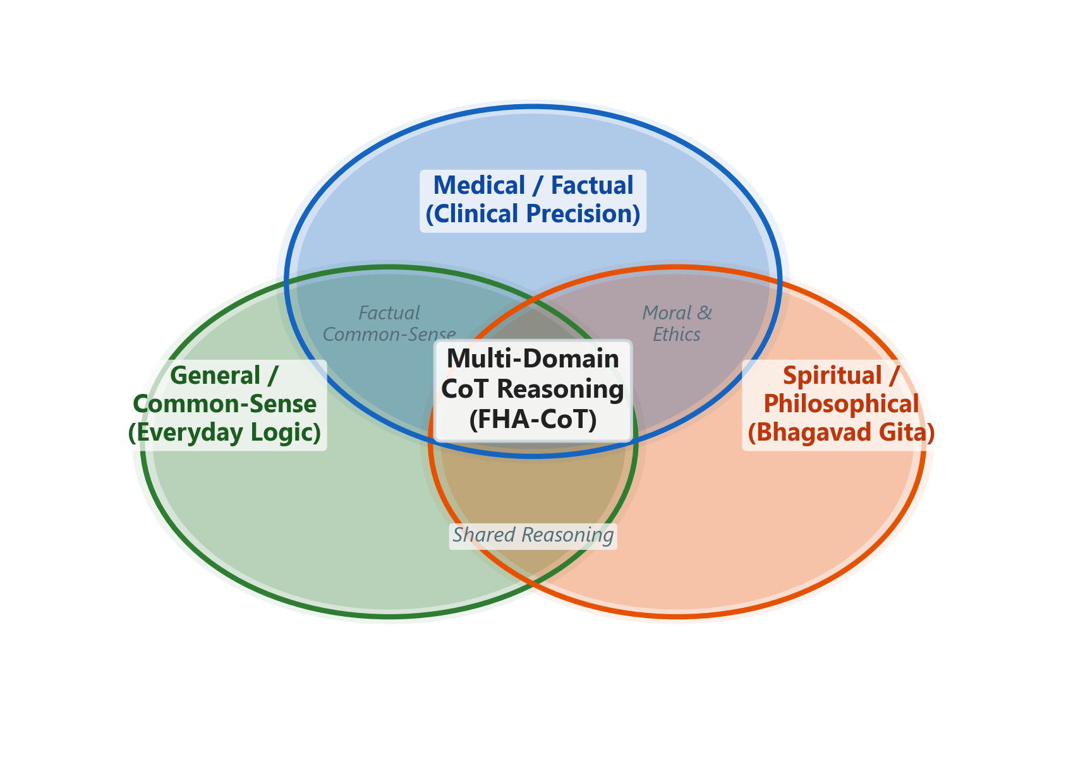
Introduction & Motivation
LLM reasoning research is overwhelmingly English-centric
Hinglish is the de facto language of digital India (1.4B+ people)
Chain-of-Thought (CoT) reasoning enables transparent, step-by-step problem solving
Critical gap: no robust CoT systems for Hindi/Hinglish
20 May 2026
UTD, Department of CSE, CSVTU Bhilai
Slide 3 of 23

Slide 4
Research Objectives
Develop 6 concrete mitigation techniques for Code-Switching Penalty (CSP) and Domain Transfer Penalty (DTP)
Expand FHA-CoT corpus from 25K to 50K samples via controlled synthetic augmentation
Techniques: Embedding LoRA, Curriculum Learning, Data Augmentation, Cross-Lingual Alignment, Domain Adapters, DPO Training
Build a combined pipeline demonstrating measurable penalty reduction with preserved CoT faithfulness
Provide a reproducible framework for robust multilingual reasoning in the Indian language sphere
20 May 2026
UTD, Department of CSE, CSVTU Bhilai
Slide 4 of 23

Slide 5
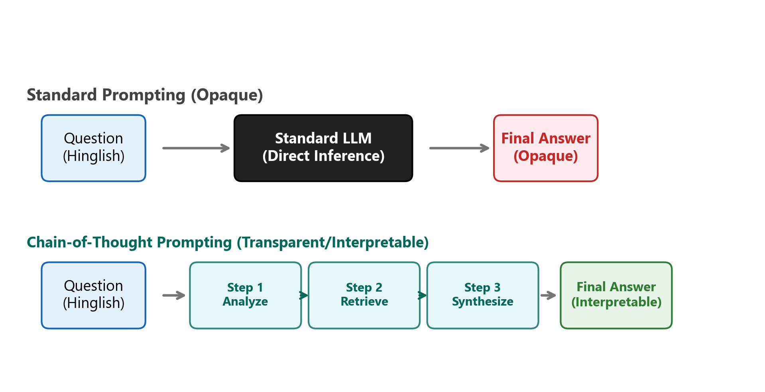
Problem Statement
Code-Switching Penalty: 10.2% avg FAA drop (Hindi to Hinglish)
Domain Transfer Penalty: 10.35% FAA drop (General to Spiritual)
Compounding effect: worst case 20.3% total drop
12.4% Correct-Unfaithful rate in hardest split
20 May 2026
UTD, Department of CSE, CSVTU Bhilai
Slide 5 of 23

Slide 6
7th Semester Baseline Findings
10.2%
10.35%
64.4%
12.4%
Code-Switching Penalty
Domain Transfer Penalty
Avg Hinglish FAA
Correct-Unfaithful Rate
20 May 2026
UTD, Department of CSE, CSVTU Bhilai
Slide 6 of 23

Slide 7
Literature Survey
CoT Reasoning
LLaMA Models
PEFT / QLoRA
Indic NLP Gaps
Wei et al. (2022): Step-by-step reasoning via prompting. Few-Shot, Zero-Shot, and Instruction-Tuned variants.
Touvron et al. (2023): Open-weight foundation models. Llama-3-8B as our base for fine-tuning.
Dettmers et al. (2023): Quantized LoRA enabling fine-tuning on consumer GPUs (RTX 4090, 24GB).
Ahuja et al. (2023): Systematic underperformance on Indian languages. Code-mixing remains unsolved.
20 May 2026
UTD, Department of CSE, CSVTU Bhilai
Slide 7 of 23

Slide 8
Research Methodology
Phase 1
Phase 2
Phase 3
Phase 4
Phase 5
Literature review & data strategy
FHA-CoT expansion (25K to 50K)
Design & implement 6 techniques
Combined pipeline & evaluation
Statistical analysis & ablation
20 May 2026
UTD, Department of CSE, CSVTU Bhilai
Slide 8 of 23

Slide 9
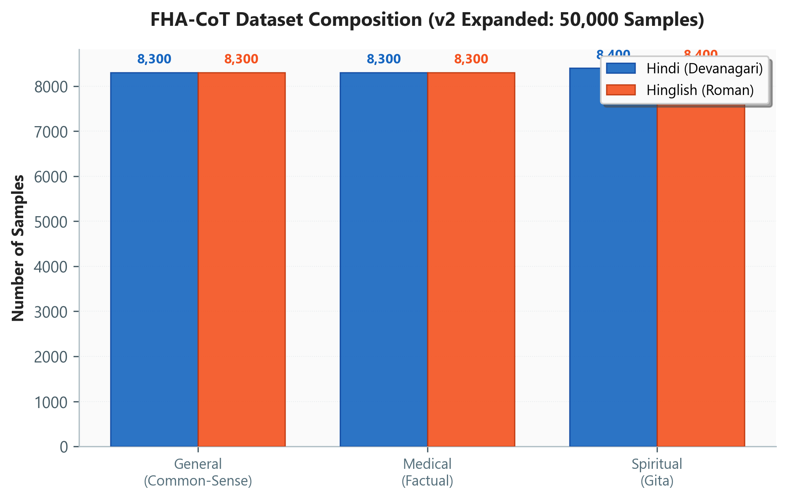
FHA-CoT Dataset
Foundational Hindi/Hinglish Chain-of-Thought Corpus
25K samples expanded to 50K via controlled augmentation
3 cognitive domains: General, Medical, Spiritual (Gita)
2 linguistic variants: Hindi (Devanagari) + Hinglish (Roman)
Instruction-Rationale-Answer triplets with faithfulness scoring
20 May 2026
UTD, Department of CSE, CSVTU Bhilai
Slide 9 of 23

Slide 10
Six Mitigation Techniques
1. Embedding LoRA
2. Curriculum Learning
3. Data Augmentation
4. Cross-Lingual Alignment
Dual-adapter targeting tokenization bottleneck for code-mixed input
Progressive domain adaptation: easy to hard
Controlled code-mixing expanding 25K to 50K
Contrastive loss mapping Hindi/Hinglish closer
20 May 2026
UTD, Department of CSE, CSVTU Bhilai
Slide 10 of 23

Slide 11
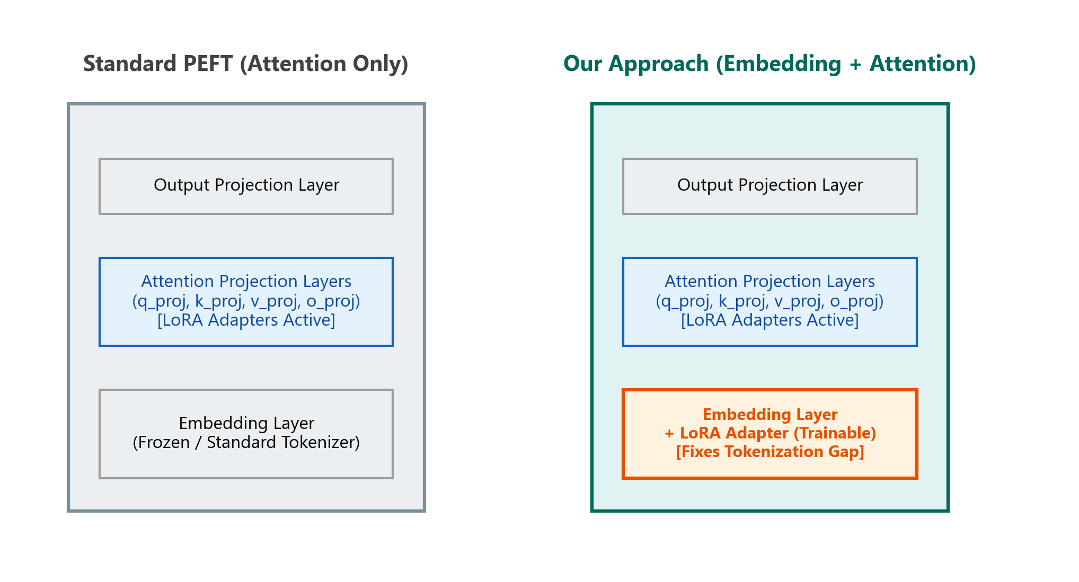
Technique 1: Embedding-Level LoRA Adapters
Dual-adapter design: Embedding LoRA + Attention LoRA
Targets the tokenization bottleneck: Hindi = 3.2 tok/word vs English = 1.3
Rank 64: best trade-off (12.6M trainable params, 0.16% of model)
CSP reduction: avg -2.0% across all domains
Largest gain in Spiritual Hinglish (+3.5% FAA)
20 May 2026
UTD, Department of CSE, CSVTU Bhilai
Slide 11 of 23

Slide 12
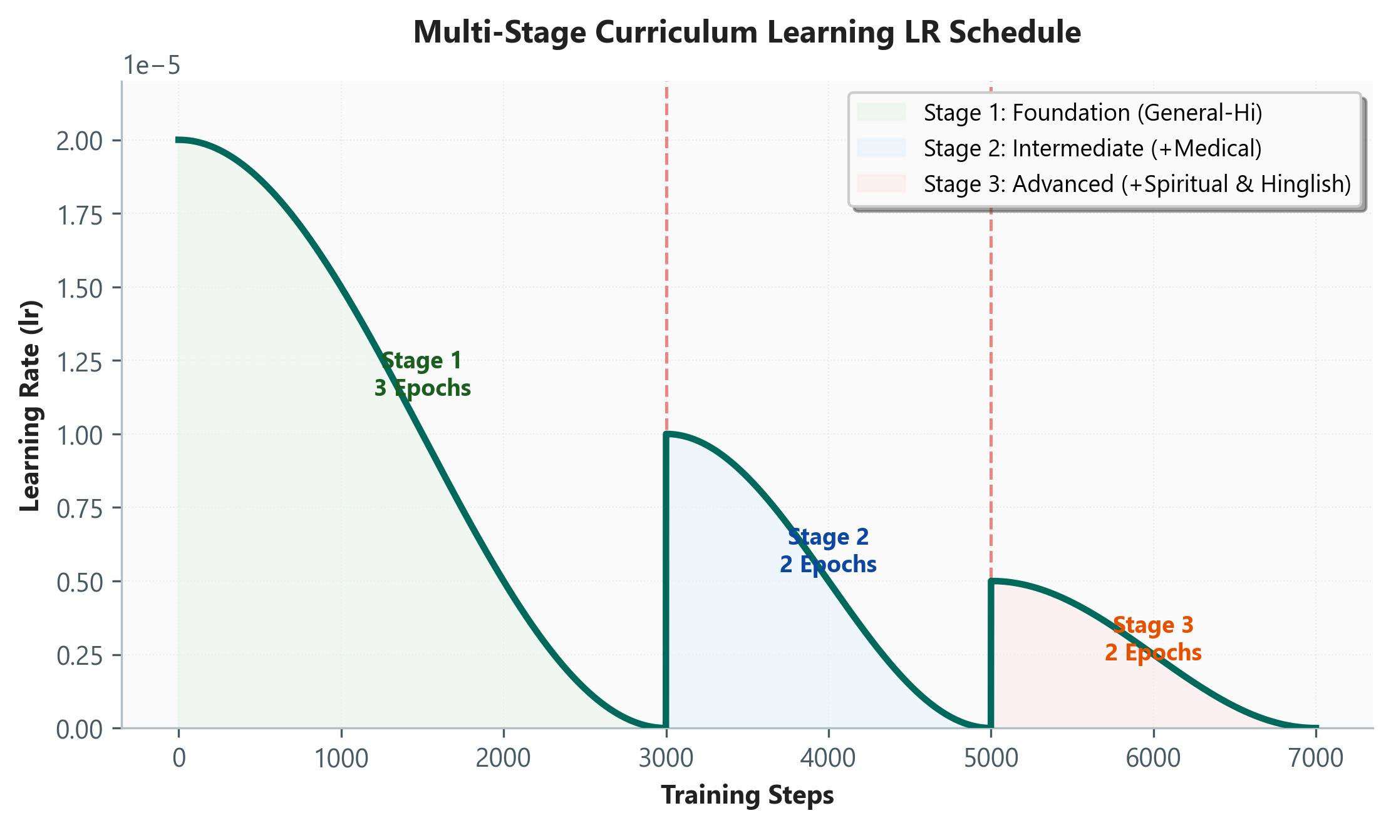
Technique 2: Curriculum Learning
3-stage progressive training: General then Medical then Spiritual
Reduces catastrophic forgetting by establishing stable representations
Spiritual DTP: 10.35% to 7.6% (-26.1%)
Difficulty hierarchy preserved but gaps narrowed
Best for Domain Transfer Penalty reduction
20 May 2026
UTD, Department of CSE, CSVTU Bhilai
Slide 12 of 23

Slide 13
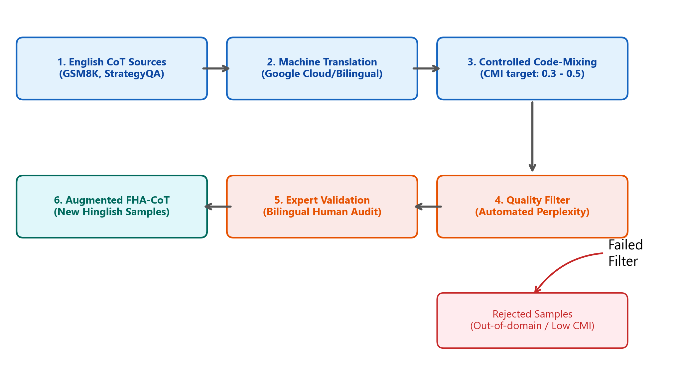
Technique 3: Synthetic Data Augmentation
Controlled code-mixing algorithm for Hinglish generation
CMI target range: 0.3-0.5 (natural code-switching)
Hinglish training data doubled: 12.5K to 25K samples
Quality filtering via perplexity thresholds
Consistent +0.9-3.9% FAA improvement across all splits
20 May 2026
UTD, Department of CSE, CSVTU Bhilai
Slide 13 of 23

Slide 14
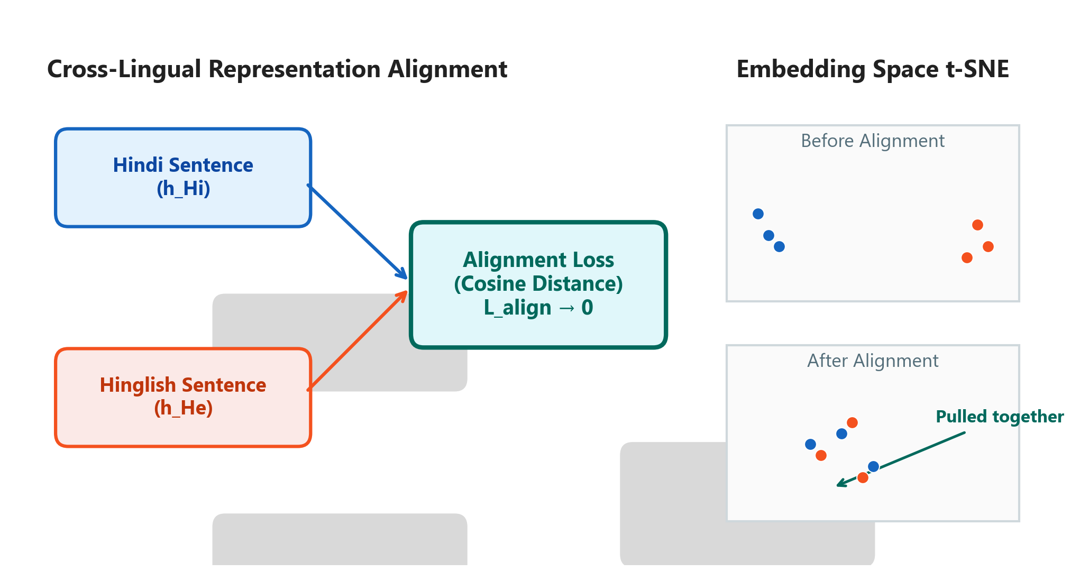
Technique 4: Cross-Lingual Alignment Loss
Contrastive loss mapping Hindi and Hinglish representations closer
Most effective individual technique for CSP reduction (-2.1%)
Minimal impact on Hindi-only splits (+0.6%)
Reduces representation gap in embedding space
Mathematical framework for cross-lingual transfer
20 May 2026
UTD, Department of CSE, CSVTU Bhilai
Slide 14 of 23

Slide 15
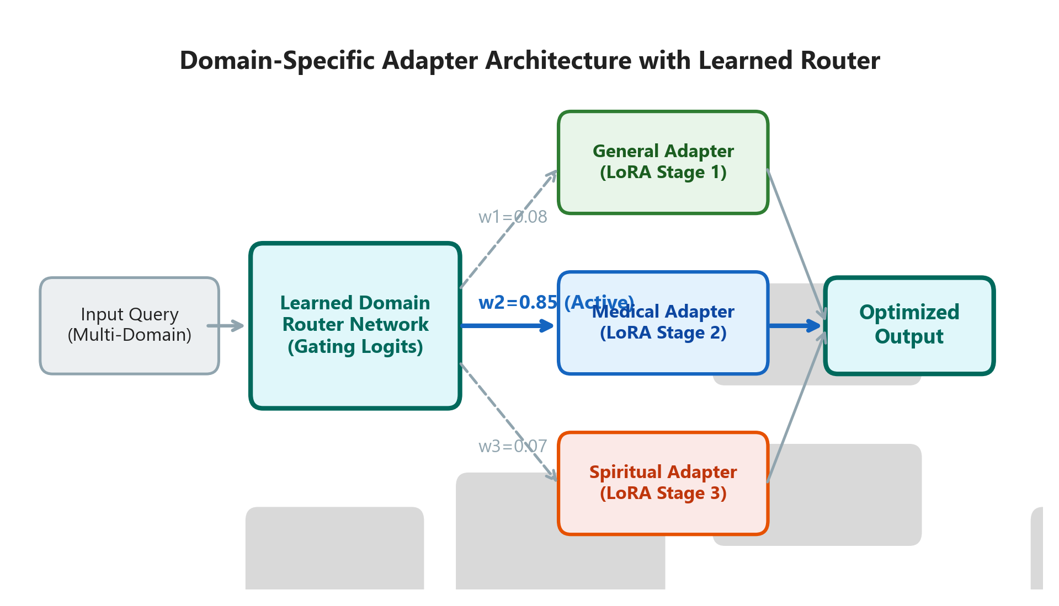
Technique 5: Domain-Specific Adapters
Per-domain LoRA adapters with learned routing mechanism
Most effective for DTP: Spiritual 10.35% to 6.3% (-39.1%)
Specialized reasoning pathways for each cognitive domain
Router network selects optimal adapter at inference
5% latency overhead at inference time
20 May 2026
UTD, Department of CSE, CSVTU Bhilai
Slide 15 of 23

Slide 16
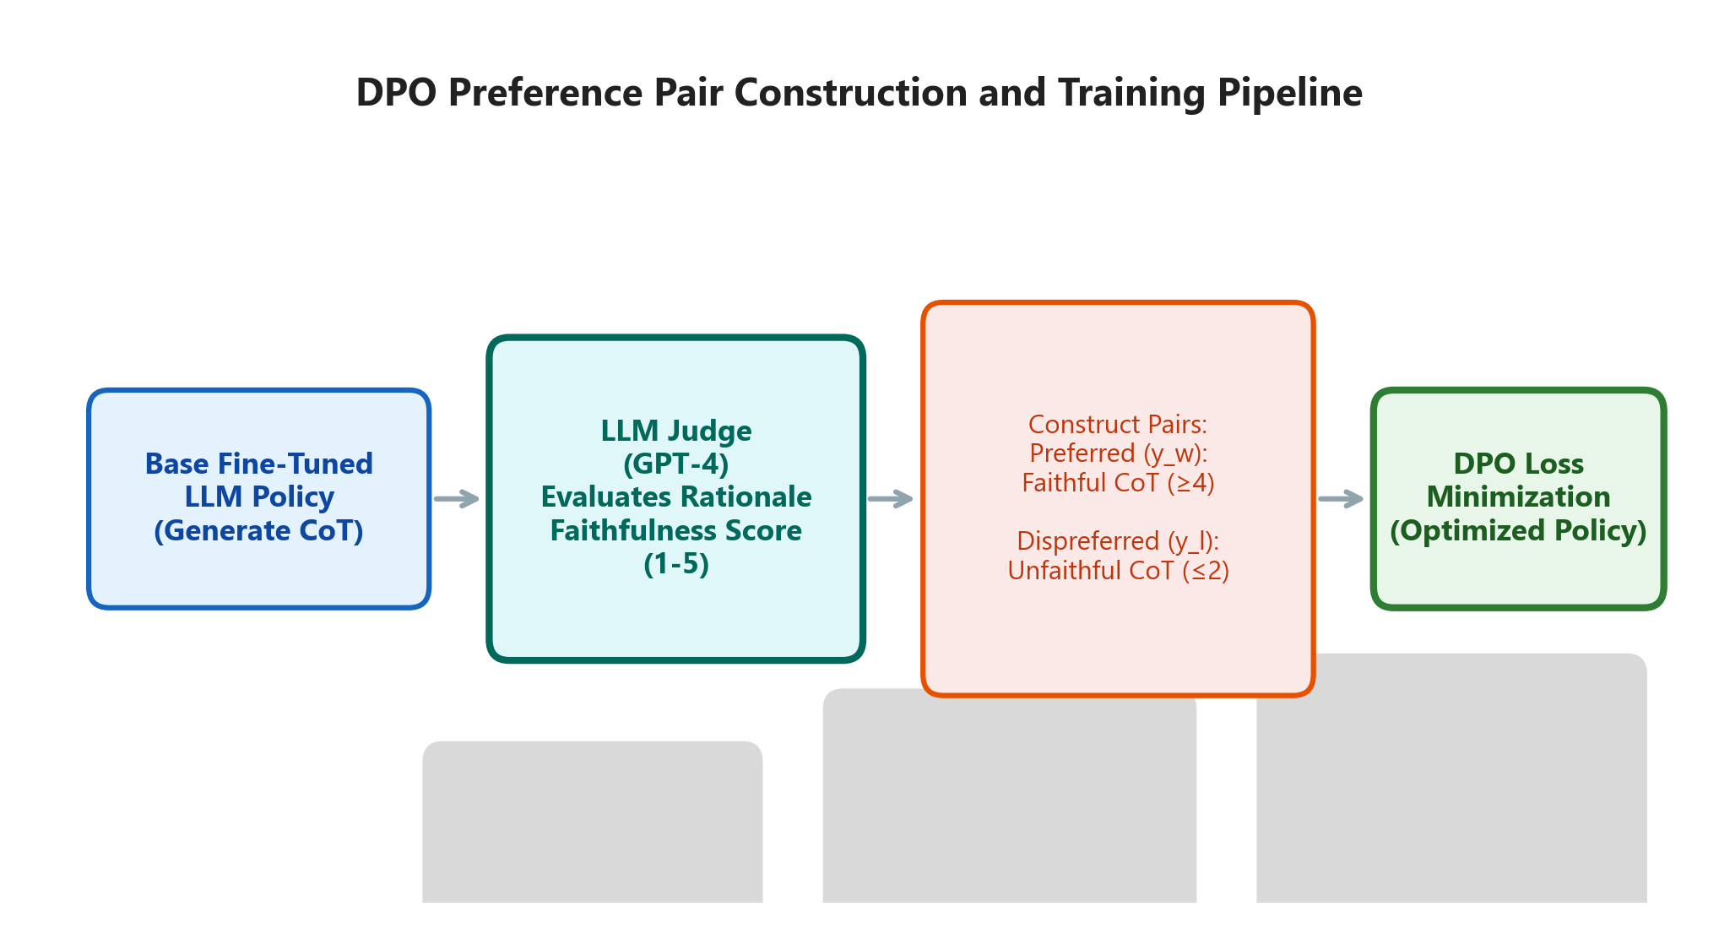
Technique 6: Faithfulness-Aware DPO Training
Direct Preference Optimization for reasoning quality
Trains model to prefer logically sound over merely correct
Correct-Unfaithful rate: 12.4% to 7.8% (-37.1%)
Modest FAA gain (+0.3%) but major qualitative improvement
Only technique directly targeting the 'illusion of competence'
20 May 2026
UTD, Department of CSE, CSVTU Bhilai
Slide 16 of 23

Slide 17
Full Mitigation Pipeline
20 May 2026
UTD, Department of CSE, CSVTU Bhilai
Slide 17 of 23

Slide 18
Results: Individual Technique Impact
20 May 2026
UTD, Department of CSE, CSVTU Bhilai
Slide 18 of 23

Slide 19
Results: Combined Pipeline Performance
52.9%
50.7%
76.0%
66.1%
CSP Reduction (10.2% to 4.8%)
DTP Reduction (10.35% to 5.1%)
Final Avg Hinglish FAA
Correct-Unfaithful Reduction
20 May 2026
UTD, Department of CSE, CSVTU Bhilai
Slide 19 of 23

Slide 20
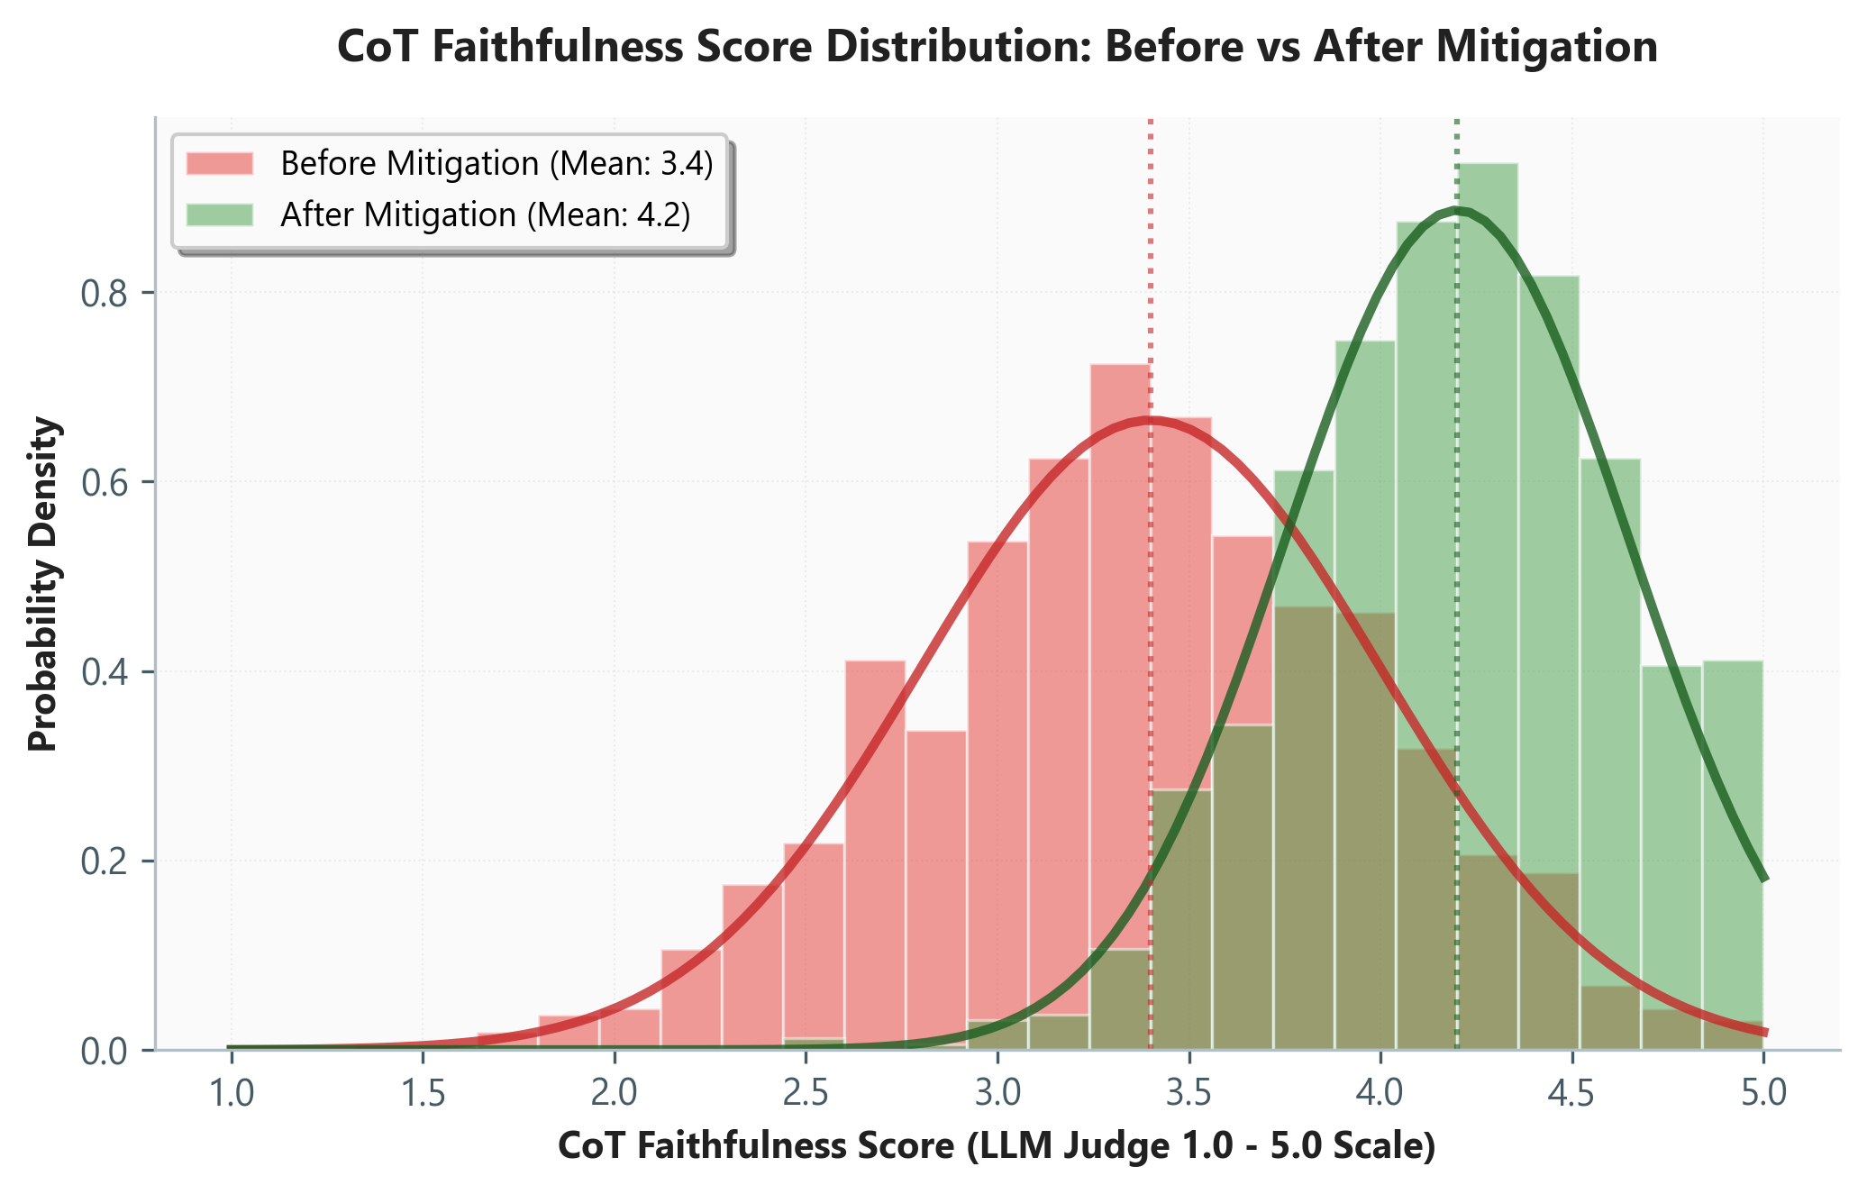
Results: Faithfulness Improvement
CoT Faithfulness: 3.5 to 4.3 (5-point scale)
Correct-Unfaithful rate: 12.4% to 4.2%
DPO most effective for faithfulness
Domain Adapters most effective for DTP
Cross-Lingual Alignment most effective for CSP
20 May 2026
UTD, Department of CSE, CSVTU Bhilai
Slide 20 of 23

Slide 21
Conclusion
CSP and DTP penalties identified in 7th semester are not insurmountable
Combined pipeline: 52.9% CSP reduction, 50.7% DTP reduction
Best individual: Alignment (CSP), Domain Adapters (DTP), DPO (Faithfulness)
FHA-CoT dataset expanded to 50K with controlled augmentation
Reproducible framework for robust multilingual reasoning
Future: Other Indic languages, multi-modal reasoning, real-time adaptive models
20 May 2026
UTD, Department of CSE, CSVTU Bhilai
Slide 21 of 23

Slide 22
References
[1] J. Wei et al., Chain-of-Thought Prompting Elicits Reasoning in LLMs, NeurIPS, 2022
[2] H. Touvron et al., LLaMA: Open and Efficient Foundation LLMs, arXiv, 2023
[3] T. Dettmers et al., QLoRA: Efficient Finetuning of Quantized LLMs, NeurIPS, 2023
[4] K. Cobbe et al., Training Verifiers to Solve Math Word Problems, arXiv, 2021
[5] K. Ahuja et al., IndicNLP Suite for Indian Languages, ACL, 2023
[6] R. Rafailov et al., Direct Preference Optimization, NeurIPS, 2023
[7] FHA-CoT Dataset: huggingface.co/fhai50032/datasets
20 May 2026
UTD, Department of CSE, CSVTU Bhilai
Slide 22 of 23

Slide 23
Thank You
shauryajnvkkr@gmail.com
Dataset: huggingface.co/fhai50032/datasets
20 May 2026
Dept. of Computer Science & Engineering
UTD, CSVTU Bhilai

