Slide 1
Data Base Management Systems and Applications Lab
Mini Project
Team Members:
R. Varshini
C. Subhalakshmi

Slide 2
Hospital Management System
Develop a database management system to manage a hospital. Assign unique IDs to the patients and store the relevant information under the same. You’ll have to add the patient’s name, personal details, contact number, disease name, and the treatment the patient is going through. You’ll also have to mention under which hospital department the patient is (such as cardiac, gastro, etc.).
After that, you should add information about the hospital’s doctors. A doctor can treat multiple patients, and he/she would have a unique ID as well. Doctors would also be classified in different departments.

Slide 3
Scope
To develop a hospital database that can insert, delete and update doctor and patient details on authorized entry.
Links the patient details to the doctor details.
Allows us to check the availability of blood.
Display doctor and patient details on entry of the specific id.

Slide 4
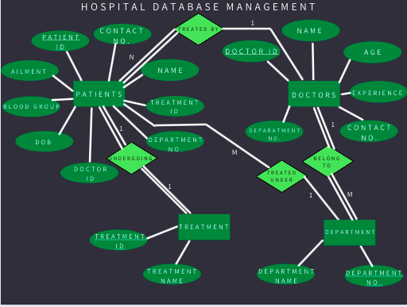
ER Diagram

Slide 5
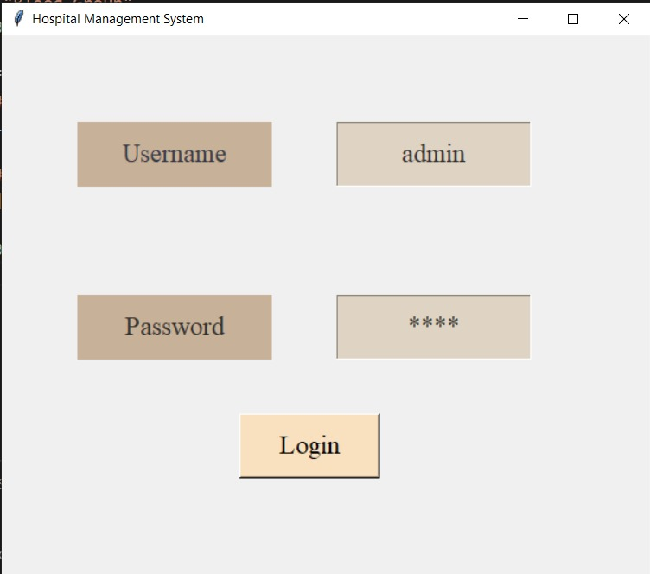
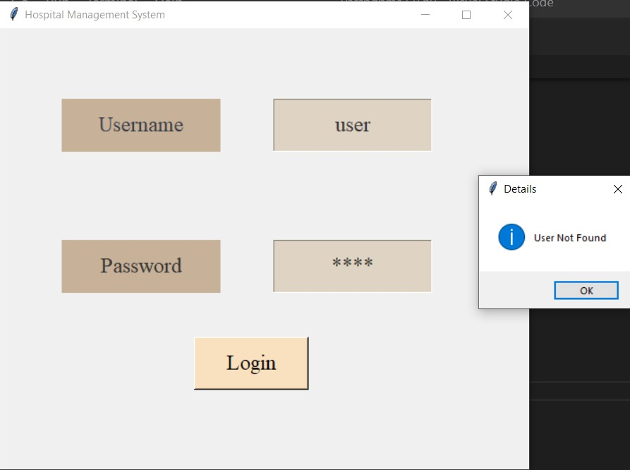
Functions in the application
Admin view
Admin can enter doctor, patient and blood availability details through this view.
User view
User can view the same details through this view.
When the user id and password is invalid, user not found error pops up in a message box.

Slide 6
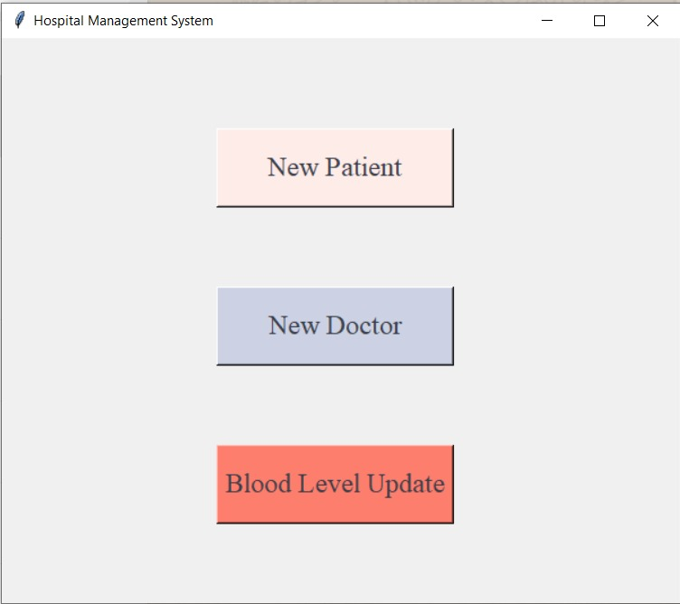
Admin View Opens To
3 Buttons that allows the admin to enter new doctor, patient and blood availability.

Slide 7
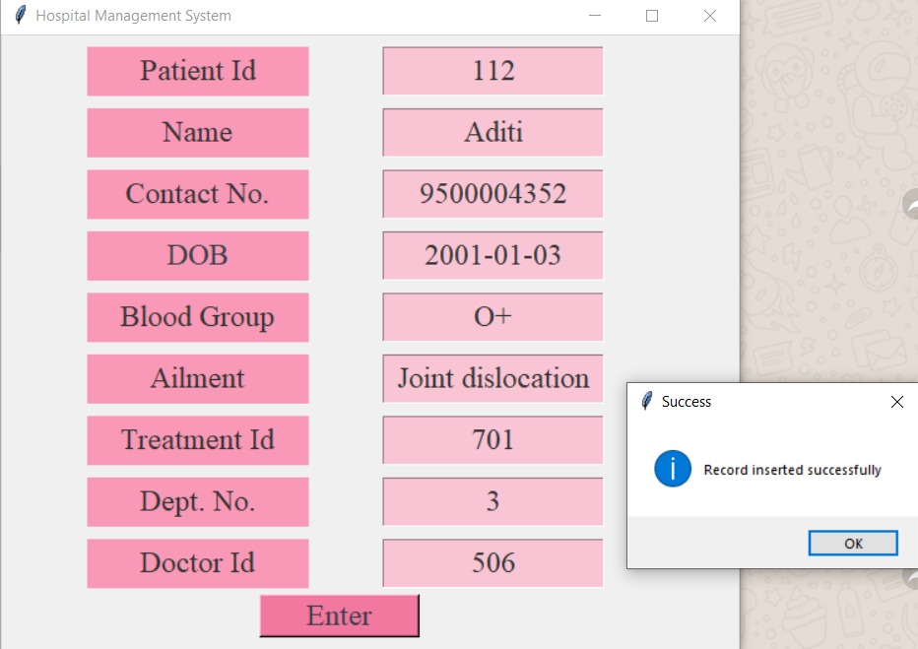
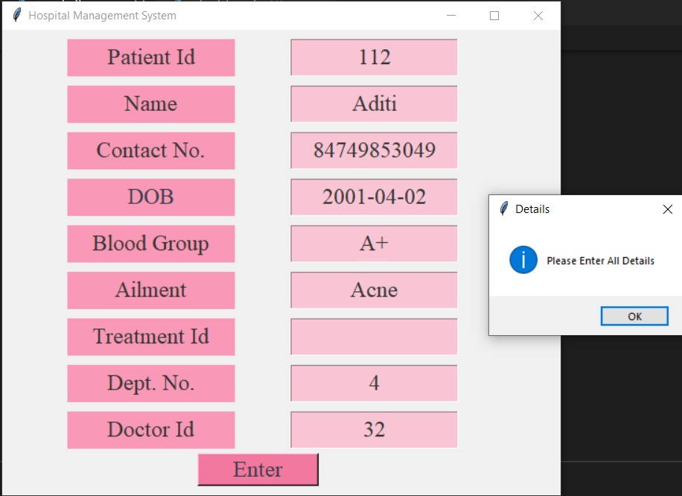
New Patient Entry
On clicking enter the given entries are entered in the table.
If the entry is successful a success messagebox pops.
If all the entries are not given error message pops.

Slide 8
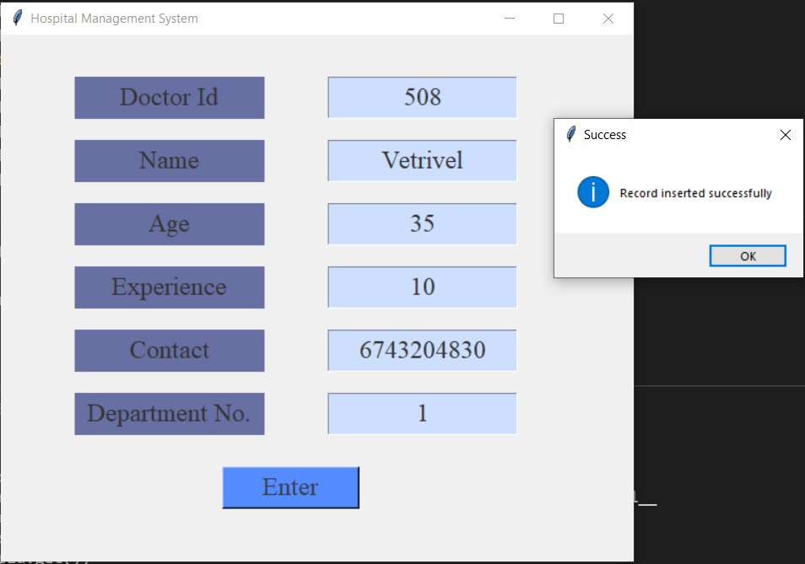
New Doctor Entry
On clicking enter the given entries about the new doctor are entered in the table.

Slide 9
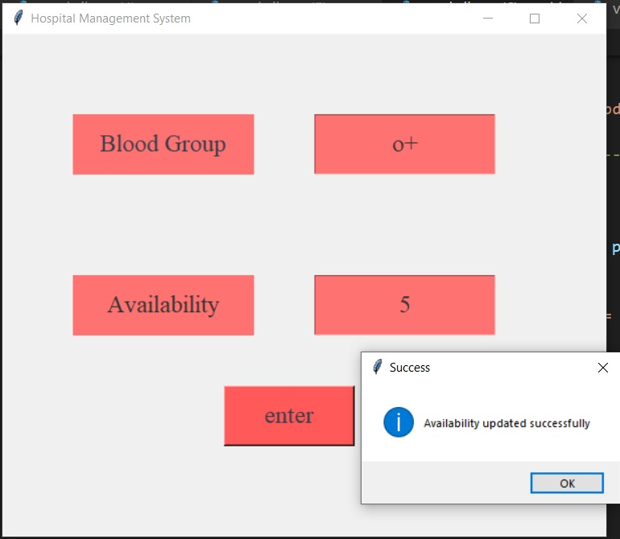
Blood Availability Update
On clicking enter the given entries about the particular blood group is updated in the table in the database.

Slide 10
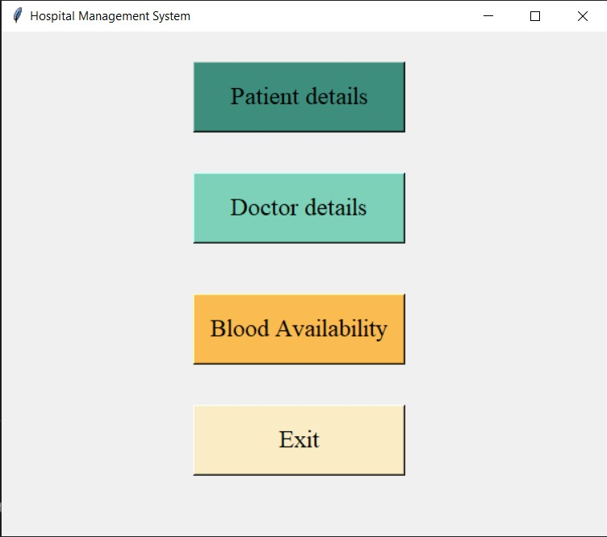
User View Opens To
4 buttons to view the details of patients, doctors and blood availability.
Exit button closes the application.

Slide 11
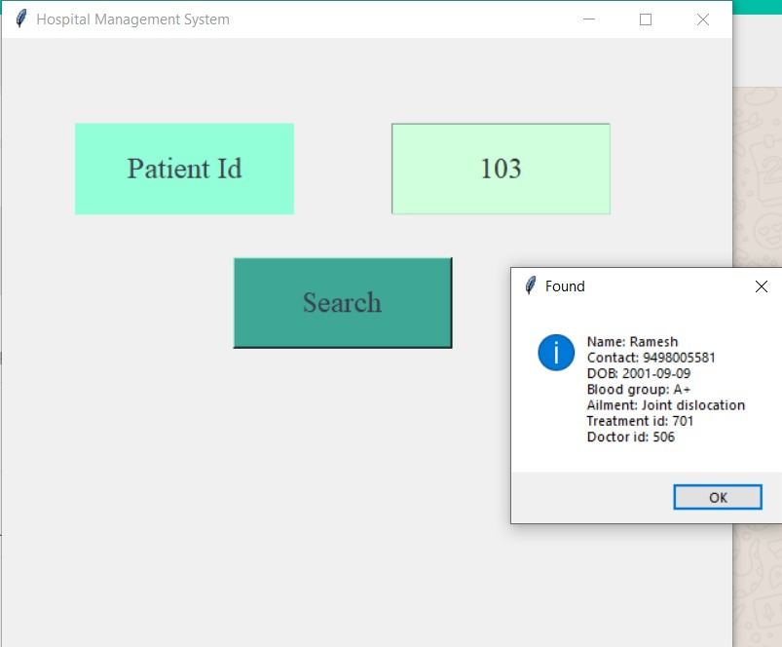
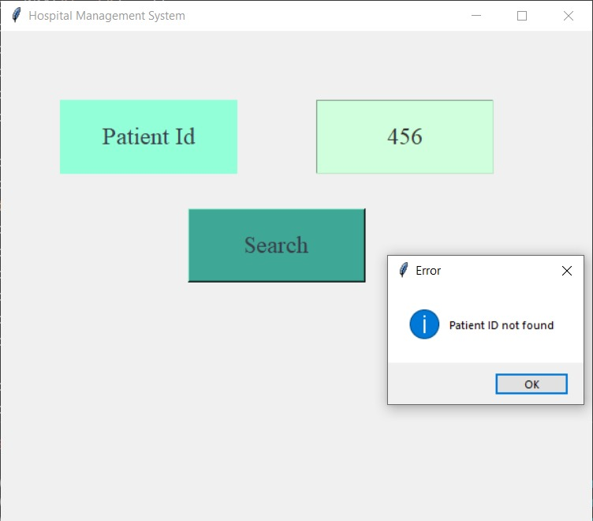
Patient Details
On entering the patient Id it displays the patient details in the messagebox.
When the entered value is an invalid patient id, user not found error messagebox pops.

Slide 12
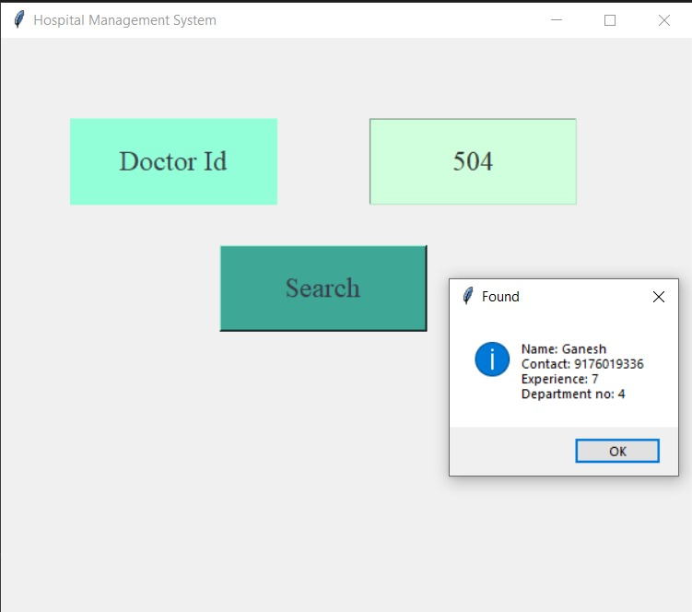
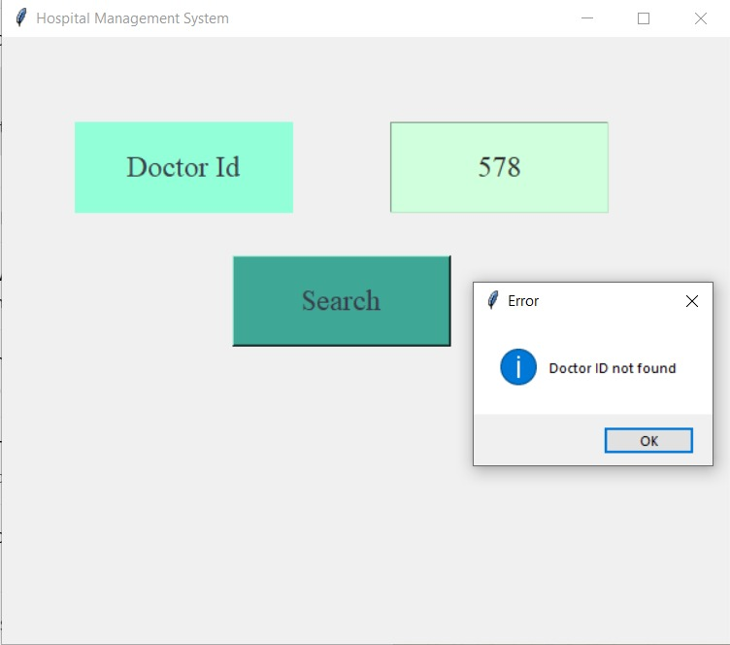
Doctor Details
On entering the doctor Id it displays the doctor details in the messagebox.
When the entered value is an invalid doctor id, user not found error messagebox pops.

Slide 13
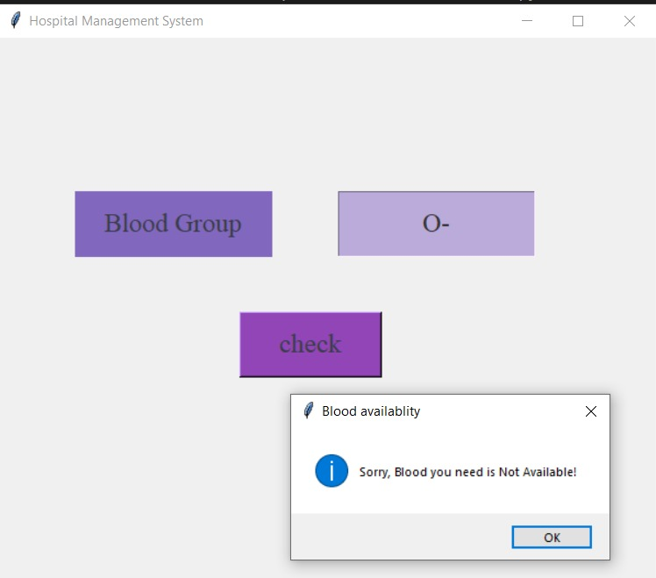
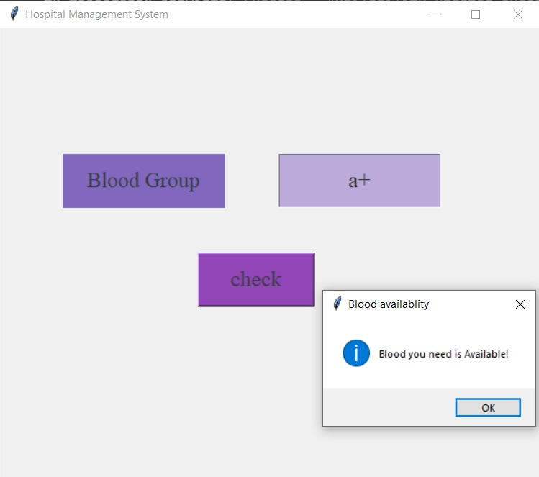
Blood Group Availability Details
On entering the blood group it displays the availability details in the messagebox.

Slide 14
Thank you

