Slide 1
PRESENTED BY : A.SUBHALAKSHMI
REG NO : 813821243052
DEPT : ARTIFICIAL INTELLIGENCE AND DATA SCIENCE
COLLEGE : SARANATHAN COLLEGE OF ENGINEERING
NM ID : subhalakshmialagappan19@gmail.com (au813821243052)

Slide 2
PROJECT TITLE
AUTISM DISORDER USING MACHINE LEARNING

Slide 3

AGENDA
PROBLEM STATEMENT
PROJECT OVERVIEW
WHO ARE THE END USERS?
YOUR SOLUTIONS AND ITS VALUE PROPOSITION
THE WOW IN YOUR SOLUTION
MODELLING
RESULTS
3/21/2024 Annual Review

Slide 4
PROBLEM STATEMENT
"Autism Spectrum Disorder (ASD) presents a multifaceted challenge, characterized by significant heterogeneity in its clinical presentation and etiology. Diagnosis remains complex and often delayed, hindering early intervention crucial for optimal outcomes. Understanding the underlying genetic, environmental, and neurological factors contributing to ASD remains elusive, impeding the development of targeted interventions. Furthermore, existing interventions vary in efficacy, and access to comprehensive support services for individuals with ASD and their families is often limited, exacerbating societal and economic burdens. Addressing these challenges requires interdisciplinary research efforts integrating clinical, genetic, neurobiological, and socio-environmental perspectives to improve early detection, enhance understanding of ASD's complexity, develop personalized interventions, and promote inclusive support systems for individuals with ASD and their families."

Slide 5
PROJECT OVERVIEW
The project aims to leverage machine learning algorithms, specifically Support Vector Machine (SVM) and Logistic Regression, to address key challenges in Autism Spectrum Disorder (ASD) research and intervention. By harnessing the power of advanced computational techniques, our initiative seeks to enhance ASD diagnosis, understand underlying etiological factors, and develop personalized interventions tailored to the unique needs of individuals on the spectrum. Through the integration of multidisciplinary data sources encompassing clinical assessments, genetic markers, neuroimaging data, and environmental influences, we aim to create predictive models capable of accurately identifying ASD, predicting treatment response, and uncovering intricate patterns within the disorder. SVM and Logistic Regression algorithms serve as core components in our analytical pipeline, offering robust frameworks for classification and regression tasks essential in ASD research. SVM, with its ability to effectively classify complex datasets by identifying optimal decision boundaries, holds promise in discerning subtle patterns inherent in ASD characteristics. Logistic Regression, on the other hand, provides valuable insights into the probability of ASD occurrence based on a combination of predictor variables, facilitating risk assessment and diagnostic decision-making. By employing these machine learning approaches, our project endeavors to advance the field of ASD research, ultimately leading to improved diagnostic accuracy, personalized interventions, and enhanced support for individuals with ASD and their families.

Slide 6

WHO ARE THE END USERS?
Clinicians and healthcare professionals specializing in neurodevelopmental disorders.
Parents, caregivers, and families of individuals with autism spectrum disorder (ASD).
Individuals diagnosed with ASD, including children, adolescents, and adults.
Educators and special education professionals working with individuals with ASD in schools and educational settings. Researchers and scientists studying ASD etiology, diagnosis, and interventions.
Advocacy groups and community organizations dedicated to supporting individuals with ASD and their families.
Government agencies and policymakers responsible for funding, policy development, and resource allocation for ASD-related initiatives.
Technology developers creating assistive technologies and digital solutions to support individuals with ASD in communication, learning, and daily activities.

Slide 7
YOUR SOLUTION AND ITS VALUE PROPOSITION
The solution to the provided problem statement involves several steps:
Data Acquisition and Preprocessing
Model Training
Model Evaluation
Fine Tuning
Testing and Deployment
Documentation and Maintenance
Value Proposition:
Accuracy and Precision
Efficiency and Automation
Enhanced Quality of Life
Social and Cultural Inclusion

Slide 8
THE WOW IN YOUR SOLUTION
Accuracy: With the utilization of machine learning algorithms such as Support Vector Machine (SVM) and Logistic Regression, coupled with comprehensive datasets on autism spectrum disorder (ASD) features, you can achieve high accuracy in ASD diagnosis and prediction.
Efficiency: SVM and Logistic Regression offer efficient algorithms for ASD classification, with manageable computational requirements even on standard hardware configurations. Preprocessing techniques such as feature selection and dimensionality reduction further enhance efficiency.
Flexibility: SVM and Logistic Regression models provide flexibility in handling various types of ASD data, including clinical assessments, genetic markers, and behavioral observations. They allow for experimentation with different feature sets and model parameters to optimize performance for different ASD subtypes and populations.
Scalability: SVM and Logistic Regression models are scalable to handle large datasets containing diverse ASD features. Additionally, advancements in parallel processing techniques and distributed computing frameworks enable scalability for processing extensive ASD datasets across multiple computing resources.
3/21/2024 Annual Review

Slide 9
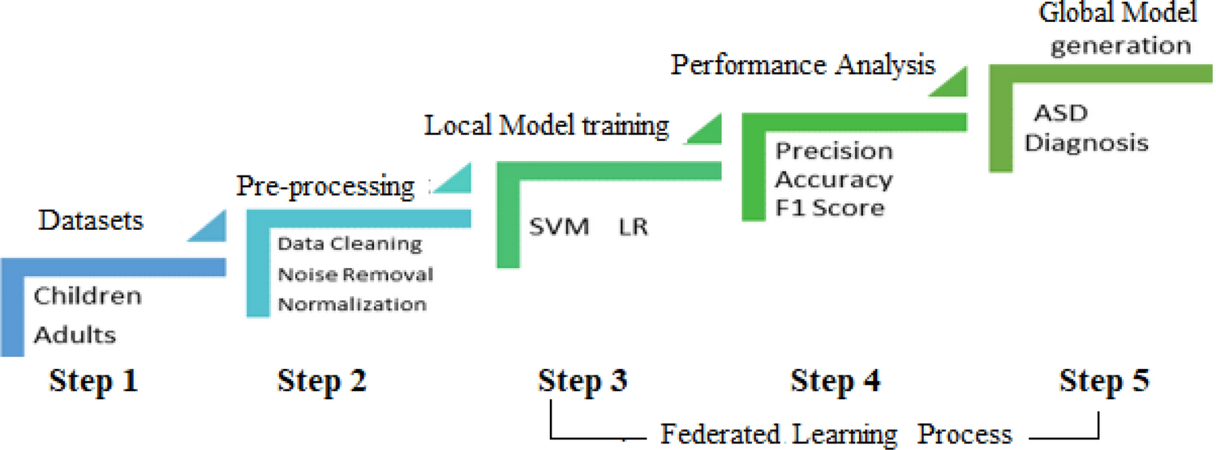
MODELLING

Slide 10
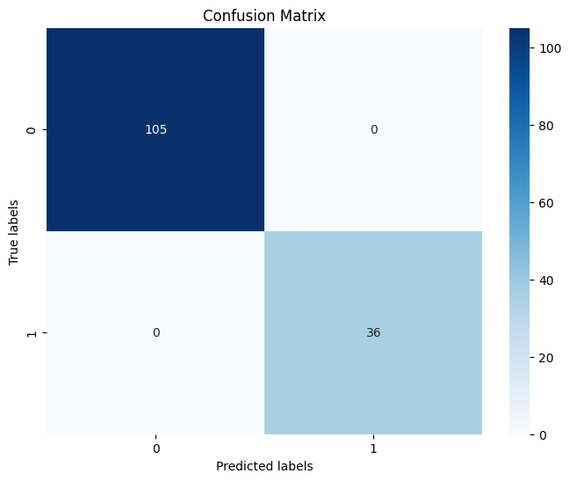
RESULTS
Logistic Regression() :
Training Accuracy : 1.0
Validation Accuracy : 1.0
SVC() :
Training Accuracy : 1.0
Validation Accuracy : 0.9952380952380953
https://github.com/subha1912/TNSDC_Generative_AI.git

