Slide 1

House Price Prediction Model

Slide 2
Group Members:
Muhammad Subhan Khokhar (f2022332081)
Areeba Tariq (f2022332037)
Farzam Shazad (f2022332043)

Slide 3

Introduction
Accurately predicting house prices is crucial for informed decision-making in the real estate market. Our predictive model helps advanced analytics to provide reliable estimates, empowering you to make data-driven investments and strategic planning decisions.

Slide 4
Data Collection and Preprocessing
Data Sources
Data Cleaning
Feature Selection
We gather data from multiple reliable sources, including real estate listings, census records, and economic indicators, to ensure a comprehensive dataset.
We clean and preprocess the data, addressing missing values, to ensure the integrity of our model inputs.
We carefully select the most relevant features, such as location, and square footage to optimize the predictive power of our model.

Slide 5
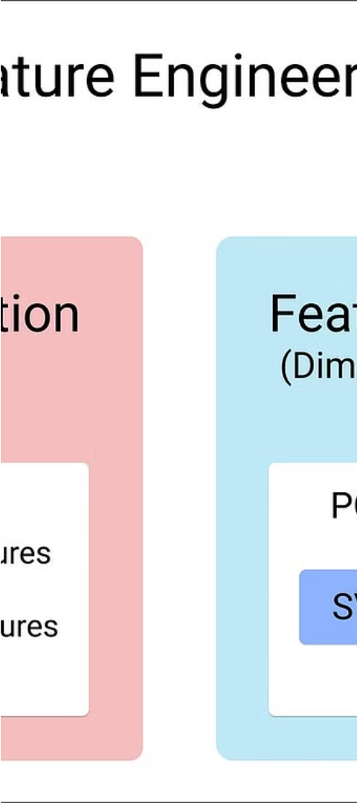
Feature Engineering
1
Feature Transformation
We apply advanced techniques, such as handling non-linearity and manages missing values, to enhance the predictive capability of our features.
2
Feature Interaction
We explore the interactions between features, unlocking hidden relationships that can further improve the model's accuracy.
3
Feature Selection
We employ feature selection algorithms to identify the most influential variables, streamlining the model and improving its performance.

Slide 6
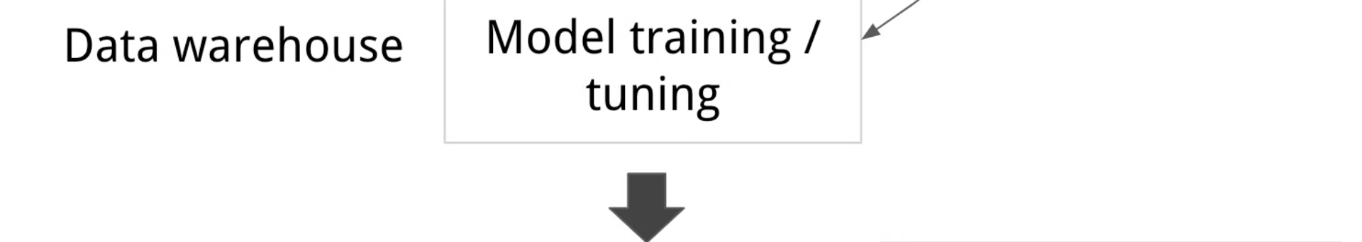
Model Selection and Training
1
Regression Algorithms
2
Hyperparameter Tuning
3
Cross-Validation
To prevent overfitting, we employ rigorous cross-validation techniques to assess the model's generalization capability on unseen data.
We evaluate a range of regression algorithms, including linear regression, decision trees, and random forests, to determine the optimal model for our use case.
We carefully tune the hyperparameters of the selected model to ensure it achieves the best possible performance on the training data.

Slide 7
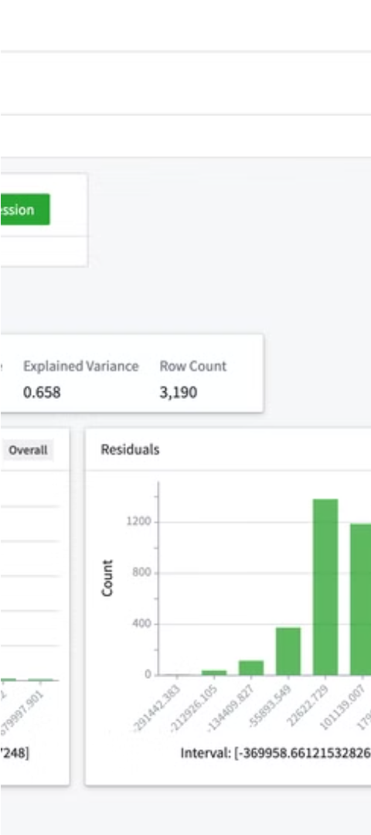
Model Evaluation
Accuracy Metrics
Robustness Testing
We measure the model's performance using mean squared error, to ensure it meets our target standards.
We put the model through extensive robustness testing, including sensitivity analyses and stress tests, to ensure it can handle a wide range of market conditions.
Comparative Analysis
We benchmark our model's performance against industry standards and other predictive models to validate its competitiveness and identify areas for further improvement.

Slide 8




Limitations and Future Improvements
Data Limitations
Model Enhancements
Scalability Challenges
We acknowledge the potential limitations of our dataset and are committed to continuously expanding and refining our data sources.
We are actively exploring advanced techniques, such as deep learning and ensemble methods, to further improve the model's predictive accuracy.
As the demand for our solution grows, we will address scalability challenges to ensure seamless performance and reliability for our users.

Slide 9
Conclusion
Accurate Predictions
Our house price prediction model provides reliable estimates, empowering you to make informed decisions.
Continuous Improvement
We are committed to ongoing enhancements and refinements, ensuring our solution stays at the forefront of industry standards.
Seamless Integration
Our user-friendly API and cloud-based deployment enable seamless integration with your existing systems and workflows.

