Slide 1
Lending Club Case Study
Group members -
Subhabrata ghosh
Mohammed Tarique Jamal

Slide 2
Background – Lending Club Case Study
Background
Lending club is the largest peer-to-peer marketplace connecting borrowers with lenders. Borrowers apply through an online platform where they are assigned an internal score. Lenders decide 1) whether to lend and 2) the terms of loan such as interest rate, monthly instalment, tenure etc.
Some popular products are credit card loans, debt consolidation loans, house loans, car loans etc.
Business Objective
To identify variables which are strong indicators of default and potentially use the insights in approval/rejection decision making.

Slide 3
The problem Statement
Company
Context
Problem Statement
Lending Club is the largest
online loan marketplace,
facilitating personal loans,
business loans, and
financing of medical
procedures.
Borrowers can easily access
lower interest rate loans
through a fast online
interface.
Lending Club wants to understand the driving factors behind loan default, i.e. the driver variables which are strong indicators of default.
The company can utilize this
knowledge for its portfolio
and risk assessment.
As a data scientist working for Lending Club analyze the dataset containing
information about past loan applicants using EDA to understand how consumer attributes and loan attributes influence the tendency of default

Slide 4
Analysis Approach
Cleaning Data
Drop columns with null values, all random values or single
Check distributions and frequencies of various numerical and categorical variables
Segmented Univariate Analysis
Analyze variables against segments of other variables
Bivariate Analysis
Do correlation analysis Check how two variables affect each other or a third variable
Summarize Result
Univariate Analysis
Convert values to proper int ,float , date representations
Create Derived Variables
Create derived variables
Analyze joint distributions
Publish insights and observations

Slide 5
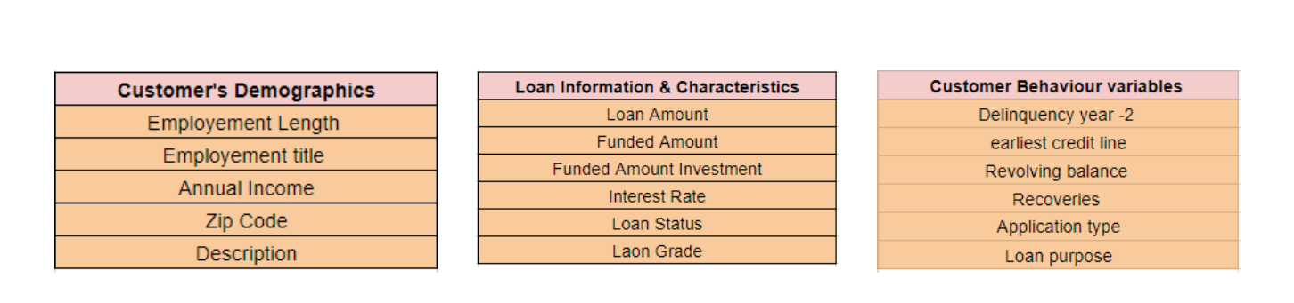
Data Understanding
Types of variables
• Customer (applicant) demographic
• Loan related information & characteristics
• Customer behavior (if the loan is granted)

Slide 6
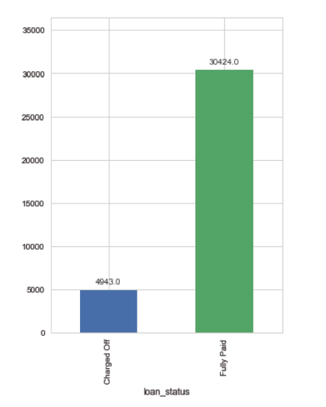
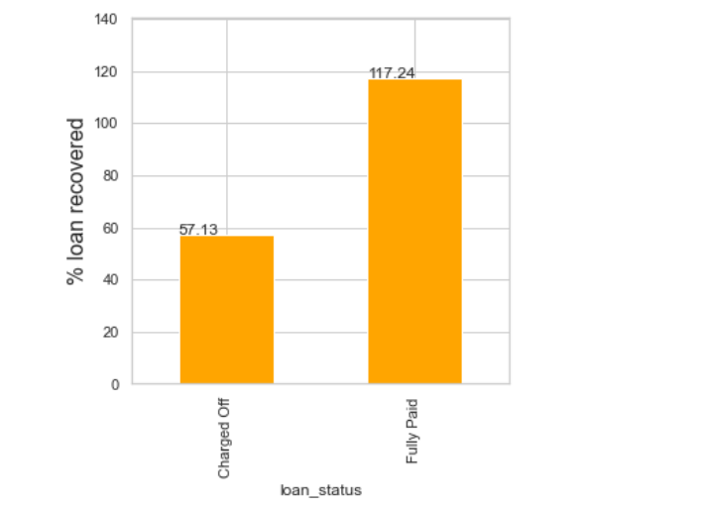
Analysis – Overall Loan Status
Approximately 14% of the loans are defaulted
Lending club recovers only 57% of the loan amount when it is defaulted.

Slide 7
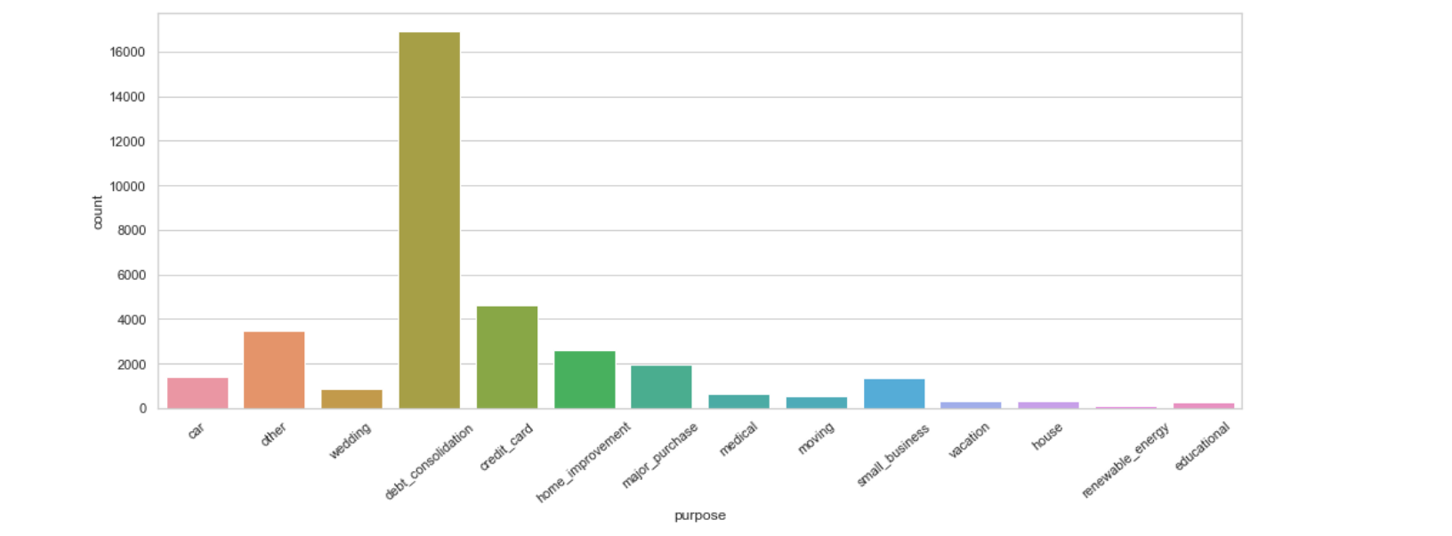
Analysis – Loan Understanding -Purpose
Maximum loans are taken for debt consolidation followed by credit card, Home improvement , Major purchase.

Slide 8
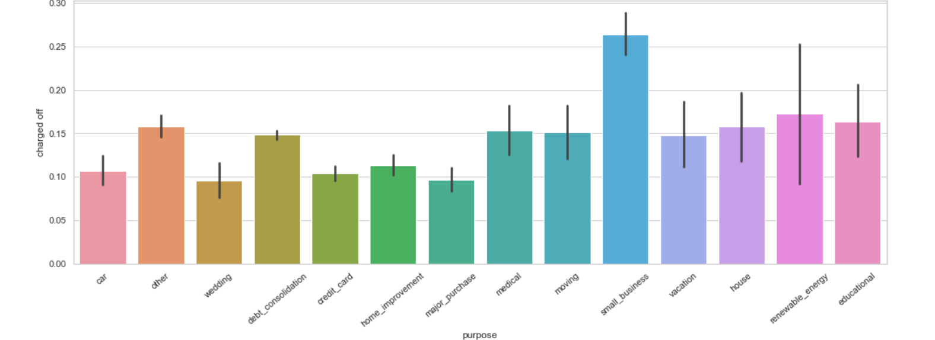
Defaults by Loan Purpose
More than a quarter of loans taken for the purpose of running a small business see defaults.

Slide 9
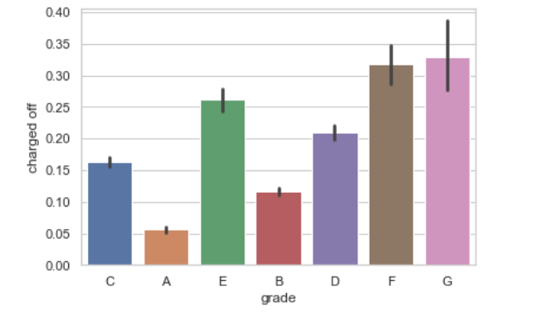
Defaults By Grade & Sub Grade
The higher default rate happens for the lower grades. So, the grading system is working.

Slide 10
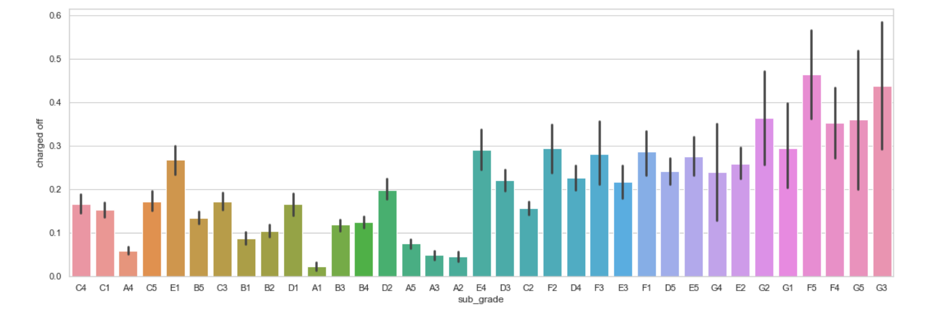
Defaults By Grade & Sub Grade
The higher default rate for the lower sub grade. The sub grading system is also working fine.

Slide 11
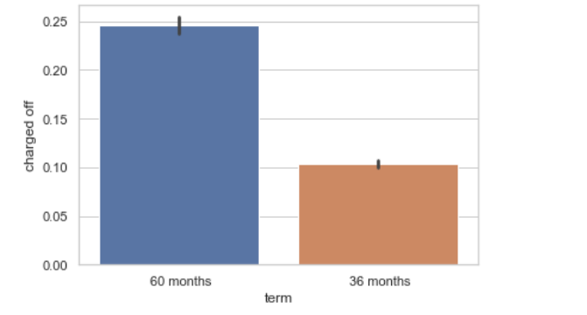
Defaults By Term
The long term loans are more likely to get defaulted. The chances are more than double for the 60 months loans. So, Lending club should focus on giving short term loans.

Slide 12
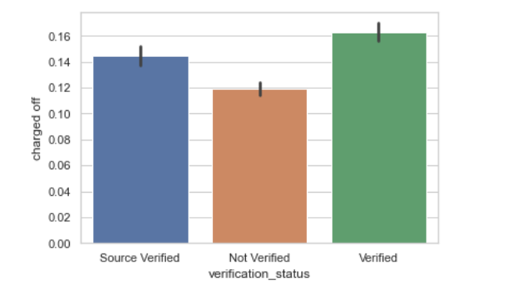
Defaults By Verification
Most loan defaults happen for the verified loans. The verification system needs to be improved.

Slide 13
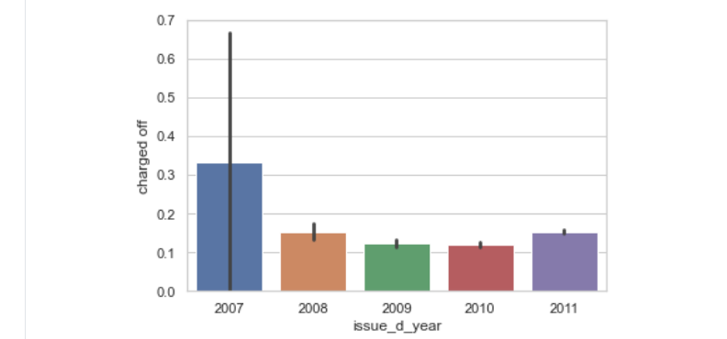
Defaults By Loan Year
Most bad loans get approved in 2007.
he default loans were decreasing from 2008 to 2010. However there is an increase in the year 2011.

Slide 14
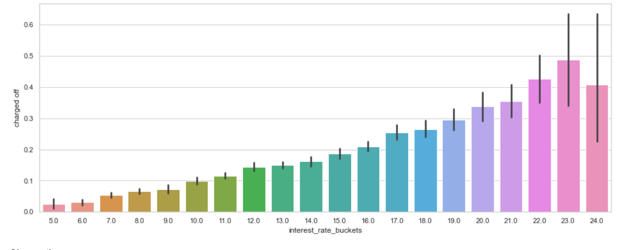
Defaults By Interest Rate
Percentage of Defaults increases monotonically with higher interest rates. At rates of 19% and above, more than 33% of loans are Charged Off.

Slide 15
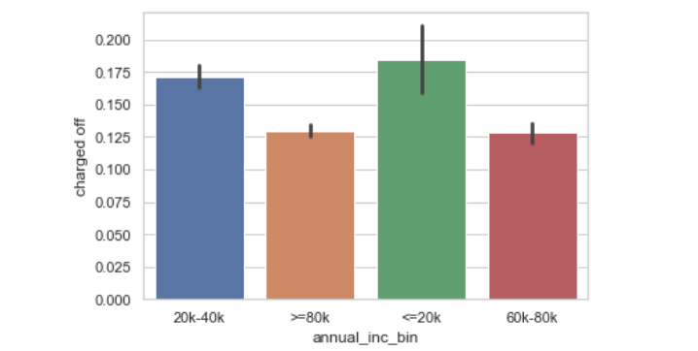
Defaults By Borrower’s Income
Borrowers having annual income less than 20000 default on their loans at much higher rates.
Loan default decreases with higher annual income.

Slide 16
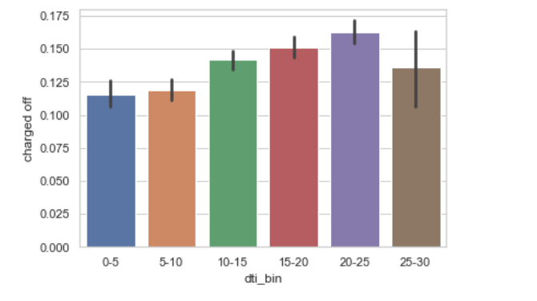
Defaults By Debt to Income Ratio
Percentage of default rises with dti ratio.
As the dti ratio rises above 20, the loans become risky.

Slide 17
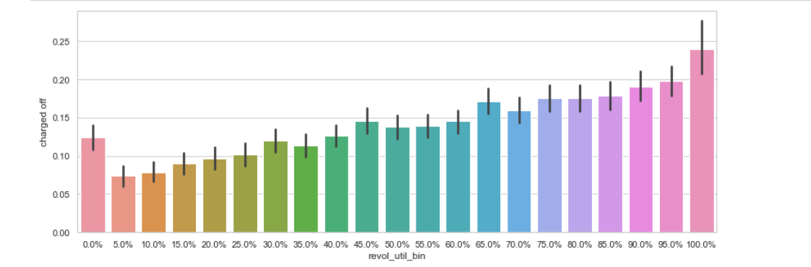
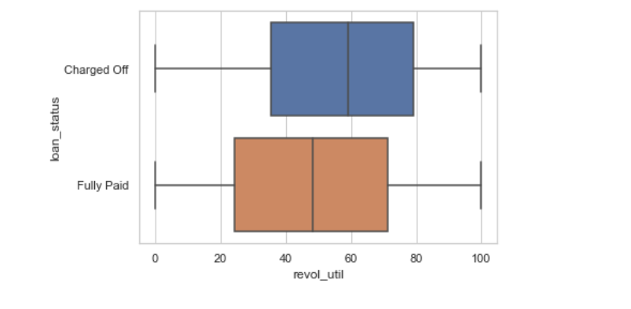
Defaults By Revolving Line Util Rate
People with high utilization of Revolving Line of Credit at the time of taking loan default more.
Loans with utilization > 75% are risky.

Slide 18
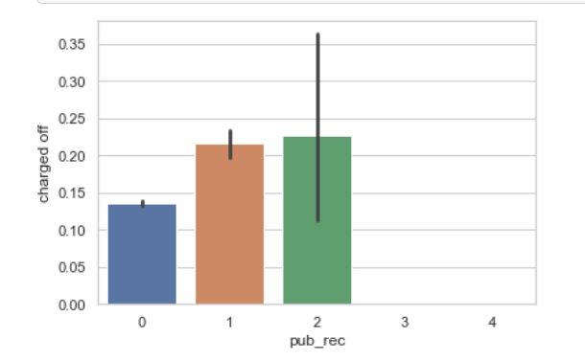
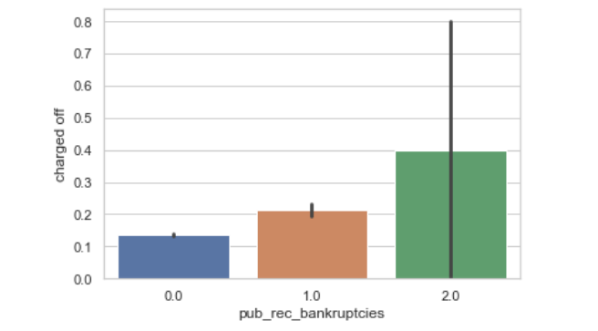
Defaults by prior bad record
94% have no Public derogatory records.
Having even 1 derogatory record increases the chances of Charge Off significantly
96% have no bankruptcy record.
Having even 1 bankruptcy record increases the chances of Charge Off significantly.
Public Derogatory Record and Public Bankruptcy records have 83% correlation. We can use any one.

Slide 19
Recommendation(s)
Stop – approving loans where amount/income is higher than 30%
Reduce – number of approvals where purpose is small business
Stop – approving high-value loans when revolving line utilization rate greater than 75%
Stop – approving loans to people with prior bad record. Or at least stop approving high-value loans
Start – charging higher interest rates for loans with dti greater than 20

Slide 20
Appendix - Correlations
Loan Amount is highly correlated (positive) with the installments , interest rates
Debt-to-Income Ratio is high correlated (positive) to loan issue year and vice-versa.
Interest rate is negatively correlated to total account
Public record is high correlated (positive) to public record bankruptcies.

Slide 21
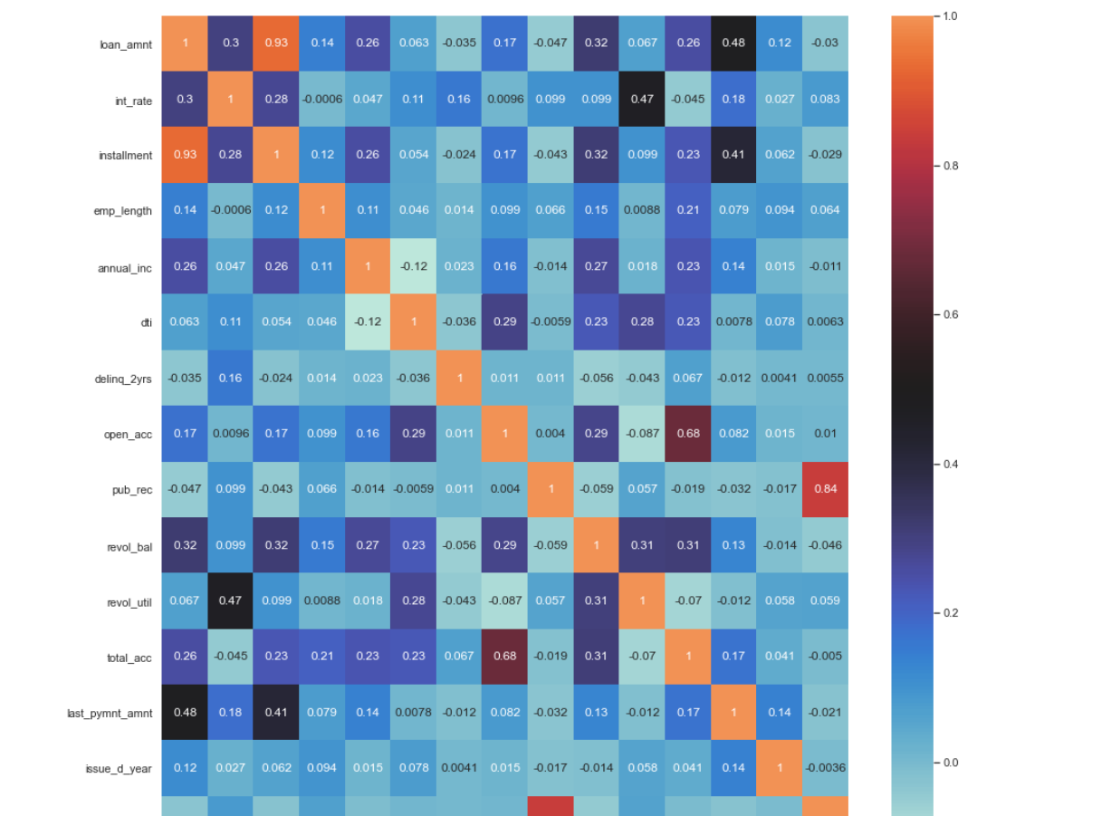
Appendix - Correlations

Slide 22
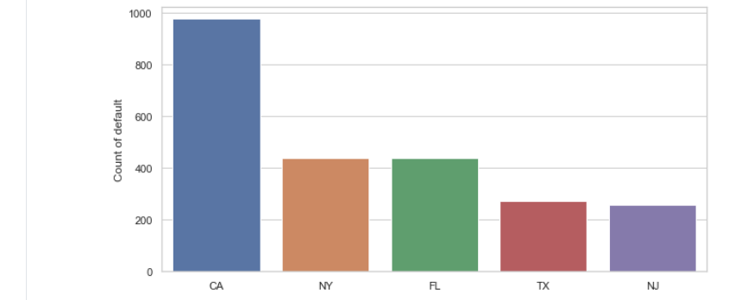
Appendix – Defaults By State
Maximum defaulters are in populous states, California, New York, Florida and Texas.

Slide 23
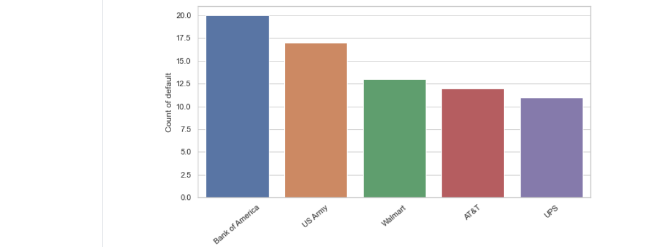
Appendix – Defaults By Employer
Maximum defaulters are from large organizations – Bank of America, US Army , Walmart , AT&T etc.

Slide 24
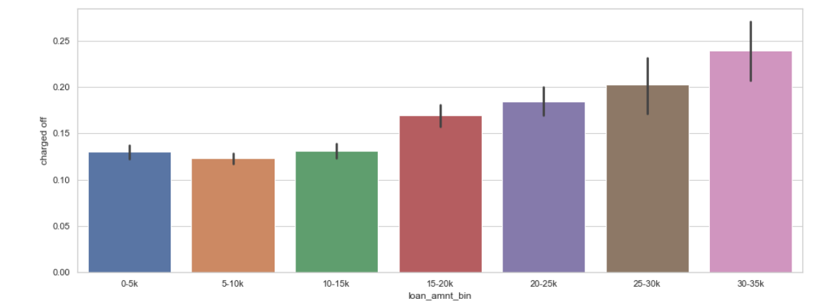
Appendix – Loan Amount
The loan amount increases the chances of default are also increases.

