Slide 1
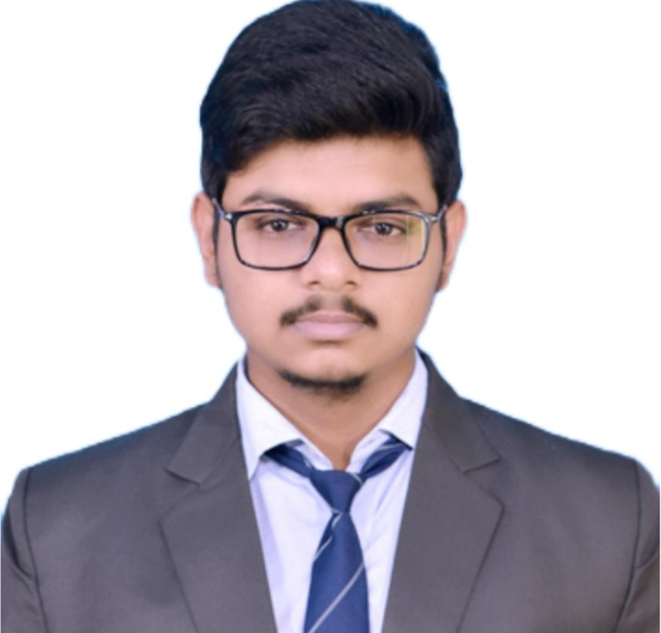



Subhabrata Panda
Analyst/Software Engineer
Bachelor of Technology in
Computer Science : 2018- 2022
Skills
Java 8 /J2EE | Java Basics, OOPS, Generics, Collections, Arrays, Loops, Lambda Exp, Stream API Junit, Mockito
Spring core | IOC & Dependency Injection, Autowire
Spring REST | REST controllers, Implementation of GET, POST, PUT & DELETE, Bean Validation & Exception Handling, Testing Services, Controller & Repository layer
Spring Data JPA | Implement DAO layer using spring Data repositories, Transaction Management
Spring Boot Microservices | Spring Boot Starters, annotations, Messaging Service, Swagger API documents
Spring Cloud | Eureka, Netflix Hystrix, Netflix Config Server
React | Components, Hooks, Event handling, Redux, Reducers
Database | MongoDB No Sql Basics, PostgreSQL Basics
UI Tech | HTML 5 & CSS 3,JavaScript, ES6
Tools | Git, Postman, Maven, Eclipse IDE, Spring Boot
Add On skills | Communications, Team management. Peer learning
Bangalore
xxxxxxxxxxx@capgemini.com
+91 7319329179
A4
Full Stack Developer
Hands on experience in creating microservices with Springboot, Spring Security with JWT, Spring Cloud API Gateway, Eureka server, Hystrix
Hands on experience in creating Single page Web Application in React with React Hooks,
Hands on experience in implementing RabbitMQ .
Experience in creating documentation with swagger and in unit testing using Junit, Mockito including code quality compliance using Sonar Lint
Hands on experience in implementing MongoDB & PostgreSQL
Agriculture Crop System
Completed end to end case study of a agriculture crop system along with microservice architecture, JWT authentication, Swagger, payment testing using Paytm, messaging queue using RabbitMQ, database using MongoDB, React used for user interface.
Employee Management System
Completed end to end case study of a employee management system along with Monolithic architecture, database using PostgreSQL with one to many relationship, React used for user interface.
Completed internship of 60 days on JEE Full Stack 2.0 with React from Capgemini
Completed TalentNext course on Java J2EE (duration: 3 months) from Wipro
Check out my work on GitHub & Video Profile

