Slide 1
REFERENCE ARCHITECTURE
Agentic Product
Development Lifecycle
AI
GOVERNED
A governed, client-extensible framework for AI-enabled software delivery
Principal AI Architecture perspective
Control at the core. Client sovereignty at the edges.
Solution architecture • governing philosophy • BYO capability model
AGENTIC PDLC FRAMEWORK
01
Notes:
[Sources]
- Agentic PDLC Solution Architecture, client-neutral reference document, 24 Aug 2026.

Slide 2
ARCHITECTURAL THESIS
The framework governs decisions—not just agent execution
The core problem
Lifecycle state is durable
Most agent platforms optimize a task. An enterprise PDLC must preserve intent, authority, evidence and accountability across an entire product lifecycle.
Every phase consumes a versioned state and emits governed artifacts, decisions and evidence.
Autonomy is earned
Risk, confidence and policy determine whether the system proceeds, pauses, escalates or requires approval.
Intelligence is replaceable
Models, agents and tools can change; the lifecycle contract, policy semantics and evidence model remain stable.
Architectural consequence
A governed operating system for product change—not a chain of prompts.
AGENTIC PRODUCT DEVELOPMENT LIFECYCLE
02
Notes:
[Sources]
- Agentic PDLC Solution Architecture document (internal)
- Prior architecture deck diagrams (internal)

Slide 3
DESIGN TENETS
Standardize semantics; federate client capabilities
These boundaries make the framework portable without weakening governance.
Tenet | What stays invariant | What clients can bring | Why it matters
Governed state | Lifecycle IDs, artifact lineage, decisions, evidence | System-of-record integrations | The journey remains reconstructable
Stable contracts | Phase inputs/outputs, capability interfaces, events | Agents, models, tools, workflows | Upgrades do not require framework forks
Policy as code | Decision points, obligations, approval semantics | Enterprise policies and risk thresholds | Autonomy stays explainable and auditable
Evidence before confidence | Provenance, validation status, confidence basis | Scanners, test engines, evaluators | Claims are tied to verifiable evidence
Least privilege | Scoped identity, credentials, tool permissions | Identity provider and secret manager | Agent authority is bounded by design
Standardize semantics and controls; federate capabilities and client-specific policy.
AGENTIC PRODUCT DEVELOPMENT LIFECYCLE
03
Notes:
[Sources]
- Agentic PDLC Solution Architecture document (internal)
- Prior architecture deck diagrams (internal)

Slide 4
FRAMEWORK CONTRACT
BYO capabilities plug into governed contracts
The framework owns
Capability port | Client implementation | Minimum conformance
Model gateway | Preferred LLMs / routers | Identity, telemetry, policy hooks
Agent runtime | Client or vendor agents | Typed I/O, timeouts, evidence emission
Tool connector | SCM, ALM, test, security, cloud | Scoped auth, dry-run, idempotency
Knowledge provider | Docs, graph, vector, catalog | Provenance, freshness, access control
Policy engine | OPA, Cedar, custom rules | Decision + obligations + rationale
Evaluator | Client quality and risk models | Versioned scores and evidence links
Lifecycle protocol
Policy decision points
State and evidence semantics
Identity and authorization context
Observability and conformance
Non-negotiable boundary
A plugin may propose or execute. It may not bypass policy, manufacture evidence, or mutate authoritative state outside the contract.
Adapters pass a conformance suite before they can participate in governed execution.
AGENTIC PRODUCT DEVELOPMENT LIFECYCLE
04
Notes:
[Sources]
- Agentic PDLC Solution Architecture document (internal)
- Prior architecture deck diagrams (internal)

Slide 5
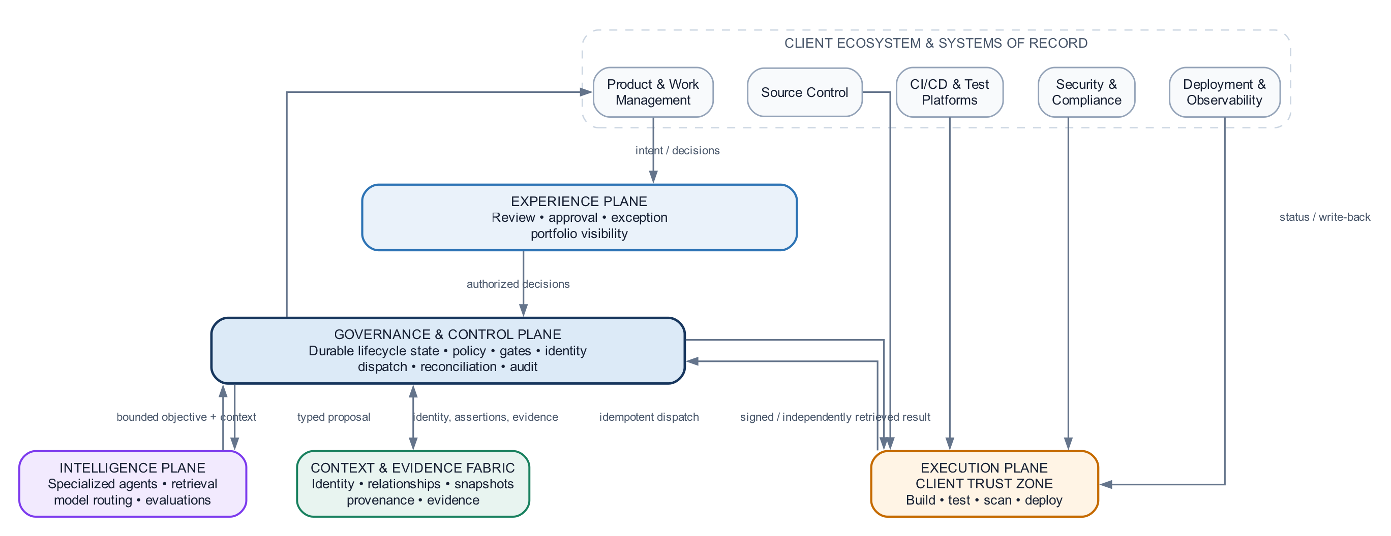
SOLUTION ARCHITECTURE
Five planes separate authority, reasoning, execution and evidence
How to read it
1
Experience initiates intent
2
Control plane owns authority
3
Intelligence proposes decisions
4
Execution performs bounded work
5
Evidence closes the loop
Control flows down. Evidence flows back.
AGENTIC PRODUCT DEVELOPMENT LIFECYCLE
05
Notes:
[Sources]
- Agentic PDLC Solution Architecture document (internal)
- Prior architecture deck diagrams (internal)
- Embedded diagram: prior architecture deck, slide 3.

Slide 6
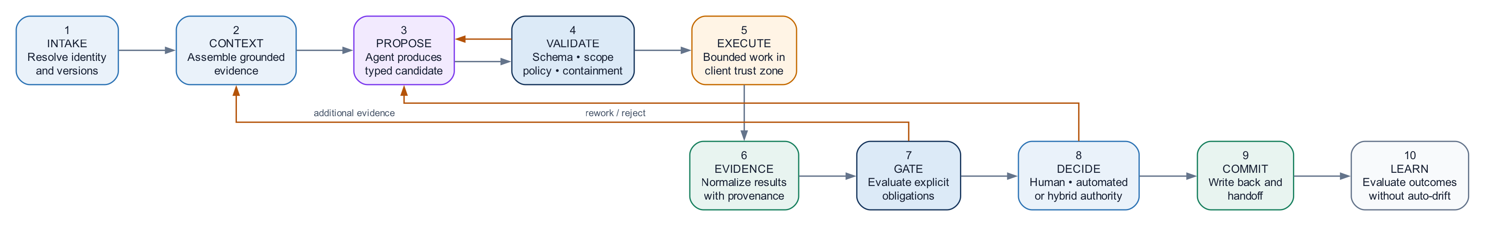
LIFECYCLE PROTOCOL
Every PDLC phase implements the same governed contract
Contract surface | Required content | Control objective
Inputs | Intent, state, policies, evidence | Start from authorized context
Reasoning | Plan, alternatives, confidence, assumptions | Make judgment inspectable
Execution | Tool calls, mutations, retries, receipts | Bound side effects
Outputs | Artifacts, decisions, findings, next-state | Produce typed lifecycle state
Gate | Policy decision, obligations, approvals | Earn progression
Evidence | Provenance, validation, audit events | Support reconstruction
AGENTIC PRODUCT DEVELOPMENT LIFECYCLE
06
Notes:
[Sources]
- Agentic PDLC Solution Architecture document (internal)
- Prior architecture deck diagrams (internal)
- Embedded diagram: prior architecture deck, slide 4.

Slide 7
SHARED FOUNDATION
Context, identity and evidence form the durable lifecycle memory
Context
Identity
Evidence
Versioned intent
Artifact graph
Dependency knowledge
Historical decisions
Actor + delegation
Tenant and project scope
Entitlements
Credential boundaries
Provenance
Validation receipts
Confidence basis
Audit-ready lineage
Lifecycle State Service
The authoritative thread that binds every phase, agent action, policy decision and artifact version.
Without this layer, the system is a collection of automations—not an end-to-end PDLC.
AGENTIC PRODUCT DEVELOPMENT LIFECYCLE
07
Notes:
[Sources]
- Agentic PDLC Solution Architecture document (internal)
- Prior architecture deck diagrams (internal)

Slide 8
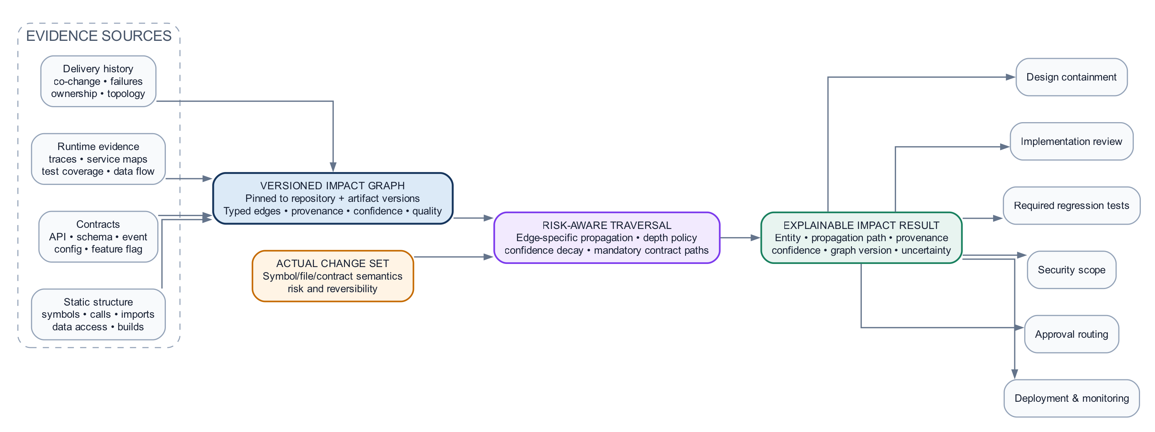
CORE DIFFERENTIATOR
Blast radius is a governed prediction—not a guess
What makes the result real
Multi-signal graph
Static dependencies + runtime traces + ownership + change history
Typed propagation
Different rules for API, data, config, security and behavior changes
Confidence calibration
Score coverage, freshness, ambiguity and contradictory evidence
Feedback learning
Compare predicted impact with defects, incidents and escaped changes
Output: affected components • risk paths • implementation worklist • QA scope • uncertainty • evidence
AGENTIC PRODUCT DEVELOPMENT LIFECYCLE
08
Notes:
[Sources]
- Agentic PDLC Solution Architecture document (internal)
- Prior architecture deck diagrams (internal)
- Embedded diagram: prior architecture deck, slide 7.

Slide 9
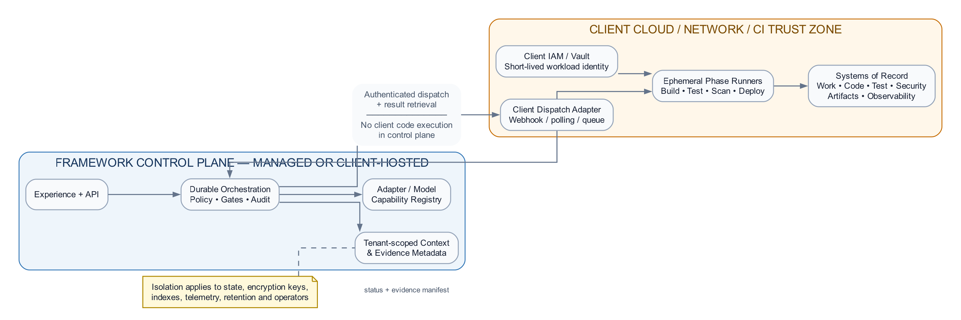
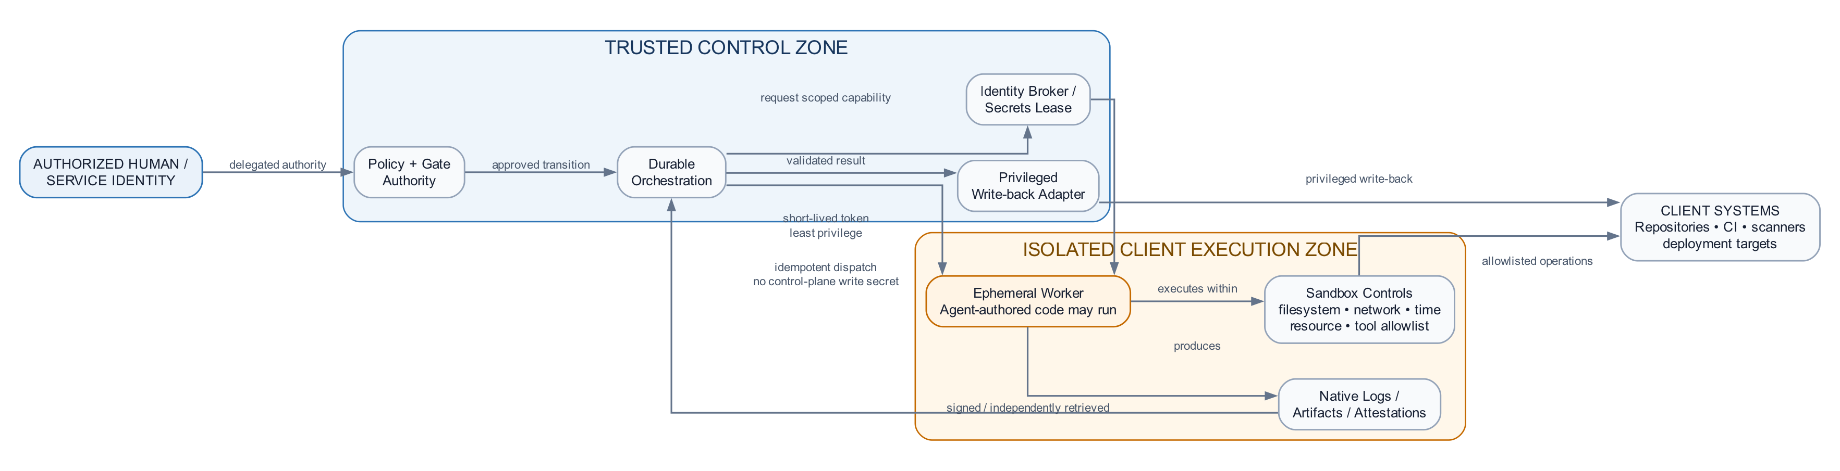
ENTERPRISE OPERATING MODEL
Trust boundaries and deployment choices preserve client control
Trust boundaries
Hybrid deployment
Concern | Framework responsibility | Client control
Identity & secrets | Propagate scoped context; never persist raw credentials | IdP, vault, token policy
Execution boundary | Sandbox tools; enforce approvals and egress rules | Network zones and runners
Data residency | Route context and artifacts by classification | Storage region and retention
Operational assurance | Durable workflows, replay, telemetry and audit | SLOs, incident and change policy
AGENTIC PRODUCT DEVELOPMENT LIFECYCLE
09
Notes:
[Sources]
- Agentic PDLC Solution Architecture document (internal)
- Prior architecture deck diagrams (internal)
- Embedded diagrams: prior architecture deck, slide 8.

Slide 10
ADOPTION PRINCIPLE
Standardize governance.
Federate capabilities.
Earn autonomy.
Never confuse replaceability with optional governance.
The architecture stands when every decision is bounded, evidenced, attributable and replayable—regardless of which client technology implements the edge.
1
Governance kernel
State • identity • policy • audit
2
Client integrations
Read-only context and system adapters
3
One bounded phase
Evidence-rich recommendation mode
4
Controlled execution
Isolation • conformance • deterministic gates
5
Risk-tiered autonomy
Expand only from measured outcomes
10
Notes:
[Sources]
- Agentic PDLC Solution Architecture, client-neutral reference document, 24 Aug 2026.

