Slide 1
REFERENCE ARCHITECTURE
Agentic Product
Development Lifecycle
Architecture position
Standardize
contracts • trust boundaries
evidence semantics • gates
Governed intelligence. Client-owned execution. Evidence-backed progression.
Federate
models • tools • clouds
policies • execution agents
Updated to the latest implementation
01
Notes:
Open with the architectural stance: AI may propose and execute, but it does not own readiness decisions.
[Sources] Internal reference implementation and architecture review, 24 Aug 2026.

Slide 2
ARCHITECTURAL THESIS
The framework is a governed decision system—not a chain of model calls
The differentiator is not agent count. It is the quality of the boundaries around authority, evidence and replacement.
Agents propose
Deterministic controls decide
Humans own risk
Designs, plans, code and tests may come from platform agents or client-supplied agents.
Schemas, scope containment, policy, coverage reconciliation and promotion checks remain framework-owned.
Approvals and exceptions are attributable, time-bound and supported by versioned evidence.
North-star outcome
Increase delivery throughput while preserving—or strengthening—traceability, containment, client sovereignty and release confidence.
AGENTIC PDLC • UPDATED 24 AUG 2026
02
Notes:
Use this slide to establish the philosophy before discussing technology.
[Sources] Internal reference implementation and architecture review, 24 Aug 2026.

Slide 3
KEY TENETS
Six tenets hold the architecture together
01
Agents propose; gates decide
02
Evidence is the currency of progression
Probabilistic components cannot self-approve.
A phase completes when required evidence exists.
03
Context is federated, not duplicated
04
Autonomy is bounded by risk
Sources of record remain authoritative; context carries pointers and provenance.
Policy sets autonomy from impact, reversibility and uncertainty.
05
Ports vary; semantics remain invariant
06
Every assurance claim is measured
Clients replace implementations behind versioned capability contracts.
Coverage and blast radius disclose scope, quality and limits.
AGENTIC PDLC • UPDATED 24 AUG 2026
03
Notes:
These are design constraints, not slogans; each maps to an implemented control or an explicit target-state gap.
[Sources] Internal reference implementation and architecture review, 24 Aug 2026.

Slide 4
BYO / PLUGGABILITY
Bring your own capabilities—without bringing your own governance
Extension seam
Client may provide
Framework retains
DesignAgent
Inline service or dispatched design agent
Catalogue review, schema and policy
TestAuthor
Planner/spec author, sync or dispatched
Testability, required regressions, spec validation
Implementation
Client cloud coding agent via WorkDispatch
Capability check, scope review, fallback
Test data
Database/fixture/environment provider
Lease lifecycle and cleanup evidence contract
Models & tools
LLM, SCM, CI, policy, evidence stores
Identity, result envelope, audit and gates
AGENTIC PDLC • UPDATED 24 AUG 2026
04
Notes:
The TestDataProvider row is target-state. The other named agent seams exist in the reference implementation.
[Sources] Internal reference implementation and architecture review, 24 Aug 2026.

Slide 5
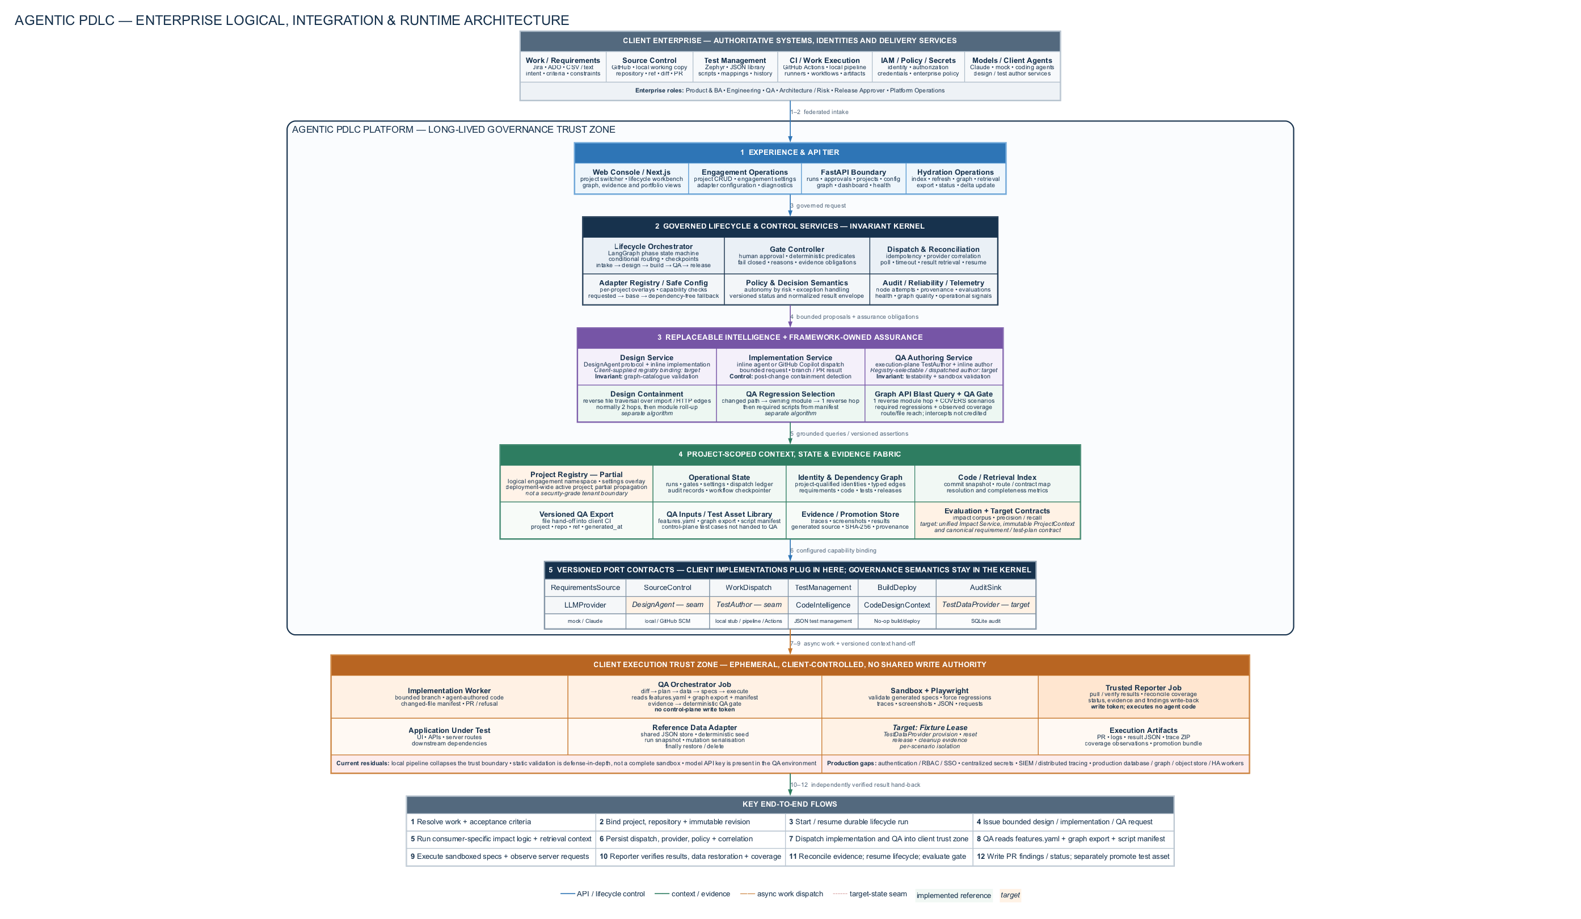
Notes:
Walk top to bottom. Separate implemented runtime paths from protocol-only seams and target-state capabilities. Call out the three non-unified impact calculations, partial project isolation, execution/reporting privilege split and residual production gaps.
[Sources] Internal reference implementation and architecture review, 24 Aug 2026.

Slide 6
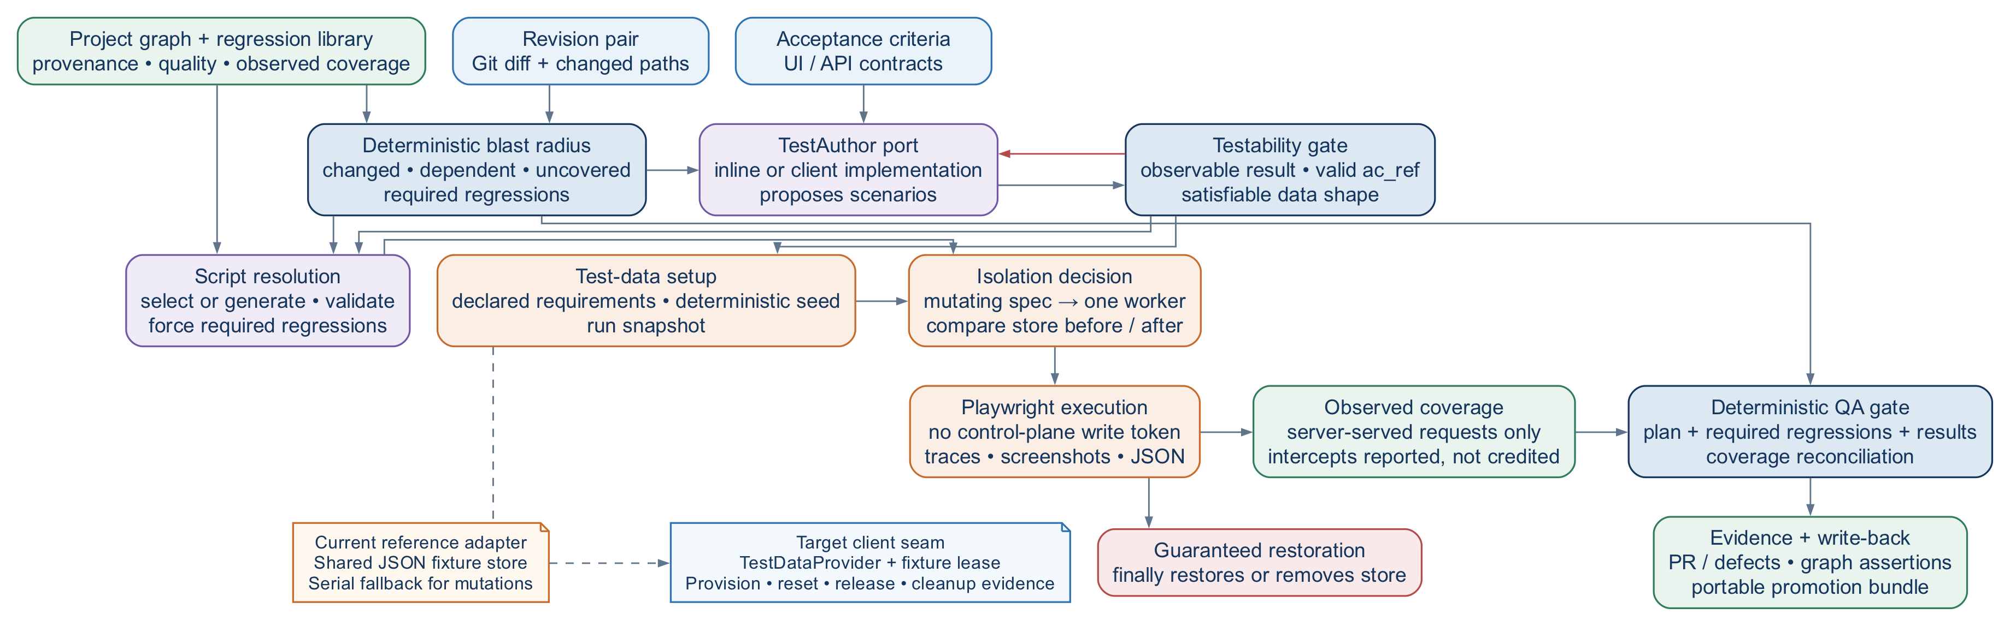
QA FLOW
QA turns change context into governed evidence
Scenario sources
Current data control
Target data control
Diff + acceptance criteria + project graph + approved library.
Deterministic seed, run snapshot, serial mutation fallback and finally-path restore.
TestDataProvider leases isolated fixtures and emits cleanup evidence.
AGENTIC PDLC • UPDATED 24 AUG 2026
06
Notes:
Answer the two recurring questions directly: scenarios come from four governed inputs; current data setup is reversible at run level, not isolated per scenario.
[Sources] Internal reference implementation and architecture review, 24 Aug 2026.

Slide 7
PROJECT + HYDRATION
Project scope is an architectural boundary, not a UI filter
Active project selects
Hydration operates
Isolation is structural
Engagement configuration
Repository and revision scope
Knowledge sources
Runtime adapter choices
Index → graph → retrieval → export
Delta refresh after change
Freshness and quality recorded
Project-qualified identities
No cross-project graph deletion
No silent identity collision
Why this matters
Blast radius, retrieval, test selection and evidence are only credible when every assertion resolves to the correct engagement and source revision.
Invariant
Project switching may change implementations and data. It must never change the meaning of evidence, gates or result status.
AGENTIC PDLC • UPDATED 24 AUG 2026
07
Notes:
Project qualification prevents the most dangerous multi-client failure: a plausible answer assembled from another engagement’s graph.
[Sources] Internal reference implementation and architecture review, 24 Aug 2026.

Slide 8
IMPACT + QA ASSURANCE
Blast radius is useful because its limits are explicit and gated
Changed
Diff-resolved files and modules
What the current reference can legitimately claim
Impact is derived from changed paths and typed graph relationships.
Dependent
Typed dependency paths from the project graph
Required regressions are enforced, not left in an agent prompt.
Observed coverage credits only server-served requests.
Uncovered
Impacted areas without an approved script
Intercepted requests remain visible but earn no coverage.
Coverage proves route/file reach—not branch or statement completeness.
Required regressions
Existing covering scripts installed by code
Principal-architect position
Treat the result as versioned decision support with provenance and uncertainty—not as an oracle.
AGENTIC PDLC • UPDATED 24 AUG 2026
08
Notes:
Do not overstate the metric. The implementation is materially real, but graph completeness and coverage granularity still bound its assurance.
[Sources] Internal reference implementation and architecture review, 24 Aug 2026.

Slide 9
OPERATING MODEL
Evidence and privilege separation make remote execution governable
1
Dispatch
2
Execute
3
Report
4
Promote
Capability-checked request with project, revision and policy context
→
Client CI or coding agent works in a bounded branch / runner
→
Trusted reporter reconciles results; execution holds no write token
→
Passing generated specs become reviewable source + SHA-256 + provenance bundles
The trust boundary
Agent-authored or repository-supplied code runs only in the execution plane. Gate decisions reference independently retrieved evidence, a policy version and a durable manifest. Promotion is a separate decision—not a side effect of a green test.
AGENTIC PDLC • UPDATED 24 AUG 2026
09
Notes:
Emphasize that pluggability does not imply shared credentials or pushed truth. The control plane reconciles independently.
[Sources] Internal reference implementation and architecture review, 24 Aug 2026.

Slide 10
PRINCIPAL ARCHITECTURE POSITION
Architecture standing comes from honest boundaries and measured controls
What is already credible
What earns the next order of confidence
✓
Project-scoped graph and hydration
1
Validate impact accuracy on client histories
✓
Replaceable design, test and implementation agents
2
Add symbol-level and contract-aware analysis
✓
Deterministic scenario/testability controls
3
Introduce TestDataProvider fixture leases
✓
Observed route/file coverage and required regressions
4
Add branch/statement and semantic side-effect coverage
✓
Reversible run-level data handling and promotion bundles
5
Make graph quality thresholds client-calibrated
Standardize lifecycle contracts, trust boundaries and evidence semantics. Federate tools, models, policies and execution. Measure every inference.
AGENTIC PDLC • UPDATED 24 AUG 2026
10
Notes:
Close on the architectural standard: replaceability at the edges, non-negotiable governance at the core.
[Sources] Internal reference implementation and architecture review, 24 Aug 2026.

