Slide 1
REFERENCE ARCHITECTURE
Agentic Product
Development Lifecycle
AI
GOVERNED
A governed, client-extensible framework for AI-enabled software delivery
Principal AI Architecture perspective
Control at the core. Client sovereignty at the edges.
Solution architecture • governing philosophy • BYO capability model
AGENTIC PDLC FRAMEWORK
01
Notes:
[Sources]
- Agentic PDLC Solution Architecture, client-neutral reference document, 24 Aug 2026.

Slide 2
ARCHITECTURAL THESIS
The framework governs decisions—not just agent actions
Agents create and execute bounded proposals. Deterministic policy, evidence, and accountable authority govern lifecycle progression.
DETERMINISTIC CORE
EVIDENCE-LINKED PROGRESSION
BOUNDED AUTONOMY
BYO THROUGH CONTRACTS
Lifecycle state, identity, policy and gates remain independent of model behavior.
A phase completes only when version-bound evidence satisfies explicit obligations.
Authority scales with risk, reversibility, observability and client policy.
Clients replace tools and providers without forking the governance kernel.
Invariant outcome
Faster delivery with stronger traceability, containment, separation of duties and client control.
AGENTIC PDLC FRAMEWORK
02
Notes:
[Sources]
- Agentic PDLC Solution Architecture, client-neutral reference document, 24 Aug 2026.

Slide 3
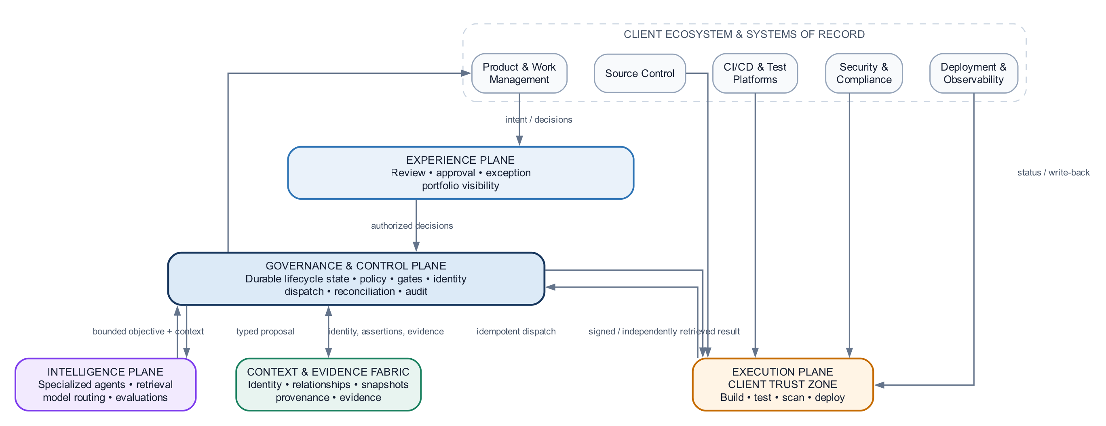
END-TO-END ARCHITECTURE
Five planes separate authority, reasoning, execution and evidence
Trust boundary
Agent-authored code executes in the client trust zone; the control plane consumes independently verifiable results.
AGENTIC PDLC FRAMEWORK
03
Notes:
[Sources]
- Agentic PDLC Solution Architecture, client-neutral reference document, 24 Aug 2026.
- Figure 1 embedded from the reference architecture document.

Slide 4
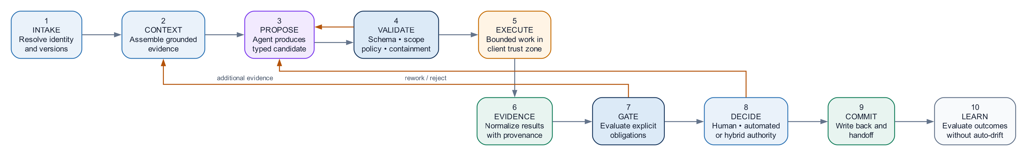
LIFECYCLE PROTOCOL
Every PDLC phase implements the same governed contract
The reusable control pattern
Agent cognition
Deterministic control
Accountable authority
Durable progression
Context → proposal → bounded repair
Validation → evidence obligations → gate
Human, automated or hybrid decision
Commit, write-back, handoff and learning
AGENTIC PDLC FRAMEWORK
04
Notes:
[Sources]
- Agentic PDLC Solution Architecture, client-neutral reference document, 24 Aug 2026.
- Figure 2 embedded from the reference architecture document.

Slide 5
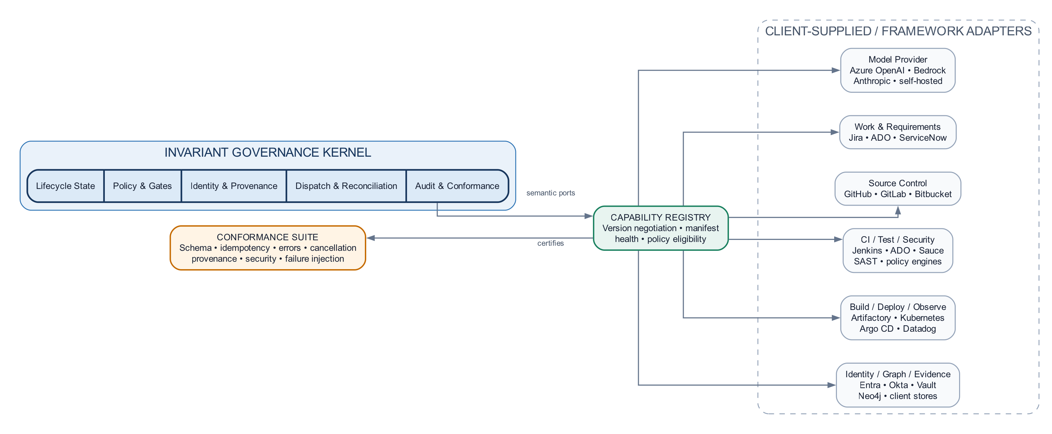
BYO AND PLUGGABILITY
Stable semantics enable client portability without forks
Replaceable at each client
• Model and inference providers
• Work, requirements and source control
• CI, test, security and deployment
• Identity, secrets, graph and evidence stores
Conformance is mandatory
Version negotiation • idempotency • provenance • error semantics • cancellation • security
AGENTIC PDLC FRAMEWORK
05
Notes:
[Sources]
- Agentic PDLC Solution Architecture, client-neutral reference document, 24 Aug 2026.
- Figure 3 embedded from the reference architecture document.

Slide 6
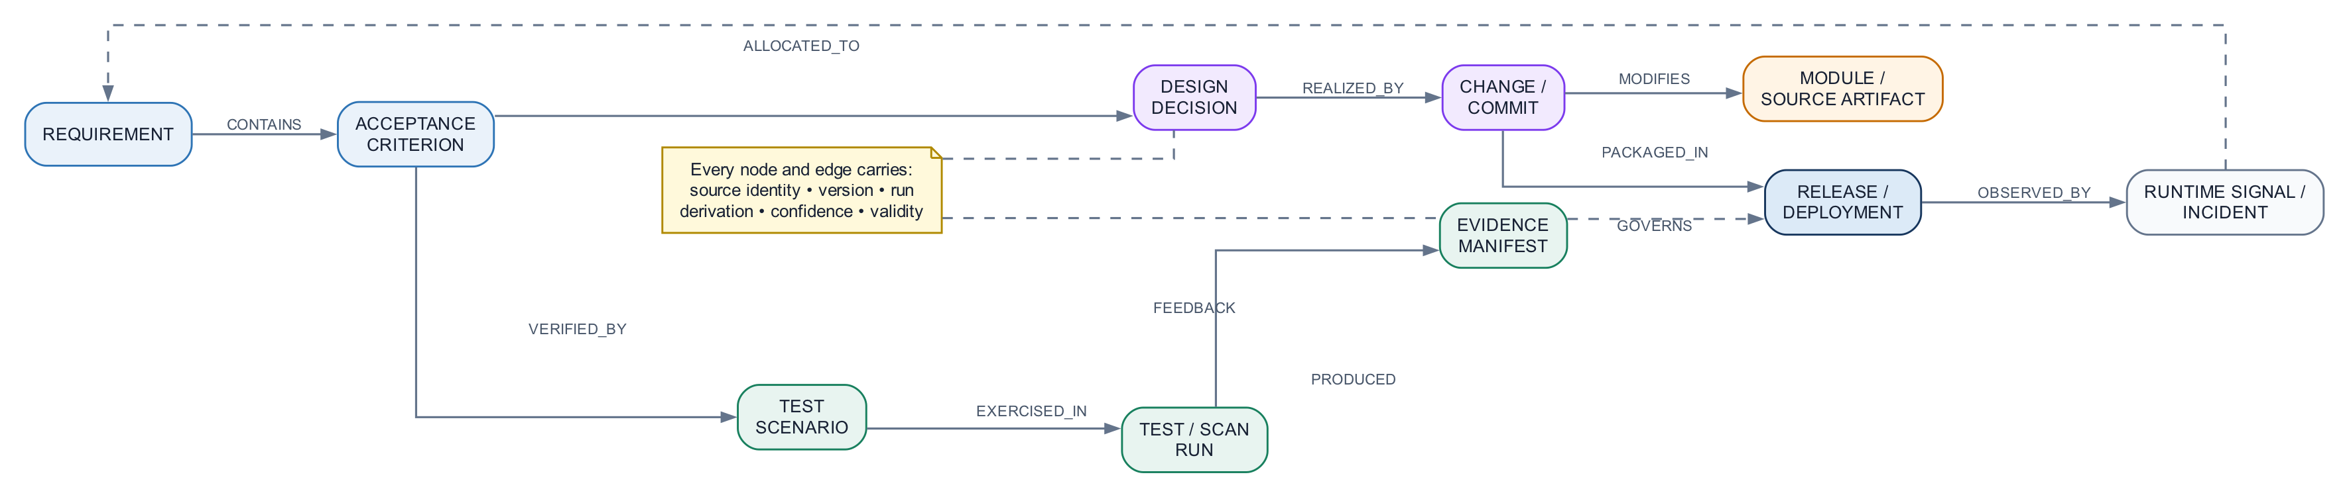
CONTEXT AND EVIDENCE FABRIC
One lifecycle identity connects intent to production outcomes
Federated
Content stays in client systems of record; the framework stores identity, relationships and provenance.
Versioned
Every assertion is bound to source, run, derivation method, confidence and validity.
Queryable
Readiness and traceability become graph questions—not narrative claims.
AGENTIC PDLC FRAMEWORK
06
Notes:
[Sources]
- Agentic PDLC Solution Architecture, client-neutral reference document, 24 Aug 2026.
- Figure 4 embedded from the reference architecture document.

Slide 7
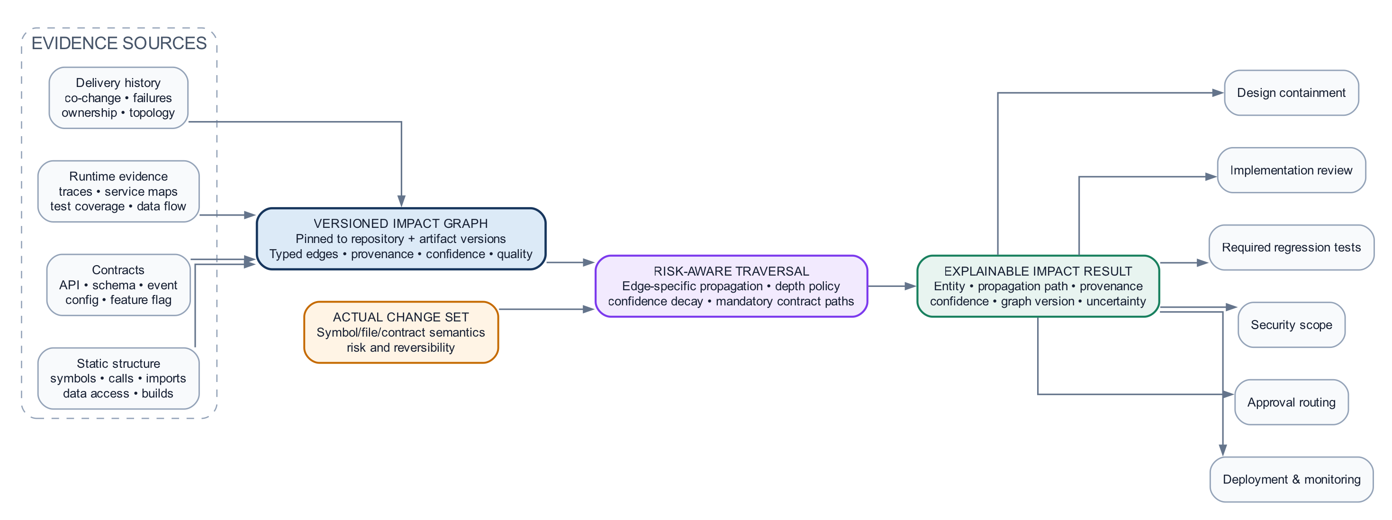
CORE DIFFERENTIATOR
Impact intelligence is the lifecycle’s shared decision engine
One graph. One explanation model.
Design containment • implementation review • required regression • security scope • approval routing • deployment monitoring
AGENTIC PDLC FRAMEWORK
07
Notes:
[Sources]
- Agentic PDLC Solution Architecture, client-neutral reference document, 24 Aug 2026.
- Figure 5 embedded from the reference architecture document.

Slide 8
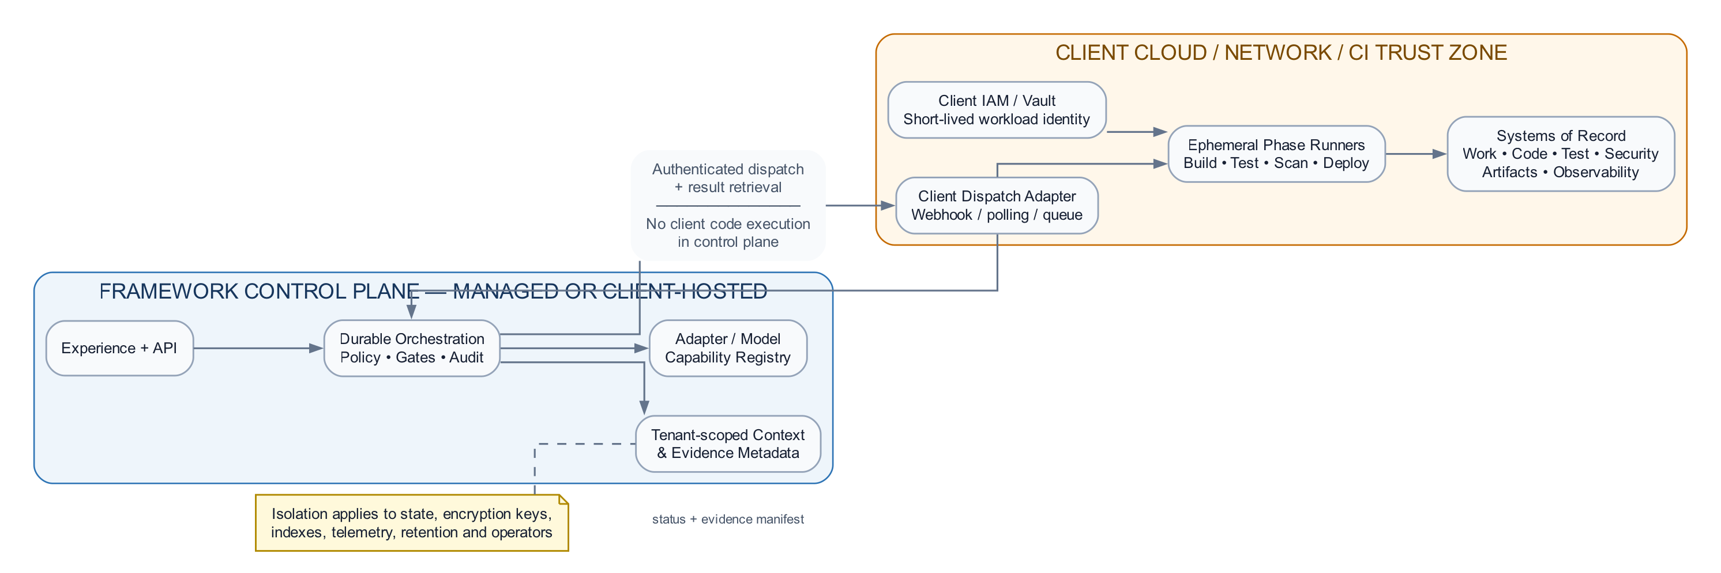
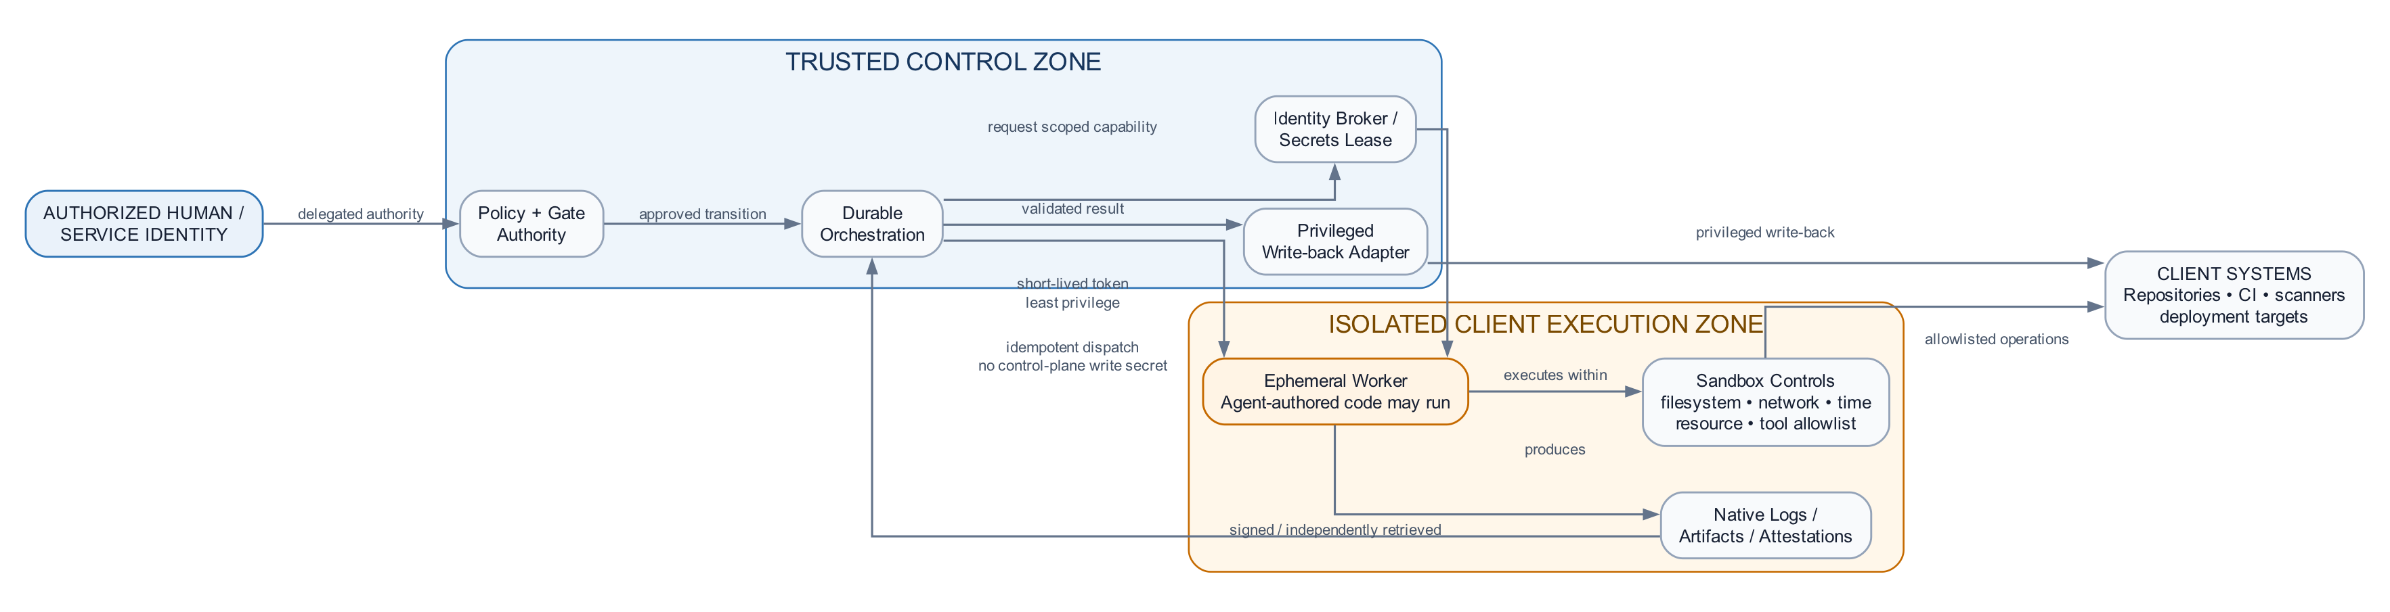
SECURITY AND DEPLOYMENT
Client-resident execution preserves existing enterprise controls
Privilege separation
Hybrid deployment
No control-plane write secrets in execution
Short-lived, phase-scoped workload identity
Signed or independently retrieved evidence
Privileged write-back through trusted adapters
AGENTIC PDLC FRAMEWORK
08
Notes:
[Sources]
- Agentic PDLC Solution Architecture, client-neutral reference document, 24 Aug 2026.
- Figures 6 and 7 embedded from the reference architecture document.

Slide 9
OPERATIONAL ARCHITECTURE
Trust requires policy, durable execution and measurable quality
POLICY
RELIABILITY
ASSURANCE
External to prompts
Durable by design
Measured continuously
• Enterprise and client policy packs
• Persist before dispatch
• Agent and phase evals
• Risk-tiered decision rights
• Idempotent correlation
• Impact recall and precision
• Time-bound exceptions
• Reconcile, resume and compensate
• Production outcome monitoring
Models, prompts, policies and adapters advance only when their versioned evidence meets defined thresholds.
AGENTIC PDLC FRAMEWORK
09
Notes:
[Sources]
- Agentic PDLC Solution Architecture, client-neutral reference document, 24 Aug 2026.

Slide 10
ADOPTION PRINCIPLE
Standardize governance.
Federate capabilities.
Earn autonomy.
Never confuse replaceability with optional governance.
The architecture stands when every decision is bounded, evidenced, attributable and replayable—regardless of which client technology implements the edge.
1
Governance kernel
State • identity • policy • audit
2
Client integrations
Read-only context and system adapters
3
One bounded phase
Evidence-rich recommendation mode
4
Controlled execution
Isolation • conformance • deterministic gates
5
Risk-tiered autonomy
Expand only from measured outcomes
10
Notes:
[Sources]
- Agentic PDLC Solution Architecture, client-neutral reference document, 24 Aug 2026.

