Slide 1
Stock Market Analysis Dashboard
Real-Time Performance Analysis of AAPL, MSFT, GOOG & NFLX
Tool: Tableau | Domain: Business Analytics

Slide 2
Business Problem Statement
Stock market data is highly volatile and complex.
Investors need clear insights into price trends, volume, and volatility.
This project transforms raw stock data into an interactive dashboard.

Slide 3
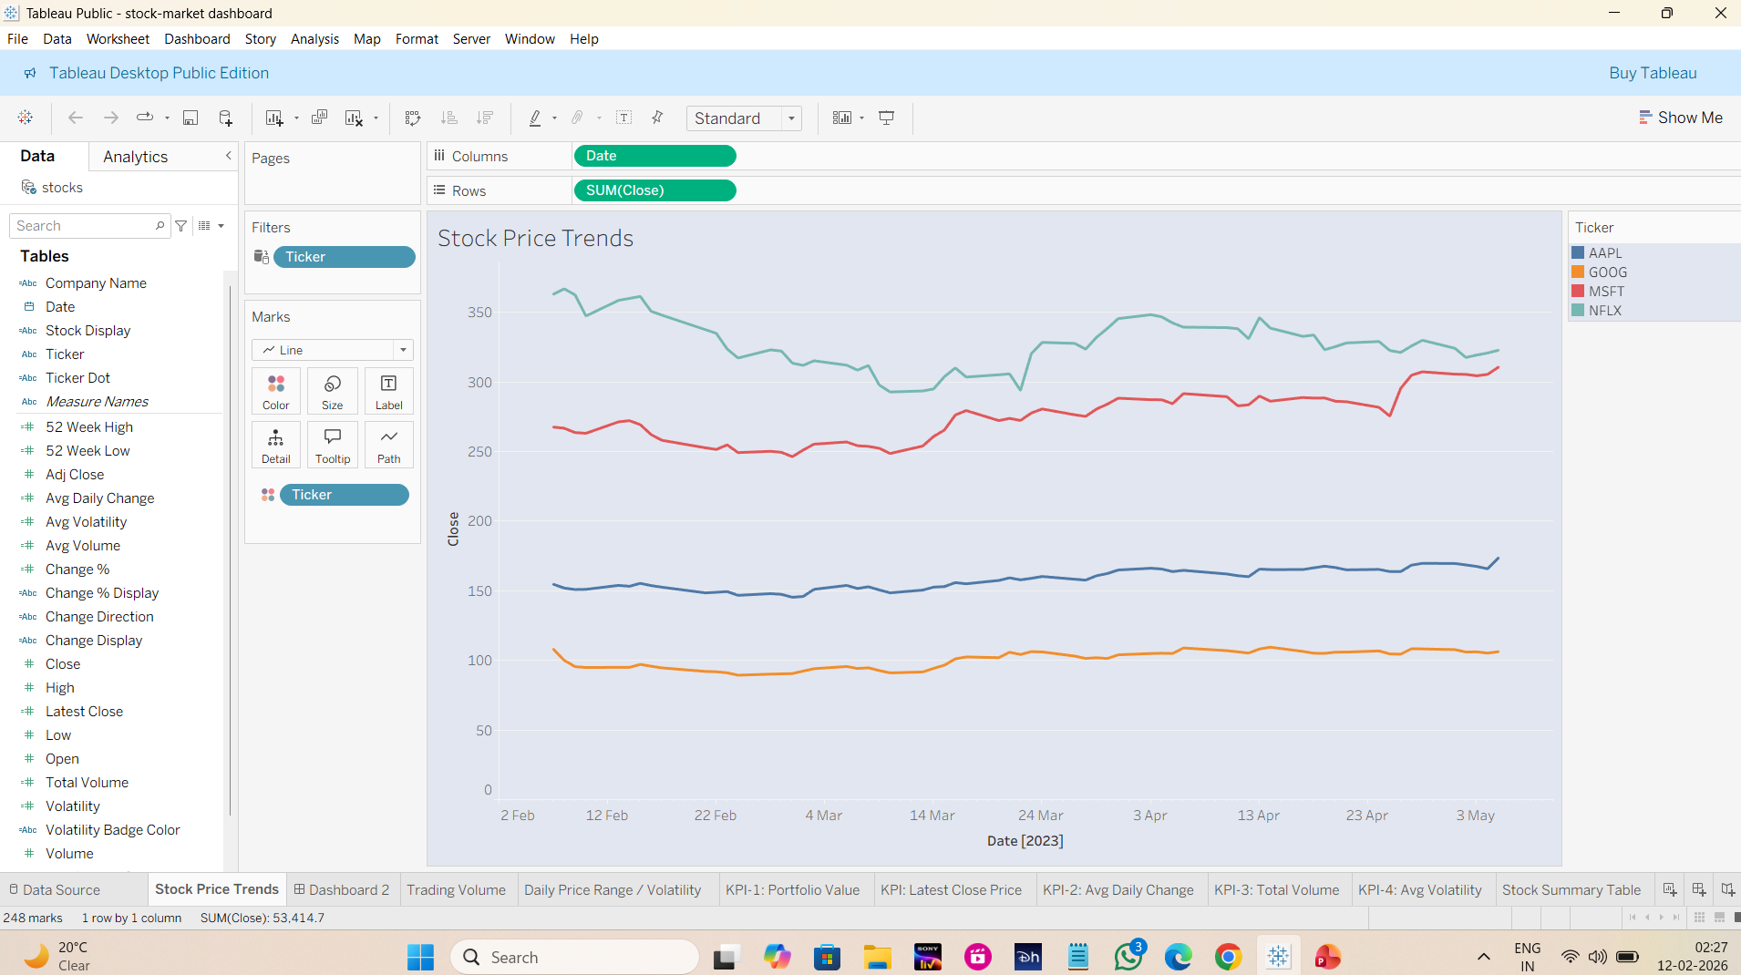

Slide 4
Dataset Overview
Historical stock price data (Feb–May 2023).
Companies: Apple, Microsoft, Google, Netflix.
Key fields: Open, Close, High, Low, Volume, Date.
Used Excel & SQL for preprocessing before Tableau.

Slide 5
Key Performance Indicators (KPIs)
Portfolio Value by Stock.
Latest Close Price.
Average Daily Change.
Average Volatility.
Total Trading Volume.

Slide 6
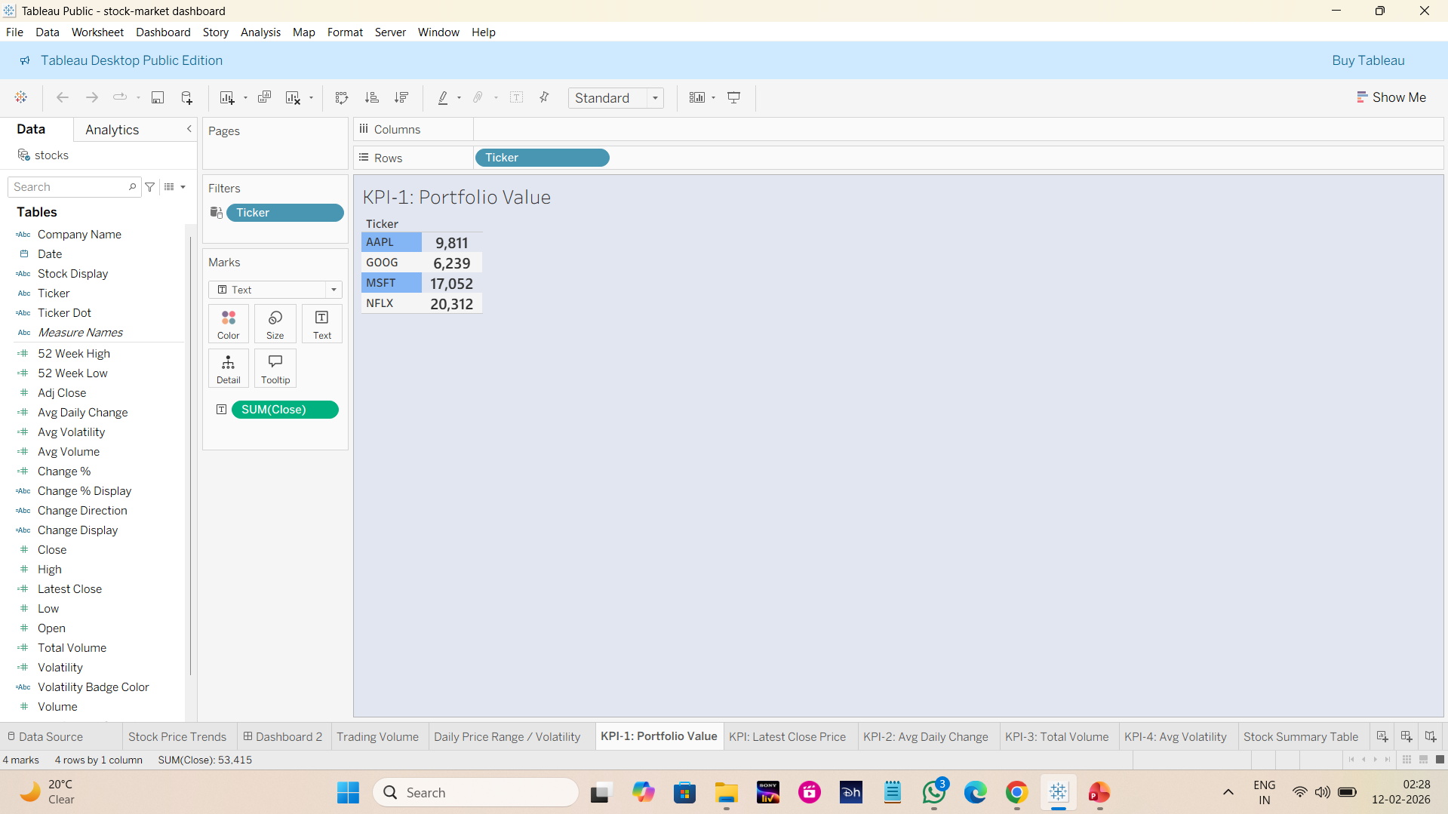

Slide 7
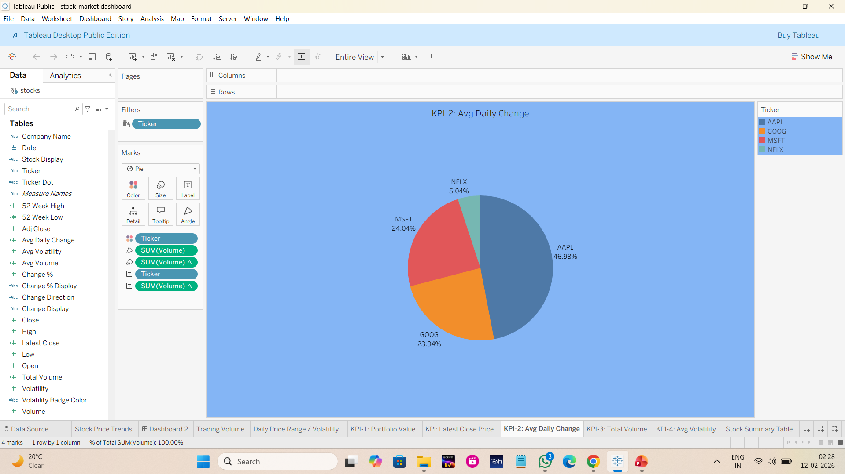

Slide 8
Dashboard Visualizations
Stock Price Trends (Line Chart).
Daily Price Range & Volatility Analysis.
Trading Volume Comparison.
Avg Daily Change (Pie Chart).
Stock Summary Table.

Slide 9
Interactivity & Advanced Features
Stock-wise filters (AAPL, MSFT, GOOG, NFLX).
Dynamic KPIs updating with filters.
Comparative analysis across multiple stocks.
User-friendly and responsive dashboard layout.

Slide 10
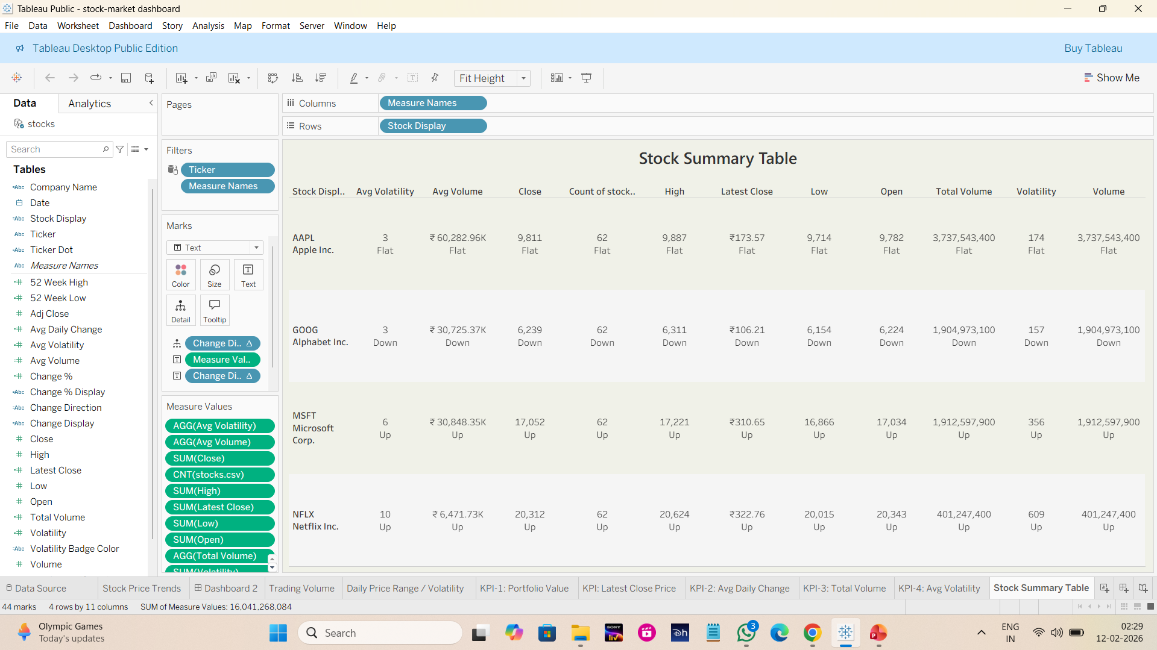

Slide 11
Key Insights & Findings
NFLX shows higher volatility compared to other stocks.
AAPL and MSFT demonstrate relatively stable price movement.
GOOG shows consistent trading volume trends.
Volatility spikes align with major market movements.

Slide 12
Conclusion & Future Scope
Dashboard provides a clear view of stock performance.
Helps investors understand trends and risks.
Future scope: live API integration & predictive forecasting.
Can be extended to more stocks and longer time periods.

Slide 13
