Slide 1

Namma Yatri – Business Insights & Strategic Recommendations
Data-Driven Analysis to Empower Urban Mobility

Slide 2
Executive Summary
Objective: Evaluate Namma Yatri’s performance and growth potential
Focus: Rider behavior, driver performance, platform efficiency
Key Takeaways: High retention, rapid growth, opportunity for scale

Slide 3
About Namma Yatri
Operates on ONDC (Open Network for Digital Commerce)
Driver-first approach with zero commission
Transparent pricing, UPI-based payment
Auto-rickshaw ride-hailing app (open mobility model)

Slide 4
Business Objectives
Reduce Trip Cancellation Rate
01
Utilising Resources Effectively to Increase Revenue
02
To Focus on Improvement Areas to Increase Customer Satisfaction
03

Slide 5
Data Overview
The data is stored as a CSV file and captures trip details, customer and driver behaviour, and payment information from rides in Bengaluru. The data is organized into five worksheets, each representing a unique aspect of the operations. These tables offer insights into trips, payments, locations, and more. The five tables are:
Assembly Table: Contains geographical area data in Bengaluru divided into assemblies
Duration Table: Tracks hourly time slots to analyse temporal ride patterns
Payment Table: Documents transaction methods to study customer preferences
Trip Details Table: Monitors trip interactions
Trips Table: Records completed journey details

Slide 6
Preview
Revenue peaks identified during non-obvious hours (12PM–3PM, 12AM–3AM)
Utilising Top zones (e.g., Mahadevapura, Bangalore South) drive volume and value
High cancellation rates suggest driver allocation & incentive challenges

Slide 7

Key Insights

Slide 8
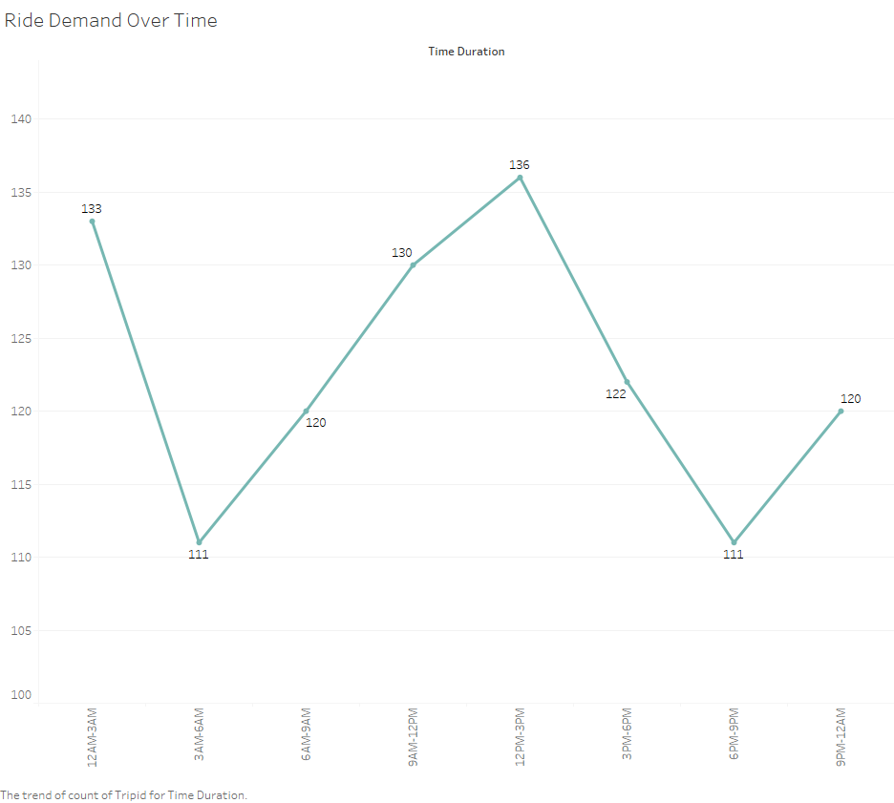
Unexpected Peak Hours
Peak hours are obtained during midnight & Midday.
Demand is steady with dips early in the morning; there is an opportunity to boost rides during mildly busy hours (12–3 PM).

Slide 9
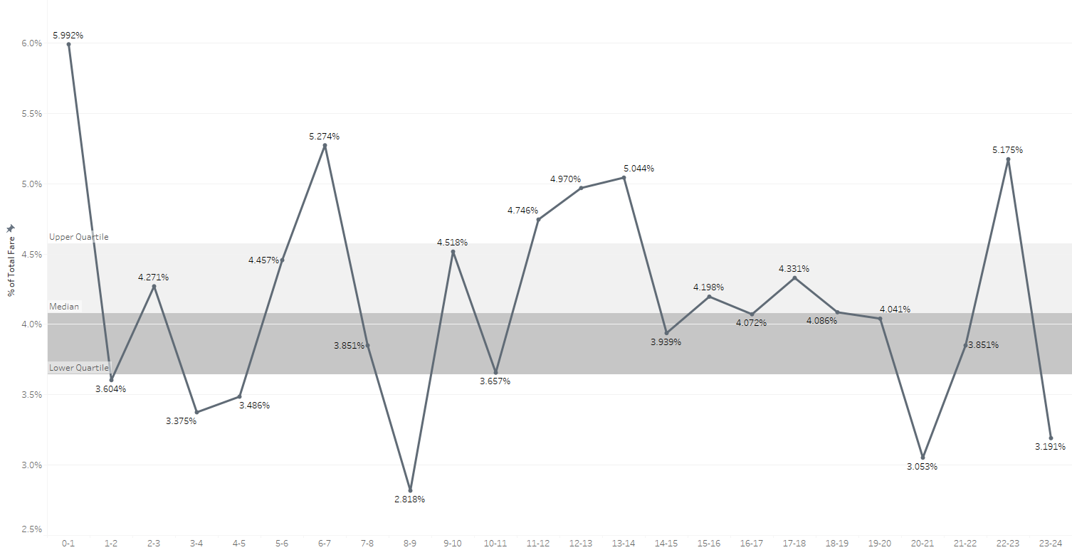
Lowest Revenue During Peak hour
During 8-9 AM lowest 2.88% Revenue of overall.
During 12PM-1AM highest 5.99% Revenue of overall.
Decision point: Explore pricing strategies or targeted driver coverage during these hours.

Slide 10
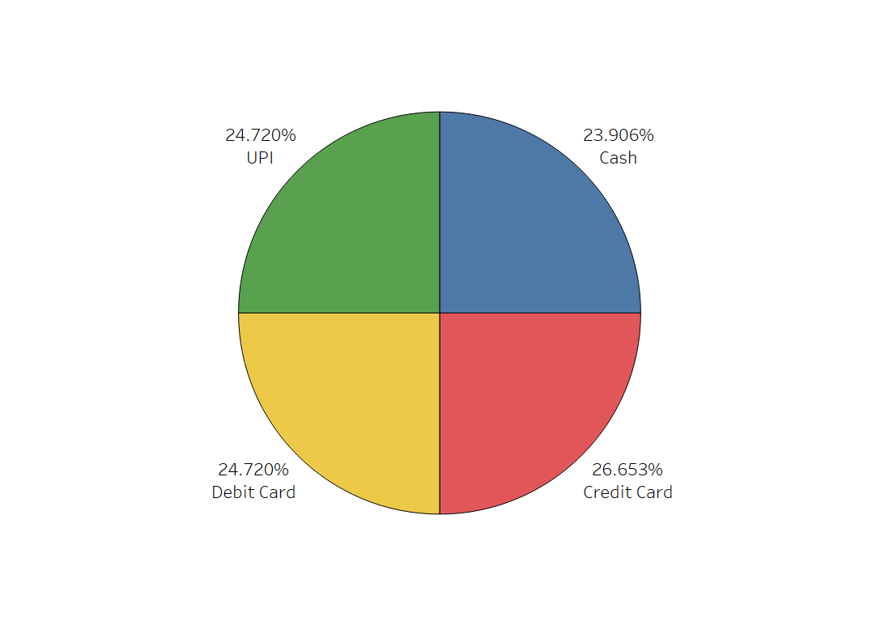
Promote UPI for Cost Saving
Credit Card (26.65%) is dominant
Suggestion: Ensure seamless experience for top methods; promote UPI for cost-saving

Slide 11
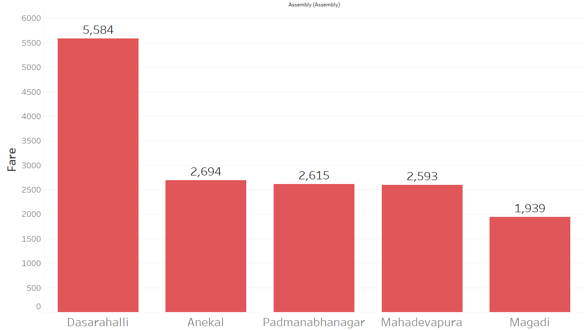
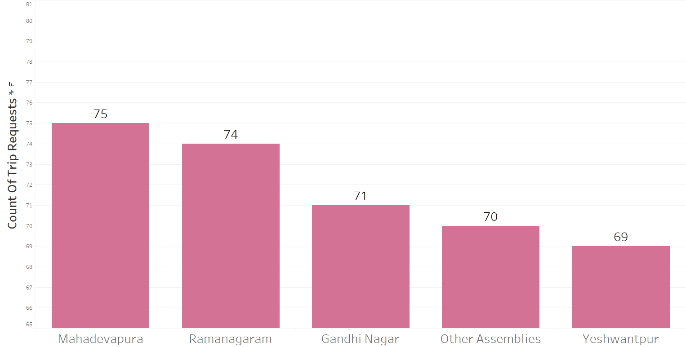
High Performing Zones
Top Zone by Trip value – Mahadevapura
Top Zone by Revenue – Bangalore South
Suggestion: Prioritize driver distribution and targeted promotions in these areas

Slide 12
47-48% Cancellation
Nearly 47 – 48% cancellation → Operational gap → lost revenue
Recommendation: Focused driver training or incentives to reduce cancellation and customer assurance initiatives
 | For Drivers | For Customer
Successful Rides | 52.75% | 51.83%
Cancelled Rides | 47.25% | 48.17%

Slide 13
Strategic Recommendations
Operational: Allocate more drivers during high-fare but low-trip hours
Geographical: Prioritize high-performing zones for incentives
Revenue: Dynamic pricing during top-revenue hours
Customers: Reduce cancellations through better ETA prediction and Discounts.

Slide 14
Summary of Actions
Focus Area | Action | Outcome
Peak Revenue Hours | Boost driver supply | More completed rides
High Cancellation Zones | Incentivize Completion | Revenue Protection
Bangalore South | Regional Offers | Max Revenue Potential
UPI Push | Marketing | Payment cost optimization

Slide 15
Thank You ...
Sargam & Subhadip

