Slide 1

Namma Yatri – Data-Driven Insights & Strategic Recommendations
Technical Report Summary SSR_Namma_Yatri_SSR

Slide 2
Introduction
Purpose: Utilize data insights to evaluate platform performance
Goal: Provide actionable strategies to enhance rider and driver retention
Scope: Bengaluru Metropolitan Region | January – March 2024

Slide 3
Technical Methodology
Data Preparation & Cleaning:
Merged datasets using tripid as primary key.
Handled nulls, corrected datatypes, and standardized formats.
Variable Classification:
Identified numerical (e.g., fare, distance, duration) and categorical (e.g., loc_from, faremethod) variables.
Time-Based Analysis:
Extracted hour from duration field for hourly distribution.
Created custom time bins: Morning, Afternoon, Evening, Night using SWITCH() in DAX.
Revenue & Demand Insights:
Aggregated trip counts and fare values by hourly slots.
Used clustered column and pie charts to analyze peak demand and revenue slots.
Zone-Level Insights:
Linked loc_from with Assembly table to map zones.
Identified high-performing zones for ride count and revenue using visualizations.
Ride Completion Analysis:
Created Ride Status column using nested SWITCH() for cancellation and success status.
Calculated % of successful and cancelled rides using pie chart visualization.
Conversion Funnel Analysis:
Created SearchedAndCompleted flag to track quote → completion.
Calculated percentage of successful trips after quote search using DIVIDE() in DAX.
Tools & Techniques:
Power BI for data modeling and visualization.
DAX for calculated columns and custom measures.
Relationships built across Trips, Trip_Details, and Assembly tables.

Slide 4
Data Overview
Assembly Table: Contains geographical area data in Bengaluru divided into assemblies
Duration Table: Tracks hourly time slots to analyse temporal ride patterns
Payment Table: Documents transaction methods to study customer preferences
Trip Details Table: Monitors trip interactions
Trips Table: Records completed journey details
Data Source: CSV file containing ride data from Bengaluru
Content: Trip details, rider and driver behavior, payment information
Structure: Five distinct worksheets, each reflecting a key operational area
Focus Areas:
Trips
Payments
Locations
Customers
Drivers

Slide 5
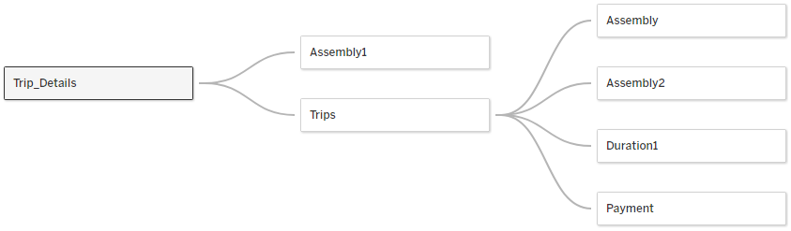
Data Relationship

Slide 6
Data Cleaning
Created Calculated Fields
Cancelled Trips – if either the Driver or the Customer cancelled the Trip
Same Location Trips – to flag loc_from = loc_to with unrealistic fare
Changed the datatypes of some variables from numeric to string to avoid aggregation errors

Slide 7
Variable Classification
Numerical Variables: Fare and Distance
Categorical Variables: All other variables

Slide 8
Ride Demand Over Time
Insight: Peak demand observed between 12 AM – 6 AM, with the highest at 12–1 AM
Trend: Demand declines during the day
Possible Reasons:
Limited public transport at night
Night-shift commutes
Visual: Line/Bar Chart showing trips by hour

Slide 9

Key Insights

Slide 10
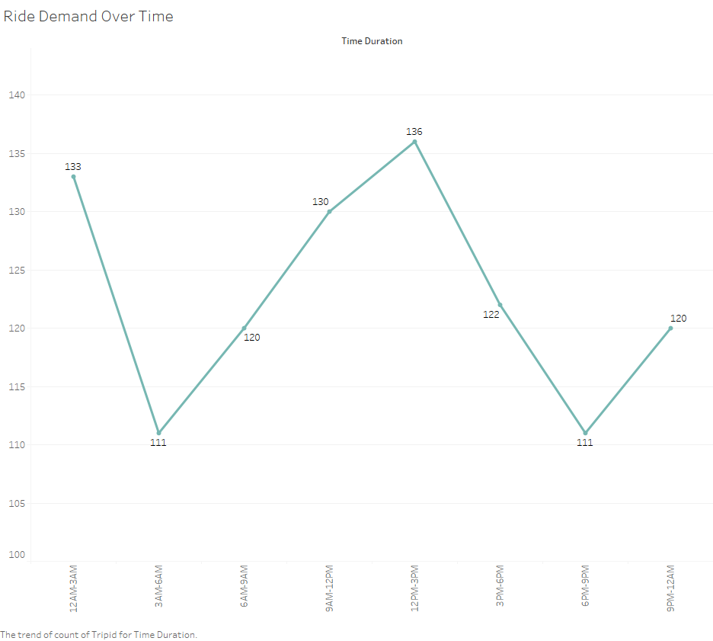
Unexpected Peak Hours
Peak hours are obtained during midnight & Midday.
Demand is steady with dips early in the morning; there is an opportunity to boost rides during mildly busy hours (12–3 PM).

Slide 11
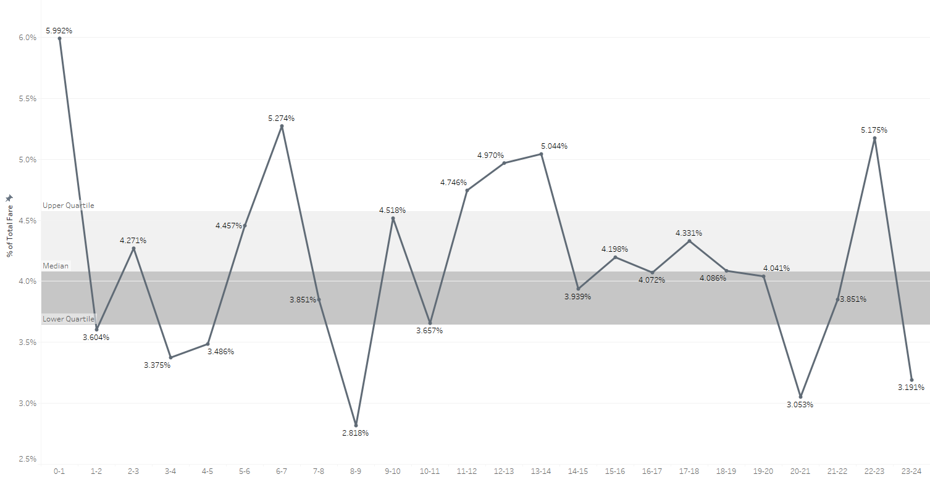
Lowest Revenue During Peak hour
During 8-9 AM lowest 2.88% Revenue of overall.
During 12PM-1AM highest 5.99% Revenue of overall.
Decision point: Explore pricing strategies or targeted driver coverage during these hours.

Slide 12
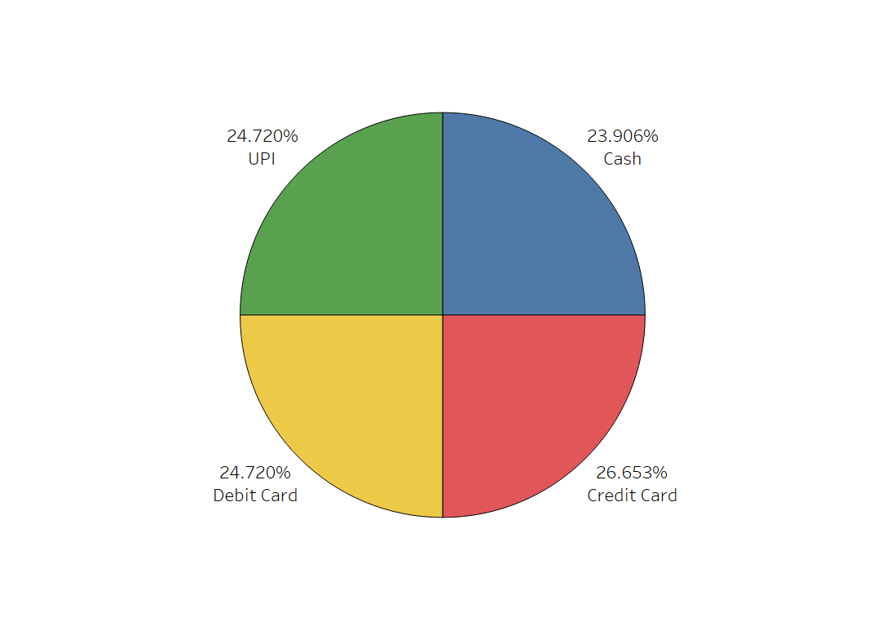
Promote UPI for Cost Saving
Credit Card (26.65%) is dominant
Suggestion: Ensure seamless experience for top methods; promote UPI for cost-saving

Slide 13
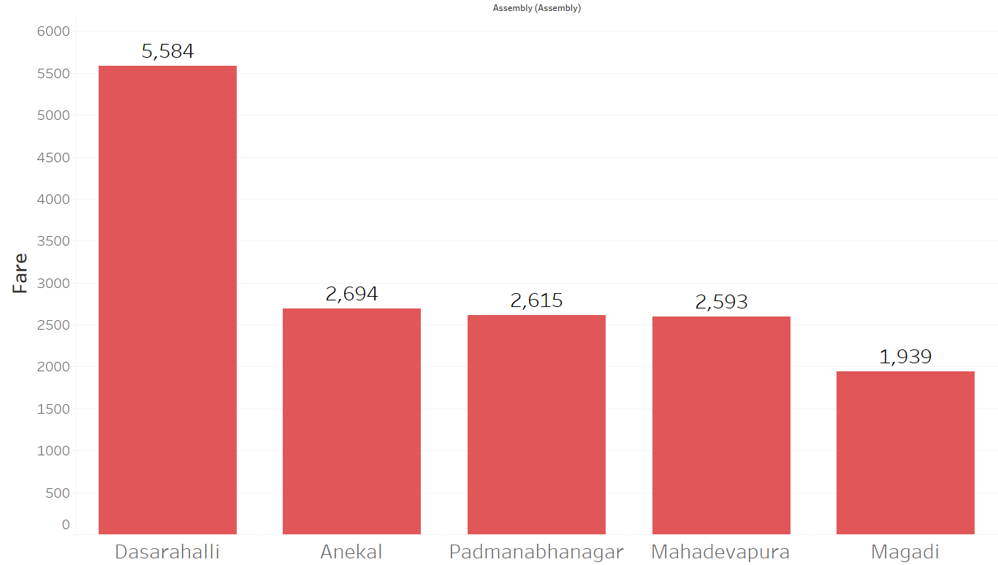
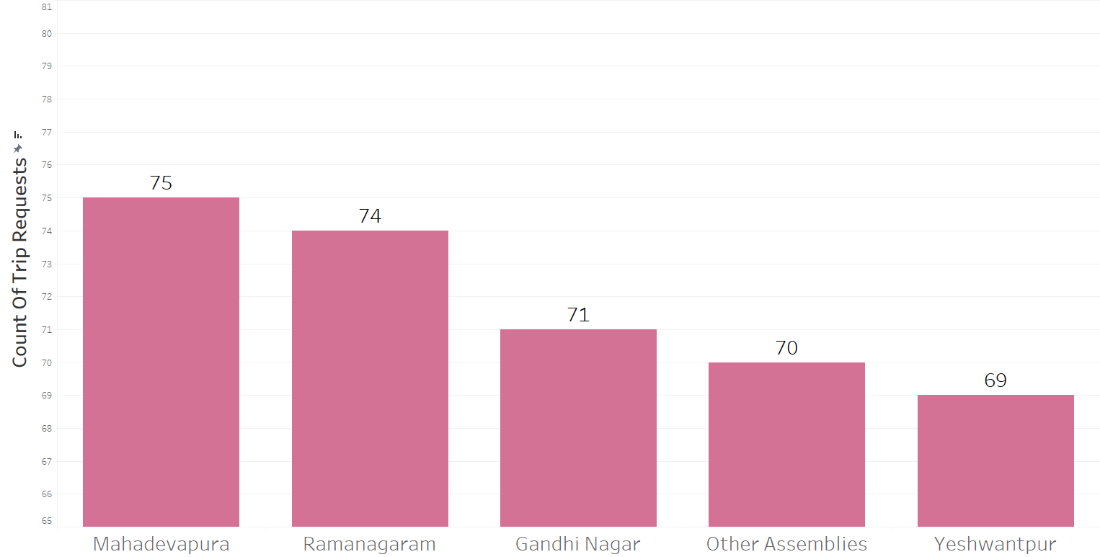
High Performing Zones
Top Zone by Trip value – Mahadevapura
Top Zone by Revenue – Bangalore South
Suggestion: Prioritize driver distribution and targeted promotions in these areas

Slide 14
47-48% Cancellation
Nearly 47 – 48% cancellation → Operational gap → lost revenue
Recommendation: Focused driver training or incentives to reduce cancellation and customer assurance initiatives
 | For Drivers | For Customer
Successful Rides | 52.75% | 51.83%
Cancelled Rides | 47.25% | 48.17%

Slide 15
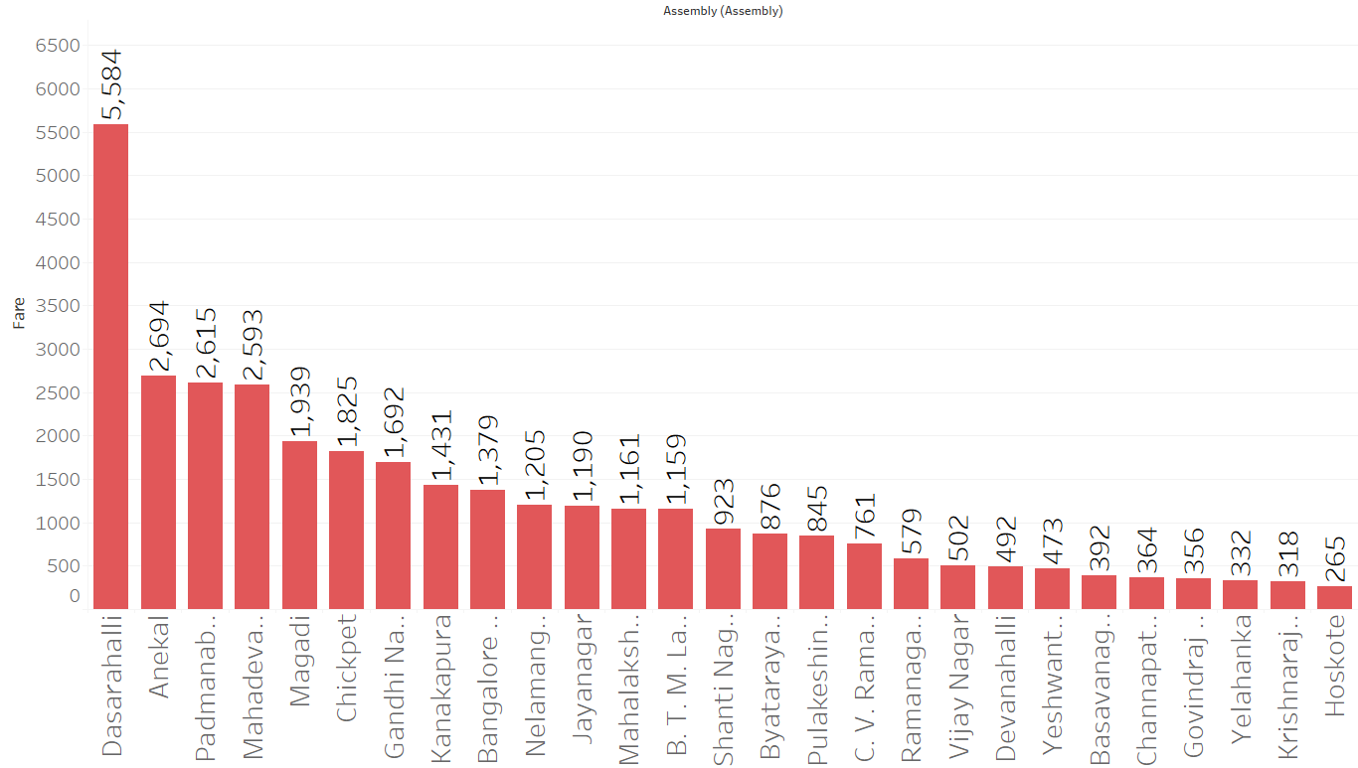
Parameter Creation & Filtering
Created Duration Parameter & Duration as Filter.
We used this to create an Interactive filter to view hourly revenue by location
Insight: e.g., Dasarahalli shows the highest revenue at 9 – 10 AM

Slide 16
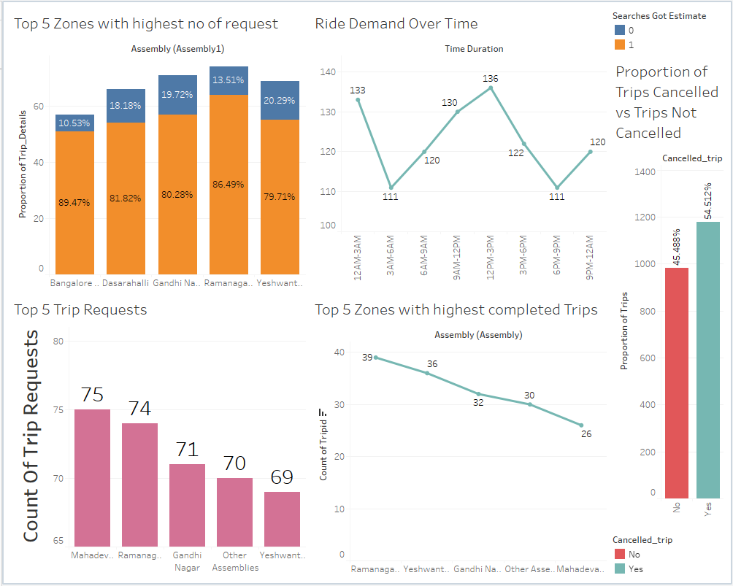
Dashboards & Interactions
Created by using charts
We can interact and do the filter operation
Data team can use this for internal monitoring

Slide 17
Conclusion & Recommendations
Key Takeaways:
Night hours see highest ride demand and revenue
Digital payment is dominant
Some zones significantly outperform others
Driver cancellations impact overall ride success
Next Steps:
Improve service during peak demand hours
Address driver-side cancellations
Promote zones with untapped potential

Slide 18
Thank You ...
Technical Report Summary Sargam & Subhadip

