Slide 1
Explorations in Circle packings
The Arbelos of Pappus, The Steiner Porism, and Soddy Circles

Slide 2
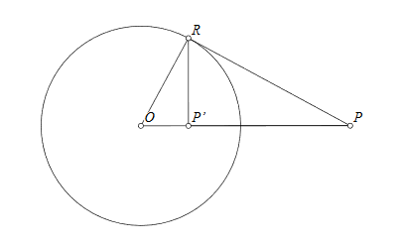
Inversion
Circles not passing through O invert to circles.
Circles passing through O invert to lines.
Lines passing through O invert to themselves.
Angle of intersection is preserved.
Cross-ratio of four collinear points is preserved if O lies on the line with the points.

Slide 3
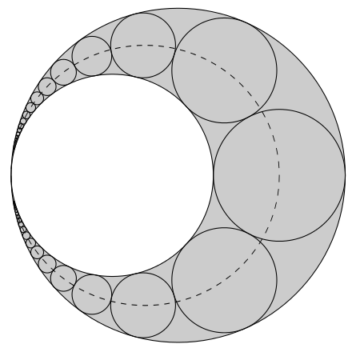
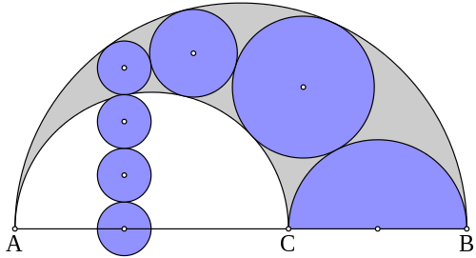

The Arbelos of Pappus
The height $hn$ of the center of the $n$^{th} circle above the base $ACB$ diameter equals $n$ times $dn$

Slide 4
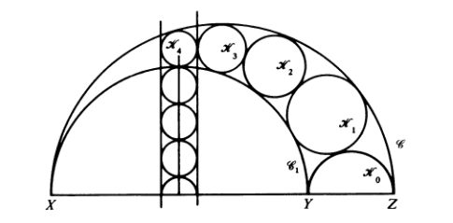
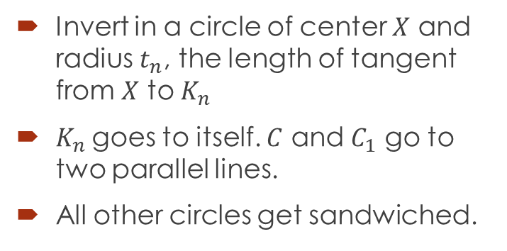
Proof of Pappus theorem
Invert in a circle of center $X$ and radius $t_{n}$, the length of tangent from $X$ to $K_{n}$
$K_{n}$goes to itself. $C$ and $C_{1}$ go to two parallel lines.
All other circles get sandwiched.

Slide 5
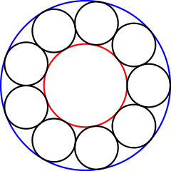
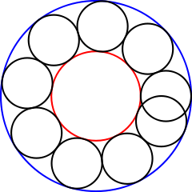
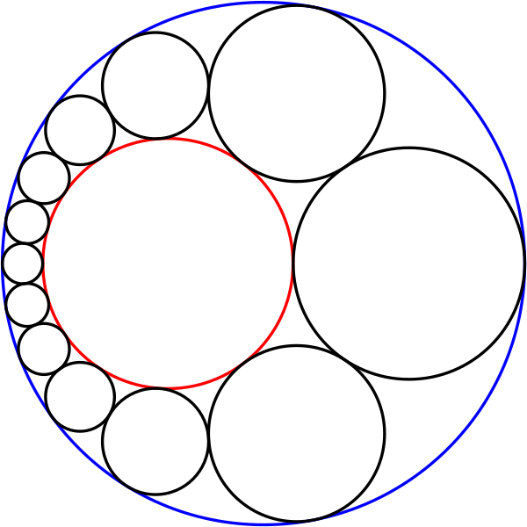
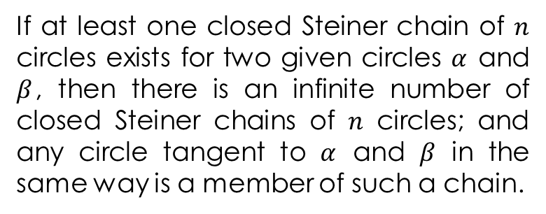
The Steiner Porism
If at least one closed Steiner chain of $n$ circles exists for two given circles $α$ and $β$, then there is an infinite number of closed Steiner chains of $n$ circles; and any circle tangent to $α$ and $β$ in the same way is a member of such a chain.

Slide 6
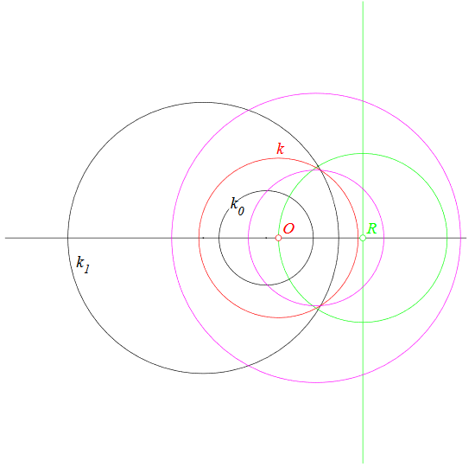
Proof of The Steiner Porism

Slide 7
Proof of The Steiner Porism

Slide 8
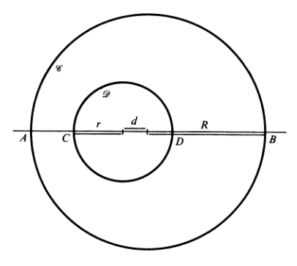
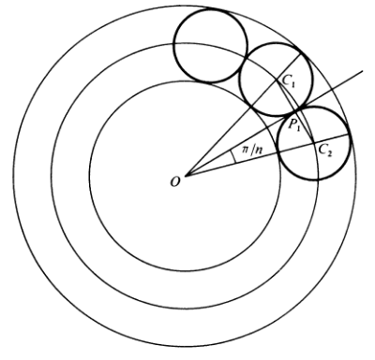

The Steiner Formula
Cross ratio of diameters is preserved by the inversion.
${\left(R−r\right)}^{2}– d^{2}=4Rr\tan^{2}\left(\frac{π}{n}\right)$
If $R,r,$and $d$ are rational, so is$\cos\left(\frac{2π}{n}\right)$
Happens only if $n=3,4,6$

Slide 9
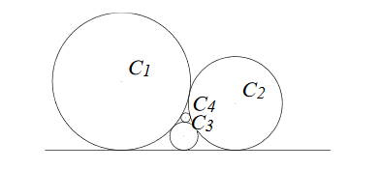

A Four-Circle problem
Let $r_{i}$and $h_{i}$denote respectively the radius and the height of the center of the$i^{th}$circle. If $r_{4}=1$, what is $h_{4} ?$

Slide 10
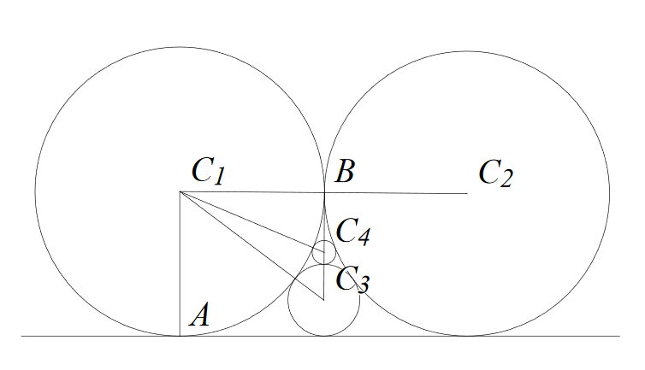
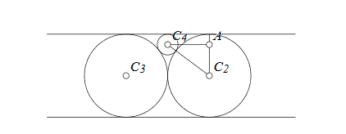
Solution
Ans: 7

Slide 11
The Kiss Precise by Frederick Soddy
(Generalized) by Thorold Gosset
And let us not confine our cares To simple circles, planes and spheres, But rise to hyper flats and bends Where kissing multiple appears, In n-ic space the kissing pairs Are hyperspheres, and Truth declares - As n + 2 such osculate Each with an n + 1 fold mate The square of the sum of all the bends Is n times the sum of their squares. In _Nature_ , January 9, 1937.
For pairs of lips to kiss maybe Involves no trigonometry. 'Tis not so when four circles kiss Each one the other three. To bring this off the four must be As three in one or one in three. If one in three, beyond a doubt Each gets three kisses from without. If three in one, then is that one Thrice kissed internally. Four circles to the kissing come. The smaller are the benter. The bend is just the inverse of The distance from the center. Though their intrigue left Euclid dumb There's now no need for rule of thumb. Since zero bend's a dead straight line And concave bends have minus sign, The sum of the squares of all four bends Is half the square of their sum. To spy out spherical affairs An oscular surveyor Might find the task laborious, The sphere is much the gayer, And now besides the pair of pairs A fifth sphere in the kissing shares. Yet, signs and zero as before, For each to kiss the other four, The square of the sum of all five bends Is thrice the sum of their squares.
In _Nature_, June 20, 1936
(Further Generalized) by Fred Lunnon
How frightfully pedestrian My predecessors were To pose in space Euclidean Each fraternising sphere! Let Gauss' k squared be positive When space becomes elliptic, And conversely turn negative For spaces hyperbolic: Squared sum of bends is sum times n Of twice k squared plus squares of bends.

Slide 12
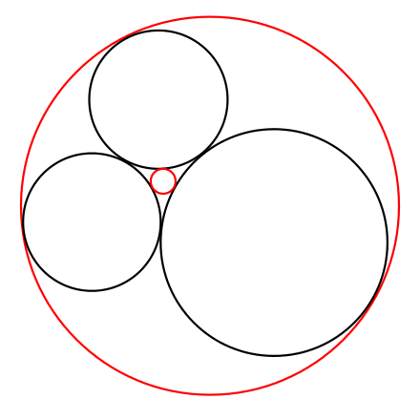
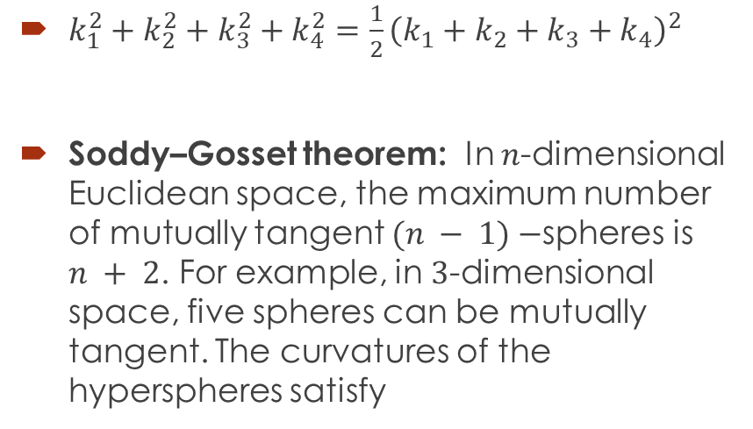
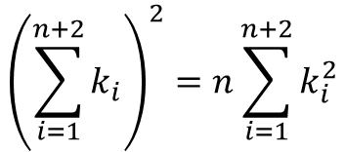
The Descartes Circle theorem
$k_{1}^{2}+k_{2}^{2}+k_{3}^{2}+k_{4}^{2}=\frac{1}{2}{\left(k_{1}+k_{2}+k_{3}+k_{4}\right)}^{2}$
Soddy–Gosset theorem: In $n$-dimensional Euclidean space, the maximum number of mutually tangent $(n − 1)−$spheres is $n + 2$. For example, in $3$-dimensional space, five spheres can be mutually tangent. The curvatures of the hyperspheres satisfy
$${\left(\sum_{i=1}^{n+2}{k_{i}}\right)}^{2}=n\sum_{i=1}^{n+2}{k_{i}^{2}}$$

Slide 13
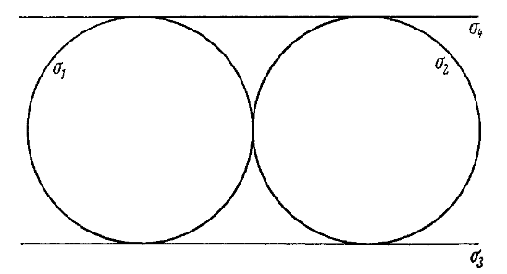
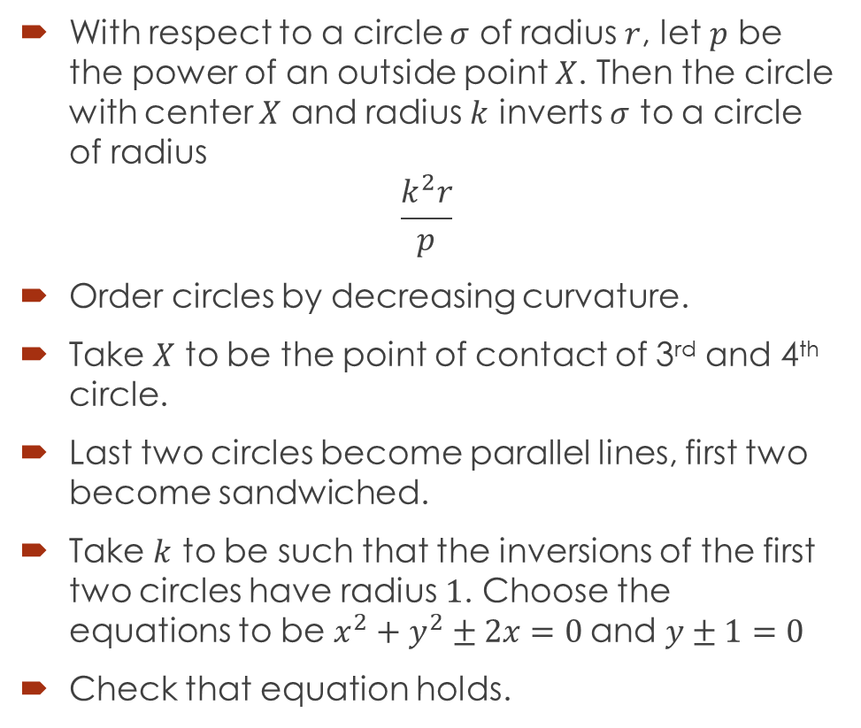
Proof of Descartes Circle theorem
With respect to a circle $σ$ of radius $r$, let $p$ be the power of an outside point $X$. Then the circle with center $X$ and radius $k$ inverts $σ$ to a circle of radius
$$\frac{k^{2}r}{p}$$
Order circles by decreasing curvature.
Take $X$ to be the point of contact of 3rd and 4th circle.
Last two circles become parallel lines, first two become sandwiched.
Take $k$ to be such that the inversions of the first two circles have radius $1$. Choose the equations to be $x^{2}+y^{2}±2x=0$and $y±1=0$
Check that equation holds.

Slide 14

Most Generalized form
The original result generalizes nicely to curved $n$-space with curvature $ν$ [e.g. $ν^{2}=1$for elliptic space, $−1$ for hyperbolic] in the form
${\left(\sum_{i}{k_{i}}\right)}^{2}−n$ $\sum_{i}{k_{i}^{2}}=2n$ $ν^{2}$
Ivars Petersen "Circle Game" in Science News (2001) \bf 159 (16) p.254

Slide 15
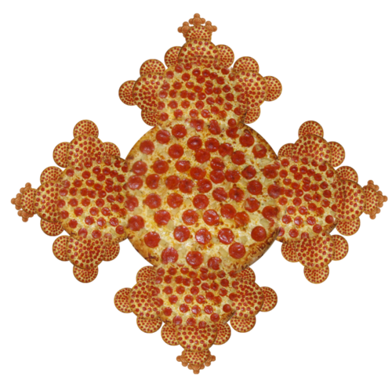
Thank you.

