Slide 1
(chess)Board Domination by Sightseeing Monarchy
Combinatorics of chessboard puzzles about domination, independence and tours

Slide 2


History
1960 - The study of domination in graphs began.
1862 - C.F. De Jaenisch attempted to determine the minimum number of queens required to cover an chess board.
N-Queens Problem:
You can place queens on an chessboard so that no two queens attack each other. A solution exists for all natural numbers n except 2 and 3.

Slide 3




Domination and Independence
In a graph G, a set S V(G) is a dominating set if every vertex not in S has a neighbor in S.
The domination number (G) is the minimum size of a dominating set in G.
A set S V(G) is a independent set if no two vertices in S are adjacent.
The independence number (G) is the maximal cardinality of an independent set in G.
A set of vertices in a graph is an independent dominating set if and only if it is a maximal independent set.
The independent domination number (G) is the minimum cardinality among all independent dominating sets of G which is also equal to the minimum cardinality of a maximal independent set in G.

Slide 4

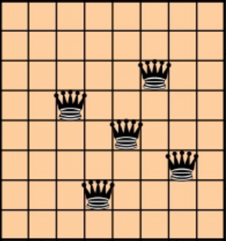
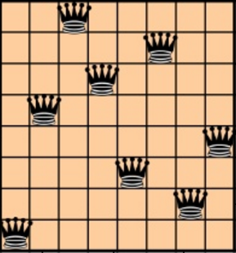


Clearly,

Slide 5




Domination by the Monarchy
Upper bound for Queen’s domination
Lower bound for Queen’s domination

Slide 6





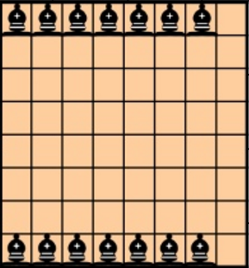
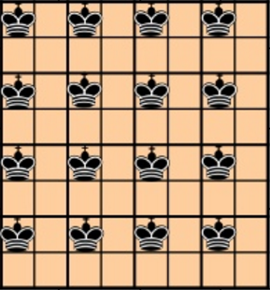


Independence of the Monarchy
, Number of permutations for square board
, Number of permutations
Number of permutations

Slide 7

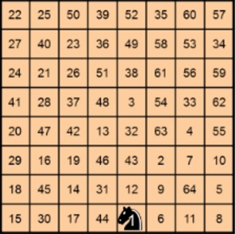

Knights put the S in BDSM
A Knight’s tour is a succession of moves made by a knight that traverses every square on a chessboard exactly once.

Slide 8
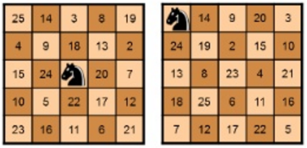



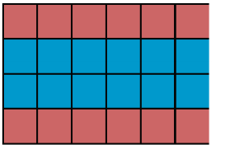

Examples
No closed Knight’s tour exists if are both odd.
Easy to prove by a coloring argument.
But open tours can exist.
A chessboard has no closed Knight’s tour.
In general, a chessboard has a closed Knight’s tour unless at least one of following three conditions hold:

Slide 9
Proof of the formula 2 slides ago
Will prove for the case of square boards only
When side length is even
Place all knights in Black squares
This independent set of Knights is maximal if the board has a closed Knight’s tour!
When side length is odd
Place all knights in whichever color has more squares
This independent set of Knights is maximal if the board has a open Knight’s tour!
Well, does it?

Slide 10

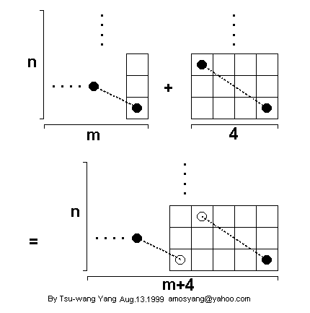
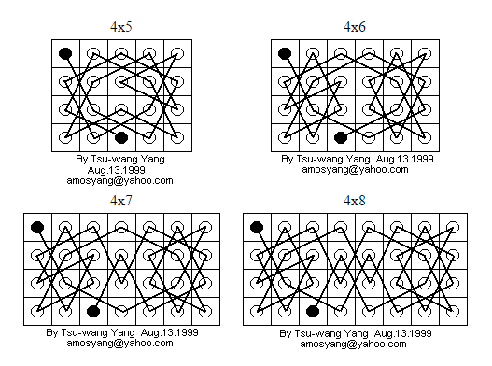
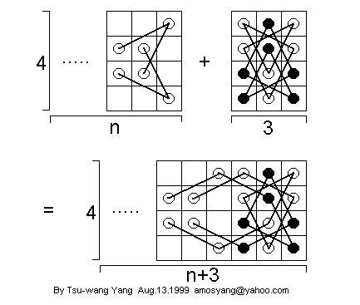
Proof of the formula 2 slides ago (ctd…)
In case
Start with
Extend further.

Slide 11

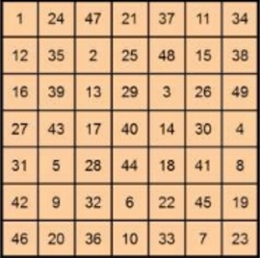
Knights tours are magical!
…as long as is not divisible by
175
175
175
175
175
175
175
175
175
175
175
175
175
175
175
175

Slide 12
Other Surfaces and Variations
Much work has been done in case of Torus, Cylinder, Klein bottle and Möbius strip
We will look at the torus case only for lack of time!
Nothing changes for Rooks!
The case of Bishops is also easy enough.
The related problems on a Queen’s graph are not so straightforward.

Slide 13

Queens graphs for chessboards on the torus

Slide 14
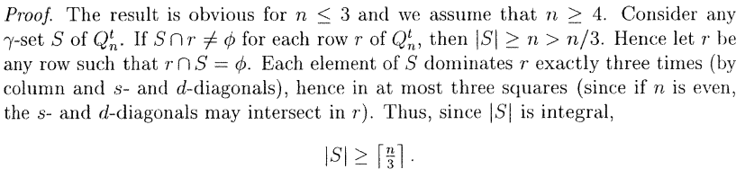

Other side of the story

Slide 15

References
Across the Board: The Mathematics of Chessboard Problems, By John J. Watkins
Chessboard Puzzles, By Dan Freeman
Queens graphs for Chessboards on the torus, By Burger, Mynhardt

Slide 16
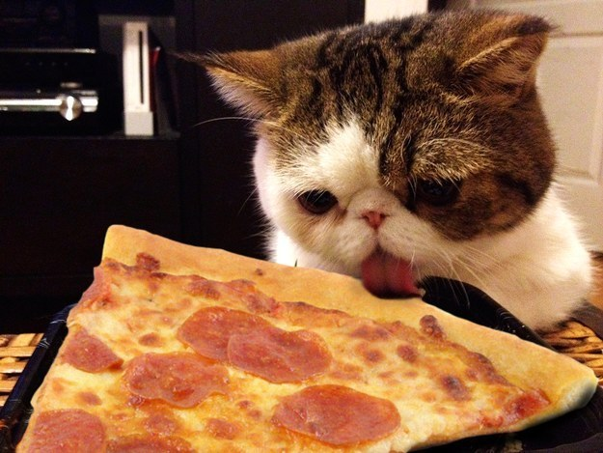
Thank you!

