Slide 1
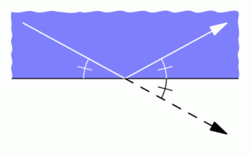
The Illumination Problem and Rational Billiards
An Introduction to Translation Surfaces

Slide 2

The Illumination Problem
Question 1
Is a region illuminable from every point in the region?
Question 2
Is a region illuminable from at least one point in the region?

Slide 3
Convex Room

Slide 4
Non-convex Room?

Slide 5
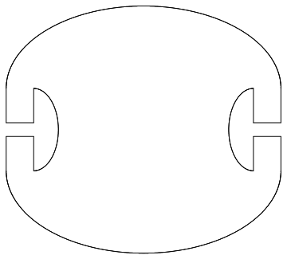
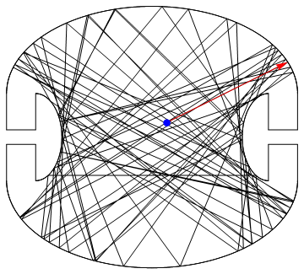
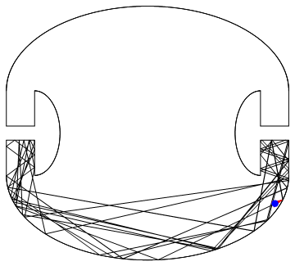
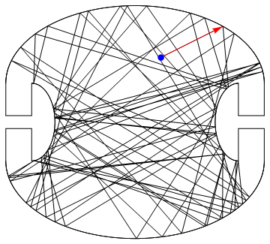
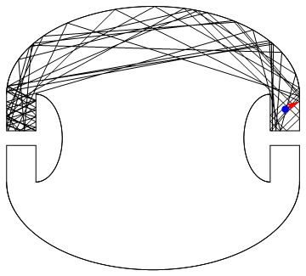
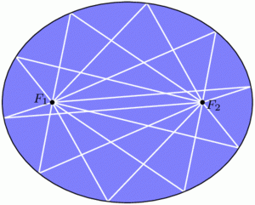
Penrose Room (1958)

Slide 6
Question 1 Is a region illuminable from every point in the region? Ans (Guy and Klee) No. There are smooth regions not illuminable from any point.

Slide 7
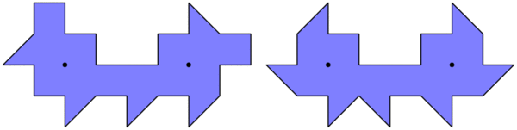
Polygonal Rooms
There is no pool shot from the yellow point to the black point.
Tokarski (1995)
Castro (1997)

Slide 8
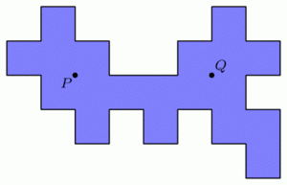
Folding and Unfolding

Slide 9
Folding Animation
See Animation

Slide 11
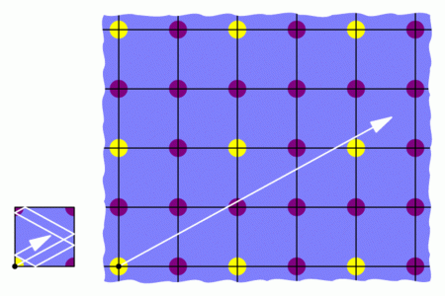
Unfolding

Slide 12
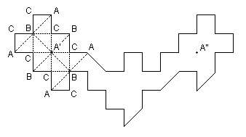
Also works with isosceles right angled triangles

Slide 13

Rational Polygon
All angles are rational multiples of $π$

Slide 15
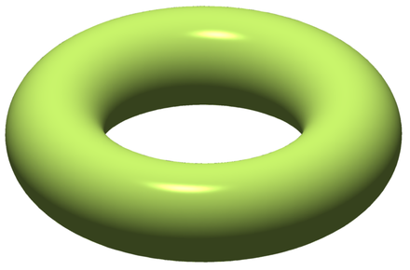
Translation Surface

Slide 16
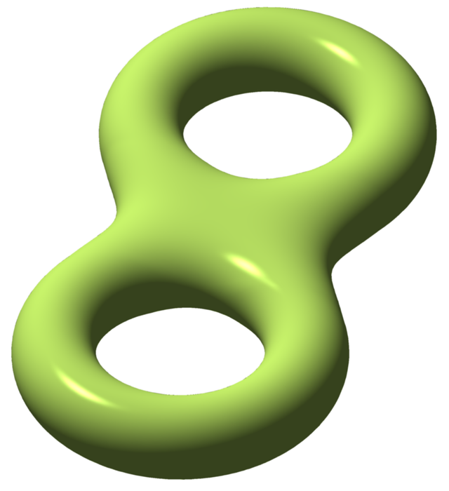
II
II
Back
Front
I
I
III
V
V
VI
IV
V
Front
Back
V
III
I
I
II
II

Slide 17
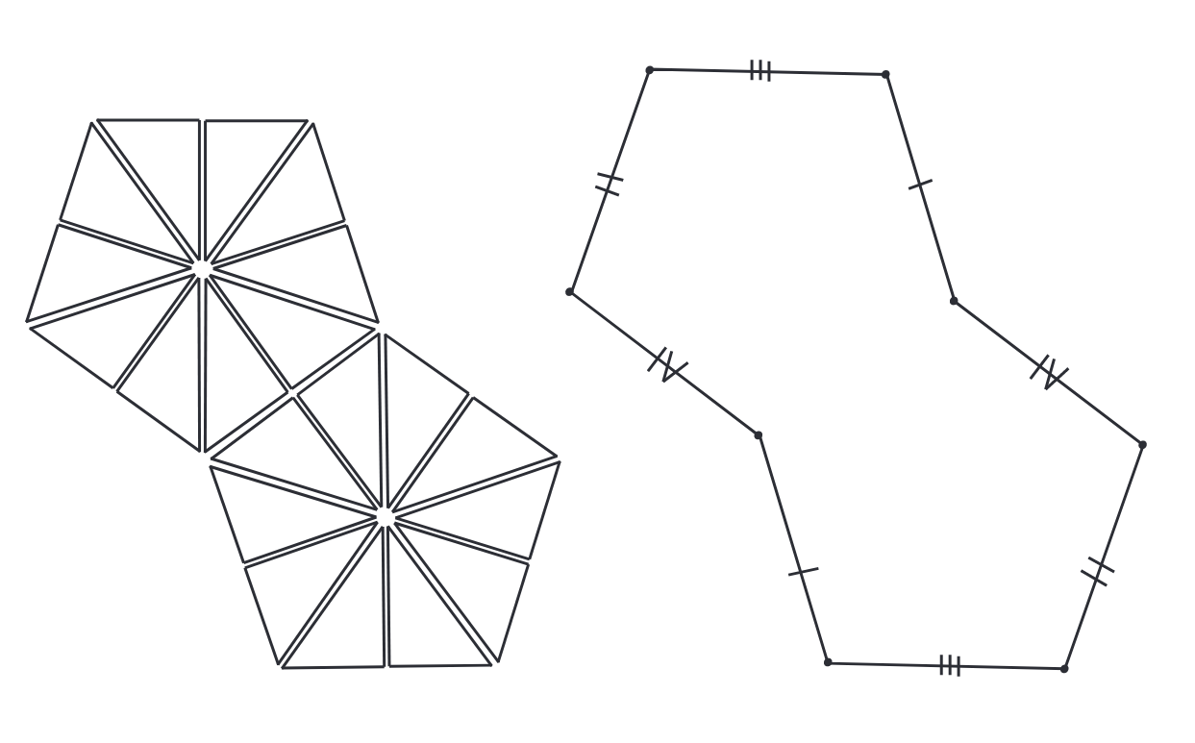
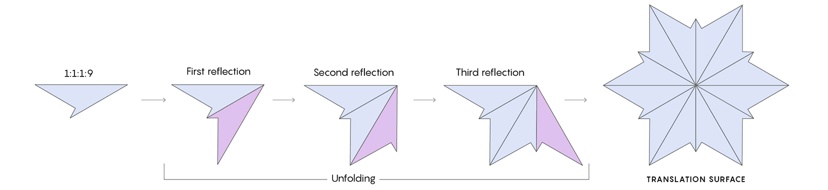

($π/5$, $3π/10$, $π/2)$ Triangle
A non-convex example
(McMullen-Mukamel-Wright)

Slide 18
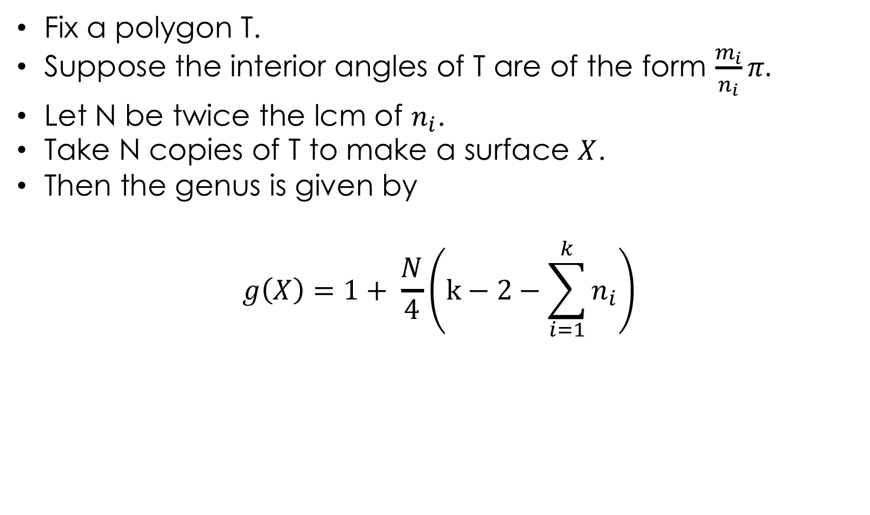
Fix a polygon T.
Suppose the interior angles of T are of the form $\frac{m_{i}}{n_{i}}π.$
Let N be twice the lcm of $n_{i}$.
Take N copies of T to make a surface $X$.
Then the genus is given by
$$g\left(X\right)=1+ \frac{N}{4}\left(k−2−\sum_{i=1}^{k}{n_{i}}\right)$$

Slide 19
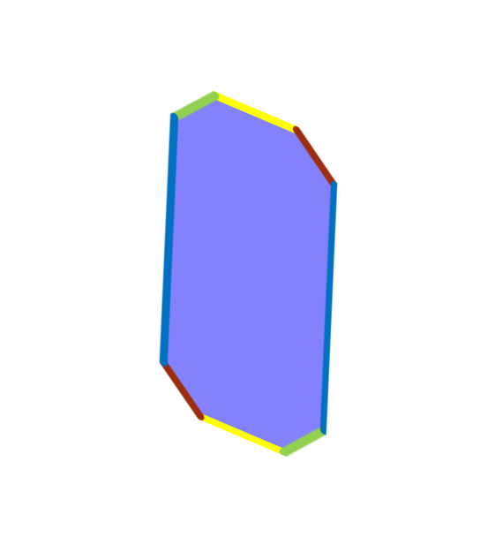
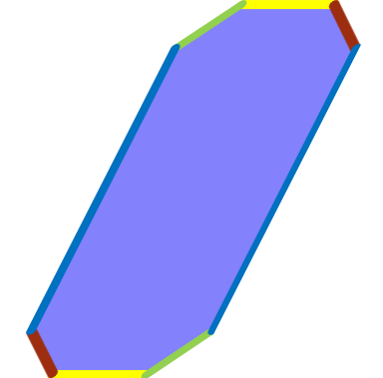
Surface Transformations

Slide 20
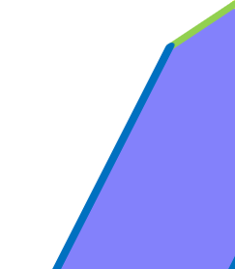


Cut and Reassemble

Slide 21
Eskin-Mirzakhani-Mohammadi

Slide 22
Consequence: Everything is illuminated! (with exception of finitely many points)

Slide 23
Thank you!
References:
Everything is illuminated, Samuel Lelievre, Thierry Monteil, Barak Weiss
Three-Cornered Things, Zachary Abel's Math Blog
Rational billiards and flat structures, Howard Masur and Serge Tabachnikov
Isolation theorems for SL(2,R)-invariant submanifolds in moduli space, Alex Eskin, Maryam Mirzakhani, and Amir Mohammadi

