Slide 2


Id
Price | Location | SqFt | Bedrooms | Bathrooms | Year Built
Id=1
350000 | Downtown | 1200 | 2 | 2 | 2010
Id=2
500000 | Suburb | 2000 | 4 | 3 | 2005
Id=3
250000 | Rural | 1500 | 3 | 2 | 1990
Id=4
600000 | Downtown | 1800 | 3 | 2 | 2015
Id=5
900000 | Beachfront | 2500 | 5 | 4 | 2020
Id=6
400000 | Suburb | 1400 | 3 | 2 | 1920

Slide 3
Id
Price | Location | SqFt | Bedrooms | Bathrooms | Year Built
Id=4
600000 | Downtown | 1800 | 3 | 2 | 2015
Id=5
900000 | Beachfront | 2500 | 5 | 4 | 2020
Id=4
600000 | Downtown | 1800 | 3 | 2 | 2015
Id=6
400000 | Suburb | 1400 | 3 | 2 | 1920
Id=5
900000 | Beachfront | 2500 | 5 | 4 | 2020
Id=3
250000 | Rural | 1500 | 3 | 2 | 1990

Slide 4
Id
Price | Location | SqFt | Bedrooms | Bathrooms | Year Built
Id=2
500000 | Suburb | 2000 | 4 | 3 | 2005
Id=6
400000 | Suburb | 1400 | 3 | 2 | 1920
Id=3
250000 | Rural | 1500 | 3 | 2 | 1990
Id=1
350000 | Downtown | 1200 | 2 | 2 | 2010
Id=6
400000 | Suburb | 1400 | 3 | 2 | 1920
Id=1
350000 | Downtown | 1200 | 2 | 2 | 2010

Slide 5
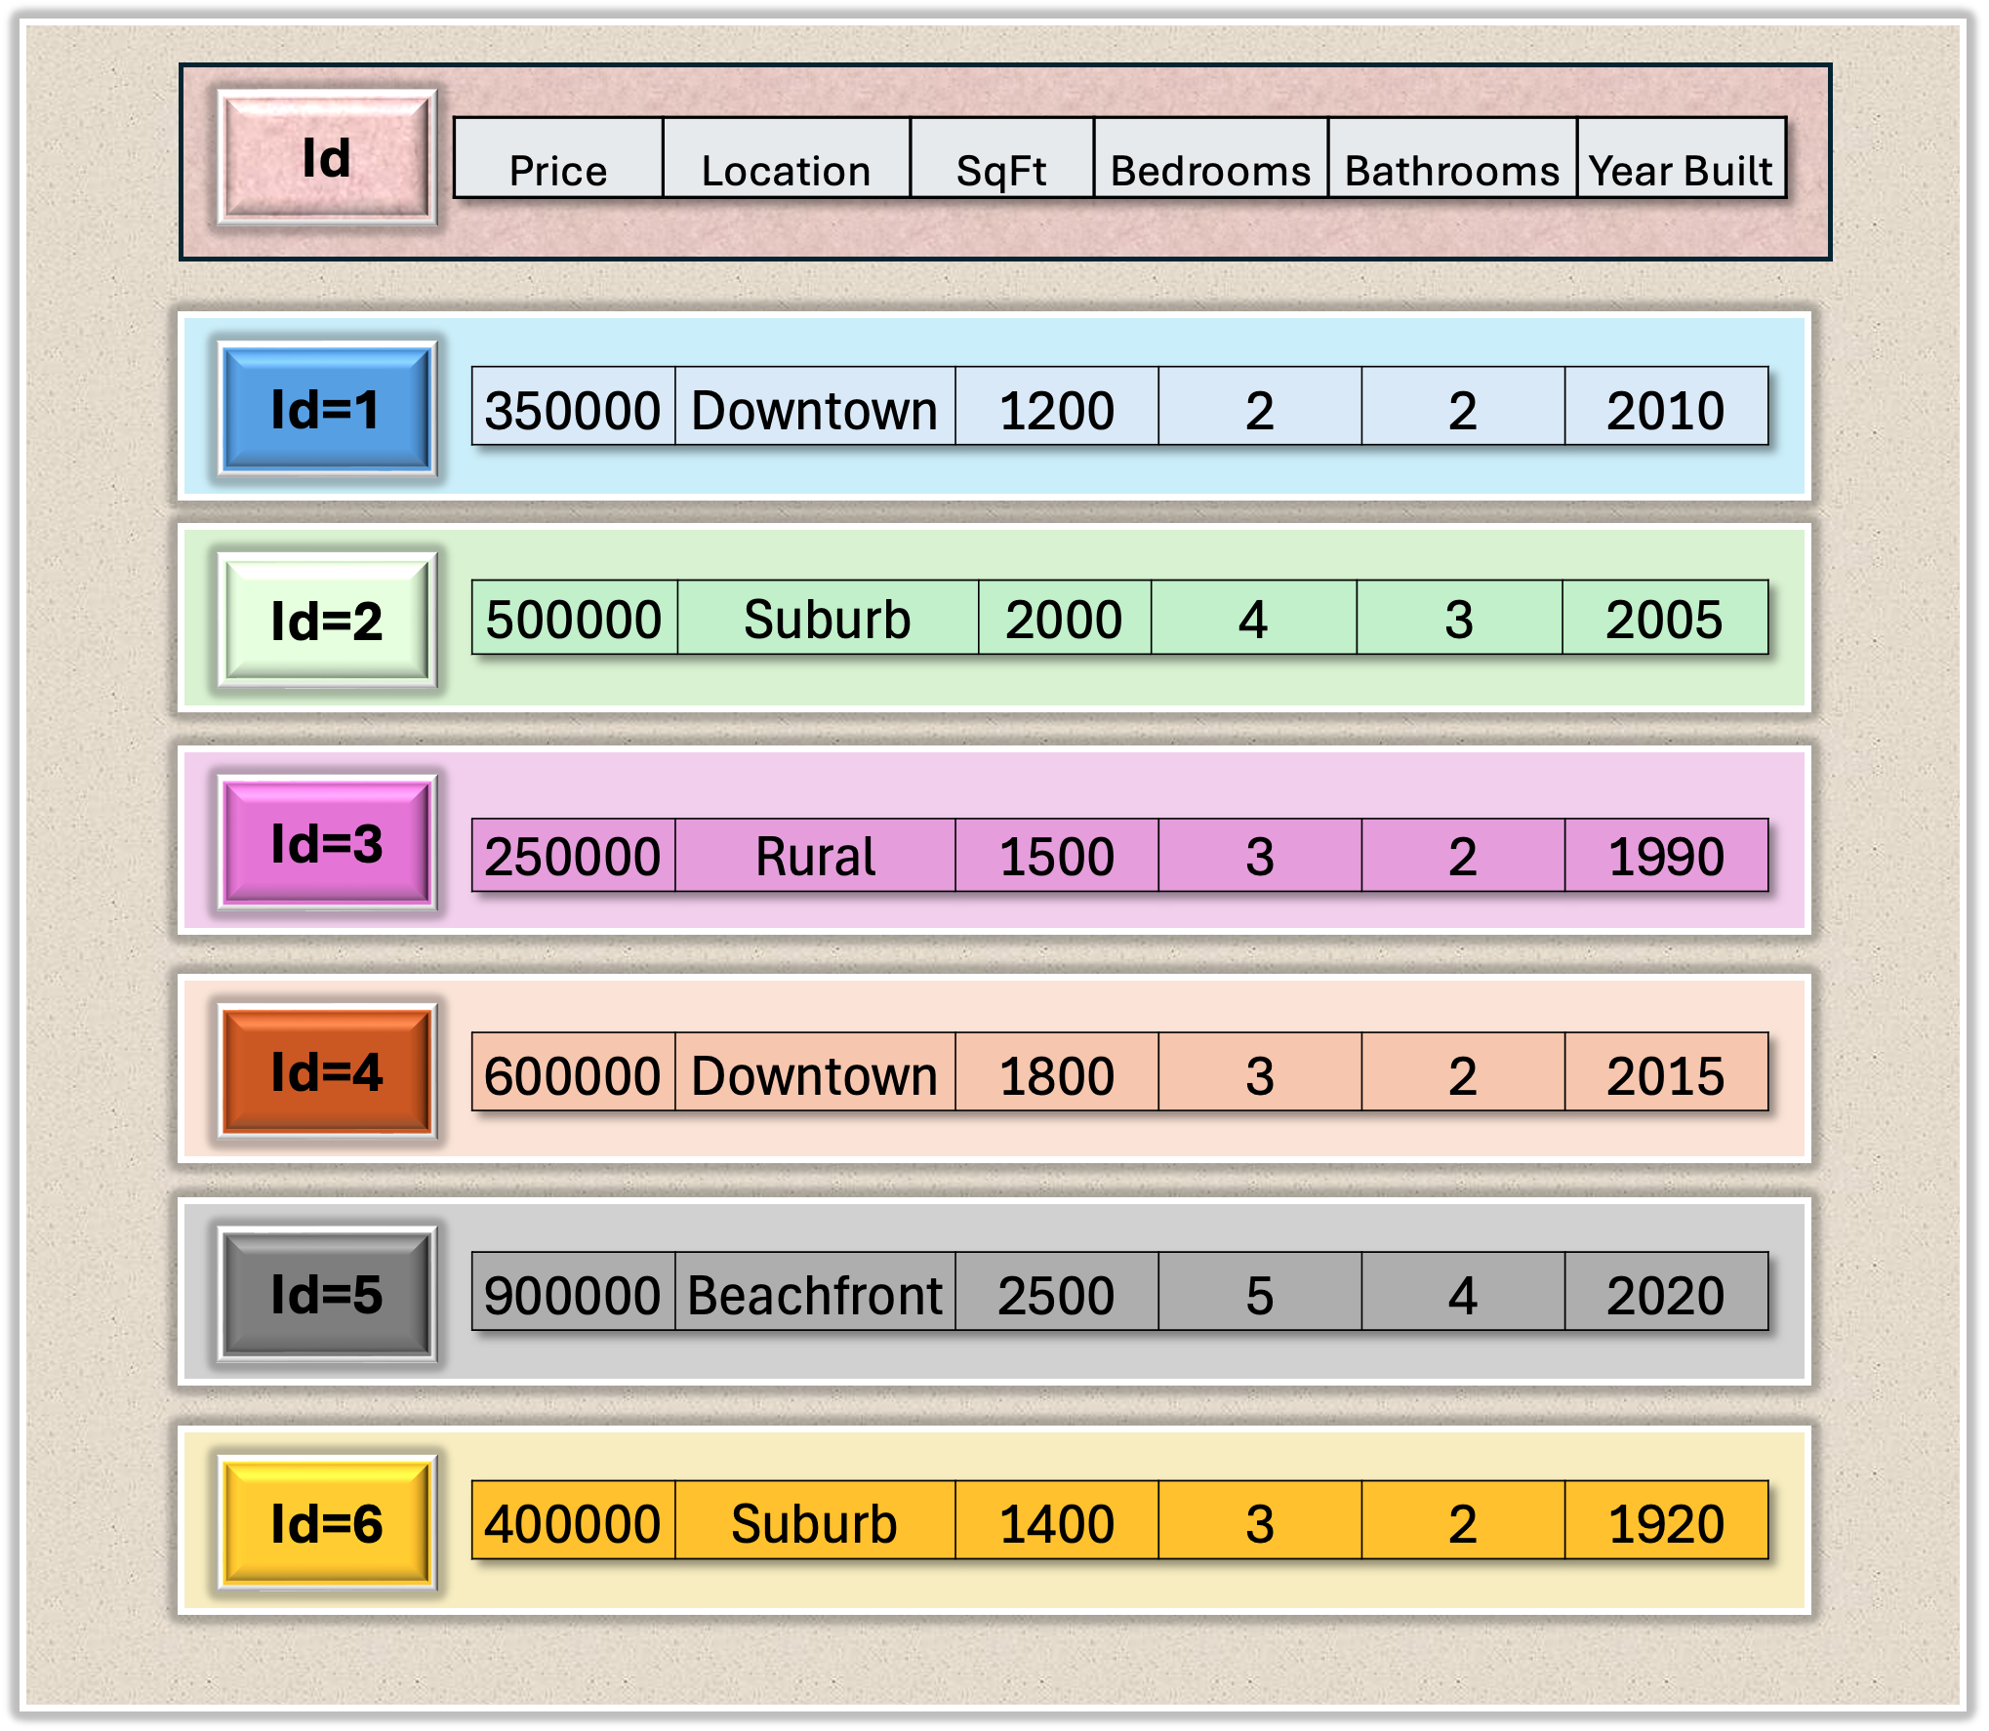
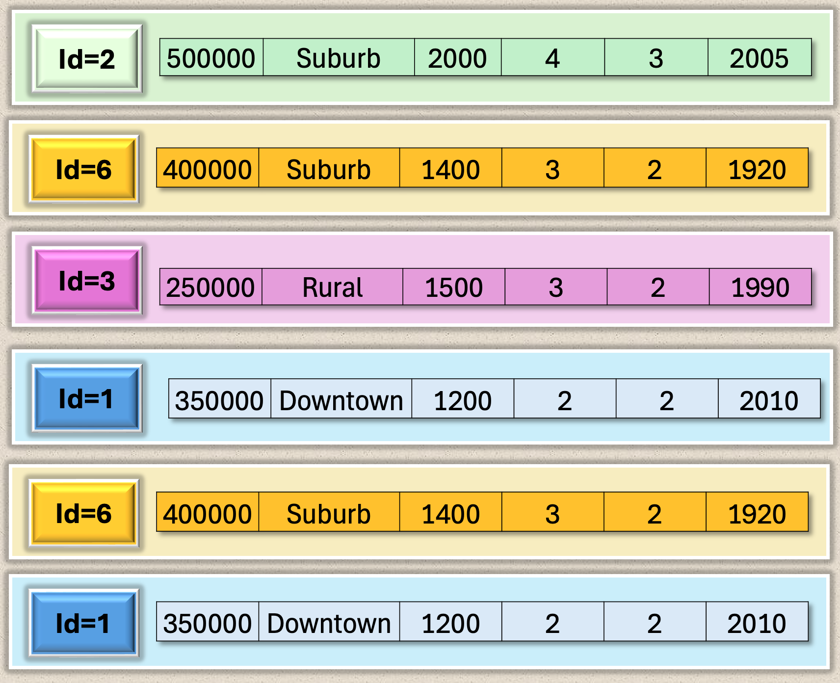
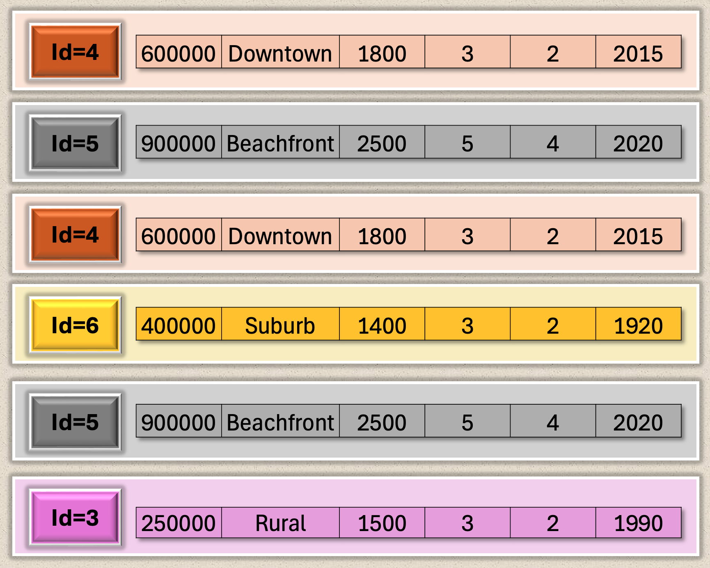
Bootstrap sample
1
Bootstrap sample
2

Slide 6
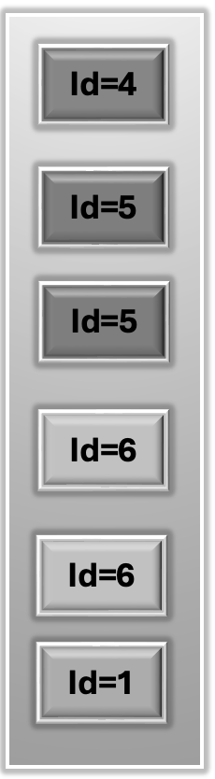
Id=2
Id=3
Id=4
Id=5
Id=2
Id=6
Id=1
Id=5
Id=2
Id=6
Id=3
Id=6
Id=3
Id=3
Id=5
Id=1
Id=4
Id=1
Id=5
Id=4
Id=2
Id=6
Id=6
Id=4
Id=6
Id=1
Id=3
Id=1
Id=3
Id=1

Slide 7
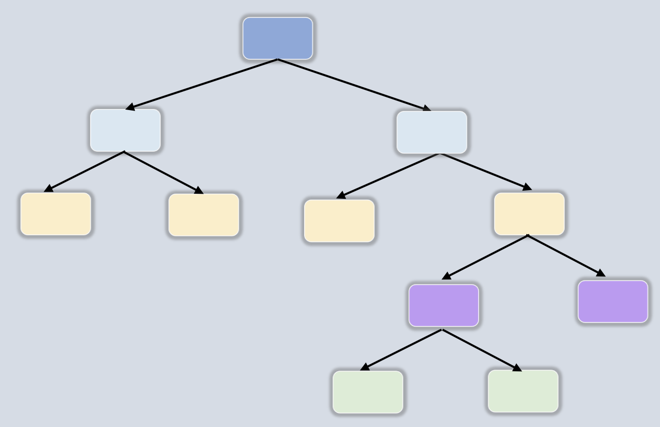
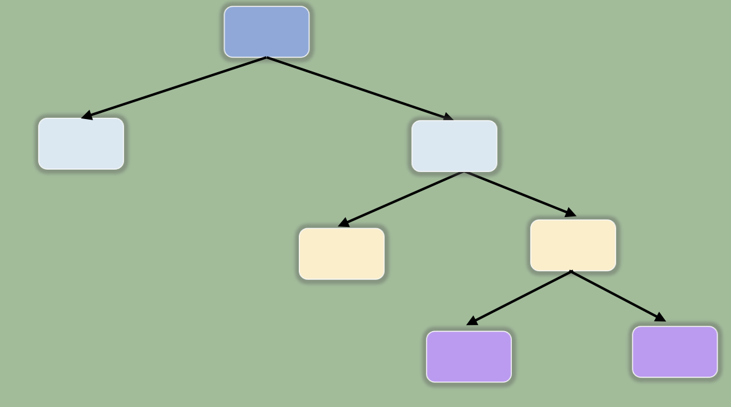
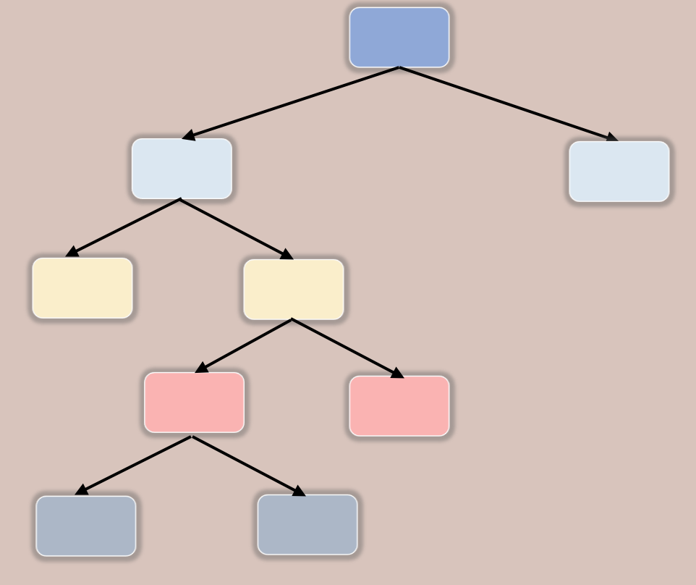
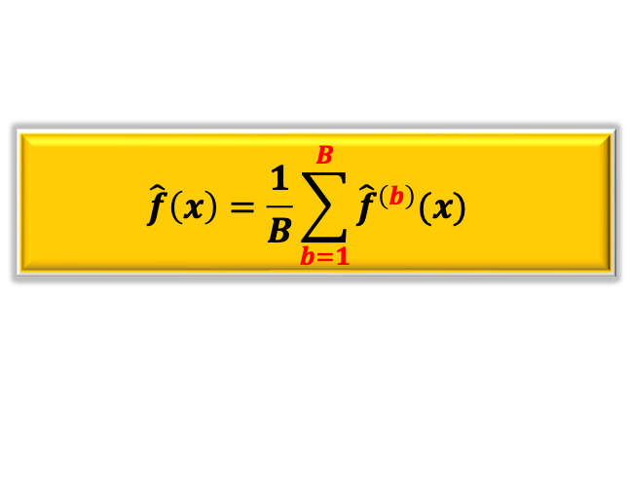
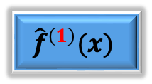
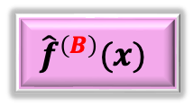
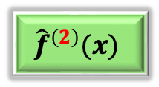
Training Data
Testing Data
Bootstrap Sample
1
Bootstrap Sample
2
Bootstrap Sample
B
…
Prediction 1
Prediction 1
Prediction 1
$${\hat{f}}^{\left(1\right)}(x)$$
$${\hat{f}}^{\left(2\right)}(x)$$
$${\hat{f}}^{\left(B\right)}(x)$$
Overall Prediction
$$\hat{f}\left(x\right)=\frac{1}{B}\sum_{b=1}^{B}{{\hat{f}}^{\left(b\right)}(x) }$$

Slide 8
Training Data
Testing Data
Bootstrap Sample
1
Bootstrap Sample
2
Bootstrap Sample
B
…
Modified
Strategy
Modified
Strategy
Modified
Strategy
Prediction 1
Prediction 1
Prediction 1
$${\hat{f}}^{\left(1\right)}(x)$$
$${\hat{f}}^{\left(2\right)}(x)$$
$${\hat{f}}^{\left(B\right)}(x)$$
Overall Prediction
$$\hat{f}\left(x\right)=\frac{1}{B}\sum_{b=1}^{B}{{\hat{f}}^{\left(b\right)}(x) }$$

Slide 9
Training Data
Testing Data
Bootstrap Sample
1
Bootstrap Sample
2
Bootstrap Sample
B
…
Prediction 1
Prediction 1
Prediction 1
$${\hat{f}}^{\left(1\right)}(x)$$
$${\hat{f}}^{\left(2\right)}(x)$$
$${\hat{f}}^{\left(B\right)}(x)$$
Overall Prediction
$$\hat{f}\left(x\right)=\frac{1}{B}\sum_{b=1}^{B}{{\hat{f}}^{\left(b\right)}(x) }$$

Slide 10









$X_{3}<4$
$X_{1}<5$
$X_{4}<7$
$X_{7}<10$
$X_{4}<1$
$X_{7}<3$
$X_{7}<5$
$X_{4}<3$
$X_{1}<11$

Slide 11

Tree1
Tree2

Slide 12








$X_{3}<4$
$X_{3}<4$
$X_{4}<7$
$X_{4}<7$
$X_{7}<3$
$X_{7}<3$
$X_{1}<11$
$X_{6}<3$

Slide 13
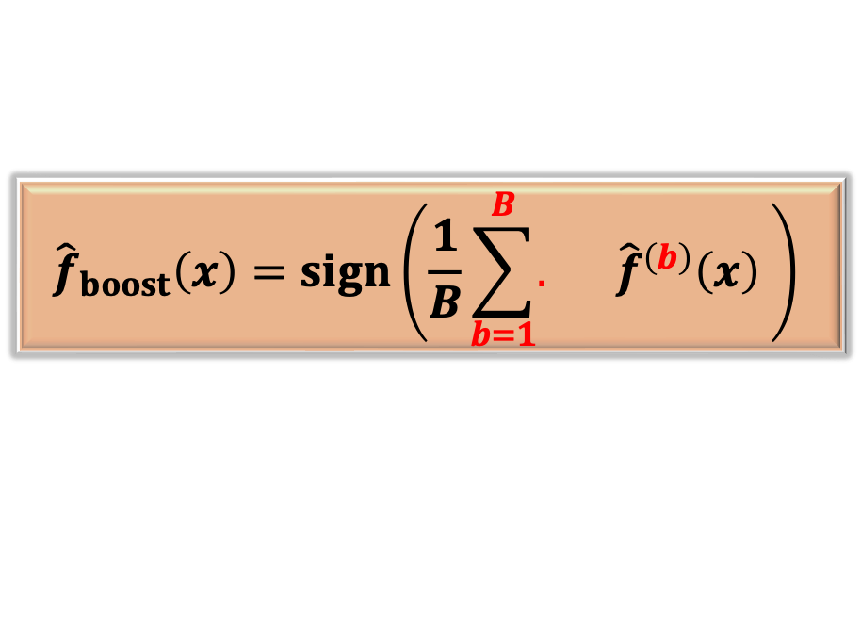




Training Data
Testing Data
Bootstrap Sample
1
Bootstrap Sample
2
Bootstrap Sample
B
…
Prediction 1
Prediction 1
Prediction 1
$${\hat{f}}^{\left(1\right)}(x)$$
$${\hat{f}}^{\left(2\right)}(x)$$
$${\hat{f}}^{\left(B\right)}(x)$$
$$α_{1}$$
$$α_{2}$$
$$α_{B}$$
Overall AdaBoost Prediction
$${\hat{f}}_{boost}\left(x\right)=sign\left(\frac{1}{B}\sum_{b=1}^{B}{. {\hat{f}}^{\left(b\right)}\left(x\right) }\right)$$
$$α_{b}$$

Slide 14

Tree1
Tree2

