Slide 1
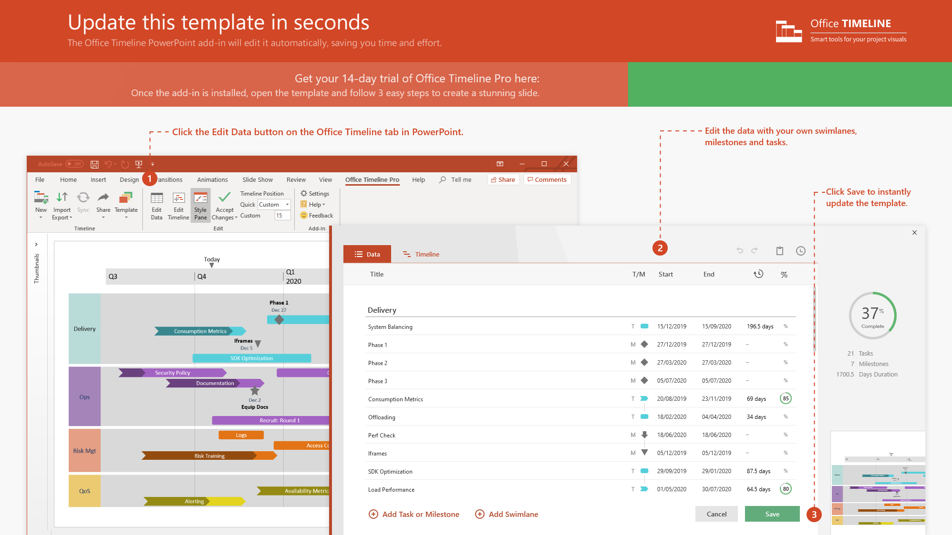
https://www.officetimeline.com/14-days-trial

Slide 2
Swimlane Diagram template
Q1 Review
Q2 Review
Q3 Review
Q4 Review
Q1
Q2
Q3
Q4
Vision
100%
Planning
Objectives
100%
100%
Goals
Strategic Intent
Sales Budget
Beta + Release Plans
Competitor Review
Market Analysis
SWOT
Strategy
Price List (Hypothesis)
Final Price List
Business Model
Price Research
Objectives
Sales Trends Analysis
Service Development
Alpha
Private Beta
Public Beta
Staging
Go Live!
6.3 wks
22 wks
May 20
Jun 30
Aug 10
Nov 15
Dec 20
75%
Product Roadmap
Development
RC
Release to Web
Business Intelligence
Service Metrics
Quality Metrics
Service Dashboard
Real-time Analytics
Sales Dashboard
Conversion Metrics
Real-time Reporting

