Slide 1
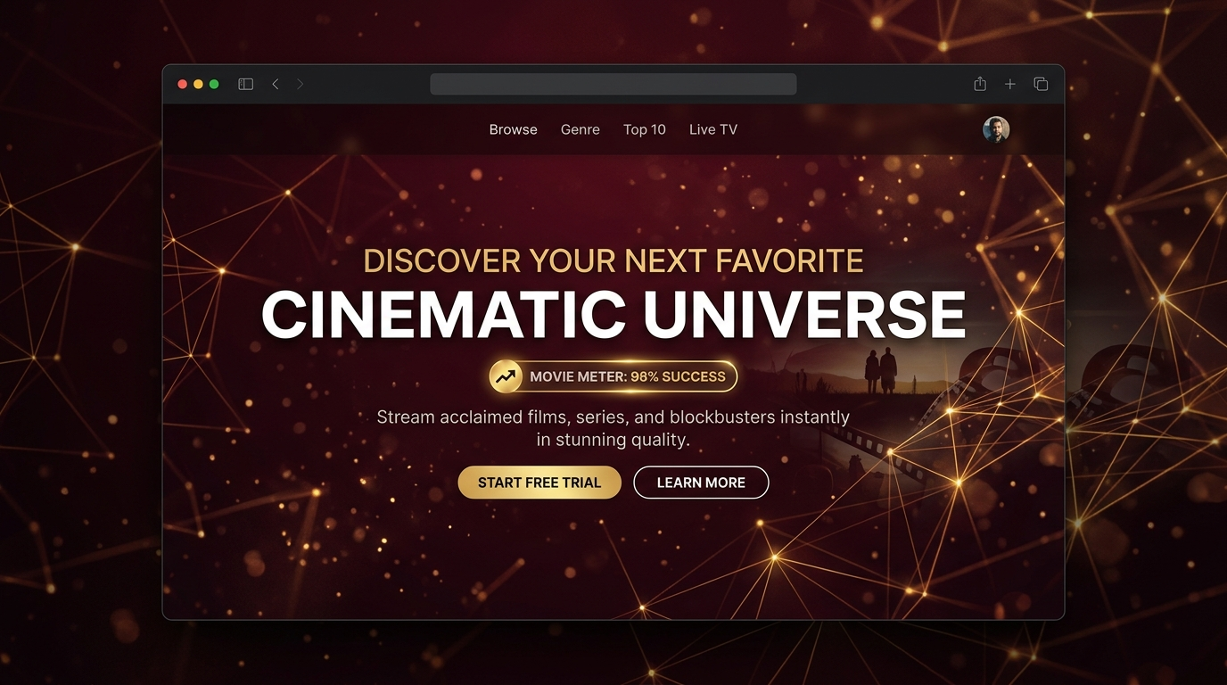
MOVIE METER
AI-Powered Cinema Success Analytics Platform
Designed for South Indian Cinema Catalog Acquisitions

Slide 2
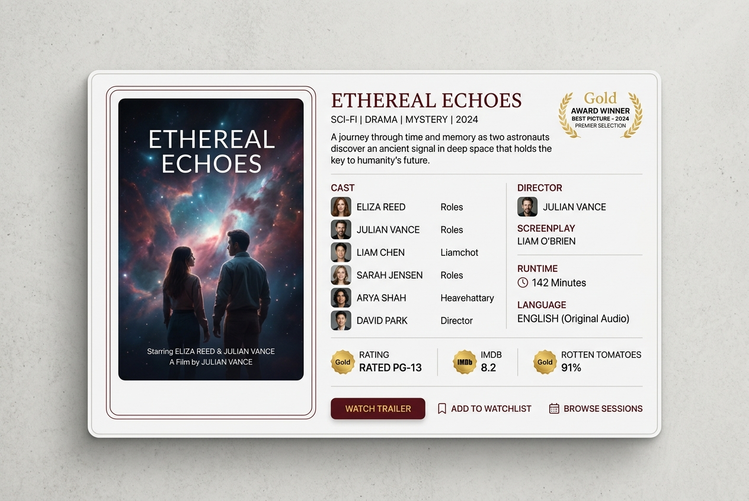
The Business Problem: Capital Risk in Acquisitions
• Traditional catalog licensing for OTT platforms carries severe premium cost risks.
• Pre-production budget planning is frequently based on subjective actor/director packaging.
• Standard predictive systems rely on ticket counts or ratings, which suffer from data leakage.
• Movie Meter provides a standardized benchmark framework for movie quality categorization before release.

Slide 3
Technical Architecture & Data Pipeline
• Memory-Efficient IMDb TSV Datasets Joining: Extracts region and language codes across 1.3 GB of official records chunk-by-chunk under low RAM bounds.
• smoothed Out-of-Fold Target Encoding: Calculates cross-validated rating distributions for actors and directors to index their reputation without data leakage.
• Custom preprocessing: Cleans duration profiles using median estimators and bins content ratings into certification nodes (G, PG, PG-13, R).
IMDb Basics & Ratings ──> Filter (Tamil/IN releases) ──> smoothed Encoding ──> XGBoost Classifier

Slide 4
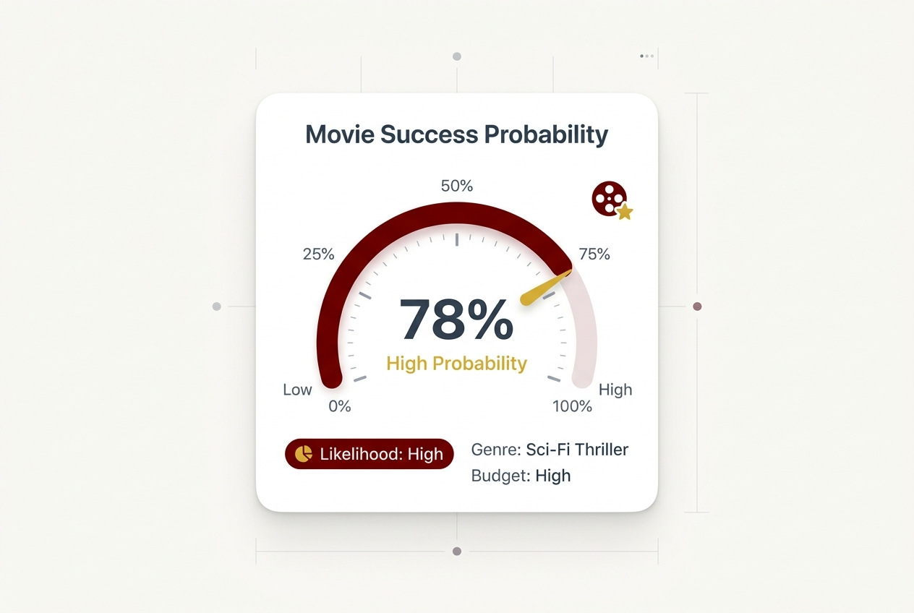
Model Benchmarks & Hyperparameters
• XGBoost Classifier selected for classification boundary accuracy.
• 5-Fold Stratified CV Accuracy: 62.1% | ROC-AUC: 73.0%.
• Outperforms baseline Logistic Regression configurations by ~12% on low/high class margins.
• Optimal parameters: estimators=300, max_depth=6, learning_rate=0.03, subsample=0.8.

Slide 5
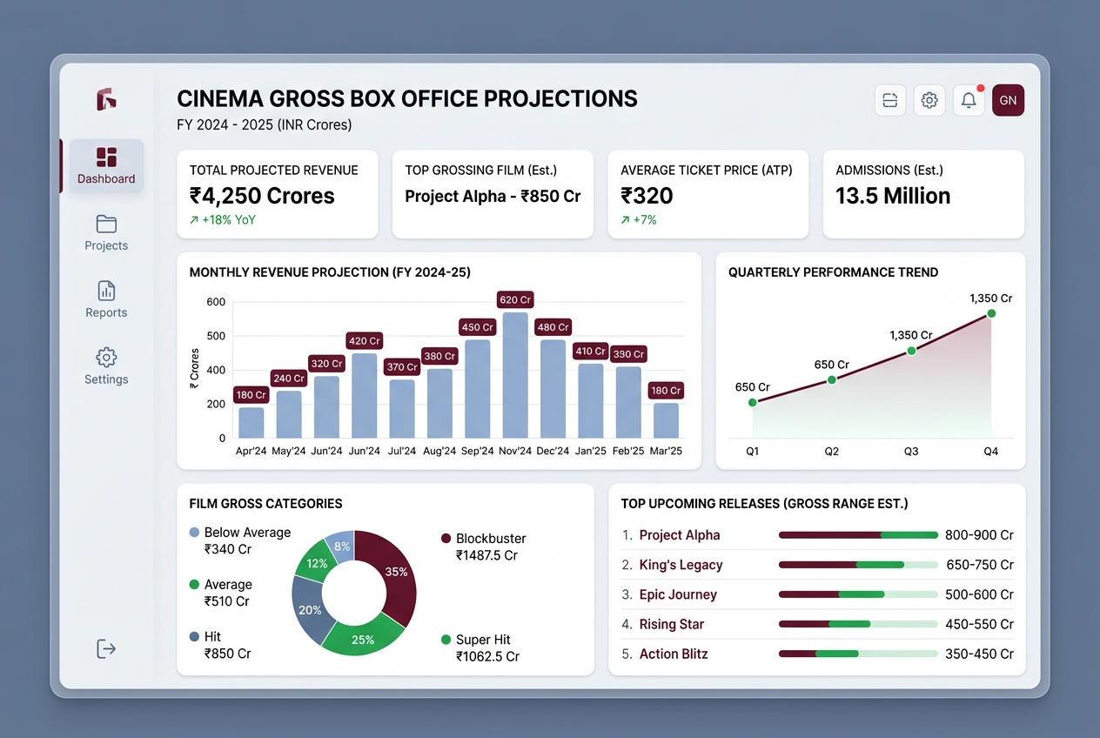
The Tech Stack & Enterprise SaaS UI
• Frontend Interface: Built using Streamlit framework with responsive HTML container overrides.
• SaaS Aesthetic: Inter and Poppins font typography paired with Font Awesome v6 vector icons.
• Interactive Plots: Plotly Express gauges and histograms.
• Digital Match: Automated OTT acquisition recommendation index logic.

