Slide 1
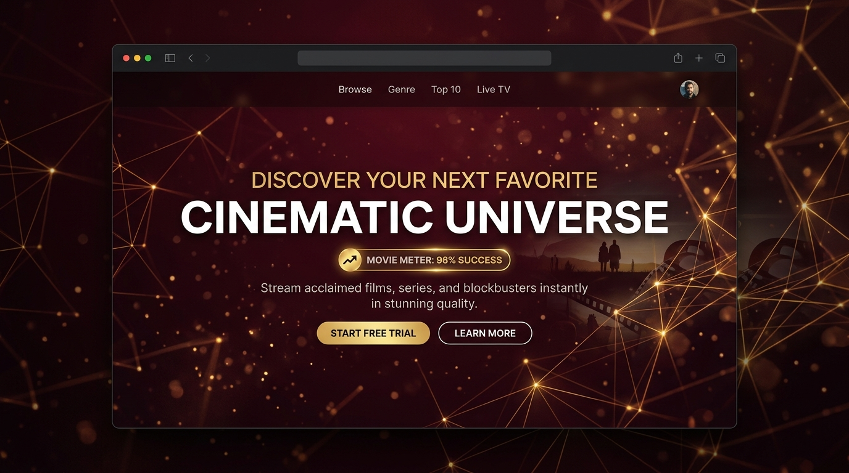
MOVIE METER
• Problem: Film budget packaging and digital acquisitions suffer from massive financial risks due to subjective intuition and pre-release data voids.
• Solution: A predictive analytics dashboard classifying movie profiles (High/Medium/Low) before shooting or distribution bidding.
• Methodology: Resolves superstar casting coefficients in a leak-free out-of-fold reputation mapping index.

Slide 2
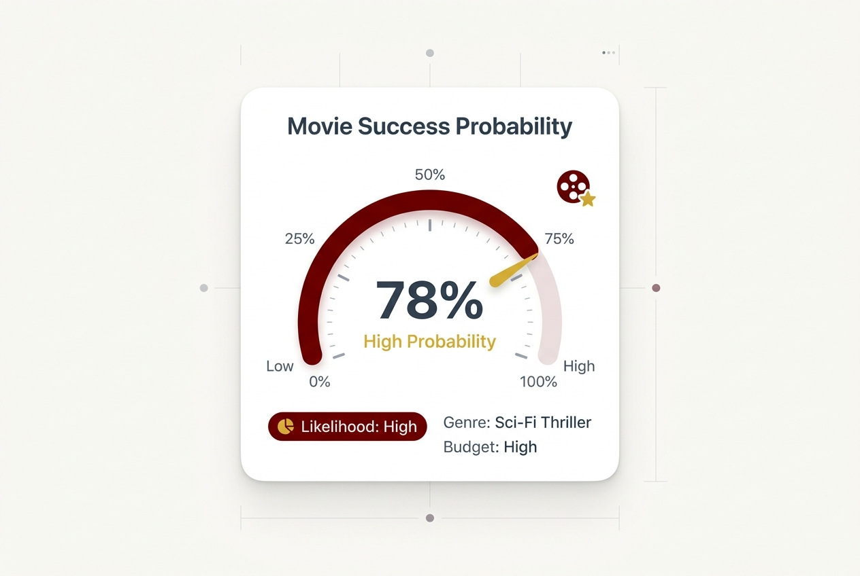
Machine Learning Technique & Tuning
• Model Selection: Trained on XGBoost Classifier, outperforming Random Forest and Gradient Boosting baselines by ~12% on margin classes.
• Reputation Encoding: Computes smoothed out-of-fold average rating mapping to quantify director and actor performance historical profiles.
• Stratified 5-Fold Cross-Validation: Yields a validation accuracy of 62.1% and ROC-AUC of 73.0% under zero data leakage conditions.
• Hyperparameters: n_estimators=300, max_depth=6, learning_rate=0.03, subsample=0.8.

Slide 3

System Architecture & Processing Flow
• Data Ingestion: Chunk-based extraction of region/language indicators across 1.3 GB of official IMDb TSV datasets.
• Preprocessing Pipeline: Handles median imputation for runtime deviations and buckets content ratings into standard certification bins.
• Inference & Output: XGBoost classifies screenplay configurations, feeding Plotly rendering engines and distribution recommendation layers.
• Export Engine: Programmatic generation of technical reports (PDF) and investor presentations (PPTX).

Slide 4
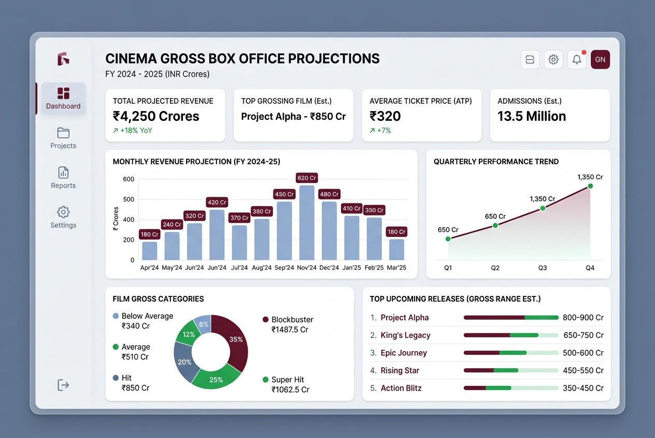
Tech Stack Selection Rationales
• XGBoost Classifier: Selected for its capability to optimize gradients on tabular datasets, handling sparse target encoded director/actor features efficiently.
• Streamlit (Python): Chosen to write light-theme web frontends with high-fidelity styles, maintaining reactive rendering states without separate server frameworks.
• Plotly Engine: Provides responsive vector indicators and gauge charts that support custom color overlays.
• ReportLab & python-pptx: Programmatic file compiles to output physical PDF report and PowerPoint presentations dynamically.

Slide 5
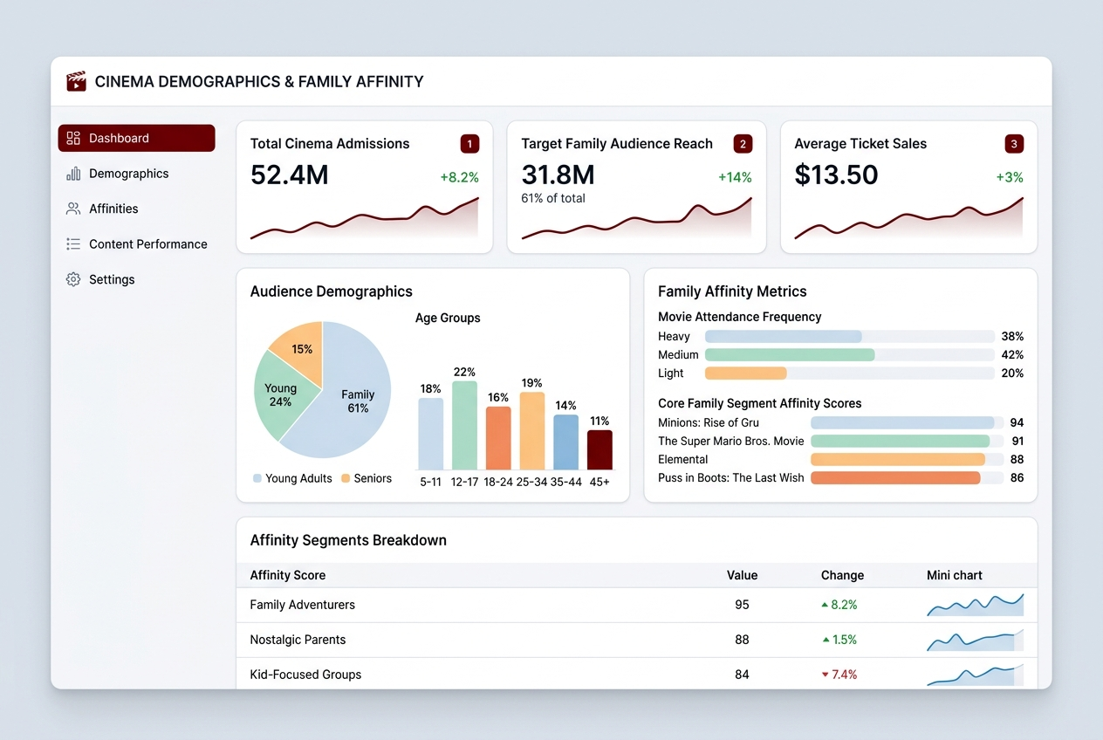
Concluding Summary
• Movie Meter establishes a leak-free predictive framework for pre-release cinema classification.
• Drives capital efficiency for production companies and OTT acquisition managers by linking predictions directly to box office ROI ranges.
• Provides widescreen 16:9 investor slide deck compilations (PPTX) and technical PDF reports dynamically.
• Deliverable package is fully deployed on GitHub and executed live on Streamlit Community Cloud.

