Slide 1

AMITY UNIVERSITY JHARKHAND
AMITY INSTITUTE OF ENGINEERING AND TECHNOLOGY

Slide 2
BRAIN STROKE PREDICTION USING MACHINE LEARNING TECHNIQUES
Under the guidance of:
Ms. Kanika Thakur
Asst. professor
AMITY SCHOOL OF ENGINEERING AND TECHNOLOGY
Compiled By:
NAME-SUBHAJIT TEWARY
PROGRAM-B.TECH. (CSE)
ENROLLMENT NO-A35705218006
BATCH-2018-22

Slide 3
AGENDA:
What and Why?
Data Analysis
Implementation
Confusion matrix of the model
Conclusion

Slide 4
WHAT AND WHY
Brain Stroke disease is a major health problem in today’s era and almost one person dies every minute due to brain stroke. There is wealthy of data available in health care system regarding brain strokes so if we use those data precisely, we can identify the problem in the early stage and proper treatment can be provided to the patient and we can save many lives.
The aim of this project is to predict whether a person will have brain stroke or not using machine learning algorithms.

Slide 5
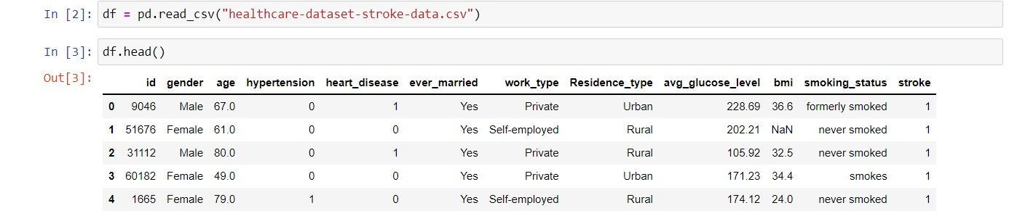
DATA ANALYSIS:
LOADING THE DATA AND GATHERING INFORMATION

Slide 6
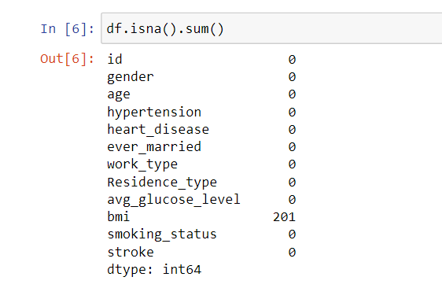
CHECKING THE NULL VALUES
So, as shown in the above picture we have around 201 null values in the bmi column and we have to handle those null values or else it can reduce the accuracy of the model.

Slide 7
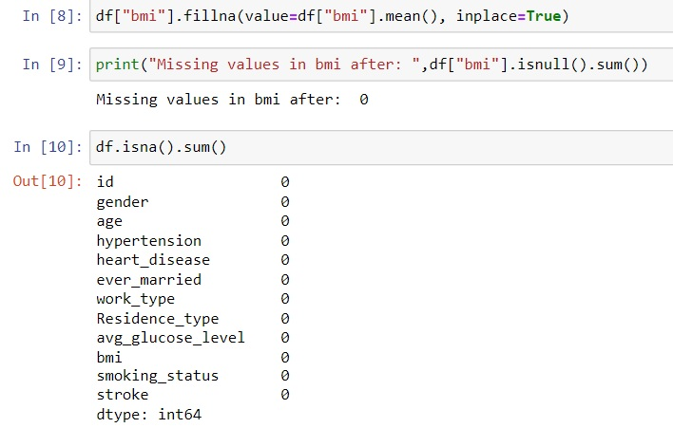
HANDLING THE NULL VALUES
So for handling null values we will use replacing with Mean. This is the most common method of imputing missing values of numeric columns
We will use the ‘fillna’ method for imputing the column ‘bmi’ with the mean of the respective column values. The fillna() method replaces the NULL values with a specified value.

Slide 8
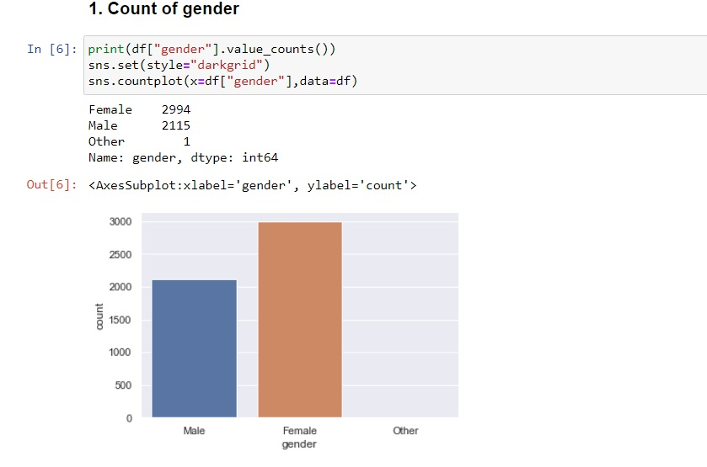
DATA VISUALIZATION:
COUNT OF GENDER

Slide 9
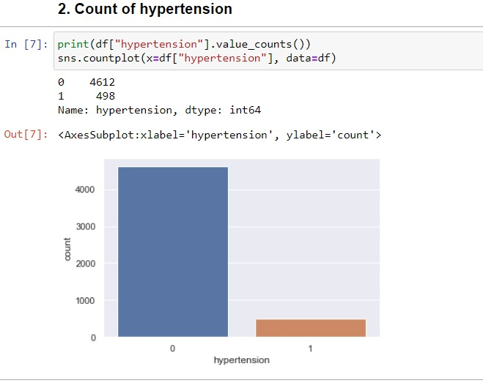
COUNT OF HYPERTENSION

Slide 10
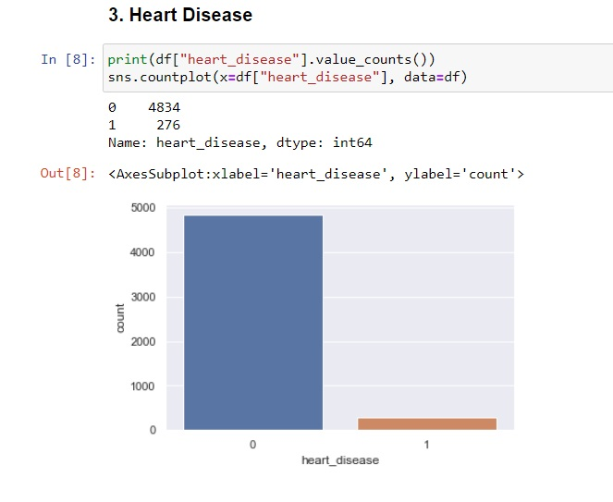
HEART DISEASE

Slide 11
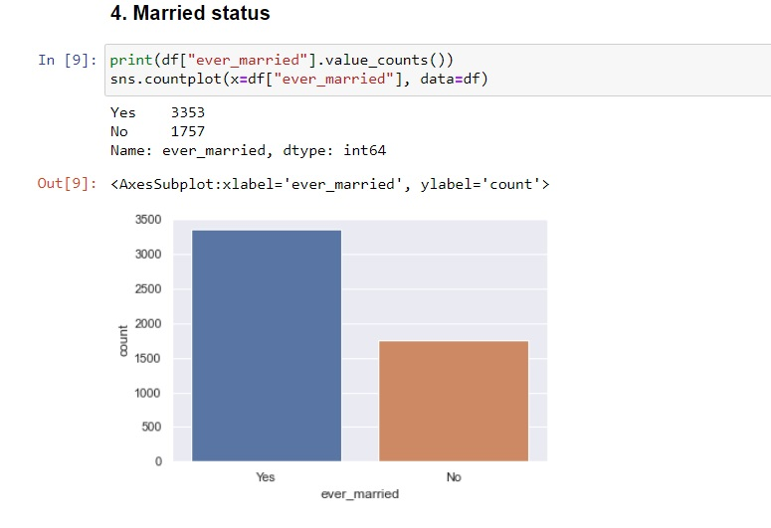
MARRIED STATUS

Slide 12
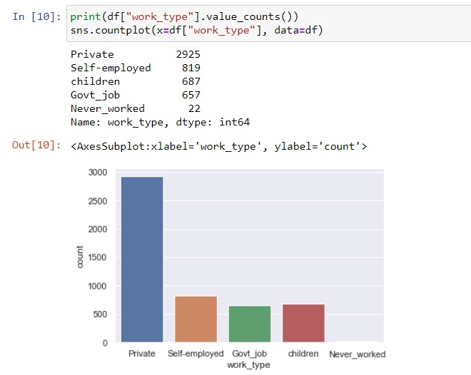
WORK TYPE

Slide 13
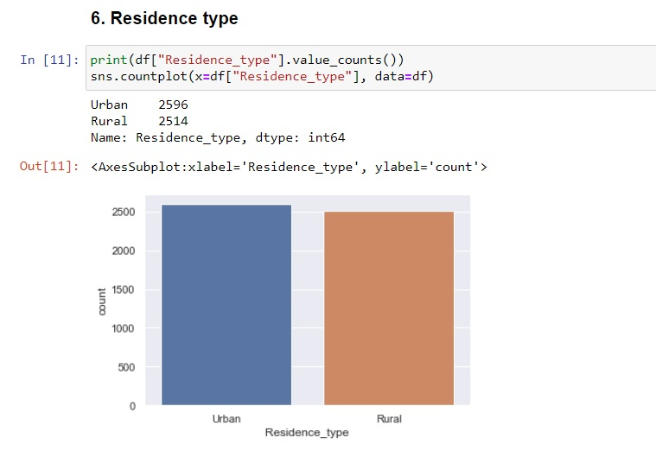
RESIDENCE TYPE

Slide 14
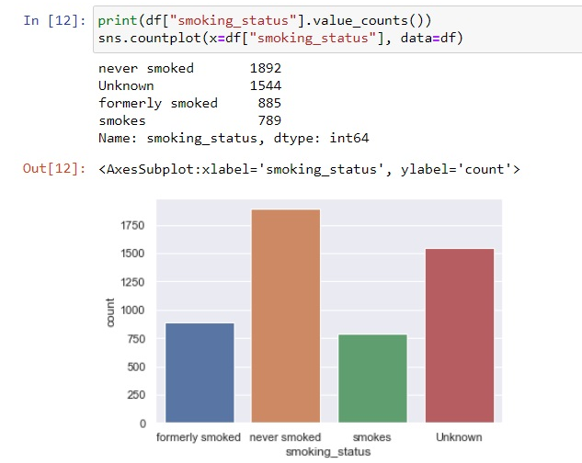
SMOKING STATUS

Slide 15
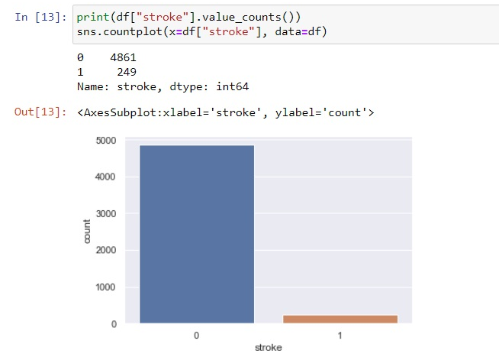
STROKE

Slide 16
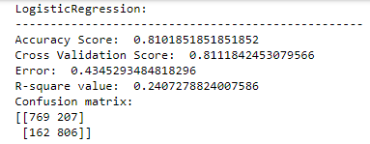
IMPLEMENTATION:
LOGISTIC REGRESSION
Logistic regression is the first machine learning approach I used to develop the brain stroke prediction model. So, as shown in the figure below (figure 26), we acquire an accuracy of 81 percent when we employ all of the features in the data set.
So, from the confusion matrix we can conclude the followings.
[0][0] we have 769 such persons that are having brain stroke and our model has correctly identified them as brain stroke patients.
[0][1] We have 207 such patients who don’t have any disease but our model has identified them as brain stroke patients.
[1][0] we are having 162 patients who are having brain stroke but our model has predicted them as no brain stroke patients.
[1][1] we have 806 such patients who don’t have any brain stroke and our model has correctly identified them as no brain stroke patients.

Slide 17
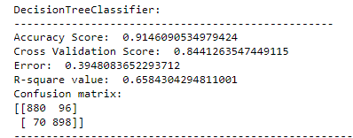
DECISION TREE
So, the next Machine learning algorithm that I have used to build the brain stroke prediction model is the Decision Tree. So in the below figure we can see that when we use all the features present in the data set we are getting an accuracy of 91%
So, from the confusion matrix we can conclude the followings.
[0][0] we have 880 such persons that are having brain stroke and our model has correctly identified them as brain stroke patients.
[0][1] We have 96 such patients who don’t have any disease but our model has identified them as brain stroke patients.
[1][0] we are having 70 patients who are having brain stroke but our model has predicted them as no brain stroke patients.
[1][1] we have 898 such patients who don’t have any brain stroke and our model has correctly identified them as no brain stroke patients.

Slide 18
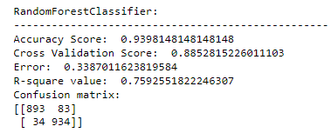
RANDOM FOREST
Now we'll move on to our next algorithm, Random Forest. As a result, we can see that when we utilise random forest as our model, we achieve a 93 percent accuracy. So, while comparing Decision Tree and Logistic Regression, we can observe that we are achieving a high level of accuracy in random forest.
So far, Random Forest has shown to be the most effective.
So, from the confusion matrix we can conclude the followings.
[0][0] we have 893 such persons that are having brain stroke and our model has correctly identified them as brain stroke patients.
[0][1] We have 83 such patients who don’t have any disease but our model has identified them as brain stroke patients.
[1][0] we are having 34 patients who are having brain stroke but our model has predicted them as no brain stroke patients.
[1][1] we have 934 such patients who don’t have any brain stroke and our model has correctly identified them as no brain stroke patients.

Slide 19
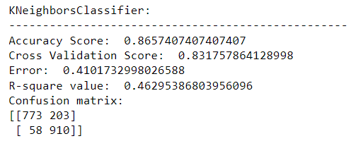
K-NEAREST NEIGHBOR
So, when we utilise KNN algorithm to build our model, we can see that we achieve a 86 percent accuracy. Now comparing KNN with the like random forest and decision tree we can see that random forest and decision tree outperforms KNN in terms of accuracy. So we can that our KNN model didn’t perform so well.
So, from the confusion matrix we can conclude the followings.
[0][0] we have 773 such persons that are having brain stroke and our model has correctly identified them as brain stroke patients.
[0][1] We have 203 such patients who don’t have any disease but our model has identified them as brain stroke patients.
[1][0] we are having 58 patients who are having brain stroke but our model has predicted them as no brain stroke patients.
[1][1] we have 910 such patients who don’t have any brain stroke and our model has correctly identified them as no brain stroke patients.

Slide 20
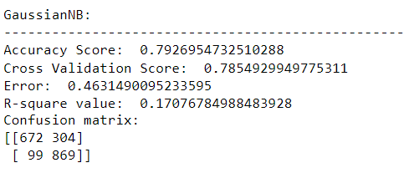
NAÏVE BAYES
Moving with our next algorithm i.e. Naïve Bayes. So in Naïve Bayes algorithm we see that is gives an accuracy of 79%. So we can see that this model didn’t perform so well as compare with all the above algorithms.
So, from the confusion matrix we can conclude the followings.
[0][0] we have 672 such persons that are having brain stroke and our model has correctly identified them as brain stroke patients.
[0][1] We have 304 such patients who don’t have any disease but our model has identified them as brain stroke patients.
[1][0] we are having 99 patients who are having brain stroke but our model has predicted them as no brain stroke patients.
[1][1] we have 869 such patients who don’t have any brain stroke and our model has correctly identified them as no brain stroke patients.

Slide 21
CONCLUSION :
The target of this work is to give an investigation of various Machine Learning strategies that can be utilized in computerized Brain stroke prediction frameworks. Different strategies and Machine Learning classifiers are characterized in this work which has arisen as of late for productive and compelling Brain stroke analysis. The investigation shows that the Random Forest has additionally performed well with 93%.

Slide 22
THANK YOU!

