Slide 1
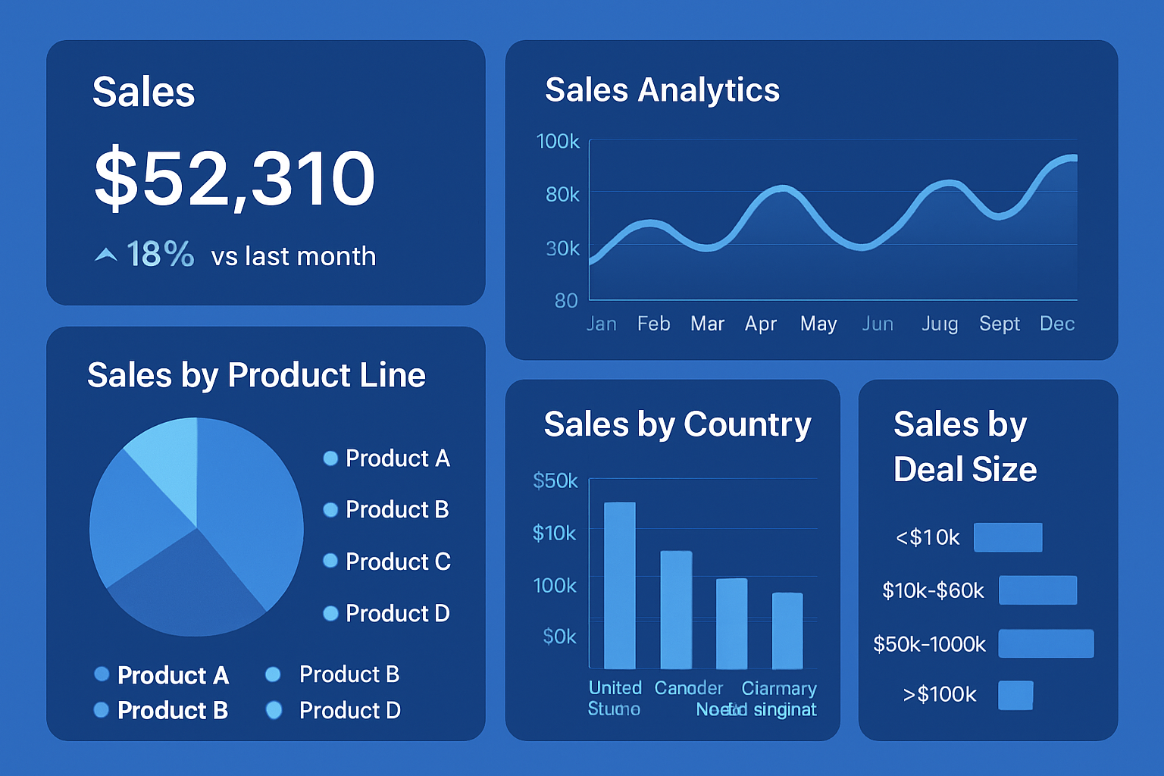
Sales Analytics Dashboard (2003–2010)

Slide 2
Key Metrics
Total Sales: 10.03M
Total Orders: 29M
Average Sales Value: 3.55K
Order Date Range: Feb 24, 2003 – Nov 16, 2010

Slide 3
Sales by Product Line
Classic Cars: Top performer with over 4M sales.
Vintage Cars: Strong contributor.
Motorcycles & Trucks/Buses: Moderate sales figures.
Diversified product lines strengthen overall sales.

Slide 4
Sales by Deal Size and Country
Deal Size Breakdown:
- Medium: 6.09M (60.68% of sales)
- Small: 2.64M (26.34%)
- Large: 1.3M (12.98%)
Country Breakdown:
- USA leads in total sales (~4M)
- Other key contributors: Spain, France, Australia

Slide 5
Insights & Recommendations
Insights:
- Medium-sized deals drive majority revenue.
- USA is largest sales market despite Australia focus.
- Classic Cars lead product sales.
Recommendations:
- Focus on acquiring larger deals.
- Invest in top-performing products and regions.

Slide 6
Dashboard Access Link
Click here to access the Power BI dashboard

