Slide 1
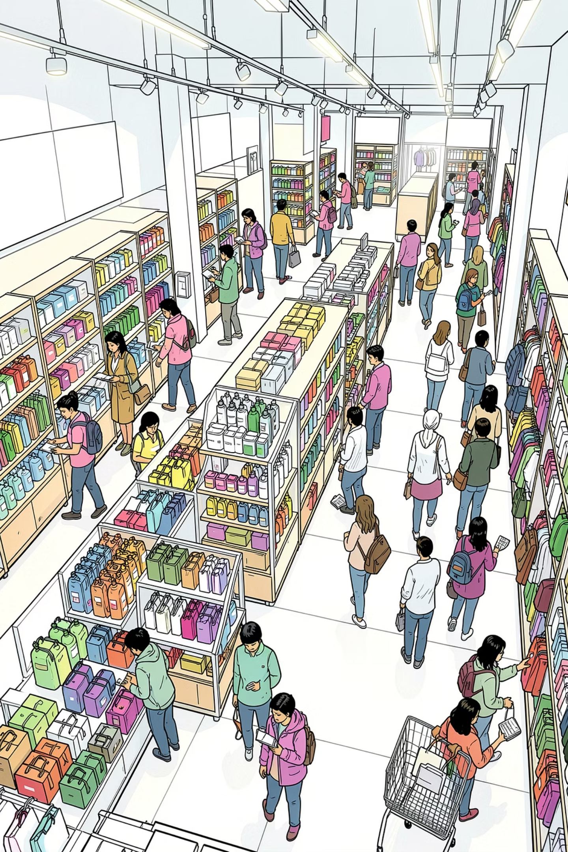
Customer Shopping Behavior Analysis
Transactional insights from 3,900 purchases across product categories — spending patterns, customer segments, and subscription behavior.

Slide 2
Dataset at a Glance
3,900
18
Purchases
Columns
37
$59.76
Missing Values
Avg. Purchase
Review Rating
Demographics · Purchase details · Shopping behavior

Slide 3

Data Preparation in Python
01
Load & Explore
pandas, df.info(), .describe()
02
Clean
Impute missing Review Ratings by category median
03
Engineer
Created age_group and purchase_frequency_days
04
Load to DB
Connected to PostgreSQL for SQL analysis

Slide 4
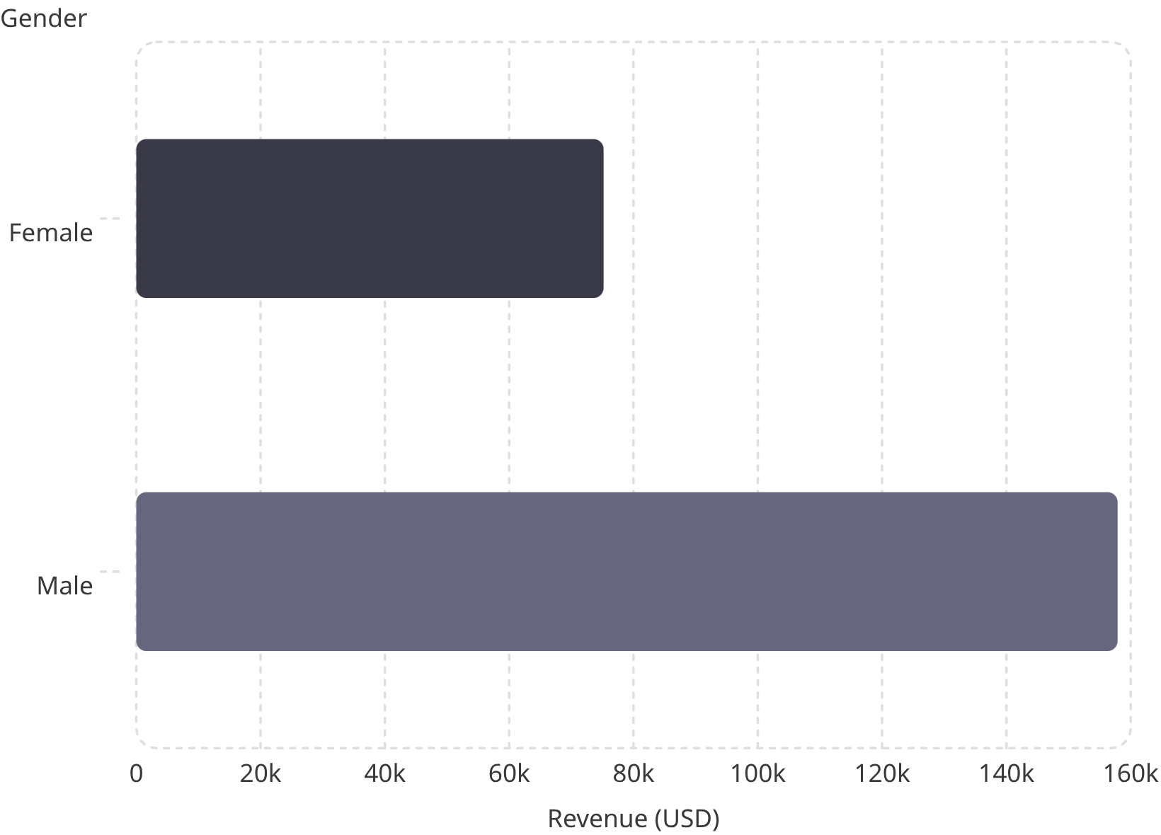
Revenue by Gender
Male customers drive 2× revenue
Male: $157,890 vs. Female: $75,191
Male shoppers also represent 68% of all customers (2,652 vs. female share).

Slide 5
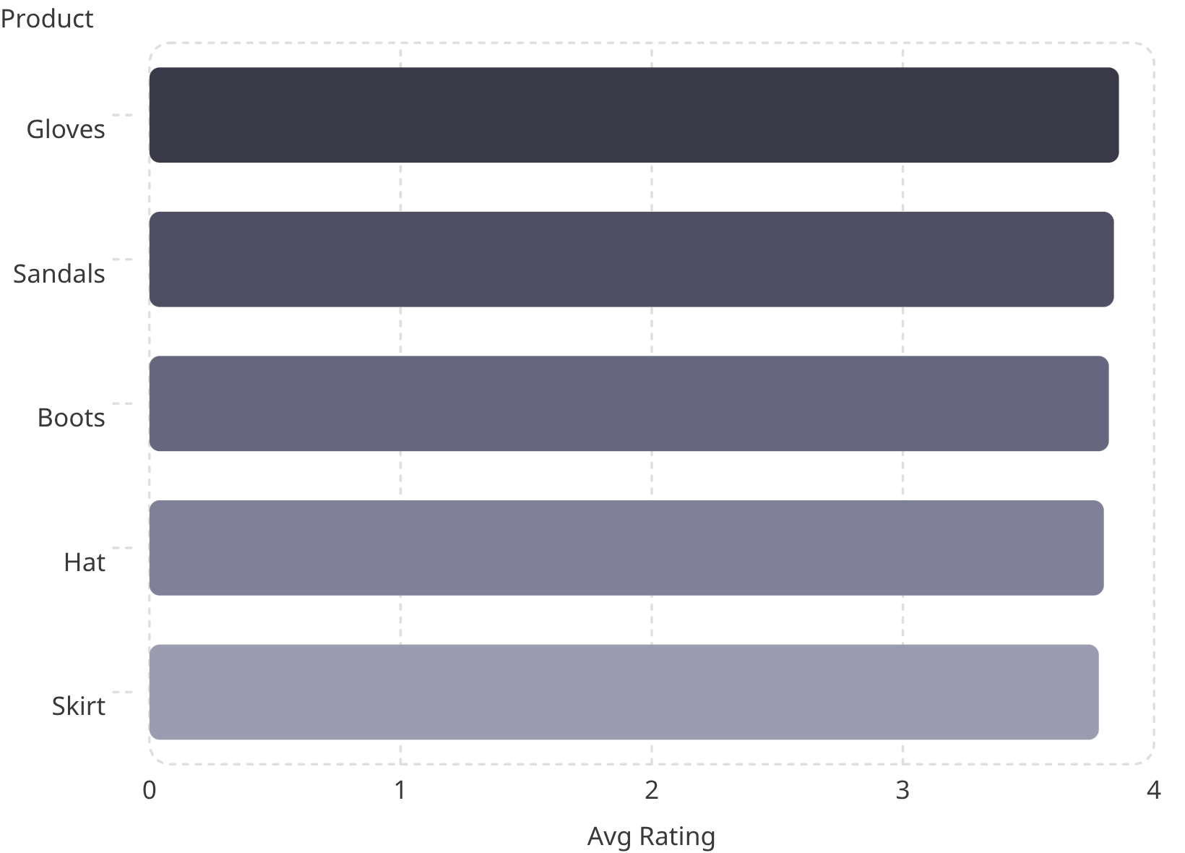
Key Product & Shipping Insights
Top 5 Products by Rating
Shipping Type Comparison
Standard: $58.46 avg
Express: $60.48 avg
Most Discount-Dependent
Hat (50%), Sneakers (49.7%), Coat (49.1%)

Slide 6
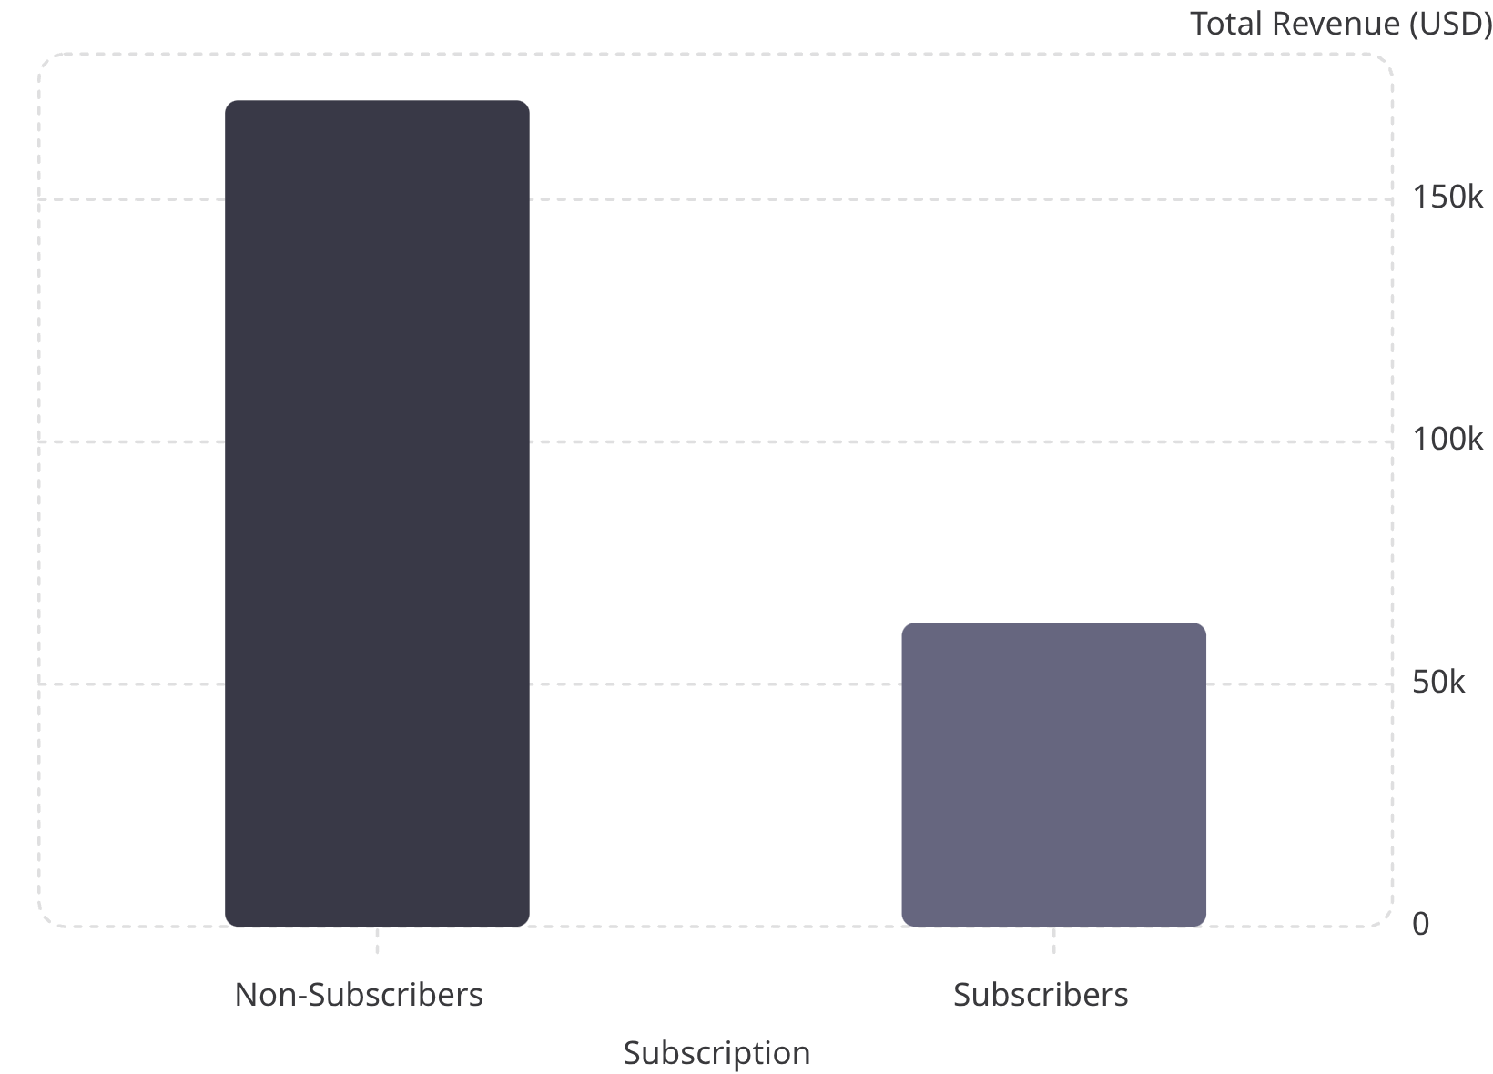

Subscribers vs. Non-Subscribers
73% are non-subscribers
Yet average spend is nearly identical: $59.87 vs. $59.49
Among repeat buyers (5+ purchases): 958 subscribe vs. 2,518 don't.
Subscribers are a high-potential growth segment.

Slide 7

Customer Segmentation
Loyal
Returning
3,116 customers
701 customers
New
83 customers
80% of customers are already in the Loyal segment — a strong retention foundation.

Slide 8
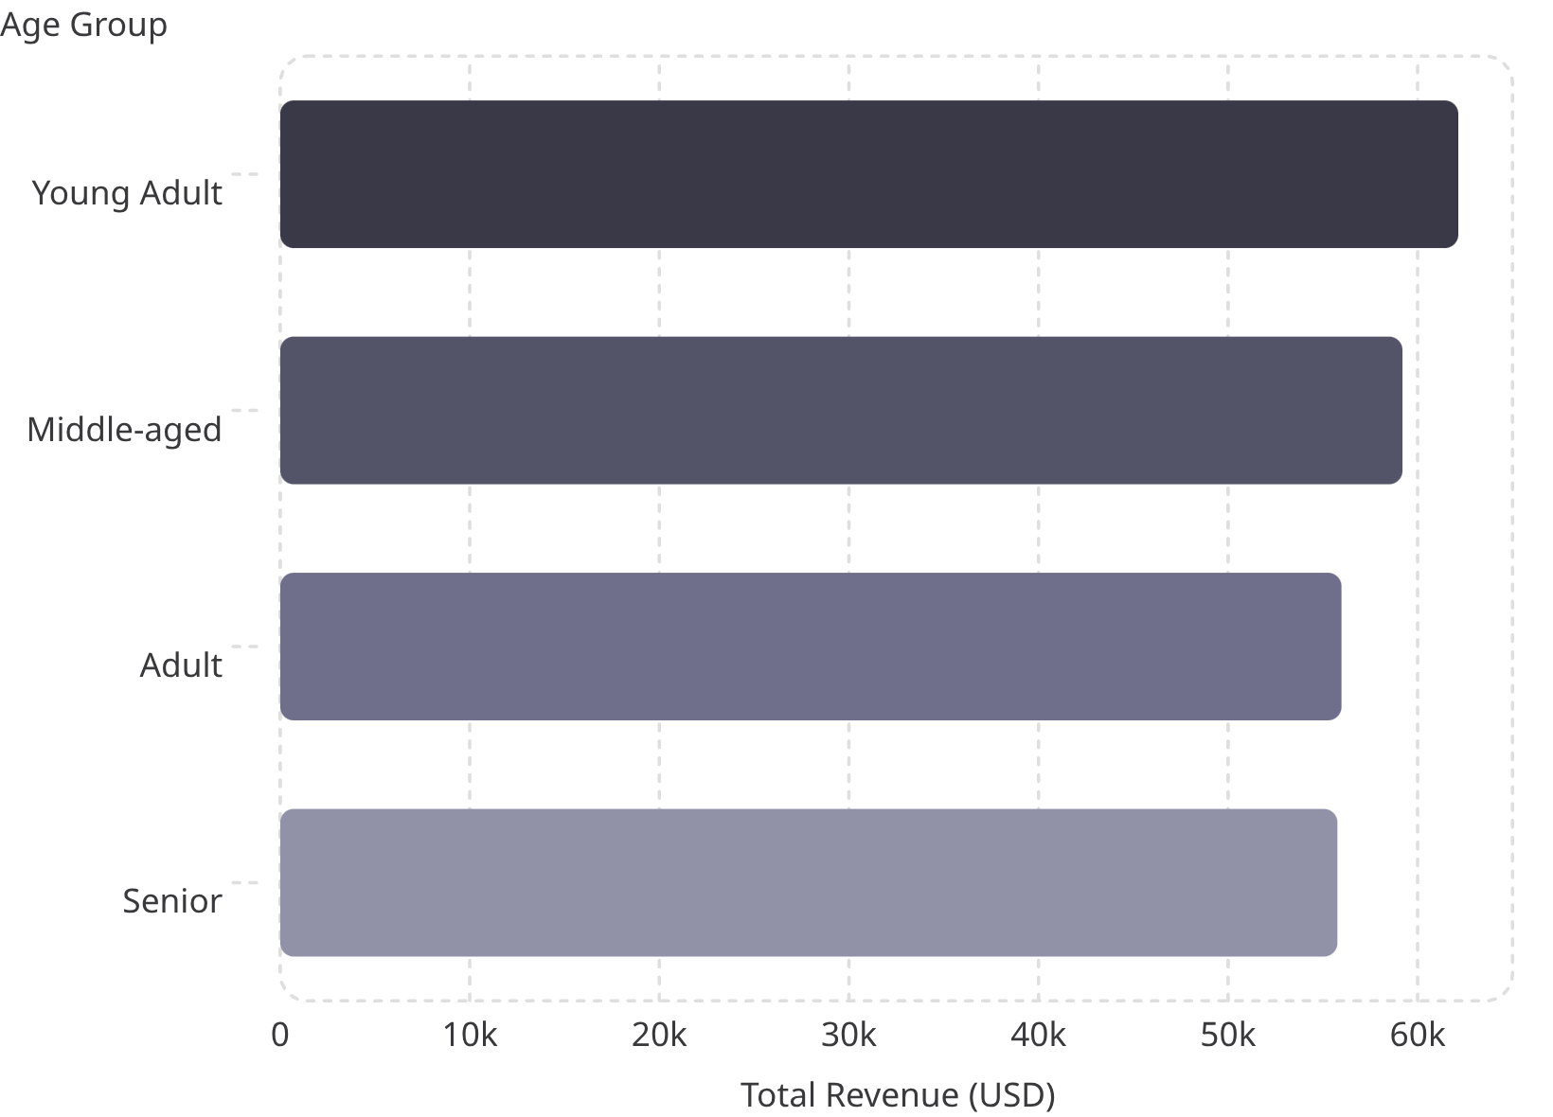
Revenue by Age Group
Young Adults lead revenue
Young Adults contribute $62,143 — the highest among all age groups.
Revenue is relatively evenly distributed across the four groups, with only a $6,380 gap between highest and lowest.

Slide 9
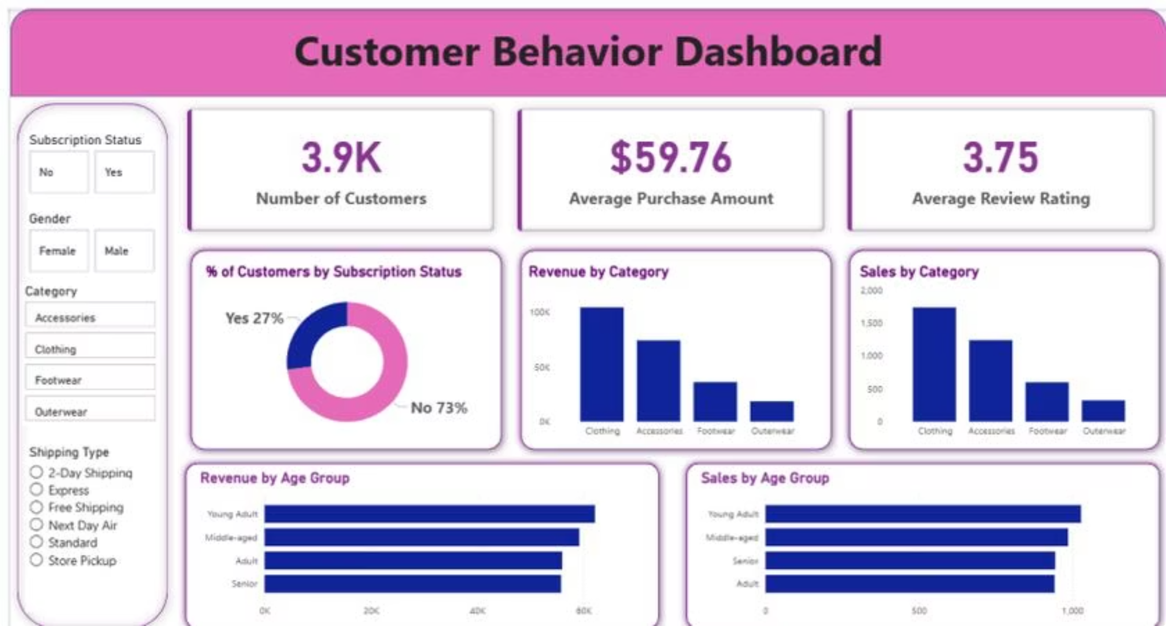
Power BI Dashboard
Interactive Dashboard Highlights
3.9K customers · $59.76 avg purchase · 3.75 avg rating
Filters: Subscription, Gender, Category, Shipping
Charts: Revenue & Sales by Category and Age Group
Subscription split: 27% Yes · 73% No

Slide 10


Business Recommendations
Boost Subscriptions
Promote exclusive subscriber benefits
Loyalty Programs
Reward repeat buyers toward "Loyal" segment
Review Discount Policy
Balance sales lift with margin control
Targeted Marketing
Focus on high-revenue age groups & express-shipping users

