Slide 1

Coffee Preference Prediction
Presented By:
Bidit Sadhukhan [B2230022]
Soumyadeep Sadhukhan [B2230035]
Subhajyoti Maity [B2230038]
Under the Supervision of:
Prof. Raju Maity (ISI)

Slide 2

Introduction
Coffee is one of the world's most popular beverages, enjoyed by millions of people for its rich flavors, aromatic qualities, and energizing effects
It is an integral part of daily life for many
Individuals have their own preferences over different coffee brands

Slide 3

Objective
Develop predictive models to analyze and interpret patterns in customer choices related to coffee preferences
Provide actionable insights for businesses to enhance product offerings and marketing strategies

Slide 4
Motivation
Explore and learn about the intricate variations in coffee preferences, uncovering unique insights into individual tastes and choices

Slide 5





DATA PREP & CLEAN
Data Collection
Collected Great American Coffee Taste Data containing info on 4,042 individuals from a Survey of James Hoffman hosted on last month. It includes tasters’ demographics, general coffee drinking habits and preferences, & more.
Data Reduction
Dropped irrelevant columns from the dataset like Submission ID, What kind of flavorings do you add?, Other reason for drinking coffee, Where else do you purchase coffee?, Etc. columns
Data Cleaning
Removed the Bool, and some categorical column and also preprocessed the null values columns which has huge percentage of NULL values
Data Categorization
Categorized columns in Attributes, Discrete Variables & Continuous Variables for Analysis purpose

Slide 6

Exploratory Data Analysis
Exploratory Data Analysis (EDA) and data visualization serve as indispensable tools in unraveling intricate insights within the coffee dataset, shedding light on latent patterns and relationships that influence consumer preferences. This analytical approach is instrumental in identifying key factors contributing to the popularity and consumer choices among the four distinct types of coffee.

Slide 7
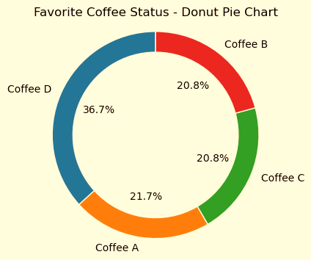

Slide 8
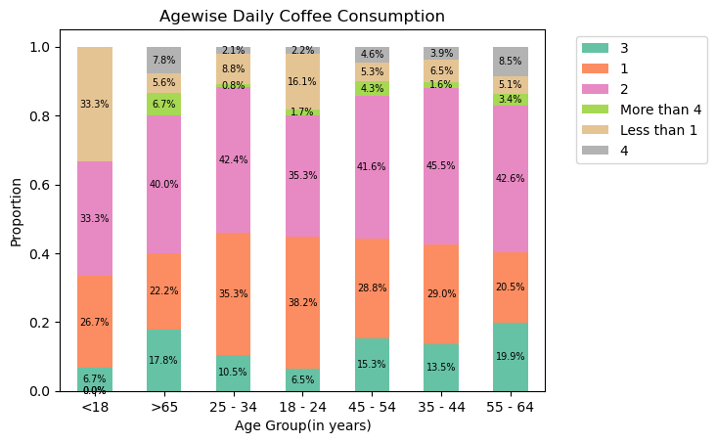

Slide 9
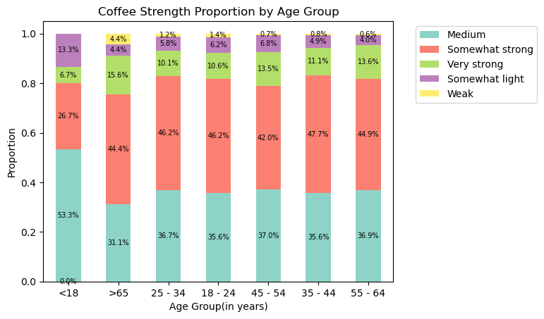

Slide 10




FEATURE ENGINEERING
Key steps include feature encoding for categorical variables, label encoding to convert labels to numerical format, dummy variable introduction for binary representation, feature scaling for magnitude uniformity and train-test splitting for model evaluation on unseen data.
Feature Encoding
Label Encoding
An Ordinal Encoding is implemented on the various important feature columns such as How Strong Do you like coffee, What is your age, How much Caffeine do you like in your coffee etc.
Dummy Introducing
The label column was Category column. Hence to feed the data in the Model we have encoded the labels into numerical values
Feature Selection
Dummy variable is introduced for some columns like What Kind Of Dairy do you add, Where do you typically drink coffee etc.
Data Splitting
The best features are selected to do the analysis by checking the feature importance
80-20 Split for Train & Test

Slide 11

Different Models
Supervised Learning
Unsupervised Learning
Random Forest
Logistic Regression
Logistic regression is employed by assembling a dataset with numerically encoded labels and utilizing the 'multinomial' option for multiclass classification. The interpretability of logistic regression allows for understanding the impact of individual features on the Preferred Coffee Selection.
Kmodes Clustering
Random Forest for a four-class Coffee Brand classification involves using an ensemble of decision trees to predict which Coffee Brand the customers are preferring.
Features like daily consumption, age, and coffee nature etc. are considered in the training process.
Kmodes Clustering is done here to Cluster the labels. We have used this method because it does not need Numerical Values to Predict. It accepts categorical variable as its features

