Slide 1


Coffee Taste Preference Prediction
Presented By:
Bidit Sadhukhan [B2230022]
Soumyadeep Sadhukhan [B2230035]
Subhajyoti Maity [B2230038]
RKMVERI BDA 2022 – ‘24
Under the Supervision of:
Prof. Raju Maity (ISI)

Slide 2

Introduction
Coffee is one of the world's most popular beverages, enjoyed by millions of people for its rich flavors, aromatic qualities, and energizing effects
It is an integral part of daily life
Individuals have their own preferences over different coffee brands

Slide 3

Objective
Develop predictive models to analyze and interpret patterns in individual’s choices related to coffee taste preferences
Provide actionable insights for businesses to enhance product offerings and marketing strategies

Slide 4
Motivation
Explore and learn about the intricate variations in coffee preferences, uncovering unique insights into individual tastes and choices

Slide 5





DATA PREP & CLEAN
Data Collection
Collected Great American Coffee Taste Data containing info on 4,042 individuals from a Survey of James Hoffman hosted on last month. It includes tasters’ demographics, general coffee drinking habits and preferences, & more.
Data source: https://bit.ly/gacttCSV
Data Reduction
Dropped irrelevant columns from the dataset like Submission ID, What kind of flavorings do you add?, Other reason for drinking coffee, Where else do you purchase coffee?, Etc. columns
Data Cleaning
Removed the Bool, and some categorical column and also preprocessed the null values columns which has huge percentage of missing values

Slide 6
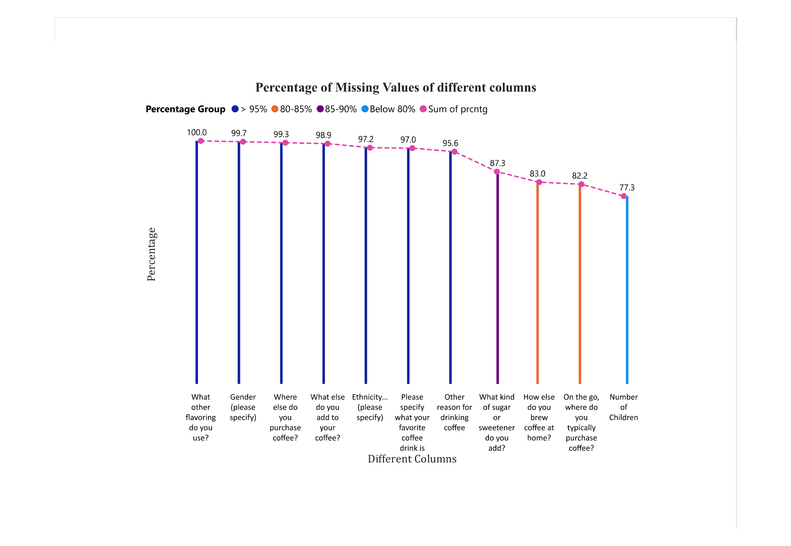
Exploratory Data Analysis

Slide 7
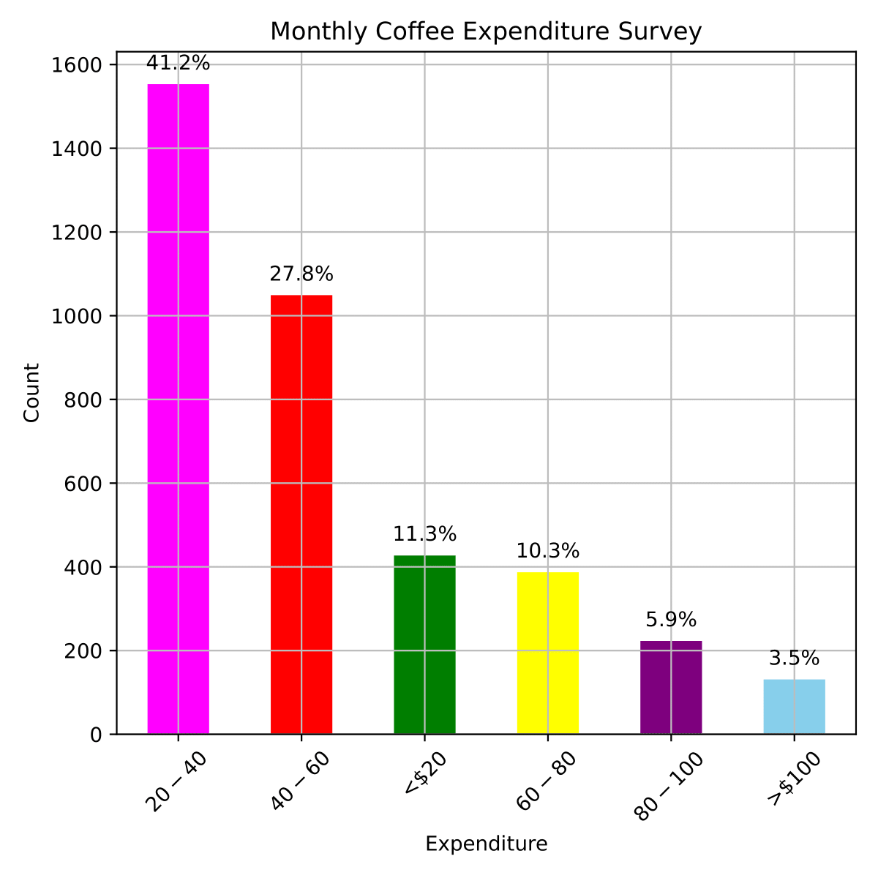
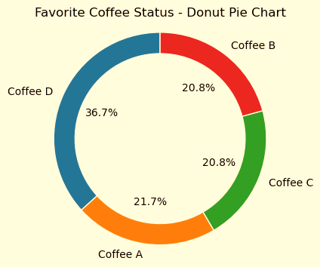

Slide 8
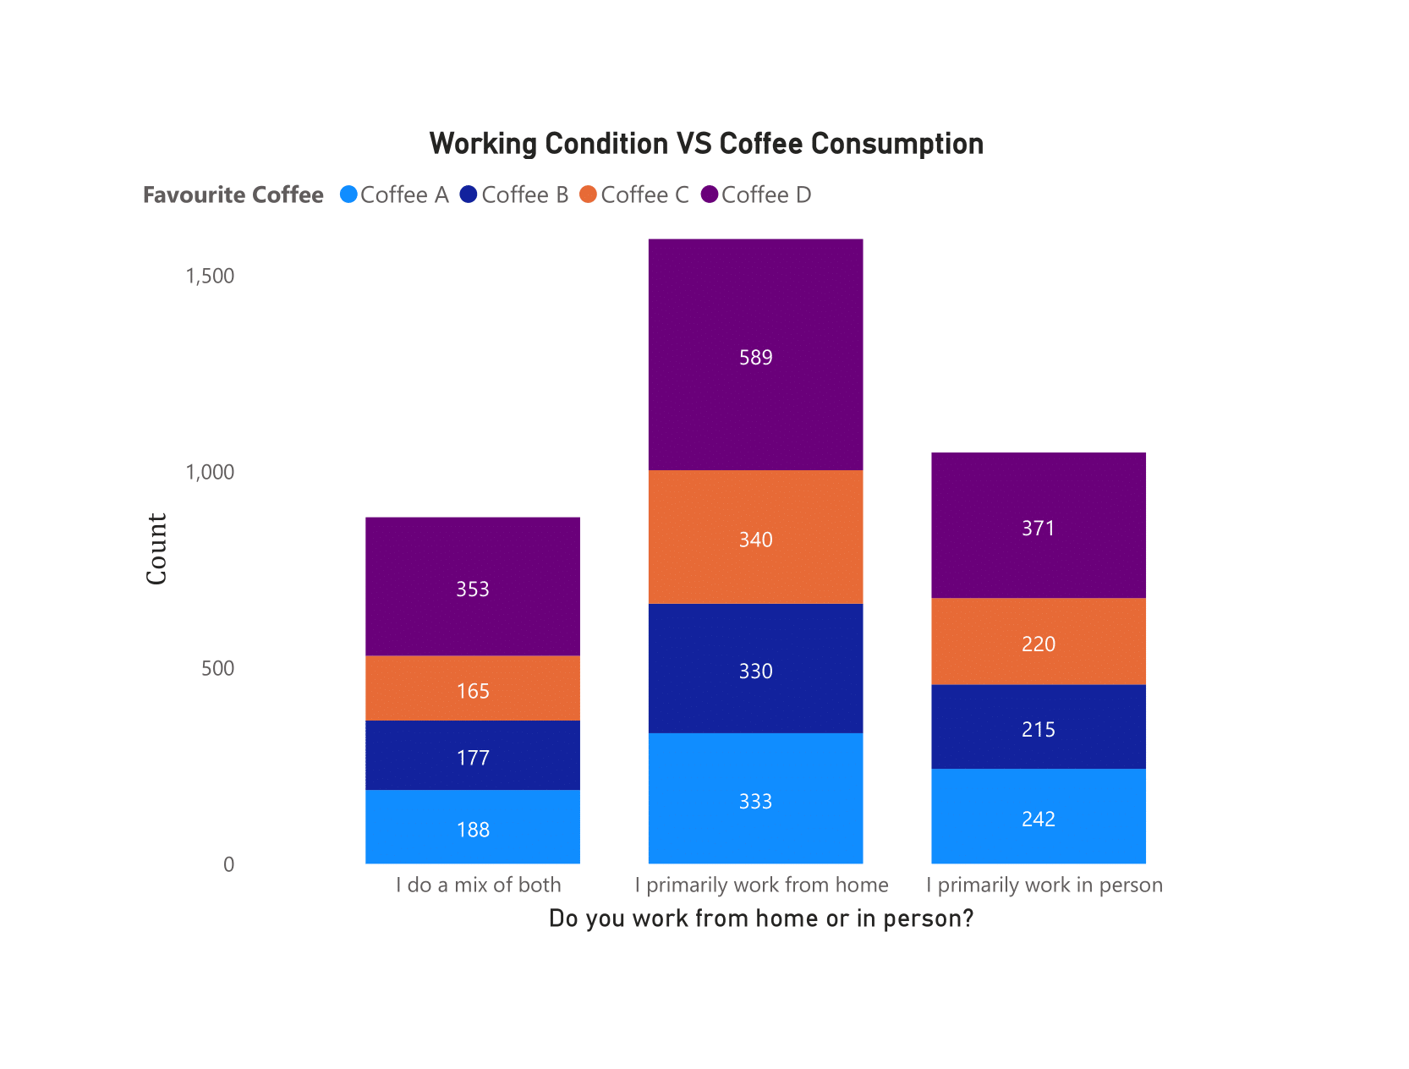

Slide 9
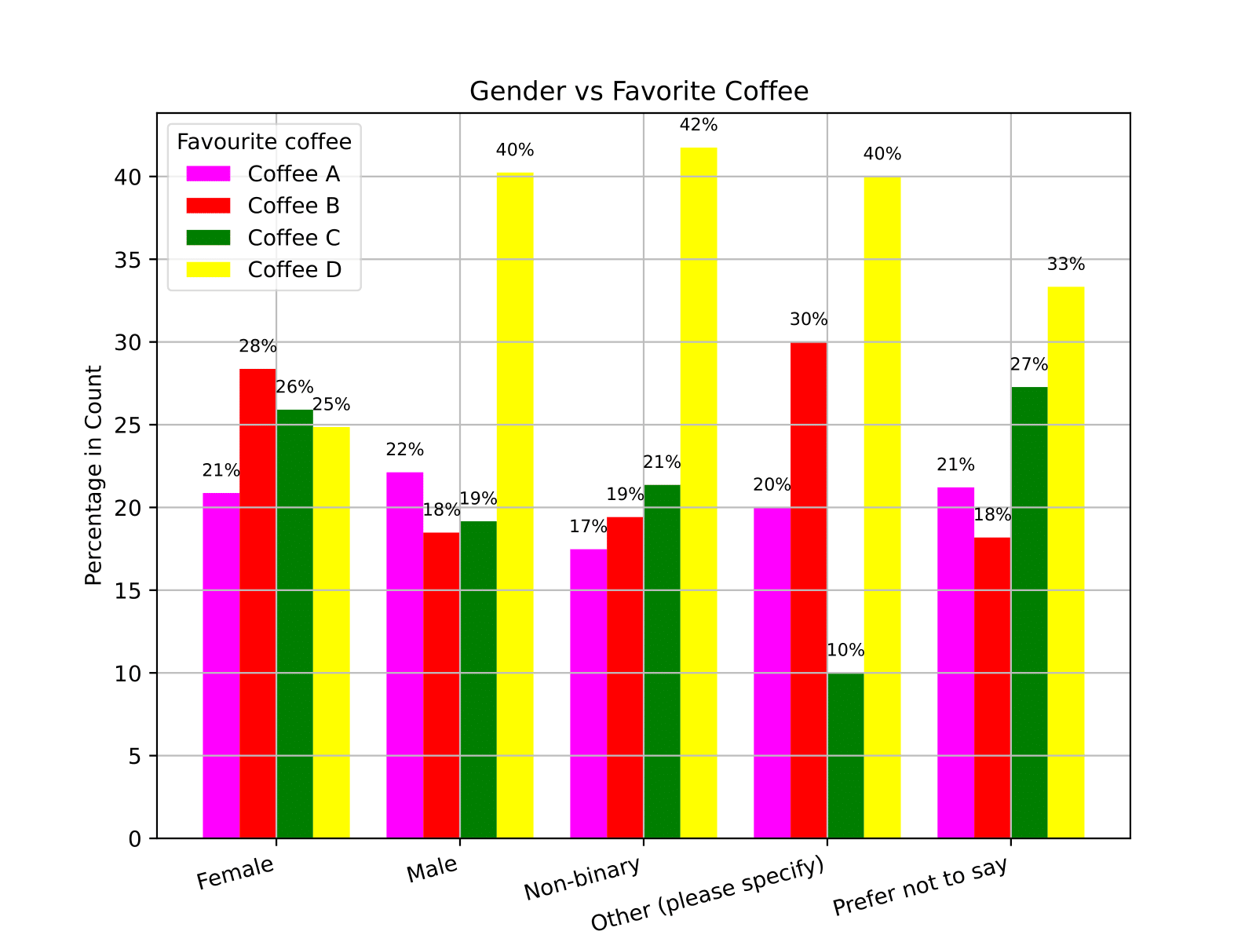

Slide 10
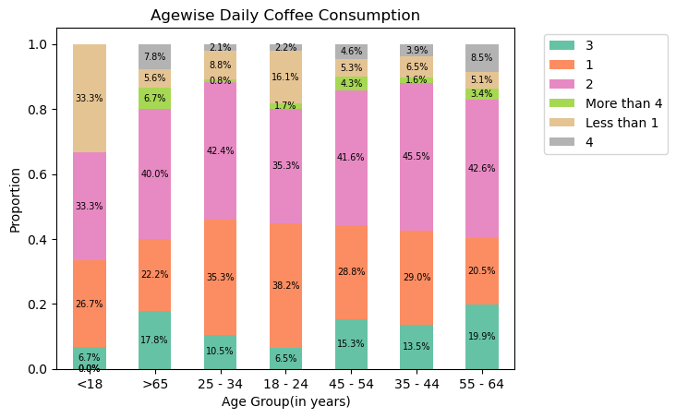

Slide 11
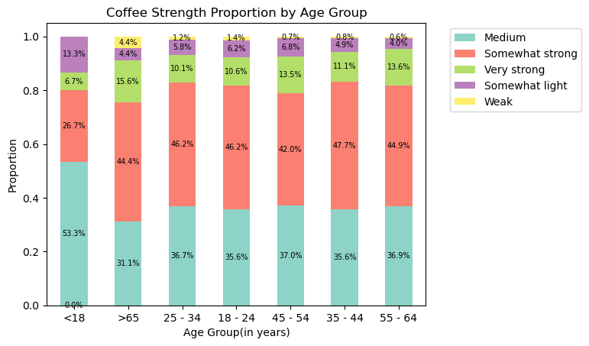

Slide 12
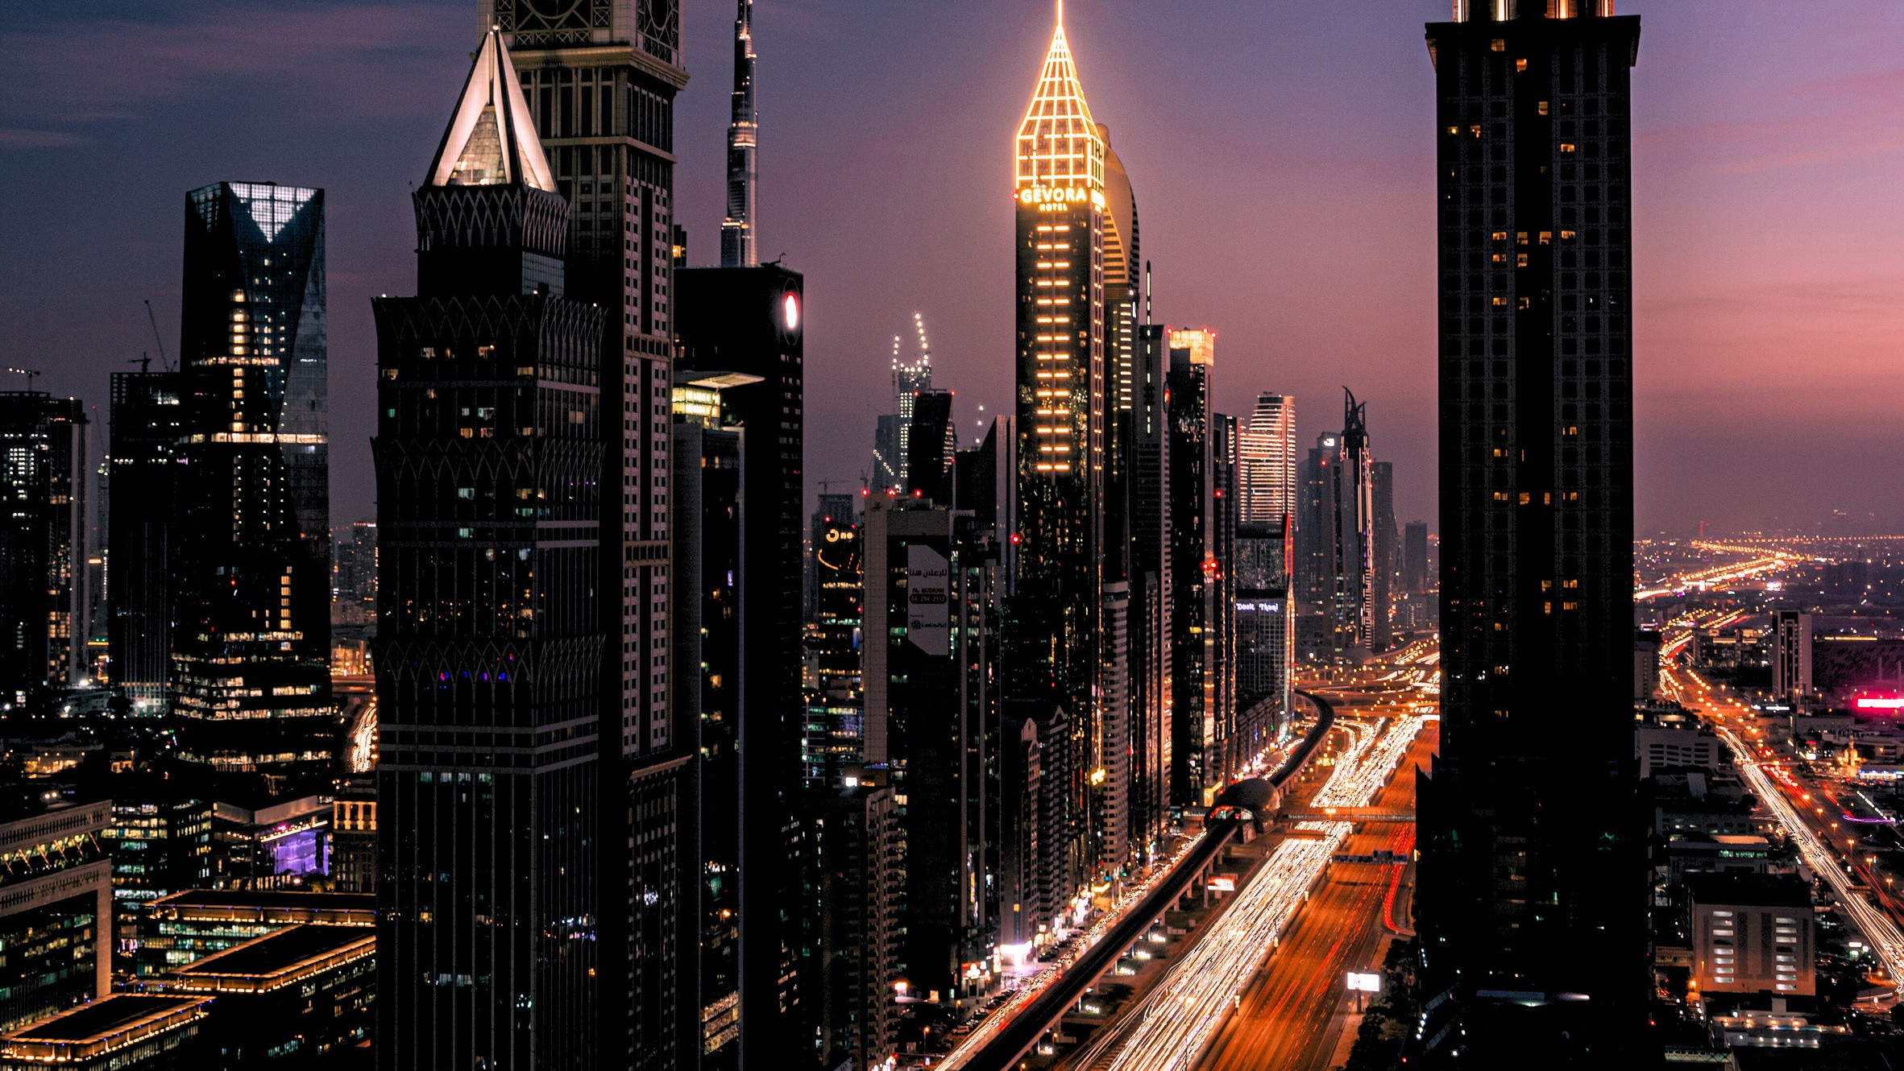



FEATURE ENGINEERING
Key steps include feature encoding for categorical variables, label encoding to convert labels to numerical format, dummy variable introduction for binary representation, feature scaling for magnitude uniformity and train-test splitting for model evaluation on unseen data.
Feature Encoding
Label Encoding
An Ordinal Encoding is implemented on the various important feature columns such as How Strong Do you like coffee, What is your age, How much Caffeine do you like in your coffee etc.
Dummy Introducing
The label column was Category column. Hence to feed the data in the Model we have encoded the labels into numerical values
Feature Selection
Dummy variable is introduced for some columns like What Kind Of Dairy do you add, Where do you typically drink coffee etc.
Data Splitting
The best features are selected to do the analysis by checking the feature importance
80-20 Split for Train & Test

Slide 13

Different Models
Supervised Learning
Unsupervised Learning
Random Forest Classifier
Multinomial Logistic Regression
Kmodes Clustering

Slide 14
Feature Importance
Column Name | Importance
Coffee D - Personal Preference | 0.12554
Coffee A - Personal Preference | 0.112486
Coffee C - Personal Preference | 0.100995
Coffee B - Personal Preference | 0.094957
Before today's tasting, which of the following best described what kind of coffee you like? | 0.026022
Lastly, how would you rate your own coffee expertise? | 0.022799
What is your favorite coffee drink? | 0.021511
What roast level of coffee do you prefer? | 0.020229
What is the most you'd ever be willing to pay for a cup of coffee? | 0.018391
Approximately how much have you spent on coffee equipment in the past 5 years? | 0.017746

Slide 15
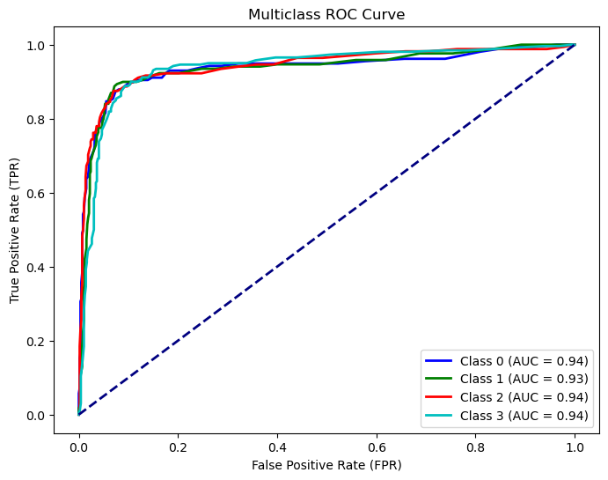

Slide 16
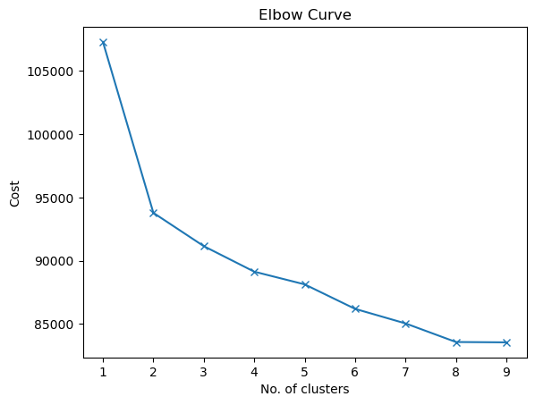
Seeing this Elbow Curve we have selected 6 Clusters

Slide 17
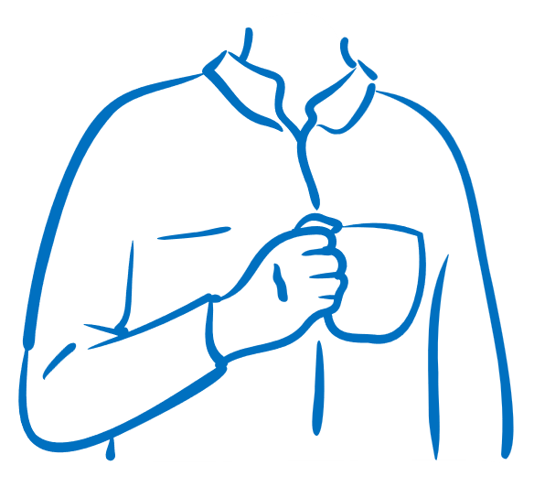

Evaluation
Accuracy Score for Random Forest Classifier is 83.16
Accuracy for Multinomial Logistic Regression is 81.83

Slide 18
Conclusion
Using Random Forest classifiers we have successfully done the identification of patterns in customer preferences based on various features
In parallel, leveraging clustering algorithm K-Modes helped us to uncover distinct groups of customers with similar coffee preferences

Slide 19
Future Work
This is done on a Survey data. So it can be biased to that part of world so we can generalize the data collection
The accuracy of Random Classifier Can be improved by working on the model or using Hyperparameters

Slide 20
THANK YOU

