Slide 1
Federated Learning for Resource Constrained IoT Devices
Samarpreet Singh
Subhajyoti Saha
Notes:
I am working on ..
A single line what is Fed Learning

Slide 2
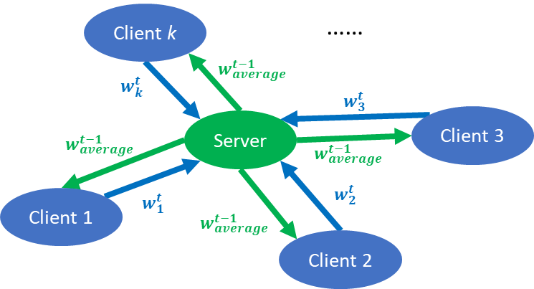
FedAvg Algorithm Algorithm

Slide 3
Reduction in Communication Cost
Achieved by changing cluster heads of the clients’ models after a specific number of iterations periodically.
Overall the data shared by all other clients except the head was a fraction of the dataset they actually possessed. Ensures less data communication.

Slide 4
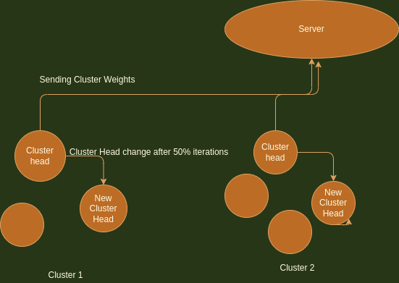
Reduction in Communication Cost

Slide 5
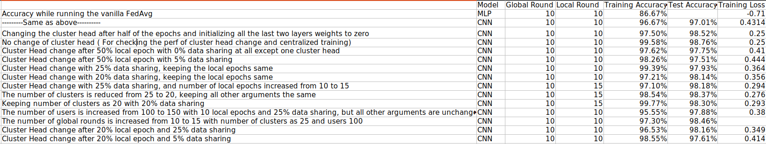
Experimental Results
By following the above approach, we can save 0.025 Joule and 0.001 Joule energy during the sharing of the weights and data by Bluetooth and Wifi respectively.
https://scholar.google.co.in/scholar?hl=en&as_sdt=0%2C5&q=Gupta+Data+Mule&btnG=

