Slide 1
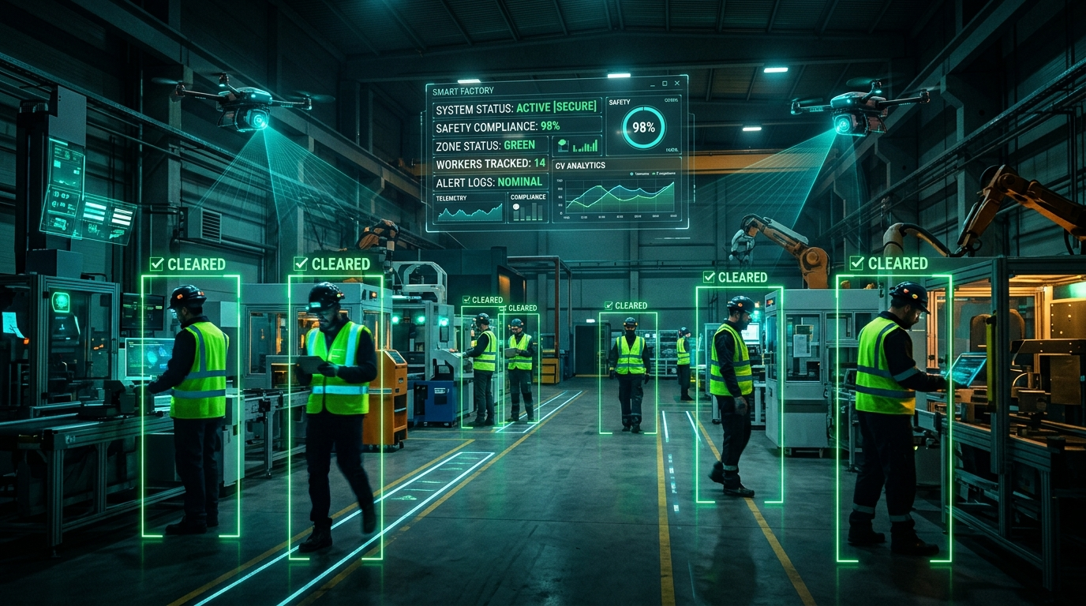
🛡️ SafeVision AI | PROJECT OVERVIEW & ARCHITECTURE | Slide 1 of 10
SafeVision AI: Autonomous Industrial Safety Gear Compliance
STPI & EmTek BPUT Hackathon Flagship Project | TEAM ID: BH26PS06T002
👥 Team Members: Subhakanta Muduli (Lead), Pradeep Kumar Sethi, Laxmipriya Jena, Biswaprakash Majhi
• Real-Time Edge Computer Vision: Sub-100ms inference using YOLOv8 & YOLO11-Pose.
• 14+ Specialized AI Safety Detectors: PPE, Height Safety, Crane Drop Zone, Fire & Confined Spaces.
• Zero-Lag Multi-Device Ecosystem: Wireless DroidCam phone camera + Edge inference + Control Room.
• Physical Acoustic Deterrence: Industrial multi-frequency siren horn + Natural Text-to-Speech voice prompts.
• Enterprise Regulatory Governance: Automated ReportLab PDF compliance audit reports & CSV incident logs.
SafeVision AI • STPI & EmTek BPUT Hackathon Flagship Project • TEAM ID: BH26PS06T002 • Live Demo Ready

Slide 2
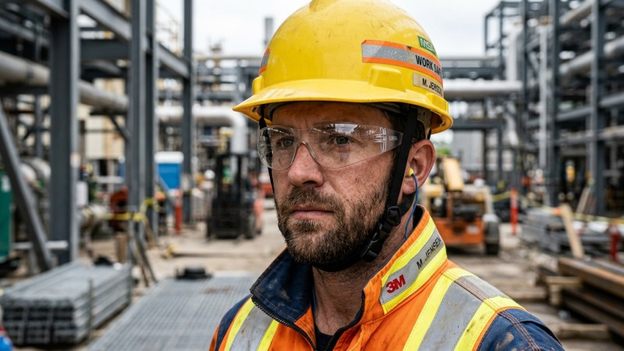
🛡️ SafeVision AI | PROBLEM ANALYSIS & NEED | Slide 2 of 10
The Industrial Safety Crisis & Human Monitoring Breakdown
Why manual audits and legacy CCTV fail to prevent catastrophic industrial accidents
• 2.78 Million Fatalities Annually: Over 7,600 workplace deaths globally every single day (ILO).
• Human Attention Breakdown: CCTV operators miss over 85% of critical safety infractions after only 20 minutes.
• Lagging & Retrospective: Traditional CCTV only records accidents for post-mortem investigations.
• Manual Clipboard Audits: Periodic spot-checks inspect <2% of worker-hours; unequipped workers slip through.
• The SafeVision Paradigm Shift: Moving from reactive forensics to autonomous sub-100ms prevention.
SafeVision AI • STPI & EmTek BPUT Hackathon Flagship Project • Live Demo Ready

Slide 3
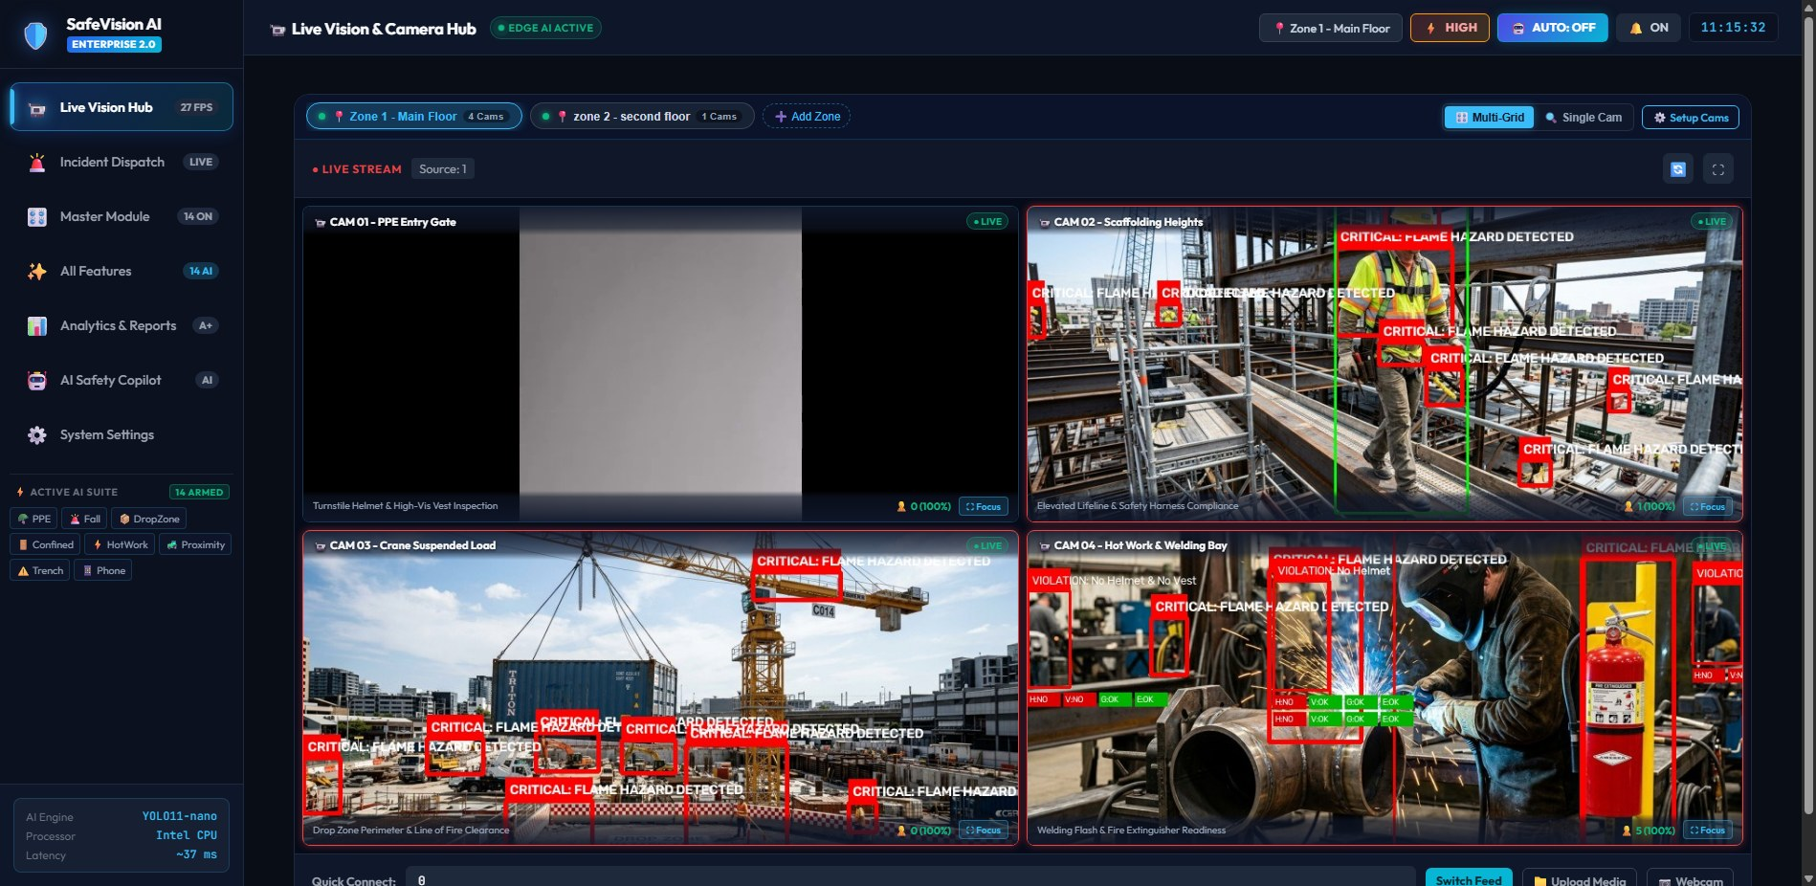
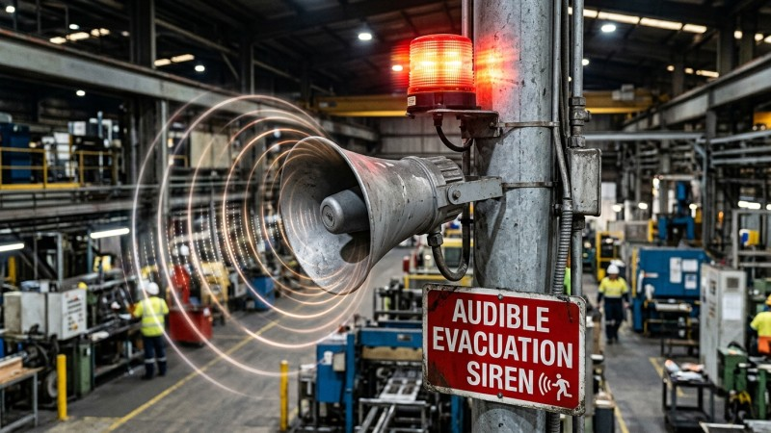
🛡️ SafeVision AI | SYSTEM ARCHITECTURE & PIPELINE | Slide 3 of 10
Distributed Edge Architecture & Multi-Device Deployment
Affordable, zero-lag edge hardware ecosystem linking mobile cameras, inference, and control rooms
• Node 1 (Mobile Camera): Wireless DroidCam Wi-Fi or zero-lag USB tethering serving as mobile floor sensor.
• Node 2 (Edge Inference Unit): Laptop 1 executing YOLOv8/11 dual neural pipelines and sound engine.
• Node 3 (EHS Command Center): Laptop 2 running remote real-time safety dashboard with live video streams.
• Node 4 (Industrial Siren): Physical external speaker unit broadcasting distinct frequency horns & voice TTS.
• Unified ZoneCameraManager: Manages multi-camera layouts across Zone 1, Zone 2 without duplicate GPU load.
SafeVision AI • STPI & EmTek BPUT Hackathon Flagship Project • Live Demo Ready

Slide 4
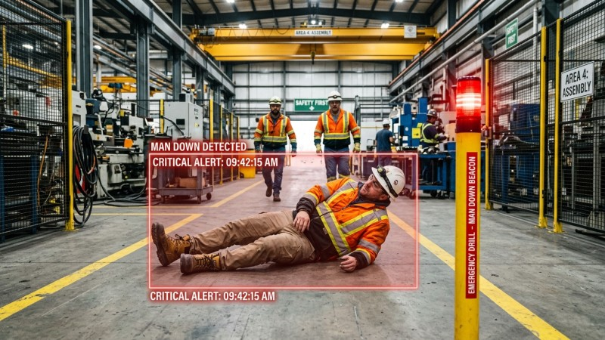
🛡️ SafeVision AI | CORE PPE & WORKER SAFETY | Slide 4 of 10
Core PPE Compliance & Worker Health Monitoring
Continuous real-time inspection, turnstile gate access control, and pose-based fall detection
• 4-Point PPE Verification: Hardhats, High-Visibility Vests, Heavy Gloves, and Protective Eyewear/Goggles. [🎥 Watch Helmet Demo ↗]
• Smart Turnstile Gate Inspection: Automated entry verification — 'Access Granted' vs 'Access Denied: Equip Safety Gear'.
• Worker Man-Down & Fall Detection: YOLO11-Pose keypoints detect slips, trips, falls, and worker collapse in <200ms. [🎥 Watch Fall Demo ↗]
• Prohibited Phone Distraction: Detects hazardous smartphone usage inside active heavy equipment pathways.
• Color-Coded Status HUD: Green compliant bounding boxes vs bold Red violation alerts.
SafeVision AI • STPI & EmTek BPUT Hackathon Flagship Project • Live Demo Ready

Slide 5
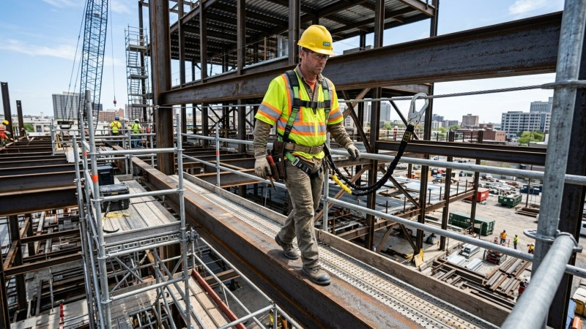
🛡️ SafeVision AI | CONSTRUCTION ENGINEERING AI | Slide 5 of 10
Advanced Construction AI: Heights, Cranes & Confined Spaces
Specialized high-risk construction safety modules built to OSHA 1926 standards
• Height Safety & Harness Compliance (OSHA 1926 Subpart M): Verifies harness straps & anchored lifelines on scaffolding.
• Crane Suspended Load 'Drop Zone': Projects dynamic 360° rotating radar perimeter directly under hoisted heavy cargo.
• Line-of-Fire Clear Zone: Alerts ground personnel entering the kill zone under suspended steel beams.
• Confined Space Headcount & Stay-Timer: Automated portal polygon monitoring entry/exit for tanks, manholes & silos.
• Atmospheric Asphyxiation Prevention: Tracks countdown timer (e.g. 45 min) to prevent toxic gas poisoning.
SafeVision AI • STPI & EmTek BPUT Hackathon Flagship Project • Live Demo Ready

Slide 6
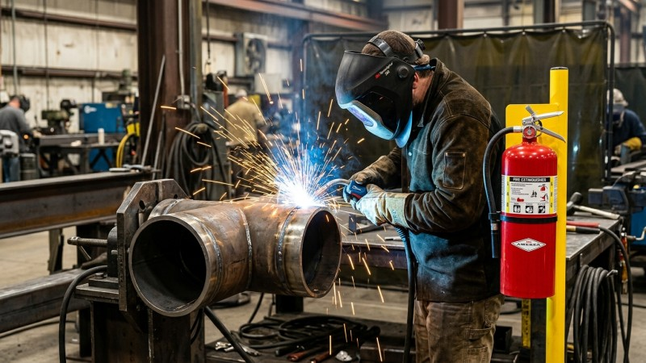
🛡️ SafeVision AI | HAZARD & MACHINERY SAFETY | Slide 6 of 10
Industrial Hazards, Fire Watch & Heavy Machinery Safety
Early spark detection, flame classification, excavation setback margins, and collision avoidance
• Hot Work & Welding Watch (NFPA 51B): Detects welding arcs and verifies certified extinguisher proximity (< 5m).
• Early Visual Fire & Smoke Detection: Sub-second visual classification of incipient flames and smoke plumes. [🎥 Watch Fire Demo ↗]
• Trench Margin Setback (OSHA 1926 Subpart P): Dynamic 1.5m / 65px setback margin along excavation trench lips.
• Heavy Machinery & Forklift Collision AI: Bounding box proximity alerts between mobile plant vehicles and pedestrians.
• Dual Emergency Escalation: High-low warble siren on plant floor + priority Telegram alert dispatch to safety team.
SafeVision AI • STPI & EmTek BPUT Hackathon Flagship Project • Live Demo Ready

Slide 7
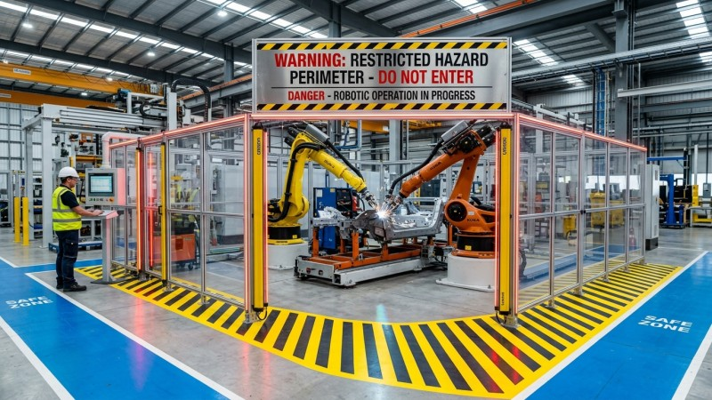
🛡️ SafeVision AI | PERIMETER & AUTO-PILOT CONTROLS | Slide 7 of 10
Dynamic Geofencing, Night Guard & Auto-Pilot Controls
Polygonal boundary intrusion, after-hours tactical lockdown, and 1-click master presets
• Dynamic Danger Zone Geofencing: Interactive canvas-drawn keep-out polygons around robotic arms and high voltage.
• Sub-50ms Tripwire Breach: Immediate siren alarm when unauthorized personnel enter restricted equipment perimeter.
• Tactical Night Guard Lockdown: Automated after-hours intruder and thermal hazard surveillance during shutdown.
• 1-Click Master Presets: Auto-Pilot (Supervisor Away), Construction Site, Hot Work Plant, Clean PPE Only, All Armed.
• Dynamic Sensitivity Engine: Ultra (0.30 conf), High (0.38 conf), Standard (0.48 conf) with temporal persistence.
SafeVision AI • STPI & EmTek BPUT Hackathon Flagship Project • Live Demo Ready

Slide 8
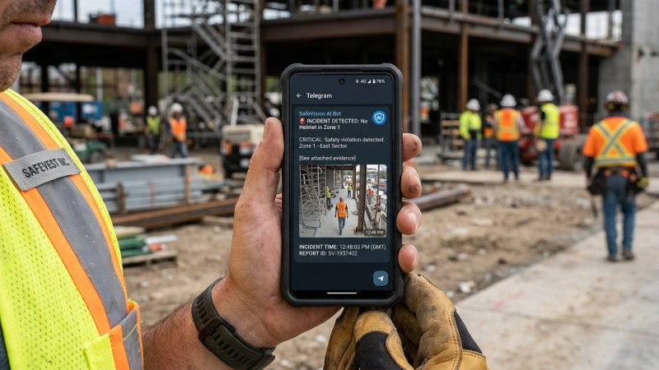
🛡️ SafeVision AI | SIRENS, TELEGRAM & WEATHER | Slide 8 of 10
Audible Sirens, Instant Telegram & IoT Weather AI
Physical frequency siren tones, spoken voice warnings, mobile alerts, and heat stress monitoring
• 18+ Distinct Siren Frequency Tones: Custom winsound acoustic patterns for fire, crane drop zone, and air horn tests.
• Dual-Engine TTS Spoken Announcer: Asynchronous audio queue broadcasts natural voice warnings without stream lag.
• Instant Telegram Bot Dispatch: Zero-delay push notification with live violation snapshot, zone ID, and timestamp.
• Real-Time IoT Weather (Open-Meteo): Live ambient temperature, humidity, and calculated NOAA Heat Index.
• Thermal Risk & Weather Alerts: Low, Moderate, High, Critical thermal risk scores + wind/rain shutdown advisories.
SafeVision AI • STPI & EmTek BPUT Hackathon Flagship Project • Live Demo Ready

Slide 9
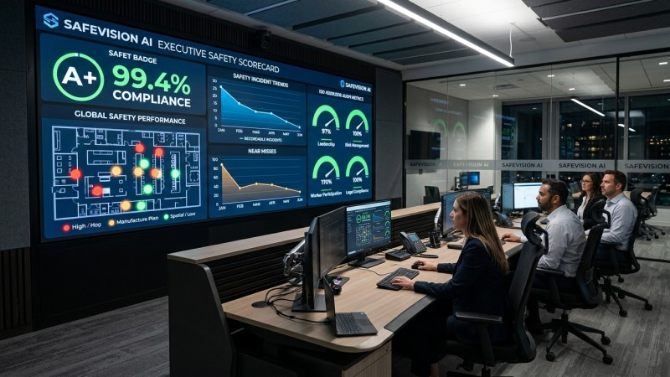
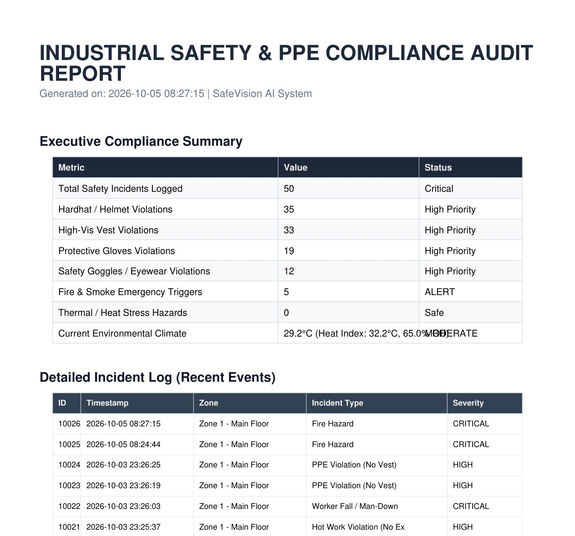
🛡️ SafeVision AI | AI COPILOT, ANALYTICS & AUDITS | Slide 9 of 10
AI Safety Copilot, Spatial Heatmaps & Audit Reports
Conversational EHS advisor grounded in real plant data, 2D hotspot analytics, and 1-click audits
• Dual-Engine AI Safety Copilot: Grounded in SQLite database records + OSHA/ISO-45001 expert rule engine.
• Google Gemini 1.5 Flash Cloud LLM: Contextual EHS intelligence answering complex industrial safety queries.
• 2D Spatial Violation Heatmap: Density mapping identifying recurring safety infraction bottlenecks.
• Hourly Compliance Trends & AI Benchmarks: Precision (94.2%), Recall (91.8%), and Processing Latency (24ms).
• 1-Click Regulatory Reports: Instant executive PDF Safety Audit Reports (ReportLab) & full CSV incident exports.
SafeVision AI • STPI & EmTek BPUT Hackathon Flagship Project • Live Demo Ready

Slide 10
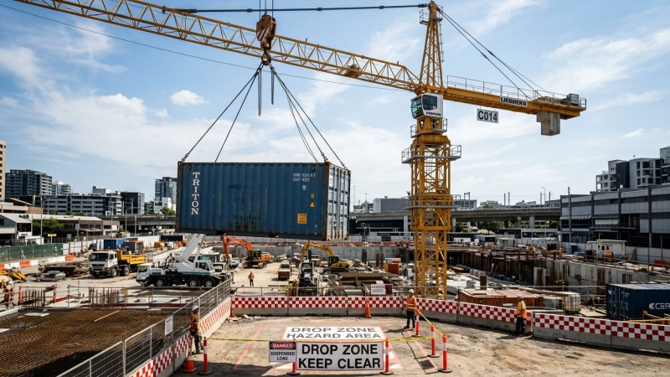
🛡️ SafeVision AI | IMPACT, SCALABILITY & ROADMAP | Slide 10 of 10
Business Impact, Scalability & Hackathon Pitch
Delivering quantifiable zero-harm safety, immense cost savings, and enterprise-grade edge deployment
• Quantifiable ROI: >92% reduction in safety infractions within first 30 days of active deployment.
• Statutory Fine Avoidance: Protects industrial facilities from $100k+ OSHA and labor ministry non-compliance fines.
• Hardware-Agnostic Scalability: Runs on commodity laptops, edge PCs, or Jetson, plugging directly into legacy RTSP CCTV.
• Zero Operator Fatigue: 24/7 continuous autonomous vigilance eliminating missed human surveillance blindspots.
• Hackathon Winning Edge: Fully functional end-to-end validated prototype ready for deployment.
• ▶ Live Prototype Demos: [🪖 Helmet Demo ↗] | [🚨 Fall Demo ↗] | [🔥 Fire Demo ↗]
THANK YOU! 🙏 | Open for Questions & Q&A | SafeVision AI

