Slide 1

SMART INDIA HACKATHON 2026
Problem Statement ID – SIH26181
Problem Statement Title- A secure, AI-powered Personal Health Companion that delivers real-time, privacy-preserving health monitoring and early warning capabilities, helping individuals recognize health risks before they become emergencies. The solution should improve resilience during heat waves, floods, pollution events, and other disasters common in India while enabling continuous health support through on-device intelligence
Theme-MedTech / BioTech / HealthTech
PS Category- Hardware
Team ID
Team Name – IOT DIVAS

Slide 2
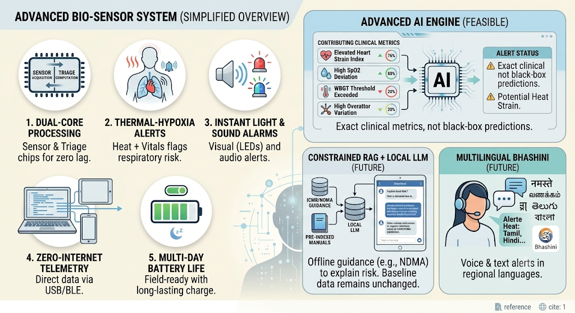
IDEA TITLE
IOT DIVAS
Problem at Hand
Why We Stand Out
100% Offline Edge Autonomy: Runs bare-metal diagnostics on the ESP32-S3 with zero internet, cloud, or server dependency.
Compound Clinical Logic: Cross-references ambient heat with heart rate and SpO2 to catch heatstroke and thermal hypoxia early.
Ultra-Low Cost & Portable: Under ₹2,500 per unit, pocket-sized, and runs on a standard Li-ion battery or power bank.
Network Collapse: Disaster zones face total blackouts, making cloud-dependent triage devices completely useless.
Fatal Delays: Cloud dependence can introduce latency and connectivity failures during mass-casualty situations.
Our Solution: AuraEdge S3 (Zero-Cloud, Edge-Compute Clinical Triage Wristband)
Costly and Bulky: Clinical bedside monitors cost ₹1.5–3 Lakhs, weight upto 8 kg, and require continuous wall power.​
Isolated Vitals: Conventional monitors track single vitals individually, missing compound risks like heat-induced shock or hypoxia.

Slide 3
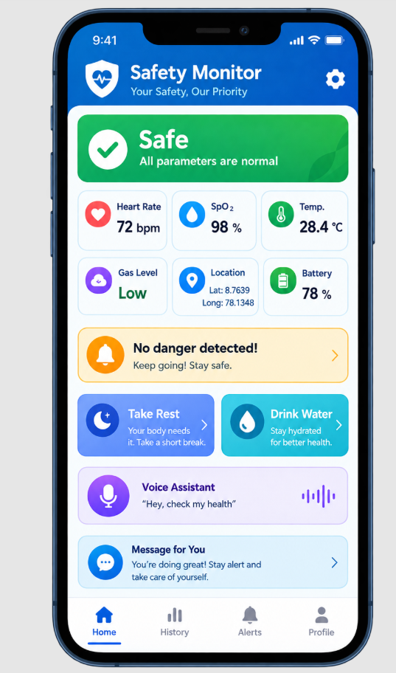
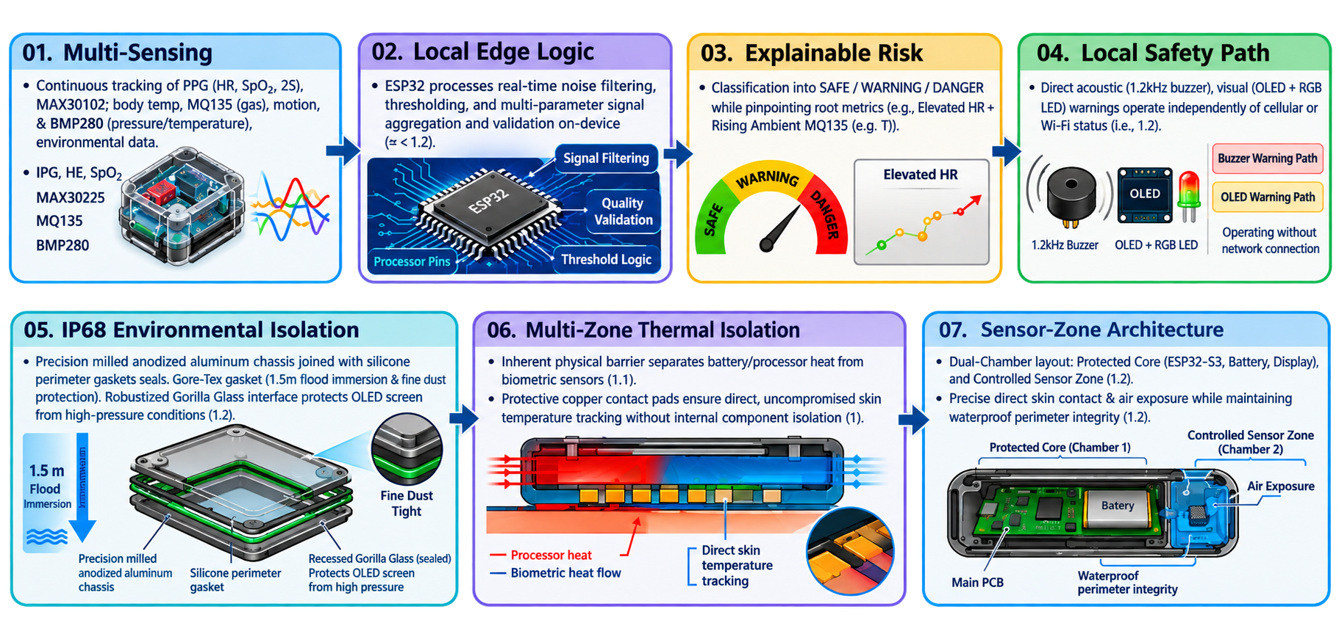
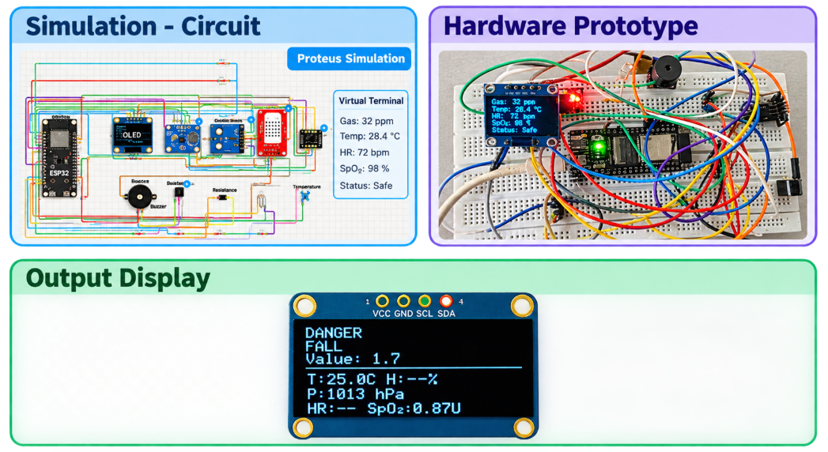
TECHNICAL APPROACH
IOT DIVAS

Slide 4
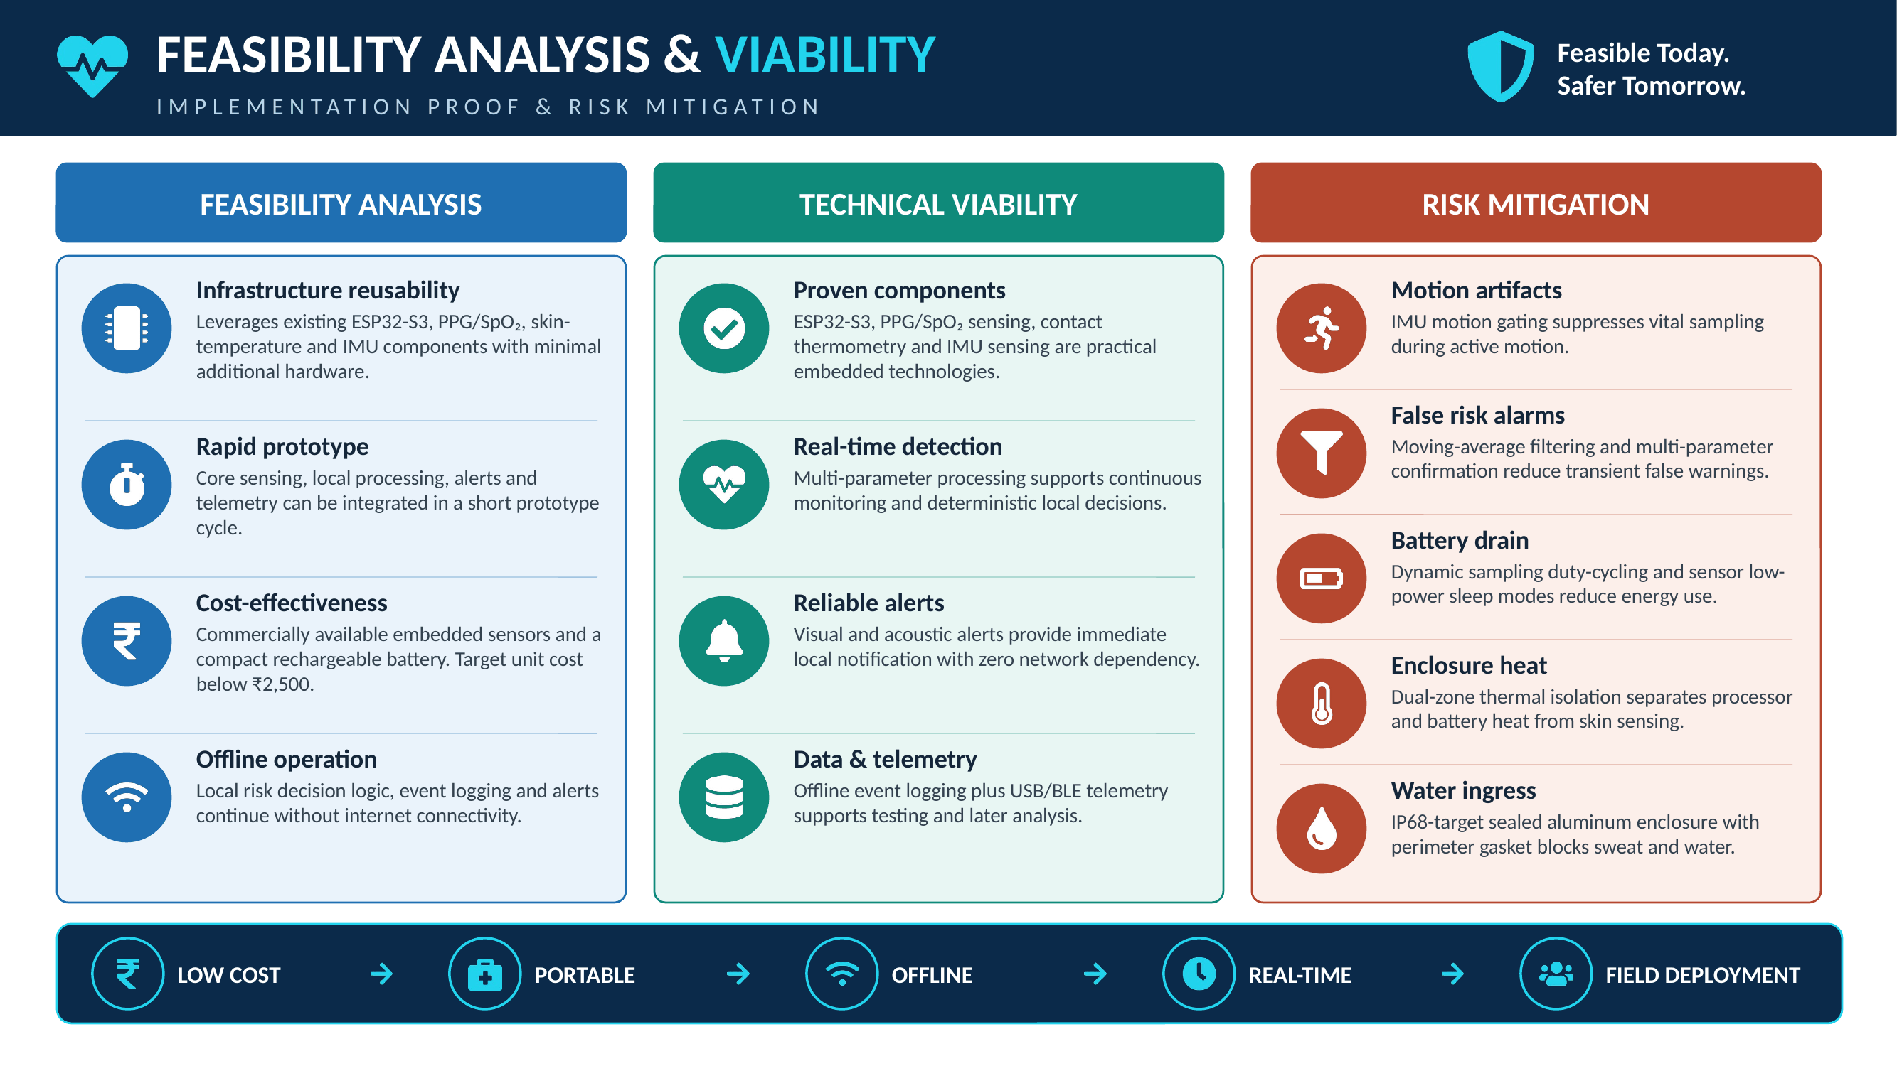
FEASIBILITY AND VIABILITY
IOT DIVAS

Slide 5
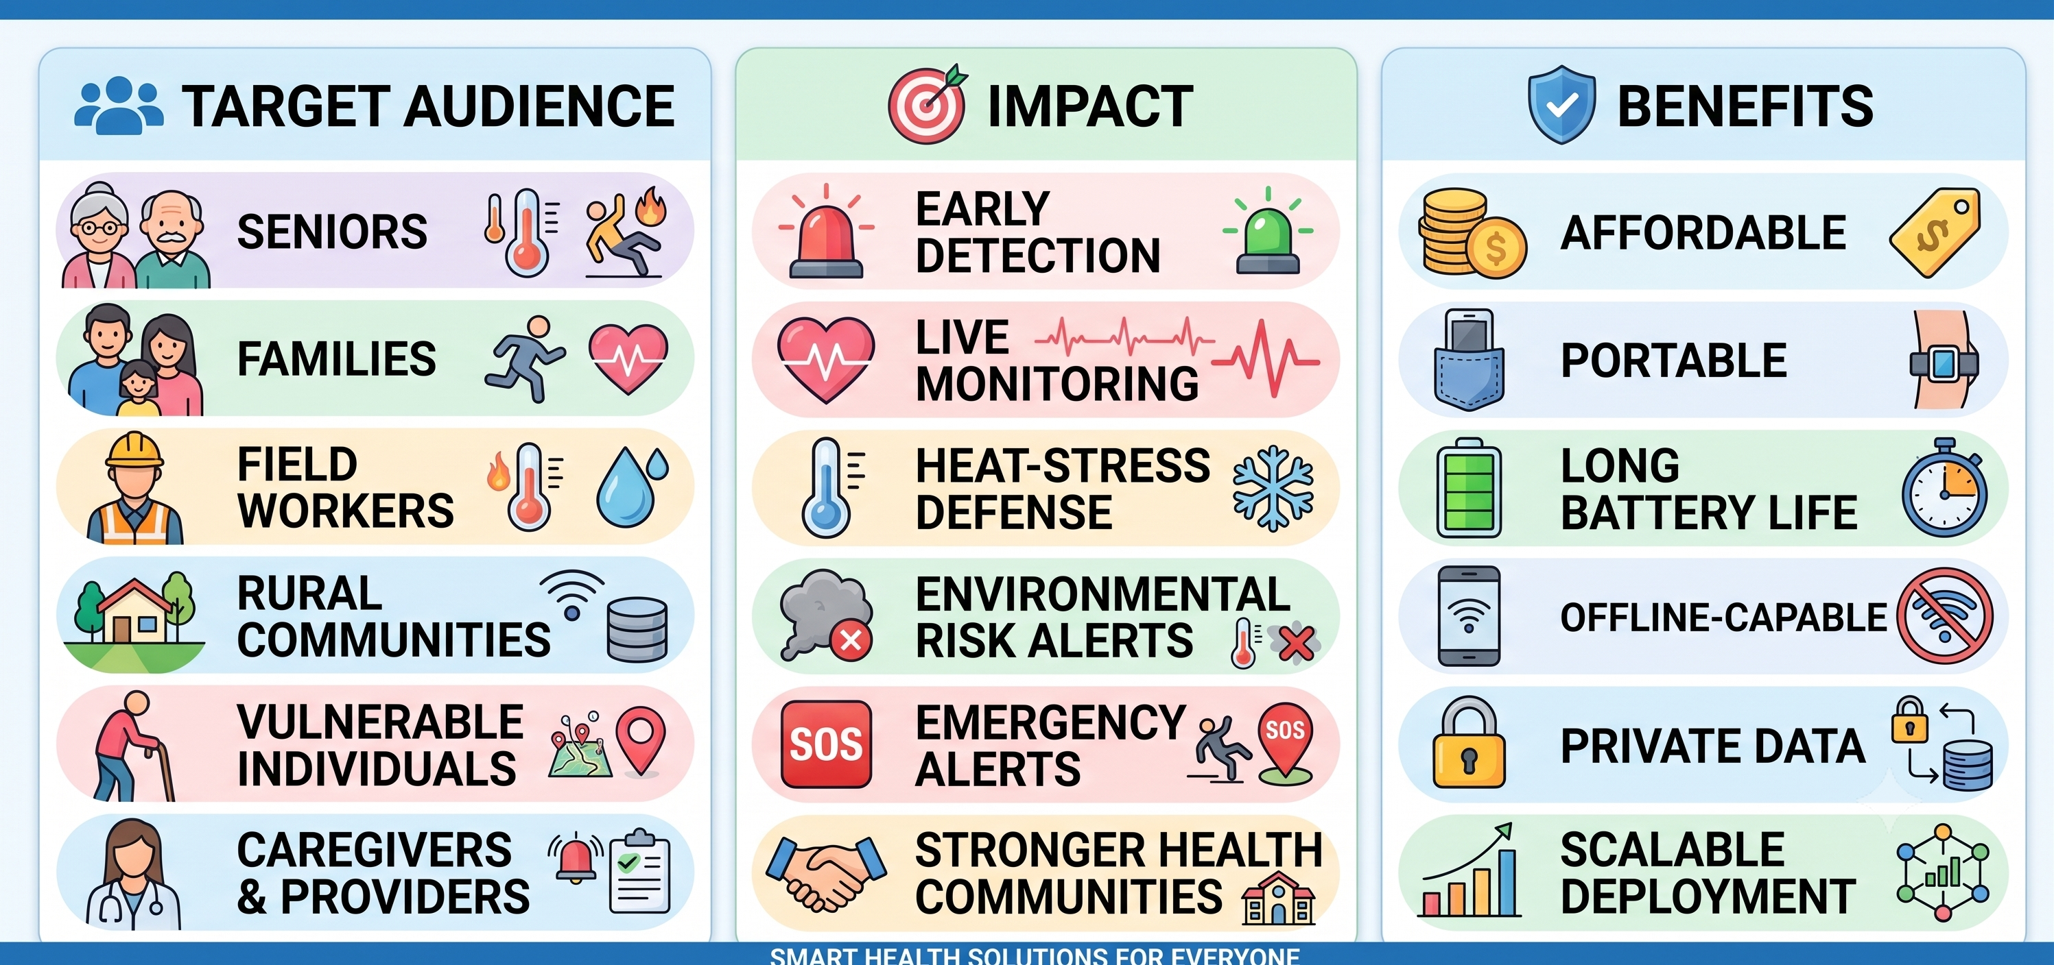
IMPACT AND BENEFITS
IOT DIVAS

Slide 6
RESEARCH AND REFERENCES
IOT DIVAS
[1] ESP32-S3 Technical Reference Manual & Datasheet https://www.espressif.com/sites/default/files/documentation/esp32-s3_datasheet_en.pdf
[4] Real-Time Monitoring Electronic Triage Tag System for Improving Survival Rate in Disaster-Induced Mass Casualty incidents doi: 10.3390/healthcare9070877
[2] Wearable, multimodal, vitals acquisition unit for intelligent field triage https://doi.org/10.1049/htl.2016.0038
[3] A wearable medical sensors system for in-situ monitoring vital signs of patients with hemorrhagic shock in big disaster scenes https://doi.org/10.1016/j.snb.2023.134448

