Slide 1



Flight Price Analysis
COMP – 8547 FINAL PROJECT

Slide 2
TEAM MEMBERS
Aby Kuruvilla(110089795)
Ajay Pallivathukkal Manoj(110089283)
Subham Gupta(110093436)
INSTRUCTOR
Dr. Mahdi Firoozjaei

Slide 3

Contents
Introduction
Working of flight price analysis
Features
Project Flow
Live Demo
Team Roles
Future Scope
Conclusion
References

Slide 4
Introduction
Flight price analysis is used to get the lowest price details of airlines.
The data is retrieved using web scarping and analyzed using different algorithms.
We are retrieving price from : https://www.travelocity.ca
The user needs to input the:
Departure city details
Arrival city details
Number of adults
Departure dates

Slide 5
Features
Web Scraping
Regex
Heap
TST
Edit Distance

Slide 6

Web Scraping
Two technologies used for web scraping are:
Selenium (Dynamic Page)
Jsoup (Static Page)

Slide 7
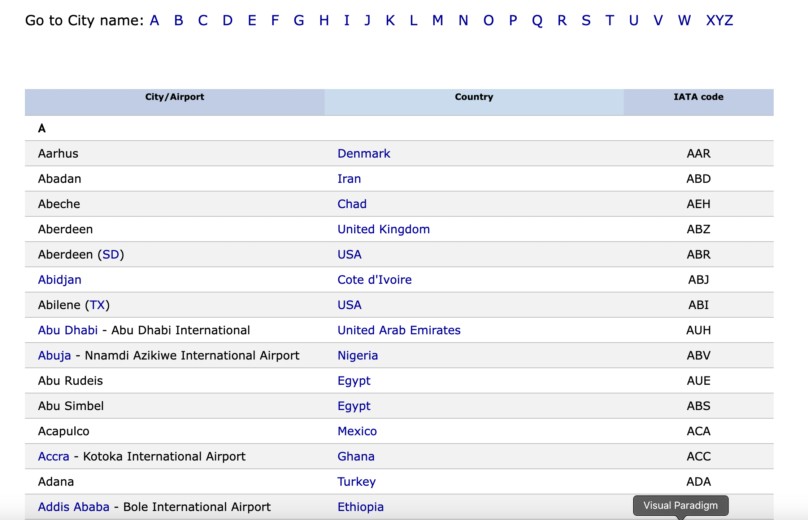
Jsoup
It used in our application to scrap data in
static page.
All the cities which contains airport and the
Airport codes are fetched.
The fetched data is stored in a HashMap.

Slide 8
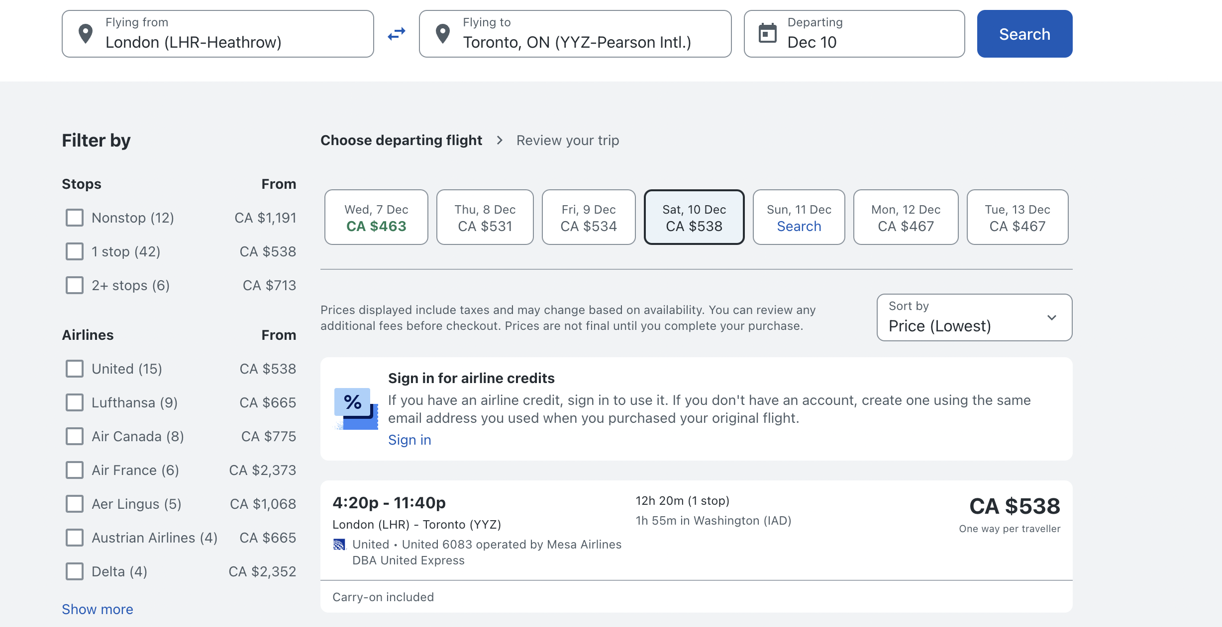
Selenium
Selenium is used to scrape data from
dynamic webpages.
Provides advanced filters to fetch
data.
The retrieved data is stored in a
HashMap.

Slide 9

Regex
Regular expression are used in our application to
Extracting necessary data from the parsed html content.
Input validation which includes the cities, dates and adult count.

Slide 10

Heap
Heap used in the application to retrieve the minimum flight rates.
We are adding all the flight details within a range of 20 days from the date provided by the user into the heap.
Using findMin the minimum price is found.

Slide 11
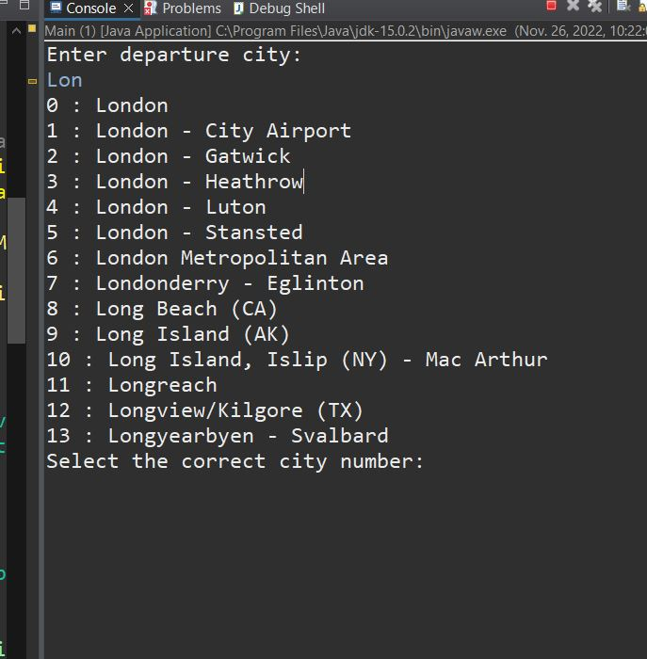
TST
TST is used in the system for auto completion of city names.
The Airport details collected using Jsoup is inserted into the TST.
When the user inputs we use prefix match to retrieve the matches.

Slide 12
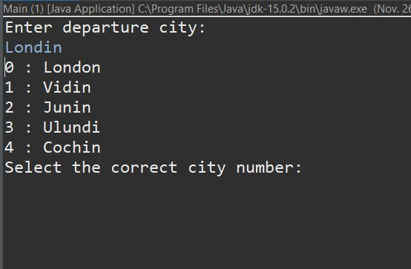
Edit Distance
Edit distance is used for spell checking.
The Airport details retrieved are added to a List.
The list is passed to the edit distance and the cities with 5
smallest score are suggested to the user.

Slide 13
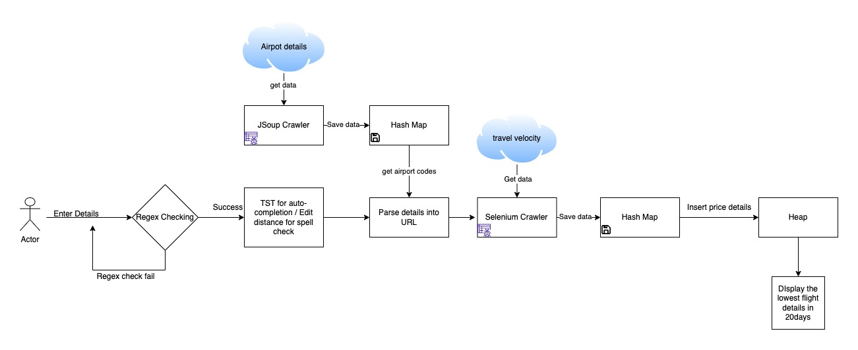
Project flow

Slide 14


Slide 15

TEAM ROLES
Aby Kuruvilla : Web Scraping using Selenium and using regex for extracting data from html parsed data.
Ajay Pallivathukkal Manoj : Web Scraping using Jsoup and regex for data validation.
Shubham Gupta: Web Scraping using Jsoup and regex for data validation. Heap Implementation, TST and Edit distance

Slide 16

Future Scope
Future features include:
Developing a GUI
Including data from different websites
Mobile application
Include round trip details
Include details of children and infants

Slide 17
Conclusion
Flight price analysis is a system which will return the cheapest rates of flights for a duration of time which is helpful for many users to get the rates much easier and faster.
From this project, we have learned to implement different algorithms and data structures which were taught in the class into our application, and we also studied about web scraping using different technologies.
The data analysis and the whole implementation was programmed with the help of Eclipse IDE.

Slide 18
References
Course materials provided for the labs and assignments.

