Slide 1
Quantile Regression Analysis of House Price Determinants
Mayank Kumar (110062284) MSc AI Specialization
Subham Gupta (110093436) MAC AI Specialization
Rayhaan Pirani (110046715) MSc AI Specialization
Course Instructor – Dr. Alioune Ngom
Notes:
Quantile Regression Analysis of House Price Determinants: A Comparative Study with Ordinary Least Squares using Feature Selection and P-Value Comparison"

Slide 2
OVERVIEW
Abstract
Introduction
Problem Statement
Problem Definition
Motivation
Justification
Related Works
Methodology
Material and Data
Models
Condition and Assumption
Formal Complexity/ Simulation Analysis
Computational Experiments
Experiments
Evaluation Metrics
Implementation Details
Results
Discussion
Conclusion
Summary
Future Research
References

Slide 3
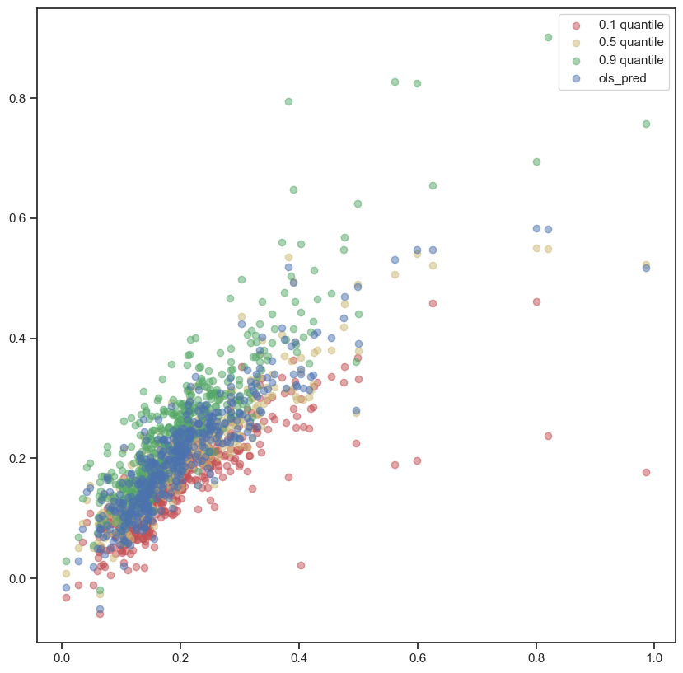
Abstract
Standard supervised regression techniques assume that the relationship between the features and target variable is consistent across the data distribution, which may not always be the case.
This study employs quantile regression techniques to identify how different housing characteristics relate to sale prices at different points of the sale price distribution.
The statistical significance of the selected features and how it behaves across different sale price distribution.
Our results confirm that different housing characteristics exhibit varying levels of significance at different quantiles of the sale price distribution.
These findings are of significant value to practitioners in the real estate industry, as they provide a better understanding of how different features contribute to the overall sale price of a property.
Fig 1. Actual Vs Pred QR and OLS

Slide 4
Introduction
One of the fundamental techniques in supervised regression problems is to study the relationship between features and the target variable.
Standard approach is to assume that this relationship is constant across the entire range of target variable. Ex – OLS
However, it is possible that the relationship vary across the range of target variable and hedonic regression analysis may not provide best interpretation of underlying relationship.
Quantile regression models the relationship between features and the target variable across different quantiles.

Slide 5
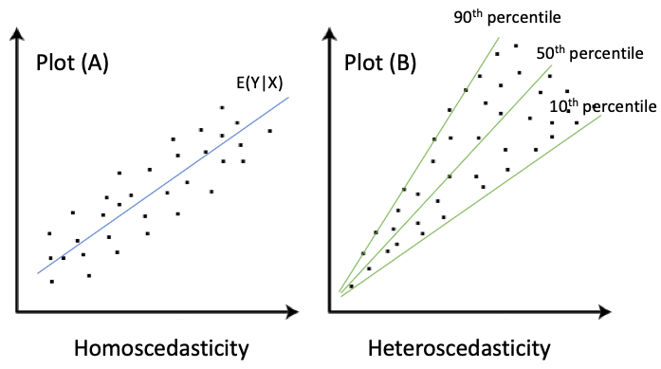
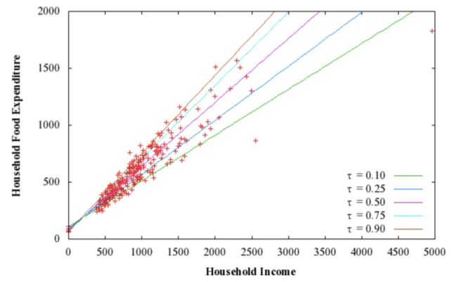
Introduction
Fig 3. Homoskedasticity vs. Heteroscedasticity [2]
Fig 2. Household Income vs. Food Expenditure [1]
Plot (A) shows the case that the variance of Y stays the same, and in Plot (B), the variance of Y increases as X increases.
In Econometrics, Plot (A) is called homoskedasticity, in which the variance of the residual term remains constant. Plot (B) is called heteroscedasticity, in which the variance varies widely.
Most real-world data would look like Plot (B) rather than Plot (A)
Household food expenditure varies even more widely for high-income households
OLS gives the prediction for the mean, but it is often needed to estimate the range of the variance.
Notes:
A Tutorial on Quantile Regression, Quantile Random Forests, and Quantile GBM | by Chris Kuo/Dr. Dataman | Dataman in AI | Medium

Slide 6

Quantile Regression
Linear regression or Ordinary least squares (OLS), we assume the relationship between our input variable X and our output label Y can be modeled by a linear function and minimizes the sum of squared errors.
Y = β₀+β₁X₁+β₂X₂+…+β_{n}X_{n}+ϵ
Median Regression minimizes the Absolute Deviation to obtain the estimator. If X is symmetric, the mean and median will be approximately the same and the estimator will be the same as that of the OLS
QR uses Least-Absolute-Deviation (LAD) to obtain the estimators.
Notes:
A Tutorial on Quantile Regression, Quantile Random Forests, and Quantile GBM | by Chris Kuo/Dr. Dataman | Dataman in AI | Medium

Slide 7

Quantile Regression
LAD regression does not have an analytical solving method like that of an OLS - Linear programming or the simplex method
It searches for the estimator that satisfies the following requirement:
LAD can be extended to Quantile regression. QR minimizes a sum that gives asymmetric penalties.
When q=0.50, the quantile regression collapses to OLS
q ∈(0,1); q^{th} Qunatile
Over-prediction
Under-prediction
Notes:
A Tutorial on Quantile Regression, Quantile Random Forests, and Quantile GBM | by Chris Kuo/Dr. Dataman | Dataman in AI | Medium

Slide 8
Problem Statement
Problem Definition: Given a housing prediction dataset (DS) with explanatory features (FS), train q+1 model – q Quantile Regression Model and 1 OLS model. Investigate and compare these models to provide analysis of House Price Determinants.
DS : Ames Housing dataset
FS : 79
q : [0.1, 0.5, 0.9]

Slide 9
Motivation
Most of the real world data show heteroscedasticity.
QR models will help better investigate and validate whether house characteristics are priced the same or different across a given distribution of house price.
Fig 4. Homoskedasticity vs. Heteroscedasticity [2]

Slide 10
Justification
Used more feature enriched house price prediction dataset comprising of 79 explanatory features.
Compare the finding of QR analysis with respect to OLS for house price determinants.

Slide 11
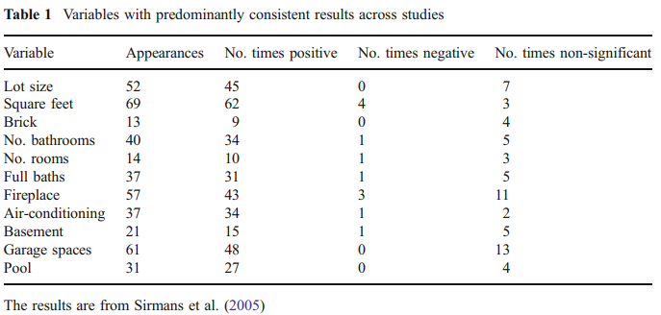
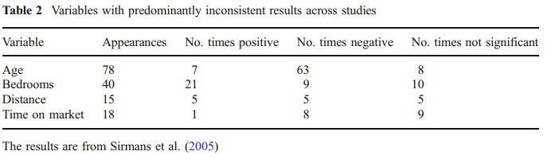
Related Work
Sirmans et al. (2005) examine hedonic pricing models for more than 125 empirical studies and find that studies often disagree on both the magnitude and direction of the effect of certain characteristics.

Slide 12
Related Work
Malpezzi (2003) notes that different consumers may value housing characteristics differently.
Newsome and Zietz (1992), housing characteristics may not be valued the same across a given distribution of housing prices.

Slide 13
Methodology - Material and Data
Dataset - Ames Housing dataset
The dataset has a total of 1460 records with 79 explanatory variables describing almost every aspect of residential homes in Ames, Iowa.

Slide 14
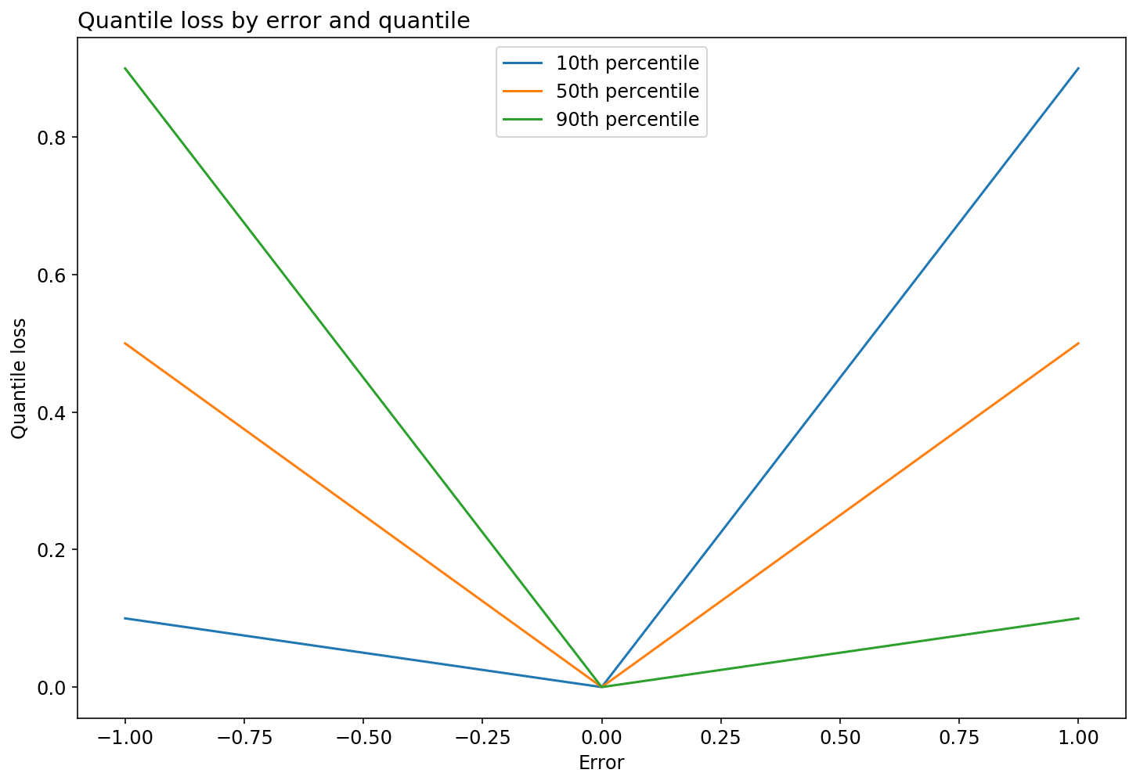

Methodology - Models
Quantile Regression
The quantile loss differs depending on the evaluated quantile.
More negative errors (over-performing) are penalized more when we specify a higher quantiles
More positive errors (under-performing) are penalized more for lower quantiles
OLS
q
Positive error /
Under-Performing
q
Negative error /
Over-Performing
Fig 5. QR Loss plot with q = 0.1, 0.5, 0.9 for dummy data

Slide 15
Condition and Assumption
The study aims to find the variation in relationship between determinants and house price based on the variation in house price. The study do not consider any external or other relationship such as spatial location for the same.

Slide 16
Formal Complexity
For solving Quantile LAD regression, linear programming approach are used.
The computational complexity depends on the number of observations and the number of independent variables.

Slide 17
Computational Experiments
Experiments – We trained 3 Quantile Regression models for q = [0.1, 0.5, 0.9] percentile and 1 OLS model.
We performed the below mentioned steps
EDA and handle missing value
Feature Selection – Univariate, Forward Selection – AIC, Multi-collinearity
Vectorization – One hot encode
Normalization – Min Max Scalar
Train – Test Split
Train Models
Visualize and Compare experiments results and summary

Slide 18
Evaluation Metrics
We have reported below metrics
Quantile loss
RMSE
Also, multiple plots to compare the feature relationship with target across various quantile.

Slide 19
Computational Experiments
Implementation Details
Platform Detail – Google Colab, GIT
Toolkit/Software – python, statsmodel, scikit-learn, seaborn

Slide 20
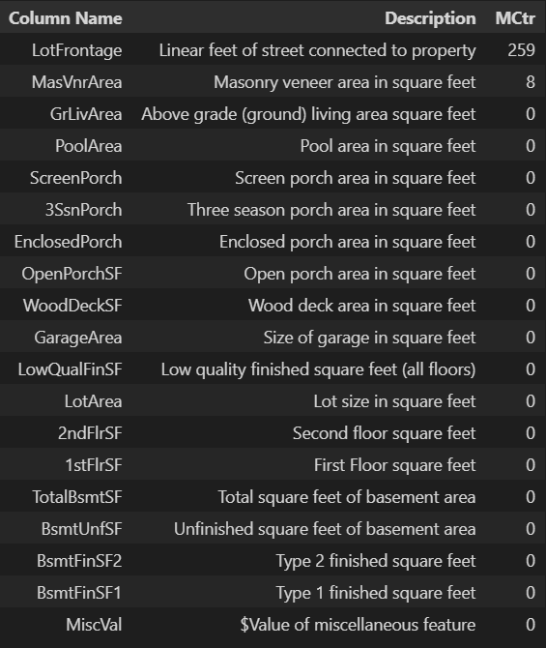
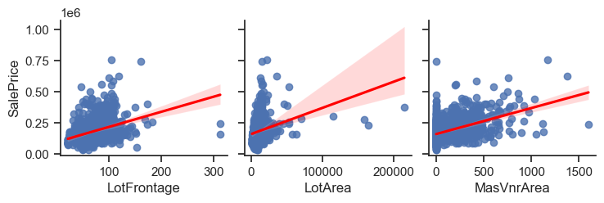
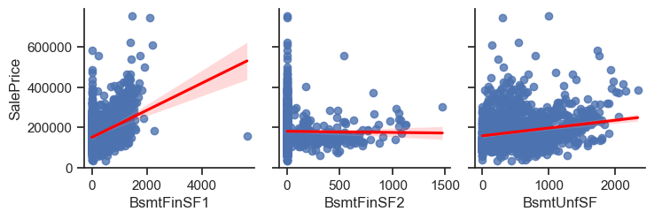

Implementation - EDA
Feature Set - Continuous
Handling Missing Value

Slide 21
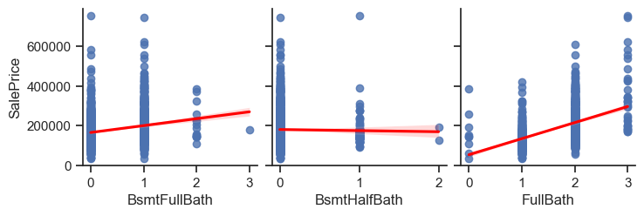
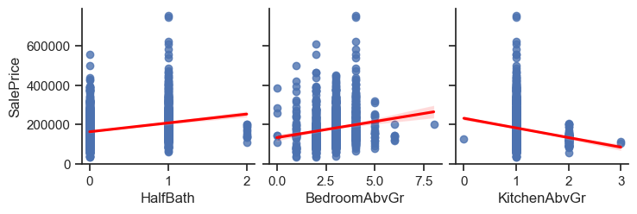
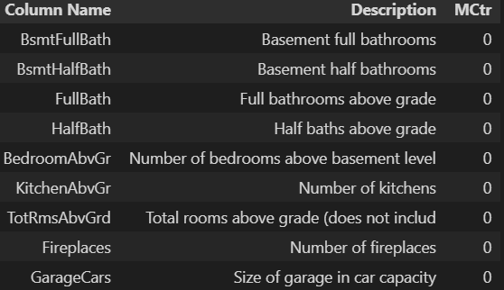
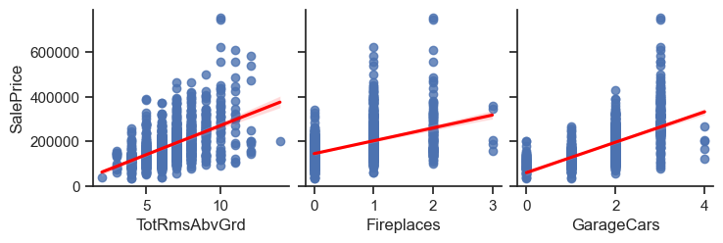
Implementation - EDA
Feature Set - Discrete

Slide 22
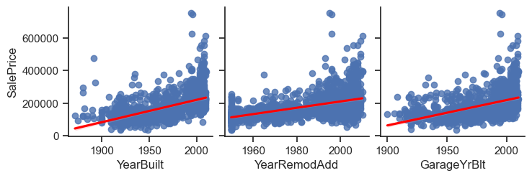
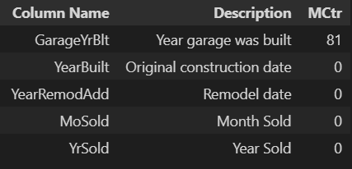
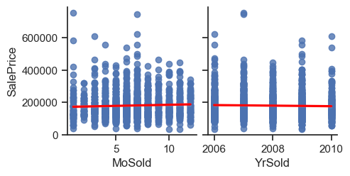
Implementation - EDA
Feature Set - Year
Handling Missing Value

Slide 23
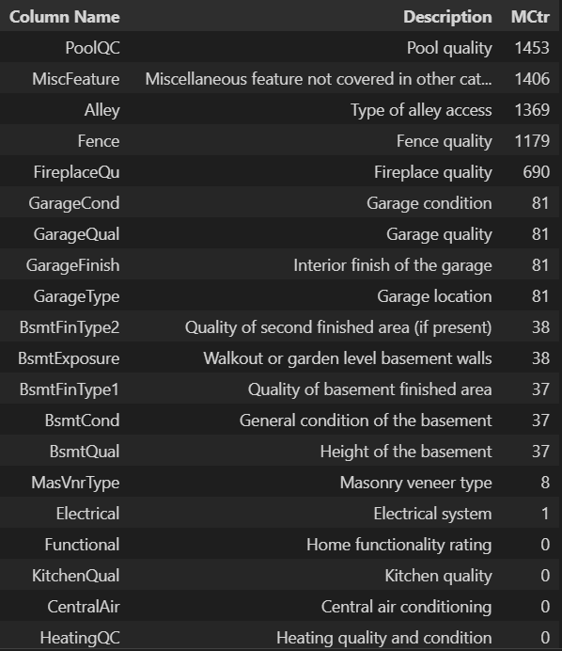
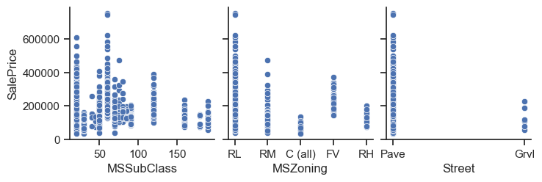
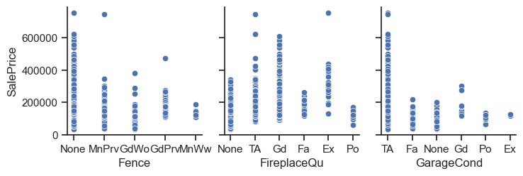
Implementation - EDA
Feature Set - Categorical
Handling Missing Value

Slide 24
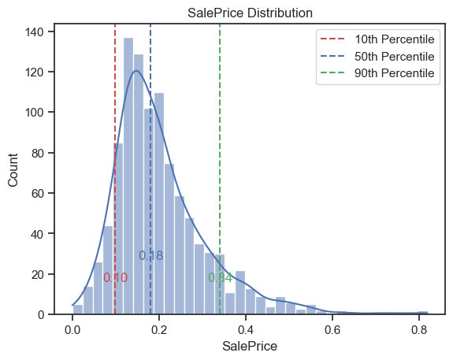
Implementation - EDA
Fig 6. SalePrice Distribution – Overall Data

Slide 25
Implementation - Feature Selection
79
Filter Methods
Basic methods - remove constant and quasi-constant features.
Constant features are those that show the same value, just one value, for all the observations of the dataset
Quasi-constant features are those that show the same value for the great majority of the observations of the dataset.
Correlation Matrix with Heatmap
Correlation is a measure of the linear relationship of 2 or more variables.
Variables should be correlated with the target but uncorrelated among themselves
One hot encoding
374
Remove quasi-constant
262
Remove Colinear features
209
Remove Multi-colinear features
wrt target
83

Slide 26
Implementation - Feature Selection
79
One hot encoding
Wrapper Methods
Forward Selection - using AIC as performance indicator
374
Remove quasi-constant
262
Remove Colinear features
209
Remove Multi-colinear features
wrt target
83
Wrapper Method
50

Slide 27
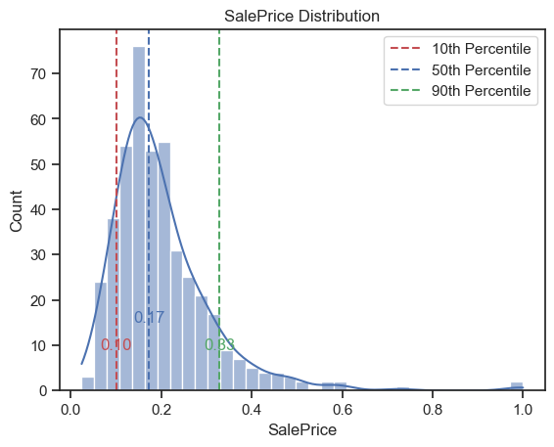
Implementation - Data split
Train (70%) Test (30%)
Fig 8. SalePrice Distribution – Test Data
Fig 7. SalePrice Distribution – Train Data

Slide 28
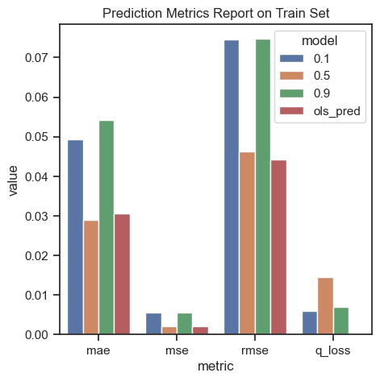
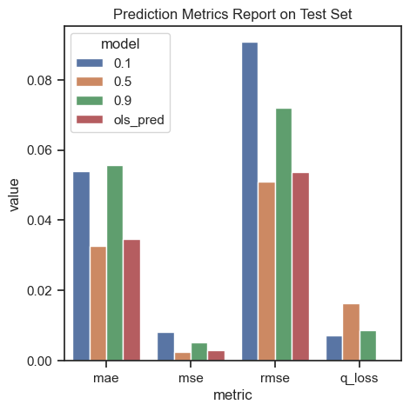
Model Train & Test Metrics
Fig 9. Prediction Metric Report – Train Set
Fig 10. Prediction Metric Report – Test Set
Model | MAE | MSE | RMSE | Quantile Loss
0.1 – QR | 0.049 | 0.006 | 0.075 | 0.006
0.5 – QR | 0.029 | 0.002 | 0.046 | 0.015
0.9 – QR | 0.054 | 0.006 | 0.075 | 0.007
OLS | 0.031 | 0.002 | 0.044 | --
Model | MAE | MSE | RMSE | Quantile Loss
0.1 – QR | 0.054 | 0.008 | 0.091 | 0.007
0.5 – QR | 0.033 | 0.003 | 0.051 | 0.016
0.9 – QR | 0.056 | 0.005 | 0.072 | 0.009
OLS | 0.035 | 0.003 | 0.054 | --

Slide 29
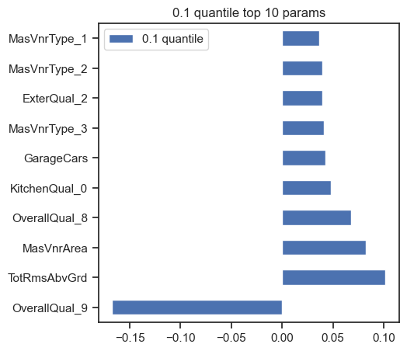
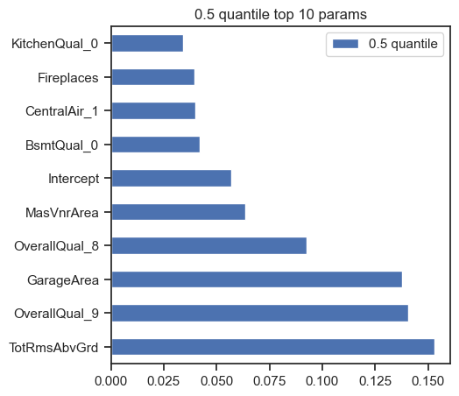
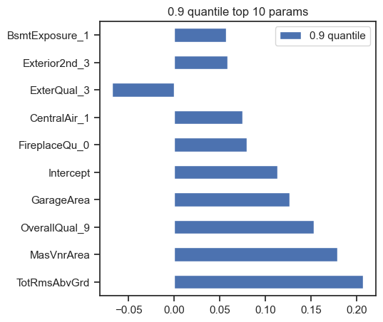






Results – House Price Determinant Analysis
Quantile Regression – 0.1, 0.5, 0.9 Quantile Analysis
Fig 11. Top 10 Features 0.1 QR
Fig 12. Top 10 Features 0.5 QR
Fig 13. Top 10 Features 0.9 QR
High Priced House – Basement Exposure, FireplaceQu
Low Priced House – KitchenQual

Slide 30
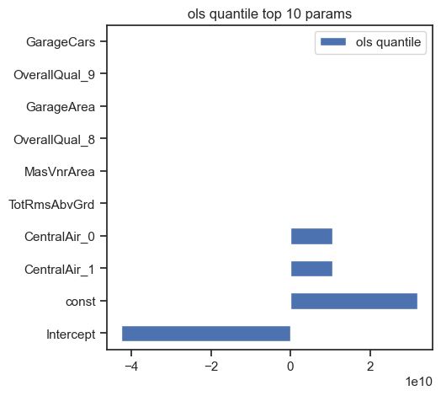






Results – House Price Determinant Analysis
0.1 Quantile, OLS, 0.9 Quantile Analysis
Fig 14. Top 10 Features 0.1 QR
Fig 15. Top 10 Features OLS
Fig 16. Top 10 Features 0.9 QR

Slide 31
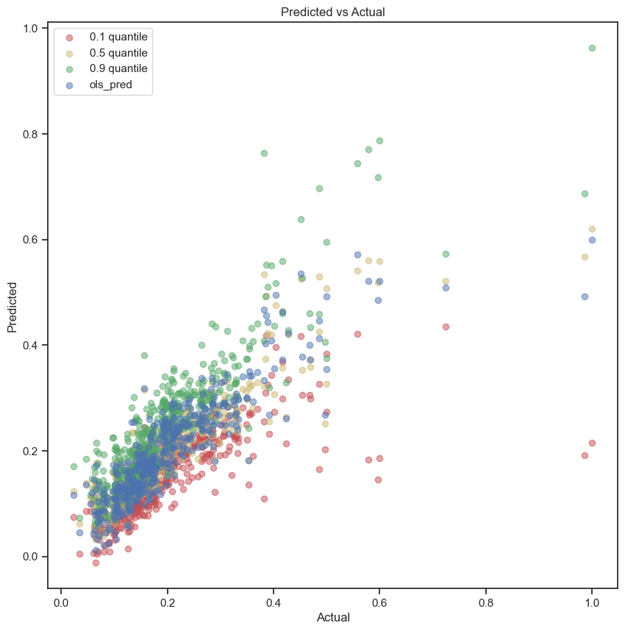
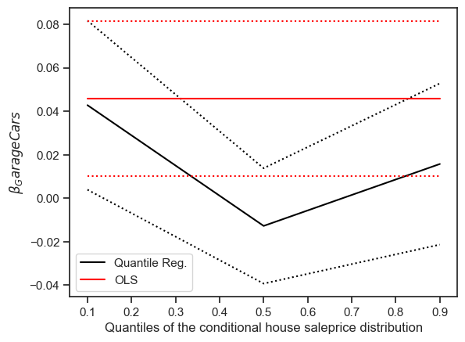
Results – House Price Determinant Analysis
Fig 17. GarageCars Feature Coeff and Interval
Fig 18. Actual Vs Predicted

Slide 32
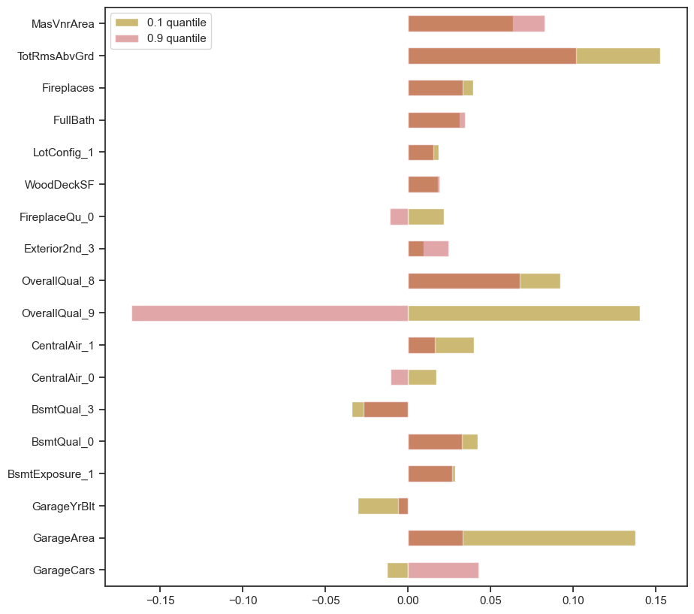





Discussion
Our experimentations verify that housing price determinants/features are valued differently across target – SalePrice Distribution.
Fig 19. Feature coefficient 0.1 Vs 0.9 QR

Slide 33
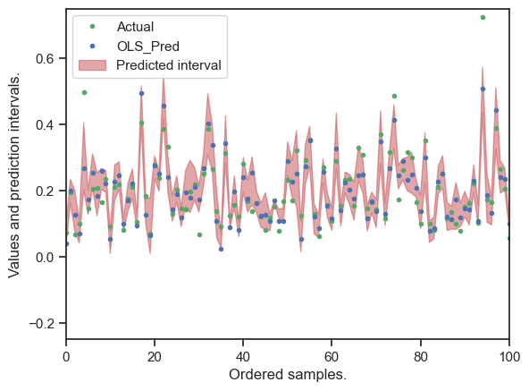
Discussion
Quantile regression are prone to outlier and the same help in more inclusive study of the relationship between housing price and its determinants.
Image on the right, show the housing data and the predicted interval. We can see most of the observation are within the interval.
Fig 20. Actual, Predicted and Interval using QR

Slide 34










Conclusion
Simrans et al. (2005) study found multiple feature which are consistent across literature as important features for house price prediction. On the right, our method’s top-10 features, show 5 features from the study.
We also, saw how few of the housing determinants relationship can be modelled/analysed better using quantile analysis. The study finds multiple feature which contributes significantly different based on the SalePrice.
Fig 21. Top 10 Features 0.5 QR

Slide 35
Future Research
We can address the issue of curse of dimensionality and feature selection using other quantile based approaches – tree, deep learning methods.

Slide 36
References
[1] Koenker, R. (2005). Quantile Regression (Econometric Society Monographs). Cambridge: Cambridge University Press. doi:10.1017/CBO9780511754098
[2] https://medium.com/dataman-in-ai/a-tutorial-on-quantile-regression-quantile-random-forests-and-quantile-gbm-d3c651af7516
[3] Sirmans, G. & Macpherson, David & Zietz, Emily. (2005). The Composition of Hedonic Pricing Models. Journal of Real Estate Literature. 13. 3-43. 10.1080/10835547.2005.12090154.
[4] Turner, B., & Malpezzi, S. (2003). A Review of Empirical Evidence on the Costs and Benefits of Rent Control. Swedish Economic Policy Review, 10, 11-56.

Slide 37
THANK YOU

