Slide 1
WELCOME
AccessLab
Authentication Studio
Account registration and password verification
Subham Mohanty b425058 CSE B Semester III
Supervisor: Mr Srichandan Shobhanayak
IIIT Bhubaneswar Academic period 2025 to 2029
1 November 2026
Notes:
Welcome to the AccessLab project demonstration. This presentation follows registration, saved verifier storage, login verification, and session closure. Advance on click.

Slide 2
AccessLab Project Workflow
Account registration and password verification
Create an
account
Generate a
salted hash
Save the
account record
Submit the
sign in form
Sign out or
try again
Allow or reject
the login
Compare the
hash bytes
Recompute with
the stored salt
The database persists account verifiers. Each application process starts signed out.
Subham Mohanty b425058 CSE B Semester III IIIT Bhubaneswar
02
Notes:
Follow the first row from account creation to the saved record, then follow the second row from sign-in input to verification and session outcome. Sign-out clears the active identity. The next launch reloads accounts but requires authentication again.
Sources: src/AuthenticationService.cpp; src/JsonAccountStorage.cpp; gui/AuthenticationWindow.cpp
Submitted AccessLab implementation. This native application performs the demonstration locally without contacting a website.

Slide 3
Application Startup
Launch
AccessLab
Acquire the
database lock
Read
accounts.json
Validate format
and parameters
Show the
account portal
File missing
Open an empty portal
Invalid file
Stop and show an error
No account database is written until registration succeeds.
03
Notes:
JsonAccountStorage acquires a cooperative OS lock and loads a bounded file. A missing database returns an empty collection. Invalid structure, unsupported costs, duplicate records or oversized input stop startup before normal account actions.
Sources: src/JsonAccountStorage.cpp; src/PlatformFile.cpp; src/AuthenticationService.cpp; gui/main.cpp
Submitted AccessLab implementation. This native application performs the demonstration locally without contacting a website.

Slide 4
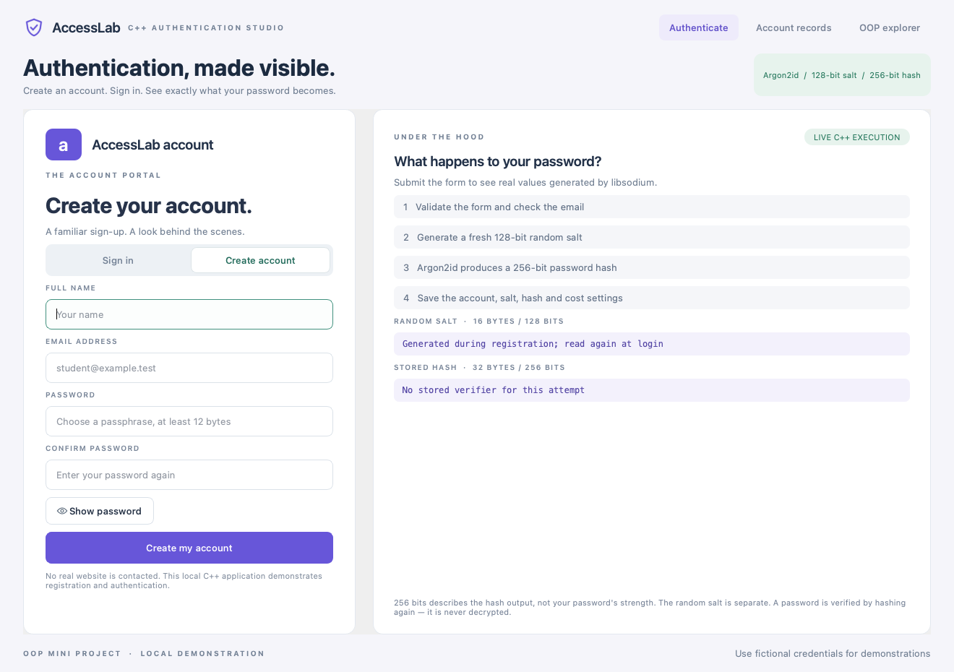
Registration Form and Validation
Match password confirmation
Validate name, normalized email
and password length
New email?
Yes
No
Name, email, password
and confirmation
Continue to hashing
Show input error
Any failed check returns an error.
04
Notes:
The GUI consumes and clears password fields. A mismatch stops before service registration. The service validates name, normalized email, password bounds, account limit and duplicate email before invoking the hasher. Every failed check keeps the user signed out. Screenshot uses fictional demonstration credentials.
Sources: gui/AuthenticationWindow.cpp; src/AuthenticationService.cpp; src/UserAccount.cpp; docs/screenshots/create-account.png
Submitted AccessLab implementation. This native application performs the demonstration locally without contacting a website.

Slide 5
Salt Generation and Password Hashing
Entered password
Temporary memory
Argon2id 1.3
2 operations
64 MiB memory
Password hash
32 bytes or 256 bits
Fresh random salt
16 bytes or 128 bits
Save the salt, hash
and cost settings
randombytes_buf
Each newly registered account receives an independent random salt.
05
Notes:
Argon2idHasher calls randombytes_buf for a 16-byte salt and crypto_pwhash for a 32-byte output with explicit Argon2id 1.3. The project freezes opslimit 2 and memory 67108864 bytes. Output size does not measure password entropy.
Sources: src/Argon2idHasher.cpp; include/PasswordDigest.h; https://libsodium.gitbook.io/doc/password_hashing/default_phf
Submitted AccessLab implementation. This native application performs the demonstration locally without contacting a website.

Slide 6
Account Storage and Checked Commit
Build the
UserAccount
Propose an updated
account collection
Serialize identity
and verifier fields
Write a temporary
JSON file
Return to the
sign in form
Publish the saved
collection in memory
Commit the
complete file
Flush and close
the temporary file
Write or commit failure
Keep the previous records and show an error
06
Notes:
Registration serializes public account metadata plus the salt, verifier and fixed algorithm/cost settings. The service saves a proposed vector before swapping it into the live account collection. Pre-commit file failures do not publish a phantom account. The JSON database is not encrypted or authenticated as a whole.
Sources: src/AuthenticationService.cpp; src/JsonAccountStorage.cpp; src/PlatformFile.cpp
Submitted AccessLab implementation. This native application performs the demonstration locally without contacting a website.

Slide 7
Login Lookup and Hash Recalculation
Submit email
and password
Stored salt, hash
and settings
Yes
User
found?
Recompute the
256 bit hash
Normalize email
and look up account
Random dummy
verifier
No
Both paths perform Argon2id hashing. Only an existing account can sign in.
07
Notes:
A known email selects its stored verifier. An unknown valid email uses a random dummy record for hashing work and cannot create a session. Both paths perform derivation, but successful authentication additionally requires that the account exists. The inspector hides dummy verifier fields.
Sources: src/AuthenticationService.cpp; src/Argon2idHasher.cpp
Submitted AccessLab implementation. This native application performs the demonstration locally without contacting a website.

Slide 8
Hash Comparison and Login Outcome
Stored password hash
5a9ec521b57ef5e5ef942e77e9b2d3cf2b0f18453dc3b19ed61d71b1fb570902
Candidate hash from the correct fictional password
5a9ec521b57ef5e5ef942e77e9b2d3cf2b0f18453dc3b19ed61d71b1fb570902
User exists
Hash matches?
Yes
No
Set the active account ID
Open the signed in page
Show a generic credential error
Create no session
08
Notes:
The two displayed hashes are the same real verifier shown by the successful fictional registration/login demonstration, exported in Example_Stored_Record.json and visible in login-success.png. They illustrate the matching path. The actual code compares candidate and stored bytes through sodium_memcmp, and also requires a found account. Wrong-password and unknown-account attempts remain signed out.
Sources: docs/Example_Stored_Record.json; docs/screenshots/login-success.png; src/Argon2idHasher.cpp; src/AuthenticationService.cpp
Submitted AccessLab implementation. This native application performs the demonstration locally without contacting a website.

Slide 9
Sign Out and Application Restart
Sign out during the current process
Active account
page
Select
Sign out
Clear the active
account ID
Return to
sign in
Close and reopen the application
Close the
current process
Launch a
new process
Reload the saved
account database
Authenticate
again
Accounts persist in JSON. The signed in identity does not persist.
09
Notes:
logout sets currentId_ to zero. Destroying the application also discards its in-memory identity. A new service loads account records while currentId_ starts at zero. Login must succeed again before currentUser can be accessed through the session API.
Sources: include/AuthenticationService.h; src/AuthenticationService.cpp; gui/AuthenticationWindow.cpp
Submitted AccessLab implementation. This native application performs the demonstration locally without contacting a website.

Slide 10
Registration Object Handoffs
Qt interface
AuthenticationService
IPasswordHasher
IAccountStorage
Argon2idHasher
JsonAccountStorage
Submit registration form
hash(password)
Return salt and hash
save(proposed accounts)
Return checked commit result
Return to sign in
Login calls verify through the hasher interface and does not call storage save.
10
Notes:
This sequence shows method calls in registration. The service owns unique_ptr base interfaces and calls their concrete implementations through virtual dispatch. Storage must return success before the service swaps the candidate collection into the live vector. Exceptions return a visible error through the GUI handler.
Sources: src/AuthenticationService.cpp; include/IPasswordHasher.h; include/IAccountStorage.h; src/JsonAccountStorage.cpp
Submitted AccessLab implementation. This native application performs the demonstration locally without contacting a website.

Slide 11
ACCESSLAB AUTHENTICATION STUDIO
Thank you
Questions and live demonstration
Subham Mohanty
Supervisor: Mr Srichandan Shobhanayak
IIIT Bhubaneswar CSE Semester III 1 November 2026
Notes:
End of the workflow presentation. Questions and live demonstration.

