Slide 1

Diabetes Prediction Using
Machine Learning
Subham Sinha(1900320100166)
Suyash Pratap Singh(1900320100172)
Shashank Pratap Singh(1900320100147)
Guide Name : Ms. Shweta Roy

Slide 2

Problem Statement
Diabetes is a most common disease caused by a group of metabolic disorders. It is also known as Diabetic mellitus. It affects the organs of the human body. It can be controlled by predicting this disease earlier. If diabetics patient is untreated for a long time, it may lead to increase blood sugar.
Now a days, Healthcare industries generating large volume of data. Machine Learning algorithms and statistics are used to predict the disease with the help of current and past data. Machine learning techniques helps the doctors to predict early stage for diabetics.
Diabetics patient medical record and different types of algorithms are added in dataset for experimental analysis. we use logistic regression, random forest, decision tree classifier and gradient boosting to predict whether a patient has diabetes based on diagnostic measurements. Performance and accuracy of the applied algorithms is discussed and compared.

Slide 3
Aim
The Aim of this project is to develop a system which can perform early prediction of diabetes for a patient with a higher accuracy by combining the results of different machine learning techniques.

Slide 4
Introduction
Diabetes is a chronic disease and commonly stated by health professionals or doctors as diabetes mellitus, which describes a set of metabolic diseases in which the person has blood sugar, either insulin production inefficient, or because of the body cell do not return correctly to insulin, or by both reason. This will increase concentration levels of glucose in the blood. The majority of cases of diabetes can be broadly classified in two categories, type 1 and type 2, although some cases are difficult to classify. Many complications occur if diabetes remain untreated. Therefore, it is not only a disease but also a creator of different kinds of diseases like heart attack, blindness, kidney diseases, etc. If the pancreas is not able to produce enough insulin (insulin deficiency) or if the body cannot use the insulin it produces (insulin resistance), glucose builds up in the bloodstream and diabetes develops. Diabetes Mellitus means high levels of sugar (glucose) in the blood stream and in the urine.
Types of Diabetes
Type 1 Diabetes means that the immune system is compromised and the cells fail to produce insulin in sufficient amounts. There are no eloquent studies that prove the causes of type 1 diabetes and there are currently no known methods of prevention.
Type 2 Diabetes means that the cells produce a low quantity of insulin or the body can’t use the insulin correctly. This is the most common type of diabetes, thus affecting 90% of persons diagnosed with diabetes. It is caused by both genetic factors and the manner of living.
Gestational diabetes appears in pregnant women who suddenly develop high blood sugar. In two thirds of the cases, it will reappear during subsequent pregnancies. There is a great chance that type 1 or type 2 diabetes will occur after a pregnancy affected by gestational diabetes.

Slide 5
Introduction
Symptoms of Diabetes
• Frequent Urination • Increased thirst
• Tired/Sleepiness • Weight loss • Blurred vision • Mood swings
• Confusion and difficulty concentrating • frequent infections
Causes of Diabetes
Genetic factors are the main cause of diabetes. It is caused by at least two mutant genes in the chromosome 6, the chromosome that affects the response of the body to various antigens. Viral infection may also influence the occurrence of type 1 and type 2 diabetes. Studies have shown that infection with viruses such as rubella, mumps, hepatitis B virus, and cytomegalovirus increase the risk of developing diabetes. Diabetes has become one of the major causes of national disease and death in most countries. According to the International Diabetes Federation report, this figure is expected to rise to more than 642 million in 2040, so early screening and diagnosis of diabetes patients have great significance in detecting and treating diabetes on time. The analysis of diabetes data is a challenging issue because most of the medical data are nonlinear, abnormal, correlation structured, and complex in nature.

Slide 6
Motivation
In 2020, according to the International Diabetes Federation (IDF), 463 million people have diabetes in the world and 88 million people in the Southeast Asia region. Of this 88 million people, 77 million belong to India. The prevalence of diabetes in the population is 8.9%, according to the IDF. According to the IDF estimates, India has the second highest number of children with type 1 diabetes after the United States. It also contributes to the largest proportion of incident cases of type 1 diabetes in children in the SEA region. Per the World Health Organization, 2% of all deaths in India are due to diabetes.
The number of people with diabetes in India has increased from 26 million in 1990 to 65 million in 2016. According to the 2019 National Diabetes and Diabetic Retinopathy Survey report released by the Ministry of Health and Family Welfare, the prevalence was found to be 11.8% in people over the age of 50. The prevalence of diabetes is 6.5% and prediabetes 5.7% among the adults below the age of 50 years, according to the DHS survey.
There are four sub-groups or clusters of people with type 2 diabetes in India, two of which are unique to the country. These sub-groups have different risk levels of complications and might need different treatments.
The people who are hit worst from this are women and many cases has been reported in young children and youth and hence looking at such concerning figures we have decided to work on diabetes detection application using Machine learning.

Slide 7
Scope Of Project
Scoping is the process of planning out a project and making decisions on what resources to employ to accomplish the project. But it’s more than just planning, it involves asking the right question, finding the business objective, and aligning that with Machine Learning solutions. Scoping is part of the larger process of a machine learning project but is the first step and is often regarded as the most important one.
The World Health Organization (WHO) predicts that by 2030 there will be approximately 350 million people worldwide affected by diabetes and by 2040 642 million people will be affected by diabetes world wide.
Thus the scope involves the building of machine learning models and testing them to find most accurate ones to apply in real world scenarios and mitigate the diabetic plague upon us.

Slide 8
Literature Review Summary
K. Vijiya Kumar [1] proposed Random Forest Algorithm for the prediction of diabetes developed a system which can perform early prediction of diabetes for a patient with a higher accuracy by using Random Forest algorithm in machine learning technique. The proposed model gives the best results for diabetic prediction and the result showed that the prediction system is capable of predicting the diabetes disease effectively, efficiently and most importantly, instantly. Nonso Nnamoko presented predicting diabetes onset: an ensemble supervised learning approach they used five widely used classifiers are employed for the ensembles and a meta-classifier is used to aggregate their outputs. The results are presented and compared with similar studies that used the same dataset within the literature. It is shown that by using the proposed method, diabetes onset prediction can be done with higher accuracy.
Aishwarya [2] aims to discover solutions to detect the diabetes by investigating and examining the patterns originate in the data via classification analysis by using Decision Tree and Naive Bayes algorithms. The research hopes to propose a faster and more efficient method of identifying the disease that will help in well-timed cure of the patients. Using PIMA dataset and cross validation approach the study concluded that J48 algorithm gives an accuracy rate of 74.8% while the naive Bayes gives an accuracy of 79.5% by using 70:30 split.

Slide 9
Literature Review Summary
Lee et al. [3] focus on applying a decision tree algorithm named as CART on the diabetes dataset after applying the resample filter over the data. The author emphasis on the class imbalance problem and the need to handle this problem before applying any algorithm to achieve better accuracy rates. The class imbalance is a mostly occur in a dataset having dichotomous values, which means that the class variable have two possible outcomes and can be handled easily if observed earlier in data preprocessing stage and will help in boosting the accuracy of the predictive model.

Slide 10
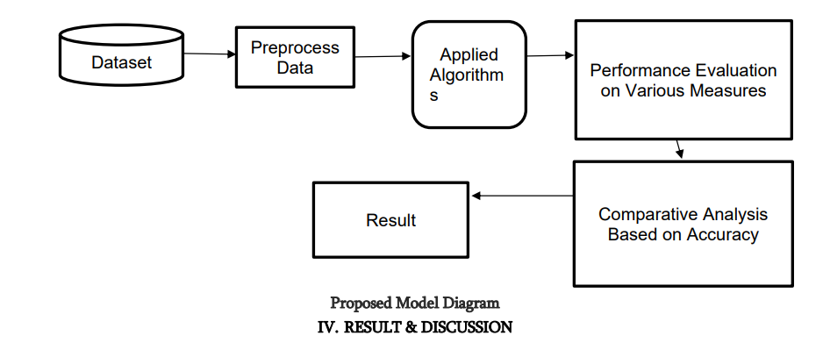
Methodology/Techniques
System Design

Slide 11
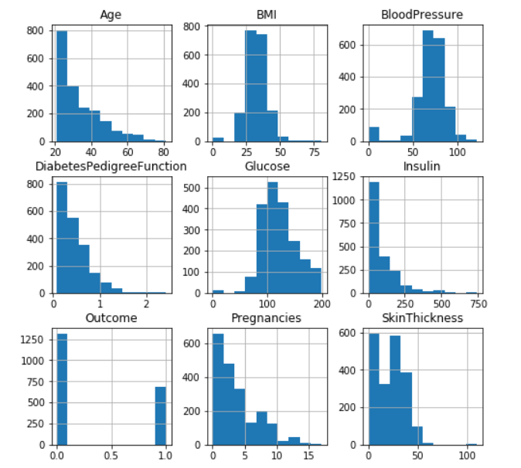
Methodology/Techniques
Histogram

Slide 12
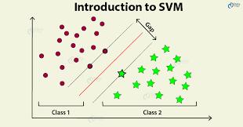
Methodology/Techniques
1. Support Vector Machine -
Support Vector Machine also known as svm is a supervised machine learning algorithm. SVM is most popular classification technique. SVM creates a hyperplane that separate two classes. It can create a hyperplane or set of hyperplane in high dimensional space. This hyper plane can be used for classification or regression also. SVM differentiates instances in specific classes and can also classify the entities which are not sup- ported by data. Separation is done by through hyperplane performs the separation to the closest training point of any class.
Algorithm- 1. Select the hyper plane which divides the class better. 2. To find the better hyper plane you have to calculate the
distance between the planes and the data which is called Margin. 3. If the distance between the classes is low then the chance
of miss conception is high and vice versa. So we need to 4. Select the class which has the high margin.
Margin = distance to positive point + Distance to negative point.

Slide 13
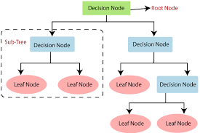
Methodology/Techniques
2. Decision Tree
Decision tree is a basic classification method. It is supervised learning method. Decision tree used when response variable is categorical. Decision tree has tree like structure based model which describes classification process based on input feature. Input variables are any types like graph, text, discrete, continuous etc.
Steps for Decision Tree Algorithm-
1. Construct tree with nodes as input feature.
2. Select feature to predict the output from input
feature whose information gain is highest.
3. The highest information gain is calculated for
each attribute in each node of tree.
4. Repeat step 2 to form a sub-tree using the
feature which is not used in above node.

Slide 14
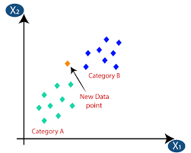
Methodology/Techniques
3. K-Nearest Neighbor
KNN is also a supervised machine learning algorithm. KNN helps to solve both the classification and regression problems. KNN is lazy prediction technique. KNN assumes that similar things are near to each other. Many times data points which are similar are very near to each other. KNN helps to group new work based on similarity measure.KNN algorithm record all the records and classify them according to their similarity measure. For finding the distance between the points uses tree like structure. To make a prediction for a new data point, the algorithm finds the closest data points in the training data set its nearest neighbors. Here K= Number of nearby neighbors, its always a positive integer. Neighbors value is chosen from set of class.
Algorithm- 1. Take a sample dataset of columns and rows named as Pima Indian Diabetes data set. 2. Take a test dataset of attributes and rows. 3. Find the Euclidean distance by the help of formula. 4. Then, Decide a random value of K. is the no. of nearest neighbors. 5. Then with the help of these minimum distance and Euclidean
distance find out the nth column of each. 6. Find out the same output values. If the values are same, then the patient is diabetic, otherwise not.

Slide 15
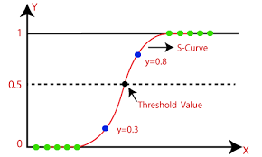
Methodology/Techniques
4. Logistic Regression
Logistic regression is also a supervised learning classification algorithm. It is used to estimate the probability of a binary response based on one or more predictors. They can be continuous or discrete. Logistic regression used when we want to classify or distinguish some data items into categories. It classify the data in binary form means only in 0 and 1 which refer case to classify patient that is positive or negative for diabetes. Main aim of logistic regression is to best fit which is responsible for describing the relationship between target and predictor variable. Logistic regression is a based on Linear regression model. Logistic regression model uses sigmoid function to predict probability of positive and negative class.
Sigmoid function P = 1/1+e – (a+bx)
Here P = probability,
a and b = parameter of Model.

Slide 16
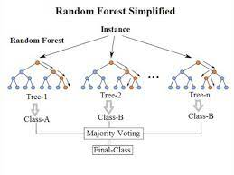
Methodology/Techniques
5. Random Forest
It is type of ensemble learning method and also used for classification and regression tasks. The accuracy it gives is grater then compared to other models. This method can easily handle large datasets. Random Forest is developed by Leo Bremen. It is popular ensemble Learning Method. Random Forest Improve Performance of Decision Tree by reducing variance. It operates by constructing a multitude of decision trees at training time and outputs the class that is the mode of the classes or classification or mean prediction (regression) of the individual trees.
Algorithm- l The first step is to select the R features from the total
features m where R<<M. l Among the R features, the node using the best split point. l Split the node into sub nodes using the best split. l Repeat a to c steps until l number of nodes has been reached. l Built forest by repeating steps a to d for a number of
times to create n number of trees.

Slide 17
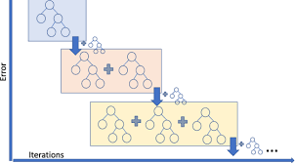
Methodology/Techniques
6. Gradient Boosting
Gradient Boosting is most powerful ensemble technique used for prediction and it is a classification technique. It combine week learner together to make strong learner models for prediction. It uses Decision Tree model. it classify complex data sets and it is very effective and popular method. In gradient boosting model performance improve over iterations.
Algorithm- l Consider a sample of target values as P l Estimate the error in target values. l Update and adjust the weights to reduce error M. l P[x] =p[x] +alpha M[x] l Model Learners are analyzed and calculated by loss function F l Repeat steps till desired & target result P.

Slide 18
System Requirements
HARDWARE REQUIREMENTS:
System : Pentium i3 Processor.
Hard Disk : 500 GB.
Monitor : 15’’ LED
Input Devices : Keyboard, Mouse
Ram : 2 GB
SOFTWARE REQUIREMENTS:
Operating system : Windows 10.
Coding Language : Python
Libraries : NumPy
Panda
Data Set : Pima India Dataset

Slide 19
Conclusion and Future Directions
One of the important real-world medical problems is the detection of diabetes at its early stage. In this study, systematic efforts are made in designing a system which results in the prediction of diabetes. During this work, six machine learning classification algorithms are studied and evaluated on various measures. Experiments are performed on Pima Indian Database.
Algorithms | Accuracy ( in %)
SVM | 0.7480314960629921
Decision Tree | 0.7165354330708661
Random Forest | 0.7677165354330708
XGBoost Classifier | 0.7401574803149606
Future Directions
In future, the designed system with the used machine learning classification algorithms can be used to predict or diagnose other diseases. The work can be extended and improved for the automation of diabetes analysis including some other machine learning algorithms.

Slide 20
References
1. Arora, R., Suman, 2012. Comparative Analysis of Classification Algorithms on Different Datasets using WEKA. International Journal of Computer Applications 54, 21–25. doi:10.5120/8626-2492.
2. Rani, A. S., & Jyothi, S. (2016, March). Performance analysis of classification algorithms under different datasets. In Computing for Sustainable Global Development (INDIACom), 2016 3rd International Conference on (pp. 1584- 1589). IEEE.
3. Kavakiotisab I, Tsave O, Salifoglou A, Maglaveras N, Vlahavasa I, Chouvarda I. Machine learning and data mining methods in diabetes research. Computational and Structural Biotechnology Journal. 2017; 15: 104- 16.
4. Sun YL, Zhang DL. Machine learning techniques for screening and diagnosis of diabetes: A survey. Tehnički Vjesnik. 2019; 26(3): 872-80.
5. https://www.kaggle.com/datasets/uciml/pima-indians-diabetes-database.
6. https://www.researchgate.net/publication/350745659_Diabetes_Diagnosis_Using_Machine_Learning.
7. https://www.ijert.org/diabetes-prediction-using-machine-learning-techniques.

Slide 21
THANK YOU

