Slide 1
Lending Club Case Study
Group : Sushma and Subham Bansal

Slide 2
Problem Statement
Apply risk analytics in banking and financial services on data that institution has collected tracked as history of loans.
Main objective to prevent or define the parameters by which out client can identity a risky customer who most likely to defaults in repayment of loan such that can avoid lending money in order to save money and mitigate credit risk
We as a data analyst expected here to identify the main driving vaiables using which can identy a defaulter matric form raw data after applying EDA
To learn and understand how data is used to minimise the risk of losing money while lending to customers for financial system
01

Slide 3
Strategy Followed
Clean Data
Univariate Analysis
Segmented Univariate Analysis
- Drop columns with null values, all random values or single category value - Convert values to proper int, float, date representations
- Check distributions and frequencies of various numerical and categorical variables
- Create derived variables
- Analyze variables against segments of other variables
- Create derived variables
Bi-Variate Analysis
Graph Plot
Publish Insights
- Do correlation analysis Check how two variables affect each other or a third variable -- Analyze joint distributions
Plot the graph and analysis to get the hidden insight of the data
Publish insights and observations

Slide 4
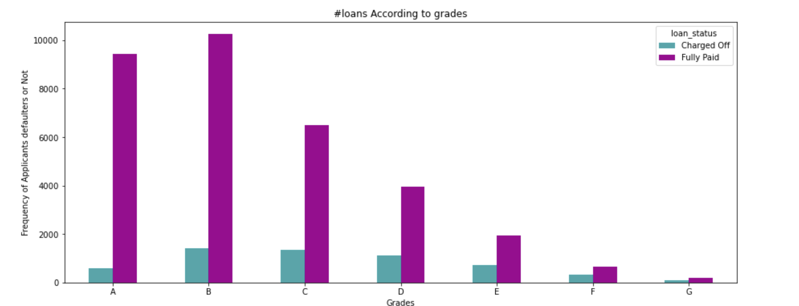
Analysis:
Sdasas
Dsa
D
Sad
Sada
Da
Dsa
Ad
Ad
Sad
01

Slide 5
Analysis - Overall Loan Status
Asdsa
Sa
Dsa
Dsa
Da
ds
01

Slide 6
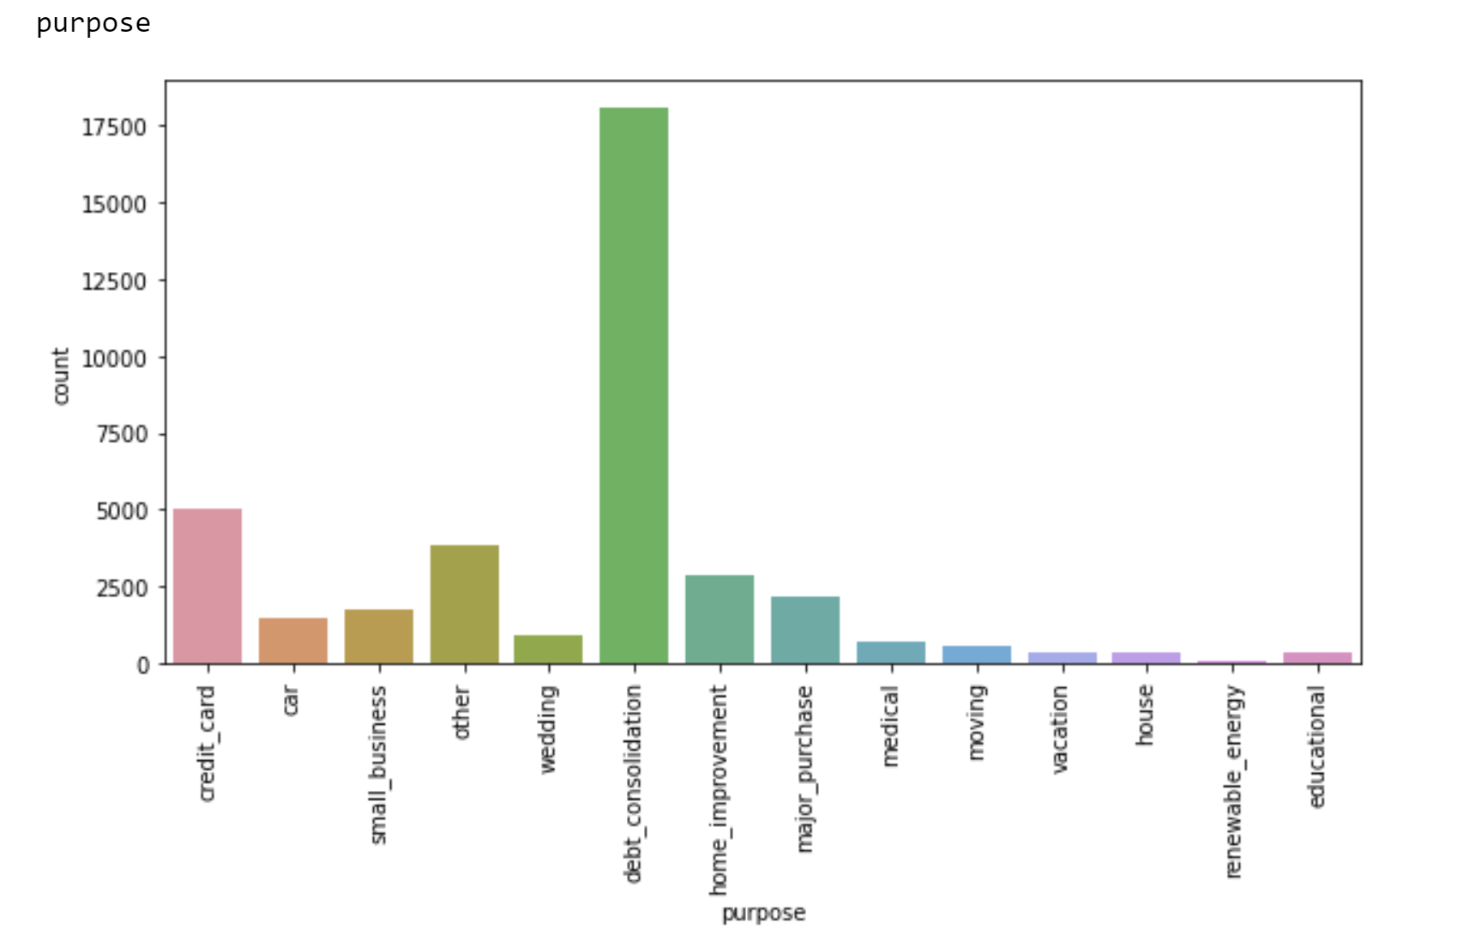
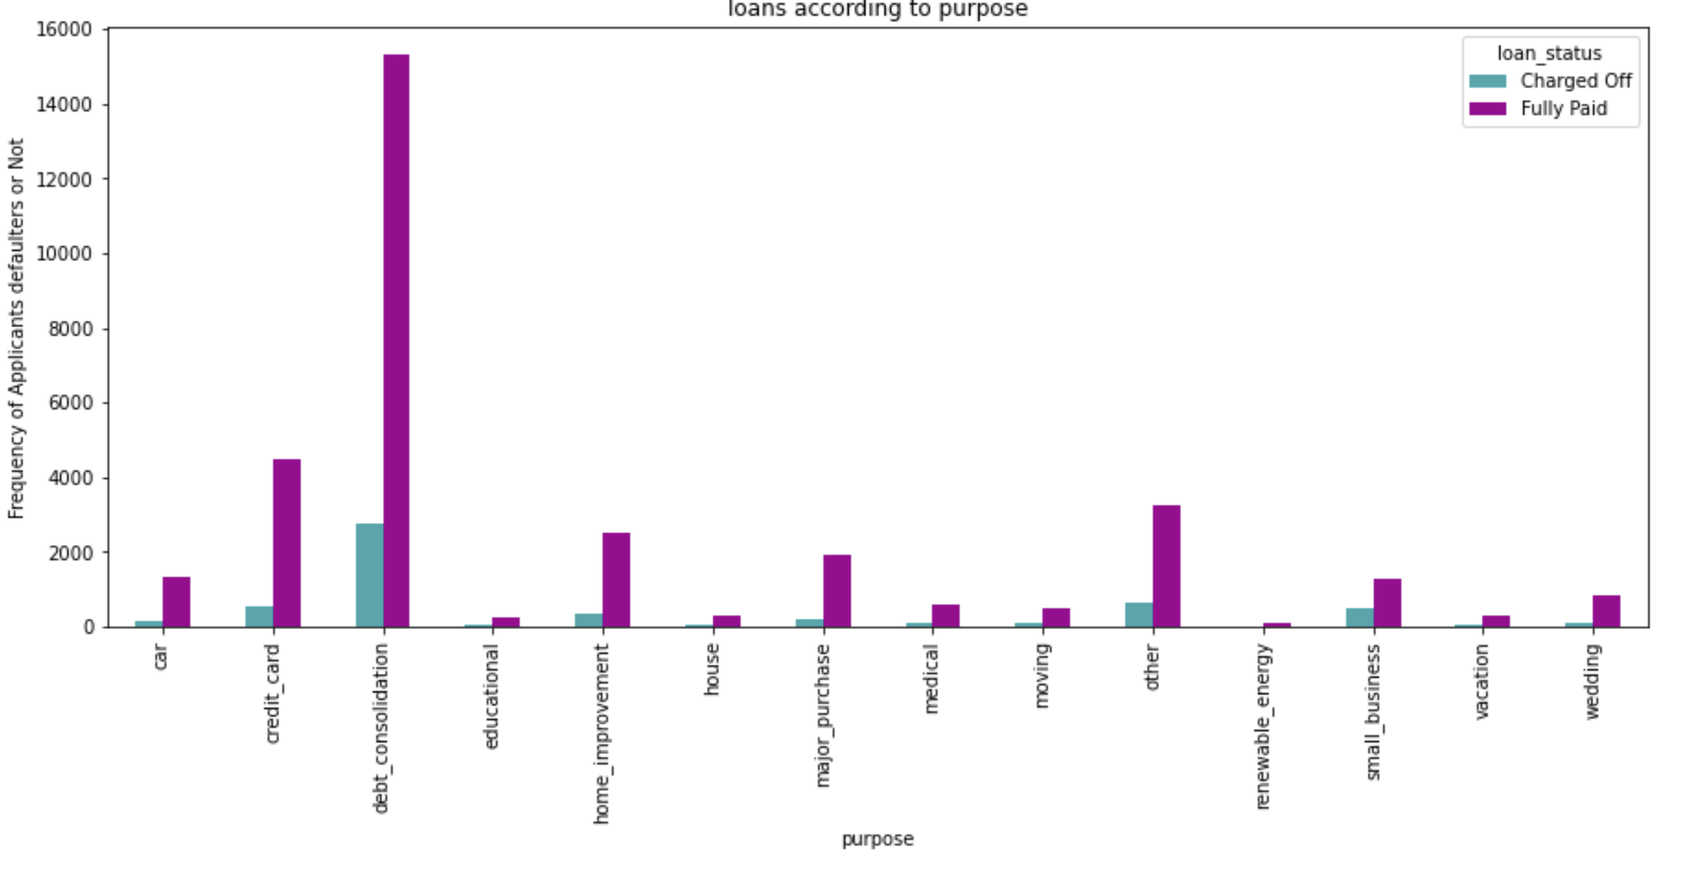
Analysis: Loan Types
01
Dsaaasd
A
Dsa
Daa
sd
Dsaaasd
A
Dsa
Daa
sd

Slide 7
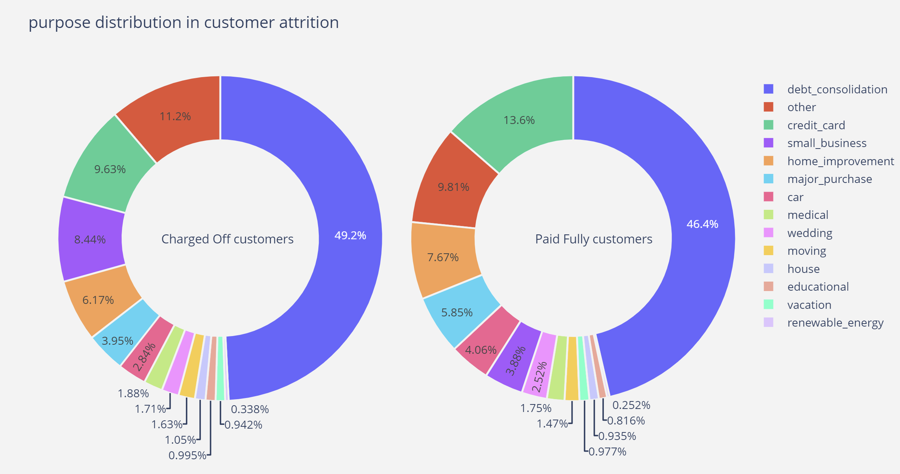
Problem Statement
01
Apply risk analytics in banking and financial services on data that institution has collected tracked as history of loans.
financial system

Slide 8
Problem Statement
01
Apply risk analytics in banking and financial services on data that institution has collected tracked as history of loans.
financial system

Slide 9
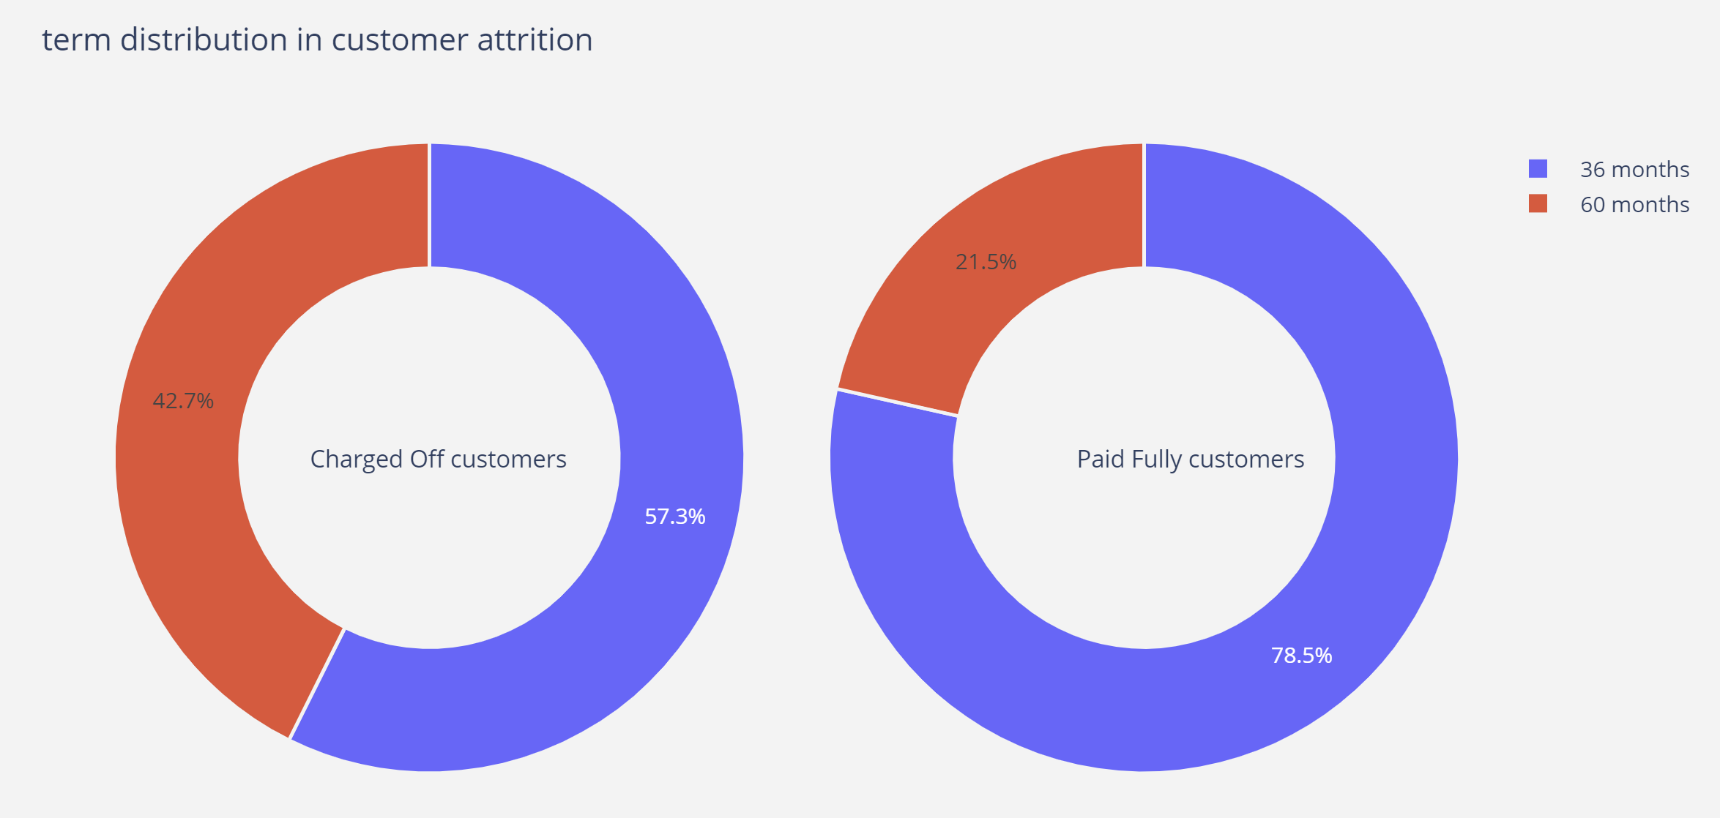
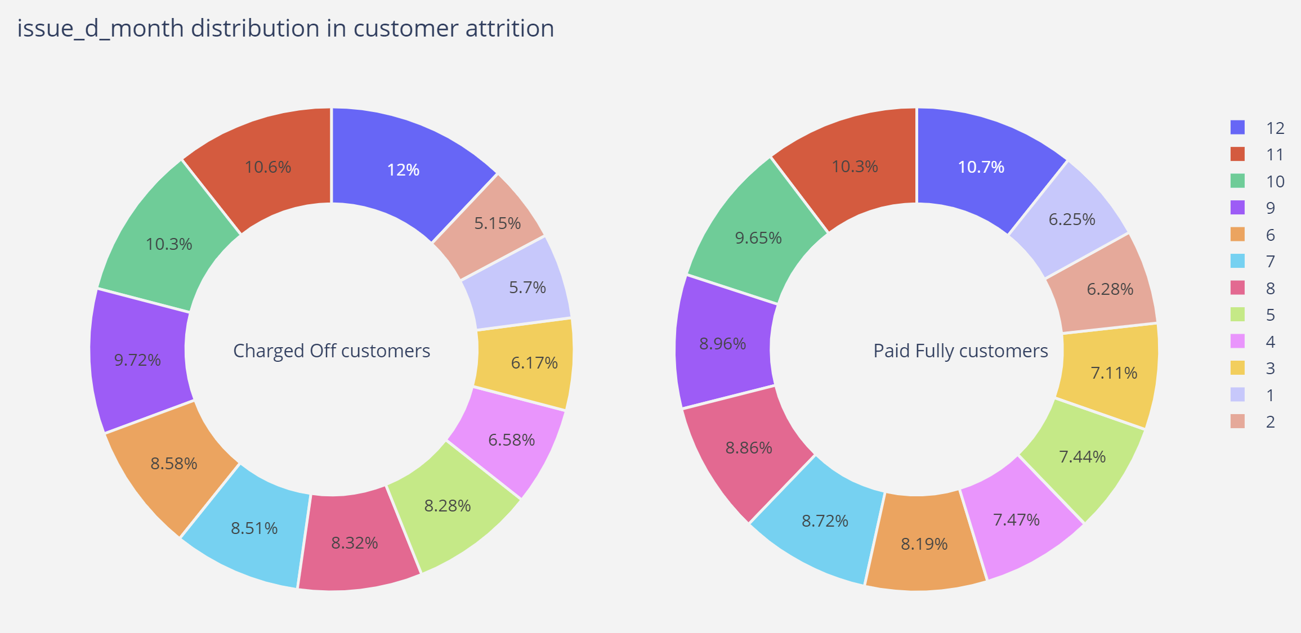
Problem Statement
01
Apply risk analytics in banking and financial services on data that institution has collected tracked as history of loans.
financial system

Slide 10
Problem Statement
01
Apply risk analytics in banking and financial services on data that institution has collected tracked as history of loans.
financial system

Slide 11
Conclusion on Insight Revealed

Slide 12
Results:
Apply risk analytics in banking and financial services on data that institution has collected tracked as history of loans.
Main objective to prevent or define the parameters by which out client can identity a risky customer who most likely to defaults in repayment of loan such that can avoid lending money in order to save money and mitigate credit risk
We as a data analyst expected here to identify the main driving vaiables using which can identy a defaulter matric form raw data after applying EDA
To learn and understand how data is used to minimise the risk of losing money while lending to customers for financial system
01

Slide 13
Thank You…

