Slide 1

Minor PROJECT PRESENTATION ON
DIABETES RISK PREDICTION SYSTEM
USING MACHINE LEARNING
SCHOOL OF ENGINEERING AND TECHNOLOGY
DEPARTMENT OF COMPUTER SCIENCE AND ENGINEERING
Presented By:
Subham Bisoyi (24UG010155)
Preeti Subudhi (24UG010200)
Rudra Narayan Sahoo (24UG010212)
Under the Guidance of
Mr. Pankaj Yadav
Dept. Of CSE,
GIET University , Gunupur
Notes:
Good morning. We are Subham, Preeti and Rudra. Our minor project is a Diabetes Risk Prediction System built with machine learning, under the guidance of Mr. Pankaj Yadav. In the next few minutes we will show the working application, its features, how the model was built and tested, and what its limits are.

Slide 2
OUTLINES
1. Functional Prototype / Product Demonstration
2. Functionality & Feature Completeness
3. Testing & Validation
4. Final Presentation & Viva-Voce
5. Documentation & User Manual
Notes:
This is how our presentation is organised. We will start with the problem and our solution, then follow the five review areas in this order.

Slide 3
Why early diabetes screening matters
589 M
252 M
89.8 M
adults living with diabetes worldwide (2024)
of them do not know they have it
adults with diabetes in India (2024)
What exists today
Lab tests: accurate, but need a visit and money
Fixed-score questionnaires: do not learn from data, keep no history
Research notebooks: a model with no usable app
What is missing
A secure, easy web app
A probability and a health score, not just yes / no
Saved history to see change over time
A report the user can show a doctor
Source: IDF Diabetes Atlas, 11th edition (2025)
Diabetes Risk Prediction System Using Machine Learning | 3
Notes:
Diabetes is common and often silent. The IDF Diabetes Atlas (11th edition, 2025) estimates 589 million adults had diabetes in 2024, and about 252 million of them do not know it. India alone had around 89.8 million. Today a person can use a lab test, a fixed questionnaire, or a research notebook. Each has gaps: lab tests need a visit, questionnaires do not learn or keep history, and notebooks are not usable by ordinary people.

Slide 4
Our solution: Diabetes Risk Check
Answer a few questions
ML model estimates risk
Risk %, health score, PDF
1
2
3
Compare 5 classifiers on male and female data
Preprocess without leaking test data
Secure Flask web application
4
5
6
Estimate glucose and BP when lab values are missing
Save each result and show a dashboard
Deploy with Docker, Render, Railway, Fly.io
Diabetes Risk Prediction System Using Machine Learning | 4
Notes:
Our answer is a web application called Diabetes Risk Check. The user answers a few questions, the trained model estimates the risk, and the user gets a risk percentage, a health score and a PDF report for the doctor. Our objectives were: compare five classifiers on data from both sexes, avoid test-data leakage, build a secure Flask app, estimate glucose and blood pressure when lab values are missing, save history, and deploy with Docker and cloud platforms.

Slide 5
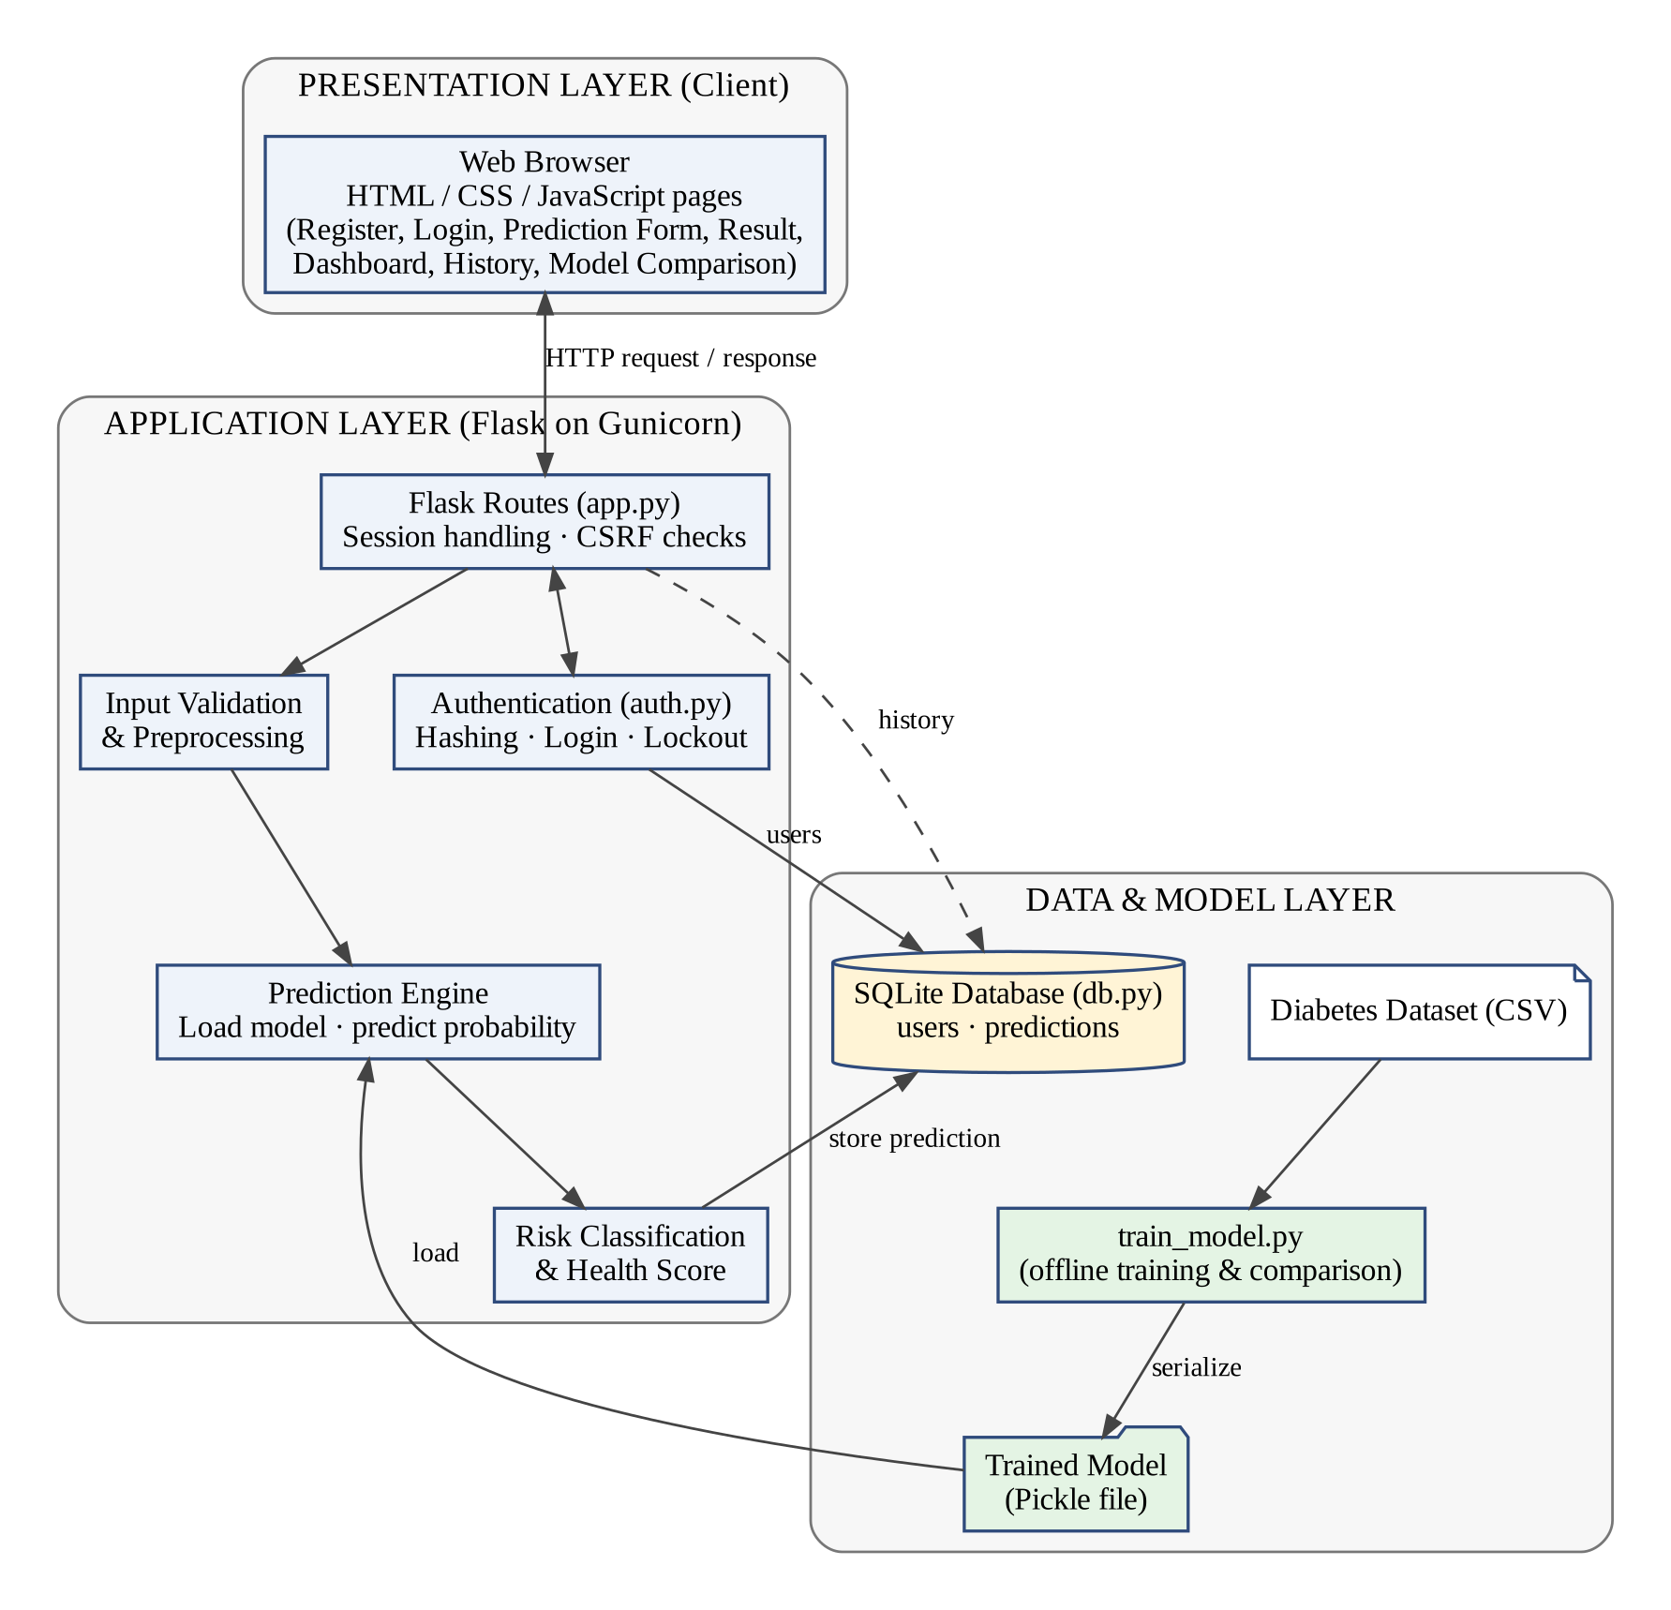
System architecture: three tiers
Browser
HTML, CSS and JavaScript pages: form, live result, dashboard, Models page
Flask on Gunicorn
Routes, authentication, validation, preprocessing, prediction, PDF report
SQLite + trained model
Users and predictions in SQLite; Random Forest loaded once from a Pickle file
Diabetes Risk Prediction System Using Machine Learning | 5
Notes:
The system has three tiers. The browser shows the pages. The Flask application, served by Gunicorn, does login, validation, preprocessing and prediction. The data tier is a SQLite database for users and predictions, plus a Pickle file with the trained model, which train_model.py creates offline. The model is loaded once, so each prediction is fast.

Slide 6
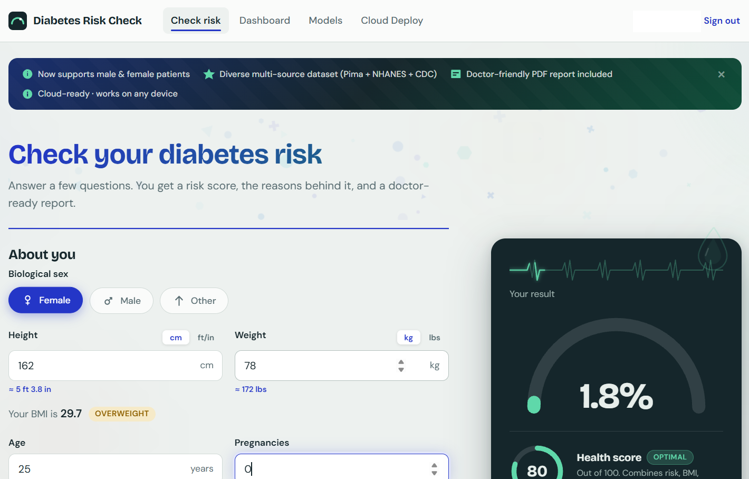
Demo: fill the form, see the result live
1 · FUNCTIONAL PROTOTYPE / PRODUCT DEMONSTRATION
1
Sex-aware form: Female, Male or Other
2
Unit switch: cm / ft-in and kg / lbs
3
Live BMI with category: 29.7, Overweight
4
Result card updates as you type
Application running locally at 127.0.0.1:5000
Sample input used in the demo: Female, 25 years, 162 cm, 78 kg, 0 pregnancies
Diabetes Risk Prediction System Using Machine Learning | 6
Notes:
This is the running application. The user picks biological sex, enters height and weight in cm or feet-inches, kg or pounds, and the page converts them. BMI is calculated live, here 29.7, Overweight. Pregnancies are fixed to zero for male users. The result card on the right updates as the user fills the form.

Slide 7
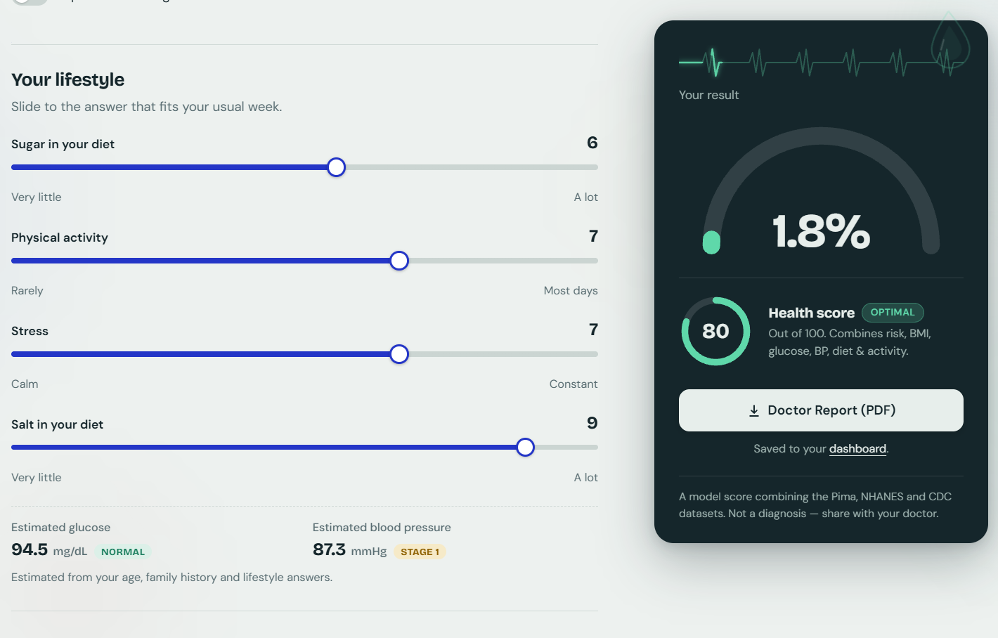
Demo: estimated values, risk and report
1 · FUNCTIONAL PROTOTYPE / PRODUCT DEMONSTRATION
1
Four lifestyle sliders
2
Estimated glucose 94.5 mg/dL and BP 87.3 mmHg
3
Risk 1.8%, health score 80 (Optimal)
4
Doctor Report (PDF); saved to dashboard
Same input as the previous slide, lifestyle sliders 6 / 7 / 7 / 9
Own lab values? A switch lets the user enter their own glucose, blood pressure, insulin and skin-fold thickness.
Diabetes Risk Prediction System Using Machine Learning | 7
Notes:
Further down, four lifestyle sliders: sugar, physical activity, stress and salt. If the user has no lab report, the system estimates glucose and blood pressure from age, family history and lifestyle: here 94.5 mg/dL, Normal, and 87.3 mmHg, Stage 1. The result is a risk of 1.8 percent and a health score of 80, Optimal. The user can download a Doctor Report as PDF, and the result is saved to the dashboard. A user with lab values can switch on their own glucose and blood pressure.

Slide 8








Functionality and feature completeness
2 · FUNCTIONALITY & FEATURE COMPLETENESS
Smart input form
Sex-aware, unit switch, live BMI
Estimated glucose and BP
Or enter your own lab values
Risk % and health score
Gauge, label and short explanation
Doctor report (PDF)
Inputs, risk and score to share
Dashboard
Saved predictions for each user
Models page
5 models, male and female accuracy
Secure accounts
Hashing, CSRF, lockout, sessions
Cloud Deploy page
Render, Railway, Fly.io, Docker
Diabetes Risk Prediction System Using Machine Learning | 8
Notes:
All planned features are implemented: the sex-aware form, estimated glucose and blood pressure, the risk gauge and health score, the PDF report, the dashboard, the Models page with accuracy for male and female patients, secure login, and the Cloud Deploy page. These match the 16 functional requirements in our report.

Slide 9
Data: 3,568 records from both sexes
2 · FUNCTIONALITY & FEATURE COMPLETENESS
3,568
KNN imputation of impossible zeros (glucose, BP, BMI), fitted on training folds only
1
total records
Pregnancies fixed to 0 for male patients
45% / 55%
2
male / female patients
Balanced class weights for the 41% / 59% split
3
41%
diabetic cases (1,470)
80 : 20 stratified hold-out split (untouched test set)
4
3 sources
5-fold stratified cross-validation to rank models
Pima, NHANES, CDC
5
Diabetes Risk Prediction System Using Machine Learning | 9
Notes:
The dataset has 3,568 records: 1,600 male and 1,968 female, and 41 percent are diabetic. It combines the Pima data with NHANES and CDC sources, because Pima alone has only female patients. Preprocessing is leakage-free: impossible zeros in glucose, blood pressure and BMI are imputed with a KNN imputer fitted only on training folds. Male pregnancies are fixed to zero. We hold out 20 percent for the final test and use 5-fold stratified cross-validation.

Slide 10
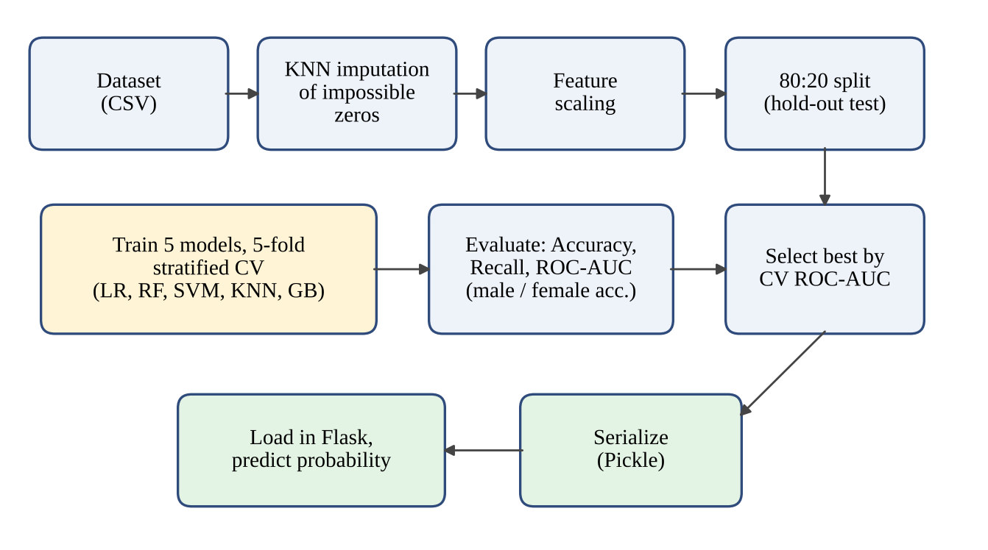
Five models, one fair comparison
2 · FUNCTIONALITY & FEATURE COMPLETENESS
Logistic Regression
linear
Random Forest
deployed
SVM (RBF)
margin-based
KNN
instance-based
Gradient Boosting
boosting
Diabetes Risk Prediction System Using Machine Learning | 10
Notes:
The pipeline cleans the data, splits it, trains five classifiers with cross-validation and evaluates them with accuracy, recall and ROC-AUC. We chose five different families: linear, bagged trees, margin-based, instance-based and boosting. The best model by cross-validated ROC-AUC, Random Forest, is saved with Pickle and loaded by the Flask app.

Slide 11
Random Forest leads on CV ROC-AUC
2 · FUNCTIONALITY & FEATURE COMPLETENESS
Cross-validated ROC-AUC (5-fold, %)
Hold-out test set (20%)
Model | Acc. | Recall | AUC
Logistic Reg. | 87.68 | 87.76 | 94.56
Random Forest | 88.10 | 89.80 | 95.26
SVM (RBF) | 88.52 | 89.12 | 95.29
KNN | 87.96 | 80.61 | 94.16
Grad. Boosting | 88.52 | 90.48 | 94.90
Values in %, as shown on the app's Models page
Axis starts at 92%. Dark bar = deployed model.
Deployed: Random Forest. Hold-out accuracy 88.1%, recall 89.8%, ROC-AUC 95.26%; cross-validated ROC-AUC 94.25% ± 1.02.
The top three CV scores differ by only 0.30 points (less than one standard deviation), so their ranking is not conclusive.
Diabetes Risk Prediction System Using Machine Learning | 11
Notes:
On the left is the 5-fold cross-validated ROC-AUC. Random Forest is highest at 94.25 percent plus or minus 1.02. Note the axis starts at 92 percent. On the right are hold-out test results. Random Forest has 88.1 percent accuracy, 89.8 percent recall and 95.26 ROC-AUC. Be honest: Gradient Boosting has slightly higher recall and the SVM slightly higher test AUC. The top three differ by only 0.30 points, less than one standard deviation, so the ranking is not conclusive.

Slide 12
Lower accuracy for female patients
2 · FUNCTIONALITY & FEATURE COMPLETENESS
Gap: 6.5 to 9.5 points
Random Forest: 92.6% male vs 84.6% female
Cause not tested yet
We do not claim a reason without evidence
Next step
External validation and per-sex analysis
Hold-out accuracy (%). Axis starts at 78%.
Diabetes Risk Prediction System Using Machine Learning | 12
Notes:
Every model is more accurate for male patients, 91.6 to 93.9 percent, than for female patients, 83.6 to 85.1 percent. The gap is 6.5 to 9.5 points; for Random Forest it is 92.6 against 84.6. We report this openly on the Models page. We have not yet tested the cause. The next step is external validation and a per-sex analysis.

Slide 13

Security and deployment
2 · FUNCTIONALITY & FEATURE COMPLETENESS
Security
Deployment
Salted password hashes (Werkzeug)
Signed session cookies
CSRF token on every form
Account lockout after repeated wrong passwords
Parameterised SQL queries
SECRET_KEY and settings in environment variables
Gunicorn production server
Multi-stage Docker build
Render (render.yaml), Railway (railway.json)
Fly.io and Docker Compose
In-app Cloud Deploy page
COOKIE_SECURE, DATABASE_PATH, FLASK_DEBUG variables
Diabetes Risk Prediction System Using Machine Learning | 13
Notes:
Health data is sensitive, so passwords are stored only as salted hashes, sessions are signed, every form has a CSRF token, accounts lock after repeated wrong passwords, and all SQL uses parameters. Secrets live in environment variables. For deployment we use Gunicorn and a multi-stage Docker build. The app ships with configuration for Render, Railway, Fly.io and Docker Compose, and a Cloud Deploy page explains each option.

Slide 14
Testing and validation: 26 of 26 passed
3 · TESTING & VALIDATION
26 / 26
What the tests covered
Registration, login, lockout
CSRF check and protected pages
Prediction, BMI, unit conversion, estimated values
Dashboard, per-user data, Models page
PDF report and Docker build
test cases passed (100%)
Level | Run | Passed
Unit | 6 | 6
Integration | 5 | 5
System | 10 | 10
Security | 5 | 5
Minor validation and interface issues were found, fixed and re-tested. No unresolved defects.
Diabetes Risk Prediction System Using Machine Learning | 14
Notes:
We ran 26 test cases at four levels: 6 unit, 5 integration, 10 system and 5 security tests. All 26 passed. They covered registration, login and lockout, CSRF and protected pages, prediction and BMI, unit conversion, estimated values, user data separation, the Models page, the PDF report and the Docker build. A few minor validation and interface issues were found, corrected and re-tested; no defect was left open.

Slide 15


Limitations and future scope
4 · FINAL PRESENTATION & VIVA-VOCE
Limitations
Future scope
Glucose and BP are estimated when no lab values are entered
Accuracy 7 to 9 points lower for female patients
Merged public sources, no external validation
A screening aid, not a diagnosis
External validation, per-sex analysis
SHAP / LIME explanations
Calibrated probabilities, guideline-based thresholds
PostgreSQL, two-factor login, mobile app
Diabetes Risk Prediction System Using Machine Learning | 15
Notes:
We want to be clear about limits. When lab values are not entered, glucose and blood pressure are estimated, so the risk partly rests on estimates. Accuracy is lower for female patients. The data come from a few public sources merged by us and have not been validated externally. This is a screening aid, not a diagnosis. In future we will validate on external data, add explanations with SHAP or LIME, calibrate probabilities, and move to PostgreSQL, two-factor login and a mobile app.

Slide 16
Conclusion
4 · FINAL PRESENTATION & VIVA-VOCE
94.25%
88.1%
26 / 26
cross-validated ROC-AUC, Random Forest (± 1.02)
hold-out accuracy, with 89.8% recall
test cases passed
A complete, secure web application, not only a notebook model
Five models compared; Random Forest chosen on cross-validated evidence
Honest limits: estimated lab inputs, female accuracy gap, no clinical validation
A screening aid: confirm with a lab test and a doctor
Diabetes Risk Prediction System Using Machine Learning | 16
Notes:
To conclude: we built a complete, secure and deployable web application, not only a model in a notebook. Five models were compared fairly and Random Forest was chosen on cross-validated evidence. All 26 tests passed. We also state the limits openly, and the tool is a screening aid that should be confirmed with a lab test and a doctor. Thank you.

Slide 17


Documentation and user manual
5 · DOCUMENTATION & USER MANUAL
Documentation
User manual
Project report: 9 chapters, introduction to future scope
IEEE references, figures and tables lists
Test cases with results (26)
10-week development log
Cloud Deploy page in the app: options and environment variables
1
Register and log in
2
Choose sex; enter height, weight, age
3
Move the lifestyle sliders; add lab values if you have them
4
Press Check my risk
5
Read risk and health score; download the Doctor Report
6
Open the dashboard for saved results
Diabetes Risk Prediction System Using Machine Learning | 17
Notes:
Documentation: a full project report with nine chapters from introduction to future scope, IEEE references, test cases and results, and the weekly development log. The app also has a Cloud Deploy page that explains deployment and environment variables. The user manual is six simple steps, from registration to the dashboard.

Slide 18
Q&A
Thank you all for your attention! Any questions?
Notes:
Thank you. We are happy to answer questions and to show any part of the application again.

