Slide 1
Group 9: Suburban Outfitters
Josh Beard, mateus Conaway, SUBHAM DANDOTIYA

Slide 2
INTRODUCTION
WE WANTED TO MAKE A WEBSITE THAT WAS EASY TO USE, FUNCTIONAL, ALLOWED THE USERS TO GIVE THEIR INSIGHTS, AND GIVE THEM A QUICK AND EASY SHOPPING EXPERIENCE
WE WILL GO OVER THE FOLLOWING:
AUTHENTICATION/LOGIN, PASSWORD VERIFY AND SANITIZATION
SESSION MANAGEMENT
LOGOUT AND SESSION DESTORY
ROLE MANAGEMENT
CRUD USE CASES
INTERACTIVE USE CASES

Slide 3
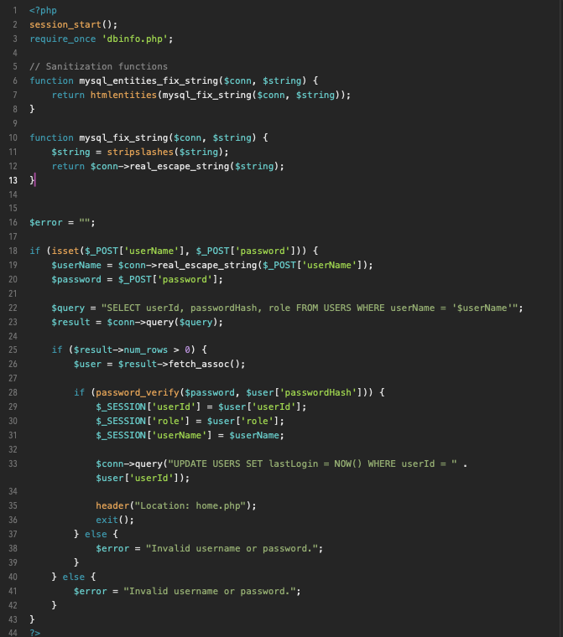
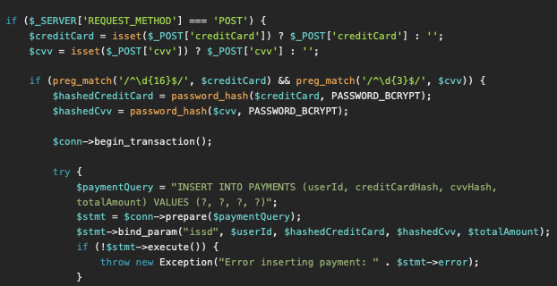
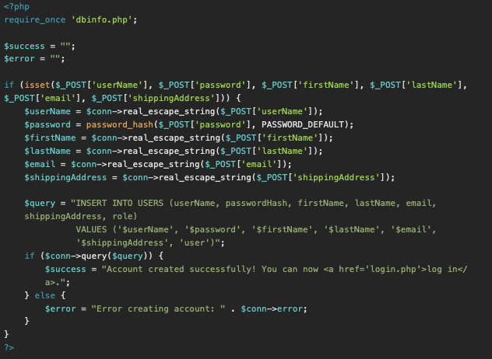
AUTHENTICATION/SECURITY
LOGIN AUTHENTICATION AND PASSWORD HASHING + SANITIZATION
CREDIT CARD AND CVV FOR PAYMENT HASHING IN DATABASE
CREATE ACCOUNT AUTHORIZATION

Slide 4

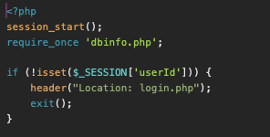
SESSION MANAGEMENT
SESSION MANAGEMENT USED THROUGH VARIOUS PAGES. SESSION IS LINKED TO THE USER SO USER EXPERIENCE IS THEIRS ONLY

Slide 5
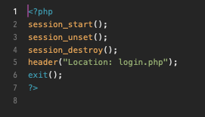
LOGOUT AND SESSION DESTORY
CODE FOR DESTROYING SESSION UPON LOGGING OUT

Slide 6

ROLE MANAGEMENT
CODE EXAMPLE OF HOW ADMINS ONLY HAVE ACCESS TO CERTAIN PAGES THAT USERS DON’T. THIS WOULD INCLUDE ANYTHING OF SALES REPORTS, MANAGING ALL USERS, ADDING PRODUCTS, ETC.

Slide 7
NOW TIME FOR DEMO OF CRUD USE CASES AND SPECIAL USE CASES

