Slide 1
Presentation of Matrix Multiplication Algorithms
Parallel Programming - AI5085 (SoSe2025)
By Group – I
Muhammad Azeem Taufiq
Pritpal Singh
Subham Gaurav
Lecturer:
Anna – Lena Roth

Slide 2
Implementation of Cannon´s Algorithm
Presented by
Pritpal Singh
1563366
Notes:
Start of presentation
Team Memebers

Slide 3
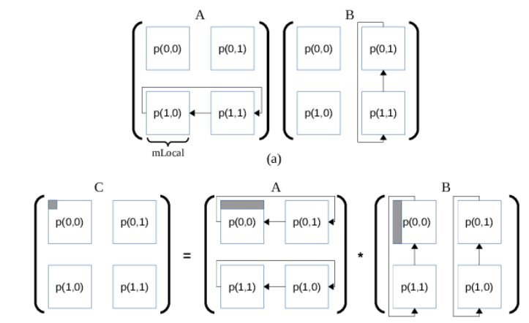
Cannon’s Algorithm – Task A
Goal: Multiply two square matrices (n × n) using n² processes.
Process Mapping & Data Distribution:
Rank → 2D grid: row = rank/n, col = rank % n.
Root (rank 0) initializes matrices and sends one element to each process via MPI_Send / MPI_Recv (blocking p2p).
Initial Skewing:
A row i → shift left by i.
B column j → shift up by j.
MPI_Sendrecv_replace used for circular shifts.
Computation (n steps):
Each step: c += a * b.
Shift A left by 1, B up by 1 (wrap-around).
MPI_Sendrecv_replace used for simultaneous send/receive.
Result Collection:
Each process sends result back to root using MPI_Send / MPI_Recv.
Root reconstructs final matrix C.

Slide 4
Task B - Process Topology & Data Distribution
Scalable Approach: Uses matrix blocks instead of individual elements.
Cartesian Topology:
Created with MPI_Cart_create, wrap-around topology (periods={1,1}).
Processes addressed by (row, col) coordinates → simplifies communication.
Data Distribution:
Root process (rank 0) divides and sends matrix blocks using MPI_Send/MPI_Recv.
Each process stores a local block (Ablock, Bblock).
Initial Skewing:
A shifted left by row index; B shifted up by column index.
MPI_Cart_shift determines neighbors.
MPI_Sendrecv_replace ensures circular shifting without deadlock.

Slide 5
Computation, Result Collection & Communication
Computation Loop (q steps, q = √P):
Local block multiplication: localMultiply(Ablock, Bblock, Cblock).
Circular shifting each step:
A one step left; B one step up.
MPI_Sendrecv_replace used for safe simultaneous send/receive.
Result Collection:
Each process sends its Cblock to root (rank 0) using MPI_Send/MPI_Recv.
Root reconstructs full matrix C.
MPI Communication Summary:
MPI_Cart_create – collective, blocking (grid creation).
MPI_Send/Recv – blocking, p2p (data distribution).
MPI_Sendrecv_replace – blocking, p2p (initial skewing & shifting).
MPI_Send/Recv – blocking, p2p (result collection).

Slide 6
Characteristics:
Blocking → simple synchronization.
P2P over collectives → control over block layout.
No one-sided or non-blocking → less complex, easier to debug.

Slide 7
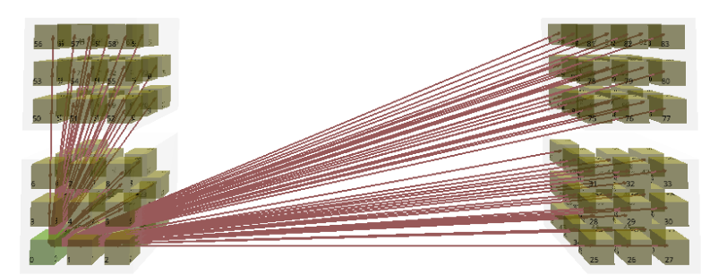
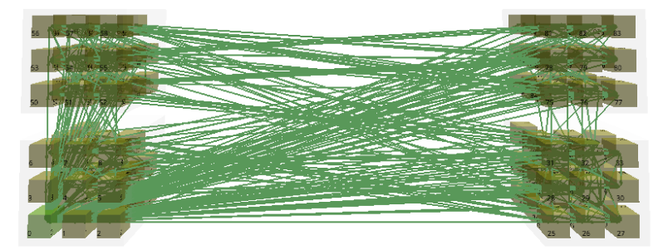
Communications displayed in EDU-MPI
Each rank sends its matrix block to a neighbor (left or up) in a structured pattern.
These green lines visualize that peer-to-peer communication, which is essential for the block shifting step in each iteration.
Which ranks receive matrix blocks during the shifting phase.
Ensures that data dependencies are correctly maintained across iterations.

Slide 8
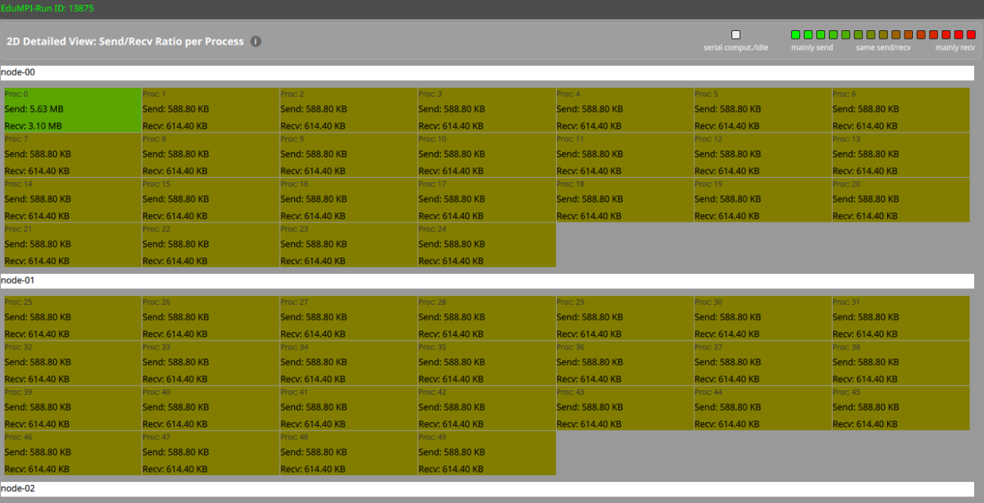
2D Visualization in EduMPI
The consistent send/receive sizes across most processes (except Proc 0) indicate:
A balanced communication pattern, which is a hallmark of Cannon’s algorithm.
Proc 0’s higher data volume may be due to:
Collecting final results.
Distributing initial data.
Acting as a master or I/O process.

Slide 9
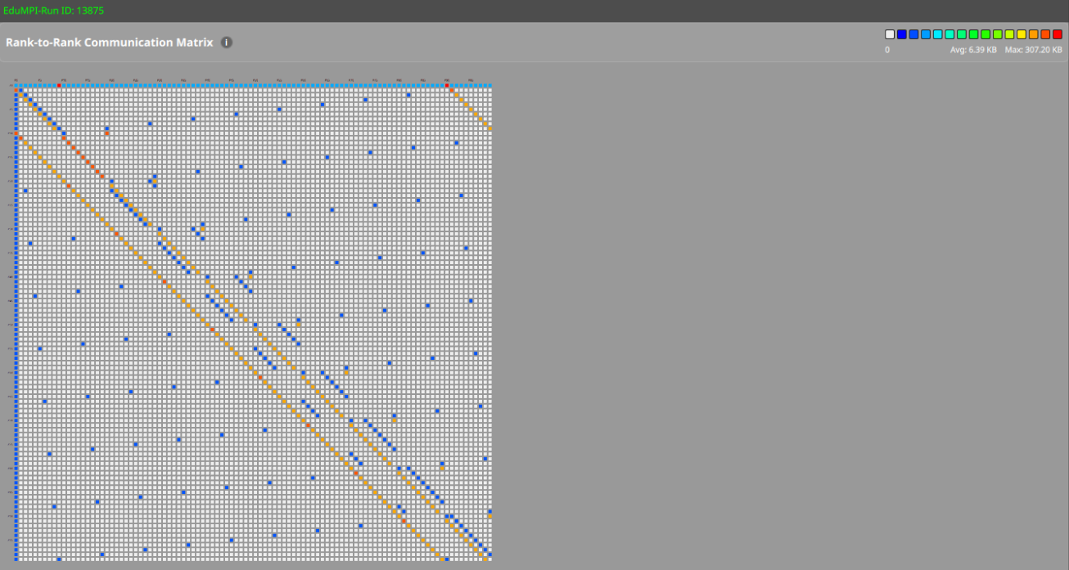
Rank to Rank Communication Matrix
Dominant Neighbor Communication: The main bands indicate the algorithm mostly communicates with neighboring processes due to circular shifting (left/up) of blocks.
Balanced Communication: The relatively consistent color intensity means communication volume per process is well balanced.
No Global Bottleneck: No single process is significantly overloaded (no large bright red hotspots away from the diagonal).

Slide 10
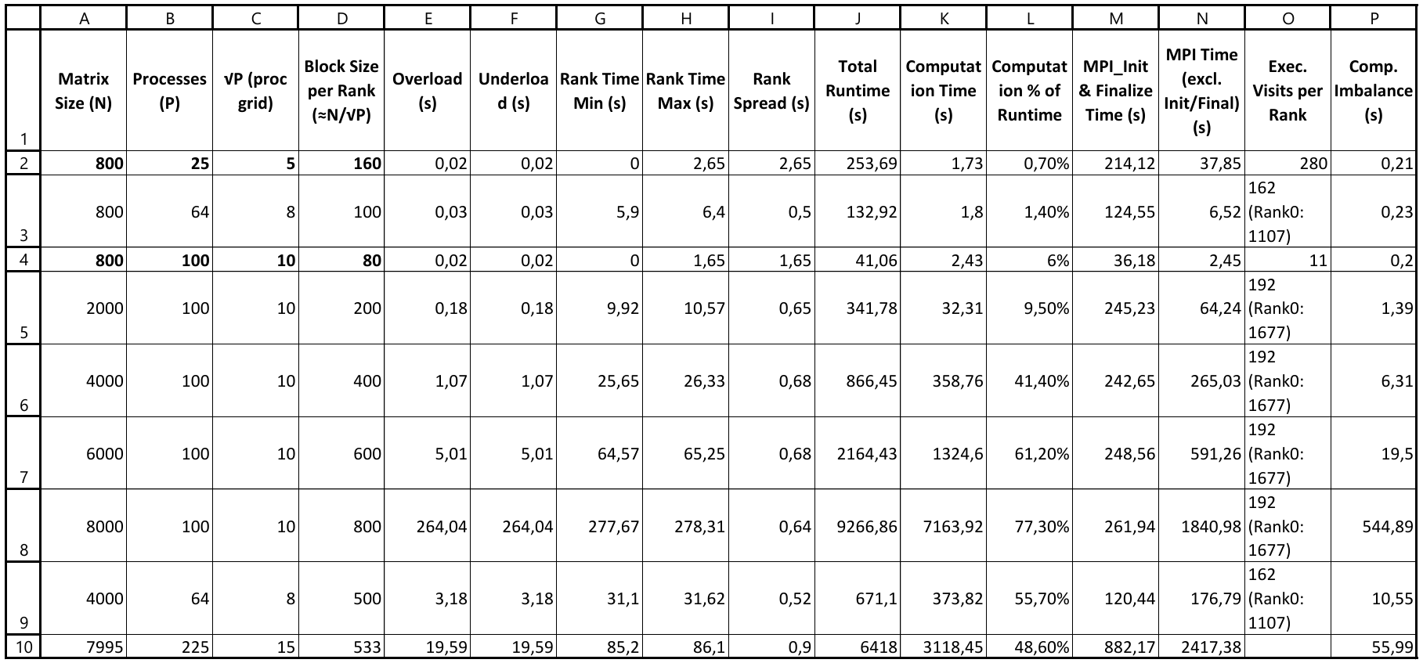
Performance Analysis

Slide 11
Performance Observations
Overhead & Underload:
Generally small for smaller matrices (e.g., 800×800, P=25 → Overload = 0.02s).
Increases drastically for very large matrix sizes and high process counts (e.g., 8000×8000 → Overload = 264s).
Rank Time Spread:
Small for small problems (max spread ~2.65s).
Grows with problem size, showing imbalance (e.g., 85.2s for 7995×7995).
Computation % of Runtime:
Low for small tasks (0.7–6%) → dominated by MPI communication & initialization.
Increases with problem size (77.3% for 8000×8000), showing improved compute utilization.
MPI Time:
Significant portion of runtime for small problems (e.g., MPI Init/Finalize 214s vs. computation 1.73s).
For large problems, MPI communication time increases but relative overhead decreases.
Load Imbalance:
Execution visits per rank uneven (Rank0 often visited more → e.g., 1677 vs. others 192).
Causes waiting states (LateSender / LateReceiver).

Slide 12
Scalability & Bottlenecks
Strong Scaling:
Increasing processes (P) for fixed problem size (800×800) reduces runtime drastically (253.69s → 41.06s) but shows low compute utilization (0.7–6%).
Overhead from MPI_Init/Finalize dominates small tasks.
Weak Scaling (Large Matrices):
As matrix size grows (4000–8000), compute utilization improves (>40%), showing good scalability for computation.
Bottleneck shifts to communication overhead (e.g., MPI Time 1840.98s at 8000).
Load Balance:
Some ranks (esp. Rank 0) experience heavier workload (more visits), causing LateSender effects and idle waiting on others.
Memory Efficiency:
Block size per rank influences load balancing (larger blocks for fewer processes → better compute ratio).
Main Bottlenecks Identified:
Initialization overhead for small problems.
Communication overhead & rank imbalance for large problems.

Slide 13
Total Runtime Comparison
Cannon’s algorithm is better for medium-to-large matrices and for cases with a high number of processes due to balanced load and reduced communication overhead.
For small matrix sizes with fewer processes, row-wise can still be effective because its simpler communication avoids Cannon’s skewing overhead.
Matrix Size (N) / Processes (P) | Cannon's Algo | Row-wise Matrix Multiplication
800 / 25 | 253,69 | 49,55
800 / 64 | 132,92 | 142,93
800 / 100 | 41,06 | 285,79
2000 / 100 | 341,78 | 574,75
4000 / 64 | 671,1 | 1876,46
4000 / 100 | 866,45 | 2251,97
6000 / 100 | 2164,43 | 7632,27
7995 / 225 | 6418 | 30800
8000 / 100 | 9266,86 | 22700

Slide 14
Matrix-Multiplication with DNS
(Deckel, Nassimi, Sahni) Algorithm
Notes:
Start of presentation
Team Memebers

Slide 15
Step-by-Step Overview
Initialize MPI and determine process coordinates.
Master creates and fills input matrices.
Master divides matrices into sub-matrices.
Master sends blocks to all processes.
Create sub-communicators for DNS axes.
Broadcast A and B blocks along k and i axis.
Multiply local A and B blocks.
Reduce C blocks along j-axis.
Leaders send C blocks to root.
Root assembles and prints result matrix.
Free all memory and finalize MPI.

Slide 16
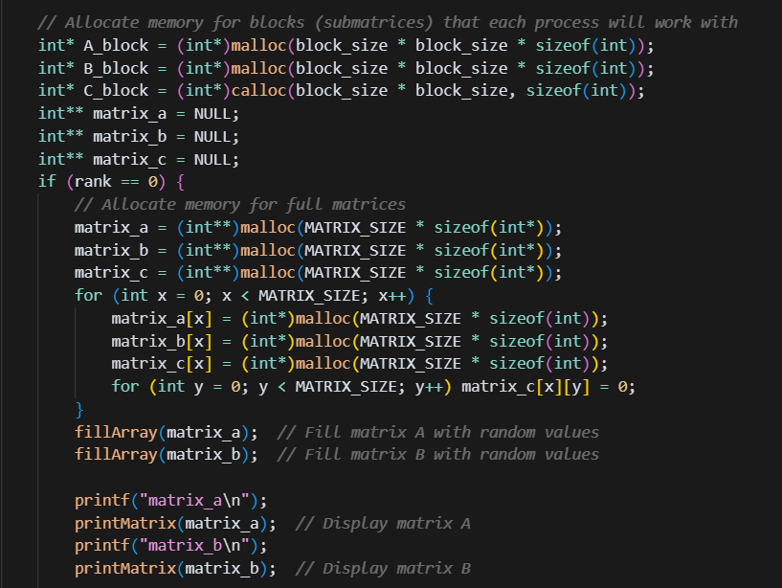
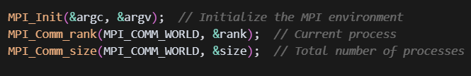
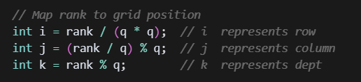
Steps 1 & 2: Initialization & Matrix Creation
The root process (rank 0) allocates memory for the full matrices A and B and fills them with random values for multiplication.
Initialize MPI, get rank/size, and compute each process’s 3D grid position.

Slide 17
Step 3 : Matrices into Sub-matrices/blocks
The root process (rank 0) allocates memory for the full matrices A and B and fills them with random values for multiplication.
Initialize MPI, get rank/size, and compute each process’s 3D grid position.

Slide 18
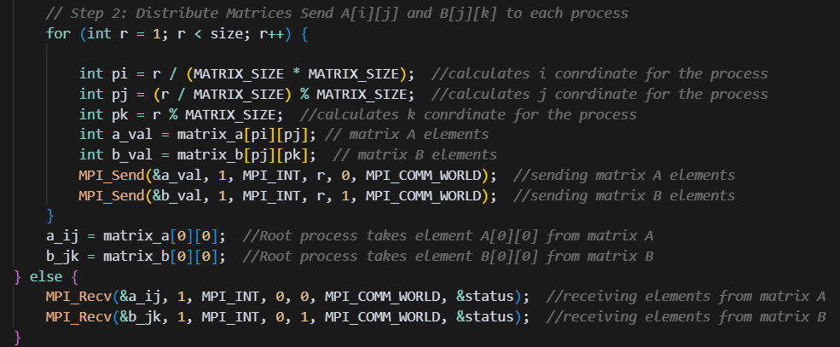
Difference between Task A and Task B
Task A distributes individuals elements to the processes.
Task B distributes sub-matrices/blocks to the processes.

Slide 19
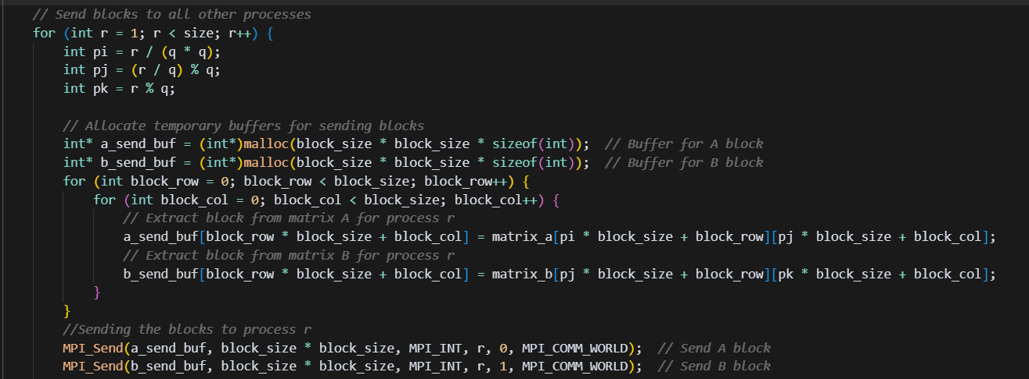
Step 4: Sending blocks to processes
The root process (node 0) sends each process its corresponding A and B blocks using MPI_Send. All other processes receive their blocks with MPI_Recv.

Slide 20
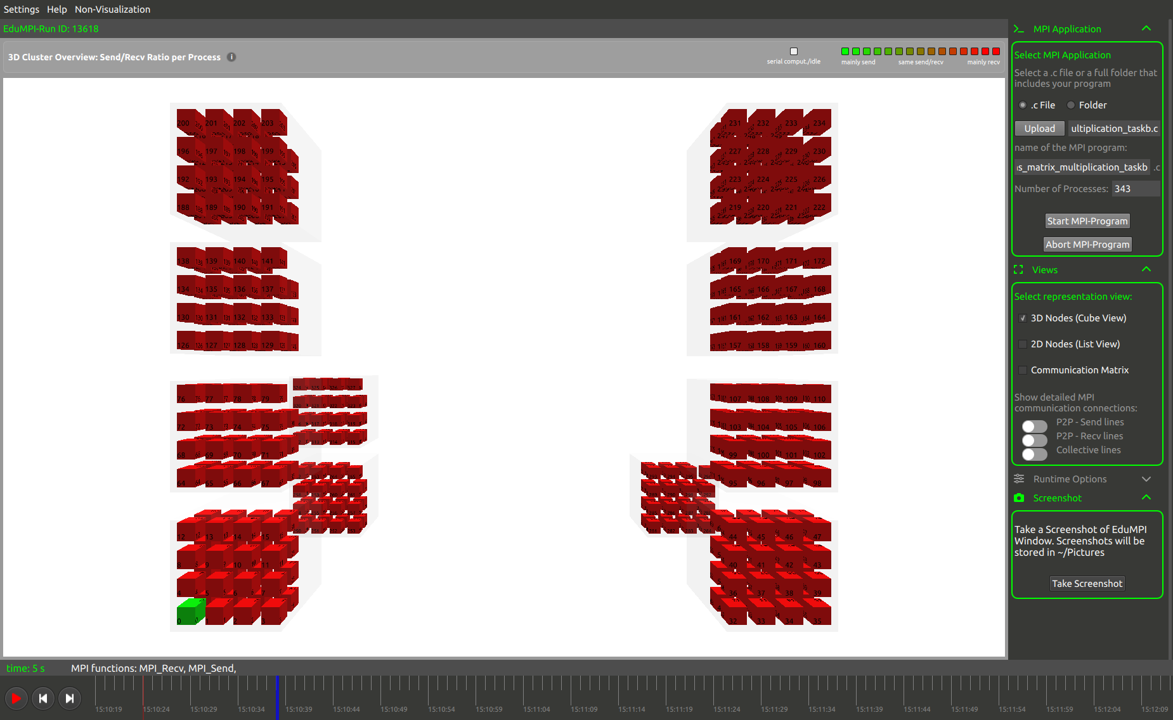
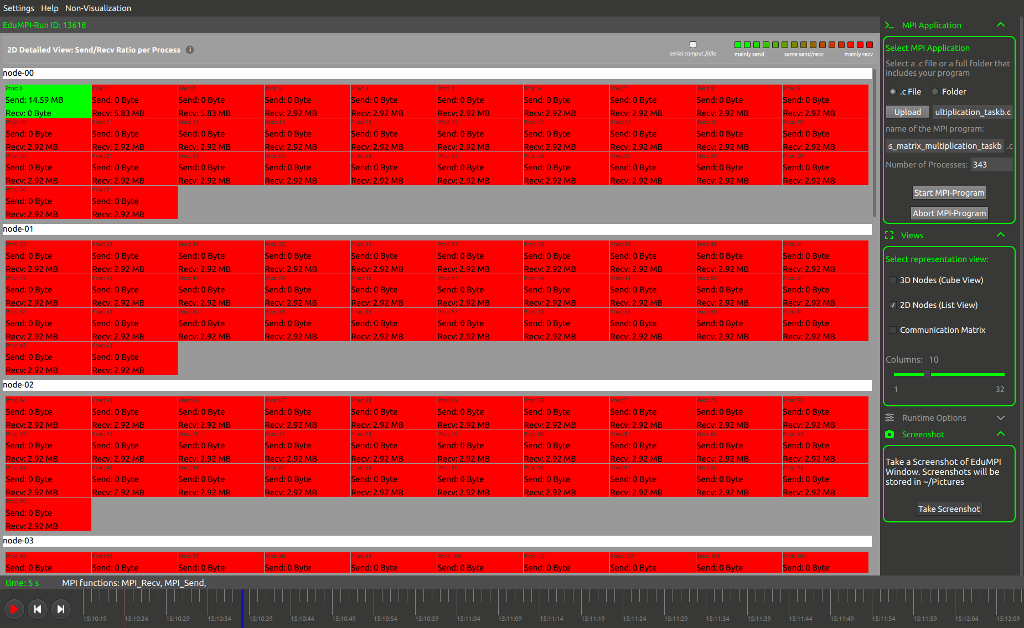
Step 4: Sending blocks to processes
3D Visualization
2D Visualization
2 MPI methods are running at this point MPI_Send and MPI_Receive. Node 0 is on sending mode and All others are receiving mode.

Slide 21
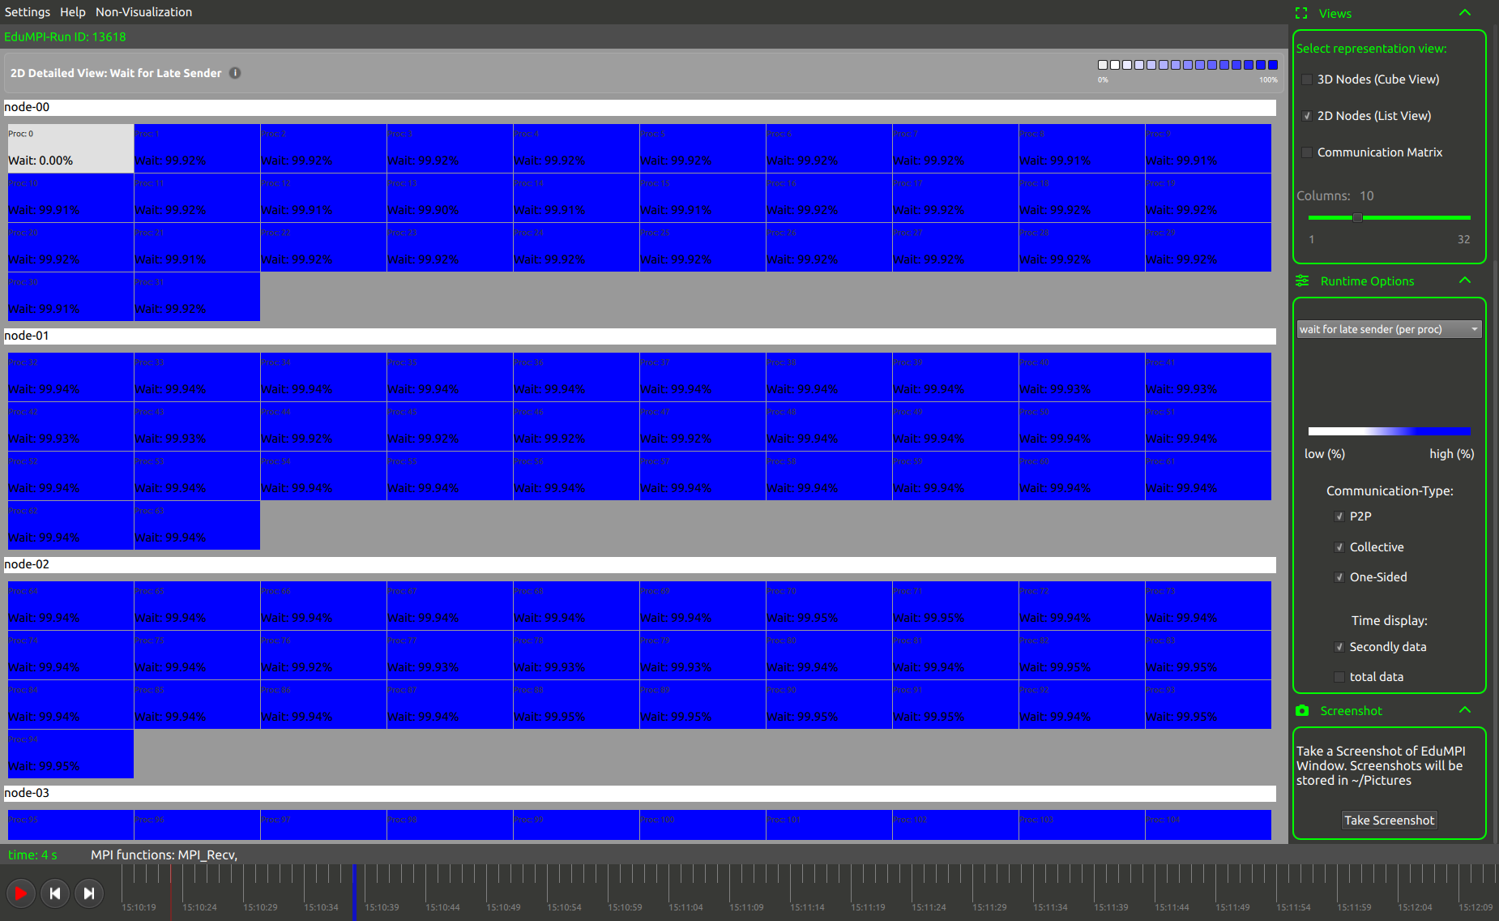
Step 4: Sending blocks to processes
There is a problem here: wait for late sender.
Why this problem?
because every node is waiting for node 0 to distribute data

Slide 22
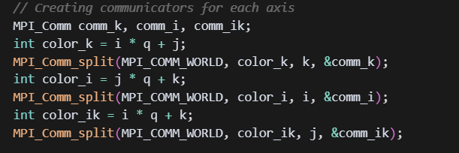
Step 5: Creating Sub-communicators
Processes are grouped into sub-communicators along each axis (k, i, and (i,k)) using MPI_Comm_split, enabling efficient collective communication for DNS.
Why:
Sub-communicators allow for targeted broadcasts and reductions, matching the DNS algorithm’s communication pattern.

Slide 23


Step 6: Broadcasting blocks
Broadcast A blocks along k-axis.
Each (i, j) Broadcasts its A block among all k processes using MPI_Bcast.
Broadcast B blocks along i-axis.
Each (j, k) Broadcasts its B block among all i processes using MPI_Bcast.

Slide 24
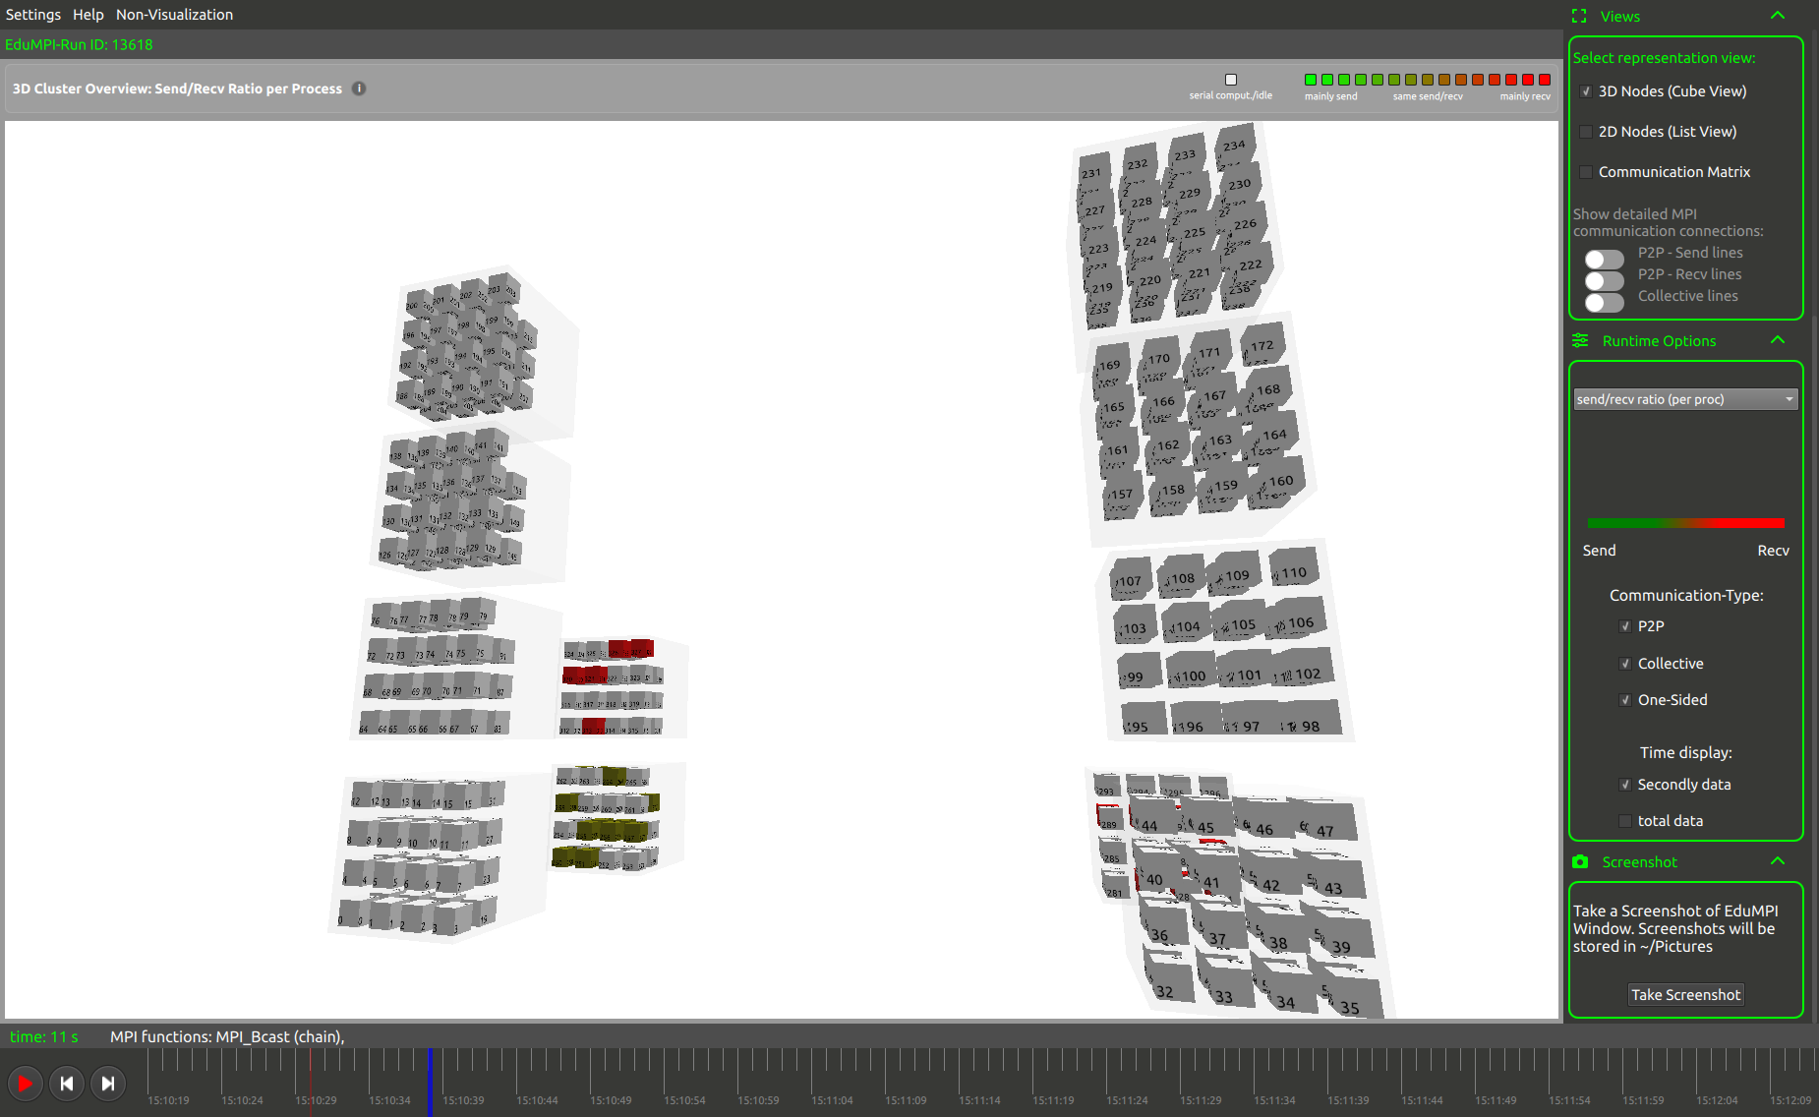
Step 6: Broadcasting blocks
MPI_Bcast method is running at this point.
This is a collective communication routine. Data is broadcasted collectively on all nodes.

Slide 25
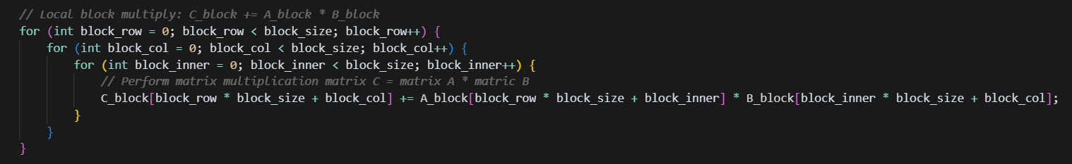
Step 7: Multiplying local blocks
Each process multiplies its local A and B blocks to compute C block using standard block matrix multiplication.

Slide 26
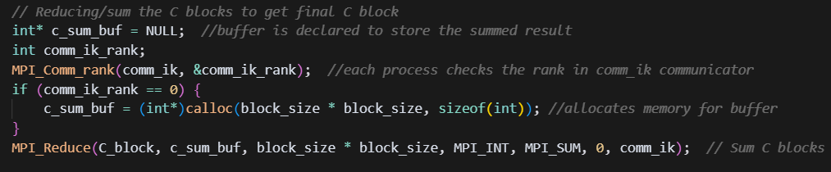
Step 8: Reducing blocks
Partial C blocks are summed across the j-axis using MPI_Reduce to get the final block for each (i, k).

Slide 27
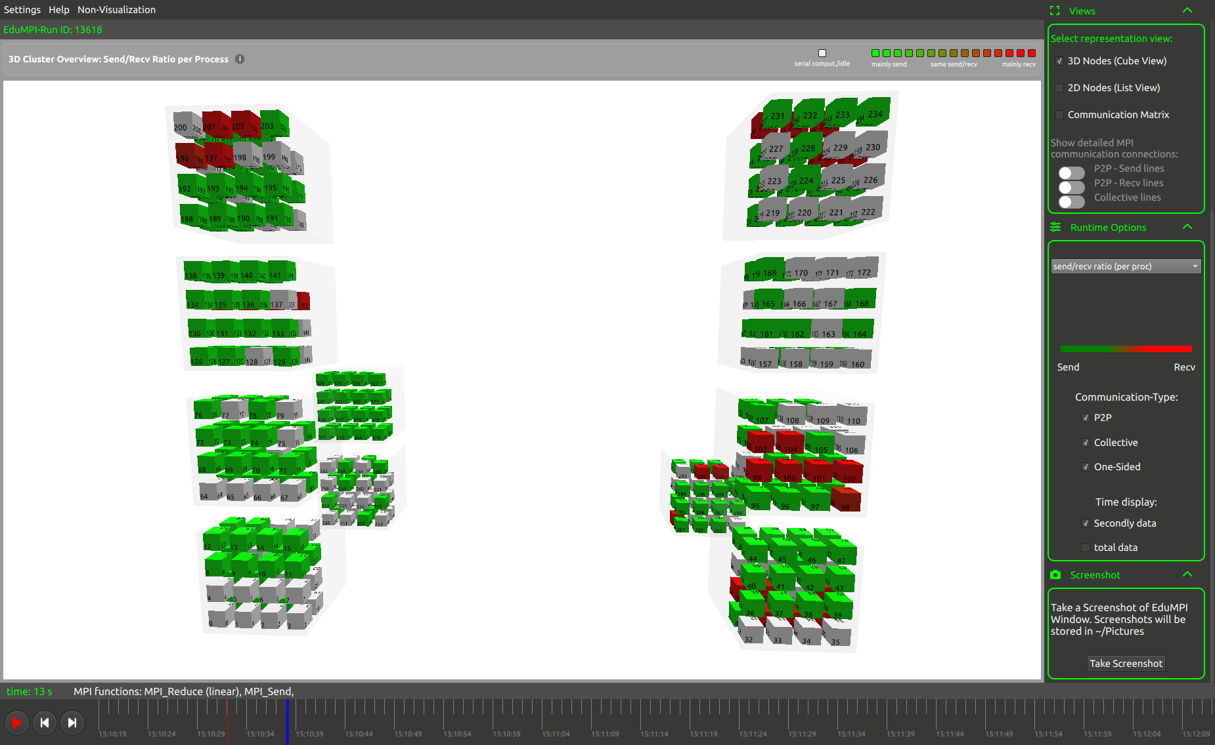
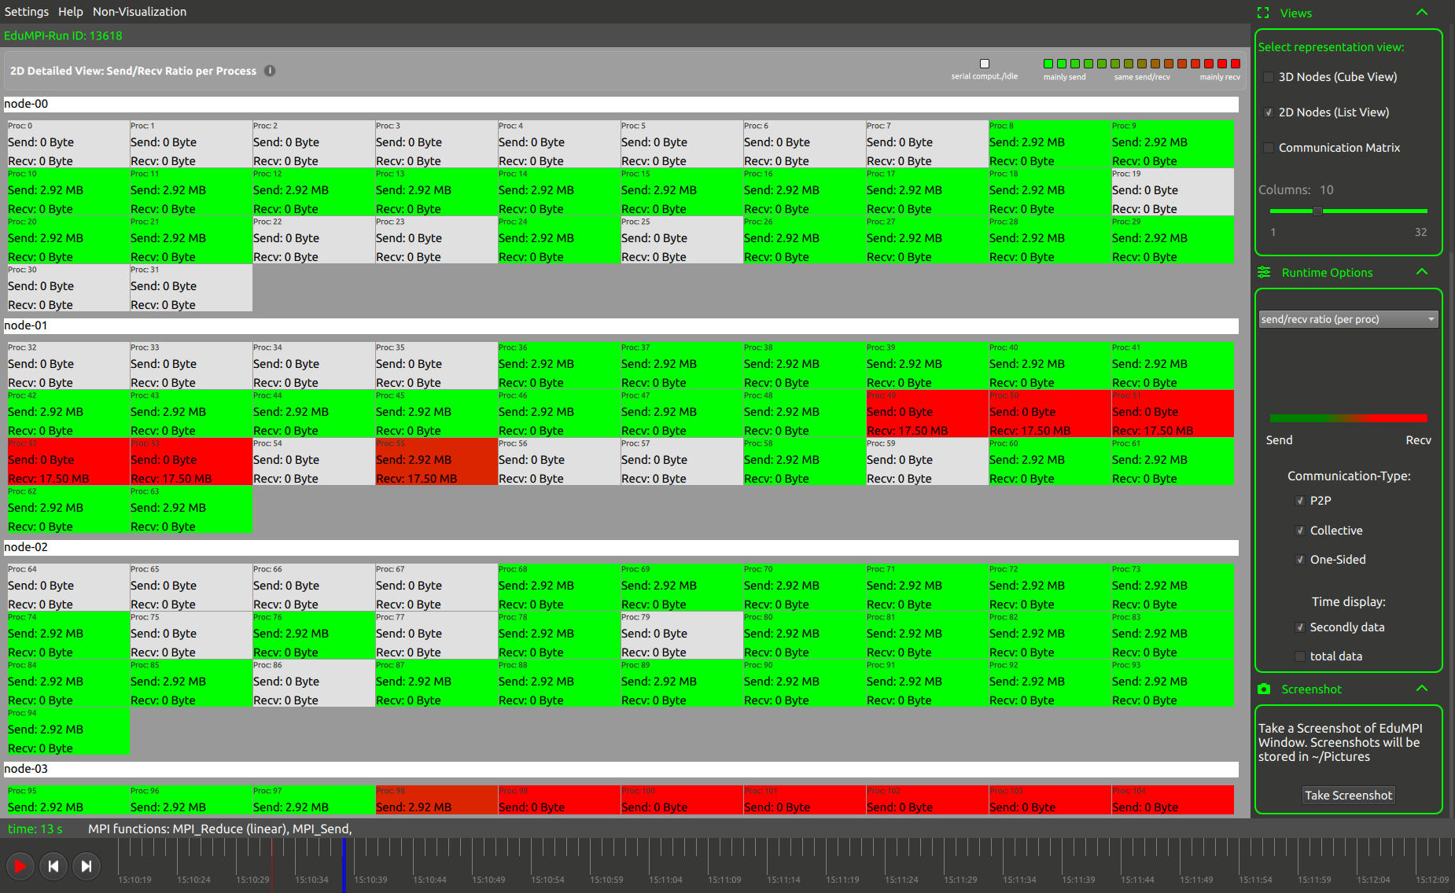
Step 8: Reducing blocks
3D Visualization
2D Visualization
Node 0 is primarily receiving the data because of MPI_Receive and all other nodes are sending data to node 0 because of MPI_Send.
We can see that some of nodes are still red this is because of MPI_Reduce.

Slide 28
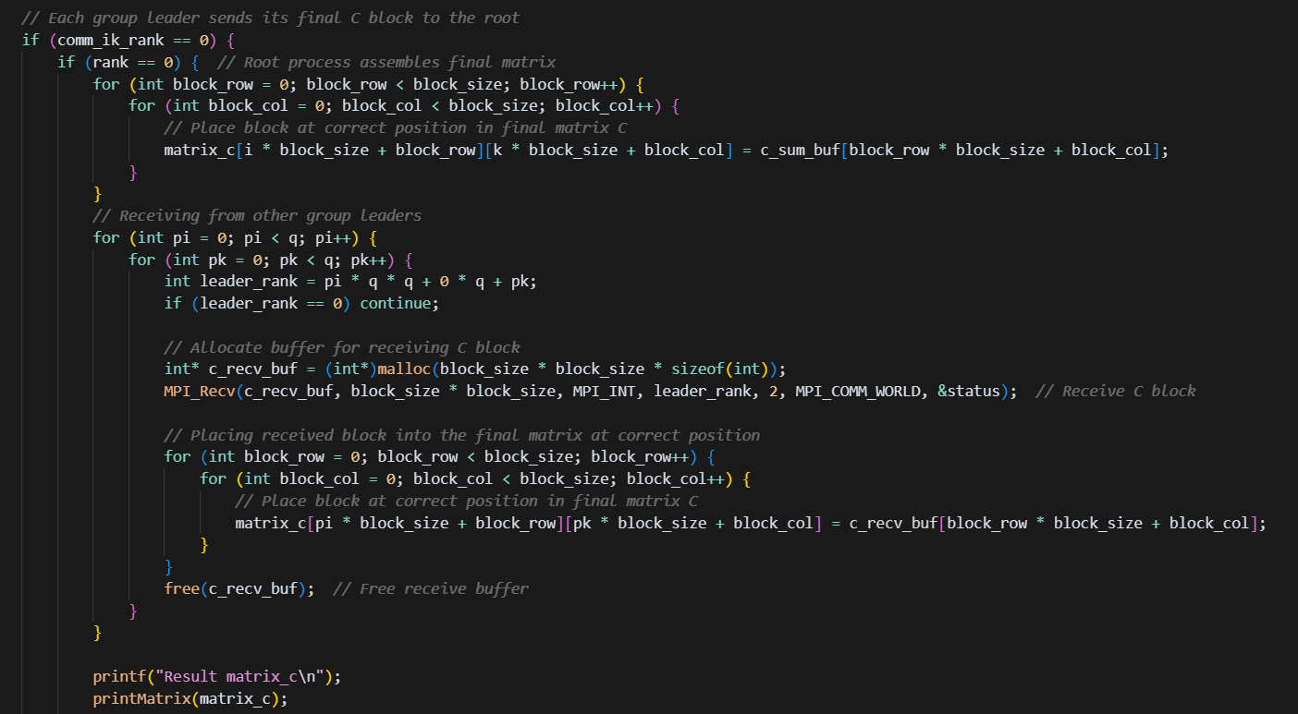
Steps 9 & 10: Sending C blocks to root process
Each (i, k) leader sends its final C block to the root process for assembly.
The root process collects all C blocks and assembles them into the full result matrix, then prints it.

Slide 29
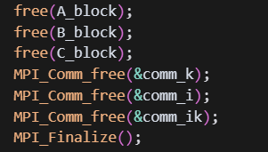
Step 11: Finalize
All processes free their allocated memory and communicators, then finalize the MPI environment.
Why ?
If we don’t use MPI_Finalize, the MPI program may not end properly, and it can lead
to memory leaks or unexpected behavior.

Slide 30
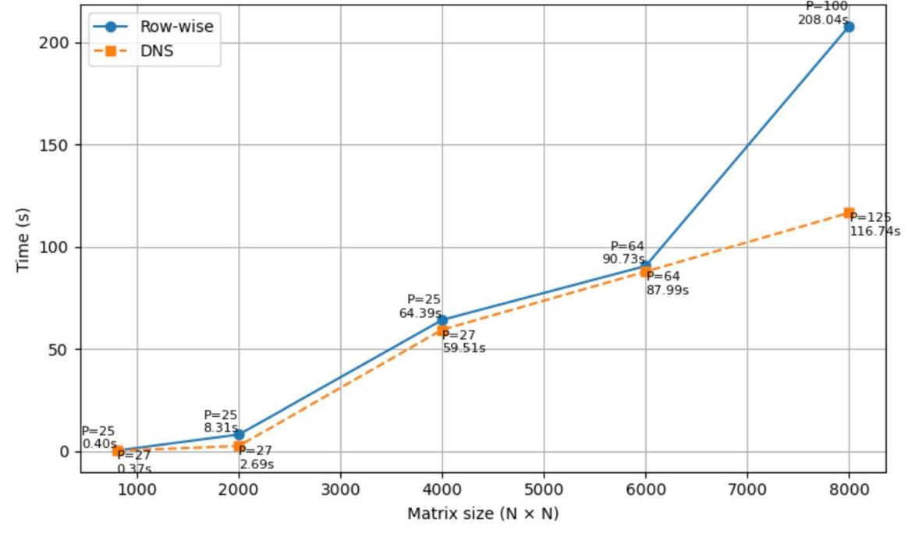
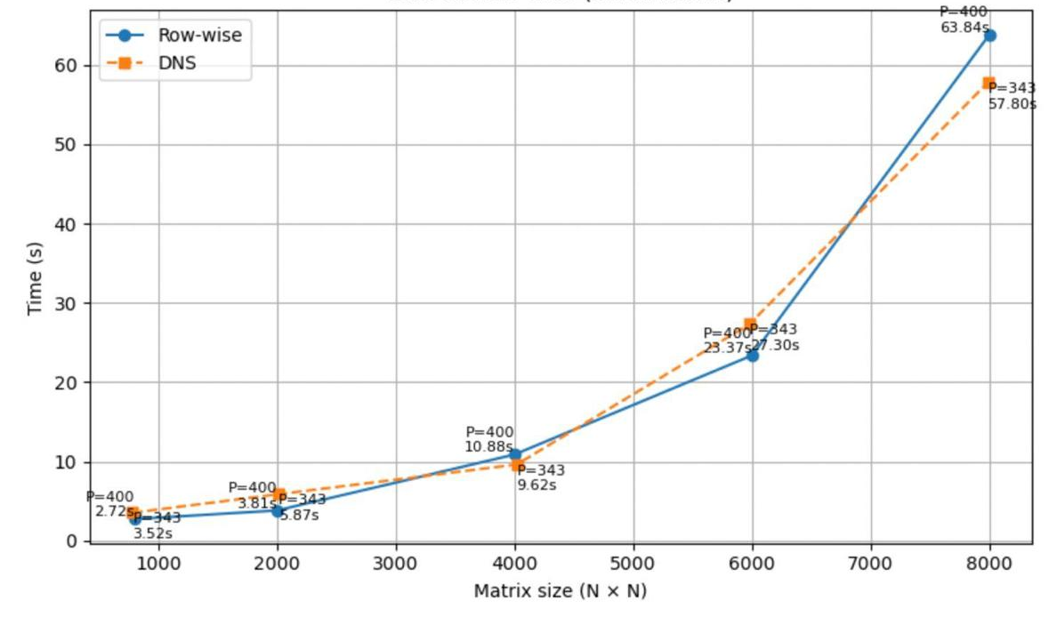
DNS VS Row Matrix
Small Ranks
Large Ranks
There is not much difference when taking small ranks for processing data but we can see the difference, when matrix size is 6000 after that there is a difference in time.
For larger ranks there is no major difference between both algorithms, the processing time is almost same.

Slide 31
Implementation of Fox algorithm
Presented By
Subham Gaurav
1564925

Slide 32
Fox Algorithm
Fox’s algorithm is a message-passing method for multiplying two n × n matrices on a distributed-memory machine.
It breaks the work and the data into row-aligned stages so that every process alternates between three simple actions
Broadcast one A block along its row
Multiply the received A with the local B
Cyclically shift B one row up.
After n stages every rank has seen every A block it needs and contributed exactly one partial product per stage, yielding its final element (or sub-matrix) of C. A final gather to rank 0 rebuilds the full result.

Slide 33
Task A Implementation of Fox algorithm
Process layout
Arrange p = n² ranks in an n × n 2-D Cartesian grid; each rank owns one element of A and B.
if (n * n != size) { if (rank == 0) printf("Error: number of processes must equal n * n.\n"); MPI_Finalize(); return 1; }
Data scatter
Rank 0 distributes one element of A and one element of B to every rank (including itself).
Using MPI_Send AND MPI_Recv ( Blocking Communication)

Slide 34
Broadcast (A-blocks)
Within each process row a different root broadcasts its A-element in every Fox iteration. Root is root = (row + k) % n
MPI_Bcast(&a_bcast, 1, MPI_INT, root, row_comm);
Shifting (B-blocks)
After multiplying, every rank rotates its B-element one row up (last row wraps to first) so the next rank gets the needed B for the next iteration. Done in a single, symmetric call.
int send_to = ((row - 1 + n) % n) * n + col;
int recv_from = ((row + 1) % n) * n + col;
MPI_Sendrecv_replace(&b, 1, MPI_INT, send_to, 2, recv_from, 2, MPI_COMM_WORLD, &status);

Slide 35
Local multiply
Each stage each process updates its private result
c += a_bcast * b;
Gather single result
Once the stage loop finishes, every rank owns exactly one finished result value. Ranks > 0 send that scalar to rank 0:
MPI_Send(&c, 1, MPI_INT, 0, TAG, MPI_COMM_WORLD);

Slide 36
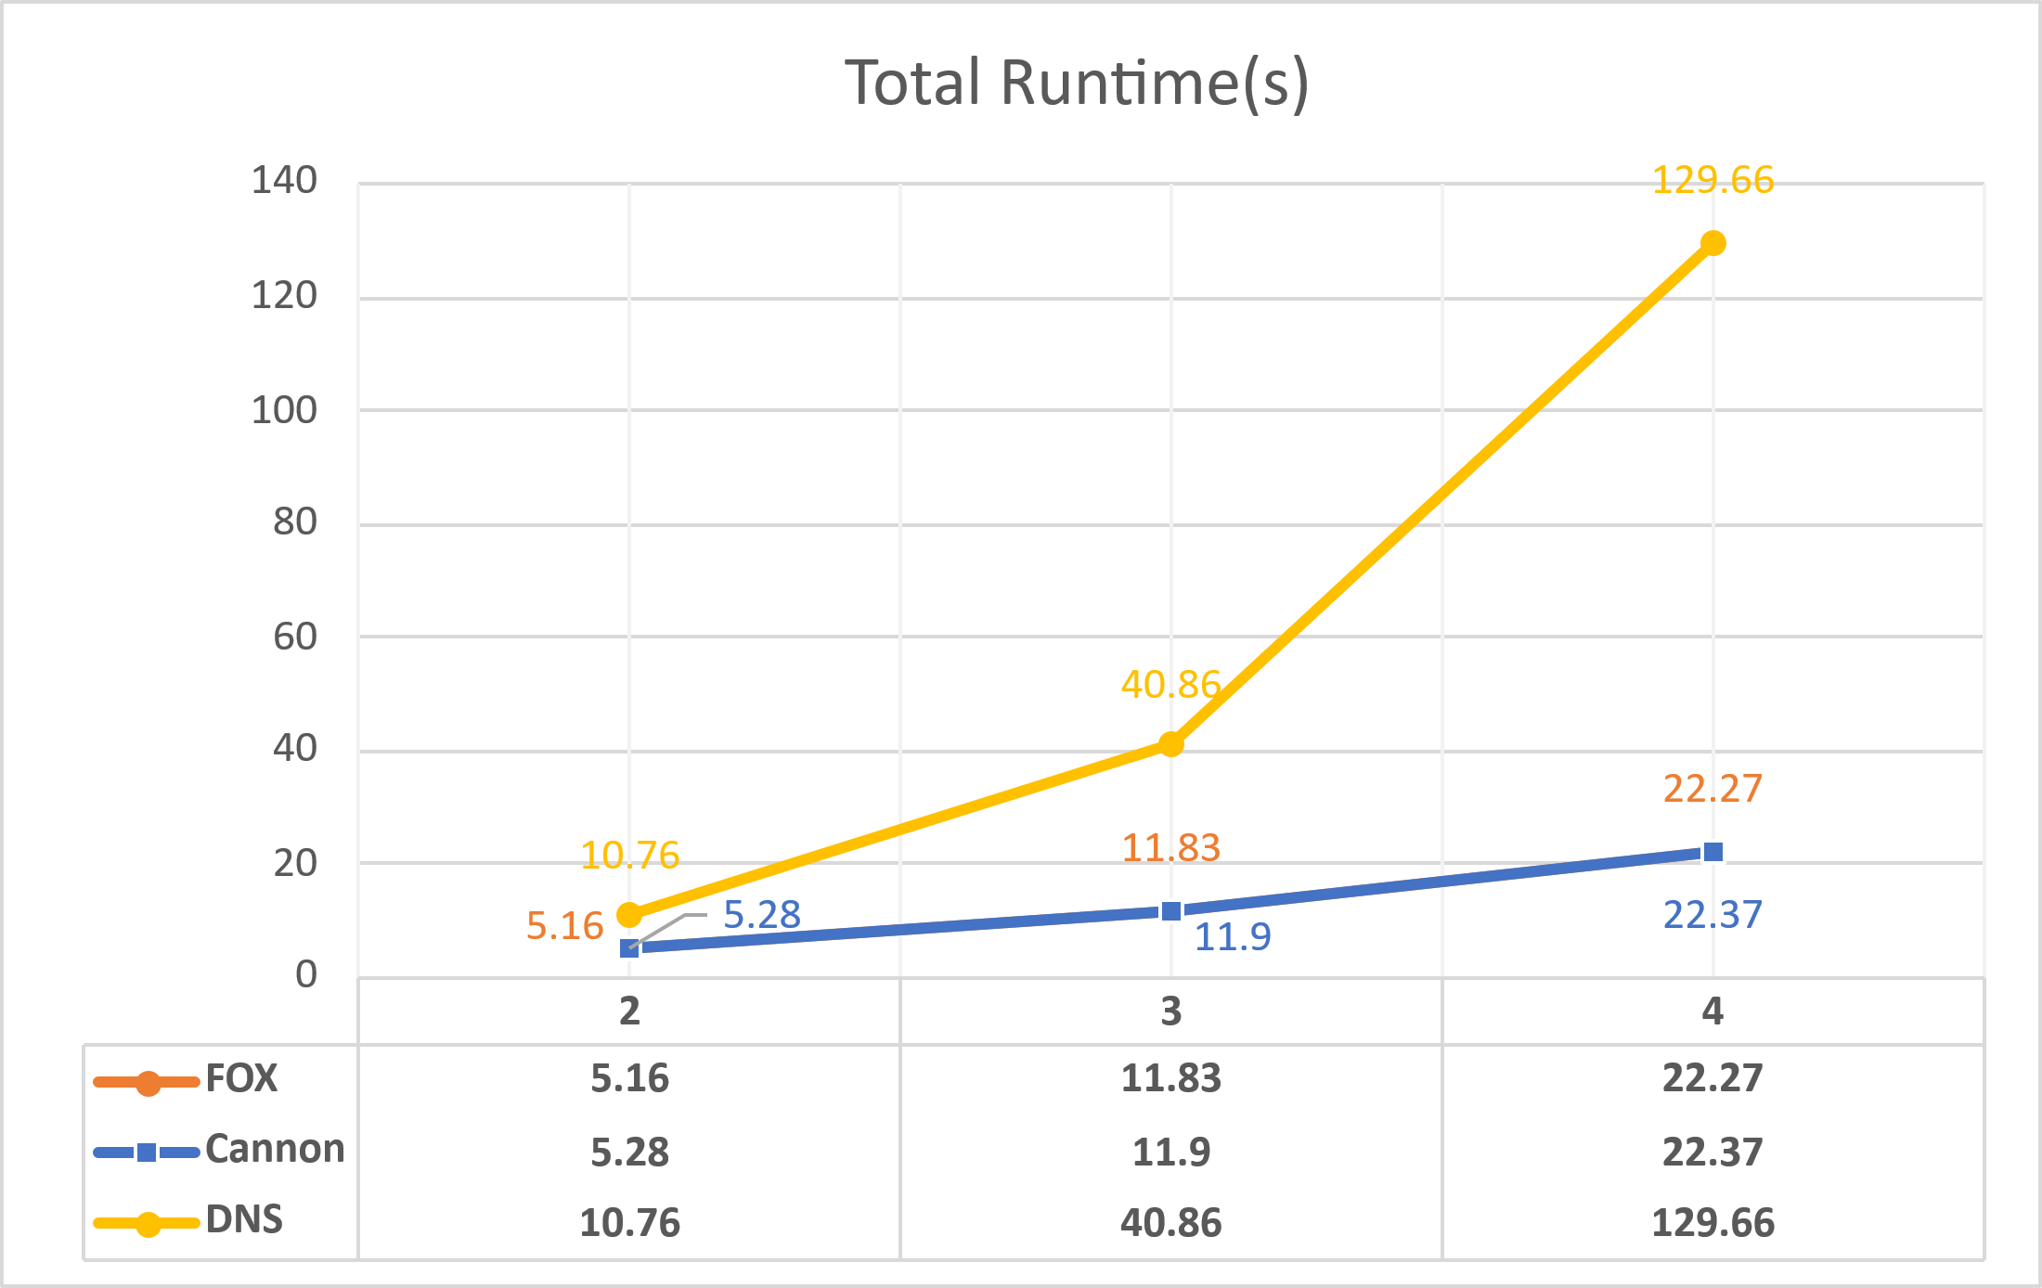
Matrix Size | FOX | Cannon | DNS
2 | 5.16 | 5.28 | 10.76
3 | 11.83 | 11.9 | 40.86
4 | 22.27 | 22.37 | 129.66
FOX ≈ Cannon, DNS far slower
For every size, FOX and Cannon finish within 2 % of each other, while DNS is 2×–6× slower.

Slide 37
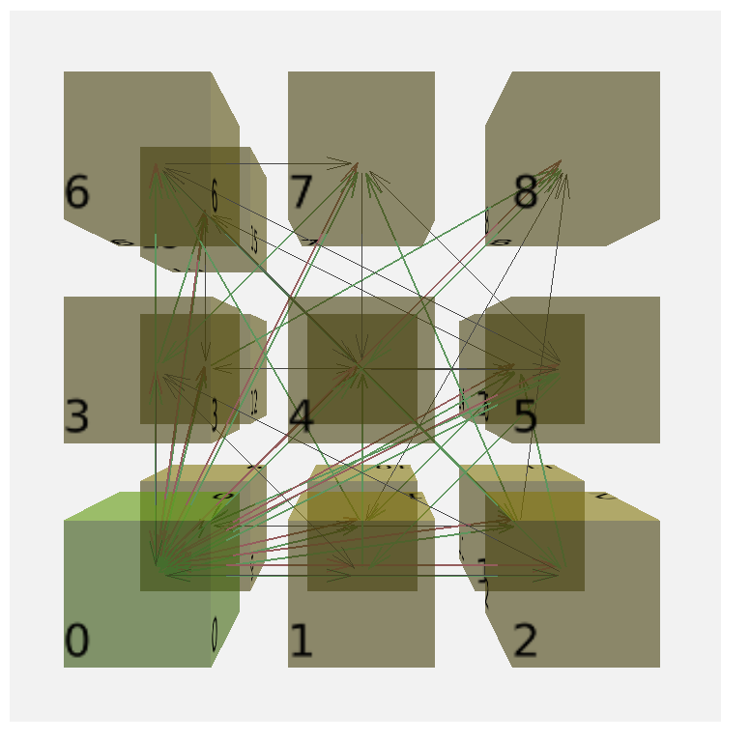

4 * 4 Matrix (16 Rank)
In the row-wise version, the master must push a whole row of B to every worker and also ship each worker its own row of A, turning rank 0 into a bottleneck. In the Fox version, each rank begins with just one element of A and B. At every step, the ranks in the same grid row broadcast that one A element among themselves, while each B element is passed up one row with a single MPI_Sendrecv_replace. Because every message is only one integer, no process is overloaded; each rank multiplies its local pair immediately and, when all steps finish, sends its single result value back to the master for assembly.

Slide 38
Task B Implementation of Fox algorithm
Process grid & prerequisites
Require process = grid² ranks and Matrix_size % Grid_size == 0.
Create a 2-D Cartesian topology with wrap-around (MPI_Cart_create, dims={Grid,Grid}, periods={1,1}) so every rank knows its (row,col) coordinates by.
MPI_Cart_Coords
Derive an extra row communicator (MPI_Comm_split) that groups ranks with the same row for fast broadcasts within rows.
Local storage
Each rank allocates only one “block_size = Matrix_size/Grid” square sub-matrix of A, B, C plus a temporary tempA buffer.

Slide 39
Data distribution at Master Node
Rank 0 fills full matA, matB with random ints.
It slices both matrices into block_size blocks and sends one block of A and B to every rank via two MPI_Send calls.(Sending one element at a time)
Non-root ranks receive the blocks with matching MPI_Recv.
Main Fox loop — for (step = 0; step < q; ++step)
Select broadcast root in the current row
bcast_root = (my_row + step) % grid – pivots move one column to the right each iteration.

Slide 40
2. Broadcast A-block inside the row
If this rank is the root column, copy its local localA into tempA;
Broadcast every row of tempA with MPI_Bcast on row_comm.
3. Local multiply-accumulate
localC += tempA × localB

Slide 41
4. Cyclic vertical shift of B-blocks
Use MPI_Cart_shift(cart_comm, /*direction=*/0, /*disp=*/-1, &src, &dst) to find up/down neighbours.
MPI_Sendrecv_replace(localB[i], block_size, MPI_INT, dst, tag, src, tag, cart_comm, …) shifts one row up (last row wraps to first) in-place for all rows i of the block.
After the shift, each rank holds the B-block needed for the next iteration
Result collection
When the loop ends every rank owns its final localC block.
Rank 0 gathers blocks back into the global result matrix with MPI_Recv / MPI_Send

Slide 42
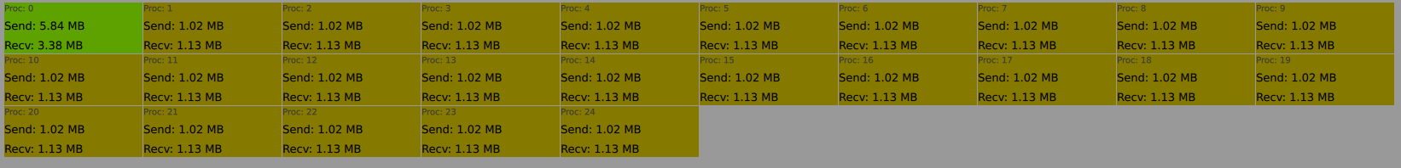
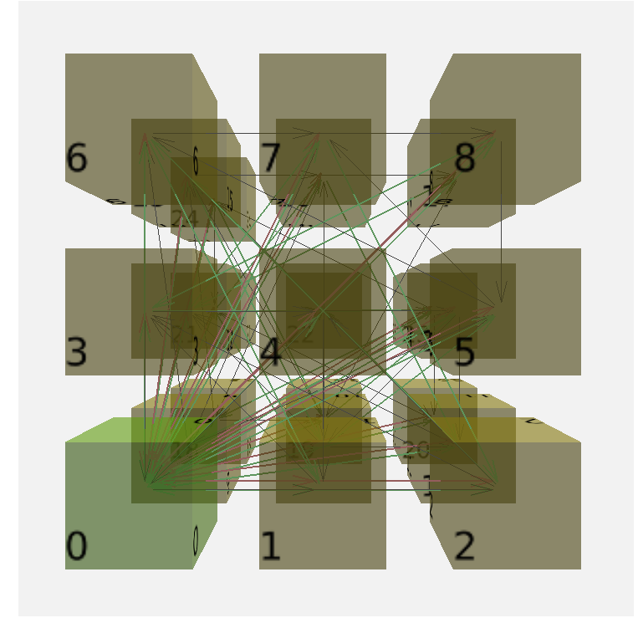

800 * 800 Matrix (25 Rank)
Metric | Row-wise | Fox | Key difference
send/recv ratio | Root network (≈ 31 MB sent) | All ranks within 1–6 MB | Even load across node
max send ratio | A step ladder cause of MPI_Bcast() | Only root’s scatter visible | Fox removes cascade of re-sends.
max recv ratio | Everyone pulls full B + extras | Root pulls less, workers same | Row-wise needs extra A-rows.
wait late sender | Workers idle ~1 % | Same ~1 % | Data-arrival stall similar.
wait late receiver | Root waits >40 % | Root waits only during setup | Fox clears runtime bottleneck.

Slide 43
Matrix Size (N) / Processes (P) | Fox Algo | Row Wise Multiplication
800 / 25 | 81.01 | 49.55
800 / 64 | 244 | 142.93
800 / 100 | 466.1 | 285.79
2000 / 100 | 1715.6 | 574.75
4000 / 64 |  | 1876.46
4000 / 100 |  | 2251.97
6000 / 100 |  | 6412.9
7995 / 225 |  | 20100
8000 / 100 |  | 20600

Slide 44
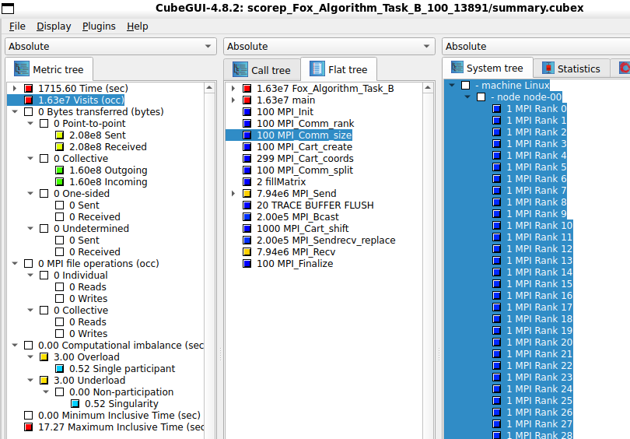

Slide 45
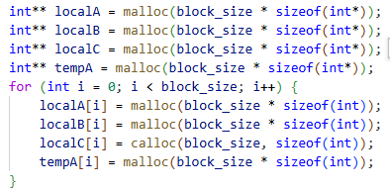
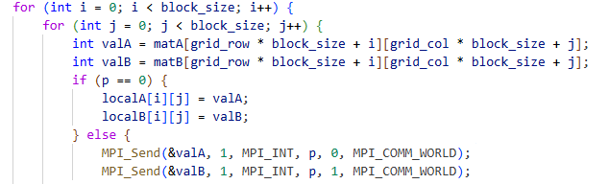
Why this code is not Scalable
Based on previous performance review: (2000 X 2000) Matrix , 100 process
Too many blocking request
Every row of A is broadcast separately Every row of B is shifted separately Result: ≈ 8 million point-to-point calls.
Solution: Change Array Matrix Structure to have 1D flatten structure
and send with MPI_send/MPI_bcast.
Sending one element in a block
Solution: Send whole block data in one MPI_send

Slide 46
Overall Execution Summary
Metric | 800×800 @ 25 ranks | 800×800 @ 64 ranks | 800×800 @ 100 ranks | 2000×2000 @ 100 ranks
Wall-clock time | 81.01 s | 244.01 s | 466.10 s | 1 715.60 s
Computational imbalance | 0.87 s (~1.1%) | 0.92 s (~0.38%) | 1.13 s (~0.24%) | 7.04 s (~0.41%)
Min / Max inclusive task time | 0 s / 3.25 s | 0 s / 3.86 s | 0 s / 4.76 s | 0 s / 17.27 s
Total bytes moved | 65.9 MB | 97.0 MB | 118 MB | 735 MB
Total MPI calls (occurrences) | 2.51 million | 2.64 million | 2.71 million | 16.3 million

Slide 47
Time in major MPI routines
Metric | 800×800 @ 25 ranks | 800×800 @ 64 ranks | 800×800 @ 100 ranks | 2000×2000 @ 100 ranks
MPI_Init | 34.94 s (43%) | 125.00 s (51%) | 237.00 s (51%) | 238.59 s (13.9%)
MPI_Recv | 21.81 s (27%) | 57.85 s (24%) | 103.47 s (22%) | 666.38 s (38.8%)
MPI_Sendrecv_replace | 11.66 s (14%) | 38.92 s (16%) | 90.22 s (19%) | 589.80 s (34.4%)
MPI_Bcast | 7.83 s (10%) | 14.50 s (6%) | 24.30 s (5%) | 152.32 s (8.9%)
MPI_Send | 1.60 s (2%) | 3.77 s (2%) | 4.66 s (1%) | 19.69 s (1.1%)
MPI_Finalize | < 0.3 s | < 0.2 s | < 0.4 s | 7.19 s (0.4%)
Other MPI calls† | < 0.3 s each | < 0.2 s each | < 0.4 s each | < 0.4 s each

Slide 48
MPI call counts
Metric | 800×800 @ 25 ranks | 800×800 @ 64 ranks | 800×800 @ 100 ranks | 2000×2000 @ 100 ranks
MPI_Send / MPI_Recv (each) | 1.23 M | 1.27 M | 1.28 M | 7.94 M
MPI_Bcast / MPI_Sendrecv_replace (each) | 20 k | 51 k | 80 k | 200 k
Topology helper calls (total MPI_Cart_*) | 224 | 767 | 1 399 | 1 499

Slide 49
Observation
Memory efficiency
Message sent per matrix element is modest ≈ 0.10 byte per element at 800², 0.18 byte at 2000²
• Trouble is too many tiny messages (millions of them).
Main bottlenecks
Blocking receives (MPI_Recv) and the swap call (MPI_Sendrecv_replace) consume >60 % of the time at large scales.
Latency
Millions of very small messages ⇒ per-message latency piles up.

Slide 50
Issue with 4000 * 4000 Matrix 64 rank
Scalability
For the 800×800 matrix, adding more than ~25 ranks slows you down (81 s → 244 s → 466 s). Start-up cost and message latency grow faster than the work shrinks.
[Score-P] Increase SCOREP_TOTAL_MEMORY and try again.

Slide 51
Comparing All Algos

Slide 52
Runtime Results Overview
Runtime Results
Row-wise Multiplication → performs moderately well at small matrix sizes but becomes extremely slow for larger matrices (e.g., 7632s for 6000×6000).
Cannon’s Algorithm → good for smaller matrices and certain process counts (e.g., 41s for 800×800 with 100–125 processes) but scales poorly for huge matrices.
DNS Algorithm → efficient for small/medium sizes (e.g., 46s for 800×800) but suffers heavy overhead for very large sizes (e.g., 14800s for 8000×8000).

Slide 53
Technical Analysis
Overhead & Communication
Row-wise: Simple but high communication overhead & waiting states (LateReceiver).
Fox: Balanced block communication, fewer waiting states.
Cannon: Needs initial skewing → setup overhead; best with square grids.
DNS: Uses 3D grid → parallel but high latency & memory overhead.
Scalability & Memory Efficiency
Row-wise: Poor scalability, best memory use.
Fox: Scales well, memory efficient.
Cannon: Decent scaling for perfect grids, slight extra memory for skewing buffers.
DNS: High parallelism but worst memory efficiency.

Slide 54
Conclusions & Recommendations
Algorithm Suitability
Small-medium matrices & few processes → Cannon or Row-wise.
Medium-large matrices & square grids → Fox (best choice).
Extremely large matrices → DNS (only on high-end HPC).
General Observations
Row-wise → good for teaching, not scalable.
Fox → best practical choice overall.
Cannon → good for perfect grids but limited flexibility.
DNS → heavy memory & latency overhead.
Cluster Dependency
Performance depends on hardware topology, interconnect, MPI library.
Always benchmark before choosing.

