Slide 1
Word Level Language Identiﬁcation in Code-Mixed Data using Word Embedding Methods for Indian Languages
Inumella Chaitanya, Indeevar Madapakula, Subham Kumar Gupta, Thara S Dept of Computer Science and Engineering
Amrita Vishwa Vidyapeetham Amritapuri, India
ichaitanya234@gmail.com, iindeevar129@gmail.com, subhamg145@gmail.com, thara@am.amrita.edu

Slide 2
Outline
Motivation
Background information/Related works
Proposed Method
Experimental Results
Summary
Future Work
References

Slide 3
Motivation
Code mixing can be simply interpreted as mixing of two or more languages in the conduct of communications.
India has 23 official state languages, besides numerous unofficial languages.
It is a common observation that a speaker, who is familiar with more than one language, interacts few words, phrases or sentences from another language.
Both the terms code-mixing and code-switching have been used interchangeably, is to highlight mixing of words from multiple languages in the process communication.
Social networking websites like Facebook, Twitter, WhatsApp etc. are being widely used by people to stay in touch on a daily basis.

Slide 4
Limitations:
Code mixing often leads to confusion while interacting with people from different regions.
It also creates a barrier in the communication and makes it difficult for people to understand each other on a global level.
Aim:
The main focus of the paper is the identification of language in code mixed data.

Slide 5
Related works
[1] Barman, Utsab, Amitava Das, Joachim Wagner, and Jennifer Foster.
”Code mixing: A challenge for language identification in the language
of social media.” In Proceedings of the first workshop on computational
approaches to code switching, pp. 13-23. 2014.
[2] Das, Amitava, and Bjrn Gambck. ”Identifying languages at the word
level in code-mixed indian social media text.” (2014).
[4]Barman, Utsab, Amitava Das, Joachim Wagner, and Jennifer Foster.
”Code mixing: A challenge for language identification in the language
of social media.” In Proceedings of the first workshop on computational
approaches to code switching, pp. 13-23. 2014.
[12] Jamatia, Anupam, and Amitava Das. ”Task report: Tool contest on
POS tagging for codemixed Indian social media (Facebook, Twitter, and
Whatsapp) Text@ icon 2016.” the proceeding of ICON 2016 (2016).

Slide 6
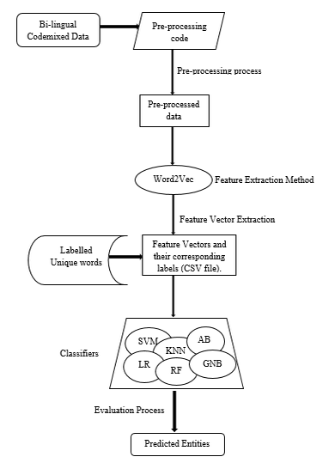
Proposed Method
Proposed method has been represented as a ﬂow chart as shown in the below figure.

Slide 7
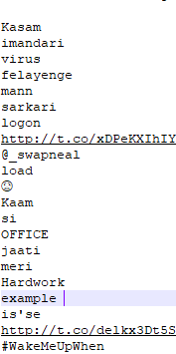
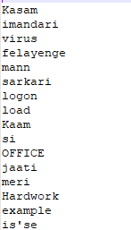
Stages of Proposed method
Pre-Processing:
This stage is a crucial step in any Natural Language Processing (NLP) tasks.
The raw data available is always in unstructured format so with the help of NLTK package we can convert it into structured and intelligible form.
For example, by removing of URLs, emoticons, hypertext links, hashtags, punctuation’s etc. from the data set i.e. raw data to form structured data as shown below

Slide 8
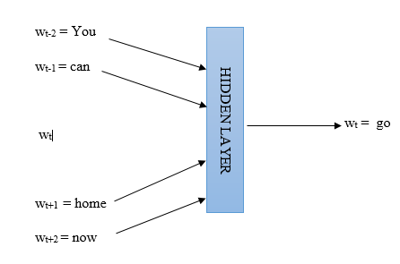
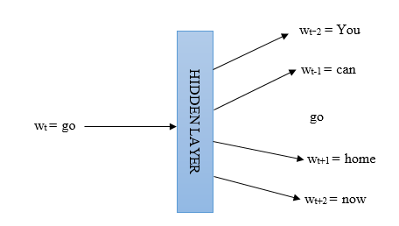
2. Word Embedding models:
The next step is to send the pre-processed data as input to the required word embedding model.
Word embedding is nothing but word vectors or vectors of weights and are useful for representing the meaning of words for different applications.
In our project, we had used Word2Vec i.e. a feature extraction method which is a combination of two models, namely Continuous Bag-of-Words (CBOW) and Skip-Gram.
Let us consider the window size of 5 for the context words as shown below
Continuous Bag-of-Words (CBOW)
Skip-Gram

Slide 9
3. Algorithms used for Classiﬁcation
The next step is classification and the feature vectors obtained from both CBOW and Skip-gram model are given as input to six different classifiers and a comparison study is performed.
In this project we have used different classifiers for comparative study which include as shown below:
1. Support Vector Machine (SVM)
2. Random Forest (RF)
3. Logistic Regression (LR)
4. Gaussian Naive Bayes (GNB)
5. k-Nearest Neighbour (KNN)
6. Ada boost
Finally these classifiers gives cross validation scores for the input feature vectors were taken as the accuracy values.

Slide 10
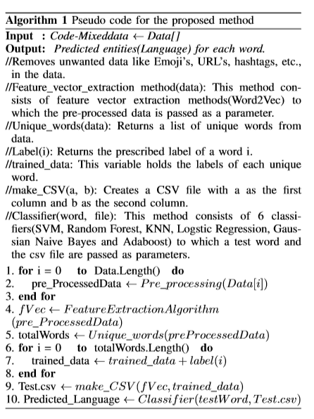

Slide 11
Experimental Results
Data set description
The ICON 2016 dataset is used for our project. It consists training data of social media sites like Facebook(1K),Twitter(1K), WhatsApp (1K) for Hindi-English language pair.
For example, Consider the sentence
“Yaar, tu god hai”.
Words in this text, are: Yaar, tu, god, hai. Despite the fact that code-mixing is a natural practice for multilingual, we are unaware of the distribution proﬁle of code-mixing in any social-media corpus.
The dataset is described as shown below
Method | No of Words | Languages | No of entities
Word2Vec | 7210 | HIN,ENG | 2

Slide 12
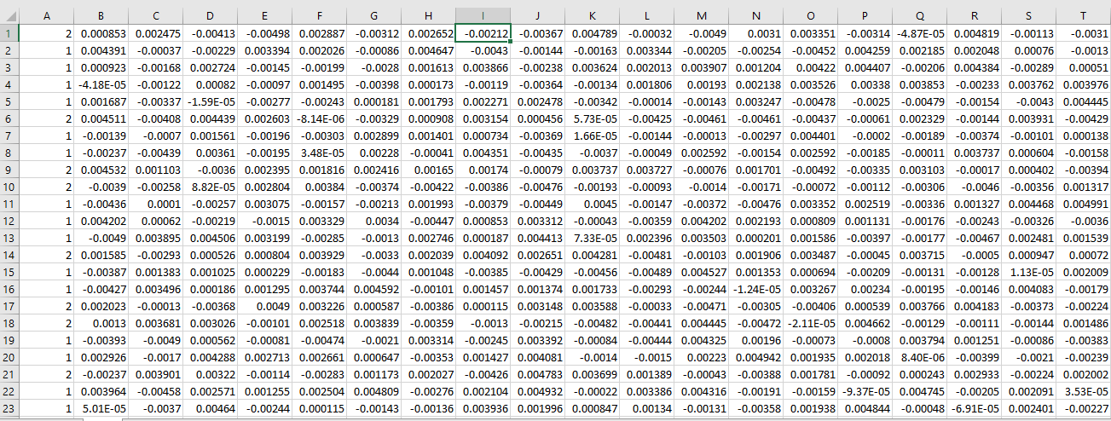
2. Results
The ﬁrst stage of our work starts with pre-processing of data, i.e removing the unwanted data like emoji's, hypertext links, etc. This process is achieved by using NLTK packages in python.
This pre-processed data is given as an input to Word2Vec algorithm. The feature vectors for a dimension of 100 with a learning rate of 0.000001 with window size of 5 were generated for CBOW and Skip-gram algorithms separately.
There were totally 6291 unique words generated by this algorithm. These feature vectors were combined with their corresponding labels into a CSV ﬁle as shown below

Slide 13
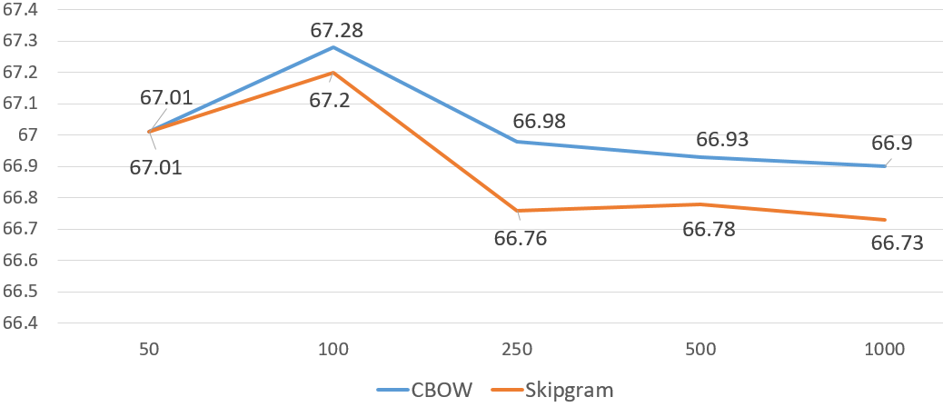
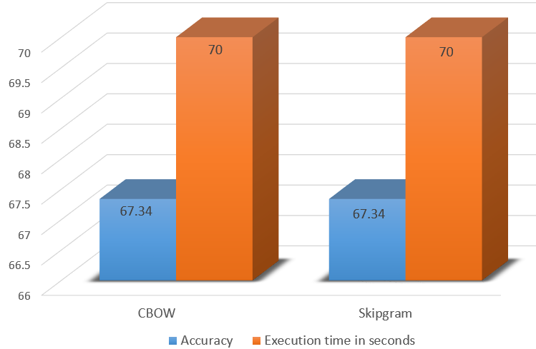
The below chart shows the accuracy of Word2Vec models i.e. CBOW and Skip-Gram models at different dimensions ranging from 50 to 1000.
The below chart shows a plot of accuracy versus execution time.

Slide 14
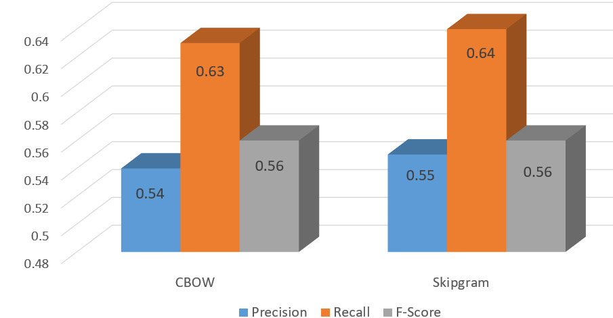
Apart from these we have three evaluation measures i.e. Precision, Recall and F-Score and these are represented in a bar chart as shown below
CSV ﬁle was given as input to all the six classiﬁers. The cross validation scores of all the classiﬁers were taken as the accuracy values as tabulated below
Classifiers | Word2Vec using CBOW | Word2Vec using Skip gram
SVM | 67.33% | 67.34%
Random Forest | 58.76% | 59.65%
Logistic Regression | 58.67% | 59.65%
GNB | 67.19% | 66.98%
KNN | 59.87% | 60.45%
Ada boost | 67.01% | 67.28%

Slide 15
Summary
Through this paper, we want to prove that Code-Mixing is not a grammar-less phenomenon with the use of Word2Vec which is a word embedding method. Our prime objective of this study was to improve accuracy of the word level identiﬁcation of language in a code-mixed data by using Word2Vec approach. With the use of traditional algorithms we made a comparison study of giving CBOW and Skip-Gram as input to these algorithms at different dimensions. Precision, recall and F-measure were also calculated.

Slide 16
Future Work
For future work we could extend it with more Indian Languages and also its accuracy can be enhanced with the help of neural network.

Slide 17
References
2013. Barman, Utsab, Amitava Das, Joachim Wagner, and Jennifer Foster. ”Code mixing: A challenge for language identiﬁcation in the language of social media.” In Proceedings of the ﬁrst workshop on computational approaches to code switching, pp. 13-23. 2014.
Das, Amitava, and Bjrn Gambck. ”Identifying languages at the word level in code-mixed indian social media text.” (2014).
Rodrigues, Paul, and Sandra Kbler. ”Part of Speech Tagging Bilingual Speech Transcripts with Intrasentential Model Switching.” In AAAI Spring Symposium: Analyzing Microtext. 2013.
Sarkar, Kamal. ”Part-of-speech tagging for code-mixed indian social media text at ICON 2015.”arXiv preprint arXiv:1601.01195 (2016).
Muysken, Pieter Cornelis. ”Code-switching and grammatical theory.” (1995).
Weka 3: Data Mining Software in Java. Available: http://www.cs.waikato.ac.nz/ml/weka/.
McCallum, Andrew Kachites. ”Mallet: A machine learning for language toolkit.” (2002).
Thara, S. ”Code-Mixing: A Brief Survey” In Advances in Computing, Communications and Informatics (ICACCI), 2018 International Conference on, pp. IEEE, 2018.

