Slide 1
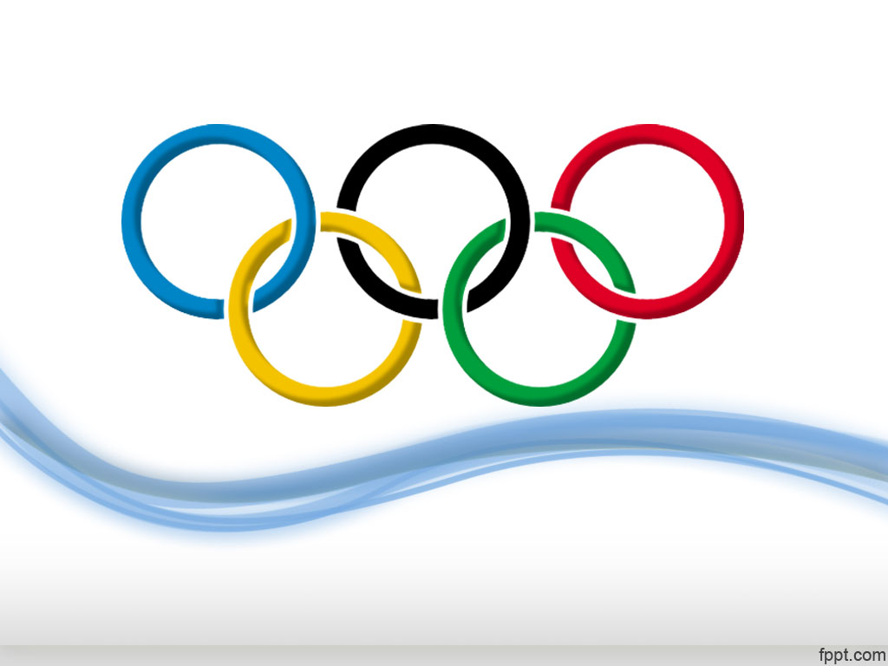
History of Olympics (1986-2016)
Submitted by: Subhamita

Slide 2
OBSERVATIONS
A total of 28 Olympic games have been hosted to date, with the United States and France hosting the most games (4 each).
Men have historically dominated the Olympics in terms of participation and medal count, although there has been a gradual increase in women's participation over the years.
Michael Phelps, Larisa Latynina, and Paavo Nurmi are the athletes with the most Olympics medals, while Simone Biles and Usain Bolt are among the most successful athletes in recent years.

Slide 3
OBSERVATIONS
The number of participating countries and athletes has been steadily increasing over the years, with a sharp increase in the number of women athletes starting from the 1980s.
The United States, followed by Russia and Germany, are the countries with the most Olympics medals, while India has a relatively low medal count.
India has won medals in individual sports such as Shooting, Wrestling, Boxing, and Athletics, and has shown improvement in recent years.

Slide 4
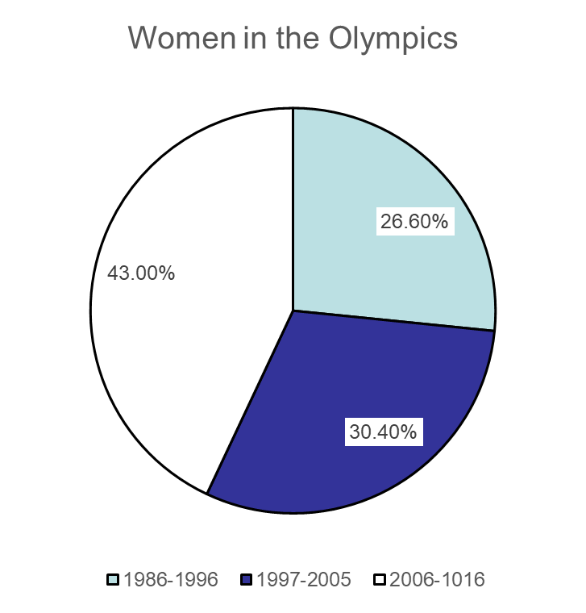
OBSERVATIONS
In terms of gender distribution, men have won the majority of the medals for India, although women's participation has been increasing over the years.
The representation of women in the Olympics has increased significantly over the years, although there is still a long way to go in achieving gender parity.

