Slide 1

SmartWatch Data Analysis
Subham Jena

Slide 2

Problem Statement
To analyze a dataset containing fitness information from 30 smartwatch users who participated in an online survey between December 2016 and May 2017. The dataset comprises minute-by-minute records of activity levels, heart rate, and sleep patterns. Each user wore different smartwatch models and had unique activity preferences, contributing to the diversity within the data. We are exploring this dataset to examine the relationship between daily calorie counts and minutes of activity for these smartwatch users allowing us to predict early warning signals of underlying health issues.

Slide 3

Key-Objectives
Explore the minute-by-minute details of activity levels, heart rate, and sleep patterns in the dataset.
Investigate the daily calorie counts and activity minutes recorded by the smartwatch users.
Analyze the variations in daily calorie consumption and activity durations among the 30 users.
Identify potential correlations between daily calorie counts and different activity levels.
Visualize the data to uncover insights into fitness patterns and trends among the smartwatch users.

Slide 4
Dataset
ActivityDate
TotalSteps
TotalDistance
TrackerDistance
LoggedActivitiesDistance
VeryActiveDistance
ModeratelyActiveDistance
LightActiveDistance
SedentaryActiveDistance
VeryActiveMinutes
FairlyActiveMinutes
LightlyActiveMinutes
SedentaryMinutes
Calories

Slide 5
What is Solution ?
Detailed exploration of activity levels, heart rate, and sleep patterns from the smartwatch dataset.
Examination of daily calorie counts and activity minutes distribution across the 30 users.
Correlation analysis between daily calorie consumption and activity durations for insights.
Visual representations to communicate findings and recommendations for fitness monitoring and health improvement.
Approach :
Import Libraries
Read Data (From CSV file)
Preprocess the Data
Check for Null Values
Check descriptive statistics of the data set
Analyze the Calories
Relationship between Calories & Total Steps
Total Active Minutes
Observations

Slide 6
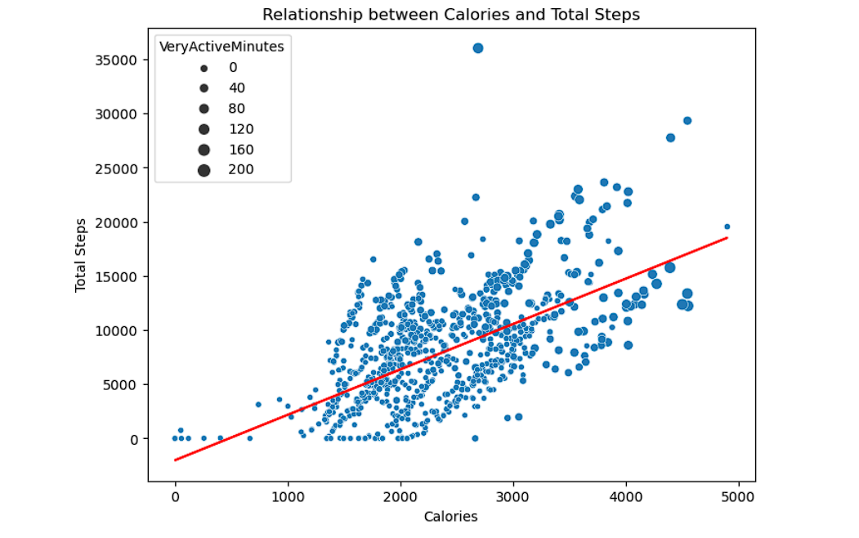
Result of Solution
Visualizes the relationship between calorie expenditure ('Calories') and total steps taken ('TotalSteps') using a scatter plot with a trendline fitted using OLS regression.

Slide 7
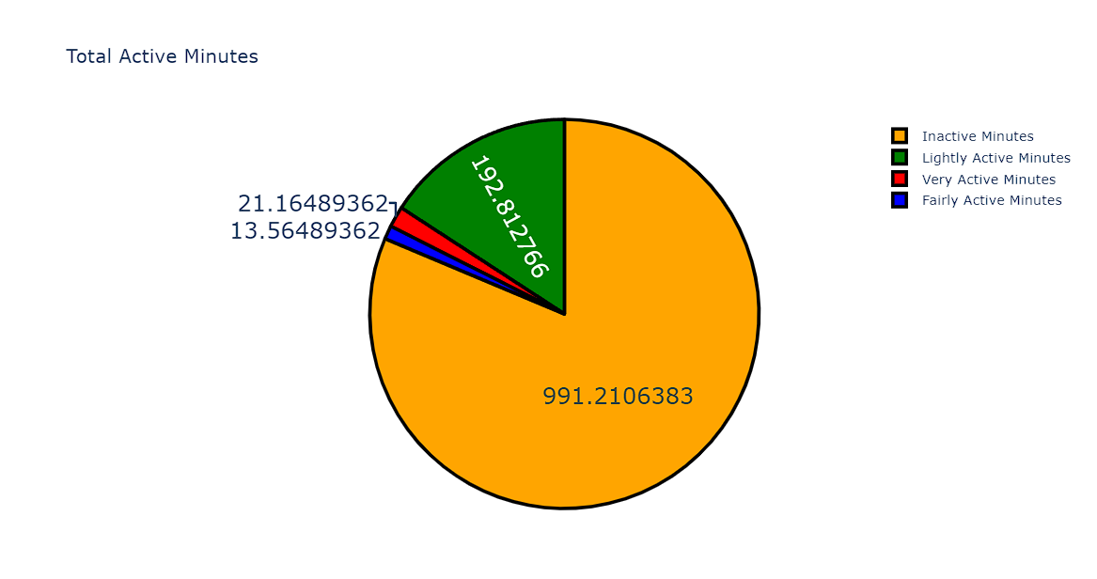
Result of Solution
Distribution of Activity (in Minutes)
This code generates a pie chart visualizing the distribution of average minutes spent in different activity levels, with each segment representing a specific activity level and its corresponding proportion of the total.

Slide 8
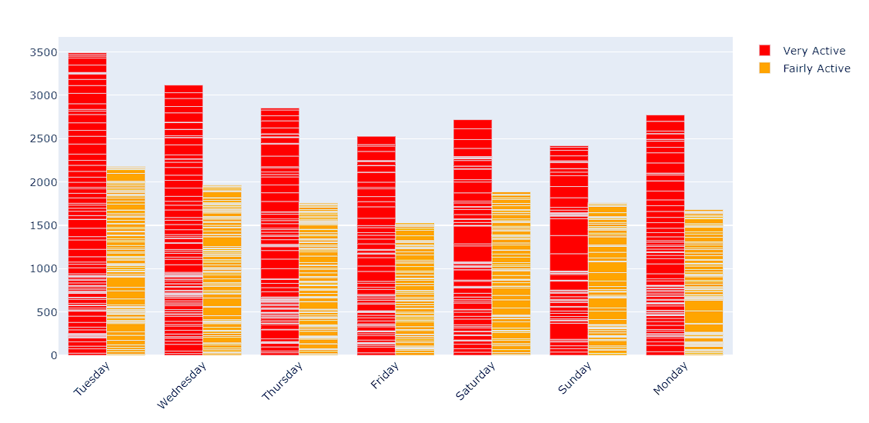
Result of Solution
ACTIVE MINUTES - (Each Day of Week)
This code generates a grouped bar chart showing the comparison of 'VeryActiveMinutes' and 'FairlyActiveMinutes' across different days, allowing for easy visual comparison of the two activity levels over time.

Slide 9
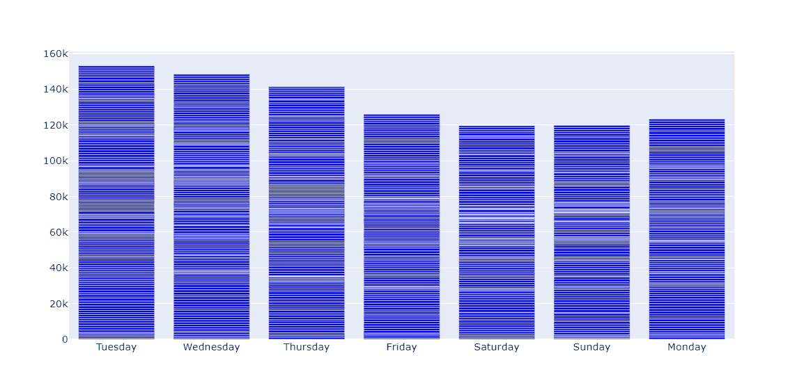
Result of Solution
Sedentary Minutes (Per day)
This code snippet generates a bar chart showing the inactive minutes across different days. The blue bars represent the time spent being sedentary.

Slide 10
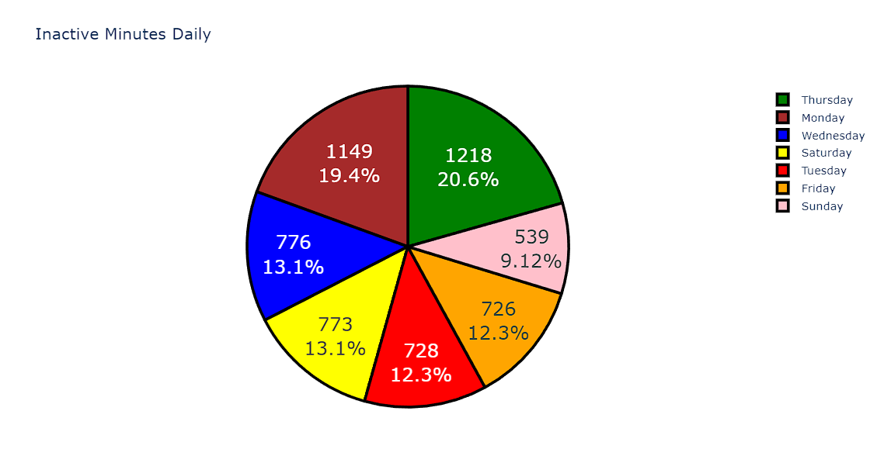
Result of Solution
Daily Inactive Minutes
This code snippet creates a pie chart illustrating the distribution of inactive minutes across different days. Each slice represents the proportion of time spent being sedentary.

Slide 11
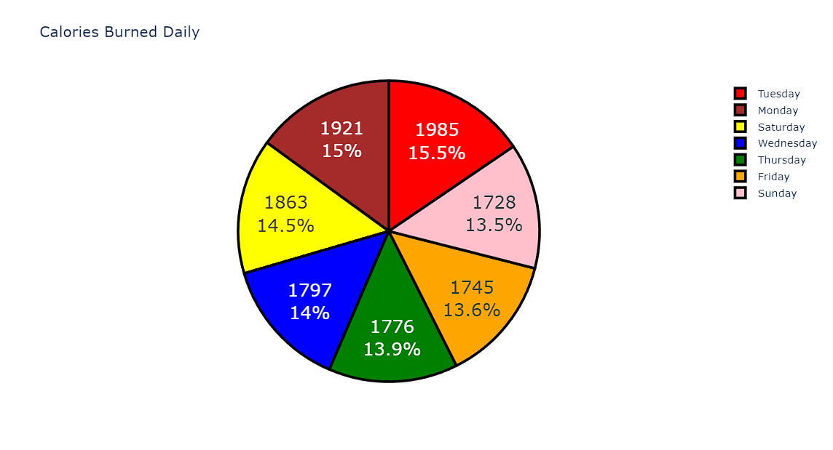
Result of Solution
Calories Burnt Daily
This code snippet creates a pie chart illustrating the distribution of calories burned across different days. Each slice represents the proportion of calories burned on a specific day.

Slide 12
Conclusion
Based on the analysis performed on the dataset "dailyActivity_merged.csv," several insights can be drawn:
Calories and Total Steps Relationship:
There is a noticeable relationship between the number of calories burned and the total steps taken. As the calories burned increase, so do the total steps, indicating a positive correlation between physical activity and calorie expenditure.
Active Minutes Distribution:
The distribution of active minutes throughout the week varies. Notably, there are higher levels of very active and fairly active minutes during certain days compared to others, suggesting potential patterns in physical activity behavior.
Inactive Minutes Distribution:
Conversely, the distribution of sedentary (inactive) minutes also varies across different days of the week. This indicates fluctuations in sedentary behavior, with certain days exhibiting higher levels of inactivity compared to others.

Slide 13
Conclusion
Daily Patterns:
Examining the distribution of sedentary minutes and calories burned across different days of the week reveals potential patterns in activity levels and calorie expenditure. For instance, there may be differences in activity and calorie burn between weekdays and weekends.
Further Analysis:
Further exploration could involve investigating the factors influencing variations in activity levels and calorie expenditure across different days. This could include factors such as work schedules, lifestyle choices, or external influences.
In conclusion, the analysis provides valuable insights into the relationship between physical activity, calorie expenditure, and daily patterns of activity and inactivity. Understanding these patterns can be crucial for promoting healthier lifestyles and designing targeted interventions to encourage increased physical activity and reduced sedentary behavior.

Slide 14

THANK YOU!

