Slide 1
TA PANDA BUSINESS OS
Phase 3 Frontend Walkthrough
Eight modules, built and verified on mock data — the marketing operations layer for Ta Panda Innovation, ready for Phase 4 API & n8n integration.
8
7
6
Pages Built
n8n Workflows Monitored
Modules Previewed as “Soon”
Ta Panda Innovation · Interior Design & Architecture, Kolkata

Slide 2
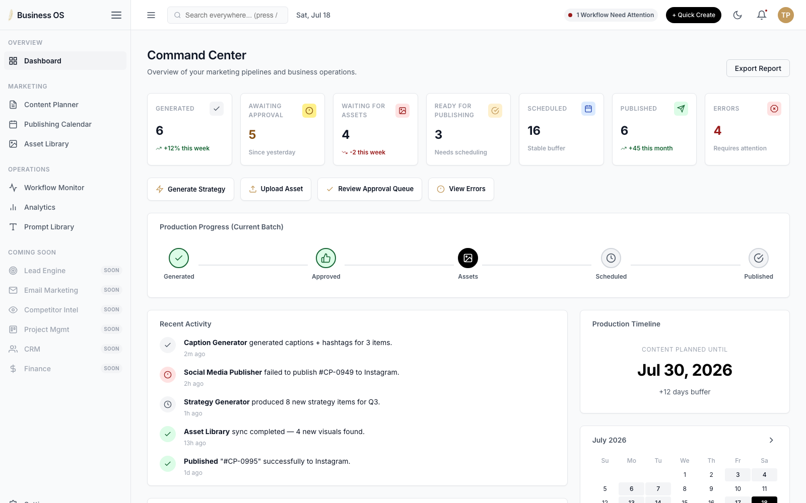
OVERVIEW
01
Executive Dashboard
The command center — a single-glance read on every pipeline, workflow, and alert.
✓
Live KPI strip: Generated, Awaiting Approval, Waiting for Assets, Ready, Scheduled, Published, Errors
✓
Production Pipeline visualizes the current batch's stage-by-stage progress
✓
Workflow Health grid summarizes all 7 n8n automations at a glance
✓
Recent Activity feed and a mini publishing calendar preview
✓
Error Centre and System Health widgets surface problems before they escalate
✓
One-click Quick Actions: generate strategy, upload asset, review approvals
Ta Panda Business OS · Phase 3 Frontend Walkthrough

Slide 3
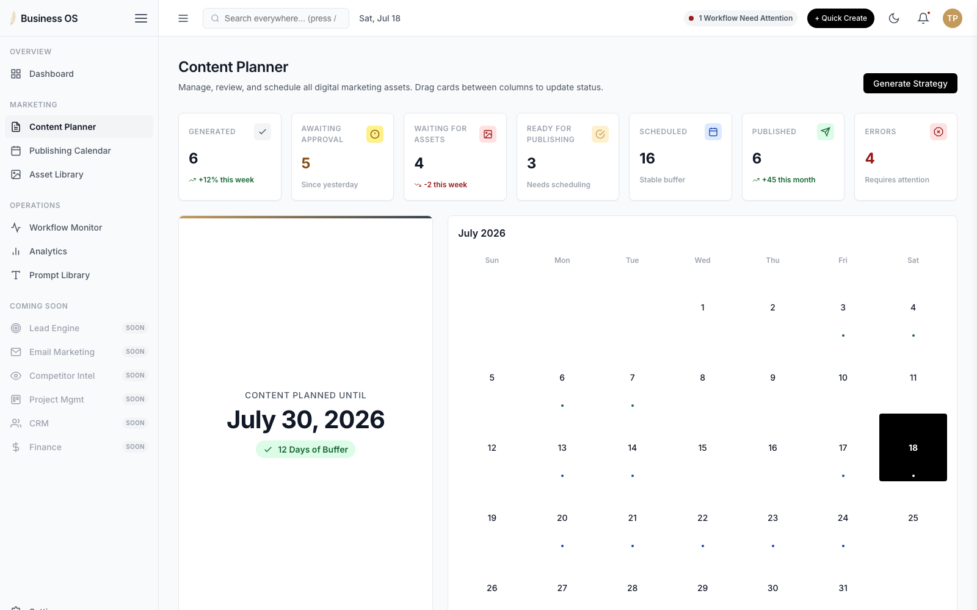
MARKETING
02
Content Planner
The production pipeline as a living board — from idea to published post.
✓
Kanban board spans the full pipeline: Generated → Approval → Approved → Assets → Ready → Scheduled → Published
✓
Fully functional drag-and-drop between columns updates status live
✓
Filter by status, content type, pillar, platform, priority, or free-text search
✓
Calendar + countdown card flags how many scheduling days of buffer remain
✓
Content Details drawer: hook, CTA, caption, hashtags, SEO meta, reviewer remarks
✓
KPI strip mirrors the Dashboard counts for at-a-glance pipeline health
Ta Panda Business OS · Phase 3 Frontend Walkthrough

Slide 4
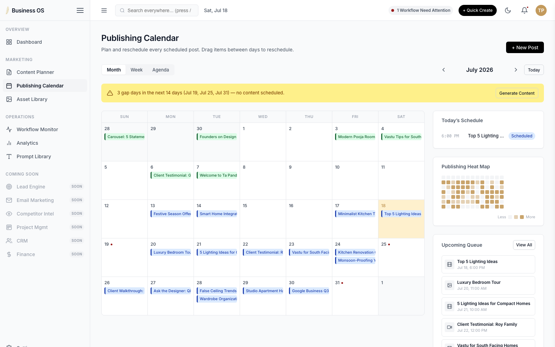
MARKETING
03
Publishing Calendar
Month, week, and agenda views of everything scheduled or live.
✓
Month / Week / Agenda view switcher for every scheduled or published post
✓
Drag-and-drop rescheduling — move a post between days, or in from the queue rail
✓
Automatic content-gap detection flags empty days in the next 14 days
✓
Publishing Heat Map shows content density over the last 13 weeks
✓
Today's Schedule and Upcoming Queue rails keep what's next front and center
✓
Click through to full item detail without leaving the calendar
Ta Panda Business OS · Phase 3 Frontend Walkthrough

Slide 5
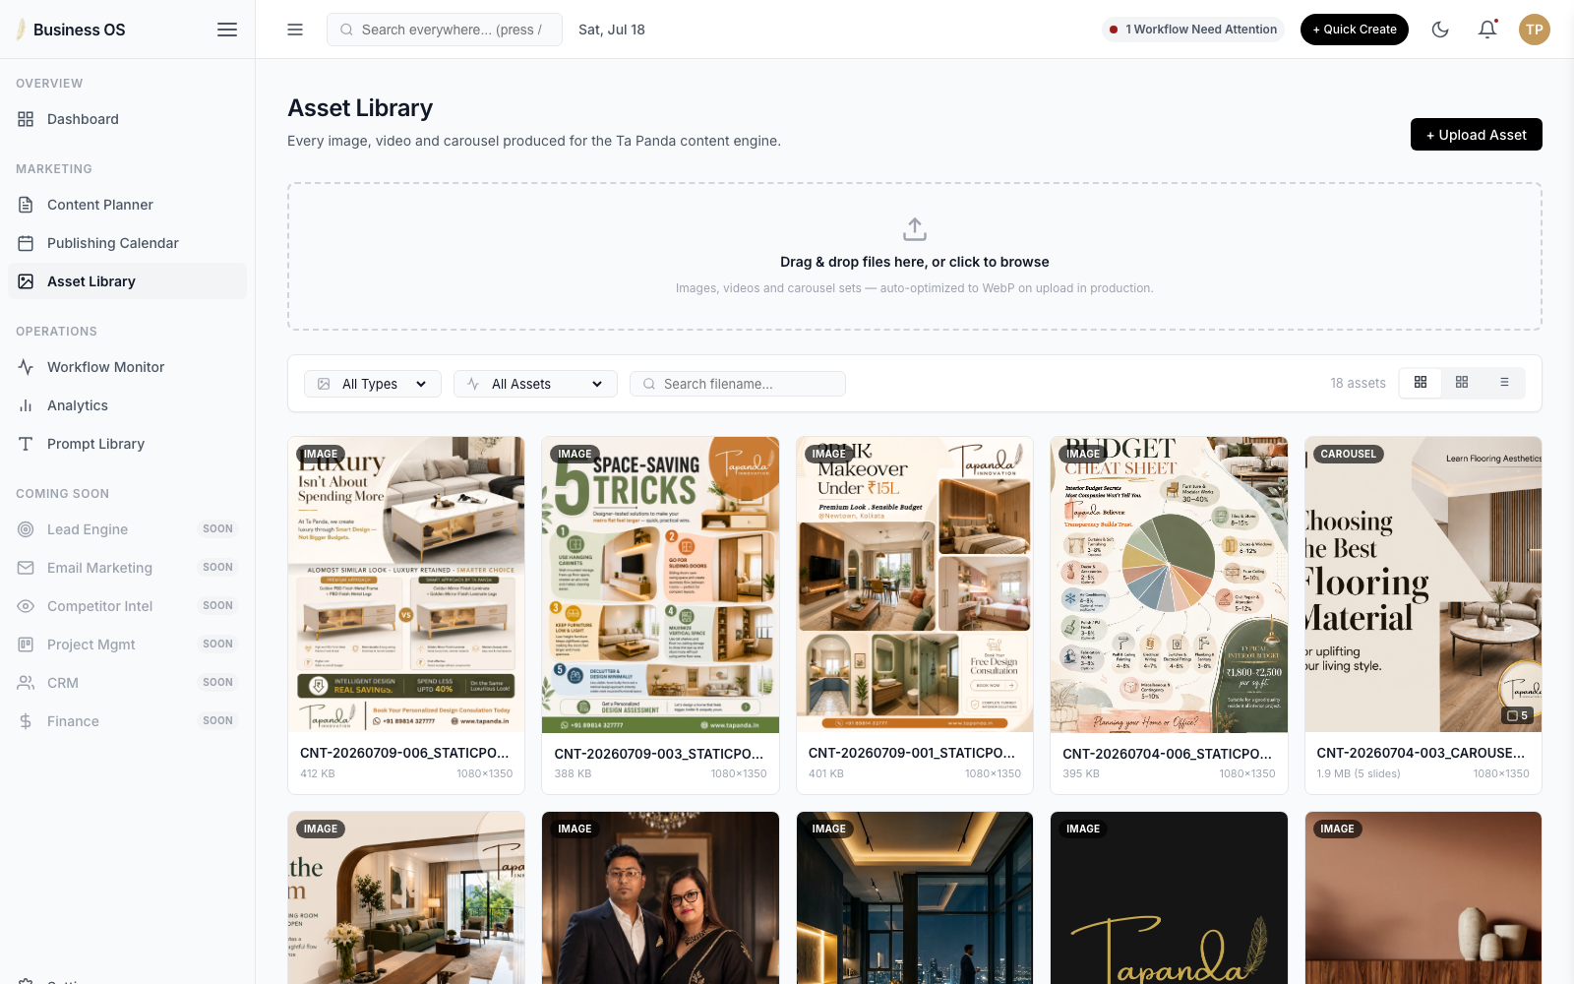
MARKETING
04
Asset Library
Every image, video, and carousel the content engine has produced.
✓
Gallery, Grid, and List views for browsing images, video, and carousels
✓
Type-aware previews: video play overlays, carousel slide counts, dimensions & size
✓
Filter by type and usage (used vs. unused), search by filename
✓
Asset Details drawer: metadata, “Used In” content links, full version history
✓
Built-in carousel viewer to page through multi-slide assets
✓
Upload dropzone ready for drag-and-drop — wires to Supabase Storage in Phase 4
Ta Panda Business OS · Phase 3 Frontend Walkthrough

Slide 6
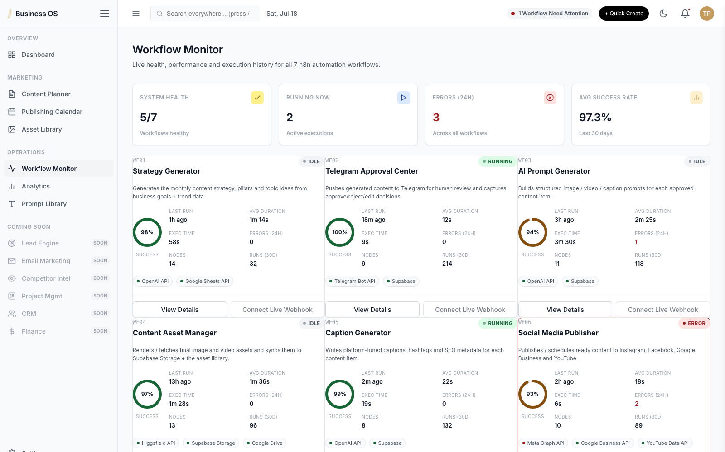
OPERATIONS
05
Workflow Monitor
Live health and performance for all 7 n8n automations, one card each.
✓
Live status cards for all 7 workflows, Strategy Generator through Telegram Command Center
✓
Success-rate ring, execution time, average duration, and 24h error counts per workflow
✓
API / integration status pills flag failing connections instantly
✓
Drawer view adds a node-by-node execution timeline and a recent logs console
✓
System-wide summary strip: overall health, active runs, 24h errors, avg success rate
✓
“Connect Live Webhook” affordance pre-wired for real n8n control in Phase 4
Ta Panda Business OS · Phase 3 Frontend Walkthrough

Slide 7
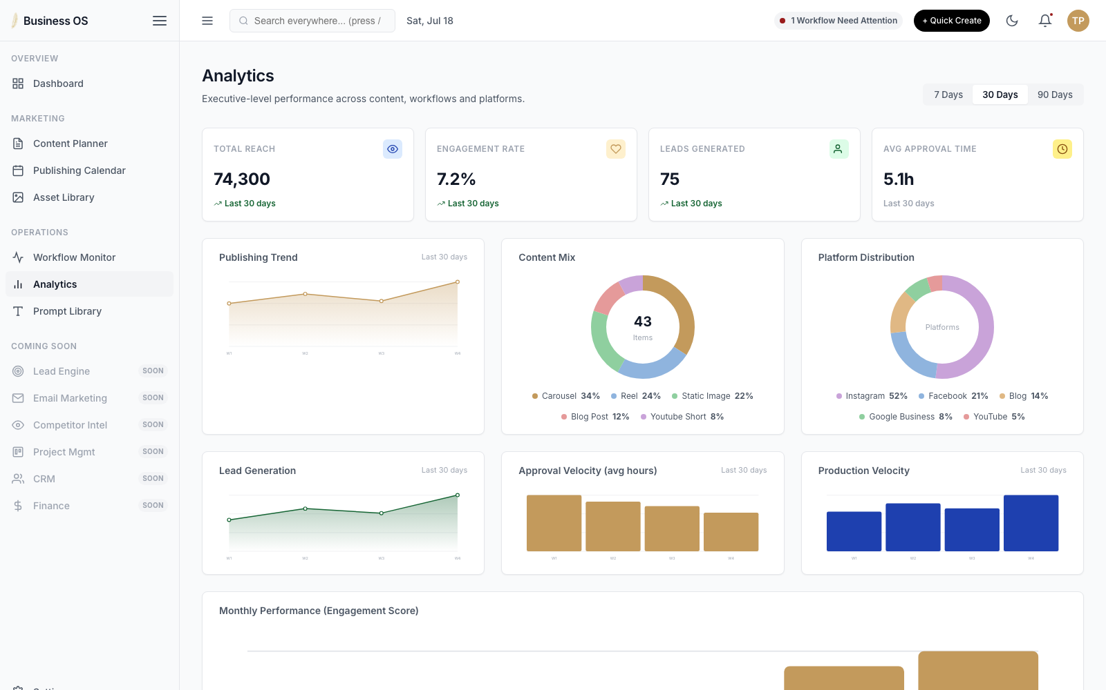
OPERATIONS
06
Analytics
Executive-level performance across content, workflows, and platforms.
✓
Executive KPI strip: total reach, engagement rate, leads generated, avg approval time
✓
7 / 30 / 90-day range switcher re-renders every trend and velocity chart instantly
✓
Content Mix and Platform Distribution donuts, Monthly Performance and Content Type bars
✓
Publication Frequency heat map spans the last quarter
✓
Every chart is hand-built SVG — zero external charting dependency
✓
Built to plug straight into real analytics once Phase 4 API integration lands
Ta Panda Business OS · Phase 3 Frontend Walkthrough

Slide 8
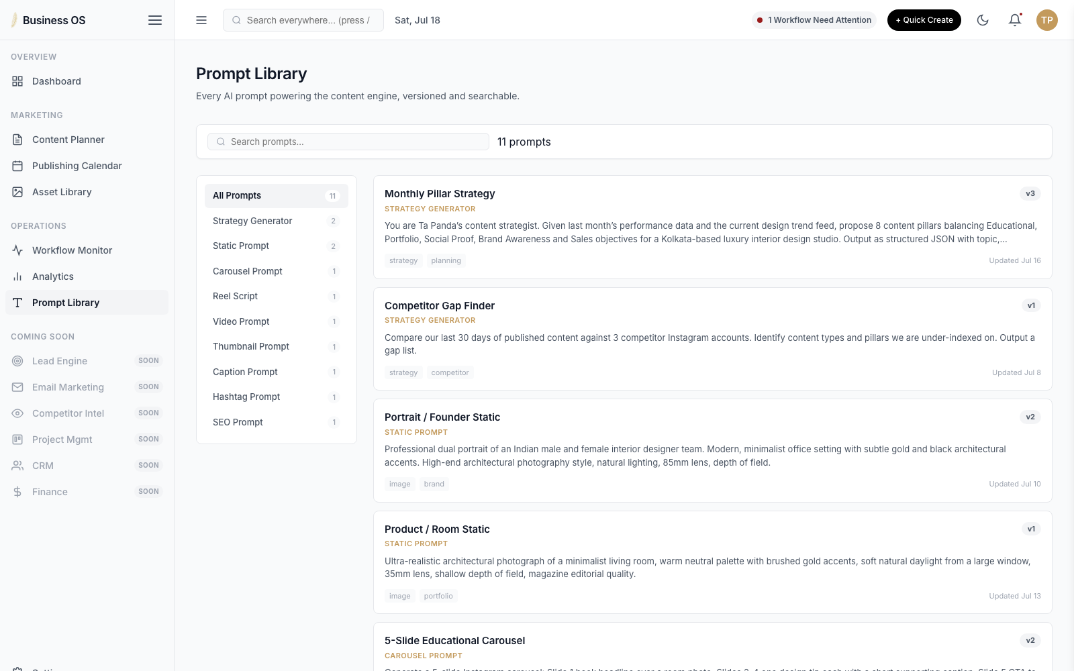
OPERATIONS
07
Prompt Library
Every AI prompt behind the content engine — versioned and governed.
✓
9 prompt categories: Strategy, Static, Carousel, Reel, Video, Thumbnail, Caption, Hashtag, SEO
✓
Full version history per prompt, with notes on what changed and why
✓
Side-by-side version comparison modal — pick any two versions to diff
✓
Searchable across prompt text, tags, and category
✓
Editable performance notes saved per prompt
✓
Sets up prompt governance ahead of live AI generation in Phase 4
Ta Panda Business OS · Phase 3 Frontend Walkthrough

Slide 9
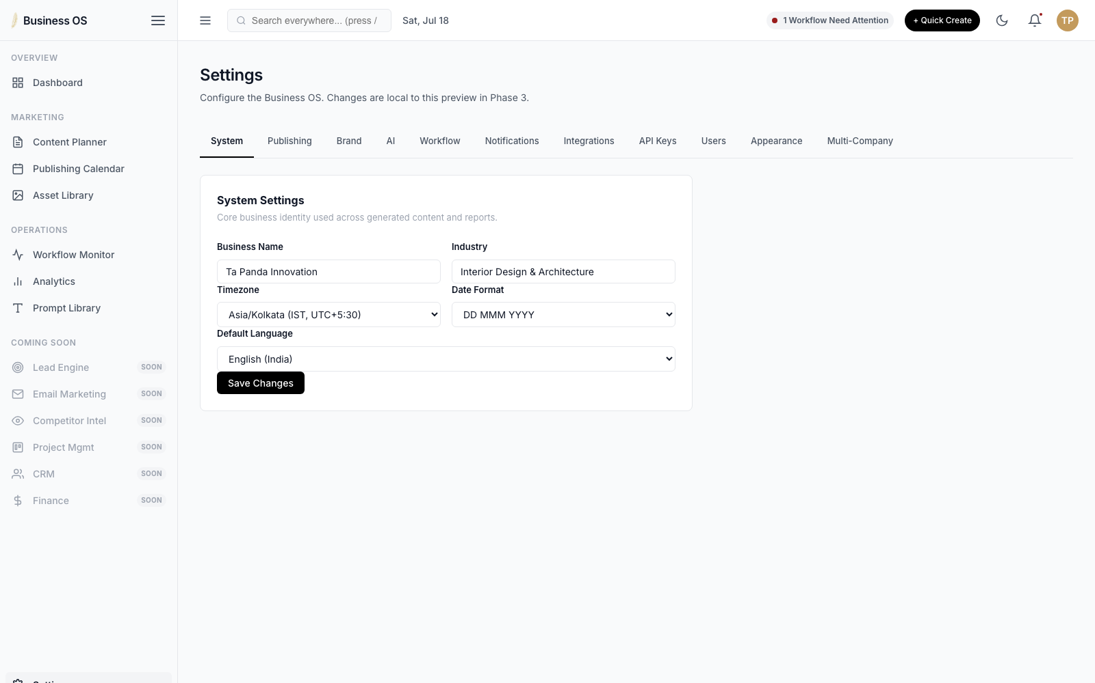
SYSTEM
08
Settings
Every configuration surface the Business OS will need, in one place.
✓
11 tabs: System, Publishing, Brand, AI, Workflow, Notifications, Integrations, API Keys, Users, Appearance, Multi-Company
✓
Per-workflow enable / disable toggles mirror the 7 live n8n automations
✓
Integration cards for Telegram, Facebook, Instagram, Google Business, Drive & Sheets
✓
Masked API key vault, ready for a real secrets manager in Phase 4
✓
User management table with roles and an invite flow
✓
Multi-Company support previewed as a “Coming Soon” placeholder
Ta Panda Business OS · Phase 3 Frontend Walkthrough

Slide 10
WHAT'S NEXT
Phase 4 — API & n8n Integration
Wire every page to live data
Connect the 7 n8n workflows
Replace os-data.js mock state with Supabase reads/writes across all 8 pages.
Turn Approve, Schedule, Publish, and “Connect Live Webhook” into real triggers.
Add authentication & roles
Go live on integrations
Replace the placeholder user list with Supabase Auth and role-based access.
Telegram, Meta, Google Business, Drive, and Sheets — for real, not mocked.
The frontend UX is frozen and ready — every interaction you saw in this deck already works end-to-end on mock data.

