Slide 1

Price Comparator for Online Shopping
Presented by Group E07
Team Members:
Debasis Rath (20CSE195)
Subham Kumar Padhy (20CSE211)
Sd. Hasnain Alli (20CSE385)
Supervisor :
Mr Murali kr. Senapathy

Slide 2
CONTENTS
Abstract
Objective
Software and Hardware Requirements
Flow Chart
Screenshot Diagram
Conclusion and limitation
Reference

Slide 3
This price comparison website for products will help to compare the price from various e-commerce websites, This Price comparison site is extremely helpful for frequent online shoppers to check prices on different online stores in one place.
ABSTRACT

Slide 4
Objective:
To provide customers with a list of price comparison and highlight the cheapest price specifically in home groceries products.
To increase price consciousness among consumers.
To ensure that the price database is updated regularly so that customers will be able to get accurate results.
To provide service for users to find the product’s price.
To provide platform for retailers to promote their products and promotion for free.

Slide 5
FEATURES:
This Project can be used to compare variety of things form different e commerce website.
Have simple and easy steps.
Clean and minimalistic User Interface.
Once can track the price of selected product using this project.

Slide 6
HARDWARE REQUIREMENTS
Processor: Intel Core i3 or higher
RAM: 2 GB or higher
Graphic card: Intel® UHD Graphics

Slide 7
SOFTWARE REQUIREMENTS
Operating System: Windows-7 or any higher version
Software Required: Google, Mozilla Firefox, Python IDLE

Slide 8
MODULE USED
Beautiful Soup
Requests
Smtplib
Tkinter

Slide 9
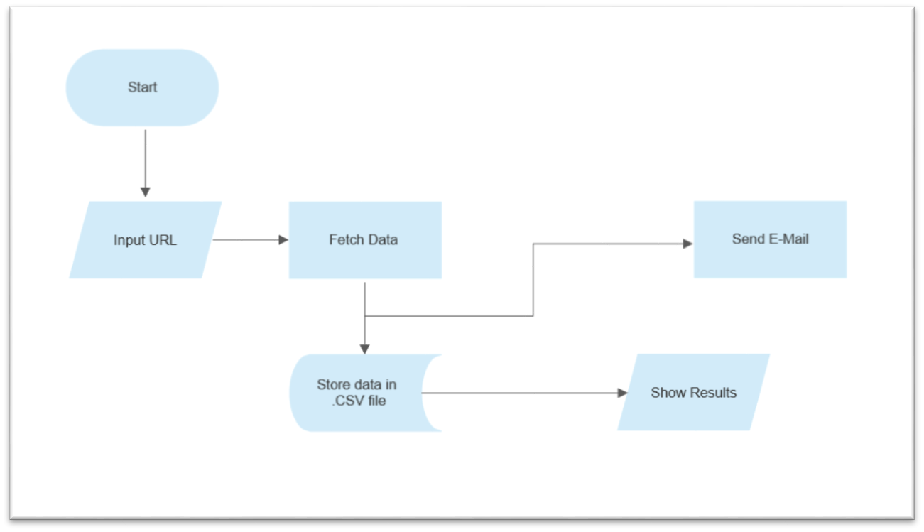
FLOW CHART

Slide 10
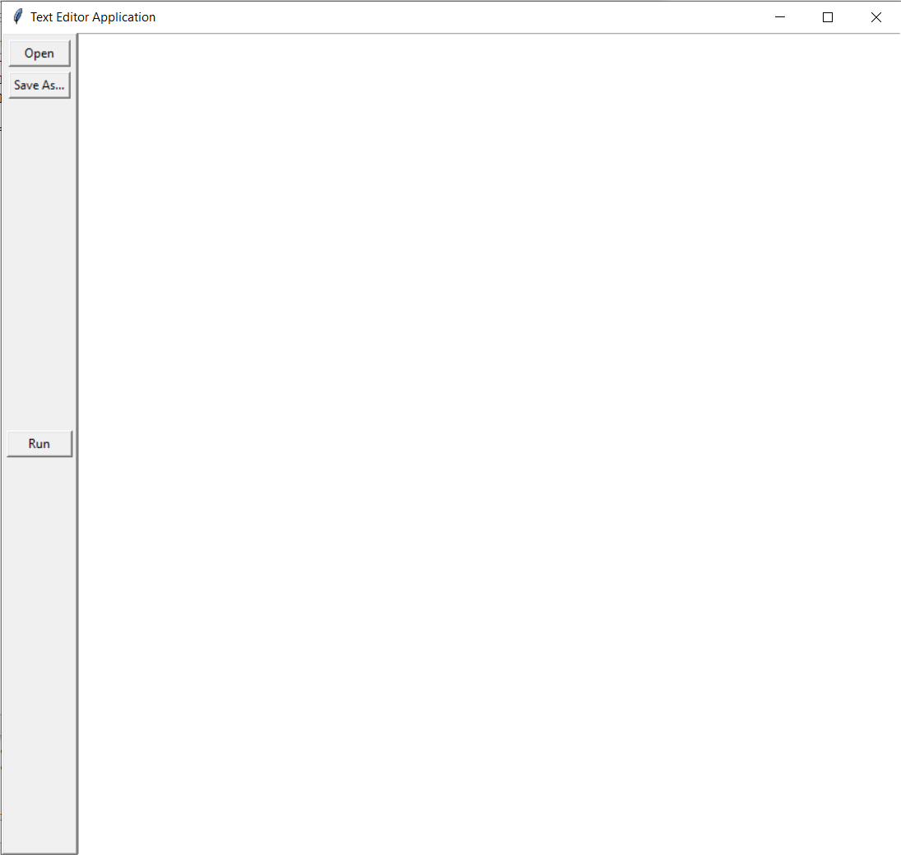
Screenshots : url editor window

Slide 11
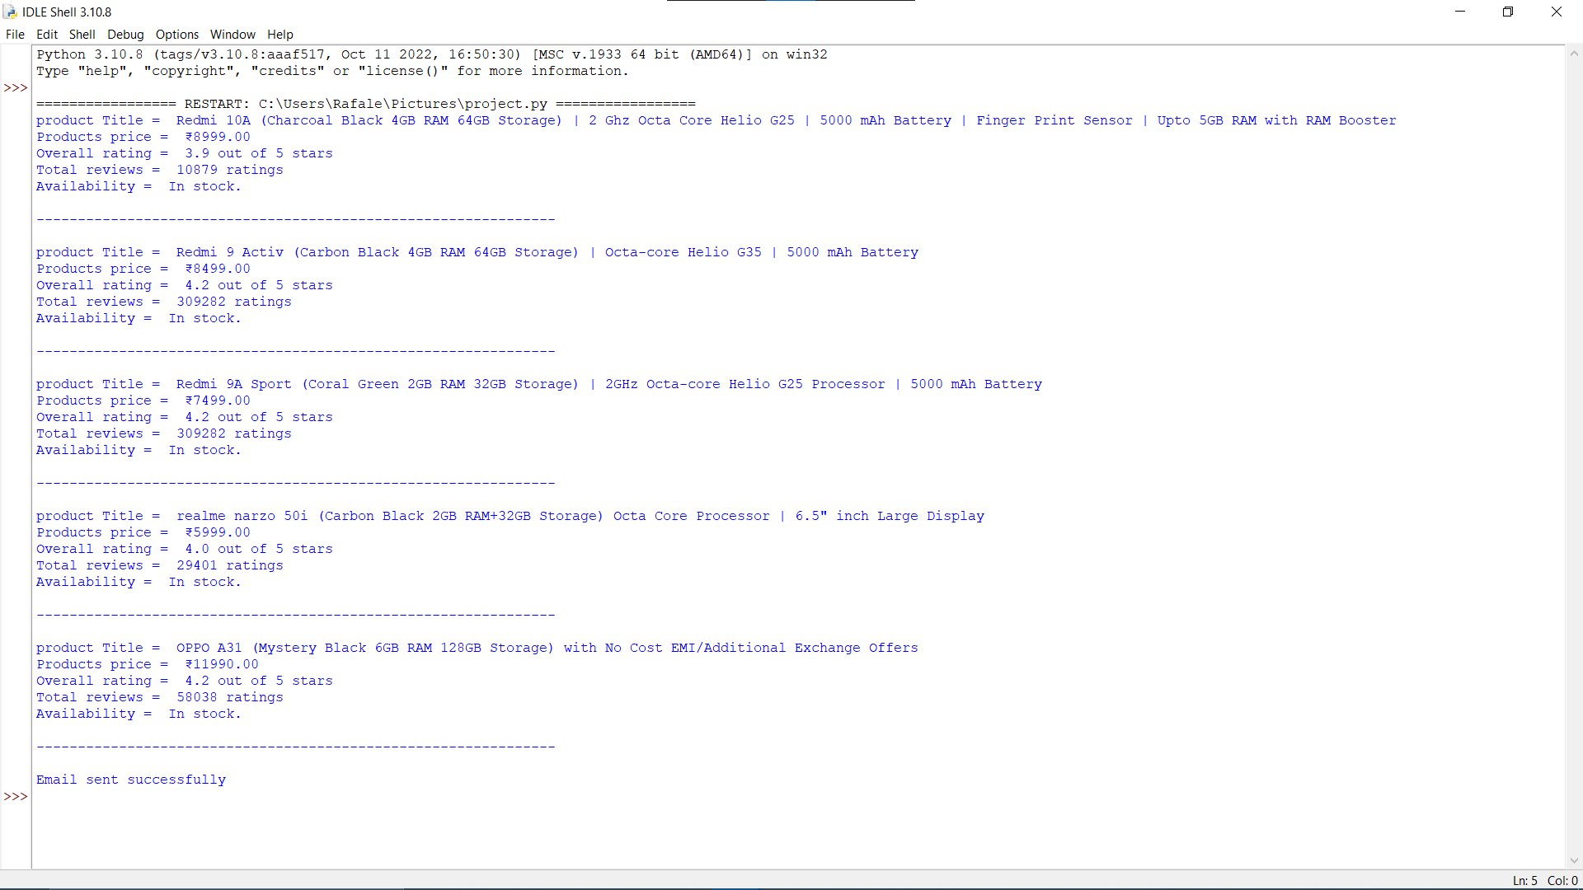
Comparison window:

Slide 12
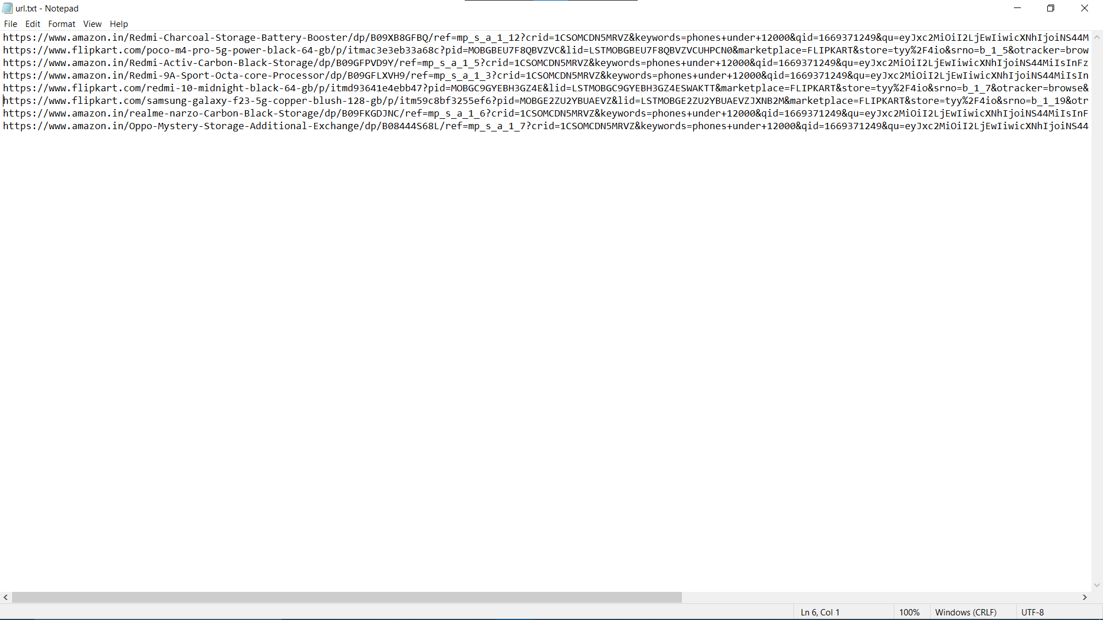
Input file: (URL.txt)

Slide 13
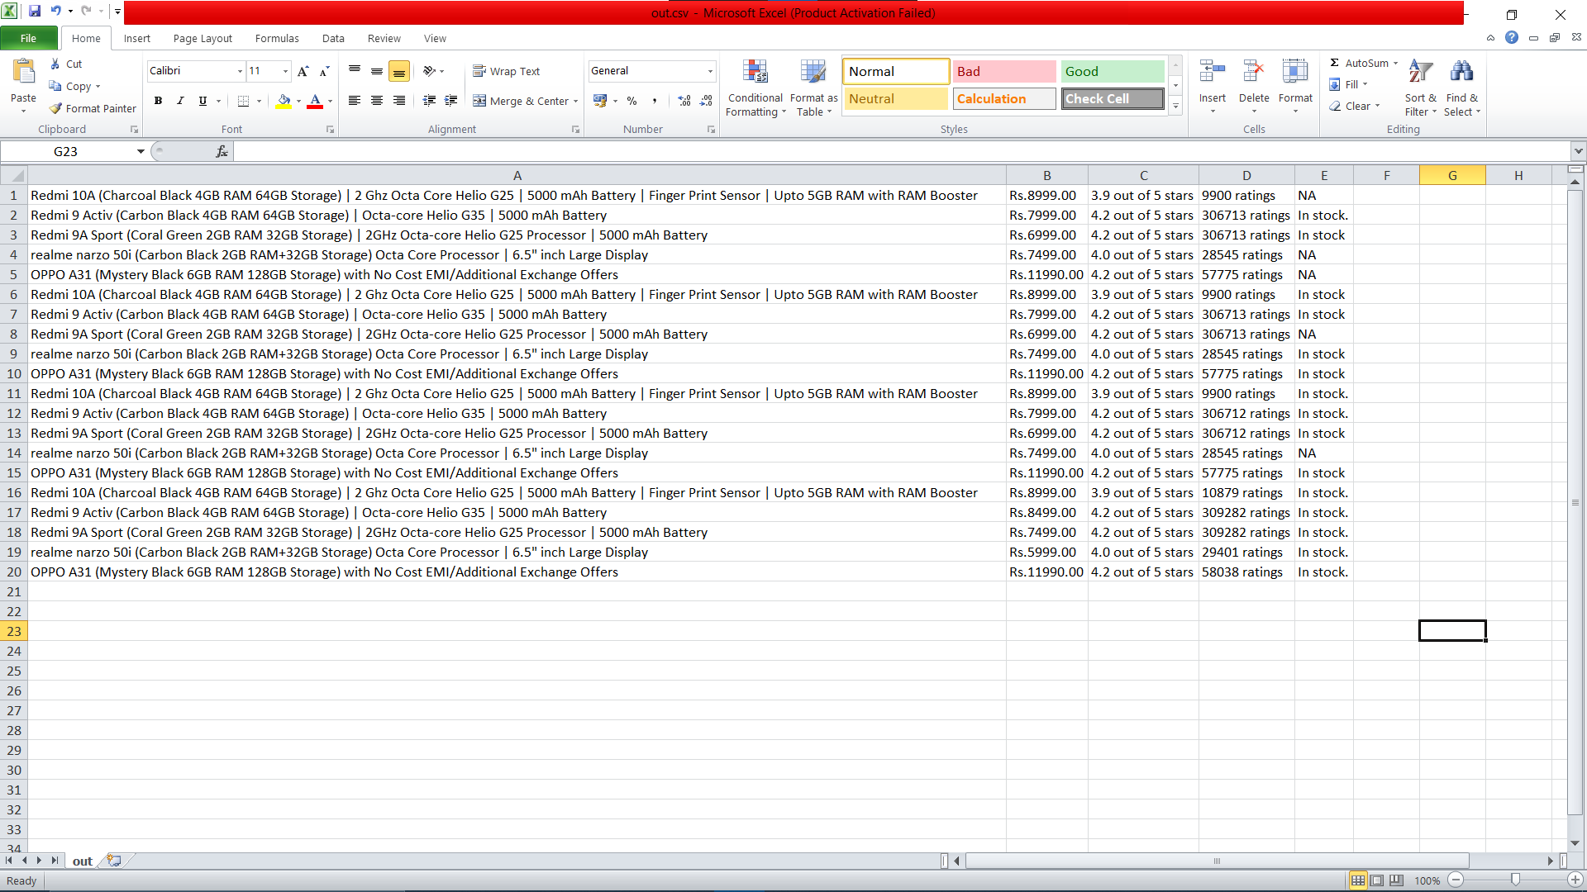
Output File:

Slide 14
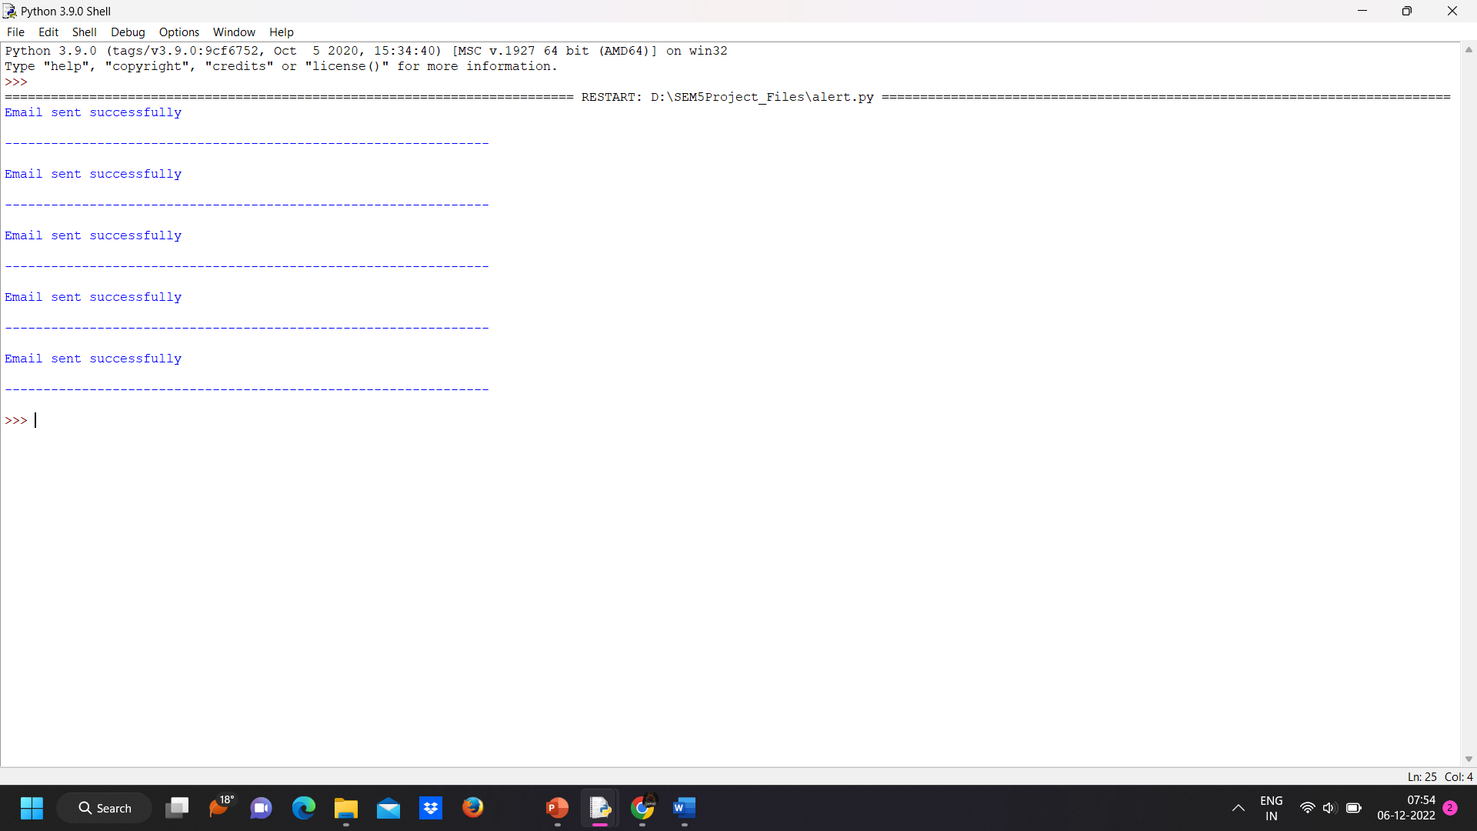
Price Alert Python Output

Slide 15
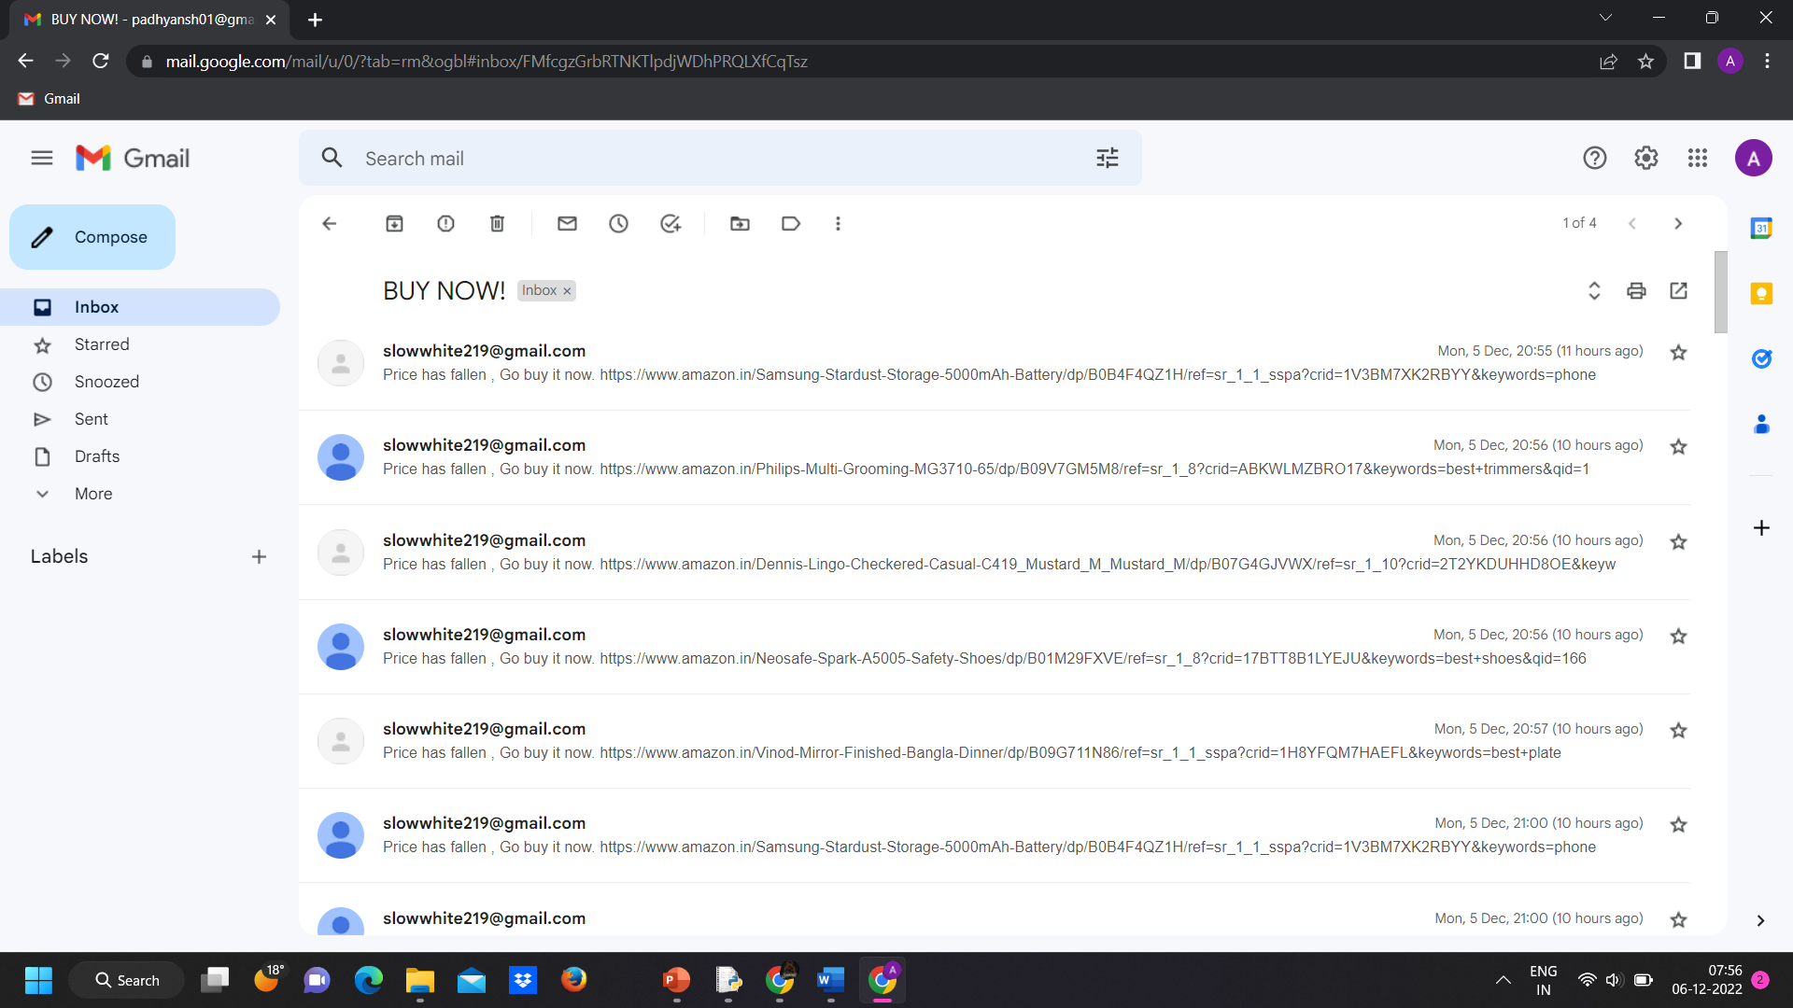
Price alert Received mail

Slide 16
Conclusion:
Thus through this project we will be able to extract data about different products and compare them to choose the product at the minimum cost.

Slide 17
Limitation:
Our project has the following limitations:
Visual effect of product during manually purchasing the product is different from viewing the product in your device
This application requires active internet connection
User need to put correct data or else it behaves abnormally

Slide 18
REFERENCE
https://www.geeksforgeeks.org/
https://www.digitalocean.com/
https://webautomation.io/

Slide 19
THANK YOU

